Slide 1
Petechiae, Purpura and Vasculitis
Basic Dermatology Curriculum
Last updated August 31, 2011

Slide 2
Module Instructions
The following module contains a number of blue, underlined terms which are hyperlinked to the dermatology glossary, an illustrated interactive guide to clinical dermatology and dermatopathology.
We encourage the learner to read all the hyperlinked information.

Slide 3
Goals and Objectives
The purpose of this module is to help medical students develop a clinical approach to the initial evaluation and treatment of patients with petechiae and purpura.
By completing this module, the learner will be able to:
  Identify and describe the morphology of petechiae and purpura
  Outline an initial diagnostic approach to petechiae or purpura
  Recognize patterns of petechiae that are concerning for life-threatening conditions
  Recognize palpable purpura as the hallmark lesion of leukocytoclastic vasculitis
  Determine when a dermatology referral for petechiae or purpura is indicated

Slide 4
Purpura: The Basics
The term purpura is used to describe red-purple lesions that result from the extravasation of blood into the skin or mucous membranes
Purpura may be palpable or non-palpable (flat/macular)
  Macular purpura is divided into two morphologies based on size:
    Petechiae: small lesions (< 3 mm)
    Ecchymoses: larger lesions (>5mm)
The type of lesion present is usually indicative of the underlying pathogenesis:
  Macular purpura is typically non-inflammatory
  Palpable purpura is a sign of vascular inflammation (vasculitis)

Slide 5
Purpura: The Basics
All forms do not blanch when pressed
  Diascopy refers to the use of a glass slide to apply pressure to the lesion in order to distinguish erythema secondary to vasodilation (blanchable with pressure), from erythrocyte extravasation (retains its red color)
Purpura may result from hyper- and hypo-coagulable states, vascular dysfunction and extravascular causes

Slide 6
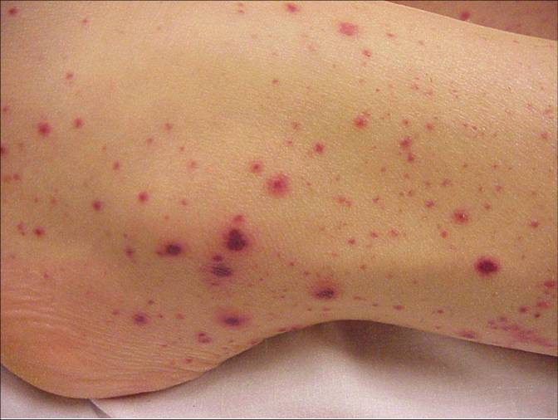
Examples of Purpura
Petechia
Ecchymosis

Slide 7
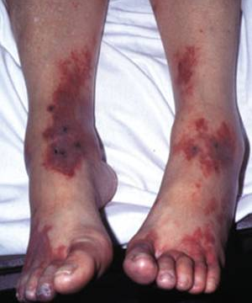
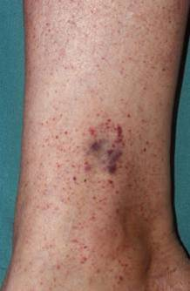
Examples of Purpura
Ecchymoses
Petechiae

Slide 8
Case One
Mr. Chad Fields

Slide 9
Case One: History
HPI: Mr. Fields is a 42-year-old man who presents to the ER with a 2-week history of a rash on his abdomen and lower extremities.
PMH: hospitalization 1 year ago for community acquired pneumonia
Medications: none
Allergies: none
Family history: unknown
Social history: without stable housing, no recent travel or exposure to animals
Health-related behaviors: smokes 10 cigarettes/day, drinks 3-10 beers/day, limited access to food
ROS: easy bruising, bleeding from gums, overall fatigue

Slide 10
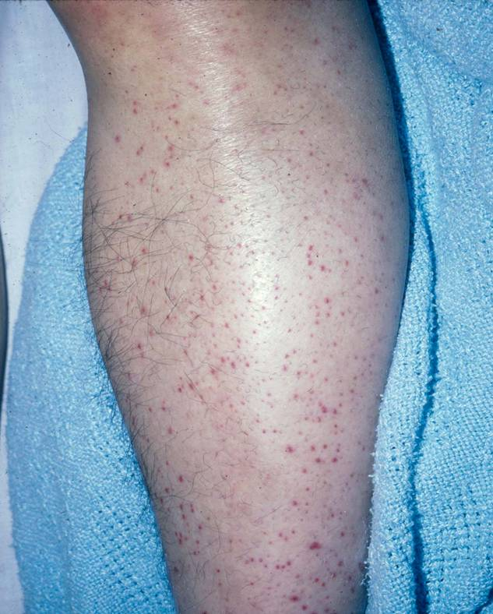
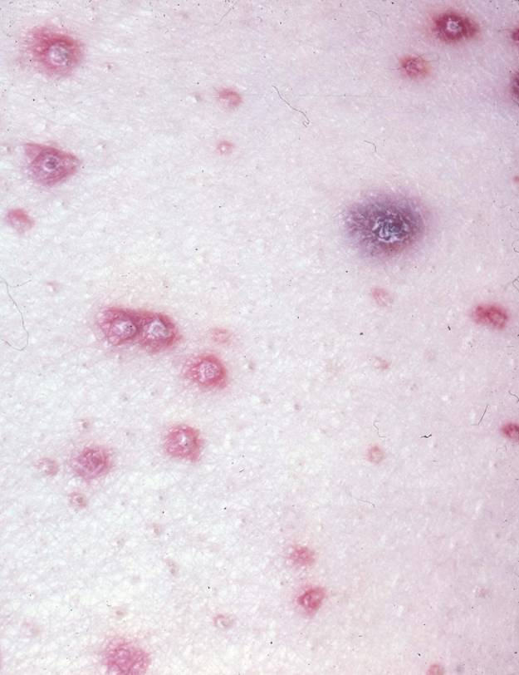
Case One: Skin Exam
Perifollicular petechiae
Keratotic plugging of hair follicles

Slide 11
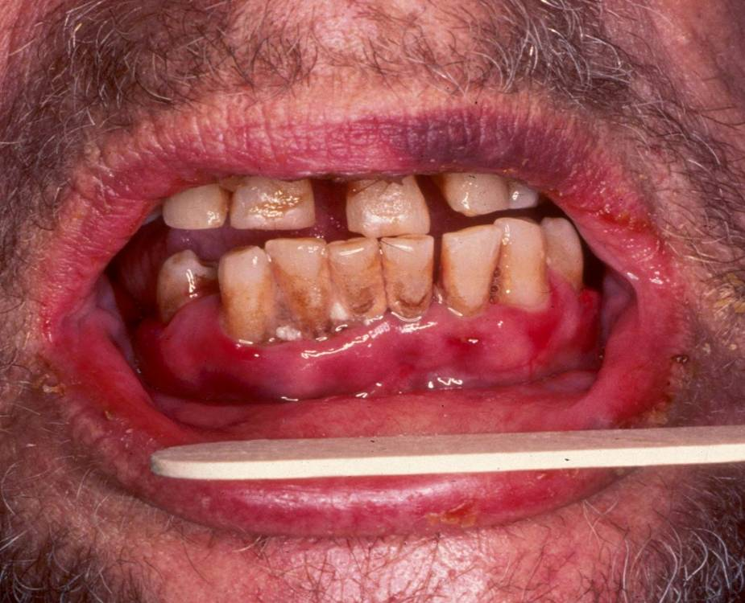
Case One: Exam
Mr. Fields also has hemorrhagic gingivitis

Slide 12
Case One, Question 1
Which of the following is the most likely diagnosis?
    Drug hypersensitivity reaction
    Nutritional deficiency
    Rocky mountain spotted fever
    Urticaria
    Vasculitis

Slide 13
Case One, Question 1
Answer: b
Which of the following is the most likely diagnosis?
    Drug hypersensitivity reaction (typically without purpuric lesions)
    Nutritional deficiency
    Rocky mountain spotted fever (no history of travel or tick bite)
    Urticaria (would expect raised edematous lesions, not purpura)
    Vasculitis (purpura would not be perifollicular and would be palpable)

Slide 14
Vitamin C Deficiency - Scurvy
Scurvy results from insufficient vitamin C intake (e.g., fad diet, alcoholism), increased vitamin requirement (e.g., certain medications), and increased loss (e.g., dialysis)
Vitamin C is required for normal collagen structure and its absence leads to skin and vessel fragility

Slide 15
Vitamin C Deficiency - Scurvy
Characteristic exam findings include:
  Perifollicular purpura
  Large ecchymoses on the lower legs
  Intramuscular and periosteal hemorrhage
  Keratotic plugging of hair follicles
  Hemorrhagic gingivitis (when patient has poor oral hygiene)
Remember to take a dietary history in all patients with purpura

Slide 16
Case Two
Mr. Andrew Thompson

Slide 17
Case Two: History
HPI: Andrew is a 19-year-old man who was admitted to the hospital with a headache, stiff neck, high fever, and rash. His symptoms began 2-3 days prior to admission when he developed fevers with nausea and vomiting.
PMH: splenectomy 3 years ago after a snowboarding accident
Medications: none
Allergies: none
Vaccination history: last vaccination as a child
Family history: non-contributory
Social history: attends a near-by state college, lives in a dormitory
Health-related behaviors: reports occasional alcohol use on the weekends with 2-3 drinks per night, plays basketball with friends for exercise

Slide 18
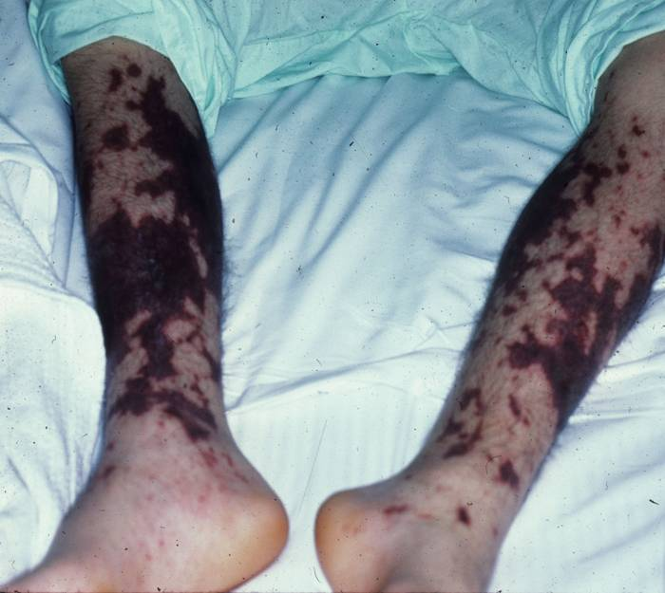
Case Two: Exam
Vitals: T 102.4 ºF, HR 120, BP 86/40, RR 20, O₂ sat 96% on room air
Gen: ill-appearing male lying on a gurney
HEENT: PERRL, EOMI, + nuchal rigidity
Skin: petechiae and large ecchymotic patches on upper and lower extremities= Purpura fulminans

Slide 19
Case Two: Initial Labs
WBC count:14,000 cells/mcL
Platelets: 100,000/mL
Decreased fibrinogen
Increased PT, PTT
Blood culture: gram negative diplococci
Lumbar puncture: pending

Slide 20
Case Two, Question 1
In addition to fluid resuscitation, what is the most needed treatment at this time?
  IV antibiotics
  IV corticosteroids
  Pain relief with oxycodone
  Plasmapheresis

Slide 21
Case Two, Question 1
Answer: a
In addition to fluid resuscitation, what is the most needed treatment at this time?
  IV antibiotics (may be started before lumbar puncture)
  IV corticosteroids (not unless suspicion for pneumococcal meningitis is high)
  Pain relief with oxycodone (not the patient’s primary issue)
  Plasmapheresis (not unless suspecting diagnosis of thrombotic thrombocytopenic purpura – TTP)

Slide 22
Sepsis and DIC
Andrew’s clinical picture is concerning for meningococcemia with disseminated intravascular coagulation (DIC)
Presence of petechial or purpuric lesions in the patient with meningitis should raise concern for sepsis and DIC
Neisseria meningitidis is a gram negative diplococcus that causes meningococcal disease
  Most common presentations are meningitis and meningococcemia
DIC results from unregulated intravascular clotting resulting in depletion of clotting factors and bleeding
  The primary treatment is to treat the underlying condition

Slide 23
Rocky Mountain Spotted Fever
Another life-threatening diagnosis to consider in a patient with a petechial rash is Rocky Mountain Spotted Fever (RMSF)
The most commonly fatal tickborne infection (caused by Rickettsia rickettsii) in the US
A petechial rash is a frequent finding that usually occurs several days after the onset of fever
Initially characterized by faint macules on the wrists or ankles. As the disease progresses, the rash may become petechial and involves the trunk, extremities, palms and soles
Majority of patients do not have the classic triad of fever, rash and history of tick bite
Notes:
23

Slide 24
Clinical Evaluation of Purpura
A history and physical exam is often all that is necessary
Important history items include:
  Family history of bleeding or thrombotic disorders (e.g., von Willebrand disease)
  Use of drugs and medications (e.g., aspirin, warfarin) that may affect platelet function and coagulation
  Medical conditions (e.g., liver disease) that may result in altered coagulation
Complete blood count with differential and PT/PTT are used to help assess platelet function and evaluate coagulation states

Slide 25
Causes of Non-Palpable Purpura
Petechiae
  Abnormal platelet function
  DIC and infection
  Increased intravascular venous pressures
  Thrombocytopenia
    Idiopathic
    Drug-induced
    Thrombotic
  Some inflammatory skin diseases
Ecchymoses
  Coagulation defects
  DIC and infection
  External trauma
  Skin weakness/fragility
  Waldenstrom hypergammaglobulinemic purpura

Slide 26
Now let’s learn about Palpable Purpura

Slide 27
Palpable Purpura
Palpable purpura results from inflammation of small cutaneous vessels (i.e., vasculitis)
Vessel inflammation results in vessel wall damage and in extravasation of erythrocytes seen as purpura on the skin
Vasculitis may occur as a primary process or may be secondary to another underlying disease
Palpable purpura is the hallmark lesion of leukocytoclastic vasculitis (small vessel vasculitis)

Slide 28
Vasculitis Morphology
Vasculitis is classified by the vessel size affected (small, medium, mixed or large)
Clinical morphology correlates with the size of the affected blood vessels
  Small vessel: palpable purpura (urticarial lesions in rare cases, e.g., urticarial vasculitis)
  Small to medium vessel: subcutaneous nodules, purpura and FIXED livedo reticularis (also called livedo racemosa). Ulceration and necrosis may be present in medium-vessel vasculitis.
  Large vessel: claudication, ulceration and necrosis
Diseases may involve more than one size of vessel
Systemic vasculitis may involve vessels in other organs

Slide 29
Vasculitides According to Size of the Blood Vessels
Small vessel vasculitis (leukocytoclastic vasculitis)
  Henoch-Schönlein purpura
  Other:
    Idiopathic
    Malignancy-related
    Rheumatologic
    Infection
    Medication
  Urticarial vasculitis

Slide 30
Vasculitides According to Size of the Blood Vessels
Predominantly Mixed (Small + Medium)
  ANCA associated vasculitides
    Churg-Strauss syndrome
    Microscopic polyangiitis
    Wegener granulomatosis
  Essential cryoglobulinemic vasculitis
Predominantly medium sized vessels
  Polyarteritis nodosa
Predominantly large vessels
  Giant cell arteritis
  Takayasu arteritis

Slide 31
Clinical Evaluation of Vasculitis
The following laboratory tests may be used to evaluate patient with suspected vasculitis:
  CBC with platelets
  ESR (systemic vasculitides tend to have sedimentation rates > 50)
  ANA (a positive antinuclear antibody test suggests the presence of an underlying connective tissue disorder)
  ANCA (helps diagnose Wegener granulomatosis, microscopic polyarteritis, drug-induced vasculitis, and Churg-Strauss)
  Complement (low serum complement levels may be present in mixed cryoglobulinemia, urticarial vasculitis and lupus)
  Urinalysis (helps detect renal involvement)
Also consider ordering cryoglobulins, an HIV test, HBV and HCV serology, occult stool samples, an ASO titer and streptococcal throat culture

Slide 32
Case Three
Jenny Miller

Slide 33
Case Three: History
HPI: Jenny is a 9-year-old girl with a 4-day history of abdominal pain and rash on the lower extremities who was brought to the ER by her mother. Her mother reported that the rash appeared suddenly and was accompanied by joint pain of the knees and ankles and aching abdominal pain. Over 3 days the rash changed from red patches to more diffuse purple bumps.
PMH: normal birth history, no major illnesses or hospitalizations
Medications: none, up to date on vaccines
Allergies: none
Family history: no history of clotting or bleeding disorders
Social history: happy child when feeling well, attends school, takes ballet
ROS: cough and runny nose a few weeks ago

Slide 34
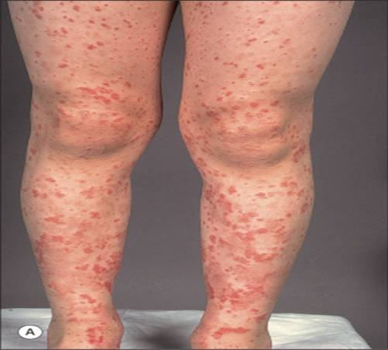
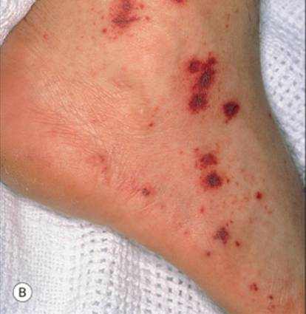
Case Three: Skin Exam
Non-blanching erythematous macules and papules on both legs and feet (sparing the trunk, upper extremities and face); diffuse petechiae

Slide 35
Case Three, Question 1
In this clinical context, what test will establish the diagnosis?
  CBC
  ESR
  HIV test
  Skin biopsy
  Urinalysis

Slide 36
Case Three, Question 1
Answer: d
In this clinical context, what test will establish the diagnosis?
  CBC
  ESR
  HIV test
  Skin biopsy (for routine microscopy and direct immunofluorescence)
  Urinalysis

Slide 37
Case Three: Skin Biopsy
A skin biopsy obtained from a new purpuric lesion reveals a leukocytoclastic vasculitis of the small dermal blood vessels
Direct immunofluorescence demonstrates perivascular IgA, C3 and fibrin deposits
A skin biopsy is often necessary to establish the diagnosis of vasculitis
Click here to watch a video on how to perform a punch biopsy

Slide 38
Case Three, Question 2
What is the most likely diagnosis?
  Disseminated intravascular coagulation
  Henoch-Schönlein Purpura
  Idiopathic thrombocytopenic purpura
  Sepsis
  Urticaria

Slide 39
Case Three, Question 2
Answer: b
What is the most likely diagnosis?
  Disseminated intravascular coagulation
  Henoch-Schönlein Purpura
  Idiopathic thrombocytopenic purpura
  Sepsis
  Urticaria

Slide 40
Henoch-Schönlein Purpura
Henoch-Schönlein Purpura (HSP) is the most common form of systemic vasculitis in children
  Characterized by palpable purpura (vasculitis), arthritis, abdominal pain and kidney disease
Primarily a childhood disease (between ages 3-15), but adults can also be affected
HSP follows a seasonal pattern with a peak in incidence during the winter presumably due to association with a preceding viral or bacterial infection

Slide 41
HSP: Diagnosis and Evaluation
Diagnosis often made on clinical presentation +/- skin biopsy
Skin biopsy shows leukocytoclastic vasculitis in postcapillary venules (small vessel disease)
  Immune complexes in vessel walls contain IgA deposition (the diagnostic feature of HSP)
Rule out streptococcal infection with an ASO or throat culture

Slide 42
HSP: Evaluation and Treatment
It is also important to look for systemic disease:
  Renal: Urinalysis, BUN/Cr
  Gastrointestinal: Stool guaiac
  HSP in adults may be a manifestation of underlying malignancy
Natural History: most children completely recover from HSP
  Some develop progressive renal disease
    More common in adults
Treatment is supportive +/- prednisone
Notes:
42

Slide 43
Case Four
Mr. Matthew Burton

Slide 44
Case Four: History
Hospital Course: Mr. Burton is a 45-year-old man who was admitted to the hospital five weeks ago with acute bacterial endocarditis. After an appropriate antibiotic regimen was started and Mr. Burton was stable, he was transferred to a skilled nursing facility to finish a six-week course of IV antibiotics.
On week #5, the patient developed a rash on his lower extremities. The dermatology service was consulted to evaluate the rash.

Slide 45
Case Four: History (cont.)
PMH: history of community-acquired pneumonia 2 years ago, history of multiple skin abscesses requiring incision and drainage (last abscess 2 months ago)
Medications: IV Vancomycin
Allergies: none
Social history: lives by himself in an apartment
Family history: noncontributory
Health-related behaviors: history of IV drug use
ROS: no current fevers, sweats or chills

Slide 46
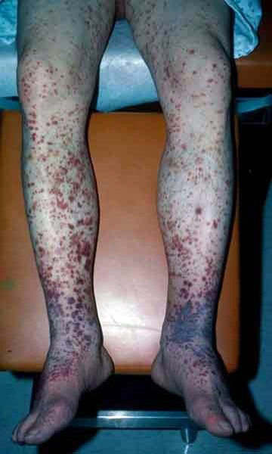
Case Four: Skin Exam
Normal vital signs
General: appears well in NAD
Skin exam: palpable hemorrhagic papules coalescing into plaques, bilateral and symmetric on lower extremities
Also with bilateral pedal edema
Labs: normal CBC, PT, PTT, INR
ANA < 1:40
Negative ANCA, cryoglobulins
HIV negative, negative hepatitis serologies (except for HBVsAb positive)

Slide 47
Case Four, Question 1
Which of the following is the most likely cause of Mr. Burton’s skin findings?
  DIC secondary to sepsis
  Leukocytoclastic vasculitis secondary to antibiotics
  Septic emboli with hemorrhage from undiagnosed bacterial endocarditis
  Urticarial vasculitis

Slide 48
Case Four, Question 1
Answer: b
Which of the following is the most likely cause of Mr. Burton’s skin findings?
  DIC secondary to sepsis (history and skin exam are less concerning for sepsis. In DIC, coagulation studies are abnormal)
  Leukocytoclastic vasculitis secondary to antibiotics
  Septic emboli with hemorrhage (these lesions tend to occur on the distal extremities)
  Urticarial vasculitis (presents with a different morphology, which is urticarial)

Slide 49
Case Four, Question 2
A skin biopsy confirmed LCV. What else should be done at this time?
    Obtain a urinalysis
    Start systemic steroid
    Stop the IV antibiotics and replace with another
    All of the above

Slide 50
Case Four, Question 2
Answer: a & c
What else should be done at this time?
  Obtain a urinalysis (detection of renal involvement will impact treatment)
  Start systemic steroid (typically used when vasculitis is systemic or severe)
  Stop the IV antibiotics and replace with another (remove the offending agent)
  All of the above

Slide 51
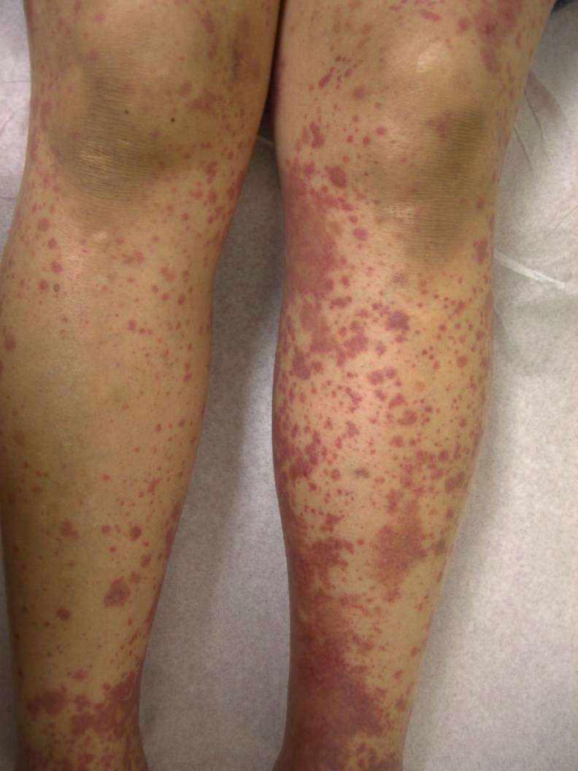
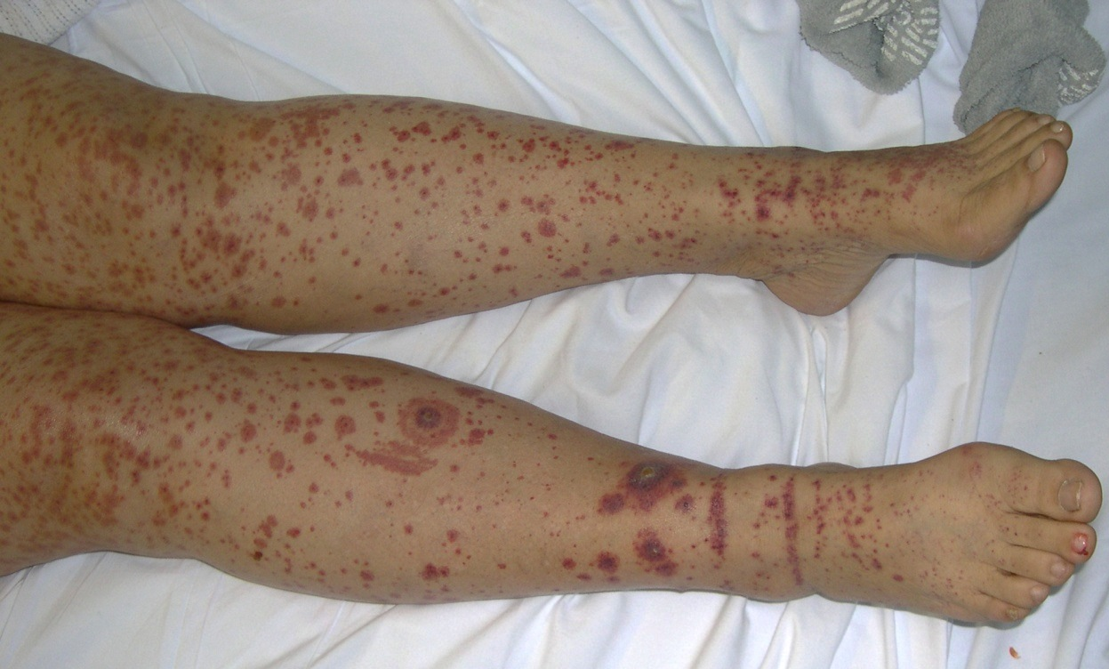
More Examples of LCV
Palpable hemorrhagic papules coalescing into plaques, bilateral on the lower extremities

Slide 52
Case Five
Dr. Katy Krueger

Slide 53
Case Five: History
HPI: Dr. Krueger is a 34-year-old previously healthy woman who was admitted to the hospital with a 5-day history of fever, weight loss, joint pain/swelling, paresthesias (both feet), and painful skin nodules
PMH: mild normocytic anemia
Medications: OCP, Malarone (malaria prophylaxis)
Allergies: sulfa
Family history: no autoimmune disease
Social history: physician; worked in Haitian hospital one month prior to admission; no animal contacts
Health-related behaviors: no tobacco, alcohol, or drug use
ROS: reports no photosensitivity, malar rash, mucosal ulcers, dry eyes/mouth, sore throat, abdominal pain, or dysuria

Slide 54
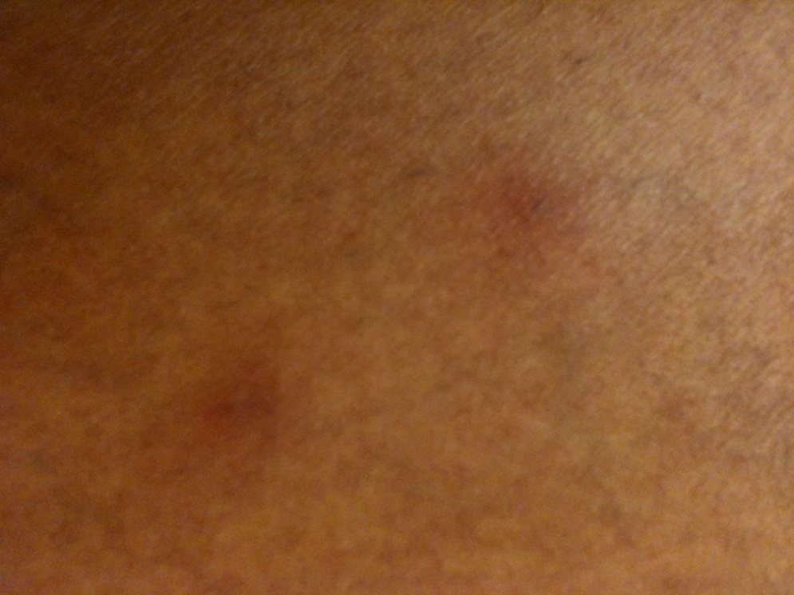
Case Five: Exam
Vitals: febrile
Gen: well-appearing, very thin African American female
HEENT: clear, no ulcers noted
No lymphadenopathy
Normal cardiac, respiratory, abdominal exams
Neurologic exam: decreased sensation and reflexes in bilateral legs
Joint exam: warmth/swelling at hands, feet, ankles, knees
Skin: lower extremities with multiple 6x8mm tender, erythematous subcutaneous nodules

Slide 55
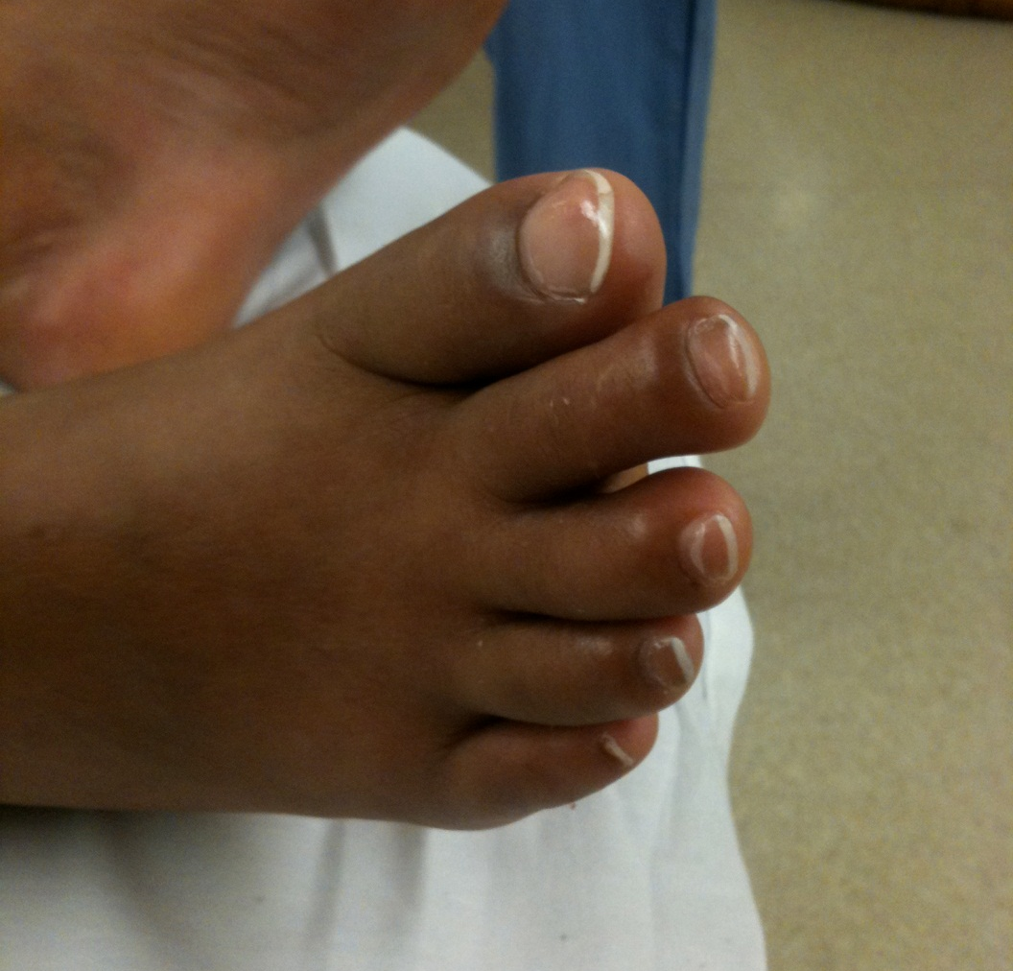
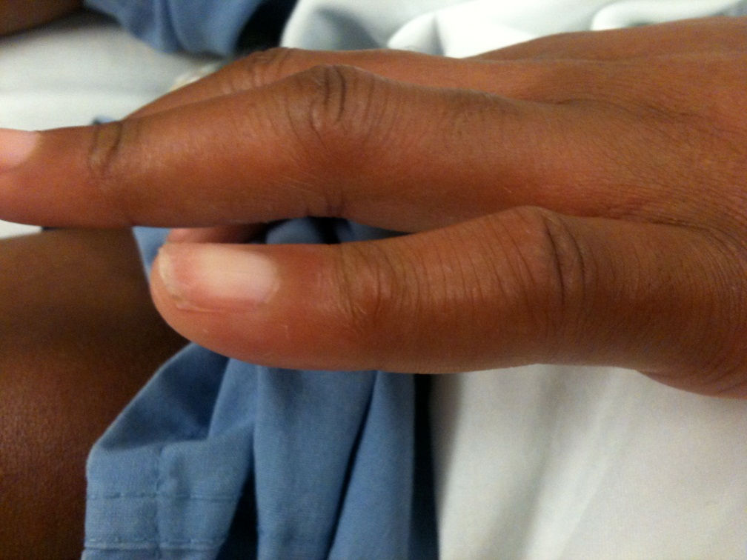
Case Five: Exam continued
Swelling of feet
Erythematous nodule

Slide 56
Case Five: Labs
CBC: anemia
ESR: 60 [0-15]; CRP: 46.8 [<6.3]
Normal liver function, BUN/Cr
UA: trace hemoglobin, trace protein
  24 hour urine: increased protein
  Urine sediment: RBCs, WBCs, tubular casts; no dysmorphic RBCs
CXR: negative
ANCAs: negative
ANA: negative
Blood/urine cultures: negative
Infectious work-up for parasites, bacteria, and viruses: negative
Work-up for hematologic malignancy and hypercoagulability: negative

Slide 57
Case Five: Skin Biopsy
A skin biopsy obtained from a subcutaneous nodule on Dr. Krueger’s leg reveals inflammation of a medium-sized artery of the skin

Slide 58
Case Five, Question 1
What is the most likely diagnosis?
  Henoch-Schönlein Purpura
  Erythema nodosum
  Polyarteritis nodosa
  Takayasu arteritis
  Urticaria

Slide 59
Case Five, Question 1
Answer: c
What is the most likely diagnosis?
  Henoch-Schönlein Purpura (affects small vessels)
  Erythema nodosum (panniculitis on biopsy)
  Polyarteritis nodosa (affects medium-sized arteries)
  Takayasu arteritis (affects large vessels)
  Urticaria (presents with a different morphology, which is urticarial)

Slide 60
Polyarteritis Nodosa
Polyarteritis Nodosa (PAN) is a potentially systemic disorder of necrotizing vasculitis of medium-sized arteries
  Characterized by painful subcutaneous nodules, which can ulcerate
  Patients may also present with livedo reticularis
Unknown etiology; may affect any organ (most often skin, peripheral nerves, kidneys, joints, and GI tract)
PAN has been associated with HBV, HCV, HIV, and parvovirus B19

Slide 61
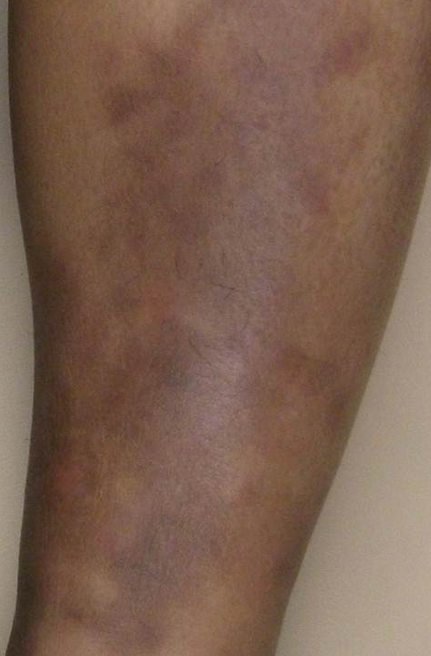
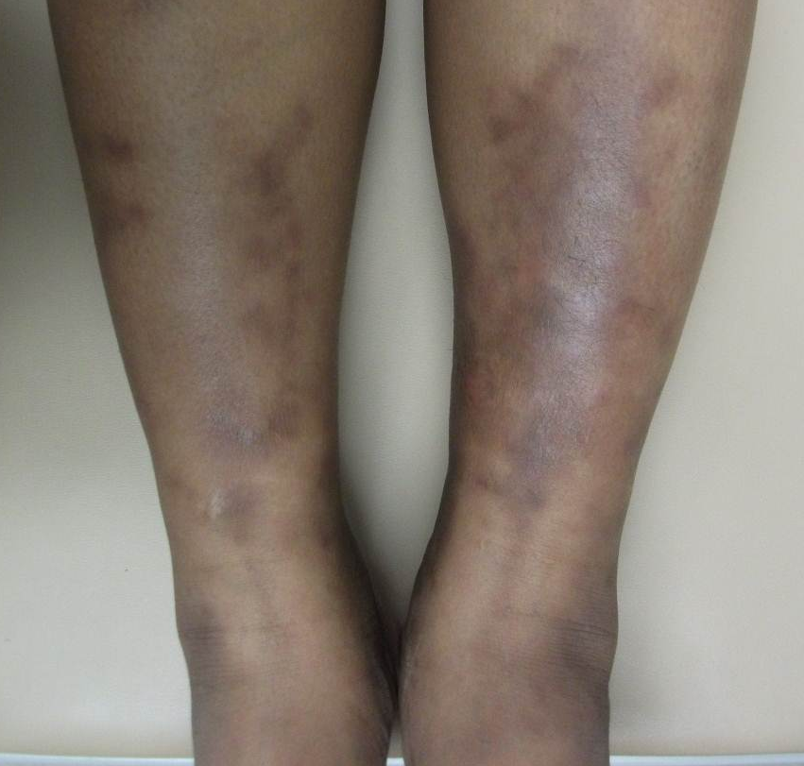
Another Example of PAN
Several hyperpigmented nodules along medium-sized vessels

Slide 62
Case Five: Systemic PAN?
Key diagnostic features of this case
    Fever
    Skin nodules with medium-sized artery inflammation on biopsy
    Renal involvement
    Paresthesias, decreased sensation and reflexes (i.e., mononeuritis multiplex)

Slide 63
Diagnosis: PAN
It is important to differentiate between cutaneous and systemic PAN to help guide therapy
Cutaneous PAN
  Skin involvement +/- polyneuropathy, arthralgias, myalgias, fever
  More common in children (may follow a strep infection)
  Chronic benign course
Systemic PAN
  Neurological involvement common: mononeuritis multiplex, stroke
  Renal: hypertension
  Joint, Heart, GI, Liver also may be affected
  Orchitis in patients with HBV

Slide 64
Management: PAN
Chronic course (months-years); exacerbations/remissions
Local wound care to any skin ulcerations
Patients without cutaneous PAN may be treated with systemic corticosteroids alone
For patients with cardiac, gastrointestinal, neurological, or renal involvement (i.e., systemic PAN):
  Specialty consultation for involved organs (especially nephrology and neurology)
  Adjunctive therapy with cyclophosphamide
Treat any underlying infections (e.g., HBV)

Slide 65
Take Home Points:
Petechiae and Purpura
The term purpura is used to describe red-purple lesions that result from extravasation of blood into the skin or mucous membranes
Purpura may be palpable and non-palpable
Purpura does not blanch with pressure
Purpura may result from hyper- and hypocoagulable states, vascular dysfunction and extravascular causes
Various life-threatening conditions present with petechial rashes including meningococcemia and RMSF
The presence of petechial or purpuric lesions in a septic patient should raise concern for DIC

Slide 66
Take Home Points:
Vasculitis
Palpable purpura results from underlying blood vessel inflammation (vasculitis)
Palpable purpura is the hallmark lesion of leukocytoclastic vasculitis
The various etiologies of vasculitis may be categorized according to size of vessel affected
A skin biopsy is usually necessary for the diagnosis of vasculitis

Slide 67
Acknowledgements
This module was developed by the American Academy of Dermatology Medical Student Core Curriculum Workgroup from 2008-2012.
Primary authors: Sarah D. Cipriano, MD, MPH; Eric Meinhardt, MD; Alina Markova; Timothy G. Berger, MD, FAAD, Kanade Shinkai, MD, PhD, FAAD.
Peer reviewers: Heather Woodworth Wickless, MD, MPH; Daniela Kroshinsky, MD, FAAD.
Revisions and editing: Sarah D. Cipriano, MD, MPH; Alina Markova. Last revised August 2011.

Slide 68
End of Module
Berger T, Hong J, Saeed S, Colaco S, Tsang M, Kasper R. The Web-Based Illustrated Clinical Dermatology Glossary. MedEdPORTAL; 2007. Available from: www.mededportal.org/publication/462.
Dedeoglu F, Kim S, Sundel R. Management of Henoch-Schönlein purpura. In: UpToDate, Basow, DS (Ed), UpToDate, Waltham, MA, 2011.
Dedeoglu F, Kim S, Sundel R. Clinical manifestations and diagnosis of Henoch-Schönlein purpura. In: UpToDate, Basow, DS (Ed), UpToDate, Waltham, MA, 2011.
Fatal Cases of Rocky Mountain Spotted Fever in Family Clusters --- Three States, 2003. MMWR Weekly May 21, 2004/53(19);407-410.
Gota Carmen E, Mandell Brian F, "Chapter 165. Systemic Necrotizing Vasculitis" (Chapter). Wolff K, Goldsmith LA, Katz SI, Gilchrest B, Paller AS, Leffell DJ: Fitzpatrick's Dermatology in General Medicine, 7e: http://www.accessmedicine.com/content.aspx?aID=2993241.
Hunder GG. Treatment of giant cell (temporal) arteritis. In: UpToDate, Basow, DS (Ed), UpToDate, Waltham, MA, 2011.

Slide 69
End of Module
Hunder GG. Classification of and approach to the vasculitides in adults. In: UpToDate, Basow, DS (Ed), UpToDate, Waltham, MA, 2011.
James WD, Berger TG, Elston DM, “Chapter 35. Cutaneous Vascular Diseases” (chapter). Andrews’ Diseases of the Skin Clinical Dermatology. 10th ed. Philadelphia, Pa: Saunders Elsevier; 2006: 820-845.
Rashid Bina A, Houshmand Elizabeth B, Heffernan Michael P, "Chapter 145. Hematologic Diseases" (Chapter). Wolff K, Goldsmith LA, Katz SI, Gilchrest B, Paller AS, Leffell DJ: Fitzpatrick's Dermatology in General Medicine, 7e: http://www.accessmedicine.com/content.aspx?aID=2989841.
Rosenstein NE, Perkins BA, Stephens DS, Popovic T, Hughes JM. Meningococcal Disease. Review Article. N Endl J Med. 2001;344:1378-1388.
Segelmark M, Selga D. The challenge of managing patients polyarteritis nodosa. Curr Opin Rheumatol. 2007 Jan; 19(10):33-8.
Stone JH. Polyarteritis nodosa. JAMA. 2002 Oct 2;288(13):1632-9.

