Slide 1
Hearing Disorders
Murad Al-momani, Ph.D., CCC-A, FAAA
American Board of Audiology

Slide 2
Objectives
By the end of this presentation, students will be able to
  Recognize type, degree and possible causes of hearing loss.
  Interpret basic audiology testing results including pure tone audiometry, Tympanometry, acoustic reflexes, speech audiometry, otoacoustic emissions and auditory brainstem response.
  Read and interpret basic vestibular and balance testing results.

Slide 3
Hearing loss
Hearing loss is defined as having one or more frequencies out of the normal hearing range and it has degrees.
The more sever the hearing loss is, the more effect will be on the overall functioning of the individual with hearing loss.
But, even slight hearing loss can impede the development and acquisition of the normal language.

Slide 4
Types of Hearing loss
Conductive hearing loss: a failure in the efficient conduction of sound waves through the outer ear, tympanic membrane (eardrum) or middle ears (ossicles).

Slide 5
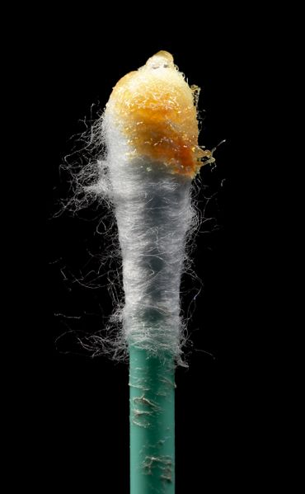
Causes of conductive hearing loss
Earwax, also known by the medical term cerumen, is a yellowish, waxy substance secreted in the ear canal of humans and many other mammals.
It plays an important role in the human ear canal, assisting in cleaning and lubrication, and also provides some protection from bacteria, fungi, and insects.
Excess or impacted cerumen can press against the eardrum and/or occlude the external auditory canal and impair hearing

Slide 6
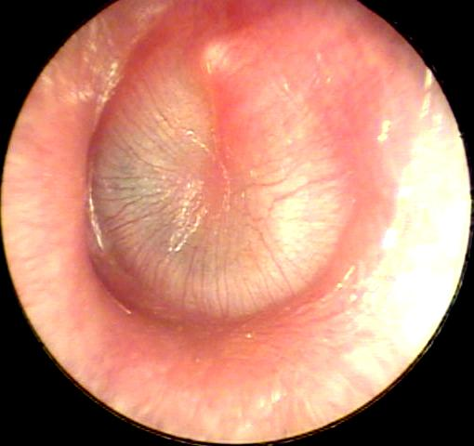
Otitis media is an inflammation of the middle ear: the space behind the ear drum.
Otitis media is very common in childhood, and includes acute and chronic conditions; all of which involve inflammation of the ear drum (tympanic membrane), and are usually associated with a buildup of fluid in the space behind the ear drum (middle ear space).

Slide 7
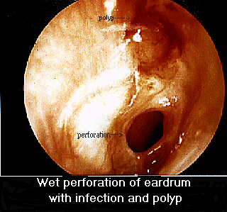
Rupture or perforation (hole) of the eardrum can occur in infection, trauma (e.g. by trying to clean the ear with sharp instruments), explosion or loud noise.

Slide 8
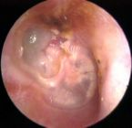
Cholesteatoma is a destructive and expanding sac in the middle ear and/or mastoid process. There are two types: congenital and acquired.

Slide 9
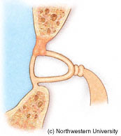
Otosclerosis is a progressive degenerative condition of the temporal bone which can result in hearing.

Slide 10
Sensorineural Hearing loss
Sensorineural hearing loss is a type of hearing loss in which the root cause lies in the vestibulocochlear nerve (Cranial nerve VIII), the inner ear, or central processing centers of the brain.

Slide 11
Causes of Sensorineural Hearing Loss
Congenital.
Acquired:
1- Inflammatory
  Suppurative labyrinthitis
  Meningitis
  Mumps
  Measles
  Viral
  Syphilis

Slide 12
Causes of Sensorineural Hearing loss
2- Ototoxic drugs.
3- Physical trauma - either due to a fracture of the temporal bone affecting the cochlea and middle ear.
4- Noise-induced - prolonged exposure to loud noises (>90 dB) causes hearing loss which begins at 4000Hz (high frequency). The normal hearing range is from 125 Hz to 20,000 Hz.
5- Presbyacusis - age-related hearing loss that occurs in the high frequency range (4000Hz to 8000Hz).
6- Meniere's disease - causes sensorineural hearing loss in the low frequency range (125 Hz to 1000 Hz). Meniere's disesase is characterized by sudden attacks of vertigo lasting minutes to hours preceded by tinnitus, aural fullness, and fluctuating hearing loss.

Slide 13
Assessment Protocols
Outer to inner.
Objective and subjective.
Determines hearing thresholds (air/bone).
Determines site of lesion.
Leads to diagnosis and intervention plan.

Slide 14
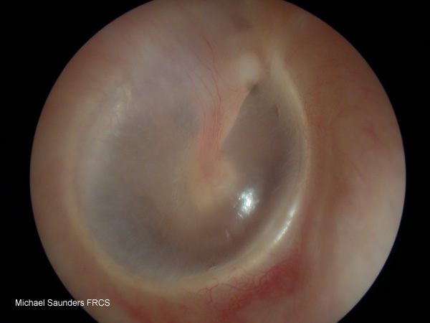
Otoscopic examination

Slide 15
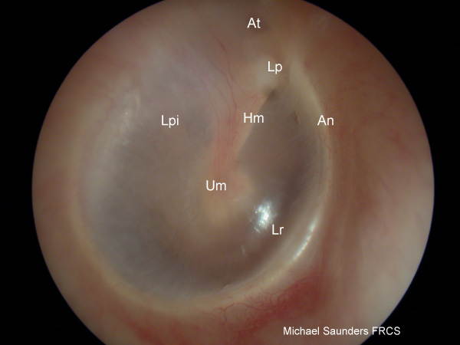
Important Landmarks
An annulus fibrosus
Lpi long process of incus - sometimes visible through a healthy translucent drum
Um umbo - the end of the malleus handle and the centre of the drum
Lr light reflex - antero-inferioirly
Lp Lateral process of the malleus
At Attic also known as pars flaccida
Hm handle of the malleus

Slide 16
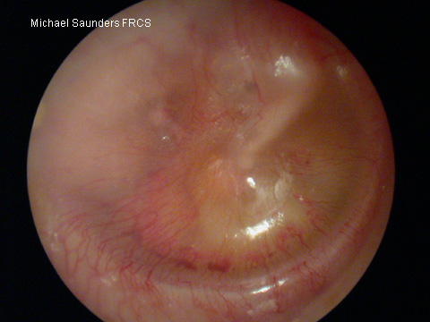
Abnormal TM
Mild retraction may be difficult to identify. The margin of the drum (annulus may become more pronounced as in this image

Slide 17
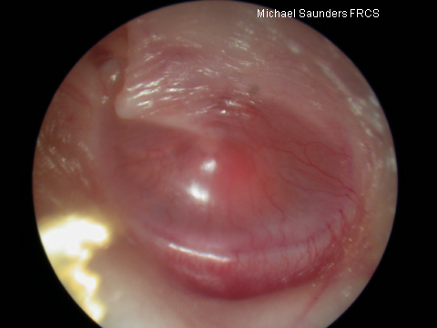
Abnormal TM
As the drum retracts so does the handle of the malleus and it may appear to be shortened on otoscopy. The lateral process will also become much more prominent than normal

Slide 18
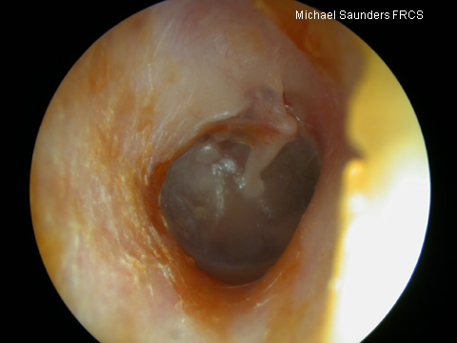
ABNORMAL TM
As the drum becomes increasingly retracted, it drapes over the ossicular chain, and the incus and stapes head may be outlined

Slide 19
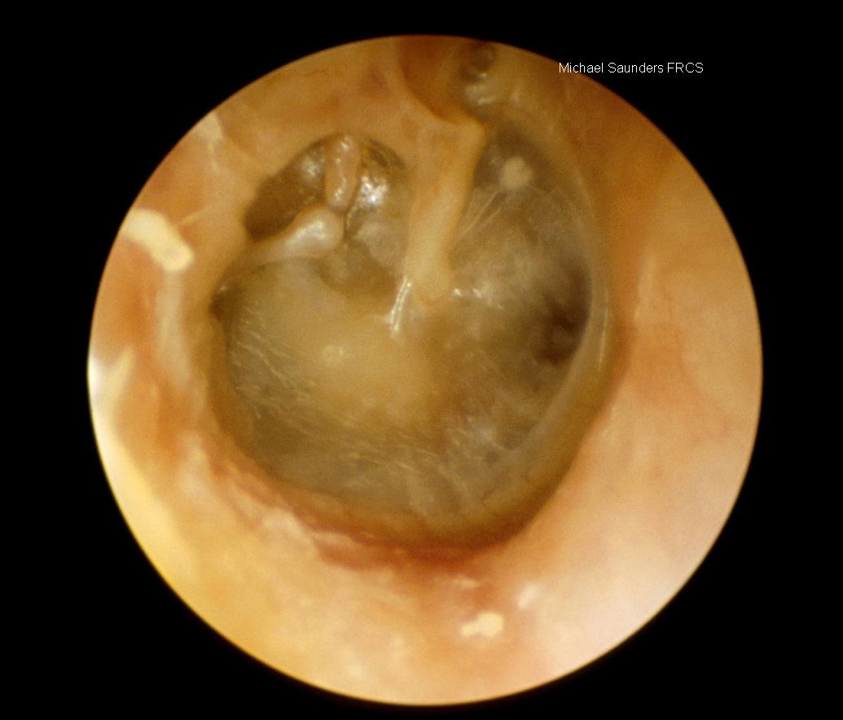
ABNORMAL TM
Eventually, nearly all the middle ear space may be lost and the drum comes into contact with the medial wall of the middle ear (this is known as atelectasis)

Slide 20
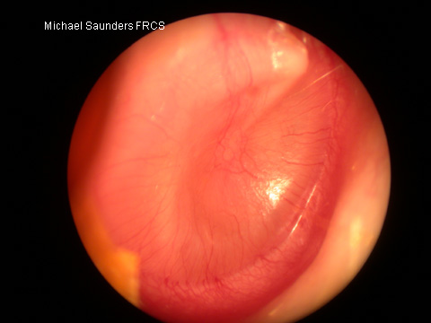
COLOR OF TM
Compare this drum with the normal one. It is opaque and pale. There is slight injection of blood vessels. This is one appearance of glue ear

Slide 21
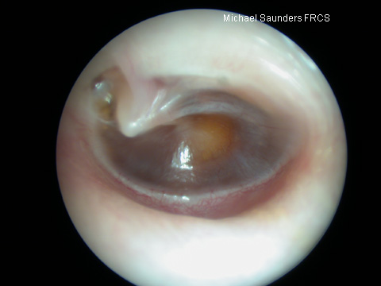
GLUE EAR
Glue ear may make the drum yellow or even darker than normal. Note also how retracted this drum is and how prominent the lateral process of the malleus appears. Blood in the middle ear will give the ear a blue or brown colour, this is called a haemotympanum

Slide 22
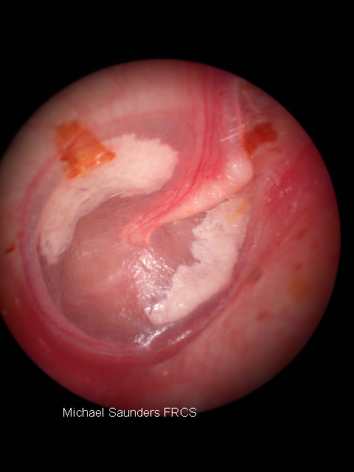
ABNORMAL TM
white patches actually on the drum or within the drum itself are usually tympanosclerosis, which is deposition of calcium into the drum itself in response to trauma or infection. This is not normally of any consequence unless it is severe, which can lead to a mild conductive hearing loss.

Slide 23
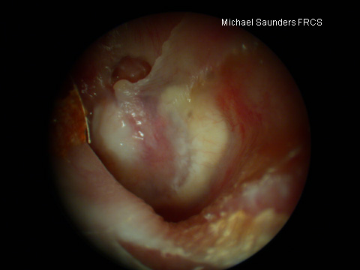
ABNORMAL TM
If the white patch is behind the drum, this may represent cholesteatoma (keratin in the middle ear). This normally needs to be treated surgically.

Slide 24
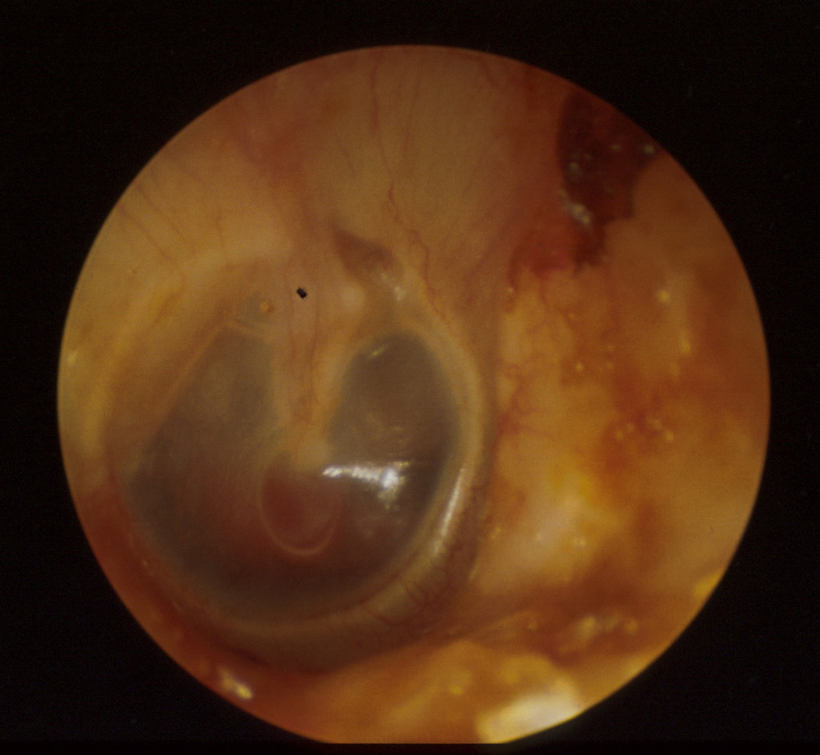
ABNORMAL TM
This small red lesion at the tip of the malleus handle is a vascular lesion called a glomus tumour. This might cause pulsatile tinnitus, but is rare. This needs surgical treatment

Slide 25
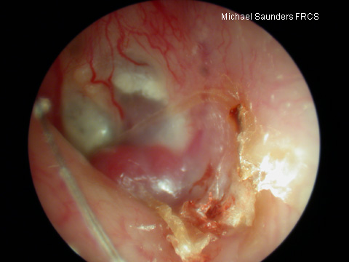
ABNORMAL TM
This red bulge in the canal is another glomus tumour (glomus jugulare). this is the tip of a much larger lesion involving the temporal bone

Slide 26
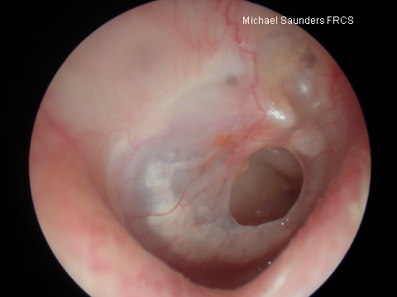
PERFORATION
Safe perforation of the anterior part of the drum. A common cause of perforations in this position is a persistent defect after the extrusion of a grommet

Slide 27
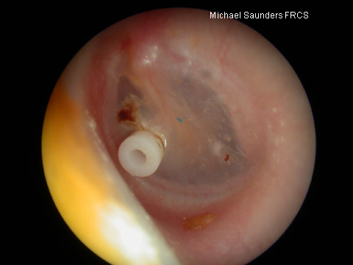
VENT TUBE
This is a grommet (ventilating tube) in the correct position in the drum. The hole in the middle should be clear of debris. Note a small dried crust above the grommet which is unimportant and may be a small clot remaining from surgery

Slide 28
Clinical applications of tympanometry
Murad Al-momani, Ph.D., CCC-A

Slide 29
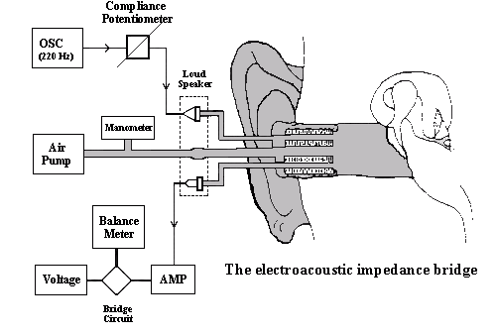

Slide 30
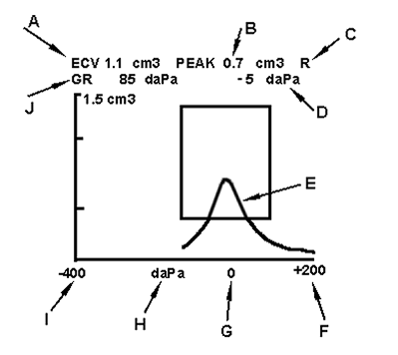

Slide 31
TYMPANOMETRIC FEATURES
Tympanometric shapes.
Static acoustic admittance.
Tympanometric width (gradient).
Tympanometric peak pressure.
Equivalent ear canal volume.

Slide 32
Tympanometric shapes
According to Jerger classification (1970).
Tympanograms are classifieds according to the height and location of the tympanometric peak.
  Type A: has normal peak height and location of the peak.
  Type B: is flat.
  Type C: the peak is displaced to the negative tail.
  Type D: double peak.
  A_{s} : normal but shallow peak admittance.
  A_{d} : normal with excessive admittance.

Slide 33
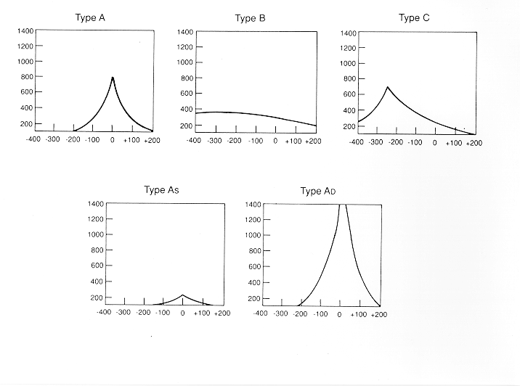

Slide 34
admittance
It is the most important feature.
It is sensitive to middle ear conditions including MEE, chronic otitis media, cholesteatoma and ossicular adhesion, ossicular discontinuity, TM perforation, glomus tumor.

Slide 35
Tympanometric width
The sharpness of the peak is an indicator of middle ear pathology.
Determined by bisecting the distance from the peak to the positive tail of the tympanogram.
The width of the tympanogram at that point is determined in daPa.
Abnormally narrow tympanograms might be related to otosclerosis but this has not been confirmed.
But abnormally wide peak has been found to be related to middle ear effusion.

Slide 36
Tympanometric peak pressure
The pressure at which the peak occurred.
Is an indicator of the pressure in the middle ear space.
Negative pressure is thought to happen because the gases of the bacteria resulted from infection is absorbed by the middle ear mucosa and then a negative middle ear pressure occur.
Studies however found that, without other tympanometric, audiometric or otoscopic abnormalities; negative pressure probably does not indicate a significant middle ear disorder.
Positive middle ear pressure has been reported in acute otitis media.

Slide 37
Equivalent ear canal volume
In the presence of a flat tympanogram, an estimate of the air in the canal can provide valuable information.
Like detecting perforations in the TM. Or patency of the myringetomy tube.
Usually high volume with flat tymps represents either perforations or patent vent tubes.

Slide 38
Sensitivity and specificity
Sensitivity has been found to be around 82% for MEE.
Normal type A has 100% specificity.
Overall sensitivity of around 80% and specificity of around 90%.
That is good but means we need to interpret results with caution.

Slide 39
Tympanometry in infants
Studies has found frequent occurrence of double peaked tymps.
Usually we use higher probe frequency when testing infants like 1000 Hz.

Slide 40
Pure tone audiometry
Murad Al-momani, Ph.D., CCC-A, FAAA, American Board in Audiology

Slide 41
Procedures for conventional pure-tone audiometry
After history taking and otoscopy we must choose how to test the hearing thresholds.
Before we do pure tone audiometry (PTA), we usually perform middle ear immitance testing
PTA will be almost done to all pts visiting us in the clinic because it is the basic test and give us a lot of information about the problem.

Slide 42
Air conduction testing
When measuring behavioral air conduction thresholds, we are measuring a response to sound passed through the entire auditory pathway.
Thus if the patient responds to pure tones at normal levels, we can be sure that the auditory system is reasonably intact from the outer ear to the auditory cortex.
But that does not imply that there is no damage some where in the auditory system.
For example in some retrocochlear lesions, the pt responds normally to pure tones but he has difficulty recognizing speech.

Slide 43
PTA
With PTA we can determine whether the pt has peripheral hearing loss (that is at the level of outer, middle, inner ear or the auditory nerve).
PTA is administered both by air (air conduction PTA) or by bone (bone conduction PTA).
Air conduction tests are administered by loudspeakers or ear phones.

Slide 44
Pure tones
Pure tones are composed of sine waves that repeats itself at regular intervals.
Pure tones may differ in either amplitude or frequency.
The pure tones that the human ear can detect is between 20 Hz to 20,000 Hz.
But we are most interested infrequencies 125 Hz to 8,000 Hz.

Slide 45
PTA
Testing should be done in a room that is quiet enough to avoid masking by the noise.
The maximum SPL that may exist in the room in order to obtain thresholds near 0 dB HL are determined by ANSI, 1991.
We usually begin at 1000 Hz because some studies found that test-retest reliability is highest at this frequency.

Slide 46
PTA
After establishing threshold at 1 KHz, we move to the frequencies (2000, 4000, and 8000Hz).
If the difference between any two adjacent frequencies is 20 dB or more, we must measure the threshold at the inter octave frequencies.
After we are done from the high frequencies, we return back and check the 1 KHz again to check for test-retest reliability.
Then we test (500, 250 and 125 Hz).

Slide 47
PTA
If we test in the sound field, we must use warble tones instead of pure tones to avoid the production of standing waves.
When using ear phones make sure that there is no excessive wax in EAC and that the earphone is snugly inserted in the canal.
All equipment (audiometer, earphones, and testing room should be calibrated according the standards (will teach you how to do that in the instrumentation course).

Slide 48
PTA-BONE CONDUCTION
The most commonly used procedure for bone-conduction testing is mastoid placement because it is more convenient.
Frontal bone can be used as the place for the bone vibrator.

Slide 49
PTA.BONE CONDUCTION
We should do bone conduction if the air conduction thresholds are above the normal range otherwise we do not need to do bone conduction testing.
We first do unmasked thresholds and then we should apply masking to the contralateral ear in order to get precise threshold measurement in this ear (will talk about masking next lecture).

Slide 50
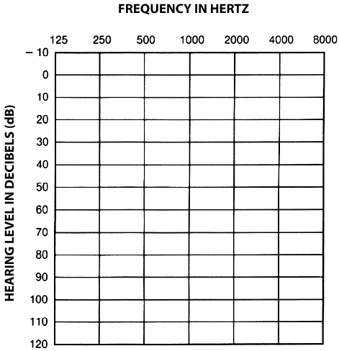
AUDIOGRAM

Slide 51
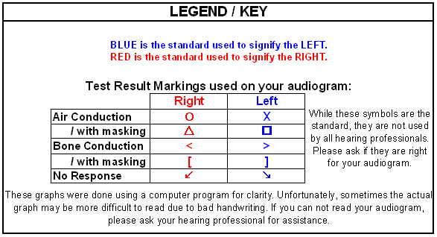

Slide 52
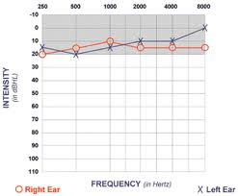

Slide 53
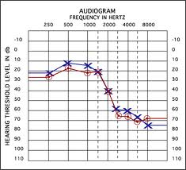

Slide 54
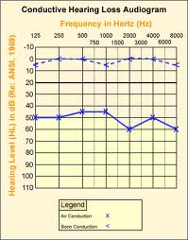

Slide 55
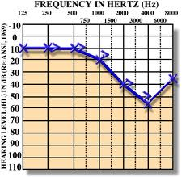

Slide 56
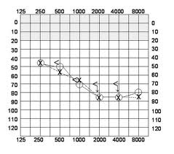

Slide 57
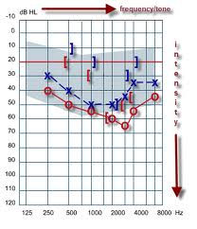

Slide 58
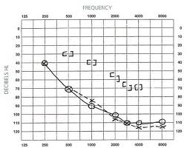

Slide 59
Information we get from audiogram
Degree of hearing loss.
Type of hearing loss.
Configuration of hearing loss.

Slide 60
Speech audiometry

Slide 61
Why we need to assess speech sensitivity?
The most important sounds that are important for humans are those related to speech.
PTA does not give the clear picture about how the pt respond to speech signals.
Some times, one might have normal sensitivity thresholds to PTA but the reception and recognition to speech signal is deteriorated like in retrocochlear lesions.

Slide 62
Speech audiometry
We need to know how sensitive our hearing to speech signals.
Sensitivity measures are threshold measures that typically are referred to as the speech-recognition-thresholds (SRT) and speech detection threshold (SDT).
Acuity measures are supra-threshold measures that typically are referred to as the speech-recognition score or word recognition performance.

Slide 63
Speech audiometry
SRT means the dB HL level at which a certain percent correct recognition of words (usually 50%).
In speech recognition, we are concerned in what a percent score (80%, 70%, 90%, 100% or so forth) does the pt have when we increase the intensity (dB HL) of the speech signal above the threshold (SRT).

Slide 64
SRT and SDT
SRT and PTA average should be in agreement.
Studies have found that PTA average (500, 1000, and 2000 Hz) and SRT should be + or – 6dB from each others.
Some times SRT are worse than the PTA average like in cases of when there is islands of normal hearing in the audiogram especially at high frequencies. Also in cases of tumors around the auditory nerve, SRT are worse than PTA average.
SRT might be better than PTA in cases of functional hearing loss.

Slide 65
Speech or word recognition scores
Usually conductive hearing loss does not affect speech discrimination scores (usually scores will be excellent, above 90%).
Cochlear lesions affect this score significantly (usually scores rarely are above 80%).
Retro-cochlear lesion affect the scores too sever.

Slide 66
Otoacoustic Emission
Murad Al-momani, Ph.D., CCC-A, FAAA
American Board in Audiology

Slide 67
Origin of OAE
Initially reported by Kemp in 1978.
OAE are considered a by-product of sensory OHCs transduction and represent cochlear amplifier that thought to be as a result of the contraction of OHCs in synchrony with BM displacement.
The contraction of the OHCs (movement) is then propagated outward toward the middle ear and moves the TM.
This in turn creates acoustic energy that is picked by the OAE probe.

Slide 68
OAE
So in order to record OAE in EAC we need to have normal middle ear function.
Conductive pathologies can prevent the recording of OAE but this does not mean that OAE is not present.

Slide 69
OAE
EOAEs are recorded as a result of the introduction of acoustic stimulation.
The first type is called transient EOAE (TEOAE): which appears as a result using a click stimulus.
The second type is the distortion product EOAE (DPOAE): is a response occurring when two pure tones of different frequencies are presented simultaneously in EAC. The DPOAE is generated at frequencies that are different than both frequencies.

Slide 70
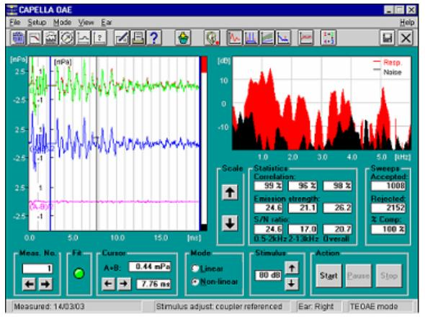
TEOAE

Slide 71
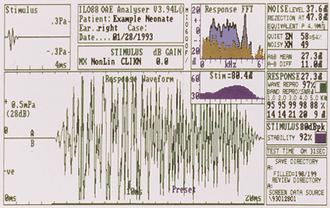
TEOAE

Slide 72
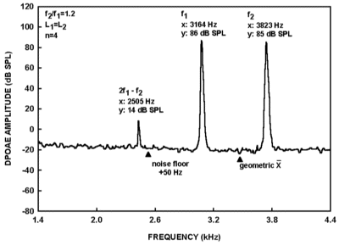
DPOAE

Slide 73
Applications of OAE
TEOAE can be recorded in all non-pathologic ears that do not display hearing loss of greater than 30 dB.
OAE can be recorded in both adults and infants.
Accordingly TEOAE and DPOAE can be used to screen for hearing loss in infants.
DPOAE provide more frequency specific evaluation that TEOAE.

Slide 74
Clinical applications of EOAE
1- can be used in newborn hearing screening. The results will indicate either fail or pass. Fail means that hearing thresholds are worse than 30 dB HL. Pass results means hearing thresholds are 30 dB HL or better.
  So, we can not use this tool to measure threshold of hearing.

Slide 75
Clinical applications of EOAE
2- in differential diagnosis of hearing loss (site of lesion). This can help in differentiating sensory from neural hearing loss.
3- monitoring of the effect of ototoxicity or noise exposure.
4- although still under research: DPOAE can be used to screen for the carriers of the recessive hearing loss genes: many studies found that DPOAE is larger (especially at high frequencies) in carriers than in non carriers when using f2/f1 of 1.3 and low stimulus levels of 50-60 dB.

Slide 76
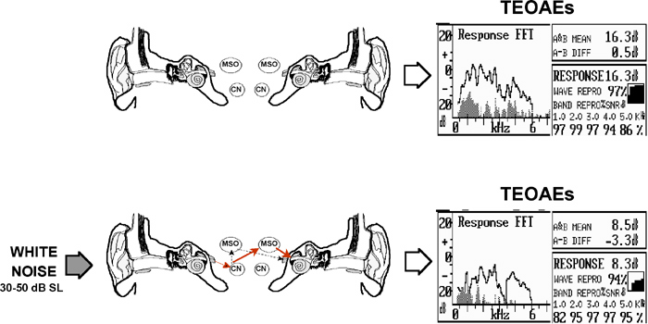

Slide 77
Medial Olivocochlear efferent pathway
the stimulation of the medial efferents alters IHCs sensitivity indirectly by altering the micromechanical properties of the OHCs.
length, tension and the stiffness of the OHCs along their longitudinal axis are under the control of the MOC bundle, thus enhancing the auditory sensitivity, especially for low level stimuli at 30-40 dB SL.
medial efferent system enhances the frequency resolving capacity and the vowel discrimination, especially in a background of noisy environment

Slide 78
Medial Olivocochlear efferent pathway
Since the medial olivocochlear bundle is mainly inhibitory, there has been already suggestions that dysfunction of the efferent auditory system, at any level from auditory cortex to cochlea, may be a basis for tinnitus generation, especially in noise-induced tinnitus cases.
It has been also suggested that hyperacusis might be associated with dysfunction of the efferent system.

Slide 79
Clinical applications of ABR
Murad Almomani, Ph.D., CCC-A, FAAA

Slide 80
The normal ABR waveform
Is characterized by 5-7 peaks.
Occurs in a latency epoch of 1.4 – 8.0 ms.
Responses are usually displayed with positive peaks reflecting neural activity toward the vertex.
These peaks are labeled with the roman numerals I through XII.
The most prominent waves are I, III, and V.

Slide 81
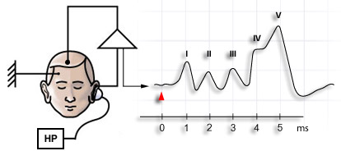

Slide 82
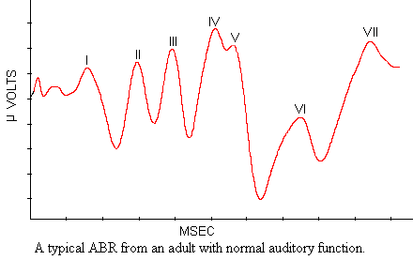

Slide 83
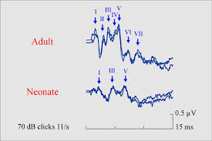

Slide 84
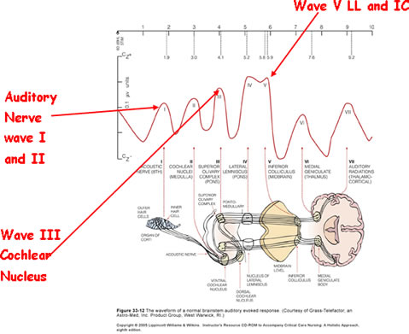

Slide 85
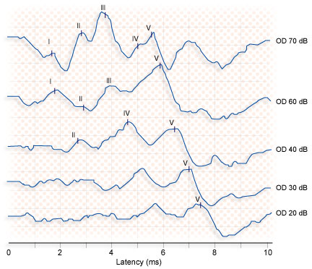

Slide 86
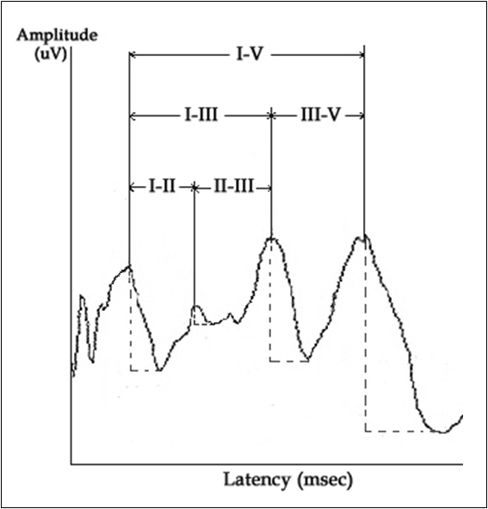

Slide 87
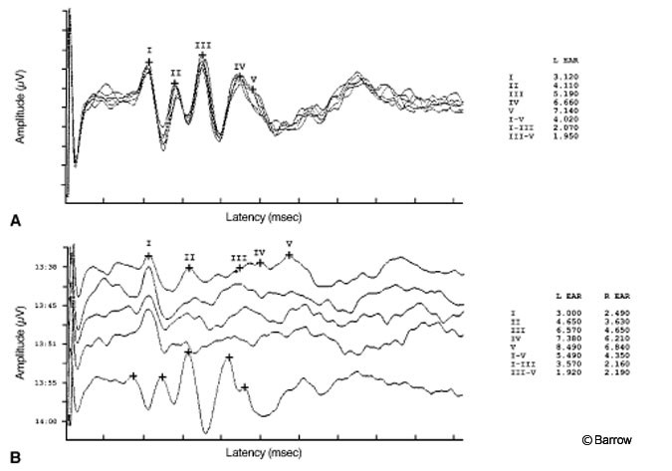

Slide 88
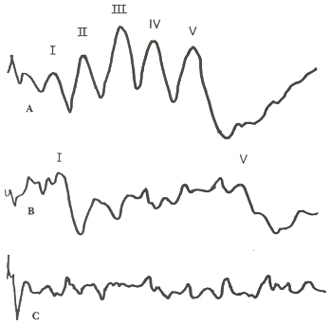

Slide 89
Clinical applications of ABR
There are two main applications for ABR in the clinical settings:
  Neurodiagnosis: to assess the auditory pathway. This feature is specially used in adult populations.
    Waves absolute latency.
    Interpeak intervals.
    Interaural wave V latency difference.
    Absence of waves.
  Hearing thresholds estimation: mainly used in infants and children population.
    Wave V threshold.
    Wave V latency-intensity function.

Slide 90
Standard ABR Measures for Acoustic Tumor Detection
IT5 = Interaural time delay for wave V
6.4
Non-Tumor Side
L1
IT5 = L2 - L1 = 0.9 ms
L2
7.3
Tumor Side
0
2
4
6
8
10
12
14
ms
I. Background: Standard ABR Tumor Detection

Slide 91
Standard ABR Measures for Acoustic Tumor Detection:
I-V Delay = Latency Difference Between Wave I and V
I. Background: Standard ABR Tumor Detection

Slide 92
Standard ABR Measures for Acoustic Tumor Detection:
I-V Delay = Latency Difference Between Wave I and V
I. Background: Standard ABR Tumor Detection

Slide 93
Neurodiagnosis
Who should be tested? Patients with:
  Dizziness.
  Unilateral tinnitus.
  Asymmetrical hearing loss.
  Sudden onset of hearing loss.
  Progressive hearing loss.

Slide 95
Specific clinical application of ABR in pediatric populations
Newborn hearing screening:
  Usually screen at 30-35 dBHL.
  It can be automated.
  If fail refer for a diagnostic ABR.
  Many studies revealed that automated ABR (AABR) is efficient in newborn hearing screening.
  Some new technologies combined OAE and AABR in one equipment and used both in the screening process resulted in less refer rate and less false positives.

Slide 96
Specific clinical application of ABR in pediatric populations
Otitis media:
  Studies has found that ABR wave V latency-intensity function shift to the right in a proportion equivalent to the conductive hearing loss.
  Wave I is abnormally prolonged in Patients with effusion.
Congenital aural atresia:
  Can use both circumaural headphones for air conduction ABR and bone vibrator for bone conduction ABR.

Slide 97
Specific clinical application of ABR in pediatric populations
Auditory neuropathy:
  No single definition.
  No data about its prevalence, although it has been found to be around 10% in NICU who have hearing loss.
  Rare in healthy babies.
  Lesions can be in IHCs, synapses, or auditory nerve.
  Can have normal or mild to moderate PTA.
  Usually poor speech discrimination especially in noise.
  Many causes like hypoxia, hyperbillirubinemia, genetic.
  Present OAE and/or CM with absent ABR or abnormal ABR (may have only wave I).
  Or present CM, absent SP and absent or abnormal ABR.

Slide 98
Specific clinical application of ABR in pediatric populations
Neoplasms and tumors:
  Neurofibromatosis type I and II: genetically autosomal dominant inherited progressive disorders. Usually tumors involving auditory nerve bilaterally.
  Brainstem gliomas: tumors in children and adolescent and tends to grow slowly.
  These disorders may show increase in ABR absolute latencies and interpeak intervals.

Slide 99
Specific clinical application of ABR in pediatric populations
Epilepsy:
  ABR may show prolongation of waves III and V.
  Increase in interpeak intervals.
Demyelinating diseases:
  Multiple sclerosis (MS): is the most common type in adults and is characterized by vertigo, unsteadiness and fluctuating SNHL.
  Schilder’s disease: a progressive childhood disease. Some consider it a variant of MS.
  ABR usually reveals an absence of waves III and V.

Slide 100
Specific clinical application of ABR in pediatric populations
Fragile X syndrome: the most common hereditary type of mental retardation:
  Long absolute latencies.
  Increase in interpeaks intervals.
Meningitis:
  Increase in interpeaks intervals and absolute latencies.
Hydrocephalus:
  Increase in absolute latencies of waves III and V.
  Increase in interpeaks intervals.

Slide 101
Specific clinical application of ABR in adult populations
Retrocochlear lesions:
  Vestibular schwannoma: mostly found in the VIII nerve. But may also involve V, VII, and XII.
  It is also used interchangeably with acoustic neuroma.
  Increase in absolute latency of wave III or V.
  Interaural Wave V latency difference.
  Increase in I-III, III-V, and I-V interpeak intervals (some or all depending on the location).
  may be absence of waves III or V.
  Stacked ABR findings.

Slide 102
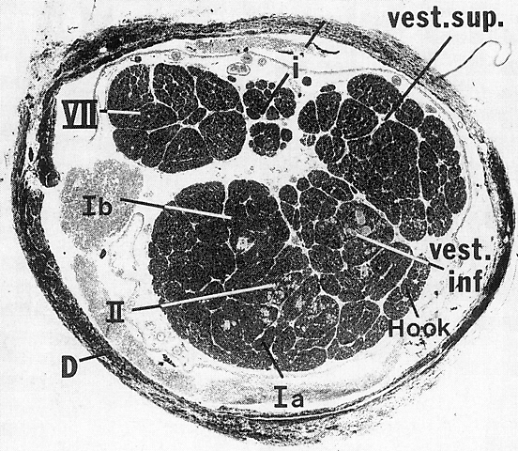
Cross Section: Human Auditory Meatus
(2 kHz)
(1 kHz)
(6 kHz)

Slide 103
Cross-section of Internal Auditory Canal (IAC)
Sup.
Vest. Nerve
Facial Nerve
Inf.
Vest. Nerve
Acoustic Nerve

Slide 104
Medium or Large Tumor in IAC
Sup.
Vest. Nerve
Facial Nerve
Tumor
Inf.
Vest. Nerve
Acoustic Nerve

Slide 105
Vestibular Testing
Vestibular testing is an important tool in the management of the patient with dizziness.
The bedside evaluation of the dizzy patient, with a careful history and a thorough neurotologic diagnosis, is a crucial for making an accurate clinical diagnosis.
We do not believe that vestibular testing is to be used as a stand alone diagnostic test battery for patients with dizziness.

Slide 106
Background
Although bedside and office examinations provide information about the status of the vestibular system, major limitations are the inability to quantify responses and to monitor the course of the illness or the results of medical and surgical management.
Current technologies available for assessing the vestibular system include ENG/VNG, rotational testing and posturography.

Slide 107
Uses of Vestibular Lab.
Aid in establishing diagnosis
Location, central versus peripheral.
Lateralization.
Documentation.
Assist in devising treatment plan.
Aid in long term management.

Slide 108
ENG or VNG
ENG/VNG is the most common method of laboratory evaluation of the vestibular system.
The exam consists of a battery of tests.
ENG monitor eye movement .
The vestibular and ocular systems are connected through the VOR.
Thus, patients with peripheral and/or central balance disorders often exhibit abnormal eye movements that can be measured and recorded.

Slide 109
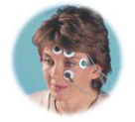
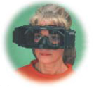
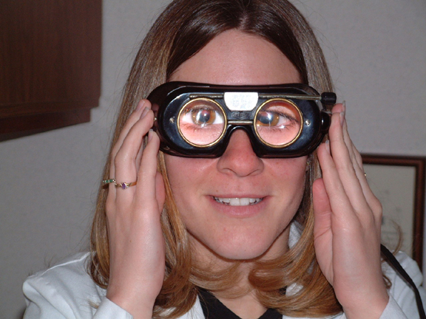
Eye Movement Recording
In performing ENG/VNG, the patient eye movements are measured relative to head position, which can be achieved in a number of ways.
Measuring electric potentials, measuring magnetic potentials, using video cameras or using infrared technology and direct observation.

Slide 110
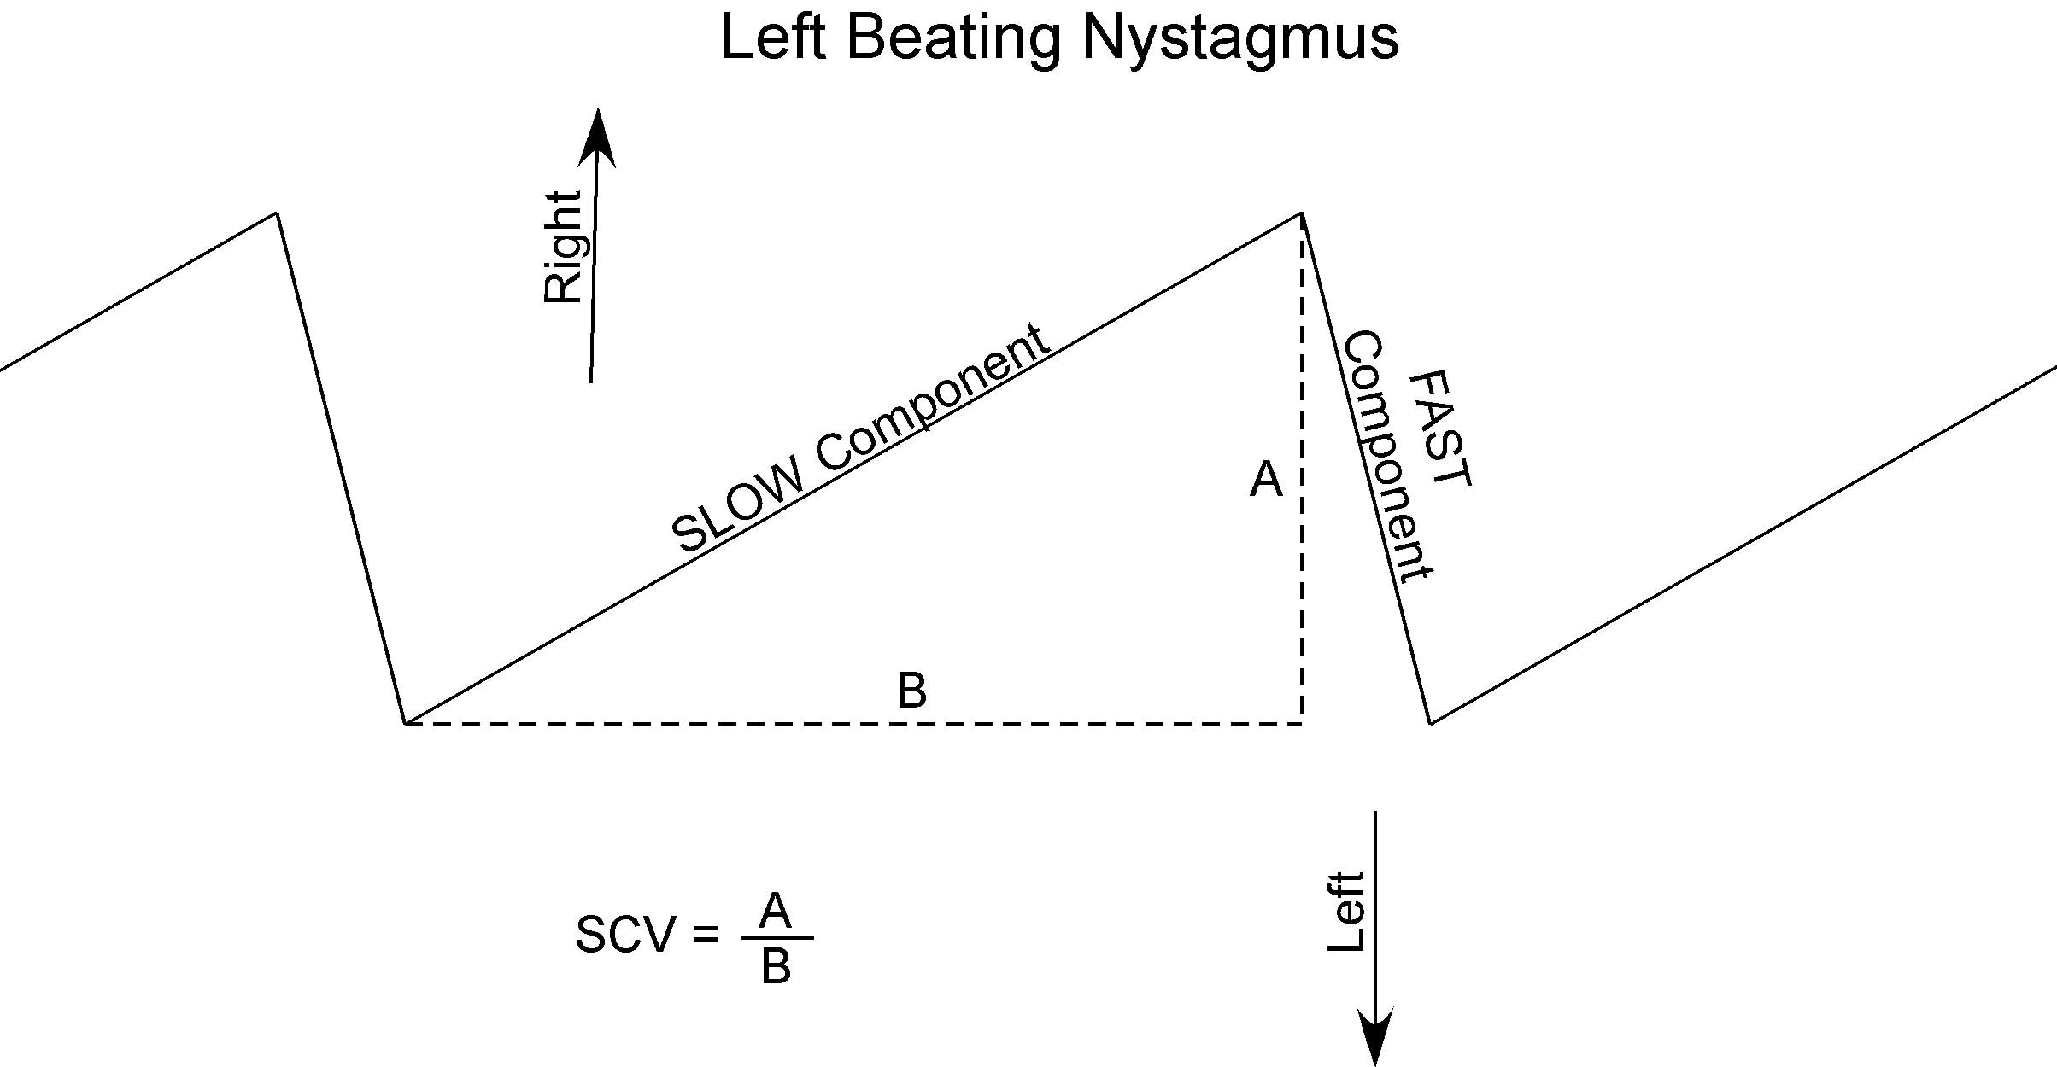
Nystagmus

Slide 111


Slide 112

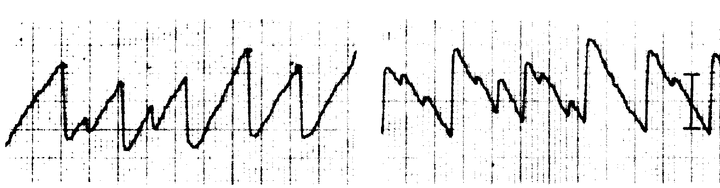
Left Beating
Right Beating
Slow
Fast

Slide 113
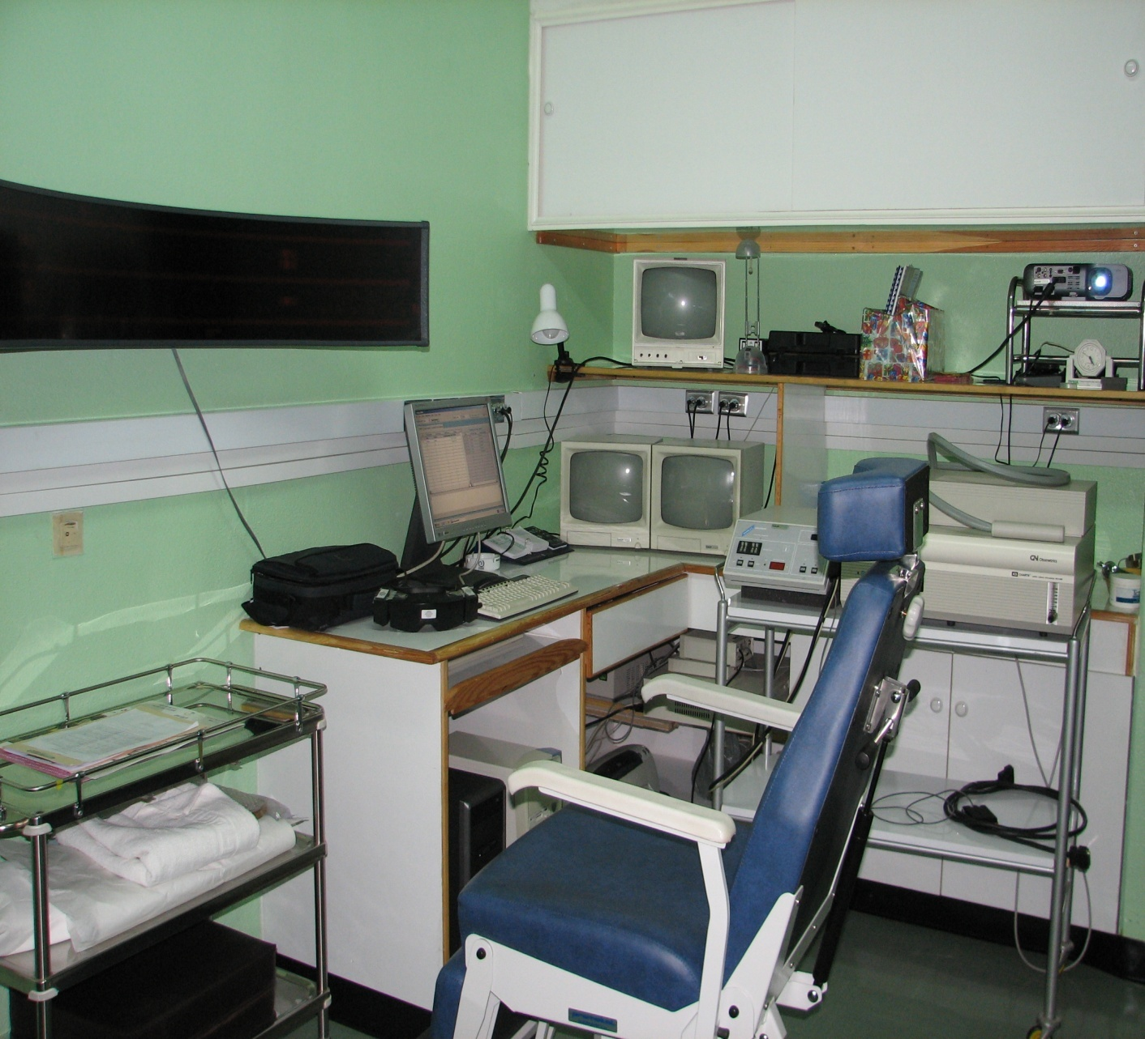
VNG Test Battery
Calibration
Gaze
Saccade
Pursuit
Optokinetic
Positional
Hallpike
Caloric

Slide 114


Gaze Test
The function of the gaze system is to maintain visual fixation of an object on the fovea of the eye.
To identify the presence of spontanoues eye movement.
Normal gaze, patient able to maintain position with eyes opened and closed.

Slide 115


Gaze results with peripheral &central lesions
Horizontal.
Directional fixed.
Suppressed with visual fixation.
Horizontal, vertical or rotatory.
Directional changing.
Enhanced with visual fixation.

Slide 116
Saccade (refixation ) Test.
The function of saccadic eye movement system is to redirect the eye from one target to another in the shortest possible time.
Inaccurate eye movement, where the eye either undershot or overshot the target is abnormal and seen frequently in patients with cerebellar dysfunction.

Slide 117


Saccade Test

Slide 118


Results:
Normal saccadic eye movement test should produce rapid and accurate eye movement.
Inaccurate eye movement, where the eyes overshot or undershot the target .

Slide 119

Saccade

Slide 120

Ocular Pursuit Test
The function of ocular pursuit system is to stabilize a slowly moving object on the fovea of the eye by matching the angular velocity of the eye with that of the moving object.

Slide 121


Pursuit Test

Slide 122
Results:
When the pursuit system is impaired, small corrective saccadic movements replace the smooth pursuit movement, so the eye can catch up the moving target.
It may be the most sensitive subtest in ENG battery for detection of brainstem and cerebellar disorders.

Slide 123
Pursuit

Slide 124

Abnormal Pursuit

Slide 125
Optokinetic Test
Optokinetic system maintain visual fixation when the head is in motion.
Target is rapidly passed in front of the subject in one direction, then the other.
Eye movements are recorded and compared in each direction.
Asymmetry suggestive of central lesion

Slide 126

Optokinetic

Slide 127

Optokinetic

Slide 128

Optokinetic

Slide 129
Dynamic Positional Test ( Hallpike )
The patient complains a motion related vertigo at certain position
It is maneuver that places the patient head in the position that creates the response.
Criteria: Latency period, subjective vertigo, Transient nystagmus, fatigable, lesion in the undermost ear,

Slide 130
Dix Hallpike maneuver
Used to provoke nystagmus and vertigo commonly associated with BPPV.
Head turned 45 degree to maximally stimulate posterior semicircular canal.
Head supported and rapidly placed into head hanging position.
Frenzel glasses eliminate visual fixation suppression of response or can be tested Using VNG.

Slide 131

Dix Hallpike Maneuver

Slide 132

Caloric Test

Slide 133
Caloric Tests
Caloric test is a part of ENG/VNG.
It reflects an attempt to discover the degree to which the vestibular system is responsive and also how symmetric the responses are, between left and right.
It is a test of the lateral semicircular canals.
Most caloric tests are nowadays are done using computerized systems, the computer analyzes the caloric data, computing peak slow-phase velocity.

Slide 134

Caloric Test

Slide 135
Caloric Test (Procedure )
Irrigations of EEC performed with cold and warm water or air.
Water - cool = 30 C; warm = 44 C
Air - cool = 24 C; warm = 50 C
Response pattern follows the form of COWS
Nystagmus induced results are calculated to obtain Unilateral Weakness and Directional Preponderance

Slide 136

Caloric Test

Slide 137

Caloric Test

Slide 138

Caloric Test

Slide 139

Posturography

Slide 140
Computerized Dynamic Posturography
It is the most commonly used system for clinical postural assessment.
The subject stand on a computer-controlled movable platform with movable visual surround.
The platform or visual surround can be fixed or move independently.
Six test conditions compose the SOT battery.

Slide 141






The six test conditions

Slide 142


Slide 143

Results

Slide 144

Results

Slide 145
Use of posturography
Evaluating patients with balance disorders.
Ordered for patients with vague symptoms of dizziness and unsteadiness.
It can be used to detect malingerers.
Planning and monitoring the course of postural rehabilitation.
Documentation of postural responses.

