Slide 1
بسم الله الرحمن الرحيم

Slide 2
Objectives
Gross applied anatomy of the ear
Nerve supply of the external and middle ears and the principles of referred earache
Central connection of the vestibulo- cochlear nerve
Physiology of the external, middle and inner ears

Slide 3
ANATOMY OF THE EAR

Slide 4
EXTERNAL EAR
Auricle
External Canal

Slide 5
The auricle

Slide 6
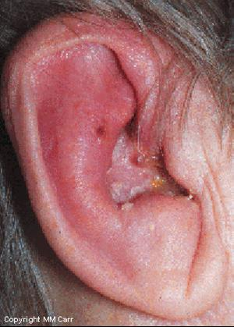
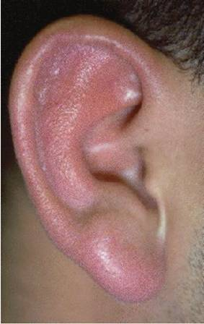
Perichondritis
Erysipelas

Slide 7
The External Auditory Canal

Slide 8
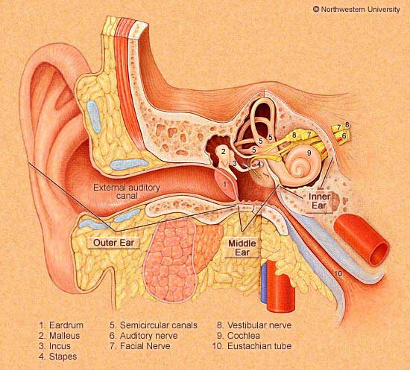
The External Auditory Canal
Lateral Third:
Medial Two Thirds:
Cartilagenous wall
Present at birth
Hair follicles
Ceruminous glands
Sebacous glands
Bony wall
Develops after birth

Slide 9
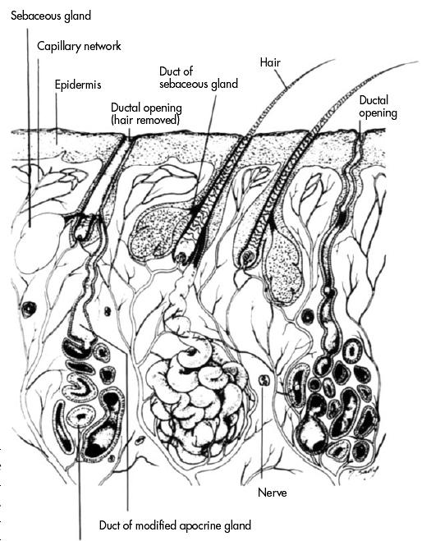

Slide 10
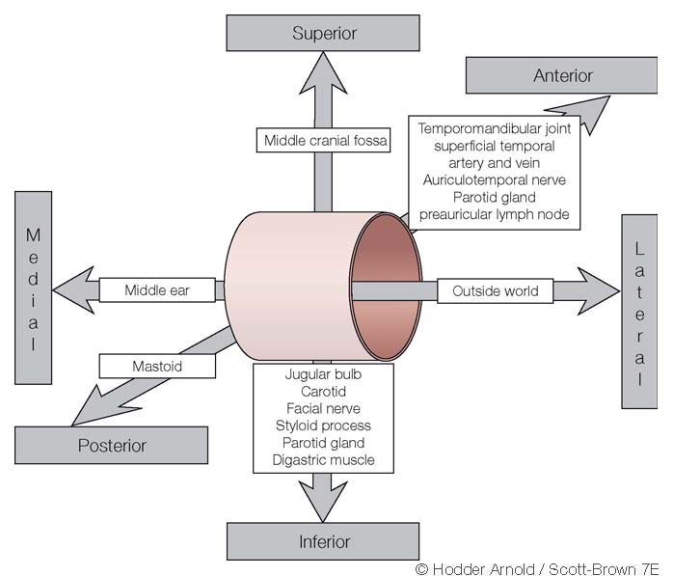
Relations of EAM

Slide 11
ANATOMY OF THE EAR
External Ear
Middle Ear Cleft
Inner Ear

Slide 12
MIDDLE EAR CLEFT
Eustachian tube (Pharyngo-tympanic)
Tympanum (Middle Ear Cavity)
Mastoid Antrum and Air Cells

Slide 13
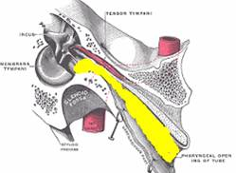
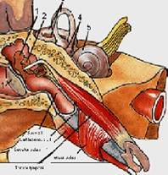
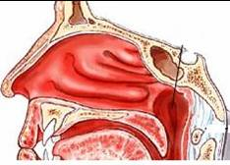
MIDDLE EAR CLEFT
Eustachian (Pharyngo-Tympanic) Tube

Slide 14
MIDDLE EAR CLEFT
Eustachian (Pharyngo-Tympanic) tube
Tympanic cavity (Middle ear cavity)

Slide 15
WALLS OF TYMPANIC CAVITY
Roof
Floor
Anterior wall
Posterior wall
Lateral wall
Medial wall

Slide 16
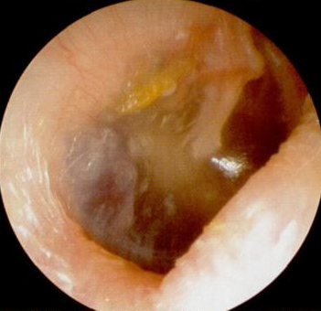
WALLS OF TYMPANIC CAVITY
Roof
Floor
Tegmen

Slide 17
WALLS OF TYMPANIC CAVITY
Roof
Floor
Anterior wall
Posterior wall

Slide 18
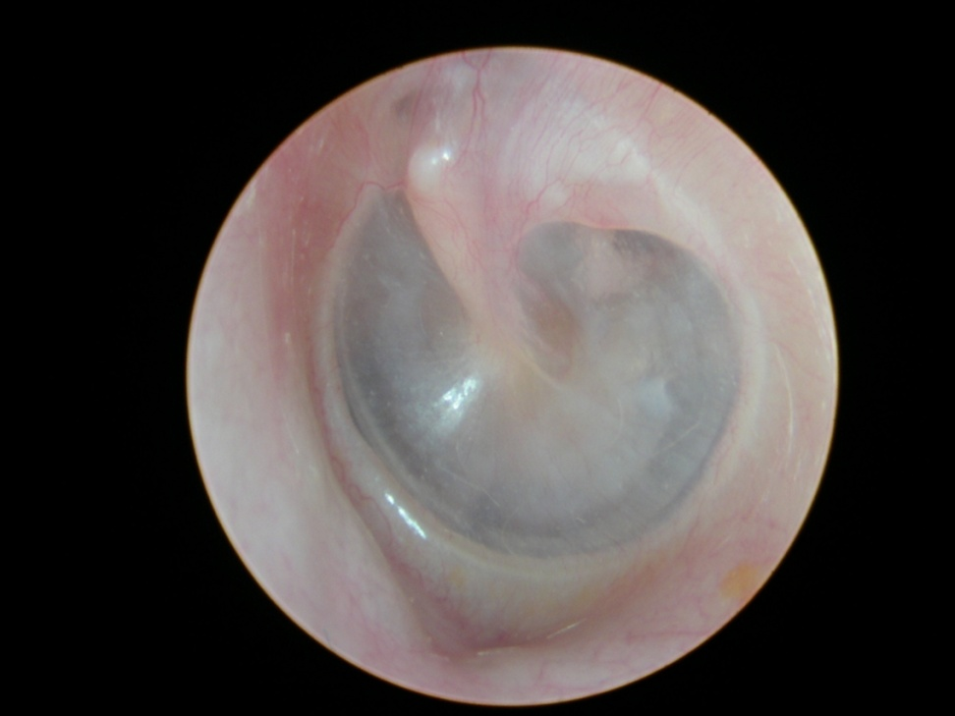
WALLS OF TYMPANIC CAVITY
Roof
Floor
Anterior wall
Posterior wall
Lateral wall
Membrana flaccida
Membrana Tensa

Slide 19
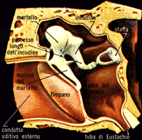
WALLS OF TYMPANIC CAVITY
Roof
Floor
Anterior wall
Posterior wall
Lateral wall
Epitympanum (attic)
Mesotympanum
Hypotympanum

Slide 20
WALLS OF TYMPANIC CAVITY
Roof
Floor
Anterior wall
Posterior wall
Lateral wall
Medial wall

Slide 21
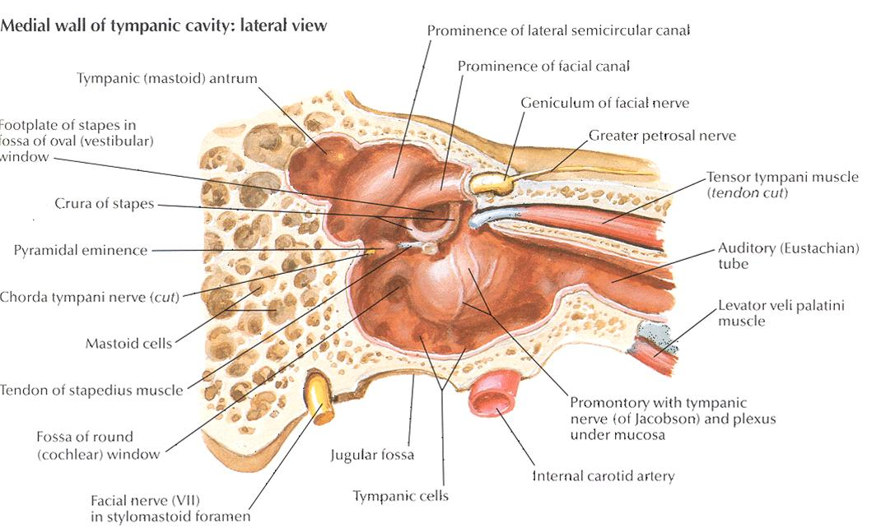

Slide 22
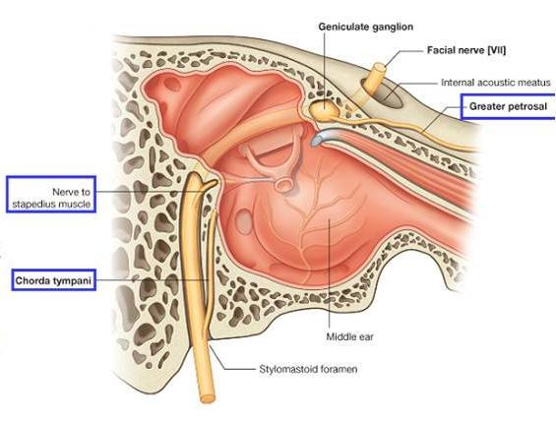

Slide 23
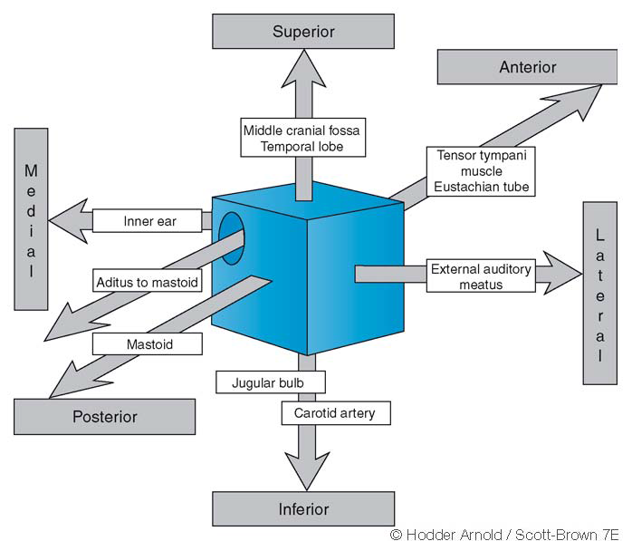

Slide 24
MIDDLE EAR CLEFT
Eustachian (Pharyngo-tympanic) Tube
Tympanic (Middle Ear) Cavity
Mastoid antrum and air cells

Slide 25
Mastoid Antrum & Air cells

Slide 26
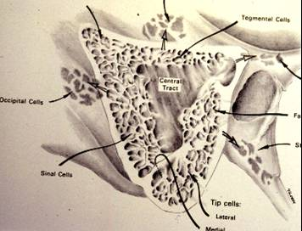
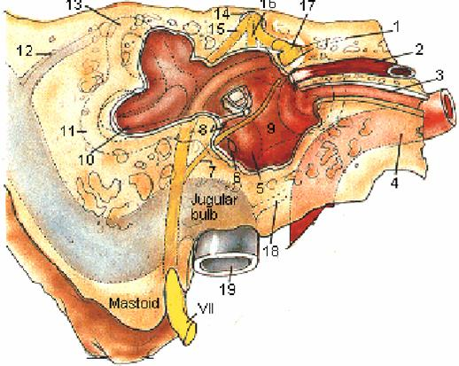
Mastoid Antrum & Air cells

Slide 27
Relationships of the mastoid antrum.

Slide 28
CONTENTS OF MIDDLE EAR CAVITY
Air

Slide 29
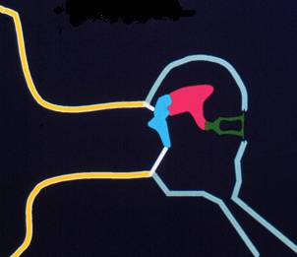
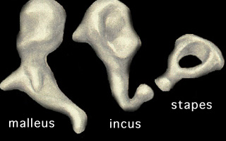
CONTENTS OF MIDDLE EAR CAVITY
Air
Ossicles
Malleus, Incus & Stapes

Slide 30
CONTENTS OF MIDDLE EAR CAVITY
Air
Ossicles
Muscles
Tensor tympani
Stapedius

Slide 31
CONTENTS OF MIDDLE EAR CAVITY
Air
Ossicles
Muscles
Nerves
Tympanic plexus
Chorda tympani

Slide 32
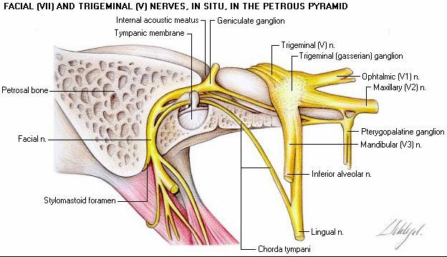

Slide 33
LINING OF MIDDLE EAR
Mucous membrane : ciliated columnar anteriorly and cuboidal or flat elsewhere

Slide 34
SENSARY SUPPLY OF MIDDLE AND EXTERNAL EAR
Cervical II & III ( great auricular and lessor occipital)
V cranial nerve ( auriculotemporal)
IX cranial nerve (tympanic or Jacobson’s)
X cranial nerve ( auricular or Arnold’s)
? VII cranial nerve

Slide 35
Referred Earache
Pain in the ear due to a disease in an area supplied by a nerve that also supply the ear.

Slide 36
Referred Earache
Cervical II & III
Cervical spondylosis, neck injury etc.
V cranial nerve
Dental infections, sinonasal diseases etc.
IX cranial nerve
Tonsillitis, post-tonsillectomy, carcinoma etc.
X cranial nerve
Tumors of hpopharynx, larynx & esophagus

Slide 37
ANATOMY OF INNER EAR

Slide 38
Osseous Labyrinth
Bony Cochlea
Vestibule
Bony semicircular canals

Slide 39
CONTENTS OF THE BONY LABYRINTH
Perilymph
Membranous labyrinth
Cochlear duct
Saccule and utricle
Membranous semicircular ducts

Slide 41
CONTENTS OF MEMBRANOUS LABYRINTH
Endolymph
Sensory epithelium
Cochlea: organ of Corti
Utricle & saccule: maculae
Semicircular canals: cristae

Slide 42
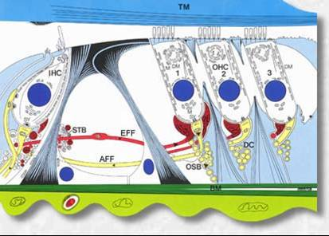
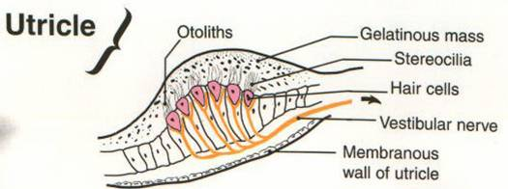
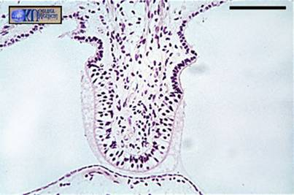
INNER EAR SENSORY EPITHELIUM
Cochlea: organ of Corti
Utricle & saccule: maculae
Semicircular canals: cristae

Slide 43
THE VESTIBULO-COCHLEAR NERVE

Slide 45
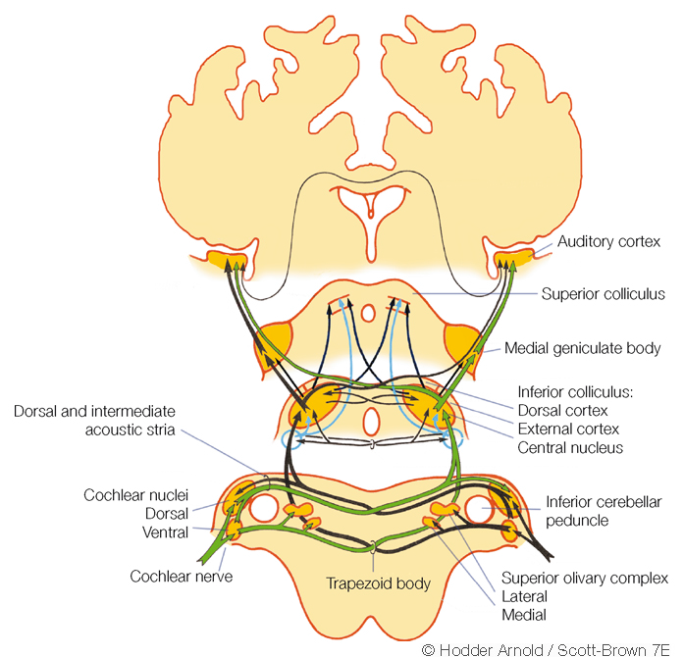

Slide 46
CENTRAL CONNECTIONS OF COCHLEAR NERVE

Slide 47
CENTRAL CONNECTIONS OF VESTIBULAR NERVE

Slide 48
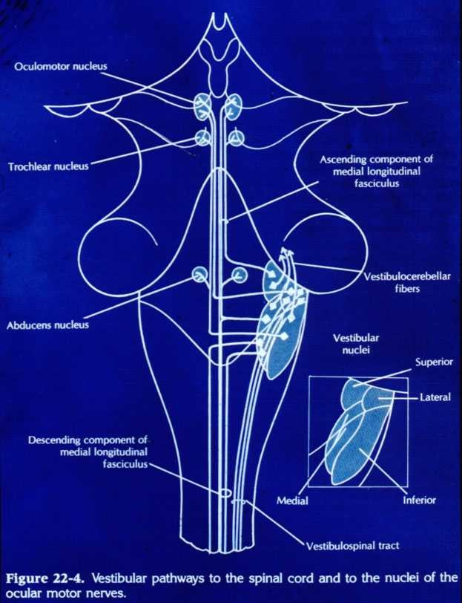

Slide 49
PHYSIOLOGY OF THE EAR

Slide 50
FUNCIONS OF THE EXTERNAL EAR
Protection of the middle ear
Curvature
Cerumen
Auditory functions:
Sound conduction
Increase sound pressure by the resonance function

Slide 51
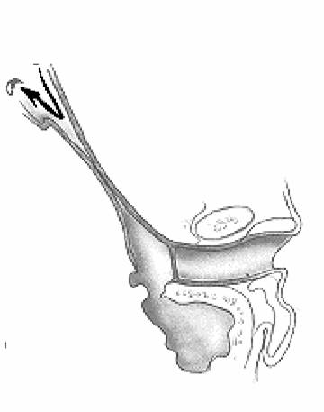
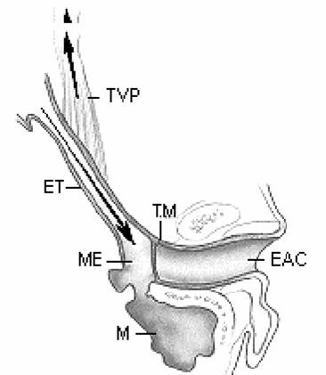
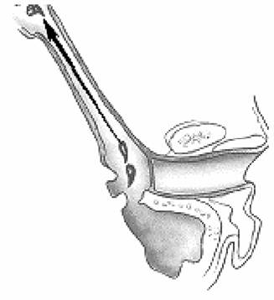
FUNCTIONS OF THE EUSTACHIAN TUBE
Protection
Ventilation
Drainage

Slide 52
FUNCIONS OF THE MIDDLE EAR
Conduction of sound
Transformer mechanism
Hydraulic action
Ossicular leverage

Slide 53
FUNCIONS OF THE MIDDLE EAR
Conduction of sound
Transformer mechanism
Hydraulic action
Ossicular leverage
Protection to the inner ear
stapedial reflex

Slide 54
FUNCIONS OF THE INNER EAR
Hearing Function:
Transduction of sound to action potentials

Slide 55
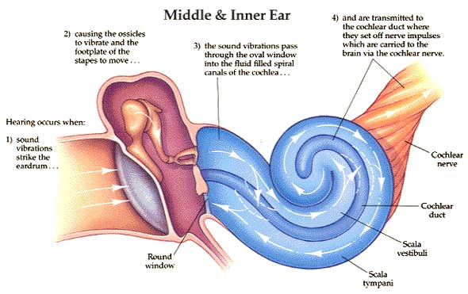

Slide 56
FUNCIONS OF THE INNER EAR
Hearing Function:
Transduction of sound to action potentials
Vestibular Function:
Participate in maintaining body balance

Slide 57
THE BALANCE SYSTEM
C. Cortex
Cerebellum
BRAIN-STEM

Slide 58
THE BALANCE SYSTEM
Vestibular
Proprioceptive
Visual
INPUT
C. Cortex
Cerebellum
BRAIN-STEM

Slide 59
THE BALANCE SYSTEM
Vestibular
Proprioceptive
Visual
INPUT
C. Cortex
Cerebellum
BRAIN-STEM
OUTPUT
Ocular muscles
Postural muscles

Slide 60
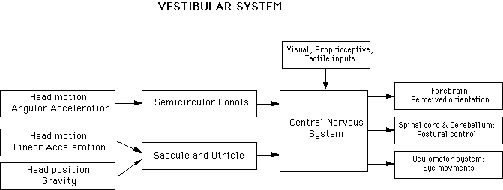

Slide 62
Diseases of External Ear & AOM

Slide 63
Objectives
Recognize the congenital anomalies of the external ear
Diagnose and treat wax accumulation
Diagnose and treat the common external ear inflammatory conditions
Discuss the pathology, clinical features and management of AOM

Slide 64
DEVELOPMENT OF THE EAR
External ear: 1st pharyngeal cleft & arch
Middle ear: 1st pharyngeal pouch & 1st and 2 ^{nd} arches

Slide 65
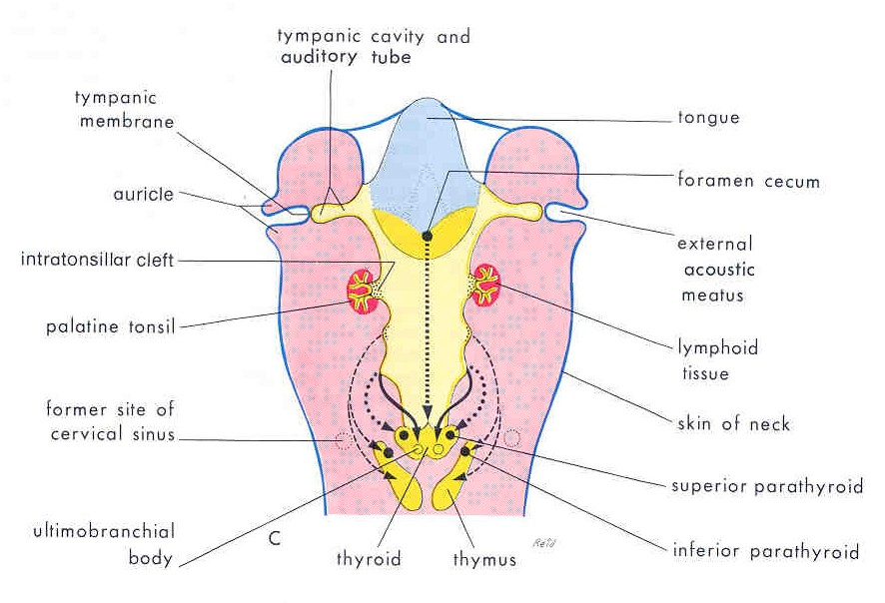

Slide 66
DEVELOPMENT OF THE EAR
External ear: 1st pharyngeal cleft & arch
Middle ear: 1st pharyngeal pouch & 1st and 2 ^{nd} arches
Inner ear: Ectoderm of hindbrain

Slide 67
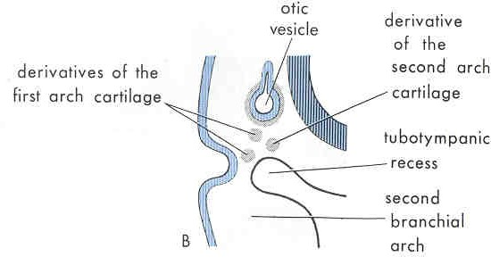

Slide 68
DISEASES OF THE EXTERNAL EAR

Slide 69
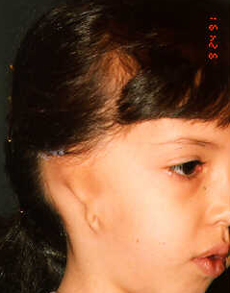
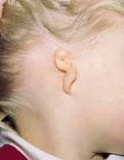
CONGENITAL MALFORMATIONS
Anotia & microtia

Slide 70
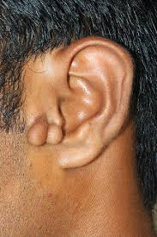
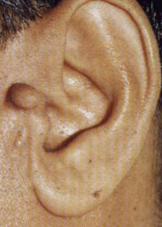
CONGENITAL MALFORMATIONS
Anotia & microtia
Accessory auricle

Slide 71
CONGENITAL MALFORMATIONS
Anotia & microtia
Accessory auricle

Slide 72
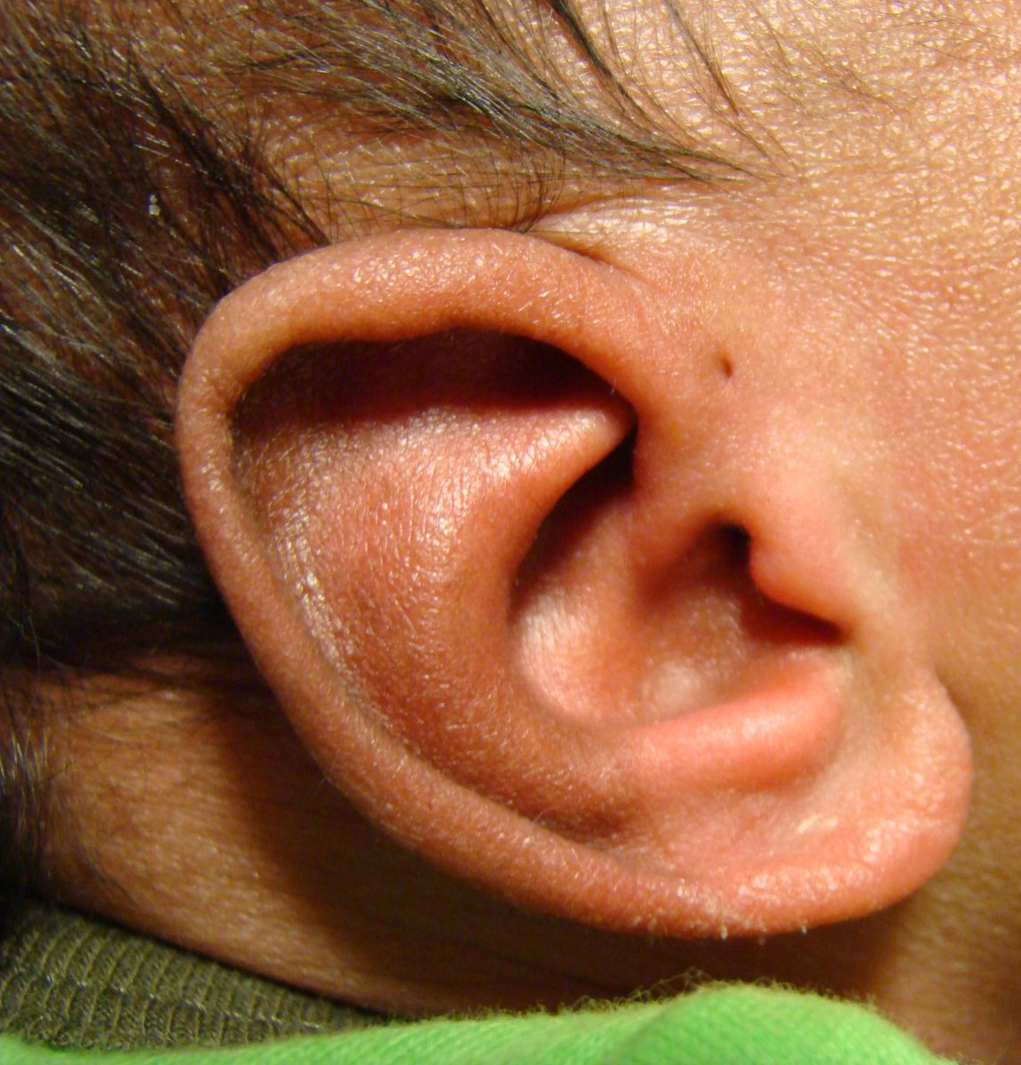
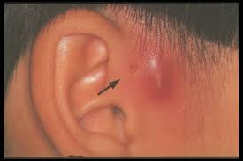
CONGENITAL MALFORMATIONS
Anotia & microtia
Accessory auricle
Pre auricular sinus

Slide 73
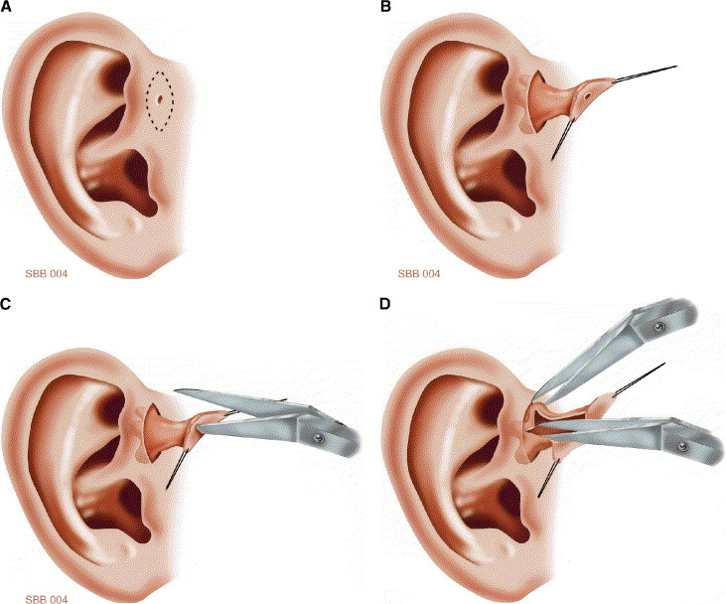

Slide 74
CONGENITAL MALFORMATIONS
Anotia & microtia
Accessory auricle
Pre auricular sinus

Slide 75
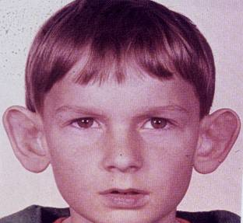
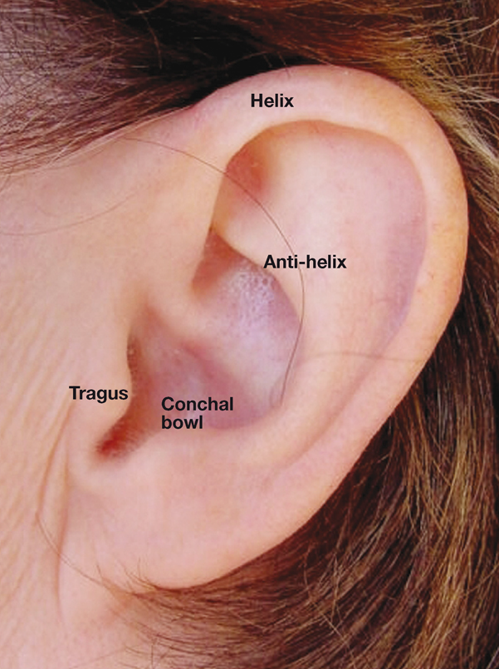
CONGENITAL MALFORMATIONS
Anotia & microtia
Accessory auricle
Pre auricular sinus
Protruding ear

Slide 76
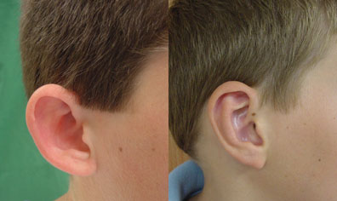

Slide 77
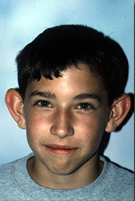
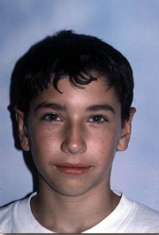

Slide 78
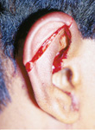
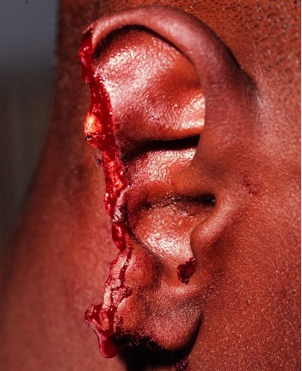
Trauma to the Auricle
Laceration

Slide 79
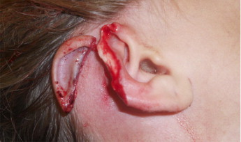

Slide 80
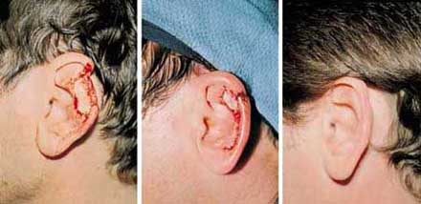

Slide 81
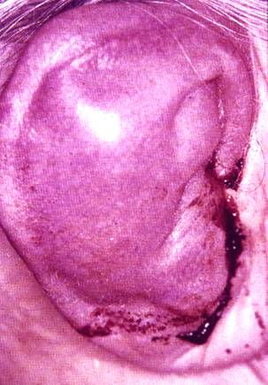
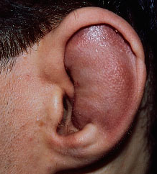
Trauma to the auricle
Hematoma auris

Slide 82
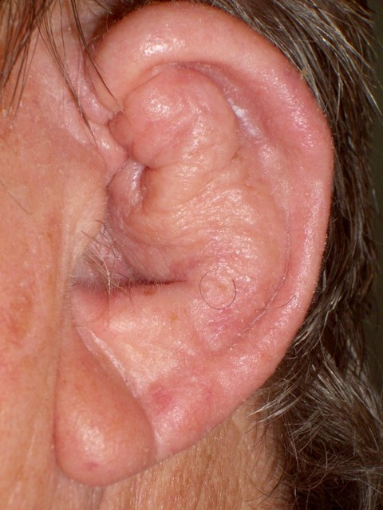
Complication
Cauliflower ear

Slide 83
Treatment

Slide 84
PERICHONDRITIS OF THE PINNA
Usually follow trauma (hematoma auris, surgical, frostbite, burn) or otitis externa
Commonly caused by Pseudomonas
Fever, pain, redness and swelling
Treatment is by antibiotics
.

Slide 85
Complication
Cauliflower ear

Slide 87
OTITIS EXTERNA

Slide 88
DEFINITION
An acute or chronic infection of the whole or a part of the skin of the external ear canal

Slide 96
CLINICAL FEATURES OF OTITIS EXTERNA
Itching
Pain
Tenderness and swelling
Otorrhea
Deafness
Changes in the lumen and skin of EAM

Slide 97
Clinical types of otitis externa
Localize O.E ( furuncle)

Slide 98
Clinical types of otitis externa
Localize O.E ( furuncle)

Slide 99
Clinical types of otitis externa
Localize O.E ( furuncle)
Diffuse infective O.E.

Slide 100
Clinical types of otitis externa
Localize O.E ( furuncle)
Diffuse infective O.E.

Slide 101
Clinical types of otitis externa
Localize O.E ( furuncle)
Diffuse infective O.E.
Otomycosis

Slide 102
Clinical types of otitis externa
Localize O.E ( furuncle)
Diffuse infective O.E.
Otomycosis

Slide 103
Clinical types of otitis externa
Localize O.E ( furuncle)
Diffuse infective O.E.
Otomycosis
Bullous myringitis

Slide 104
Clinical types of otitis externa
Localize O.E ( furuncle)
Diffuse infective O.E.
Otomycosis
Bullous myringitis

Slide 105
Clinical types of otitis externa
Localize O.E ( furuncle)
Diffuse infective O.E.
Otomycosis
Bullous myringitis
Herpetic O.E

Slide 106
Clinical types of otitis externa
Localize O.E ( furuncle)
Diffuse infective O.E.
Otomycosis
Bullous myringitis
Herpetic O.E

Slide 107
Clinical types of otitis externa
Localize O.E ( furuncle)
Diffuse infective O.E.
Otomycosis
Bullous myringitis
Herpetic O.E
Eczematous and seborrheic O.E.

Slide 108
Clinical types of otitis externa
Localize O.E ( furuncle)
Diffuse infective O.E.
Otomycosis
Bullous myringitis
Herpetic O.E
Eczematous and seborrheic O.E.

Slide 109
Management of otitis externa
Swab for culture and sensitivity

Slide 110
Management of otitis externa
Swab for culture and sensitivity
Ear toilet

Slide 111
Management of otitis externa
Swab for culture and sensitivity
Ear toilet

Slide 112
Management of otitis externa
Swab for culture and sensitivity
Ear toilet
Keep the ear dry
Local medications

Slide 113
Management of otitis externa
Swab for culture and sensitivity
Ear toilet
Keep the ear dry
Local medications

Slide 114
Management of otitis externa
Swab for culture and sensitivity
Ear toilet
Keep the ear dry
Local medications
Systemic medications
Surgery may be required in chronic cases

Slide 115
Acute necrotizing (malignant) otitis externa
An acute Pseudomonas infection of the skin of the external ear canal which has spread to the adjacent bone. It occurs mostly in elderly diabetic patients.

Slide 116
Complications

Slide 117
DIAGNOSIS
Diabetes
Advanced age
Severe otalgia
Granulation tissue & sequestra
Cranial nerve involvement
Radiology

Slide 119
TREATMENT
Control of diabetes
Anti Pseudomonas antibiotics
Local treatment and debridement
The role of surgery remains controversial

Slide 120
MISCELLANEOUS CONDITIONS OF THE EXTERNAL EAR

Slide 121
WAX
Mixture of ceruminous and sebaceous glands secretion
Normally is expelled from the canal aided by movements of the jaw
When accumulated it may cause deafness, earache or tinnitus

Slide 123
WAX
Treatment is by removal using syringing, suction or instrumentation

Slide 126
KERATOSIS OBTURANS
Accumulation of desquamated epithelium in the bony canal
It may be associated with sinusitis, bronchiectasis or primary ciliary dyskinesia
Usually cause deafness and pain
Treatment is periodic removal

Slide 127
ACUTE OTITIS MEDIA

Slide 128
DEFINITION
Acute infection of the mucous membrane lining of the middle ear cleft

Slide 129
PREDISPOSING FACTORS
Age
Maleness
Bottle feeding
Climate
Crowded living conditions
Heredity
Associated conditions: cleft palate, immunodeficiency, ciliary dyskinesia, Down syndrome, and cystic fibrosis

Slide 130
ROUTE OF INFECTION
Eustachian tube
External auditory canal
Blood borne

Slide 131
BACTERIOLOGY
Streptococcus pneumonia
Haemophilus influenzae
Branhamella catarrhalis
Streptococcus pyogens
Staphylococcus aureus

Slide 132
PATHOLOGY

Slide 133
CLINICAL PICTURE
Tubal occlusion
Suppurative inflammation
Tympanic membrane rupture
Resolution

Slide 134
CLINICAL PICTURE
Tubal occlusion
Discomfort, autophony, retracted drum
Suppurative inflammation
Tympanic membrane rupture
Resolution

Slide 135
CLINICAL PICTURE
Tubal occlusion
Discomfort, autophony, retracted drum
Suppurative inflammation
Fever, sever earache, deafness, bulging drum
Tympanic membrane rupture
Resolution

Slide 136
CLINICAL PICTURE
Tubal occlusion
Discomfort, autophony, retracted drum
Suppurative inflammation
Fever, sever earache, deafness, bulging drum
Tympanic membrane rupture
Otorrhea... temp. & earache subside
Resolution

Slide 137
CLINICAL PICTURE
Tubal occlusion
Discomfort, autophony, retracted drum
Suppurative inflammation
Fever, sever earache, deafness, bulging drum
Tympanic membrane rupture
Otorrhea... temp. & earache subside
Resolution

Slide 139
TREATMENT
Symptomatic
Antimicrobials
Amoxycillin/clavulanic acid
Tri-methoprim-sulphamethoxazole
Cefaclor, cefixime
Erythromycin-sulfisoxazole
Decongestant
Myringotomy
Ear toilet and local antibiotics

Slide 140
RECURRENT ACUTE OTITIS MEDIA

Slide 141
DEFINITION
Three or more attacks over a 6-months period

Slide 142
TREATMENT
Long-term low dose antimicrobials
Ventilation tube insertion

Slide 144
OFFICE HOURS Prof. YOUSRY EL-SAYED
Flat 407 - Building 5 - King Abdel-Aziz University Hospital
Mondays from 11 am to 1 pm
Thursdays 11 am to 1 pm

Slide 145
THANK YOU

