Slide 1
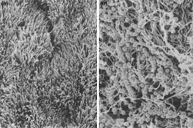

Slide 2
Diseases of the nasal septum
Epistaxis
Turbinate hypertrophy
Nasal operations
SAMI ALHARETHY
ASSIS. PROF. CONSULTANT

Slide 3
Diseases of the nasal septum
Deviated nasal septum
Septal hematoma and abscess
Perforated septum

Slide 4
DEVIATED NASAL SEPTUM

Slide 5
Etiology
Trauma
Maldevelopment

Slide 6
Symptoms
Nasal obstruction

Slide 7
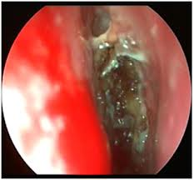
Symptoms
Nasal obstruction
External deformity
Crusting, epistaxis

Slide 8
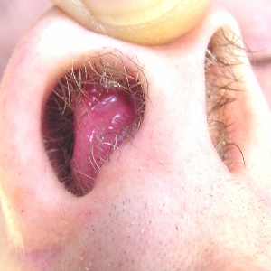
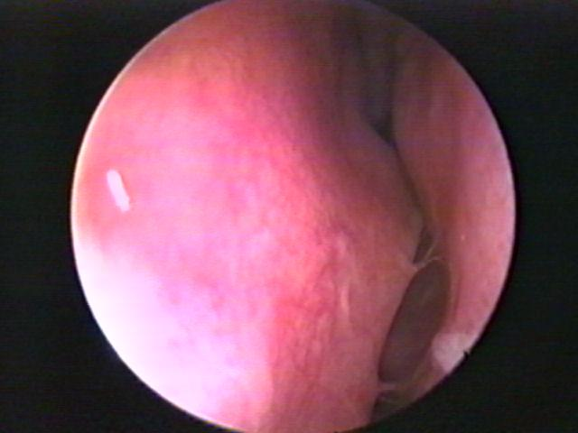
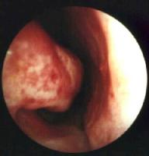
Examination

Slide 9
Radiology
Unnecessary in most cases

Slide 10
Treatment
No treatment
Septoplasty

Slide 11
Septoplasty

Slide 12
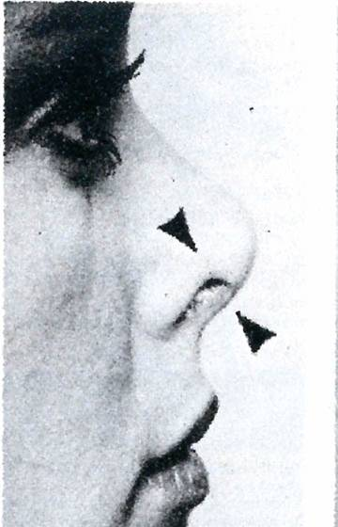
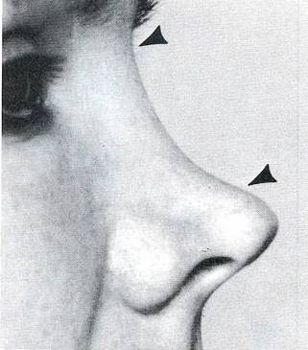
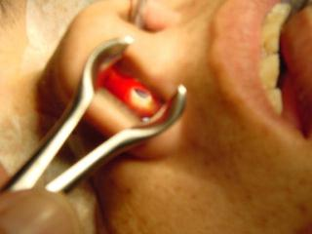
Complications of Septoplasty
Septal hematoma & abscess
Septal perforation
Nasal deformity
Synechia (adhesion)

Slide 13
HEMATOMA OF THE SEPTUM

Slide 14
Etiology
Direct trauma
Operative trauma
Blood dyscrasias

Slide 15
Clinical Features

Slide 16
Complications
Cartilage necrosis
Septal abscess
Permanent thickening of the septum

Slide 17
Treatment
Incision and drainage
Systemic antibiotics

Slide 18
PERFORATION OF SEPTUM

Slide 19
Clinical features
Asymptomatic
Crusting
Epistaxis
Whistling

Slide 20
Treatment
No treatment
Nasal wash
Surgical closure

Slide 21
Surgical Reduction of the Inferior Turbinates
Turbinate resection, total or partial
Outfracturing of the inferior turbinate
Destructive procedures, including electrocautery, cryosurgery, laser surgery, and submucous resection

Slide 22
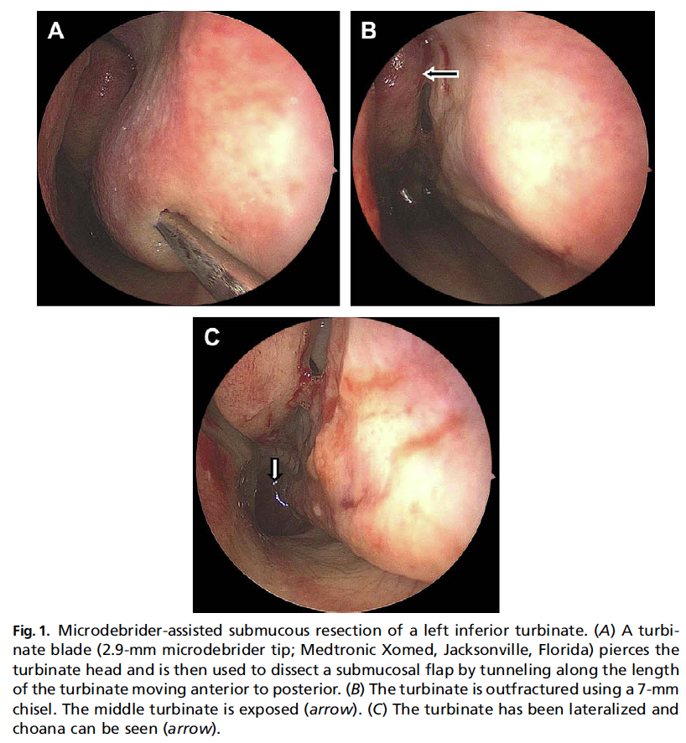

Slide 23
EPISTAXIS

Slide 24
Why bleeding from the nose ?
Vascular organ secondary to incredible heating/humidification requirements
Vasculature runs just under mucosa
Arterial to venous anastamoses
ICA and ECA blood flow

Slide 25
SITES
Anterior ( Little’s area)
Posterior (vicinity of sphenopalatine foramen)

Slide 26
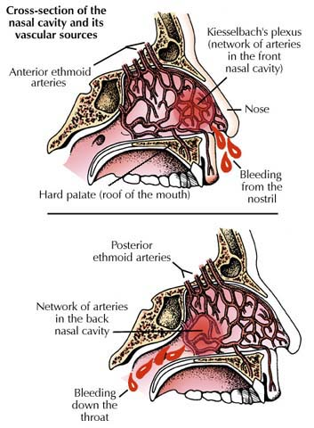
Kesselbach’s Plexus/Little’s Area:
Anterior Ethmoid (Opth)
Superior Labial A (Facial)
Sphenopalatine A (IMAX)
Greater Palatine (IMAX)
Woodruff’s Plexus:
-Sphenopalatine A (IMAX)

Slide 27
LOCAL CAUSES
Acute trauma
Chronic trauma
Deviated septum
Inflammation of the nose and sinuses
Tumors
Idiopathic

Slide 28
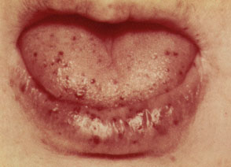
SYSTEMIC CAUSES
Coagulation and bleeding diseases
Atherosclerosis
Familial hemorrhagic telangiectasia

Slide 29
MANAGEMENT
General measures
Stop the bleeding
Prevent further bleeding

Slide 30
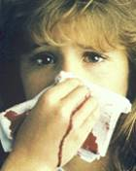
CONTROL THE BLEEDING
Digital pressure
Cautery
Anterior nasal packing
Postnasal pack
Arterial ligation
Maxillary, Ethmoids, External carotid
Arterial embolization

Slide 31
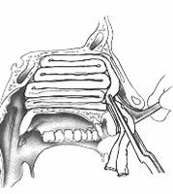
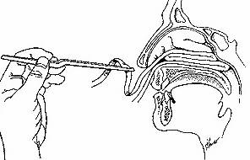
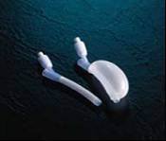
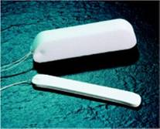
Anterior nasal packing

Slide 32
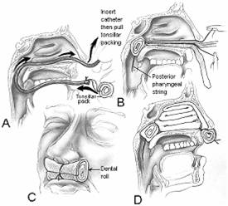
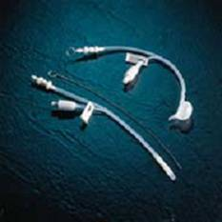
Postnasal packing

Slide 33
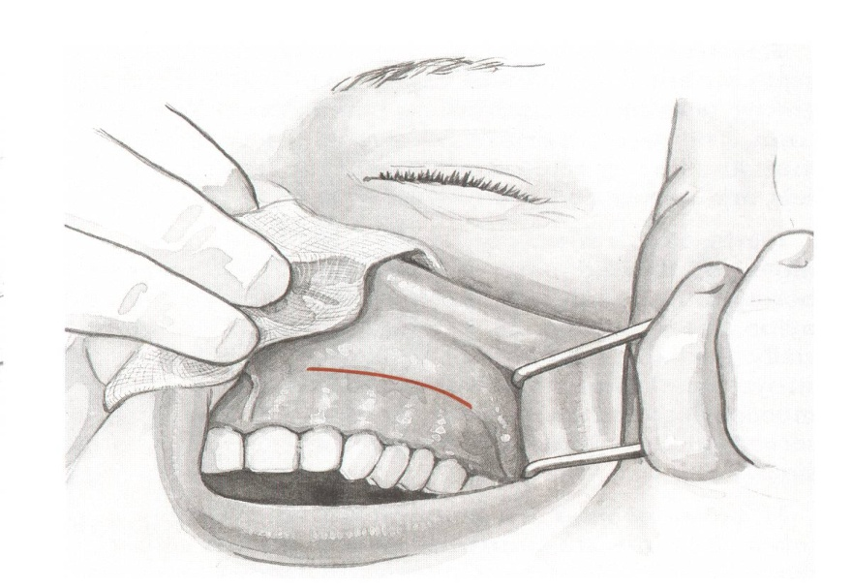
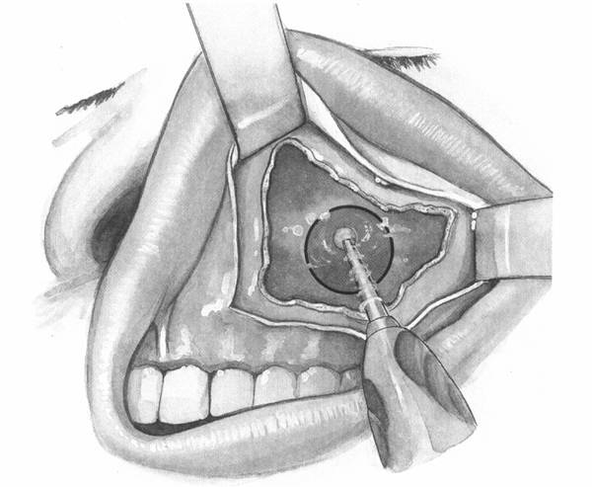
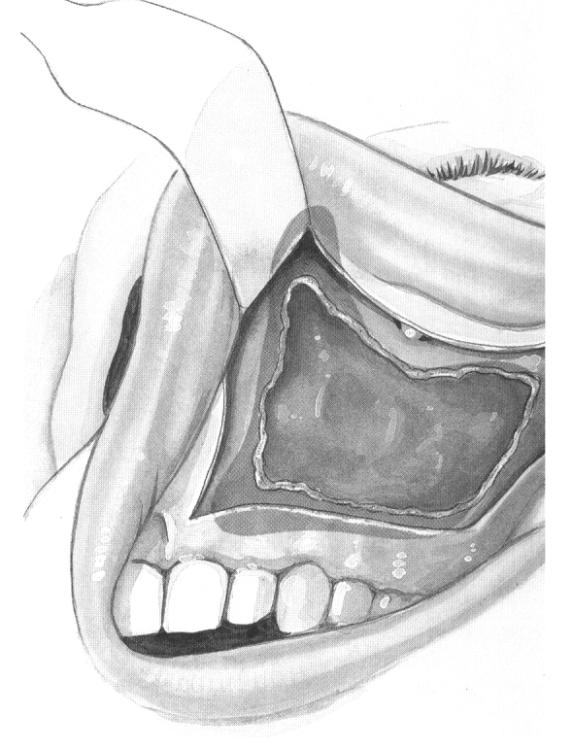
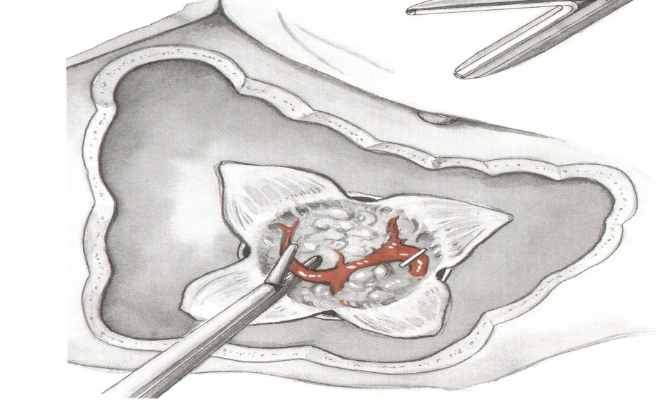
Arterial ligation

Slide 34
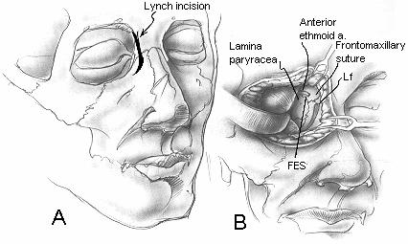
Arterial ligation

Slide 35
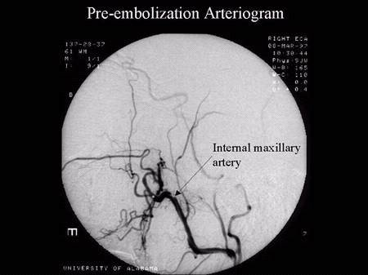
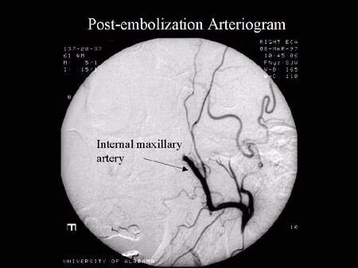
Arterial embolization

Slide 36
ANGIOFIBROMA
Juvenile nasopharengeal
Benign
Adolcent Males
Frequent chronic epistaxis
Nasal obstruction
Rhinorrhea
Conductive hearing loss
Diplopia
Otitis Media
Treatment: embolization & Surgery

Slide 37
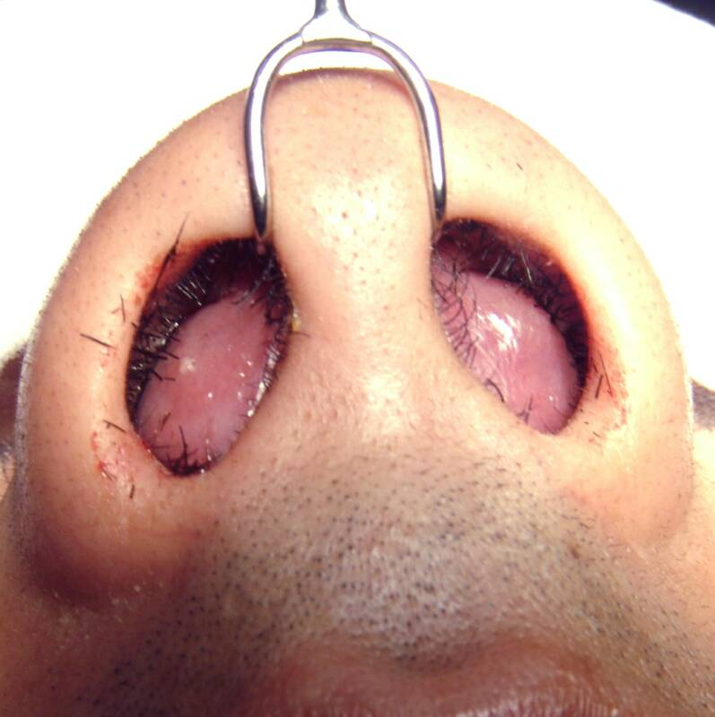
What do you think?
25 years old man post RTA with fever and nasal obstruction.
What is your diagnosis?
What is your management?

Slide 38
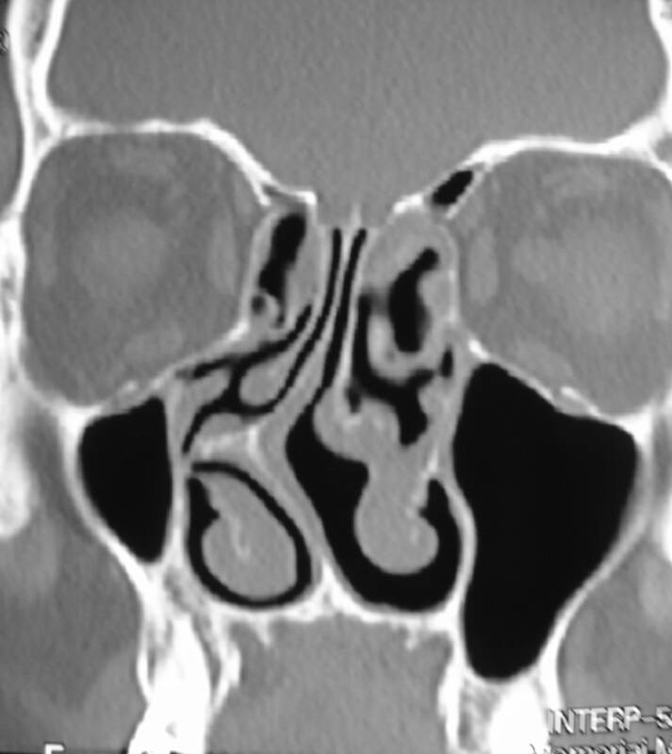
What is this radiological study? What is A,B and C?
B
C
A

Slide 39
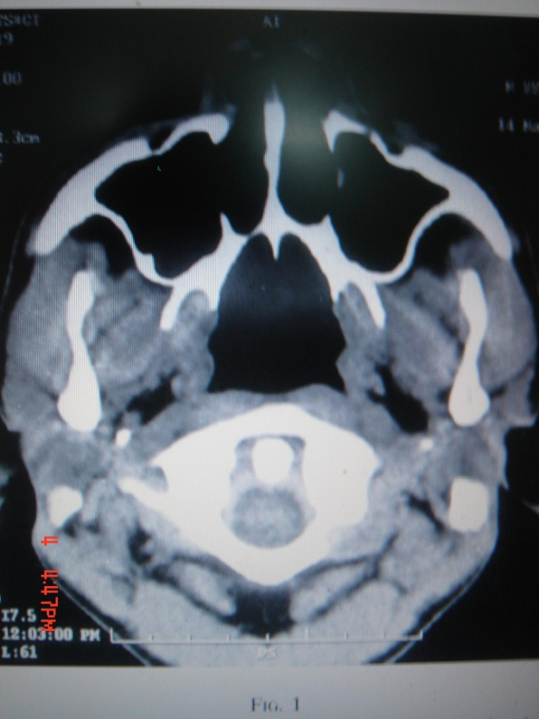
This is a CT scan of a newborne who presented with respiratory
distress.
A- what is your diagnosis?
B- what is the management?

Slide 40
thanks

