Slide 1
Head & Neck Trauma
Dr. Mohammad aloulah, MBBS, SBORL(c) Assistant Professor King Saud University
Otolaryngology Consultant
l

Slide 2
Mechanisms of Trauma
• MVA
• Iatrogenic
• Burns and frostbite
• Noise
• Barotrauma

Slide 3
Auricle injuries
• Hematomas
separate the perichondrium (blood supply) from the cartilage
Æexcise fibrous tissue
• Apply pressure dressing , drain
• Avulsion:
- Reimplantation
- Microvascular anastomosis

Slide 4
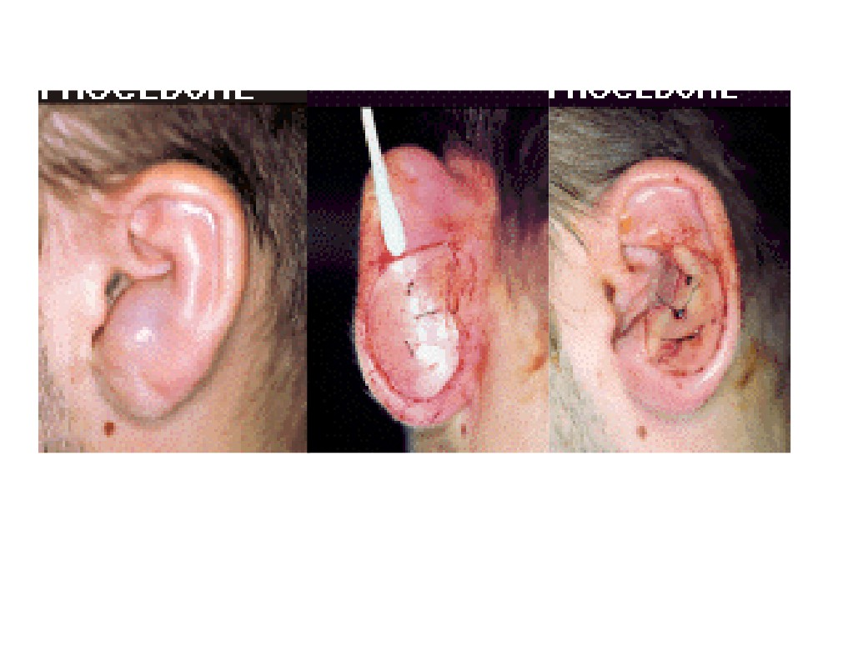

Slide 5
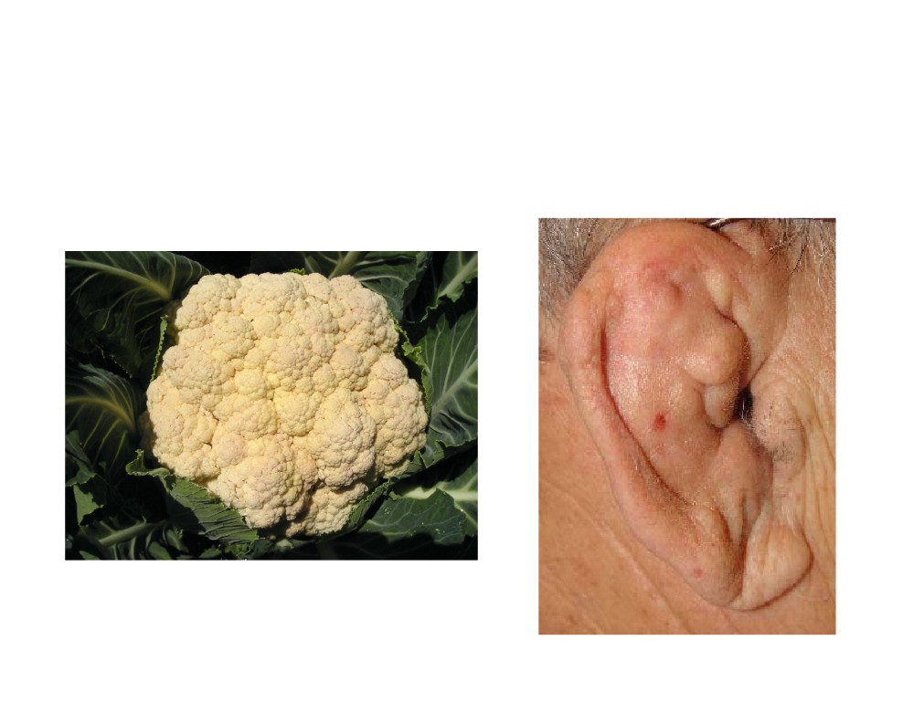
Cauliflower Ear

Slide 6
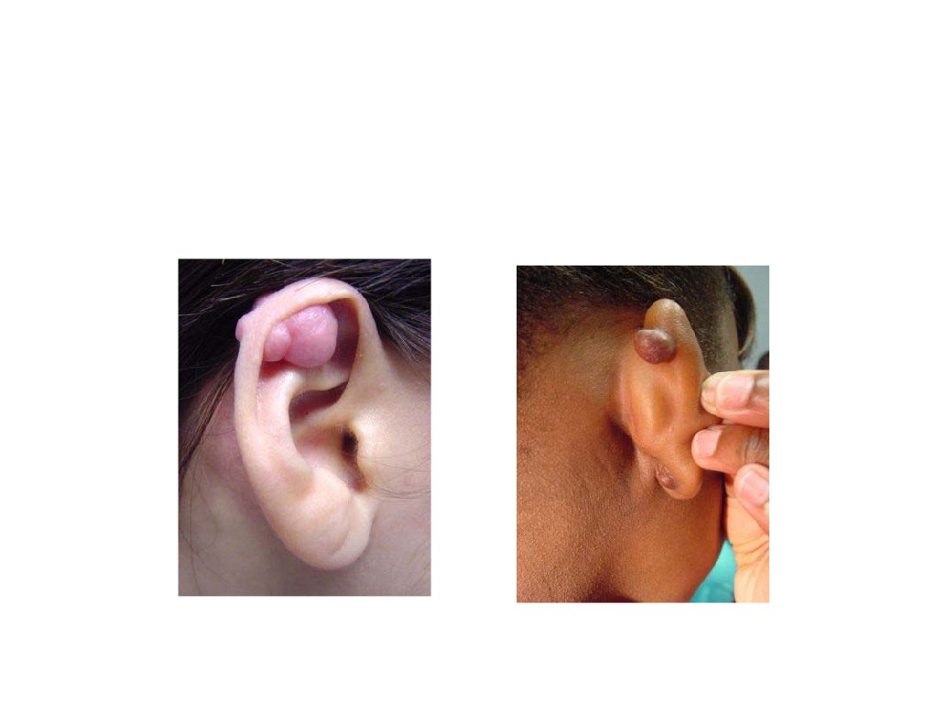
Complications of Ear-Piercing

Slide 7
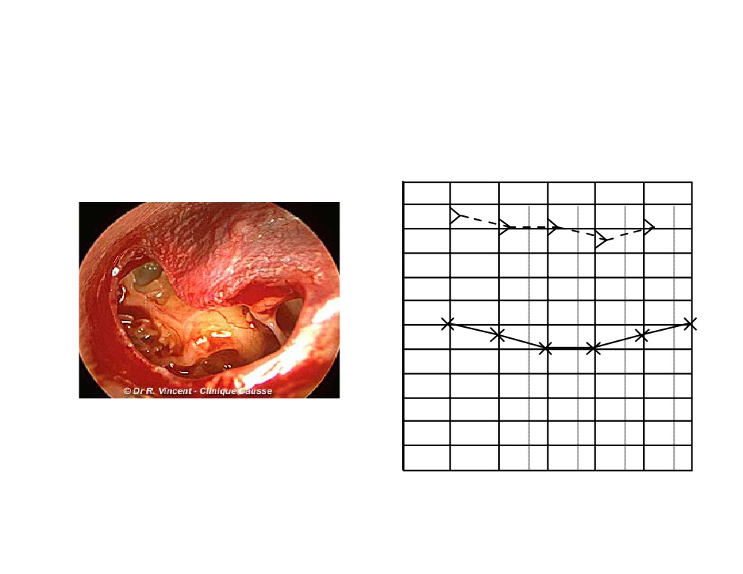
Case
LEFT EAR (AS)
250 500 1000 2000 4000 8000
0
10 20 30 40 50 60 70 80 90
NR IPSI & CONTRA
100
1
110
1

Slide 8
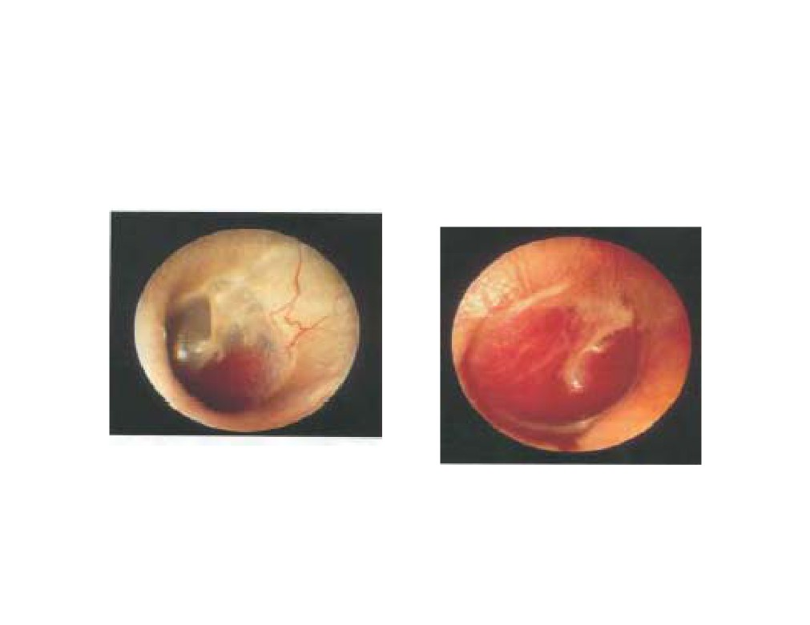
Hemotympanum

Slide 9
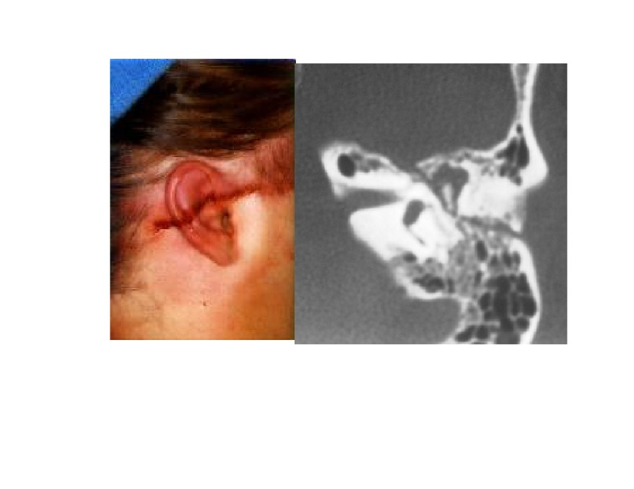
R

Slide 10
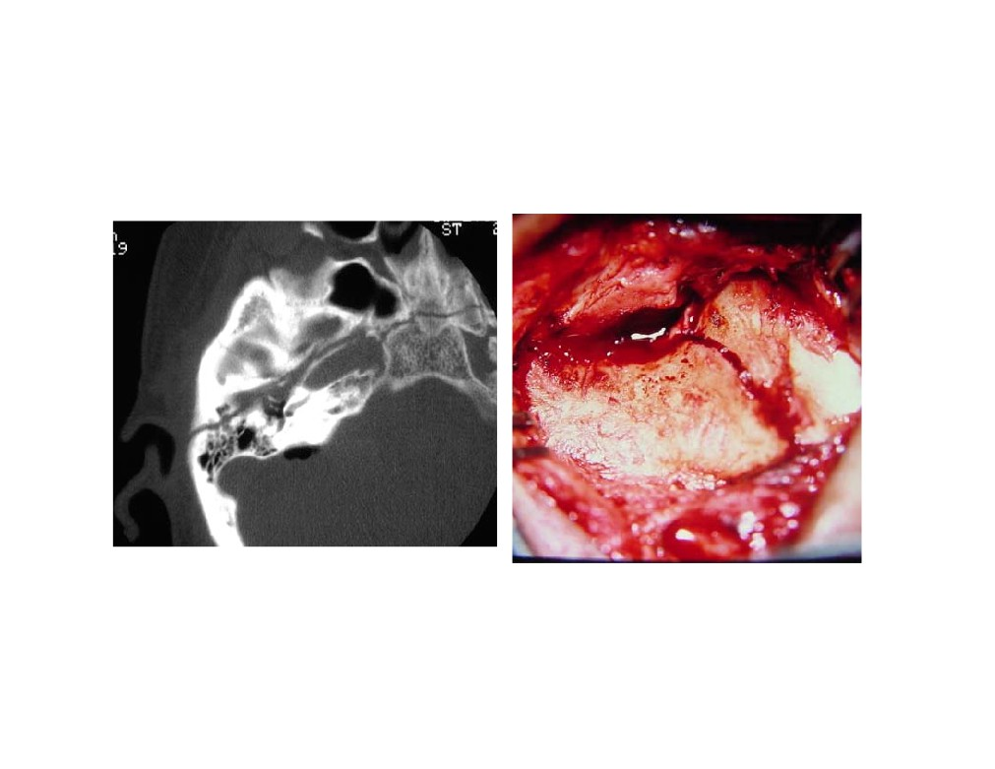
Longitudinal TB#

Slide 11
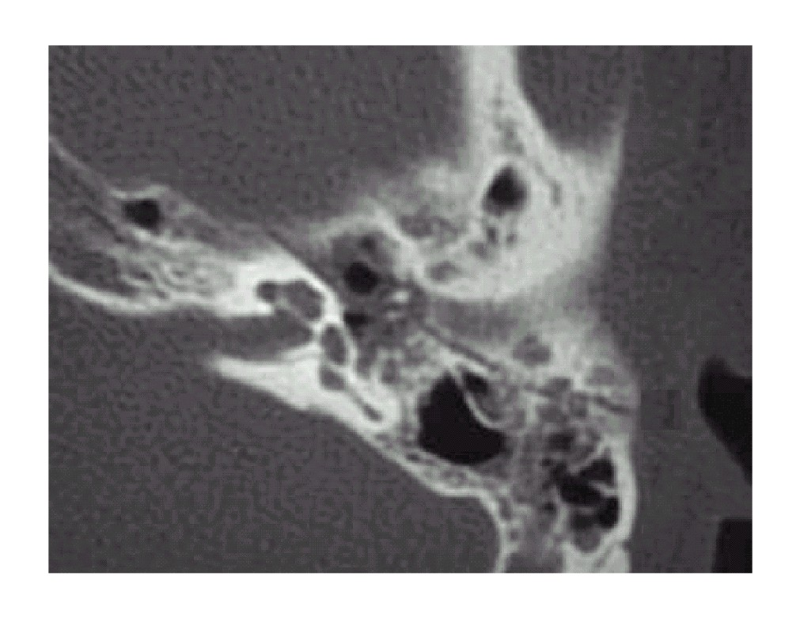

Slide 12
Complications of TB#
• Hearing loss
• Vertigo
• Tinnitus
• Facial paralysis
• CSF leak
• Carotid injury

Slide 13
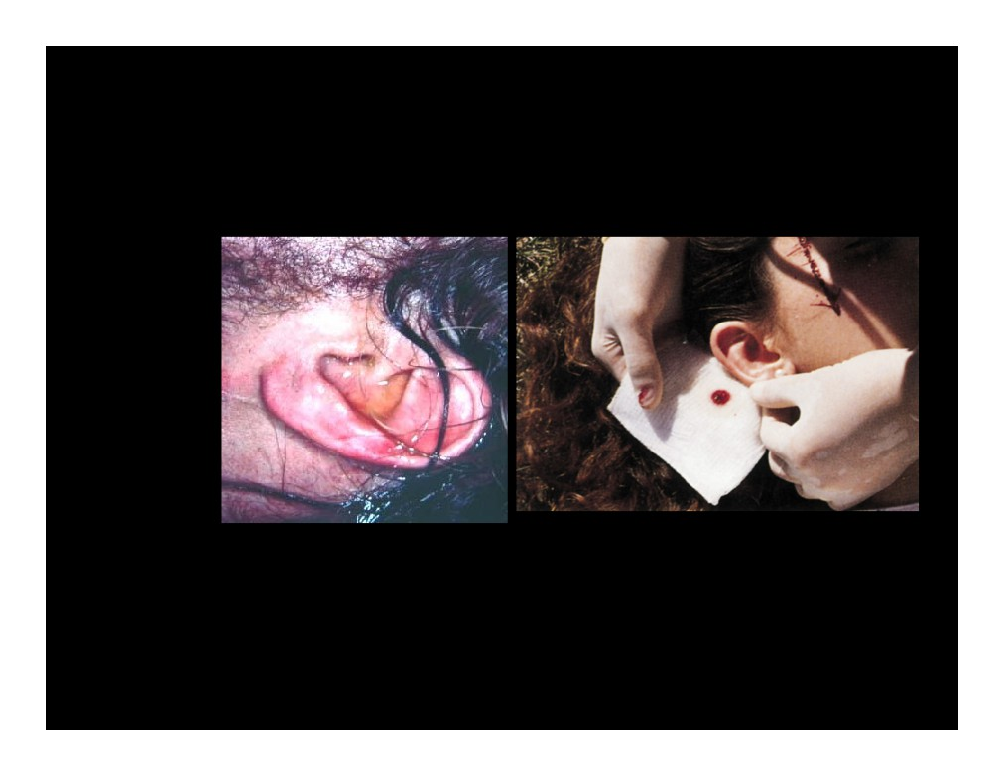

Slide 14
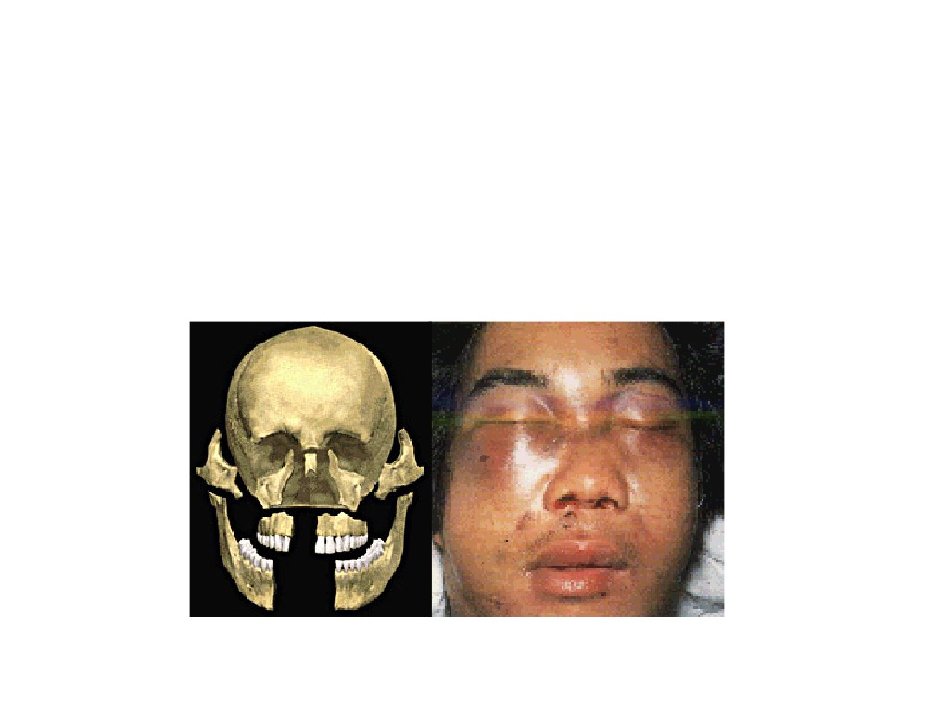
Naso-orbital Ethmoid and Frontal Sinus Fractures

Slide 15
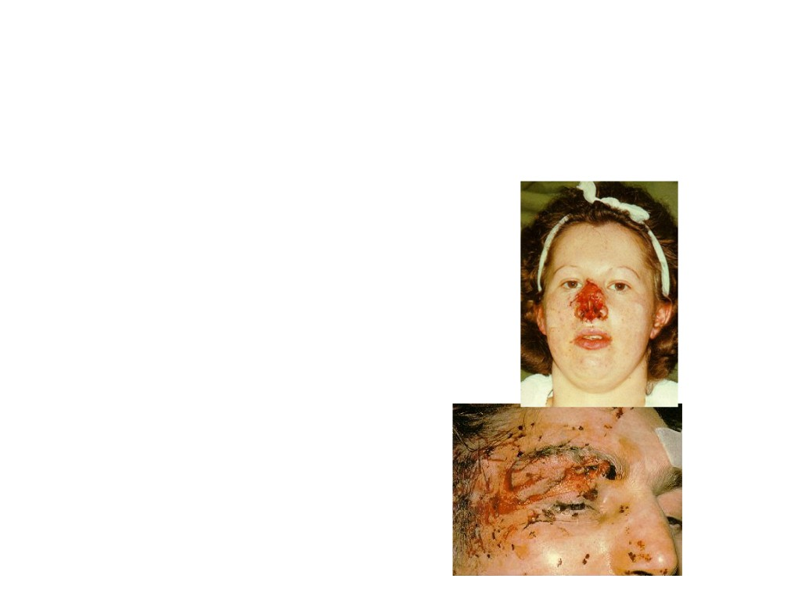
Naso-orbital Ethmoid Fractures
Failure of Diagnosis
Leads to Significant Facial Deformities

Slide 16
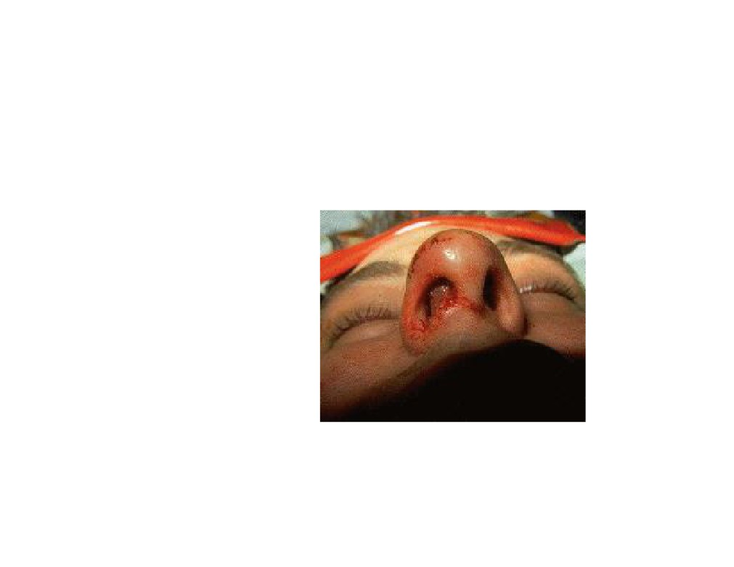
Septal hematoma

Slide 17
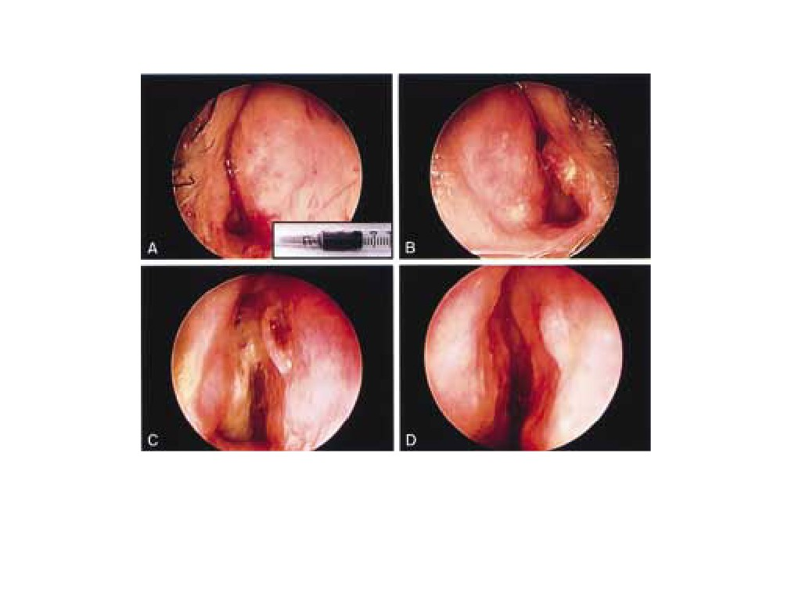
Nasal Fracture with Septal Hematoma

Slide 18
Complication
Nasal Deformity
- Flattened Nasal Dorsum
- Septal Deviation / Dislocation
Intracranial Involvement
- Cerebrospinal Fistula
- Pneumocephalus

Slide 20
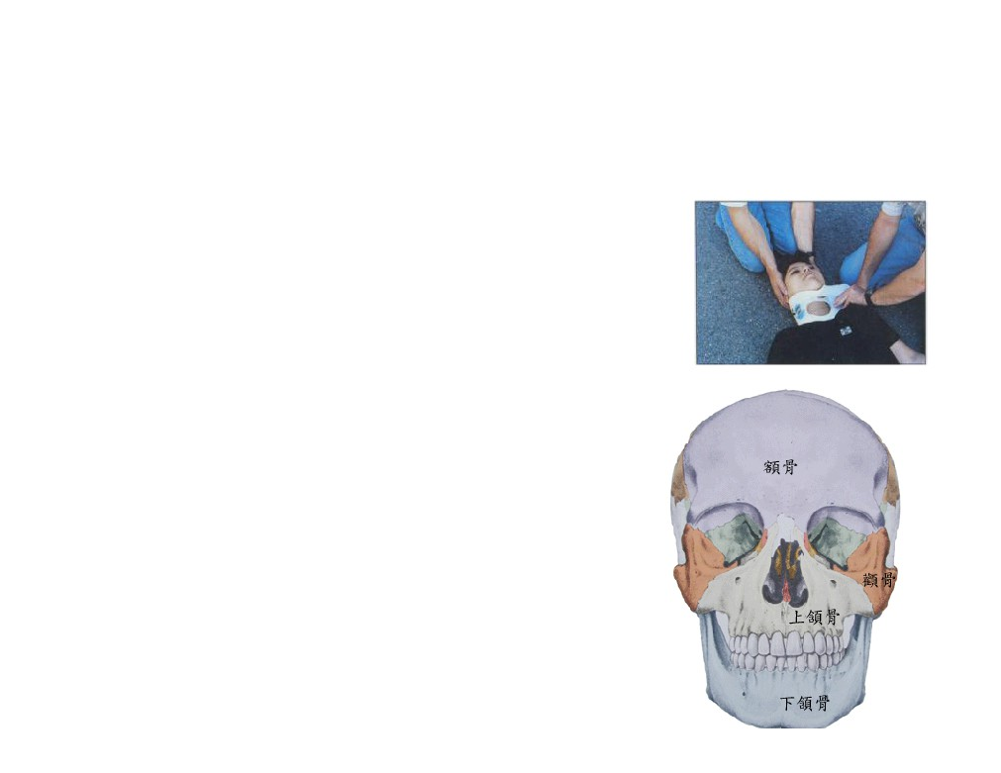
Goals of Management
• ABC
• Soft Tissue Repair
• Framework Reconstitution
- Nasas Region
- Orbital
- Nasal Support
- Sinus

Slide 21
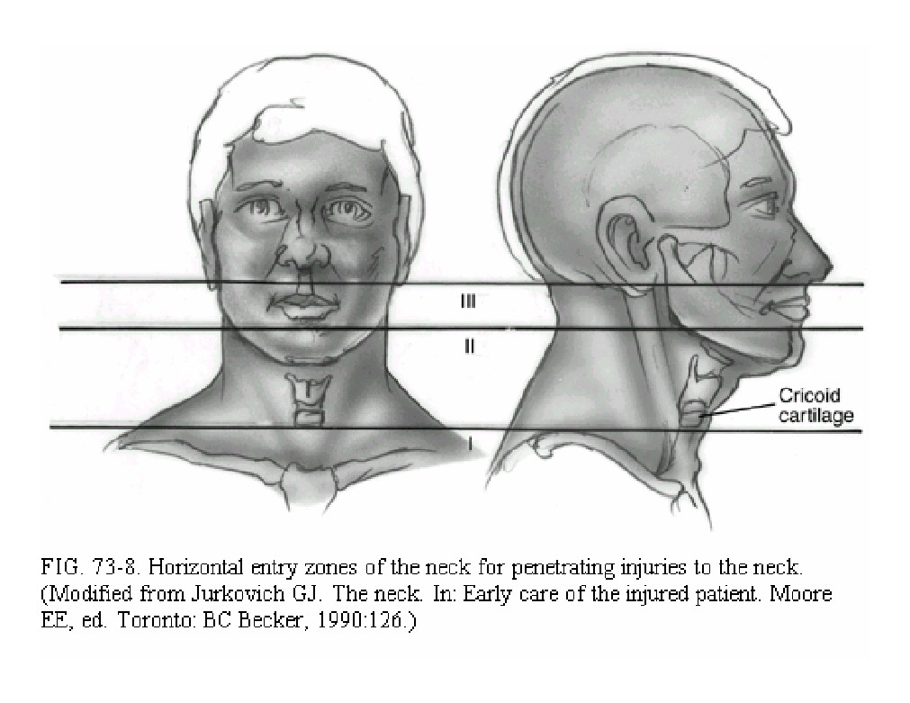

Slide 22
Anatomy/Zone I
• Cricoid Æ sternum and clavicles
• Contains the
- Subclavian arteries and veins
- Dome of the pleura
- Esophagus
- Great vessels of the neck +recurrent nerve
- Trachea
• S/S may be hidden from inspection in the mediastinum or chest

Slide 23
Anatomy/Zone II
• Cricoid Æ Angle of the mandible
• Contains the
- Larynx
- Pharynx
- Carotid artery and jugular vein
- Phrenic, vagus, and hypoglossal nerves
• Injuries here are seldom occult
• Common site of carotid injury

Slide 24
Anatomy/Zone III
• Lies above the angle of the mandible
• Contains the
- Internal and external carotid arteries
- Vertebral artery
- Several cranial nerves
• Vascular and cranial nerve injuries common

Slide 25
History
• Obtain from witnesses, patient
• Mechanisms of injury - stab wounds,
gunshot wound, high-energy, low-energy
• Estimate of blood loss at scene
• Any associated thoracic, abdominal, extremity injuries
• Neurologic history

Slide 26
Physical Examination
• Thorough head and neck exam
• Palpation and stethoscope (thrills and bruits)
• Neuro exam: mental status, cranial nerves, and spinal column
• Examine the chest, abdomen, and extremities
• Be sure to examine the back of the patient as
• Don’t blindly explore wound or clamp vessel

Slide 27
Radiographs
• CXR - inspiratory/expiratory /Lateral
• Cervical spine film to rule out fractures
• Soft tissue neck films AP and Lateral
• CT Scan
• Arteriograms, contrast studies as indicated

Slide 28
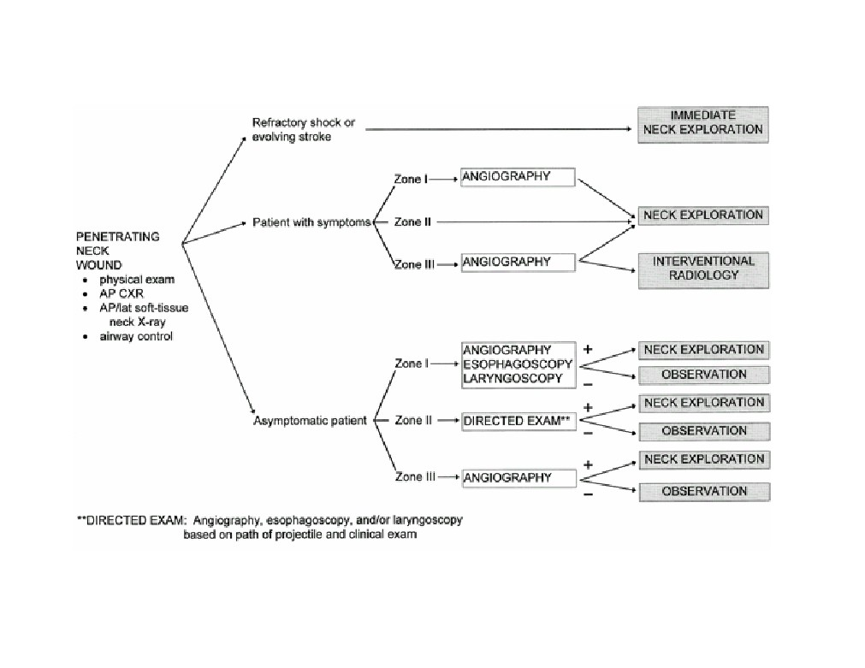

Slide 29
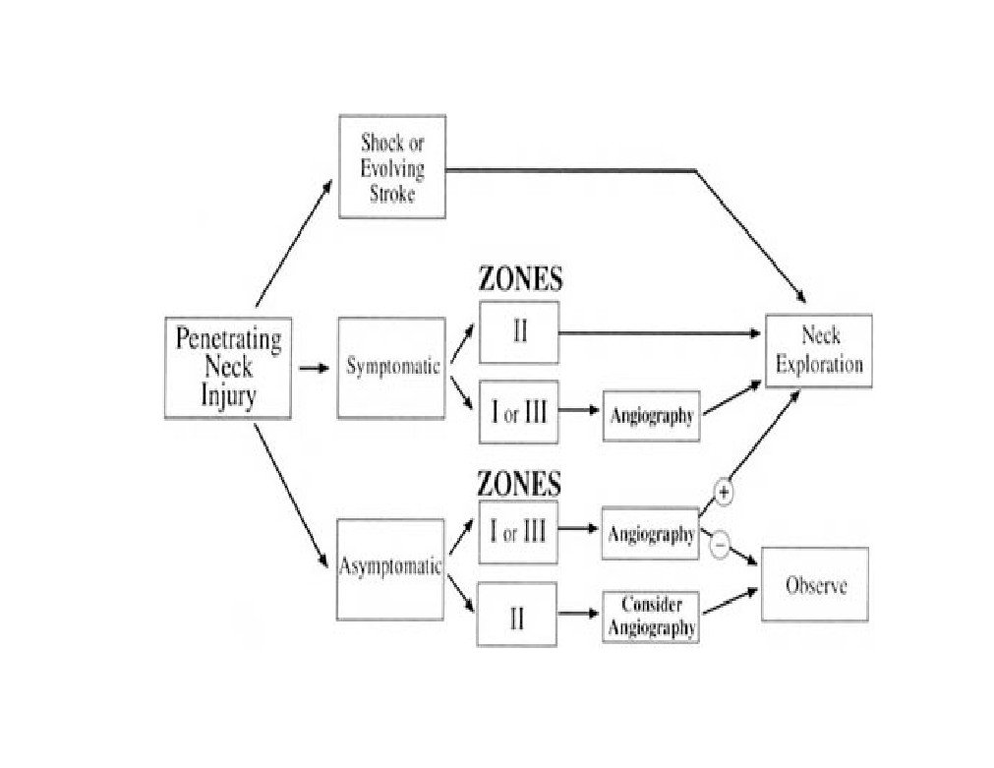

Slide 30
Intubation: Indications
• Failure to oxygenate
• Failure to remove CO2
• Increased WOB
• Neuromuscular weakness
• CNS failure
• Cardiovascular failure

Slide 31
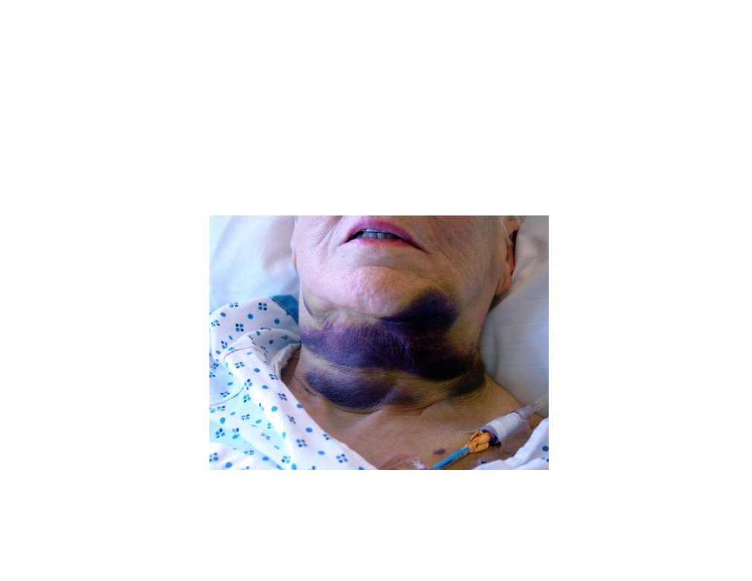
Laryngeal Trauma

Slide 32
Introduction
• Functions
- Airway
- Voice
- Swallowing
• Well protected (mandible, sternum)
• Support: Hyoid, thyroid, cricoid
• Outcome determined by initial management

Slide 33
Mechanism of Injury
• Blunt
- MVA, strangulation, clothesline, sports related
- Significant internal damage, minimal signs
• Penetrating
- GSW: damage related to velocity
- Knife: easy to underestimate damage

Slide 34
Initial Evaluation
• ABC
• Secure airway - local tracheotomy
• Intubation can worsen airway
• Avoid cricothyroidotomy
• Pediatric: tracheotomy over bronchoscope
• Clear C-spine

Slide 35
History
• Change in voice - most reliable
• Dysphagia
• Odynophagia
• Difficulty breathing - more severe injury
• Anterior neck pain
• Hemoptysis

Slide 36
Signs of Respiratory Distress
• Tachypnea
• Retractions
• Tachycardia
• Access muscles
• Grunting
• Wheezing
• Stridor
• Sweating
• Head bobbing
• Prolonged
• Flaring
expiration
• Inability to lie down
• Pulsus paradoxus
• Apnea
• Agitation
• Cyanosis

Slide 37
Physical exam
• Stridor
• Hoarseness
• Subcutaneous emphysema
• Laryngeal tenderness, ecchymosis, edema
• Loss of thyroid cartilage prominence
• Associated injuries - vascular, cervical spine, esophageal

Slide 38
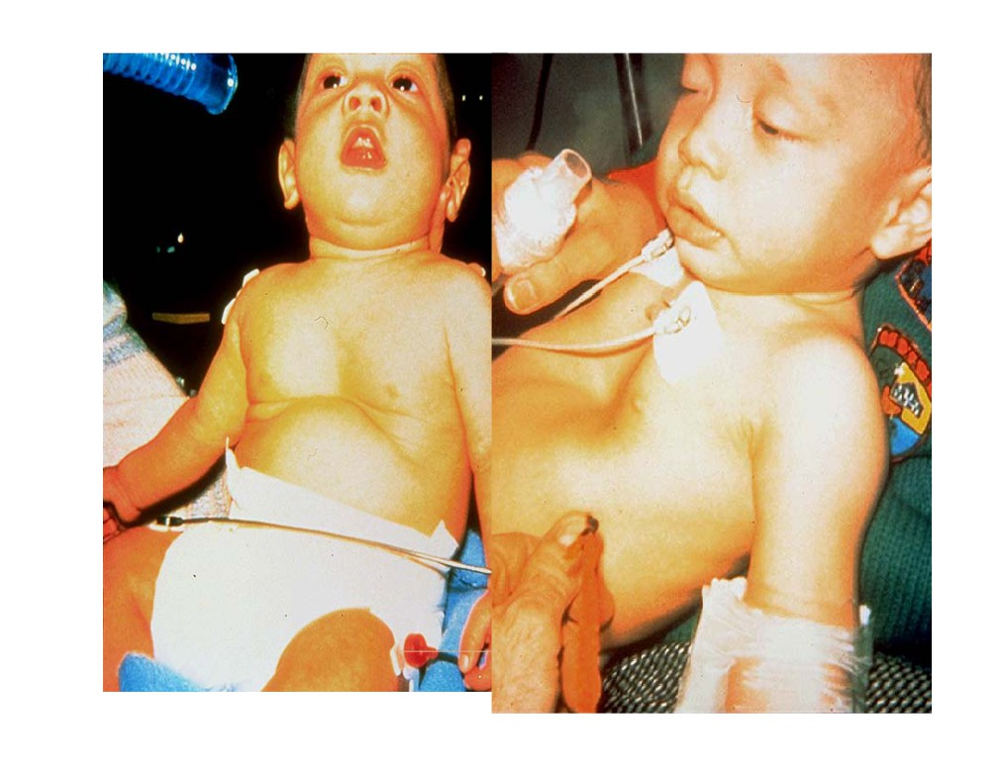

Slide 39
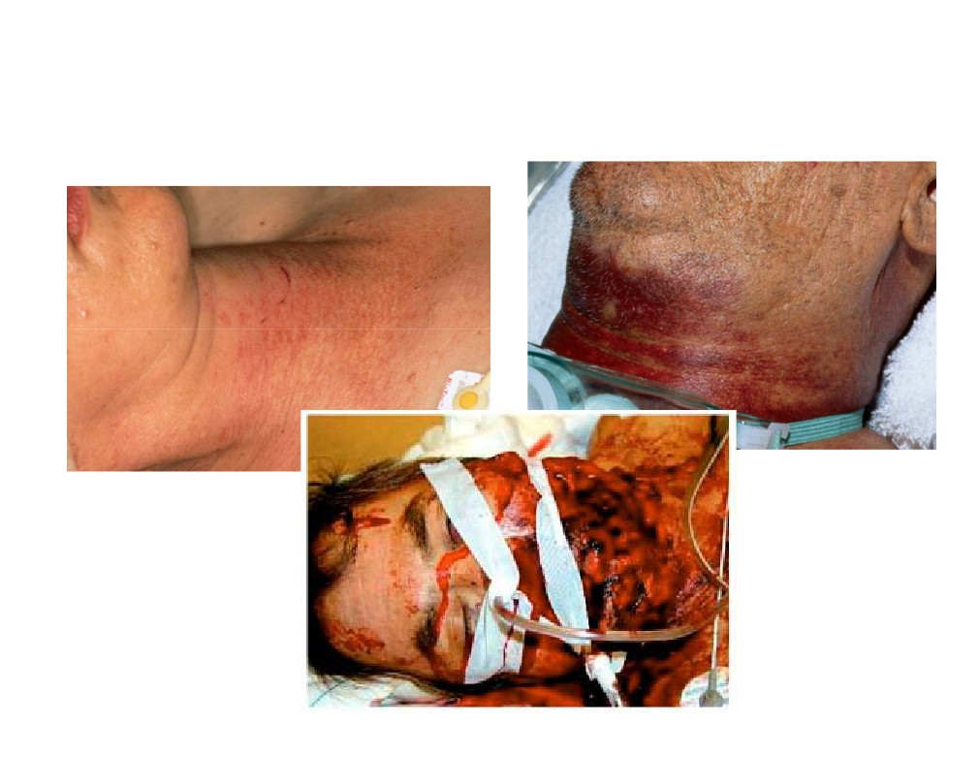
Physical Exam

Slide 40
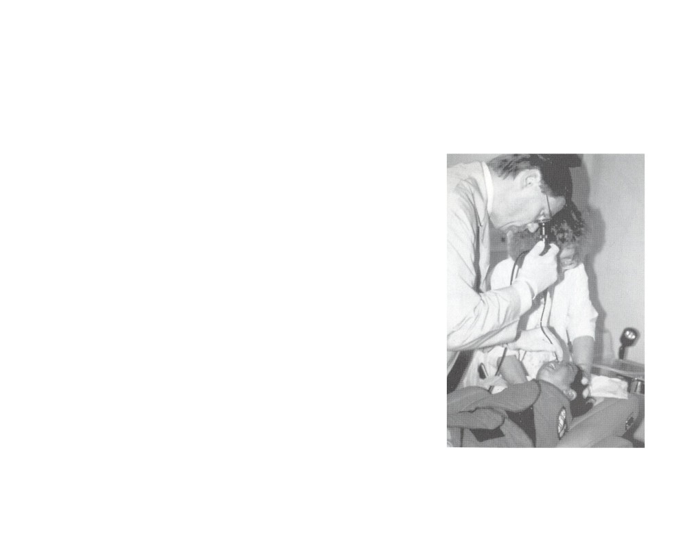
Flexible Fiberoptic Laryngoscopy
• Perform in emergency room
• Findings dictate next step
- CT scan
- Tracheotomy
- Endoscopic
- Surgical Exploration
- Other studies

Slide 41
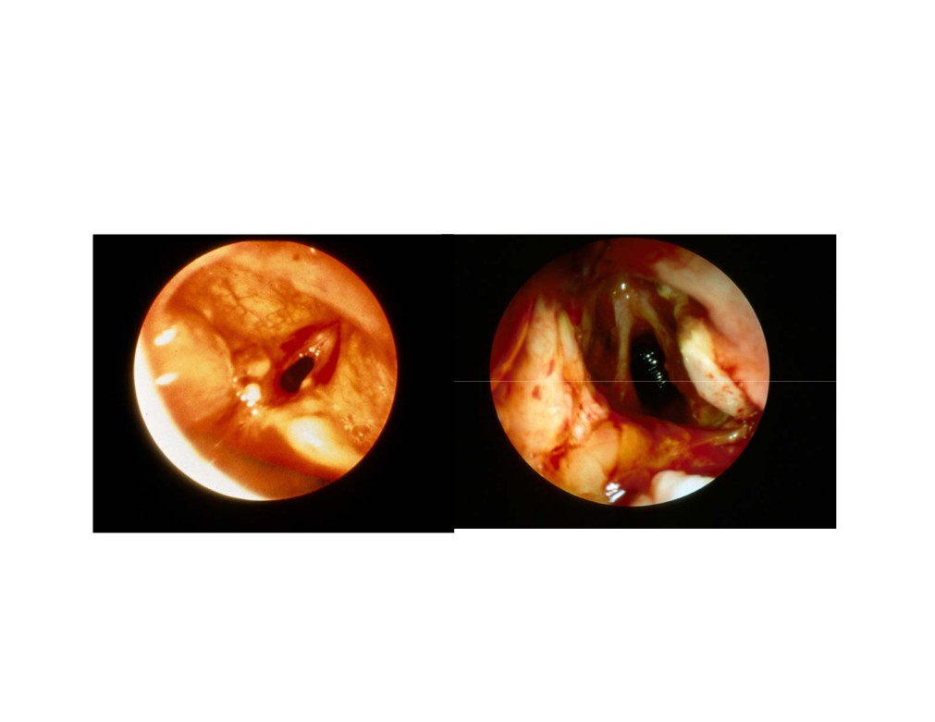
Laryngoscopic Exam

Slide 42
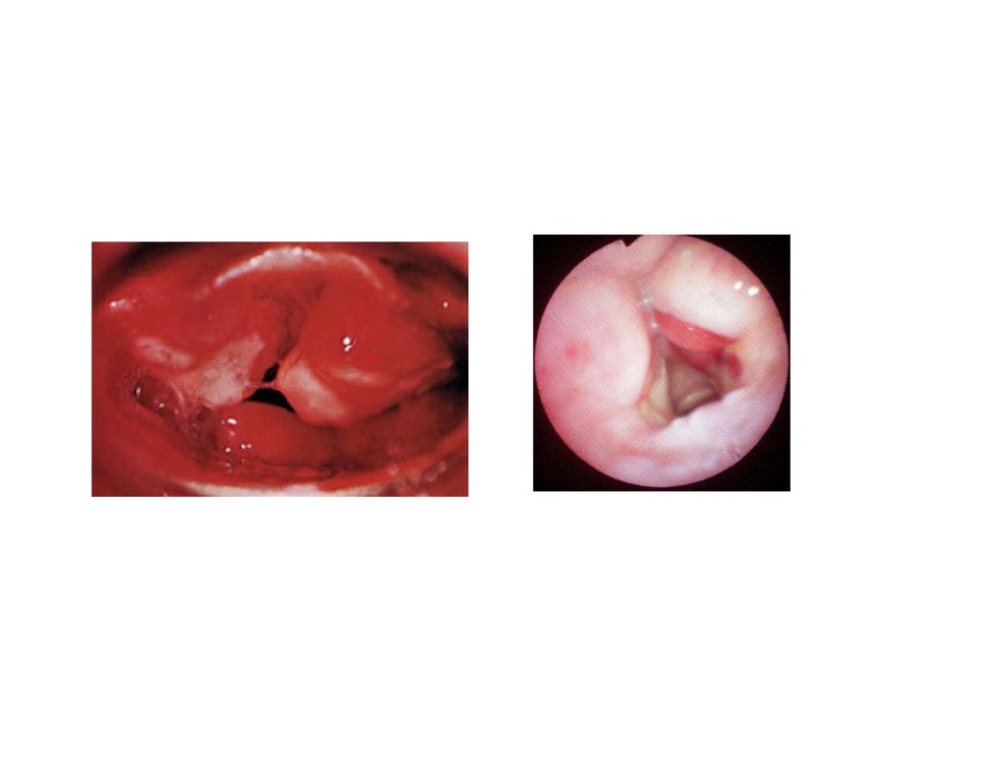

Slide 43
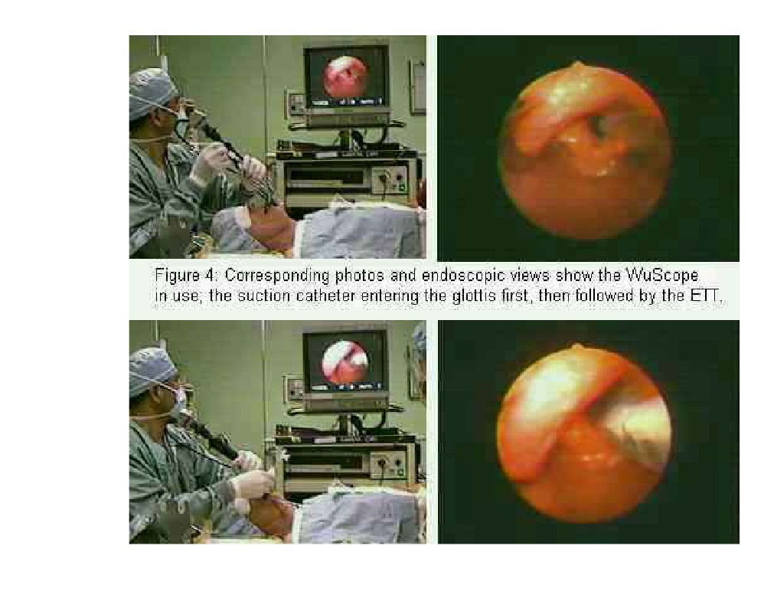

Slide 44
Radiographic Imaging
• C-spine
• CXR
• CT
• Angiography
• Contrast esophagrams

Slide 45
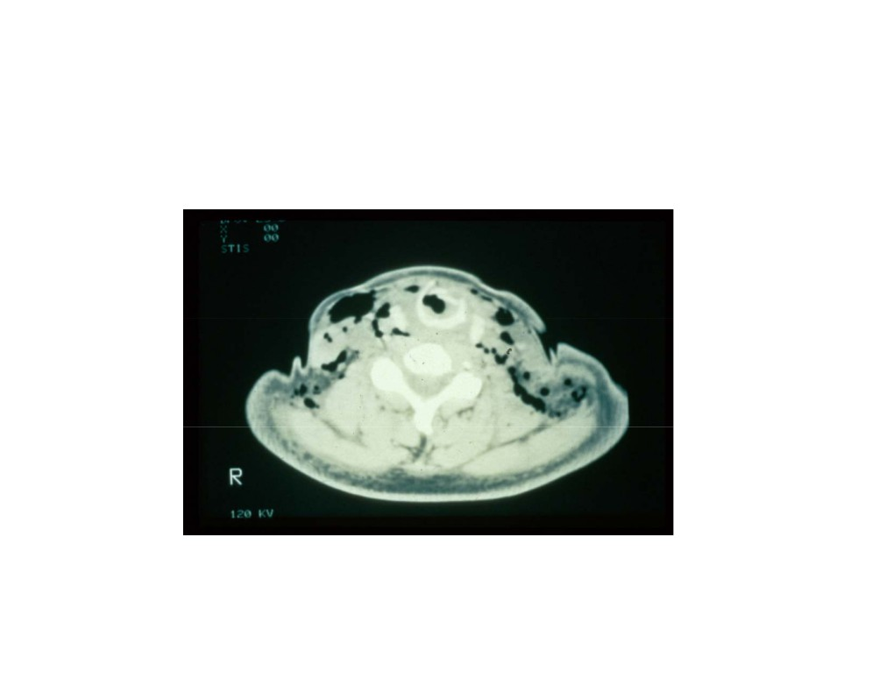
CT Scan

Slide 46
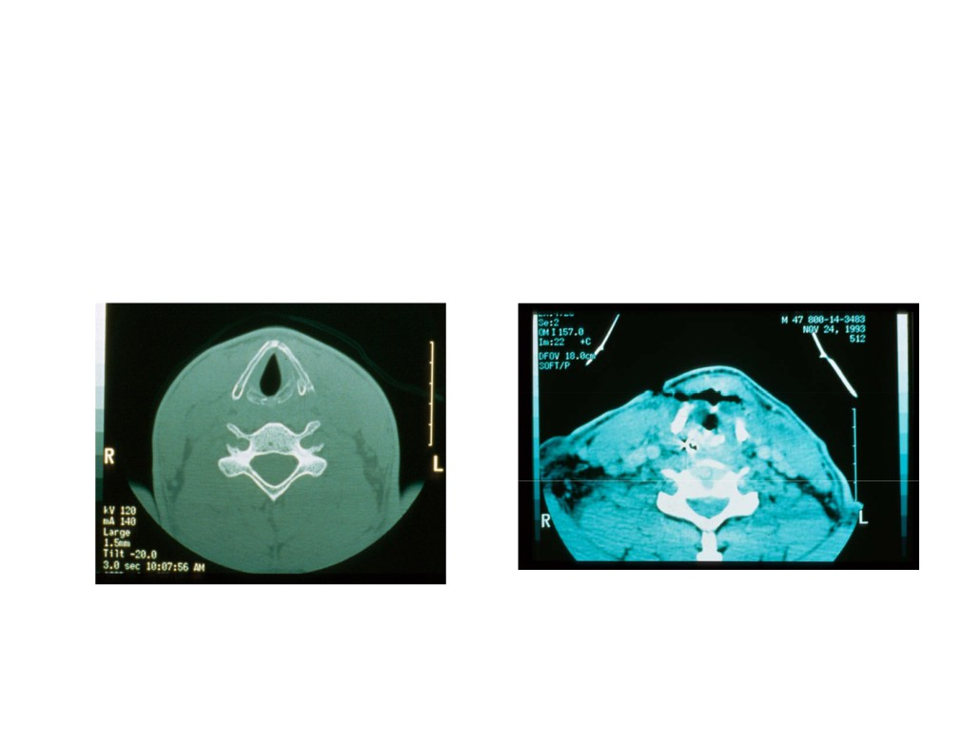
CT Scan

Slide 47
Laryngeal Trauma
Asymptomatic or minimal symptoms
F/L
CT scan
Displaced fracture
Mild Edema
(by CT or exam)
Small hematoma
Loss of mucosa or extensive laceration
Non-displaced linear fracture Intact mucosa
Bleeding
Small lacerations
Exposed cartilage Tracheotomy
Bed rest
Cool mist Antibiotics
Panendoscopy
Steroids Anti-reflux
Explore

Slide 48
Laryngeal Trauma
Respiratory distress, open wounds, bleeding
Tracheotomy
Panendoscopy Explore

Slide 49
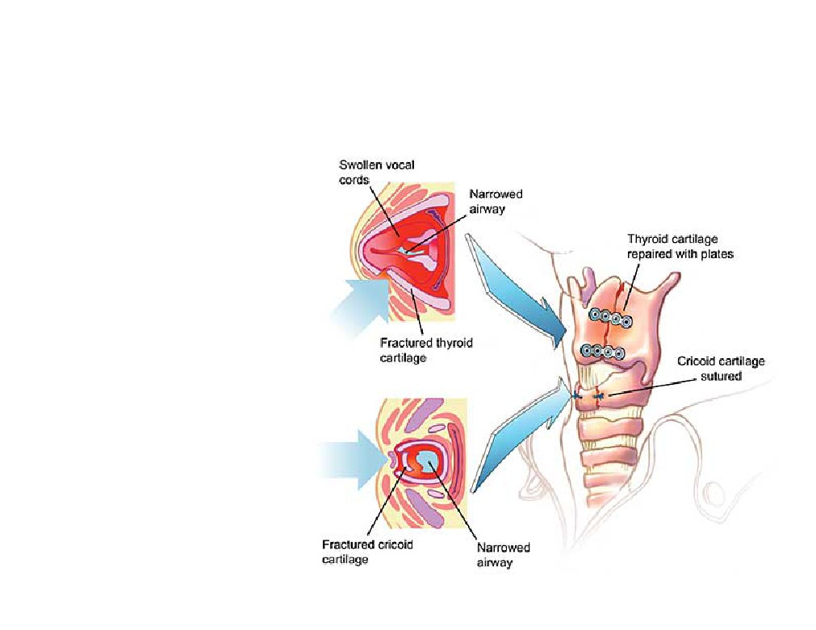

Slide 50
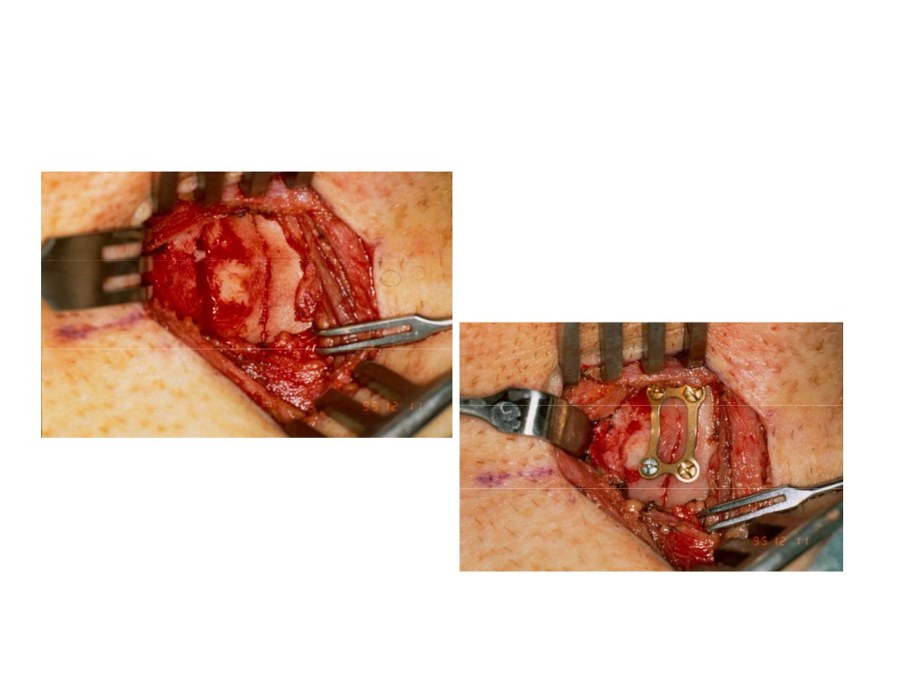
Laryngeal Framework Repair

Slide 51
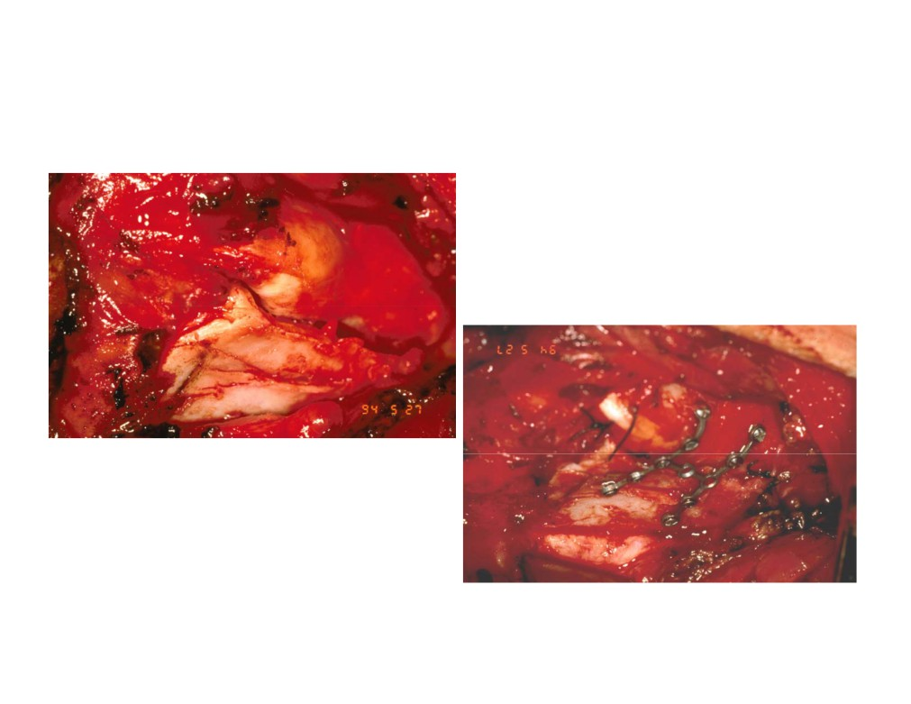
Laryngeal Framework Repair

Slide 52
Treatment Goals
• Preservation of airway
• Prevention of aspiration
• Restoration of normal voice

Slide 53
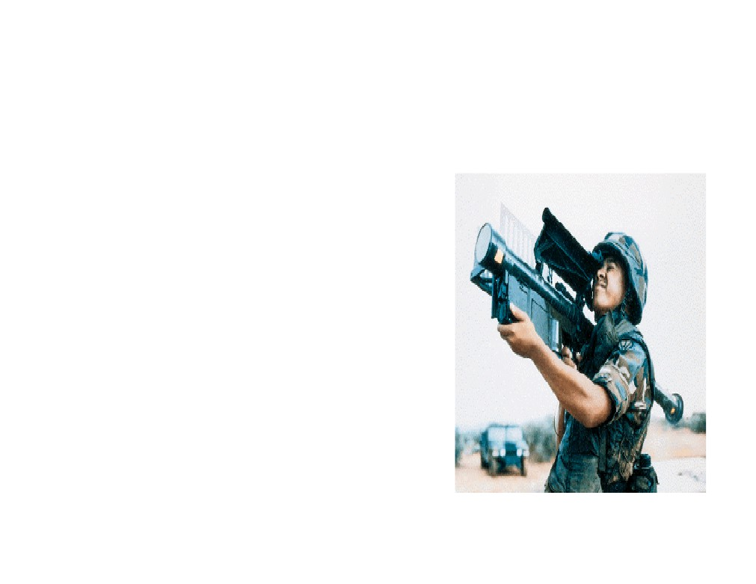
NI-SNHL
• 30 Y saudi solder
• Lt ear tinittus
• Can not sleep
• Severe depresion

Slide 54
Trauma & SNHL
• NISNHL
• Acoustic trauma
• Barotrauma

Slide 55
Noise induce SNHL
• one of the most common occupationally induced disabilities
• Tinnitus
- commonly accompanied NISNHL
- warning sign

Slide 56
Noise induce SNHL
• Usually is limited to 3, 4, and 6 kHz
•
4 kHz Greatest loss ?
•
?Susceptibility
- Age, gender, race, and coexisting vascular disease Not been shown to correlate with susceptibility to NIHL
- No known way to predict susceptibility

Slide 57
TTS vs PTS
• Temporary threshold shift (TTS)
HL recovers over the next 24 to 48 hours
• Permanent threshold shift (PTS)

Slide 58
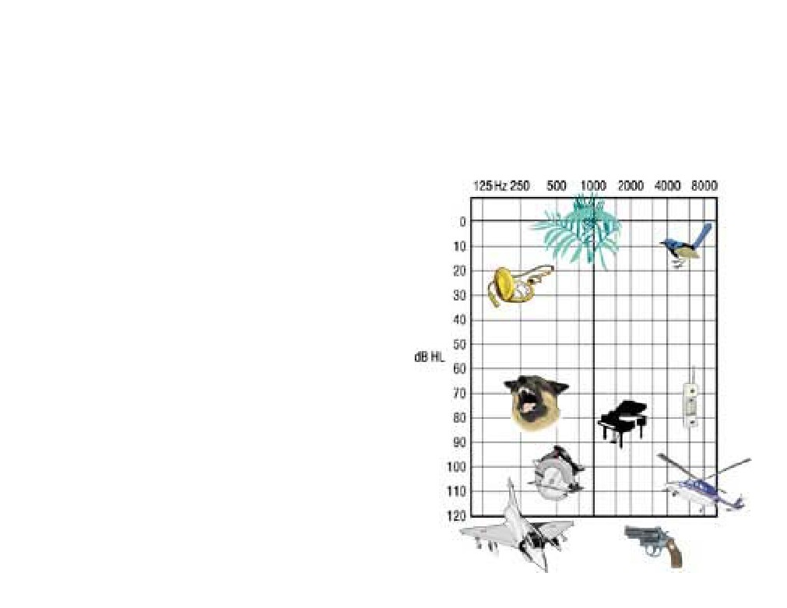
98
•
90 db for 8 hours
•
95 db for 4 hours
•
100 db for 2 hours
•
105 db for 1 hours

Slide 59
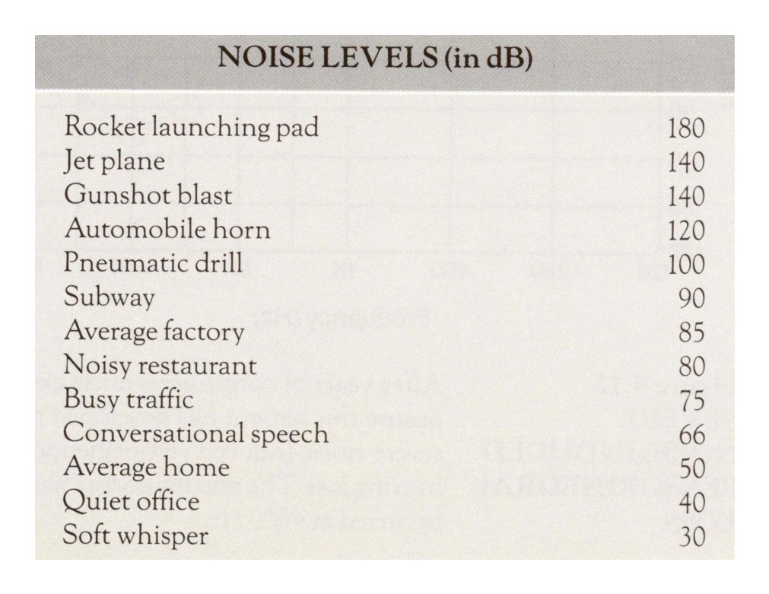

Slide 60
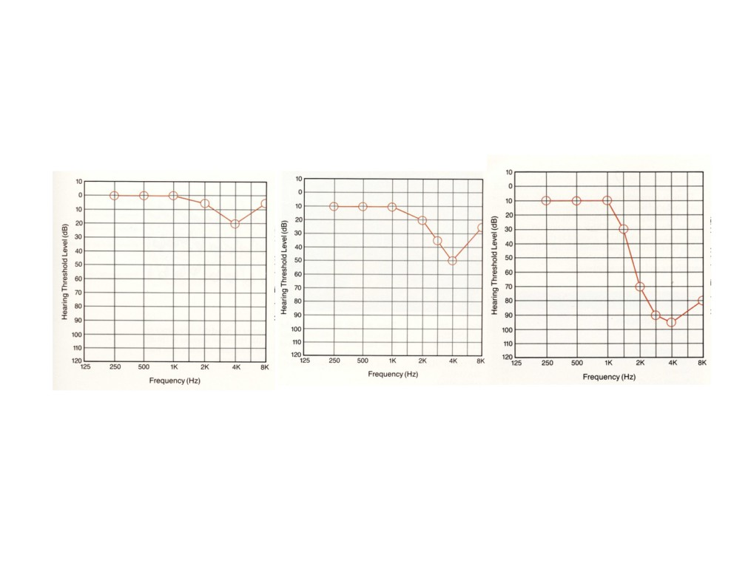

Slide 61
Primary role of otolaryngologists
• Prevention
• Early identification.

Slide 62
Barotrauma
• Injury of the TM and middle ear
• Unequalized pressure differentials between the middle and external ears
• Flying or underwater diving
• ETD may predispose

Slide 63
S/S
• Pain
• H.L
• hyperemia and possible TM perforation
• Edema and ecchymosis of the ME mucosa
• Conductive hearing loss
• Hemotympanum
• Transudative middle ear effusion

Slide 64
Foreign Bodies of the Aerodigestive Tract
Dr. Mohammad Aloulah ,MBBS. SBORL Assistant Professor King Saud University
Otolaryngology Consultant
King Abdulaziz Hospital

Slide 65
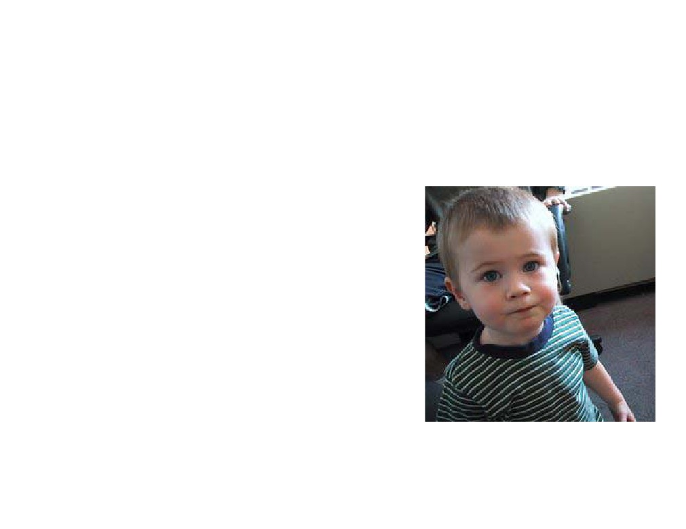
Foreign Bodies
• Foreign body ingestion
• Foreign body aspiration
• Kids
- Oral exploration
- Easy distractibility
- Cognitive development

Slide 66
Foreign Body Ingestion
• Coins
• Meat
• Vegetable matter
• Less than 24 hours in most

Slide 67
Foreign Body Aspiration
• Parental suspicion
• History
• Choking
• Gagging
• Wheezing
• Hoarseness
• Dysphonia
• Can mimic asthma, croup, pneumonia

Slide 68
Foreign Body Aspiration
• Physical exam
- Larynx/cervical trachea
• Inspiratory or biphasic stridor
- Intrathoracic trachea
• Prolonged expiratory wheeze
- Bronchi
• Unequal breath sounds
• Diagnostic triad - <50%
- Unilateral wheeze
- Cough
- Ipsilaterally diminished breath sounds
• Fiberoptic laryngoscopy

Slide 69
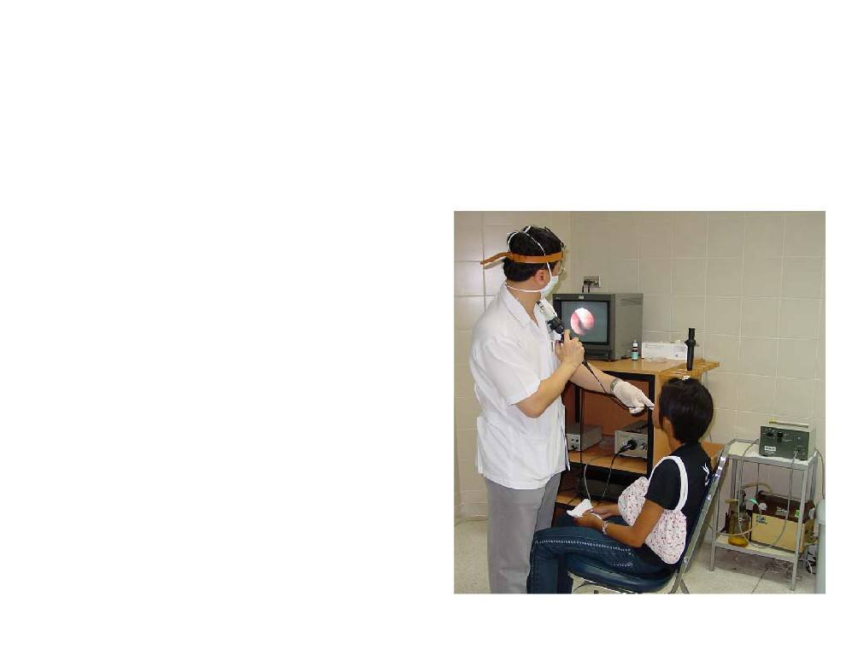
Flexible Laryngoscopy
• Proper Equipment
• Assess nares/choanae
• Assess adenoid and lingual tonsil
• Assess TVC mobility
• Assess laryngeal structures

Slide 70
Radiology
• Plain films:
- Chest and airway AP and lat
- Expiratory films
• Fluoroscopy
• Barium Swallow
• CT, MRI, Angiography

Slide 71
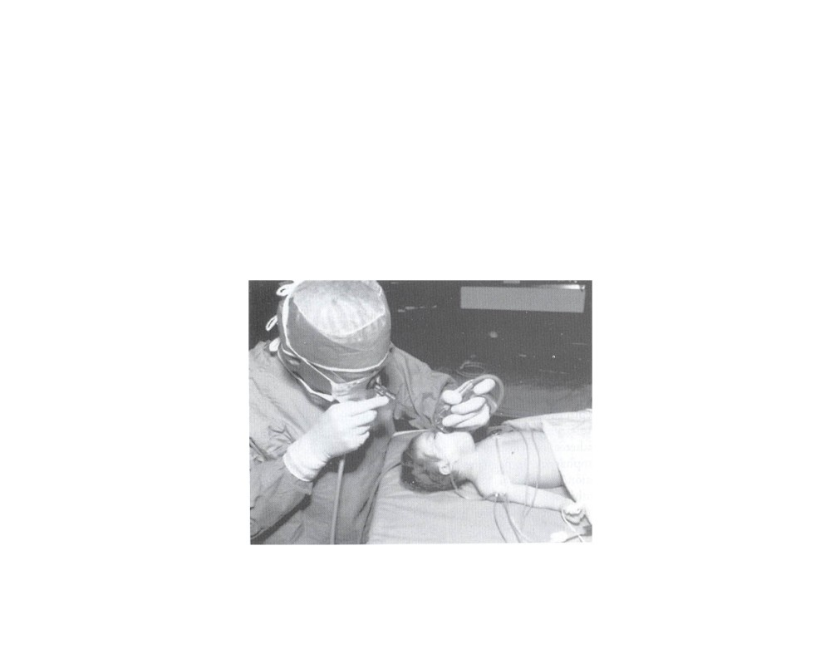
Direct Laryngoscopy

Slide 72
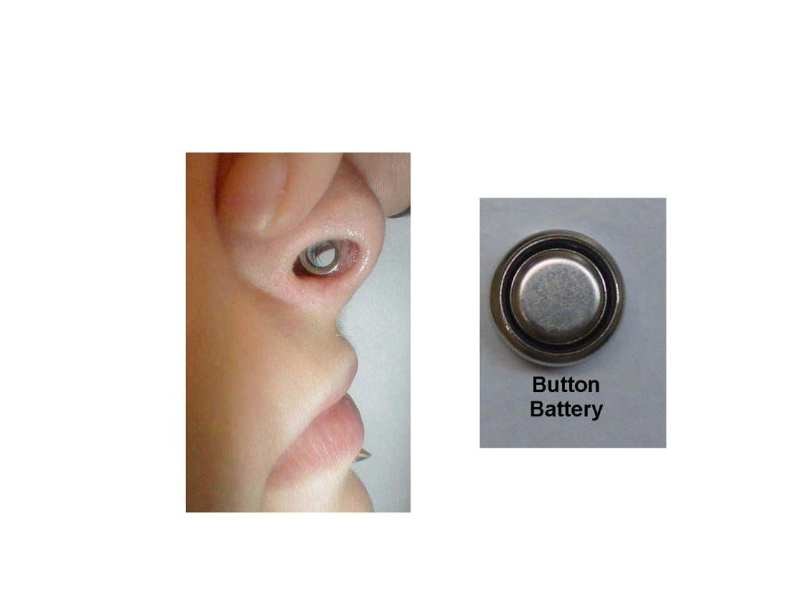

Slide 73
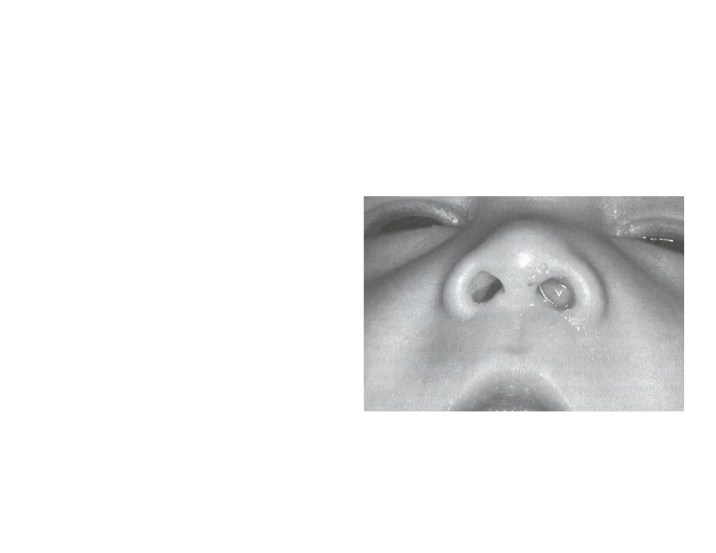
• 5y
• Unilateral discharge
• Foul smell

Slide 74
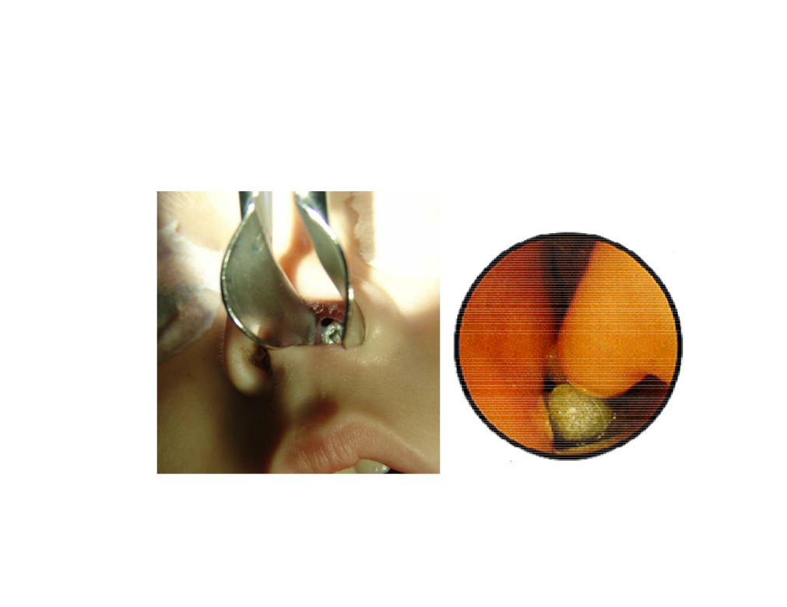

Slide 75
Foreign Body Ingestion
• Disc batteries
- Emergency (Alkaline? Acid )
- NaOH, KOH, mercury
•
1 hour - mucosal damage
•
2 to 4 hours - muscular layers
•
8 to 12 hours - perforation
– Esophagoscopy
- Laparotomy for bowel perforation

Slide 76
Foreign Body Ingestion
• Common locations
- Cricopharyngeus
- Aorta/left mainstem bronchus
- Gastroesophageal junction

Slide 77
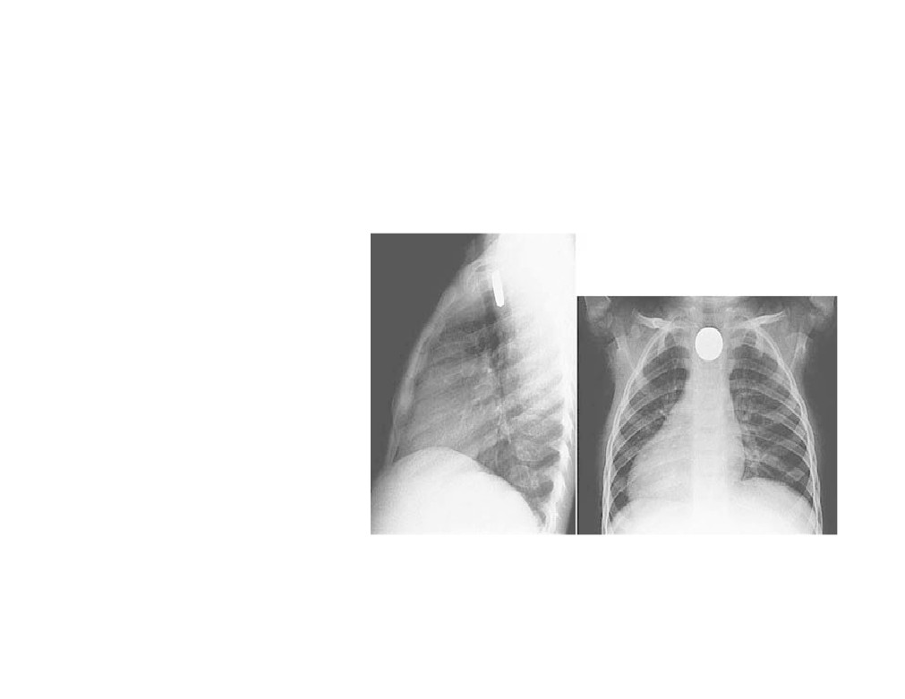
Foreign Body Ingestion
• Radiopaque
- Coins
- Cartilage/bones
• Radiolucent
- Hot dogs
• Barium swallow

Slide 78
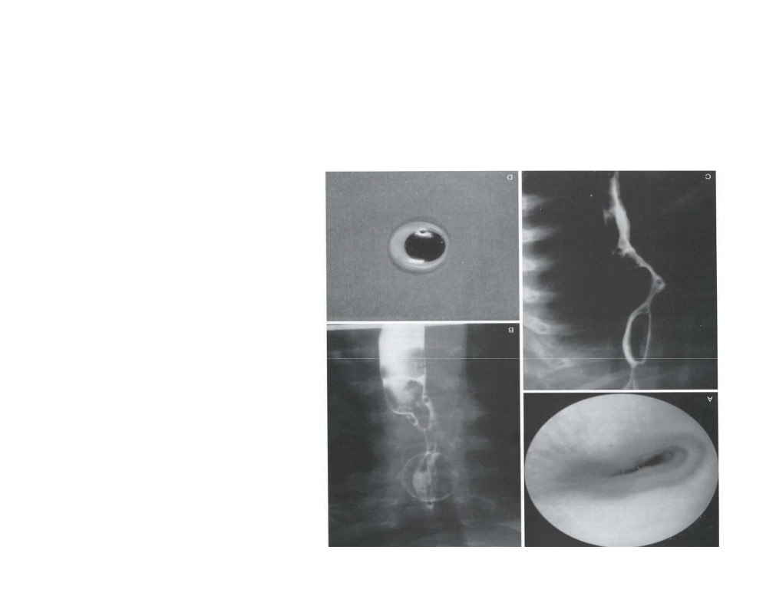
Foreign Body Ingestion
• Barium Swallow

Slide 79
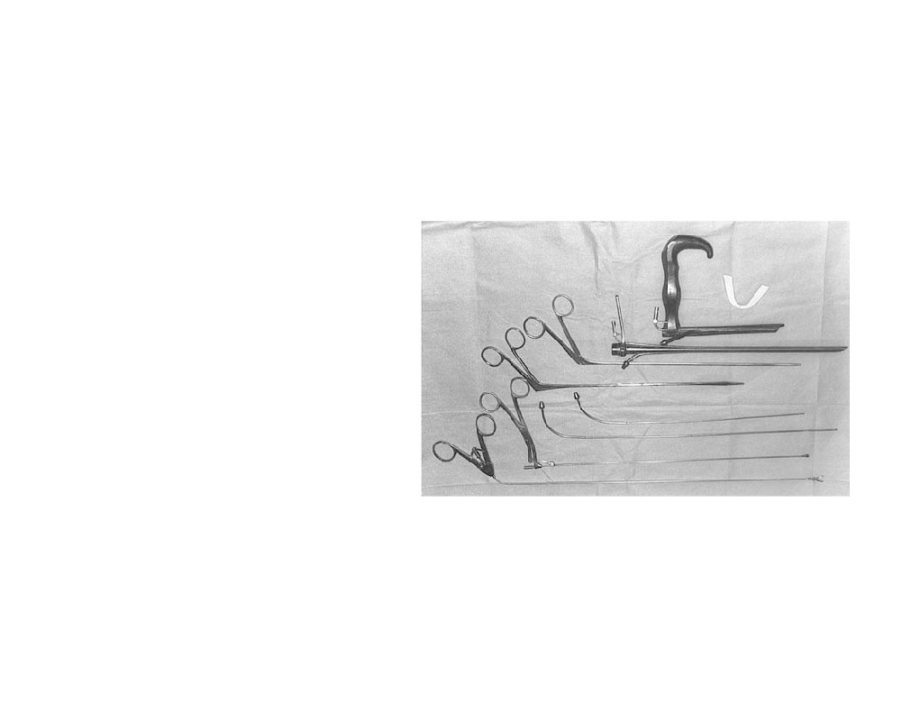
Foreign Body Ingestion
• Removal
- General anesthesia
- Intubated
- Esophagoscopy
- Examine for ulceration/perforation

Slide 80
Foreign Body Ingestion
• Postoperative management
• NPO for 4-12 hours
• Perforation
- Tachycardia
- Tachypnea
- Fever
- Chest pain

Slide 81
Foreign Body Aspiration
• Radiography
- PA & lateral views of chest & neck
- Inspiration & expiration
- Lateral decubitus views
- Airway fluoroscopy
• 25% have normal radiography

Slide 82
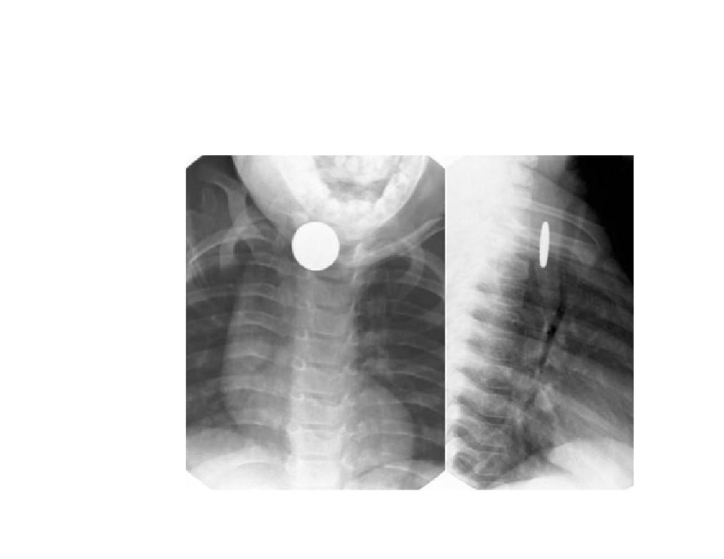

Slide 83
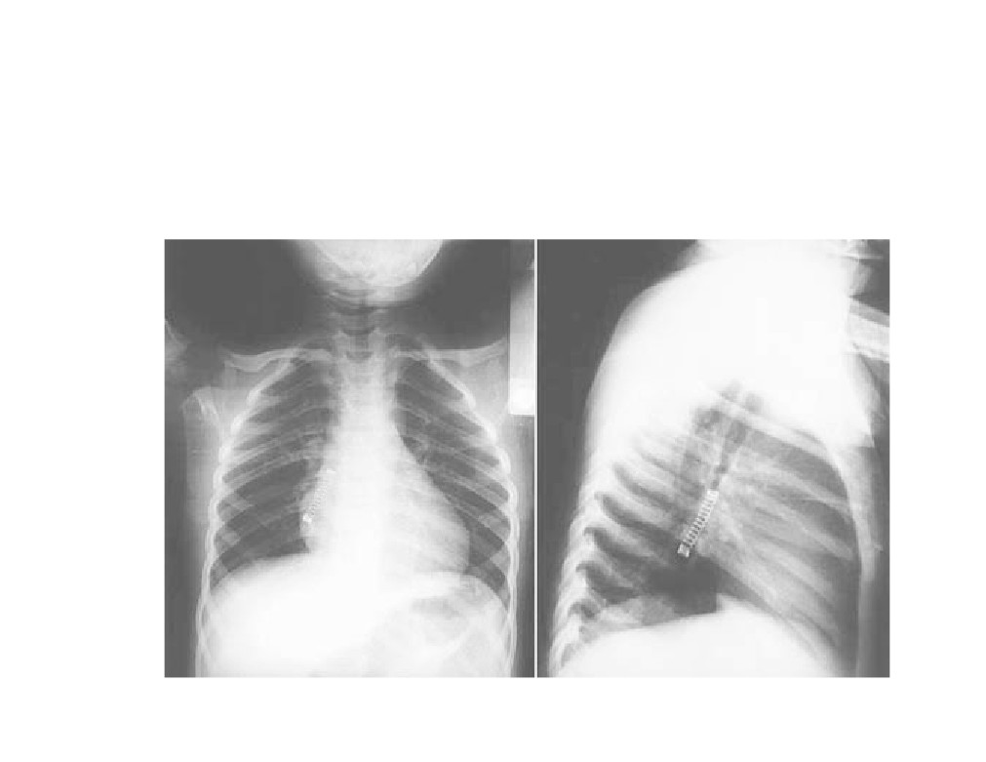
Foreign Body Aspiration

Slide 84
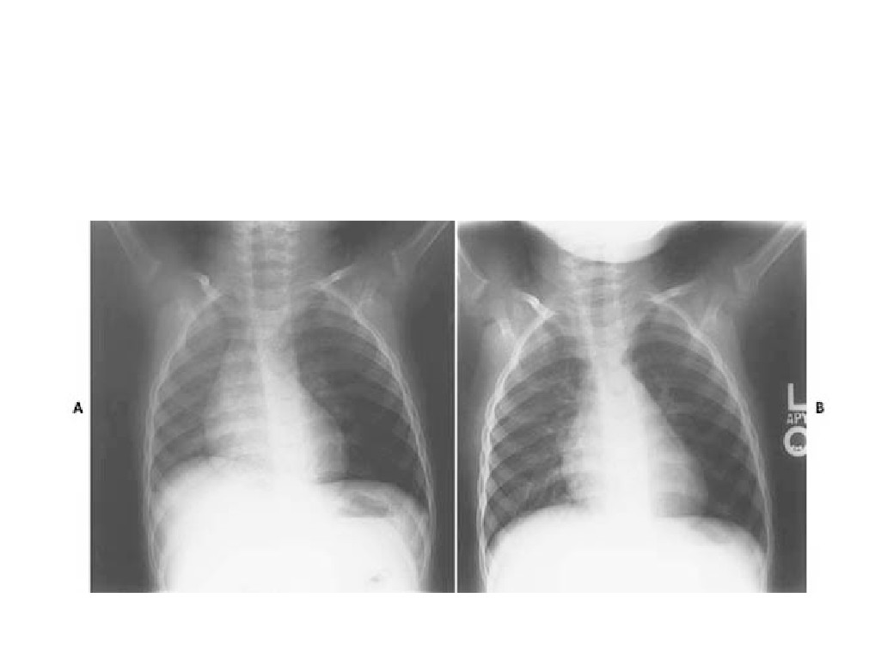
Foreign Body Aspiration

Slide 85
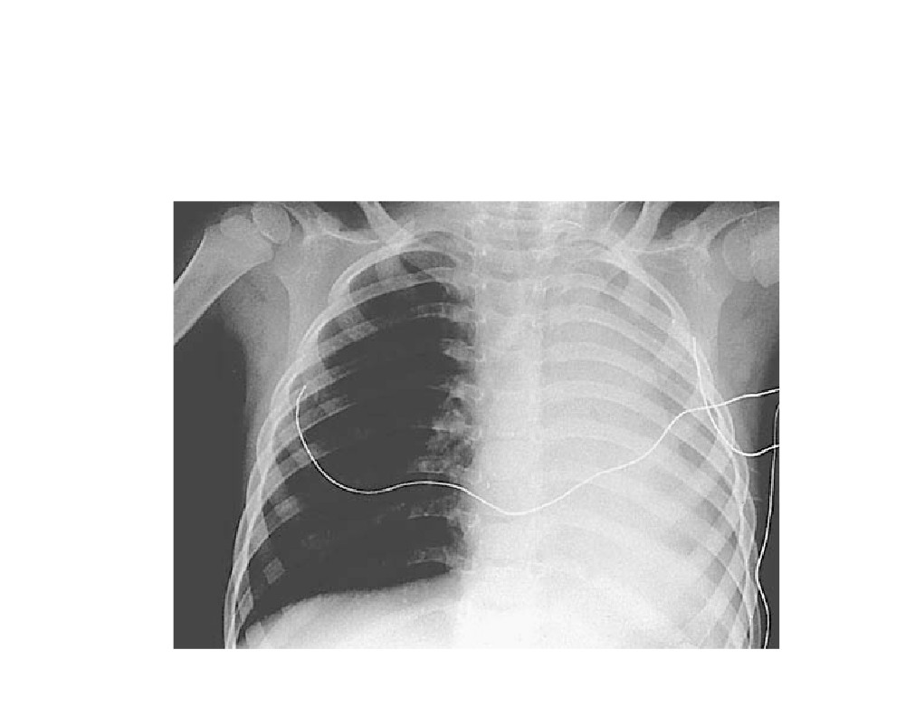
Foreign Body Aspiration

Slide 86
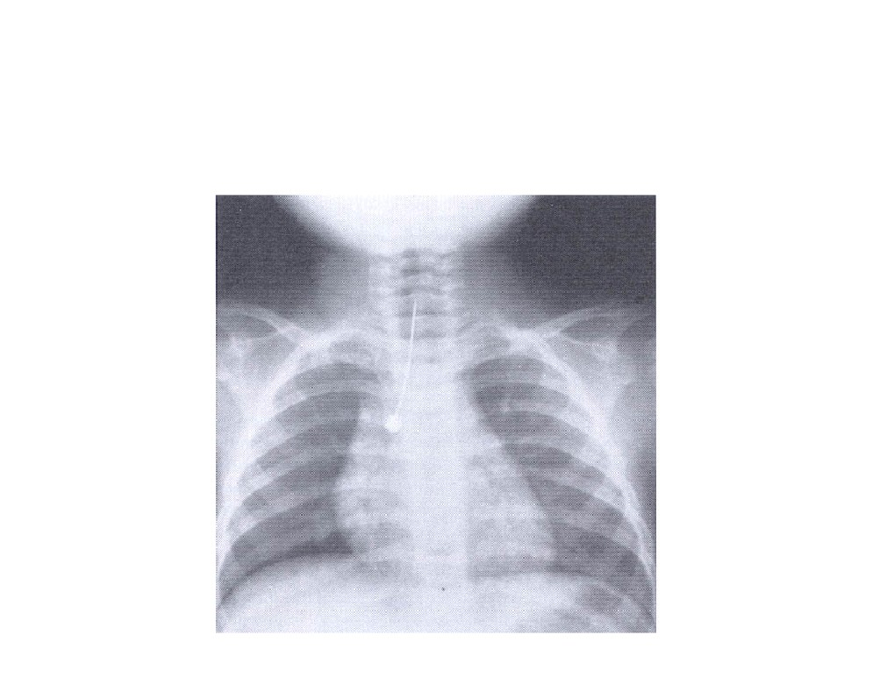
Foreign Body Aspiration

Slide 87
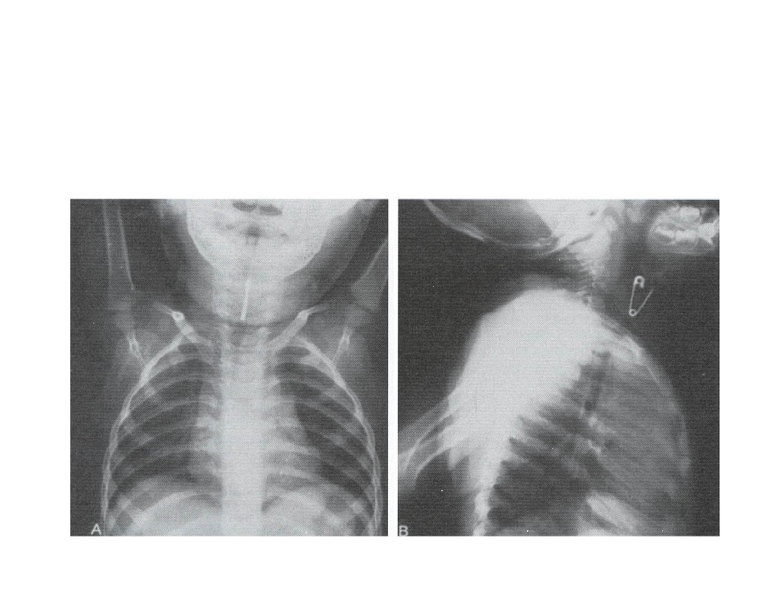
Foreign Body Aspiration

Slide 88
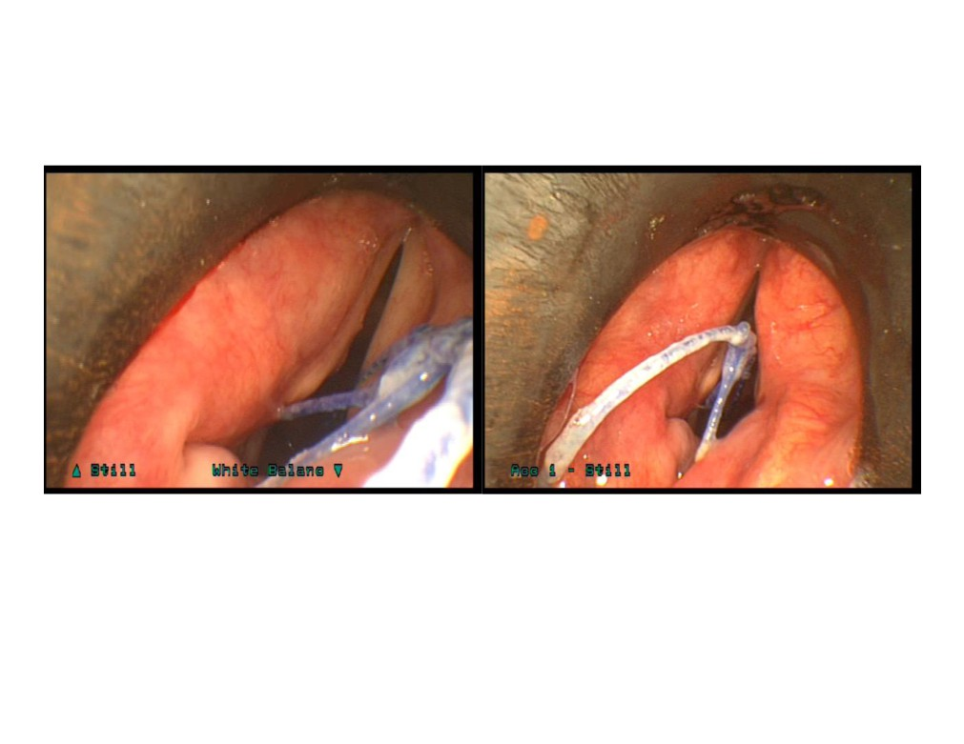

Slide 89
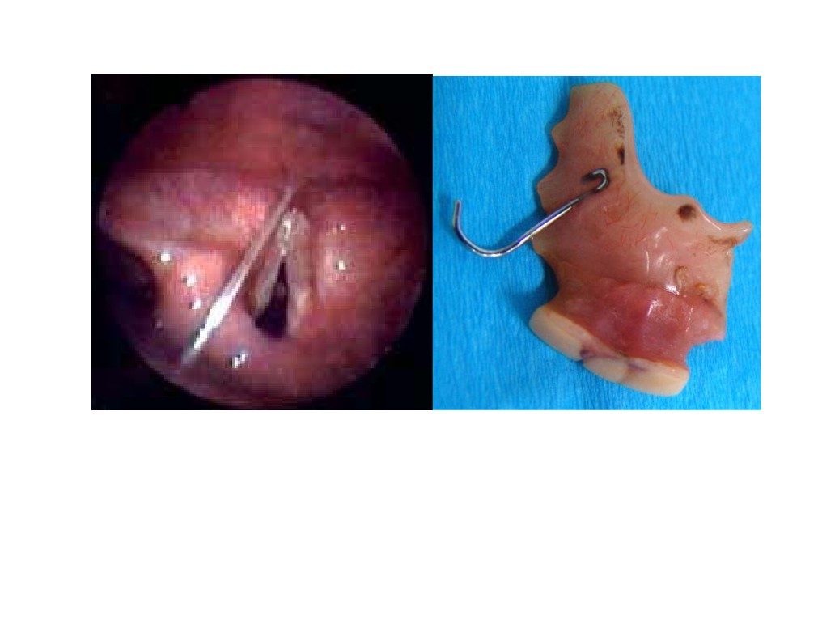

Slide 91
Foreign Body Aspiration
• Postoperative Care
- Chest physiotherapy for retained secretions
- Antibiotics
• Not routinely used
- Steroids
• Not routinely used
• Traumatic insertion or removal

Slide 92
Foreign Body Aspiration
• Complications
- Pneumonia
• Antibiotics, physiotherapy
- Atelectasis
• Expectant management, physiotherapy
- Pneumothorax
- Pneumomediastinum

Slide 96
Examine both ears

Slide 99
What do you think?
• 3 y old
• Lt side discharge
• Foul smell

