Slide 1
بسم الله الرحمن الرحيم

Slide 2
Objectives
Gross applied anatomy of the ear
Nerve supply of the external and middle ears and the principles of referred earache
Central connection of the vestibulo- cochlear nerve
Physiology of the external, middle and inner ears

Slide 3
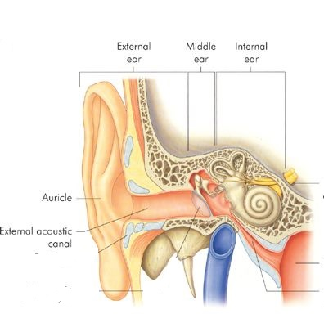
ANATOMY OF THE EAR

Slide 4
EXTERNAL EAR
Auricle
External Canal

Slide 5
The auricle

Slide 6
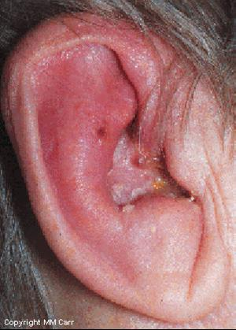
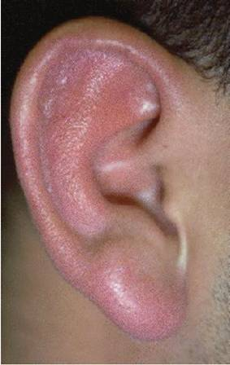
Perichondritis
Erysipelas

Slide 7
The External Auditory Canal

Slide 8
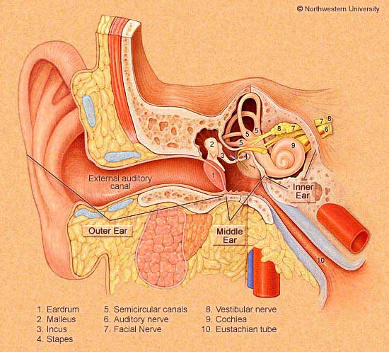
The External Auditory Canal
Lateral Third:
Medial Two Thirds:
Cartilagenous wall
Present at birth
Hair follicles
Ceruminous glands
Sebacous glands
Bony wall
Develops after birth

Slide 9
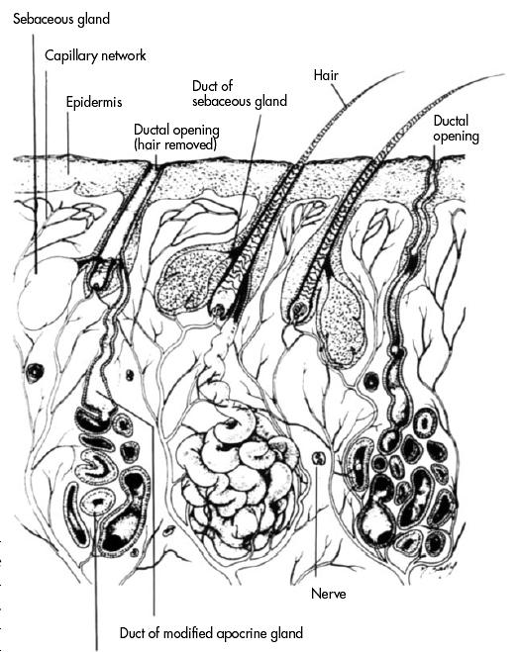

Slide 10
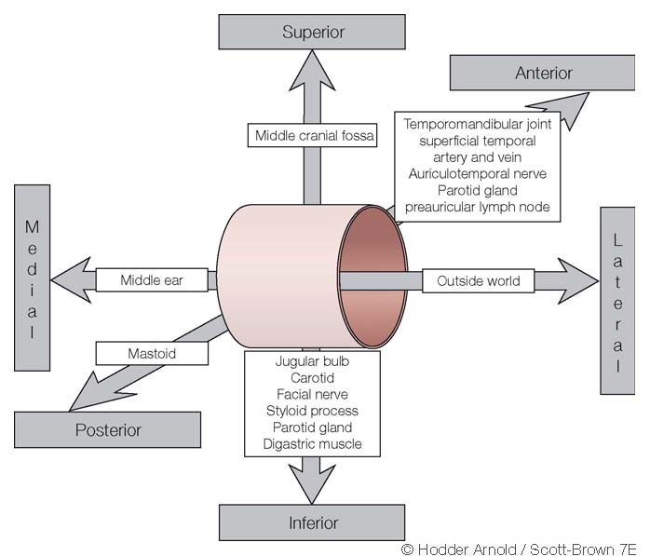
Relations of EAM

Slide 11
ANATOMY OF THE EAR
External Ear
Middle Ear Cleft
Inner Ear

Slide 12
MIDDLE EAR CLEFT
Eustachian tube (Pharyngo-tympanic)
Tympanum (Middle Ear Cavity)
Mastoid Antrum and Air Cells

Slide 13
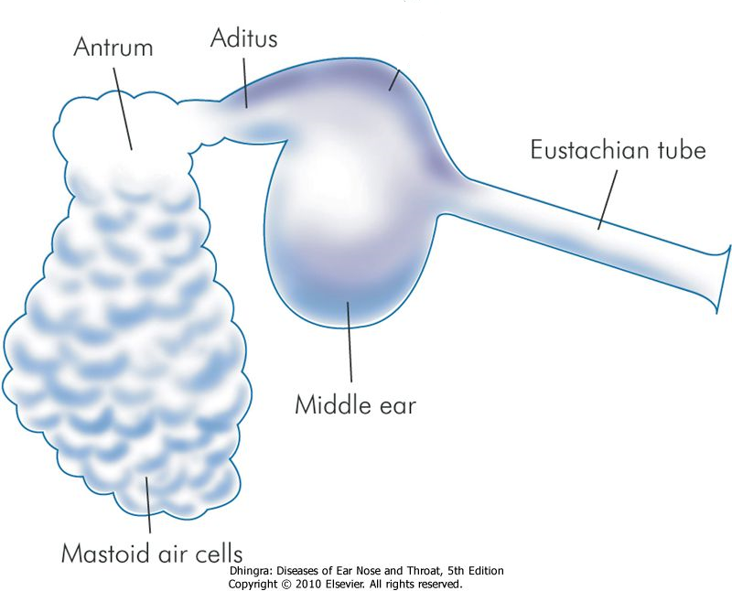

Slide 14
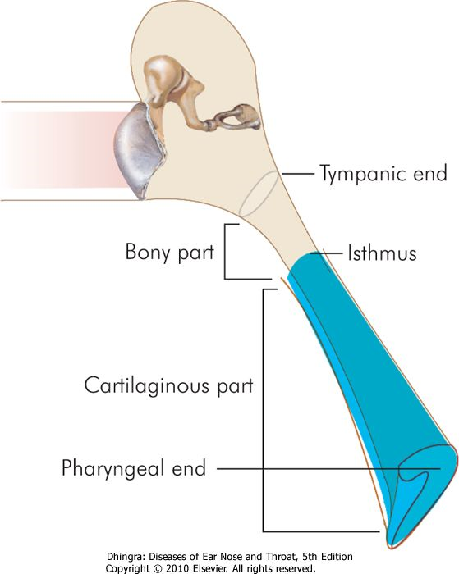
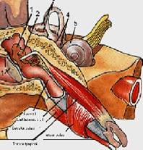
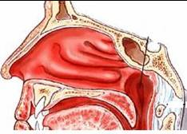
MIDDLE EAR CLEFT
Eustachian (Pharyngo-Tympanic) Tube

Slide 16
MIDDLE EAR CLEFT
Eustachian (Pharyngo-Tympanic) tube
Tympanic cavity (Middle ear cavity)

Slide 17
WALLS OF TYMPANIC CAVITY
Roof
Floor
Anterior wall
Posterior wall
Lateral wall
Medial wall

Slide 18
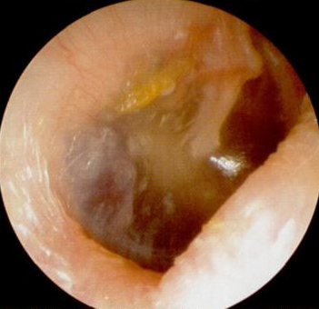
WALLS OF TYMPANIC CAVITY
Roof
Floor
Tegmen

Slide 19
WALLS OF TYMPANIC CAVITY
Roof
Floor
Anterior wall
Posterior wall

Slide 20
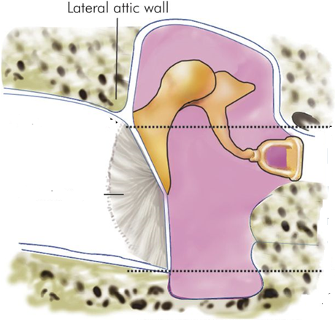
WALLS OF TYMPANIC CAVITY
Roof
Floor
Anterior wall
Posterior wall
Lateral wall

Slide 21
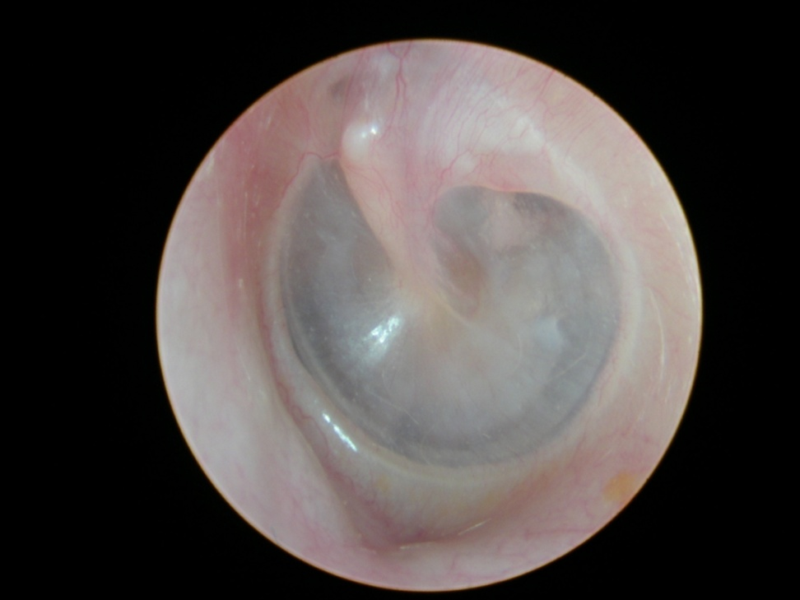
WALLS OF TYMPANIC CAVITY
Roof
Floor
Anterior wall
Posterior wall
Lateral wall
Membrana Flaccida
Membrana tensa

Slide 22
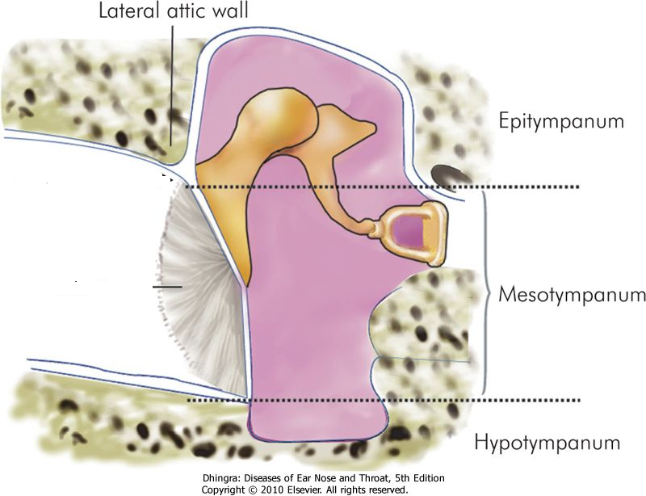

Slide 23
WALLS OF TYMPANIC CAVITY
Roof
Floor
Anterior wall
Posterior wall
Lateral wall
Medial wall

Slide 24
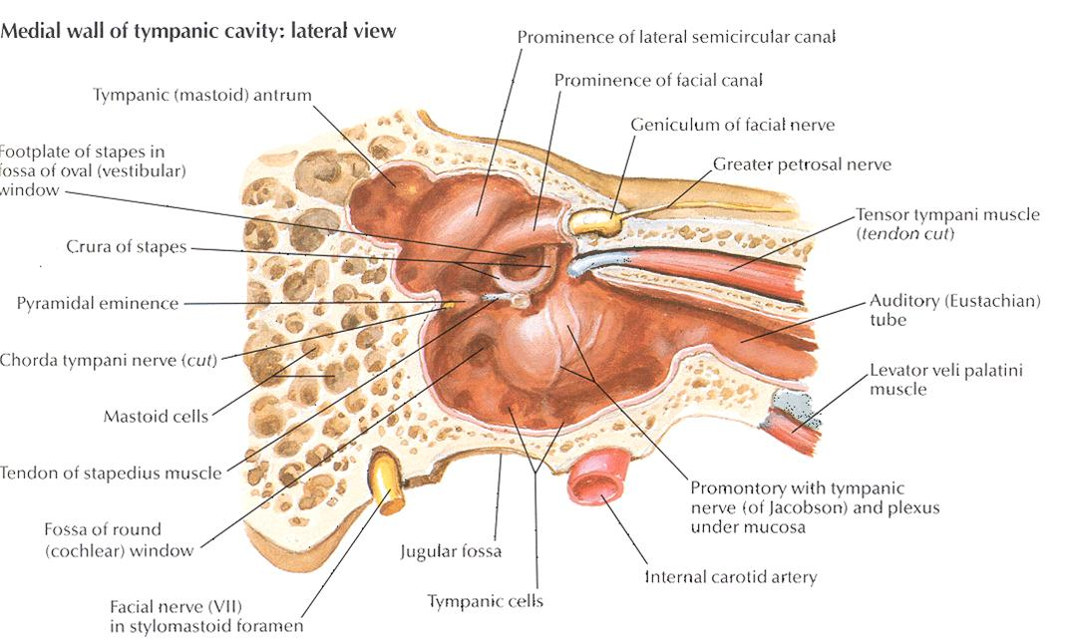

Slide 25
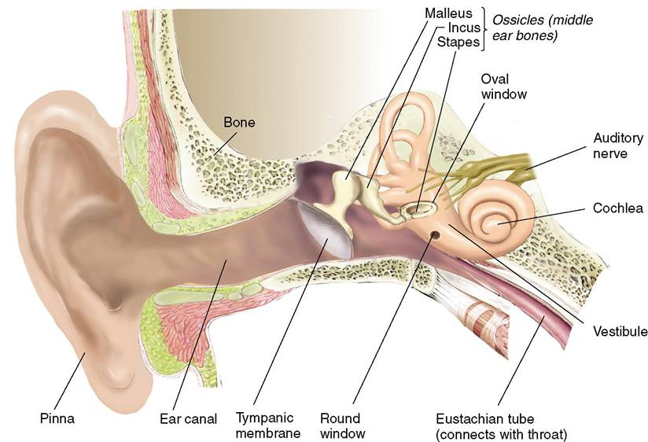

Slide 26
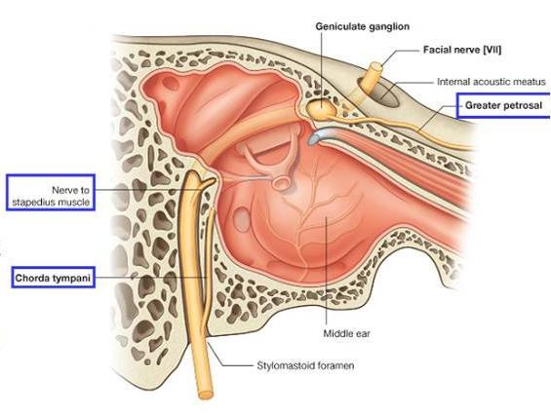

Slide 27
MIDDLE EAR CLEFT
Eustachian (Pharyngo-tympanic) Tube
Tympanic (Middle Ear) Cavity
Mastoid antrum and air cells

Slide 28
Mastoid Antrum & Air cells

Slide 29
Mastoid Antrum & Air cells

Slide 30
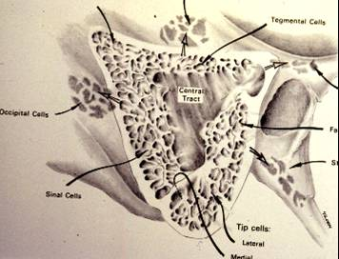
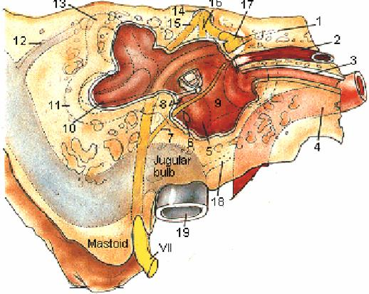
Mastoid Antrum & Air cells

Slide 31
CONTENTS OF MIDDLE EAR CAVITY
Air

Slide 32
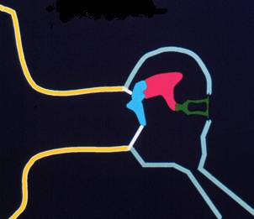
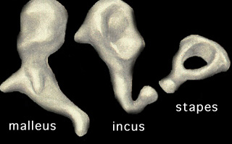
CONTENTS OF MIDDLE EAR CAVITY
Air
Ossicles
Malleus, Incus & Stapes

Slide 33
CONTENTS OF MIDDLE EAR CAVITY
Air
Ossicles
Muscles
Tensor tympani
Stapedius

Slide 34
CONTENTS OF MIDDLE EAR CAVITY
Air
Ossicles
Muscles
Nerves
Tympanic plexus
Chorda tympani

Slide 35
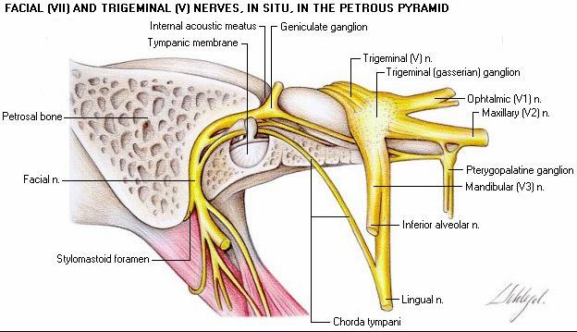

Slide 36
LINING OF MIDDLE EAR
Mucous membrane : ciliated columnar anteriorly and cuboidal or flat elsewhere

Slide 37
SENSARY SUPPLY OF MIDDLE AND EXTERNAL EAR
Cervical II & III ( great auricular and lessor occipital)
V cranial nerve ( auriculotemporal)
IX cranial nerve (tympanic or Jacobson’s)
X cranial nerve ( auricular or Arnold’s)
? VII cranial nerve

Slide 38
Referred Earache
Pain in the ear due to a disease in an area supplied by a nerve that also supply the ear.

Slide 39
Referred Earache
Cervical II & III
Cervical spondylosis, neck injury etc.
V cranial nerve
Dental infections, sinonasal diseases etc.
IX cranial nerve
Tonsillitis, post-tonsillectomy, carcinoma etc.
X cranial nerve
Tumors of hpopharynx, larynx & esophagus

Slide 40
ANATOMY OF INNER EAR

Slide 41
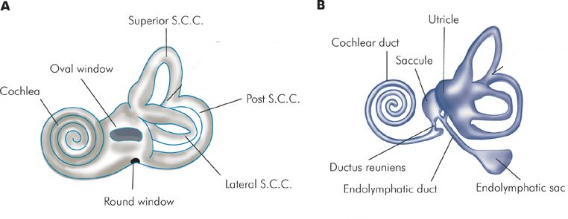
ANATOMY OF INNER EAR

Slide 42
Osseous Labyrinth
Bony Cochlea
Vestibule
Bony semicircular canals

Slide 43
CONTENTS OF THE BONY LABYRINTH
Perilymph
Membranous labyrinth
Cochlear duct
Saccule and utricle
Membranous semicircular ducts

Slide 45
CONTENTS OF MEMBRANOUS LABYRINTH
Endolymph
Sensory epithelium
Cochlea: organ of Corti
Utricle & saccule: maculae
Semicircular canals: cristae

Slide 46
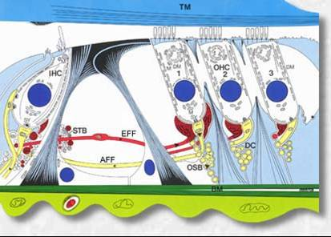
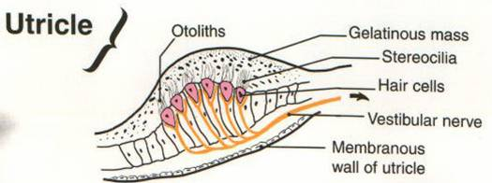
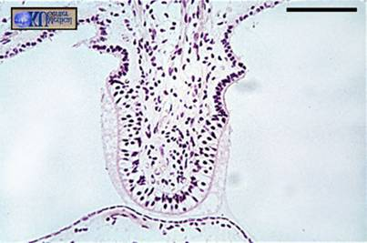
INNER EAR SENSORY EPITHELIUM
Cochlea: organ of Corti
Utricle & saccule: maculae
Semicircular canals: cristae

Slide 47
THE VESTIBULO-COCHLEAR NERVE

Slide 49
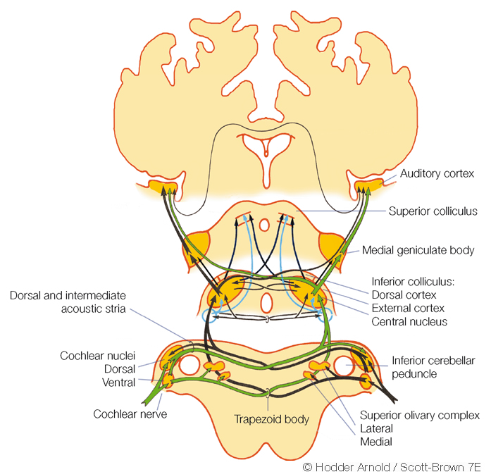

Slide 50
CENTRAL CONNECTIONS OF COCHLEAR NERVE

Slide 51
CENTRAL CONNECTIONS OF VESTIBULAR NERVE

Slide 52
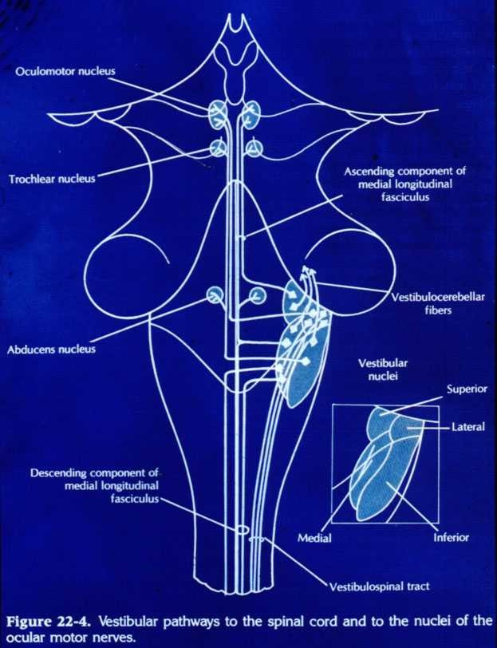

Slide 53
PHYSIOLOGY OF THE EAR

Slide 54
FUNCIONS OF THE EXTERNAL EAR
Protection of the middle ear
Curvature
Cerumen
Auditory functions:
Sound conduction
Increase sound pressure by the resonance function

Slide 55
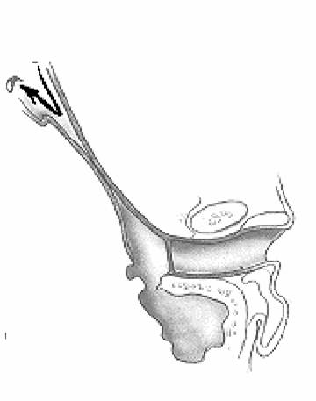
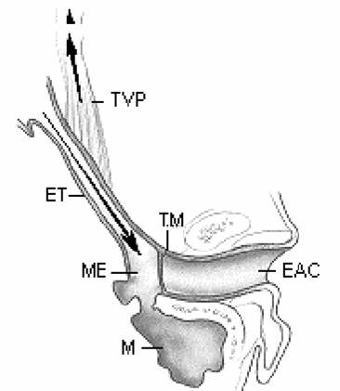
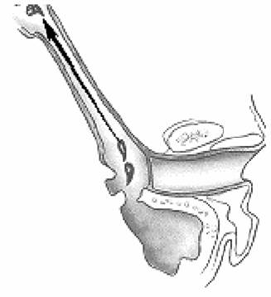
FUNCTIONS OF THE EUSTACHIAN TUBE
Protection
Ventilation
Drainage

Slide 56
FUNCIONS OF THE MIDDLE EAR
Conduction of sound
Transformer mechanism
Hydraulic action
Ossicular leverage

Slide 57
FUNCIONS OF THE MIDDLE EAR
Conduction of sound
Transformer mechanism
Hydraulic action
Ossicular leverage
Protection to the inner ear
stapedial reflex

Slide 58
FUNCIONS OF THE INNER EAR
Hearing Function:
Transduction of sound to action potentials

Slide 59
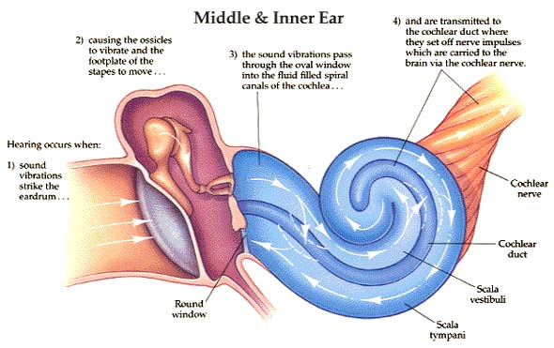

Slide 60
FUNCIONS OF THE INNER EAR
Hearing Function:
Transduction of sound to action potentials
Vestibular Function:
Participate in maintaining body balance

Slide 61
THE BALANCE SYSTEM
C. Cortex
Cerebellum
BRAIN-STEM

Slide 62
THE BALANCE SYSTEM
Vestibular
Proprioceptive
Visual
INPUT
C. Cortex
Cerebellum
BRAIN-STEM

Slide 63
THE BALANCE SYSTEM
Vestibular
Proprioceptive
Visual
INPUT
C. Cortex
Cerebellum
BRAIN-STEM
OUTPUT
Ocular muscles
Postural muscles

Slide 64
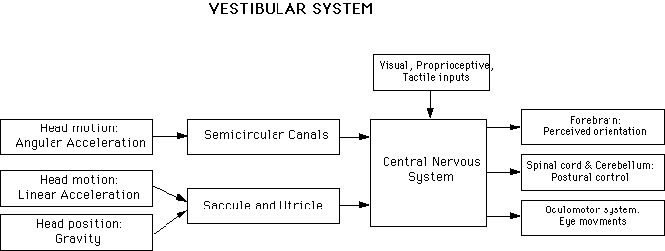

Slide 66
Diseases of External Ear & AOM

Slide 67
Objectives
Recognize the congenital anomalies of the external ear
Diagnose and treat wax accumulation
Diagnose and treat the common external ear inflammatory conditions
Discuss the pathology, clinical features and management of AOM

Slide 68
DEVELOPMENT OF THE EAR
External ear: 1st pharyngeal cleft & arch
Middle ear: 1st pharyngeal pouch & 1st and 2 ^{nd} arches

Slide 69
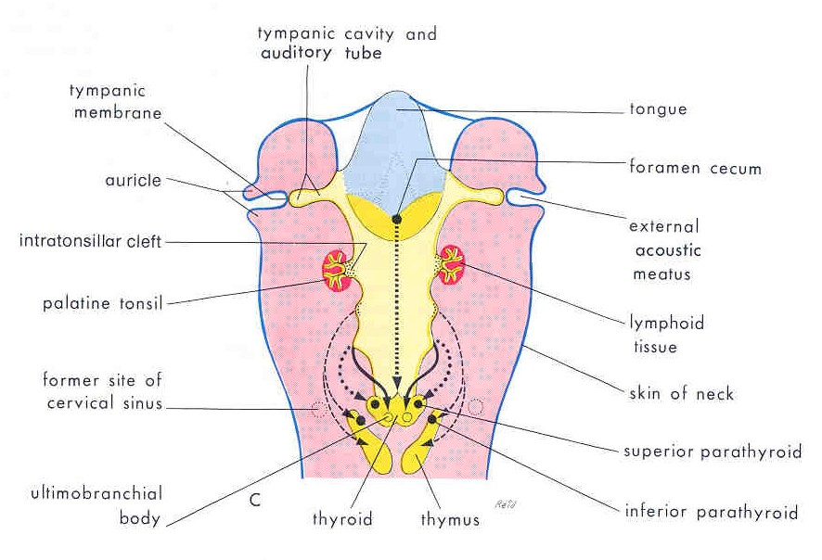

Slide 70
DEVELOPMENT OF THE EAR
External ear: 1st pharyngeal cleft & arch
Middle ear: 1st pharyngeal pouch & 1st and 2 ^{nd} arches
Inner ear: Ectoderm of hindbrain

Slide 71
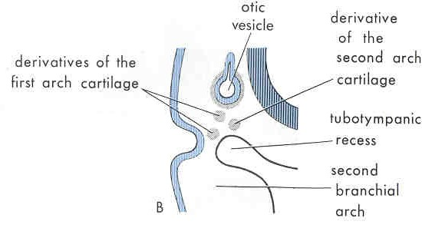

Slide 72
DISEASES OF THE EXTERNAL EAR

Slide 73
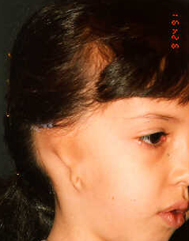
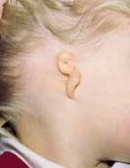
CONGENITAL MALFORMATIONS
Anotia & microtia

Slide 74
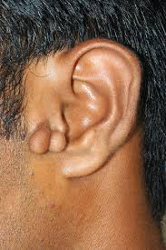
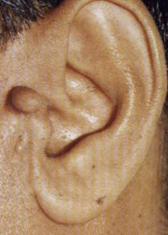
CONGENITAL MALFORMATIONS
Anotia & microtia
Accessory auricle

Slide 75
CONGENITAL MALFORMATIONS
Anotia & microtia
Accessory auricle

Slide 76
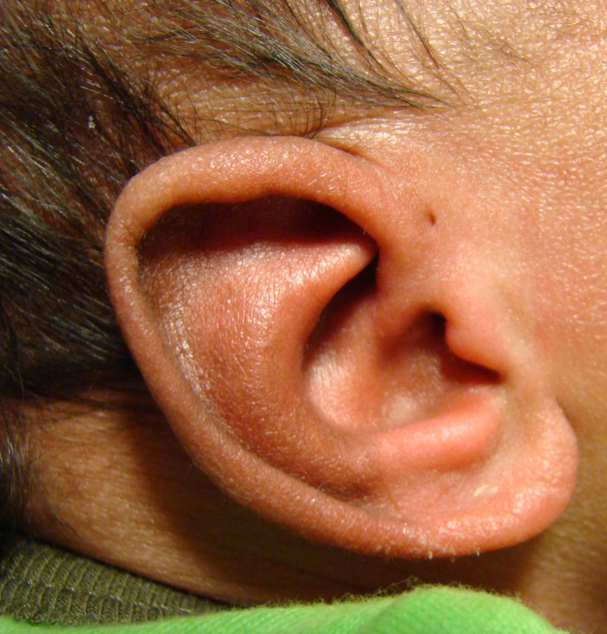
CONGENITAL MALFORMATIONS
Anotia & microtia
Accessory auricle
Pre auricular sinus

Slide 77
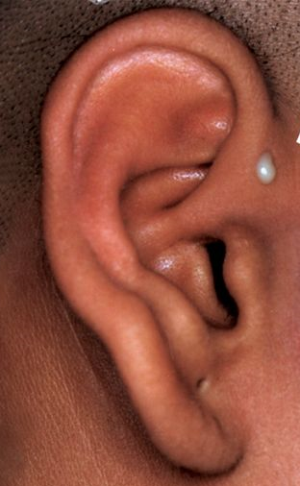
CONGENITAL MALFORMATIONS
Anotia & microtia
Accessory auricle
Pre auricular sinus

Slide 78
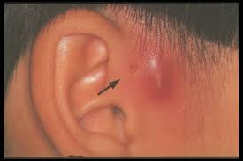
CONGENITAL MALFORMATIONS
Anotia & microtia
Accessory auricle
Pre auricular sinus

Slide 79
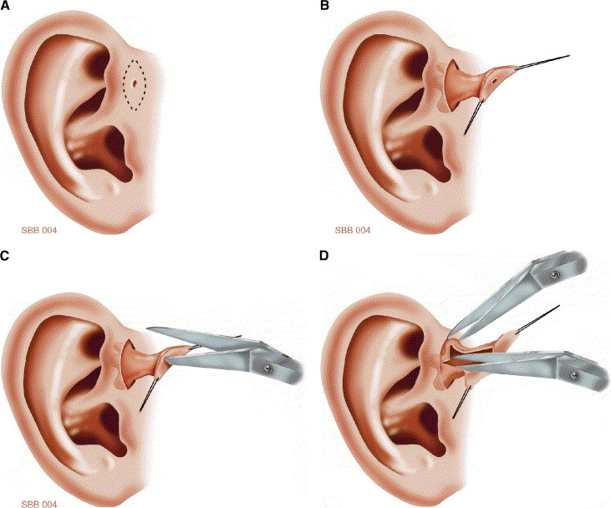

Slide 80
CONGENITAL MALFORMATIONS
Anotia & microtia
Accessory auricle
Pre auricular sinus

Slide 81
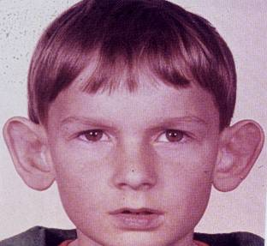
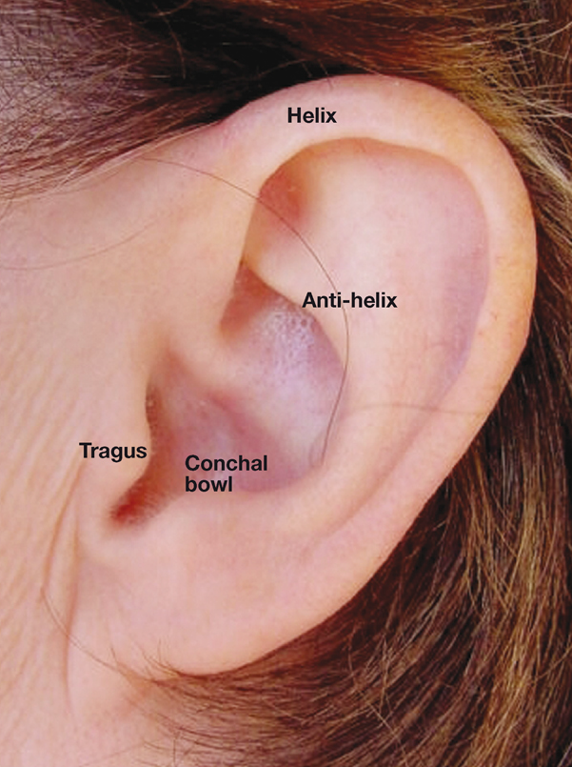
CONGENITAL MALFORMATIONS
Anotia & microtia
Accessory auricle
Pre auricular sinus
Protruding ear

Slide 82
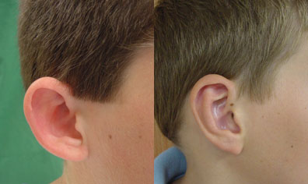

Slide 83
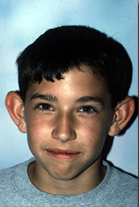
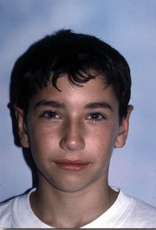

Slide 84
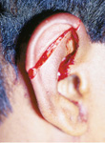
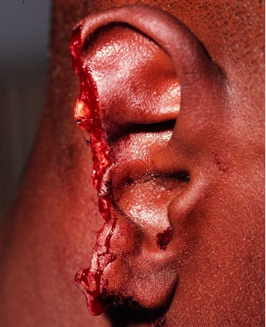
Trauma to the Auricle
Laceration

Slide 87
Trauma to the auricle
Hematoma auris

Slide 88
Complication
Cauliflower ear

Slide 89
Treatment

Slide 90
PERICHONDRITIS OF THE PINNA
Usually follow trauma (hematoma auris, surgical, frostbite, burn) or otitis externa
Commonly caused by Pseudomonas
Fever, pain, redness and swelling
Treatment is by antibiotics
.

Slide 91
Complication
Cauliflower ear

Slide 93
OTITIS EXTERNA

Slide 94
DEFINITION
An acute or chronic infection of the whole or a part of the skin of the external ear canal

Slide 102
CLINICAL FEATURES OF OTITIS EXTERNA
Itching
Pain
Tenderness and swelling
Otorrhea
Deafness
Changes in the lumen and skin of EAM

Slide 103
Clinical types of otitis externa
Localize O.E ( furuncle)

Slide 104
Clinical types of otitis externa
Localize O.E ( furuncle)

Slide 105
Clinical types of otitis externa
Localize O.E ( furuncle)
Diffuse infective O.E.

Slide 106
Clinical types of otitis externa
Localize O.E ( furuncle)
Diffuse infective O.E.

Slide 107
Clinical types of otitis externa
Localize O.E ( furuncle)
Diffuse infective O.E.
Otomycosis

Slide 108
Clinical types of otitis externa
Localize O.E ( furuncle)
Diffuse infective O.E.
Otomycosis

Slide 109
Clinical types of otitis externa
Localize O.E ( furuncle)
Diffuse infective O.E.
Otomycosis
Bullous myringitis

Slide 110
Clinical types of otitis externa
Localize O.E ( furuncle)
Diffuse infective O.E.
Otomycosis
Bullous myringitis

Slide 111
Clinical types of otitis externa
Localize O.E ( furuncle)
Diffuse infective O.E.
Otomycosis
Bullous myringitis
Herpetic O.E

Slide 112
Clinical types of otitis externa
Localize O.E ( furuncle)
Diffuse infective O.E.
Otomycosis
Bullous myringitis
Herpetic O.E

Slide 113
Clinical types of otitis externa
Localize O.E ( furuncle)
Diffuse infective O.E.
Otomycosis
Bullous myringitis
Herpetic O.E
Eczematous and seborrheic O.E.

Slide 114
Clinical types of otitis externa
Localize O.E ( furuncle)
Diffuse infective O.E.
Otomycosis
Bullous myringitis
Herpetic O.E
Eczematous and seborrheic O.E.

Slide 115
Management of otitis externa
Swab for culture and sensitivity

Slide 116
Management of otitis externa
Swab for culture and sensitivity
Ear toilet

Slide 117
Management of otitis externa
Swab for culture and sensitivity
Ear toilet

Slide 118
Management of otitis externa
Swab for culture and sensitivity
Ear toilet
Keep the ear dry
Local medications

Slide 119
Management of otitis externa
Swab for culture and sensitivity
Ear toilet
Keep the ear dry
Local medications

Slide 120
Management of otitis externa
Swab for culture and sensitivity
Ear toilet
Keep the ear dry
Local medications
Systemic medications
Surgery may be required in chronic cases

Slide 121
Acute necrotizing (malignant) otitis externa
An acute Pseudomonas infection of the skin of the external ear canal which has spread to the adjacent bone. It occurs mostly in elderly diabetic patients.

Slide 122
Complications

Slide 123
DIAGNOSIS
Diabetes
Advanced age
Severe otalgia
Granulation tissue & sequestra
Cranial nerve involvement
Radiology

Slide 125
TREATMENT
Control of diabetes
Anti Pseudomonas antibiotics
Local treatment and debridement
The role of surgery remains controversial

Slide 126
MISCELLANEOUS CONDITIONS OF THE EXTERNAL EAR

Slide 127
WAX
Mixture of ceruminous and sebaceous glands secretion
Normally is expelled from the canal aided by movements of the jaw
When accumulated it may cause deafness, earache or tinnitus

Slide 129
WAX
Treatment is by removal using syringing, suction or instrumentation

Slide 132
KERATOSIS OBTURANS
Accumulation of desquamated epithelium in the bony canal
It may be associated with sinusitis, bronchiectasis or primary ciliary dyskinesia
Usually cause deafness and pain
Treatment is periodic removal

Slide 133
ACUTE OTITIS MEDIA

Slide 134
DEFINITION
Acute infection of the mucous membrane lining of the middle ear cleft

Slide 135
PREDISPOSING FACTORS
Age
Maleness
Bottle feeding
Climate
Crowded living conditions
Heredity
Associated conditions: cleft palate, immunodeficiency, ciliary dyskinesia, Down syndrome, and cystic fibrosis

Slide 136
ROUTE OF INFECTION
Eustachian tube
External auditory canal
Blood borne

Slide 137
BACTERIOLOGY
Streptococcus pneumonia
Haemophilus influenzae
Branhamella catarrhalis
Streptococcus pyogens
Staphylococcus aureus

Slide 138
PATHOLOGY

Slide 139
CLINICAL PICTURE
Tubal occlusion
Suppurative inflammation
Tympanic membrane rupture
Resolution

Slide 140
CLINICAL PICTURE
Tubal occlusion
Discomfort, autophony, retracted drum
Suppurative inflammation
Tympanic membrane rupture
Resolution

Slide 141
CLINICAL PICTURE
Tubal occlusion
Discomfort, autophony, retracted drum
Suppurative inflammation
Fever, sever earache, deafness, bulging drum
Tympanic membrane rupture
Resolution

Slide 142
CLINICAL PICTURE
Tubal occlusion
Discomfort, autophony, retracted drum
Suppurative inflammation
Fever, sever earache, deafness, bulging drum
Tympanic membrane rupture
Otorrhea... temp. & earache subside
Resolution

Slide 143
CLINICAL PICTURE
Tubal occlusion
Discomfort, autophony, retracted drum
Suppurative inflammation
Fever, sever earache, deafness, bulging drum
Tympanic membrane rupture
Otorrhea... temp. & earache subside
Resolution

Slide 145
TREATMENT
Symptomatic
Antimicrobials
Amoxycillin/clavulanic acid
Tri-methoprim-sulphamethoxazole
Cefaclor, cefixime
Erythromycin-sulfisoxazole
Decongestant
Myringotomy
Ear toilet and local antibiotics

Slide 146
RECURRENT ACUTE OTITIS MEDIA

Slide 147
DEFINITION
Three or more attacks over a 6-months period

Slide 148
TREATMENT
Long-term low dose antimicrobials
Ventilation tube insertion

Slide 150
OFFICE HOURS Prof. YOUSRY EL-SAYED
Flat 407 - Building 5 - King Abdel-Aziz University Hospital
Mondays from 11 am to 1 pm
Thursdays 11 am to 1 pm

Slide 151
THANK YOU

