Slide 1
Antepartum hemorrhage (APH)

Slide 2
Antipartum hemorrhage :
-affects 3-5 % of pregnancies
-bleeding from or into the genital tract
Occurring from 20 weeks of pregnancy and prior to the birth of the baby.
Causes:
-placenta previa
-placenta abruption
-local causes ( cervical or vaginal lesions , lacerations
-unexplained ( SGA, IUGR )
-Vasa previa
-uterine rupture

Slide 3
-APH is the leading cause of prenatal and maternal morbidity and prenatal mortality (mainly prematurity )
-obstetrics hemorrhage remains one of the major causes of maternal death in the developing countries
Management :
In the hospital maternity unit with facilities for resuscitation such as :
-anesthetic support
-blood transfusion resources
-performing emergency operative delivery
-multidisciplinary team including (midwifery, obstetric staff, neonatal and anesthetic )

Slide 4
Investigations :
-tests if suspecting vasa previa are often not applicable
-tocolysis : shouldn’t be used in :
1-unstable patient
2-fetal compromise
3- major APH
it’s a decision of a senior obstetrician
Senior (consultant) anesthetic care needed in high risk hemorrhage
-risk of PPH : pt should receive active management of 3rd stage of labor using syntometrine ( in absence of high B.P)
-AntiD IG should be given to all non sensitized RH –ve if the have APH
At least 500 IU antiD ig followed by a test of FMH if it is more than 40 ml of RBC additional antiD required
-AntiD ig should be given at minimum of 6 weeks intervals
-Vaginal speculum examination should be done to rule out local causes.

Slide 5
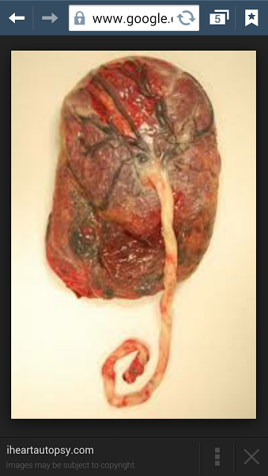
Vasa previa : 1:2000
-rare but very serious cause of vaginal bleeding
-bleeding is fetal in origin associated with velamentous cord insertion where fetal blood vessels in the membranes cross the cervix .
Rupture of membranes can lead to tearing of fetal B.V with exsanguination of the fetus
Diagnosis by color flow doppler ultrasound
Risk factors:
-velamentous insertion
-Bi-lobed or succenturiate lobed placenta
-multiple pregnancy
-low lying placenta
-IVF pregnancy
Normal placenta

Slide 6
Placenta Abruption (abruptio placentae)

Slide 7
Definition: bleeding at the decidual-palacental interface that causes partial or total placental detachment prior to delivery of the fetus over 20 weeks of gestation
Types:
Concealed and revealed hemorrhage .

Slide 8
Incidence:
0.4%-1% of pregnancies
40-70% occurs before 37 weeks .
It is a significant cause of maternal morbidity and perinatal morbidity and mortality (Pnmortality :12% and 77% occurs in utero )
PNm Rate : the number of stillbirths and deaths in the first week of life per 1000 live birth.

Slide 9
Risk factors:
1-Abdominal trauma / accidents
2-cocain or other drug abuse
3-Poly hydramnios
4-hypertensive disease during pregnancy
5-premature rupture of membranes
6-chorioamnionitis , I uGR
7- previous abruptio
8- with increasing age, parity and moking
9-uterine anomalies , leiomyoma, uterine synchiae
10-first trimester bleeding

Slide 10
Clinical presentation:
-vaginal bleeding (mild,moderate or severe)
-Abdominal pain or back pain ( if posterior placenta)
-DIC occurs in 10-20% of severe abruption and death of fetus(severe if placenta separate >50%)
B.P ,FH abnormalities or death
Tender or rigid or firm abdomen (woody feel)
Hypertonic uterine contractions
DIC
Hypovolemic shock , renal failure , ARDS multiorgan failure
blood transfusion,rarely death

Slide 11
Fetal & neonatal outcome:
Increased mortality and morbidity due asphyxia , IUGR8, and preterm delivery.
-Recurrence:
Several – fold higher risk of abruption in subsequent pregnancy= 5-15%
Risk of third rises 20-25%
Chronic abruption: light, chronic, intermittent bleeding , oligohydroamnious , IUGR, pre-ecclampsia , preterm ro.m
Coag.studies usually normal .

Slide 12
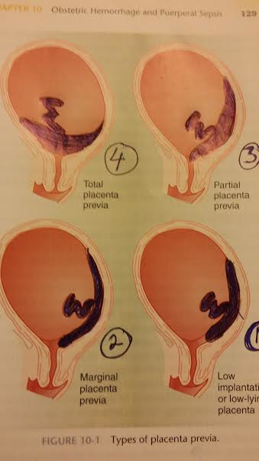
Placenta previa
Definition: the presence of placental tissue that extends over or lies proximate to the internal cervical os. (beyond 20 weeks of gestation )
Degrees:
1-total or complete placenta previa: the placenta completely covers the internal os
2-partial previa : the placenta partially covers the I.O
3-marginal previa : the edge of the placenta extends to the margin of the I.O
4-low-lying placenta : placental margin is within 2cm of I.O

Slide 13
Presentation:
-painless , recurrent vaginal bleeding in 70-80%
-uterine contractions in 10-20%
Prevalence :
3.5-4.6/1000 births
Recurrence : 4-8%
Risk factors:
-previous c/s, placenta previa
-multiple gestation, multiparity , advanced maternal age.
-infertility treatment , previous abortion
-previous intrauterine surgical procedures
-maternal smoking , cocaine use
-non white race , male fetus

Slide 14
Associated conditions :
Placenta accreta : complicated 1-5% patients with placenta previa .
If previous c/s : 11-25%
Two c/s : 35-47%
Three c/s : 40%
Four c/s : 50-67%
Preterm labor , rupture of membrane , mal presentation ,IUGR, vasa previa , congenital anomalies , amniotic fluid embolism .

Slide 15
Diagnosis :
Soft abdomen , normal fetal heart , mal presentation
-avoid vaginal ,rectal examination or sexual intercourse
Investigation:
1-abdominal u/s : false +ve 25% due to over distended bladder or uterine contractions , or can be missed if fetal head is low in pelvis
2-transvaginal u/s : (if diagnosis by abdominal u/s not certain) , or trans perineal u/s
3-MRI : High cost

Slide 16
Management :
Treatment depends on gestational age , amount of vaginal bleeding , maternal status and fetal condition .
Expectant management :
If fetus is preterm less than 37 weeks :
-hospitalization
-investigations ( cbc , rft , lft , coagulation factors , blood grouping and rh )
Steroids (between 24-34 weeks )
antiD ig if the mother is rh negative
-cross match blood and blood products .
-CTG
-elective c/s : if fetus more than 37 weeks
-emergency c/s : if severe bleeding or fetal distress

Slide 17
Morbidity and mortality :
-hemorrhage
-hypovolemic shock (renal.f , shehan’s syndrome, death)
-blood transfusion risk
-hysterectomy , uterine/iliac A ligation or embolization of pelvic vessels
Increase mmR
Increase neonatal morbidity .

