Slide 1
Endometrial neoplasm
Karima salamah

Slide 2
leiomyomas
Definitions
Pathogenisis, Behavior & malignant potential.
Clinical presentations
Work – up
Managements.

Slide 3
What is it
Most common neoplasm of the uterus.
Benign monoclonal tumors.
Derived from the smooth muscle cell of the myometrium.

Slide 4
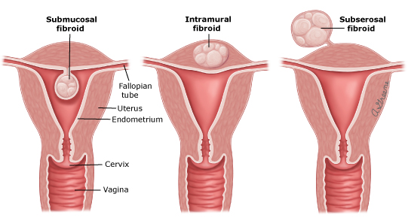
Terminology & Location

Slide 5
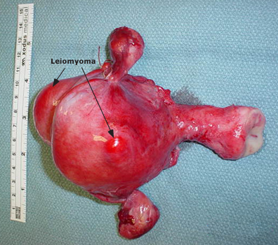

Slide 6
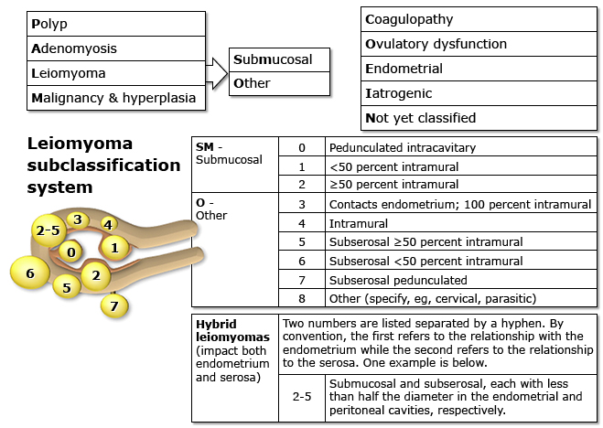
Figo staging

Slide 7
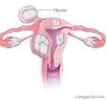
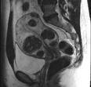
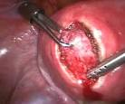
intramural
Intramural myomas (FIGO type 3,4,5) –
These leiomyomas develop from within the uterine wall.
They may enlarge sufficiently to distort the uterine cavity or serosal surface.
Some fibroids can be transmural and extend from the serosal to the mucosal surface.

Slide 8
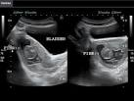
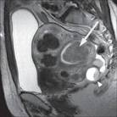
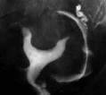
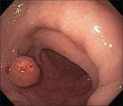
submucosal
Submucosal myomas (FIGO type 0,1,2)
These leiomyomas derive from myometrial cells just below the endometrium.
These neoplasms protrude into the uterine cavity.

Slide 9
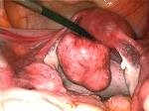
subserosal
Subserosal myomas (FIGO type 6,7)
These leiomyomas originate from the myometrium at the serosal surface of the uterus.
They can have a broad or pedunculated base and may be intraligamentary (ie, extending between the folds of the broad ligament).

Slide 10
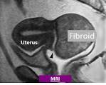
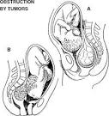
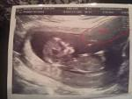
Cervical
Cervical myomas (FIGO type 8)
These leiomyomas are located in the cervix, rather than the uterine corpus

Slide 11
prevelance
A hysterectomy study found myomas in 77 percent of uterine specimens
The epidemiology of leiomyomas parallels the ontogeny and life cycle changes of the reproductive hormones estrogen and progesterone.
Myomas are clinically apparent in approximately 12 to 25 percent of reproductive age women and noted on pathological examination in approximately 80 percent of surgically excised uteri .
Most, but not all, women have shrinkage of leiomyomas at menopause.

Slide 12
Risk factors
Race.
Two- to three-fold greater in black women than in white women
The natural history of leiomyomas also differs by race. Most white women with symptomatic fibroids are in their 30s or 40s; however, black women develop symptoms on average four to six years younger and may even present with disease in their 20s
Fibroids grow at a slower rate after age 35 in white women, but not in black women
Compared with white women, black women experience more severe disease based on their symptoms and have more extensive disease at the time of hysterectomy

Slide 13
Risk factors
Menstrual history and parity
Early menarche (<10 years old) is associated with an increased risk of developing fibroids
Prenatal exposure to diethylstilbestrol is associated with an increased risk of fibroids
Parity decreases the chance of fibroid formation
Early age at first birth decreases risk and a longer interval since last birth increases risk

Slide 14
Hormonal contraception
Use of low dose oral contraceptives (OCs) does not cause fibroids to grow, therefore administration of these drugs is not contraindicated in women with fibroids
Long acting progestin-only contraceptives (eg, depot medroxyprogesterone) protect against development of leiomyomas
Heredity
Studies imply a familial predisposition to leiomyomas in some women. There is also increasing evidence of specific susceptibility genes for fibroids.

Slide 15
Ovulation induction agent
There are isolated reports of leiomyoma enlargement in women treated with clomiphene
Obesity
Most studies show a relationship between fibroids and increasing body mass index. The relationship is complex and is likely modified by other factors, such as parity, and may be more related to change in body habitus as an adult.

Slide 16
Diet, Caffeine, Alcohol & smoking
Beef and other reds meats (1.7-fold) is associated with an increased relative risk of fibroids and consumption of green vegetables (0.5-fold) and fruit (especially citrus fruit) with a decreased risk, There is increasing evidence that vitamin D deficiency or insufficiency is linked to fibroid risk
Consumption of alcohol, especially beer, appears to increase the risk of developing fibroids.
Caffeine consumption is not a risk factor.
Smoking decreases the risk of having fibroids

Slide 17
Clinical manifestations
Heavy or prolonged menstrual bleeding
Most common fibroid symptom
Degree of uterine bleeding are determined by the location of the fibroid, size is of secondary importance
Submucosal myomas that protrude into the uterine cavity (eg, types 0 and I)are most frequently related to significant menorrhagia

Slide 18
Clinical manifestations
Pelvic pressure and pain
Bulk-related symptoms
Urinary frequency, difficulty emptying the bladder, and, rarely, urinary obstruction can all occur with fibroids
Fibroids that place pressure on the rectum can result in constipation.
Back pain may, on occasion, be related to the presence of myomas
Very large uteri may compress the vena cava and lead to increase in thromboembolic risk
Dysmenorrhea
Dysmenorrhea is also reported by many women with fibroids. This pain in many women appears to be correlated with heavy menstrual flow and/or passage of clots.
Dyspareunia
It is controversial
anterior or fundal fibroids are the most likely to be associated with deep dyspareunia.

Slide 19
Clinical manifestations
Leiomyoma degeneration or torsion
Infrequently, fibroids cause acute pain from degeneration or torsion of a pedunculated tumor.
Pain may be associated with a low grade fever, uterine tenderness on palpation, elevated white blood cell count, or peritoneal signs.
The discomfort resulting from degenerating fibroids is self-limited, lasting from days to a few weeks, and usually responds to nonsteroidal antiinflammatory drugs.

Slide 20
Clinical manifestations
Reproductive dysfunction
Leiomyomas that distort the uterine cavity (submucosal or intramural with an intracavitary component) result in difficulty conceiving a pregnancy and an increased risk of miscarriage.
Adverse pregnancy outcomes (placental abruption, fetal growth restriction, malpresentation, and preterm labor and birth)

Slide 21
diagnosis
Pelvic exam
Bimanual pelvic examination, an enlarged, mobile uterus with an irregular contour
Infrequently, on speculum exam, a prolapsed submucosal fibroid may be visible at the external cervical os

Slide 22
diagnosis
Imaging
Ultrasound
Transvaginal ultrasound has high sensitivity (95 to 100 percent) for detecting myomas in uteri less than 10 weeks' size
Most widely used modality due to its availability and cost-effectiveness
Saline infusion sonography (sonohysterography) improves characterization of the extent of protrusion into the endometrial cavity by submucous myomas

Slide 23
diagnosis
Diagnostic hystroscopy
Office flexible hystroscope to diagnose submucos myoma and extend of protrusion to endometrial cavity
MRI
Best modality for visualizing the size and location of all uterine myomas. Due to the expense of this modality, its use is best reserved for surgical planning for complicated procedures
HSG
Good technique for defining the contour of the endometrial cavity

Slide 24
Difrential diagnosis
Leiomyoma
Uterine adenomyosis or adenomyoma
Leiomyoma variant
Adenomatoid tumors
Pregnancy
Hematometra
Uterine sarcoma
Uterine carcinosarcoma
Endometrial carcinoma
Metastatic disease (typically from another reproductive tract primary

Slide 25
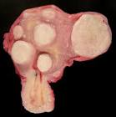
Pathology
Spherical, well circumscribed, white firm lesion with whorled appearance on cut section
Does not have true capsule… pseudocapsule.
Degenerative changes as the tumor enlarge
Hyaline degeneration ( Most common)
Cystic degeneration
Calcification ( After menopause)
Fatty degeneration ( Rare )
Red degeneration 5-10% during
pregnancy

Slide 26
Management
Relief of symptoms is the major goal in management
The type and timing of any intervention should be individualized, based upon the following factors:
Type and severity of symptoms
Size of the myoma(s)
Location of the myoma(s)
Patient age
Reproductive plans and obstetrical history

Slide 27
management
EXPECTANT
Can shrink substantially during the postpartum period,
Initial imaging study (usually an ultrasound) to confirm that a pelvic mass is a fibroid and not an ovarian mass.
Annual pelvic exams and, in patients with anemia or menorrhagia, check a complete blood count.
If symptoms or uterine size are increasing, we proceed with further evaluation and patient counseling regarding treatment options.
Rule out other causes of menorrhgea
Hypothyrodism.
Bleeding disorders.

Slide 28
management
Medical therapy
Gonadotropin-releasing hormone agonists
Most effective medical therapy for uterine myomas.
Work by initially increasing the release of gonadotropins, followed by desensitization and downregulation to a hypogonadotropic, hypogonadal state that clinically resembles menopause.
Most women will develop amenorrhea, improvement in anemia and a significant reduction (35 to 60 percent) in uterine size within three months of initiating this therapy.

Slide 29
management
GnRh agonist side effect
Rapid resumption of menses and pretreatment uterine volume after discontinuation of GnRH agonists.
Hot flashes, sleep disturbance, vaginal dryness, myalgias and arthralgias, and possible impairment of mood and cognition [15]. Bone loss leading to osteoporosis after long-term (12+ months) use is the most serious complication and most often limits therapy.

Slide 30
Used as preoperative therapy.
GnRH agonists are approved for administration for three to six months prior to leiomyoma-related surgery in conjunction with iron supplementation to facilitate the procedure and enable correction of anemia Reduction in uterine size can facilitate subsequent surgery by reducing intraoperative blood a transverse (rather than vertical) abdominal incision, or a minimally-invasive procedure

Slide 31
Gonadotropin-releasing hormone antagonists
Similar clinical results have been achieved with GnRH antagonists, which compete with endogenous GnRH for pituitary binding sites
The advantage of antagonists over agonists is the rapid onset of clinical effects without the characteristic initial flare-up observed with GnRH agonist treatment.

Slide 32
management
Interventional radiology
Uterine artery embolization
minimally invasive option for management of leiomyoma-related symptoms, excellent technical and clinical success has been reported.
It is an effective option for women who wish to preserve their uterus and are not interested in optimizing future fertility.
UFE results in shrinkage of myomas of approximately 30 to 46 percent

Slide 33
management
Magnetic resonance guided focused ultrasound
More recent option for the treatment of uterine leiomyomas in premenopausal women who have completed childbearing.
This noninvasive thermoablative technique converges multiple waves of ultrasound energy on a small volume of tissue, which leads to its thermal destruction

Slide 34
management
Surgical therapy
Myomectomy
Myomectomy is an option for women who have not completed childbearing or otherwise wish to retain their uterus.
Disadvantage of this procedure is the risk that more leiomyomas will develop from new clones of abnormal myocytes
Hysteroscopic myomectomy is the procedure of choice for removing intracavitary myomas

Slide 35
management
Surgical therapy
Hystrectomy
Women with acute hemorrhage who do not respond to other therapies
Women who have completed childbearing and have current or increased future risk of other diseases.
Women who have failed prior minimally invasive therapy for leiomyomas
Women who have completed childbearing and have significant symptoms, multiple leiomyomas, and a desire for a definitive end to symptomatology.

Slide 36
Endometrial cancer
Epidemiology
Most common gynecological cancer in the developed countries, with an incidence of 12.9 per 100,000 women and a mortality rate of 2.4 per 100,000.
In developing countries, it is the second most common gynecologic malignancy, with an incidence of 5.9 per 100,000 and a mortality rate of 1.7 per 100,000.
The average age of diagnosis of uterine cancer in the US is 61 years old
From ages 50 to 70, women have a 1.4% risk of being diagnosed with uterine cancer
Women in the US have a 2.6% lifetime risk of developing uterine cancer

Slide 37
Histological types
Two histologic categories:
Type I tumors include tumors of endometrioid histology that are grade 1 or 2; these comprise approximately 80 percent of endometrial carcinomas. These tumors typically have a favorable prognosis, are estrogen-responsive, and may be preceded by an intraepithelial neoplasm (atypical and/or complex endometrial hyperplasia).

Slide 38
Type II tumors
account for 10 to 20 percent of endometrial carcinomas. They include grade 3 endometrioid tumors & serous, clear cell, mucinous, squamous, transitional cell, mesonephric, and undifferentiated. These tumors are often high-grade, have a poor prognosis, and are not clearly associated with estrogen stimulation. A precursor lesion is rarely identified

Slide 39
Risk factors
Type I … estrogen dependent tumor
Exogenous estrogen
Tamoxifen
Unopposed systemic estrogen therapy
Postmenopausal estrogen therapy
Phytoestrogen
Endogenous estrogen
Chronic anovulation
Early menarche --- late menopause
Obesity
Estrogen secreting tumors

Slide 40
Risk factors
Family history and genetics predisposition
Lynch syndrome (hereditary nonpolyposis colorectal cancer)
Autosomal dominant caused by a germline mutation in one of several DNA mismatch repair genes
Develop the disease at a young age.
Accounts for two to five percent of all endometrial carcinomas.
Women with Lynch syndrome, the lifetime risk of endometrial carcinoma is 27 to 71 percent compared with 2.6 percent in the general population
Mean age of diagnosis of endometrial cancer 46-54yrs

Slide 41
BRCA I mutation
BRCA1 mutation carriers reported a significant increase in the risk of uterine cancer (RR 2.65, 95% CI 1.69-4.16).
Data from a prospective series suggested that the risk of endometrial carcinoma was significantly elevated only for BRCA mutation carriers taking tamoxifen

Slide 42
Associated factors
Nulliparity and infertility
The risk of endometrial carcinoma is inversely related to parity.
Nulliparity and infertility do not appear to independent risk factors for endometrial carcinoma; instead, the association is probably with the high frequency of anovulatory cycles in infertile women.
Data are inconsistent regarding whether ovulation induction for treatment of infertility is associated with an increased risk of endometrial carcinoma.

Slide 43
Diabetes and hypertension
Women with diabetes mellitus and hypertension are at increased risk for endometrial carcinoma.
Comorbid factors, primarily obesity, account for much of this risk, but some studies have found independent effects, as well.
The risk of developing endometrial carcinoma is higher in type 2 than type 1 diabetics. Diets high in carbohydrates and associated hyperinsulinemia, insulin resistance, and elevated levels of insulin-like growth factors may play a role in endometrial proliferation and development of endometrial carcinoma; this is an area of active investigation
,

Slide 44
Breast cancer
A history of breast cancer is a risk factor for development of endometrial carcinoma, clearly in women treated with tamoxifen

Slide 45
Protective factors
Hormonal contraceptives
The use of estrogen-progestin oral contraceptives (OCs) decreases the risk of endometrial carcinoma by 50 percent or higher
The benefit of hormonal contraceptives is likely due to the progestin component, which suppresses endometrial proliferation.
Studies have found that progestin-only contraceptives provide endometrial protection against development of endometrial neoplasia

Slide 46
Protective factors
Increasing age at last birth
Childbearing at an older age, independent of parity and other factors, was associated with a decreased risk of endometrial carcinoma. As an example, women who last gave birth at age 35 to 39 years had a 32 percent decrease in risk (95% CI 0.61-0.76).
Smoking
Cigarette smoking is associated with a decreased risk of developing endometrial carcinoma in postmenopausal women

Slide 47
Protective factors
Physical activity
Coffee and tea

Slide 48
Clinical presentation
Abnormal uterine bleeding
Suspicion of the presence of endometrial neoplasia (neoplastic endometrial hyperplasia or carcinoma) depends upon symptoms, age, and the presence of risk factors.
Abnormal uterine bleeding is present in approximately 75 to 90 percent of women with endometrial carcinoma
The amount of bleeding does not correlate with the risk of cancer.

Slide 49
Clinical manifestation
Postmenopausal women
Any bleeding, including spotting or staining. Three to 20 percent of women with postmenopausal bleeding are found to have endometrial carcinoma and another 5 to 15 percent have endometrial hyperplasia.
Age 45 to menopause
Any abnormal uterine bleeding, Among cases of endometrial carcinoma, 19 percent occur in women aged 45 to 54 years compared with 6 percent in those aged 35 to 44 years.
Younger than 45 years
Abnormal uterine bleeding that is persistent, occurs in the setting of a history of unopposed estrogen exposure (obesity, chronic anovulation) or failed medical management of the bleeding, or in women at high risk of endometrial cancer ( Lynch syndrome)

Slide 50
Clinical manifestation
Abnormal PAP smear..
Adenocarcinoma – Adenocarcinoma is sometimes seen on cervical cytology. Since the malignant cells may arise from either the cervix or endometrium, further evaluation with cervical and endometrial biopsy is required.
Atypical glandular cells - Atypical glandular cells detected by cervical cytology should be investigated with an endometrial (and endocervical) biopsy to determine whether an endometrial neoplasm is the cause.
Endometrial cells – The presence of endometrial cells on cervical cytology is reported in the results in women ≥40 years of age. The appearance of normal endometrial cells on cytology in asymptomatic premenopausal women is rarely associated with pathology and no further work-up is required.

Slide 51
Clinical manifestation
Incidental finding on imaging
A thickened endometrial lining is sometimes found incidentally on ultrasound, computed tomography (CT), or magnetic resonance imaging (MRI) performed for another indication.
Incidental finding at hysterectomy
Endometrial carcinoma or hyperplasia is sometimes discovered incidentally when hysterectomy is performed for benign disease.
Prior to hysterectomy, all women with abnormal uterine bleeding should have endometrial sampling

Slide 52
Work up

Slide 53
Work up
Endometrial sampling
Office endometrial biopsy,
Can be performed without anasthesia.
D&C in some women.
Cannot tolerate an office biopsy
Those with heavy bleeding (D&C is both a diagnostic and therapeutic procedure),
Hysteroscopy with D&C to ensure that focal lesions are identified and biopsied.

Slide 54
What about screening
Routine screening is not advisable except for women known with Lynch syndrome

Slide 55
management
Endometrial cancer is surgically staged disease
Further management depends on the stage
Basic surgery include
Total hystrectomy
Bilateral salpengo-oherectomy
Bilateral pelvic lymphadenectomy
Para-aortic lymphadenectomy
Omentectomy and peritoneal washing in type II

Slide 56
Preoperative work up
In endometrial biopsy
Tumor histology type
Tumor grade
Risk of lymph node involvement
G1 3% Pelvic… 2% aortic
G2 9% pelvic…5% aortic
G3 18% pelvic… 11% aortic

Slide 57
FIGO stage
Stage I
Tumor confined to the uterus
IA.. Less than 50% myometrial invasion
IB … more than 50% myometrial invasion
Stage II
Invading cervical stroma but does not extend beyond the uterus

Slide 58
figo
Stage III
Tumor extend beyond the uterus
IIIA… serosa of the uterus and or adnexa
IIIB …vagina or parametrial involvement
IIIc…lymph nodes
IIIc1 pelvic lymph nodes
IIIc2 para-aortic lymph nodes

Slide 59
figo
Stage IV
IVA… bladder or bowel mucosa
IVB… abdomial metastasis or inguinal lymphnode

Slide 60
When to give radiation
Types of radiation
External beam radiotherapy
Brachytherapy

Slide 61
Thank you
Karima salama

