Slide 1
Rh ISOIMMUNIZATION
Ghadeer Al-Shaikh, MD, FRCSC
Assistant Professor & Consultant
Obstetrics & Gynecology
Urogynecology & Pelvic Reconstructive Surgery
Department of Obstetrics & Gynecology
College of Medicine
King Saud University

Slide 2
Rh ISOIMMUNIZATION
Is an immunological disorder occurs in pregnant a Rh-ve mother carring Rh+ve fetus

Slide 3
Rh ISOIMMUNIZATION
It affects 1 in 250 live births in Europe and North America, it is much less frequent in other parts of the world such as Asia, where the Rh-negative blood group is uncommon.

Slide 4
Pathophysiology
The Rh antigen is limited to the red cell surface (Rh compex, C,D,E,c,e)

Slide 5
fetomaternal HAEMORRHAGE (fmH)
Rh isoimmunization can only take place if fetal red cells cross the placental barrier into the maternal circulation.
The placenta is subjected to maximal trauma during delivery
After abortion with a gestational age above 14 weeks
APH / trauma
External version
Amniocentesis
Complicated and difficult deliveries
Caesarean section

Slide 6
THE NATURAL HISTORY OF Rh IsoiMMUNIZATION
Rhesus antibodies are humoral antibodies or free antibody
IgM – large, unable to cross the placenta
1gG – small, able to cross the placeta and
Attach itself to Rh positive red cells
leading to haemolytic anaemia

Slide 7
IMMUNE RESPONSES ARE
a) Primary – first response to an antigen appears after several weeks and is IgM.
Secondary When exposed for the 2nd time a primed, antibody will appear within a few days and its IgG.
Generally, the quantity of antigen required to produce a secondary immune response is very much smaller than that required to initiate the primary immune response.

Slide 8
Pathophysiology
The first pregnancy is usually unaffected by RHD because FMH’s of sufficient magnitude to induce primary immunization do not usually take place until delivery.
Only about 5% of all Rh-negative mothers form antibodies.
Vast majority of FMH’s after delivery are small but about 0.2% of mothers have larger bleeds of 30 ml or more. The risk of Rh immunization is proportional to the size of the FMH.

Slide 9
ABO INCOMPATIBILITY
When the mother and the baby are ABO incompatible such as an O mother and an A baby any fetal red cell (Group A) entering the maternal circulation (Group O) is destroyed, in an exactly similar way to that occurring in an ABO incompatible blood transfusion.

Slide 10
PREGNANCY
FMH does occur during pregnancy but is much less common than following delivery. Most of the bleeds occur in the last trimester when the placenta is degenerating and the barrier may become a little more pervious.

Slide 11
The prevention of RHD
D-positive FMH’s can be neutralized by passively administered anti-D antibody (Rh immunoglobulin).
At 28 weeks
Post delivery
After abortion
APH / trauma
External version
Amniocentesis

Slide 12
FAILURE RATE:
About 1% of Rh-ve women become
immunized after D-positive pregnancies despite treatment with Rh immunoglobulin
Those already primed, even though overt antibody is undetectable by present techniques.
Large FMH’s before delivery e.g. epileptic or eclamptic patients.
Extreme sensitivity to the D-antigen: thus small bleeds will produce primary response.
Large FMHs after delivery more than the amount that can be taken care of by standard dose of immunoglobulin.
Failure to give the immunoglobulin – patients who slip through the net.

Slide 13
MANAGEMENT OF ISOIMMUNIZATION
Pregnancies complicated by clinically relevant isoimmunization are managed in centers with fetal medicine units and regional blood transfusion.

Slide 14
MANAGEMENT OF ISOIMMUNIZATION
a) Maternal blood group and antibody quantification
b) Paternal blood group genotyping
c) Fetal blood group genotyping
d) Ultrasound assessment
e) Amniotic fluid spectrophotometry
f) Fetal blood sampling
g) Fetal blood transfusion

Slide 15
MGT
Maternal blood group and antibody quantification at booking and 28 weeks if initial is –ve
Paternal blood group genotyping
Anti-D titer is not serous if below 1:16 and should be repeated every 2-4 weeks
If titer is above1:16 invasive testing:
Ultrasound assessment
Amniotic fluid spectrophotometry
Fetal blood sampling
Fetal blood transfusion

Slide 16
ULTRASOUND ASSESSMENT
The severely anemic fetus on scan will have: skin edema, ascites, pleural or pericardial effusions, cardiomegaly and an edematous placenta (Hydrops).
Middle cerebral artery blood flow is increased

Slide 17
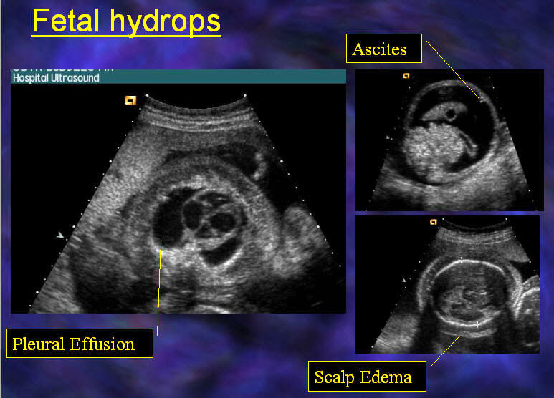

Slide 18
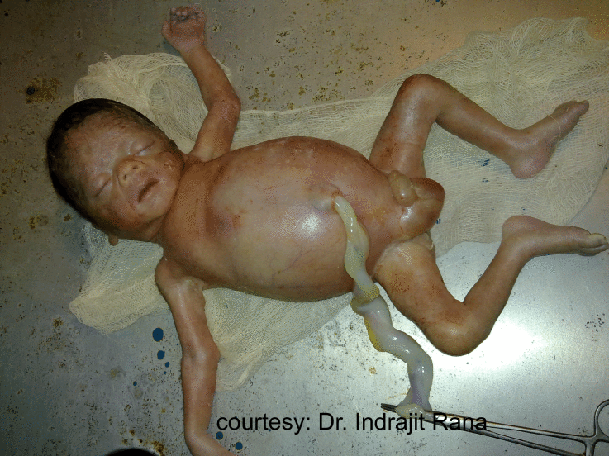

Slide 19
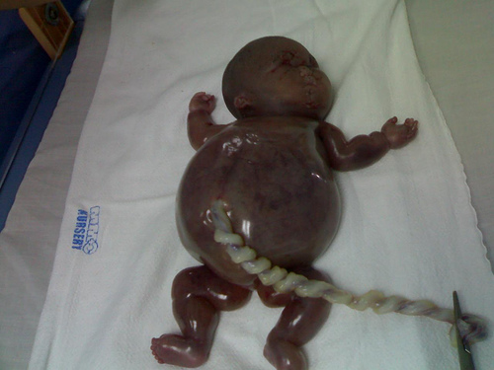

Slide 20
AMNIOCENTESIS AND AMNIOTIC FLUID ANALYSIS
When fetal heamolysis occurs the amniotic fluid becomes bright yellow from the bilirubin
Amniotic fluid bilirubin concentration can be quantified by spectrophotometry by assessing the change in optical density at 450nm ( OD 450)
Amniocentesis is started after 24 weeks under ultrasound guidance

Slide 21
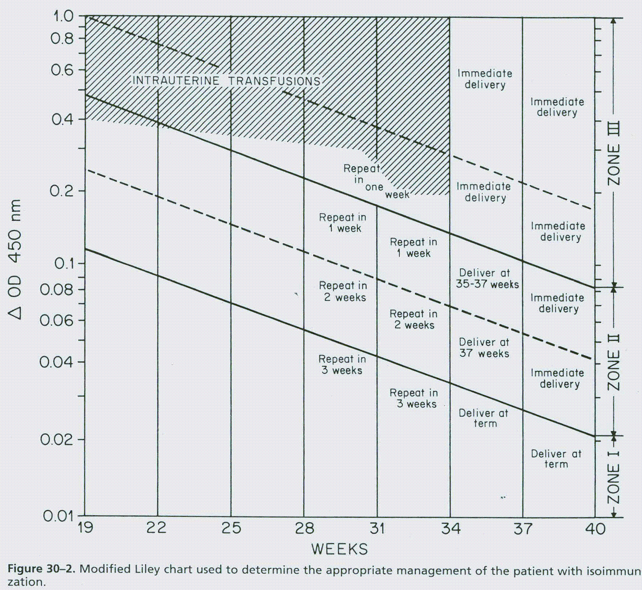

Slide 22
COMPLICATIONS FOLLOWING INTRAUTERINE TRANSFUSION
1. Premature labour
2. Pre-labour ruptured membrane
3. Fetal haemorrhage
4. Fetal bradycardia
5. Failure to obtain a sample
6. Increase in maternal Iso immunization by inducing feto-maternal haemorrhage

Slide 23
CTG
Fetal heart rate changes have been noted with severe anemia. A sinusoidal pattern with the loss of normal baseline variability of the CTG is highly suggestive of severe anaemia

Slide 24
Irregular Antibodies
2%
Kell, Duffy, Kidd….ext

Slide 25
Thank You!!!

