Slide 1
Orthopedic Emergencies: Compartment Syndrome & Acute Joint Dislocation
Original Lecture
Dr. Ahmad Bin Nasser MBBS, FRCSC
Assistant Professor
College of Medicine, KSU
Recent Editing done by
Dr.Munir Saadeddin FRCSEd
Associate Professor
College of Medicine, KSU

Slide 2
Objectives Compartment Syndrome
To explain the pathophysiology of CS.
To Identify patients at risk of developing CS.
To be able to diagnose and initially manage patients with CS.
To be able to describe the possible complications of CS.

Slide 3
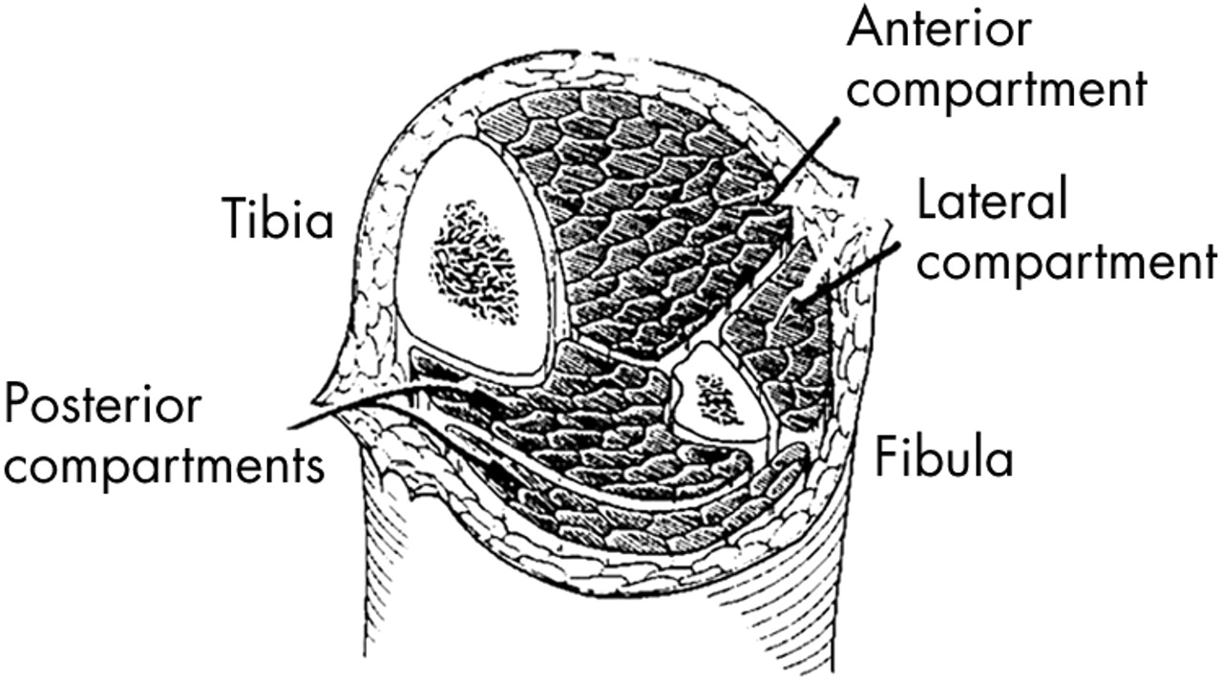
Compartment Syndrome
What is a compartment?
مقصورة, غرفة ضيقة,جزء مستقل, حيز
Dictionary: A part or a space marked or partitioned off.
At leg there are : Anterior compartment, Lateral compartment, Posterior compartment: (superficial and deep.)

Slide 4
Blood Flow in the Tissues
The normal blood flow:
Artery>arteriol>capillary bed (diffusion/exchange) >
venule> vein

Slide 5
Normal Blood Pressure
Normal Systolic pressure: 110-130 mm Hg
Normal Diastolic pressure: 60-85 mm Hg

Slide 6
Blood pressure gradient in the tissues
What is the tissue pressure normally?
Compartment pressure should be less than Diastolic pressure by 30 mm Hg.

Slide 7
Compartment Syndrome
Compartment syndrome develops when there is excessive increase at local tissue pressure in a closed compartment.
This will lead to prevention of blood and the oxygen which it is carrying from reaching the local tissues.
This happens when there is:
Less than 30 mm Hg difference between compartment pressure and diastolic pressure (clinically relevant)
Threshold pressure:
30 mm Hg (rigid)

Slide 8
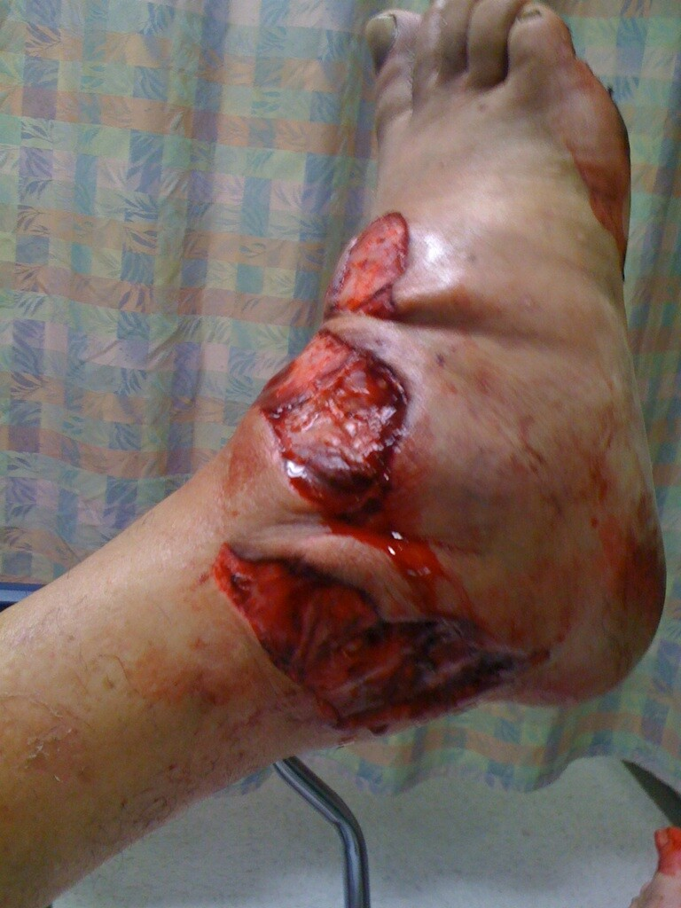
Compartment Syndrome
Pathophysiology:
Risk factors should be considered
Elevated tissue pressure
Absence of diffusion at the capillary
bed
Cell damage and swelling
Further increase in tissue pressure
Lack of oxygenation
Vicious circle

Slide 9
Compartment Syndrome
Risk factors (local):
Trauma, crush, fracture (open/closed)
Injection
Bleeding
Prolonged vascular occlusion (reperfusion injury)
Burns
Venomous bite
Intra-osseous fluid replacement
IV fluid extravasation
Tight bandage
Post surgery

Slide 10
Compartment Syndrome
Risk factors (general):
Head injury
Decreased conciseness
Late diagnosis
Hypotension

Slide 11
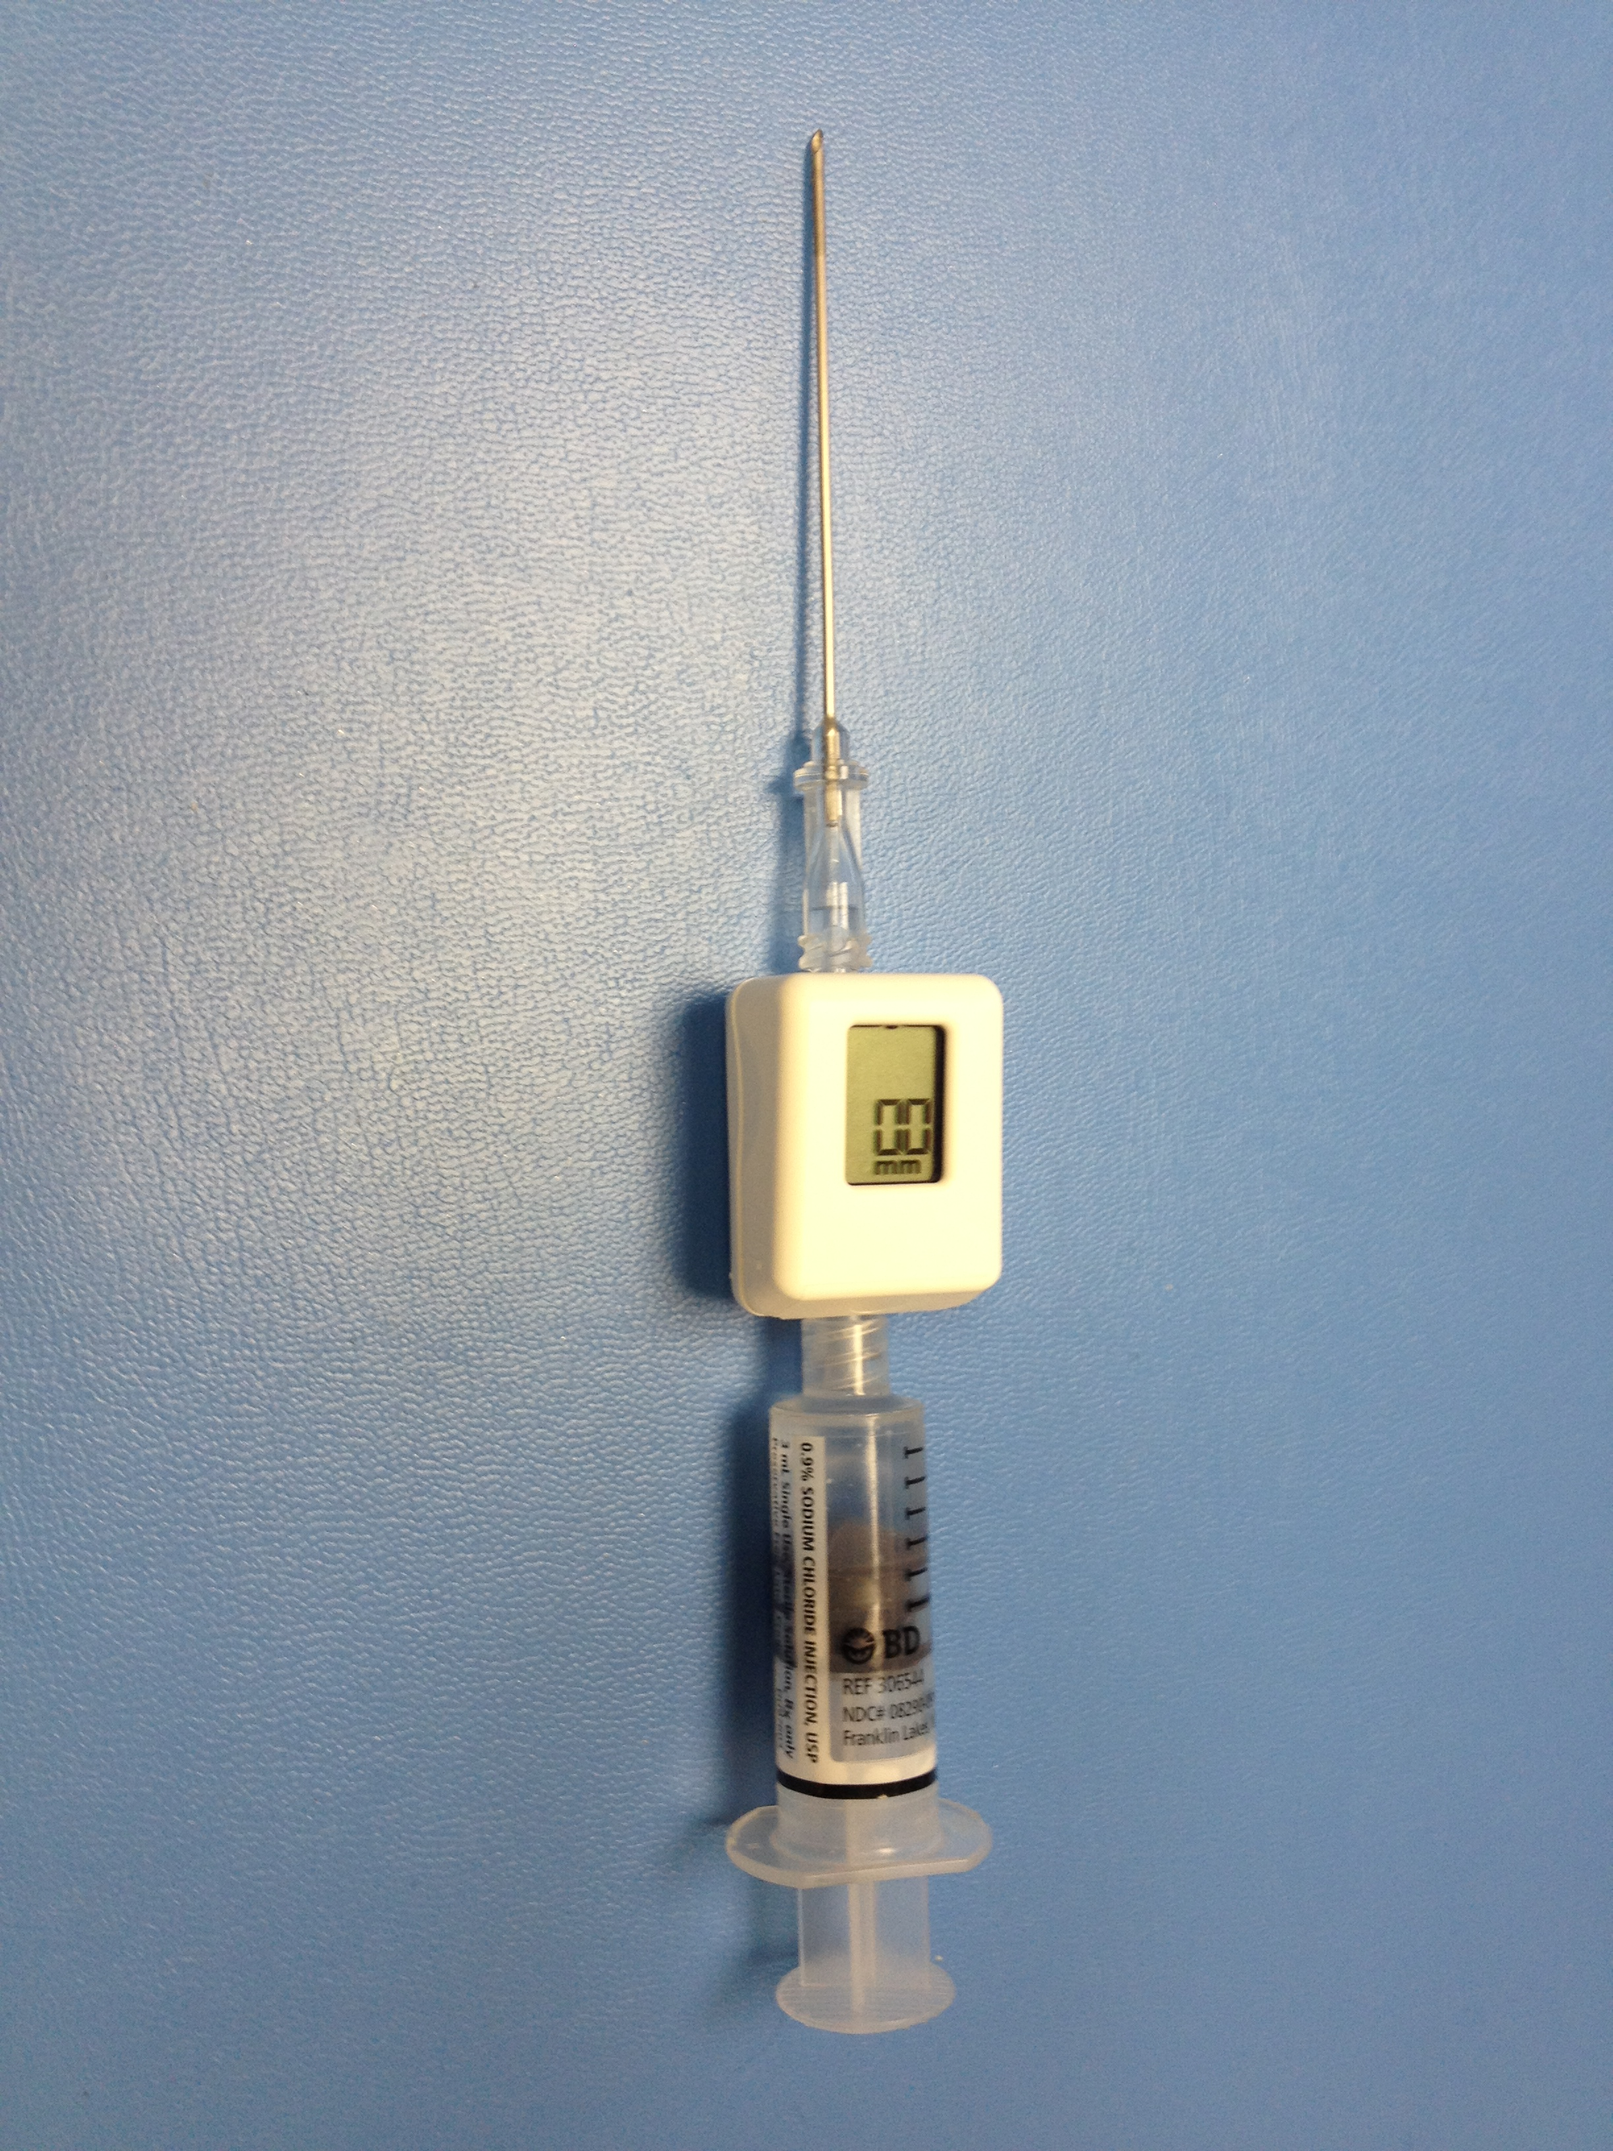
Compartment Syndrome
Diagnosis:
Early:
Pain!!!
Pain increase with stretching the involved compartment
Presence of risk factor
High index of suspicion
Measurement of compartment pressure is high

Slide 12
Compartment Syndrome
Diagnosis:
Late:
Pallor
Paresthesia
Paralysis
Severely high local pressure:
Pulselessness (RARE!)

Slide 13
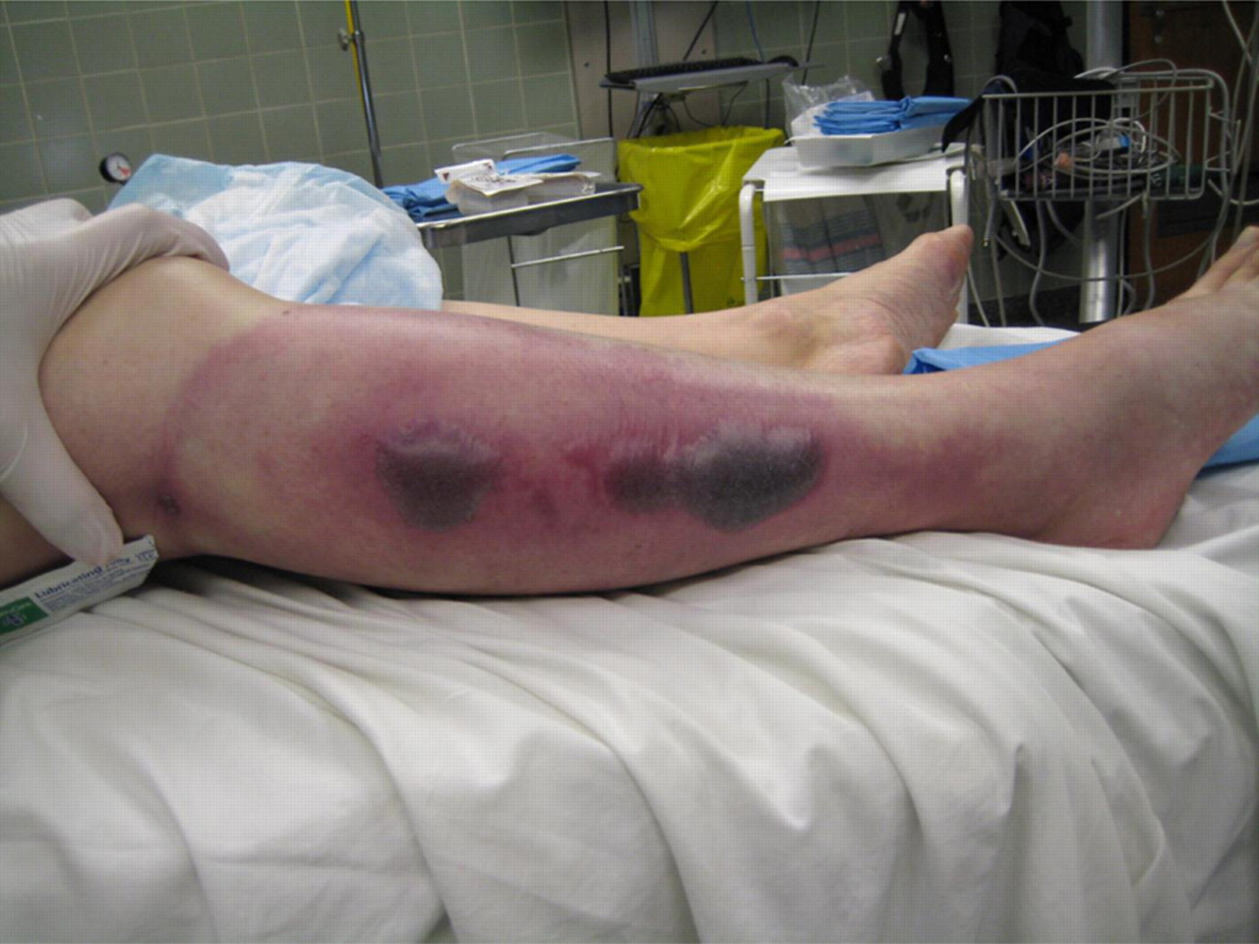
Compartment Syndrome
Diagnosis:
Tight, woody compartment
Tender compartment
Measurement:
Rarely necessary
Must be done at area of highest expected pressure
May give false low result

Slide 14
Compartment Syndrome
Management:
Initial (undeveloped CS):
Maintain normal blood pressure
Remove any constricting bandage
Keep limb at heart level
Regular close monitoring (15-30 minute intervals)
Avoid nerve blocks, sedation and strong analgesia to obtain patients feed back

Slide 15
Compartment Syndrome
Management:
Fully developed CS
Maintain normal blood pressure
Remove any constricting bandage
Keep limb at heart level
Diuresis to avoid kidney tubular injury if late
Urgent surgical decompression (Fasciotomy)

Slide 16
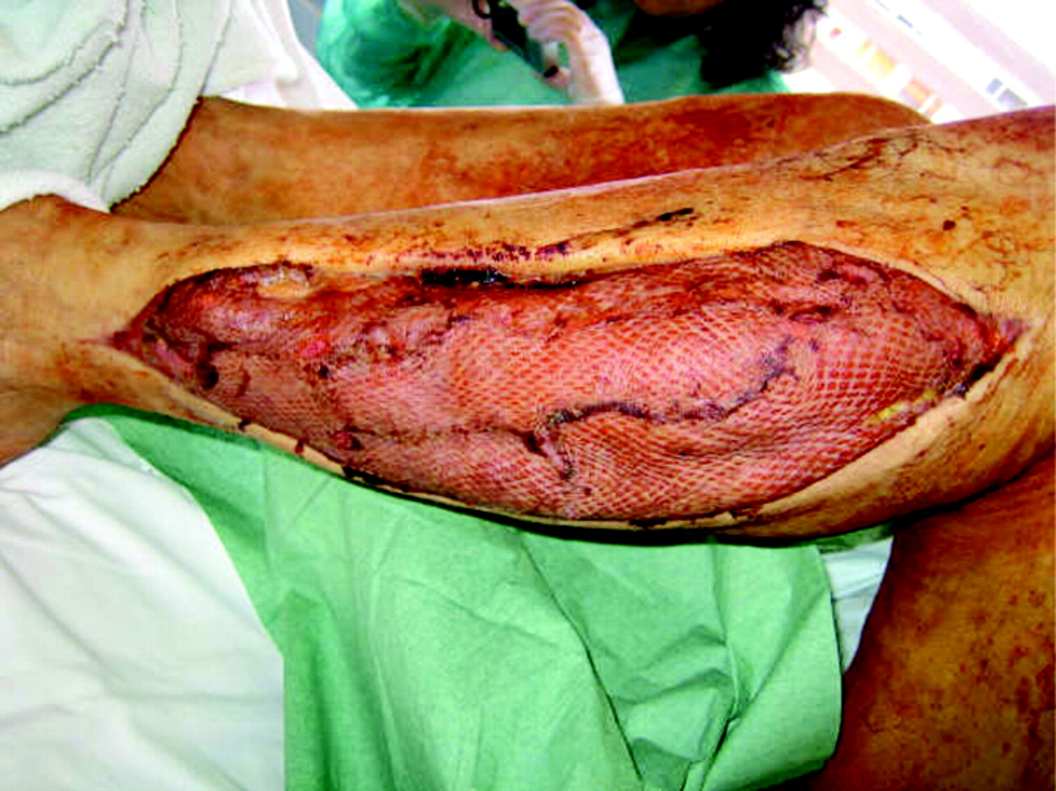
Compartment Syndrome
Fasciotomy:
Releasing the compartment fascia
Allows swollen muscles to expand in volume
Results in decreased compartment pressure
Avoids further damage
Does not reverse already occurred damage
Ideally should be done as soon as diagnosis is made

Slide 17
Compartment Syndrome
Fasciotomy:
Should be done as long as there is still viable tissue
Should not be done if there is no expected viable tissue, Otherwise infection is likely
. Debridement of all necrotic tissue is necessary
Second and third look surgeries are often required
Closure of skin is usually achieved after swelling has subsided
Skin grafting is often required

Slide 18
Compartment Syndrome
Fasciotomy:
Indications:
6 hours of total ischemia time (ex: arterial embolism)
Significant tissue injury
Worsening initial clinical picture
Delayed presentation with a picture of developed CS
Absolute Compartment pressure >30 mmHg or <30 mm Hg difference from diastolic pressure

Slide 19
Compartment Syndrome
Fasciotomy:
Is a prophylactic procedure
Does not reverse injury to permanently damaged tissue
so better to have a low threshold!

Slide 20
Compartment Syndrome
Complications:
Myonecrosis> myoglobenemia>myoglobinuria> kidney tubular damage
2.Loss of function of the involved compartment:
Flexion contracture.
Paralysis.
Loss of sensation.

Slide 21
Compartment Syndrome
Complications:
Leg:
Anterior compartment:
Drop foot
Deep posterior compartment:
Clowed toes
Loss of sensation in the sole
Forearm:
Volar compartment:Acute Volkman’s ischemia.
Volkman’s contracture: long ischemia results in fibrosis of flexor muscles of forearm= shorter muscle

Slide 22
Volkman’s contacture

Slide 23
Volkman’s contracture

Slide 25
Acute Joint Dislocation
Objectives:
To describe mechanisms of joint stability
To be able diagnose patients with a possible acute joint dislocation
to be able to describe general principles of managing a patient with a dislocated joint
to describe possible complications of joint dislocations in general and in major joints such as the shoulder, hip and knee

Slide 26
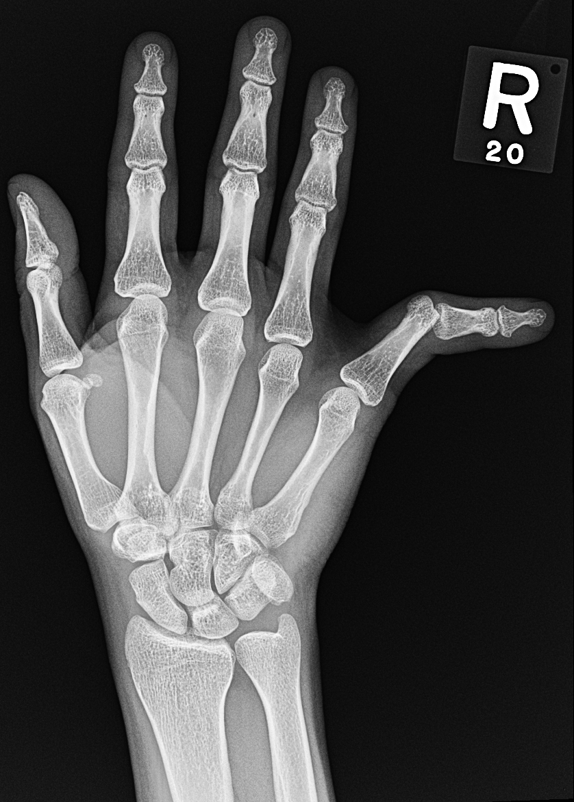
Acute Joint Dislocation
Joint stability:
Bony stability
Shape of the joint (ball and socket vs round on flat)
Soft Tissue :
Dynamic stabilizer: Tendons/Muscles
Static stabilizer: Ligaments ± meniscus/labrum
Complex synergy leading to a FUNCTIONAL and STABLE joint

Slide 27
Acute Joint Dislocation
It takes higher energy to dislocate a joint with bony stability than a joint with mainly soft tissue stability
Connective tissue disorders may lead to increased joint instability due to abnormal soft tissue stabilizers.
Dislocation of a major joint should lead to considering other injuries.

Slide 28
Acute Joint Dislocation
At risk group:
Major trauma victims
Athletes and sport enthusiasts
Connective tissue disorder patients

Slide 29
Acute Joint Dislocation
When a joint is subjected to sufficient force in certain directions it might sustain a fracture, a dislocation or a fracture dislocation
Different joints have different force victors that may lead to a dislocation
A joint might dislocate in different directions

Slide 30
Acute Joint Dislocation
A joint dislocation is described by stating the location of the distal segment
Anterior shoulder dislocation: anterior displacement of the humeral head relative to the glenoid
Posterior hip dislocation: posterior displacement of the femoral head relative to the acetabulum

Slide 31
Anterior Shoulder dislocation
Usually also inferior
There is damage ( Overstretching ) to the shoulder capsule and subscapularis muscle
Commonly there is avulsion to the antero inferior part of the Glenoid labrum with adjacent periosteom on the neck of scapula = Bankart’s Lesion

Slide 32
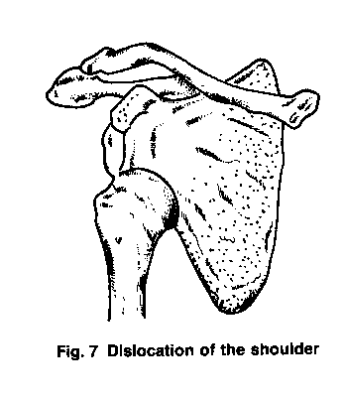
Dislocations
Complete separation of the articular surface
Distal to proximal fragment
Anterior, Posterior, Inferior, Superior.
Acute dislocation may be complicated by neurovascular injury.
Acute dislocations require urgent reduction

Slide 33
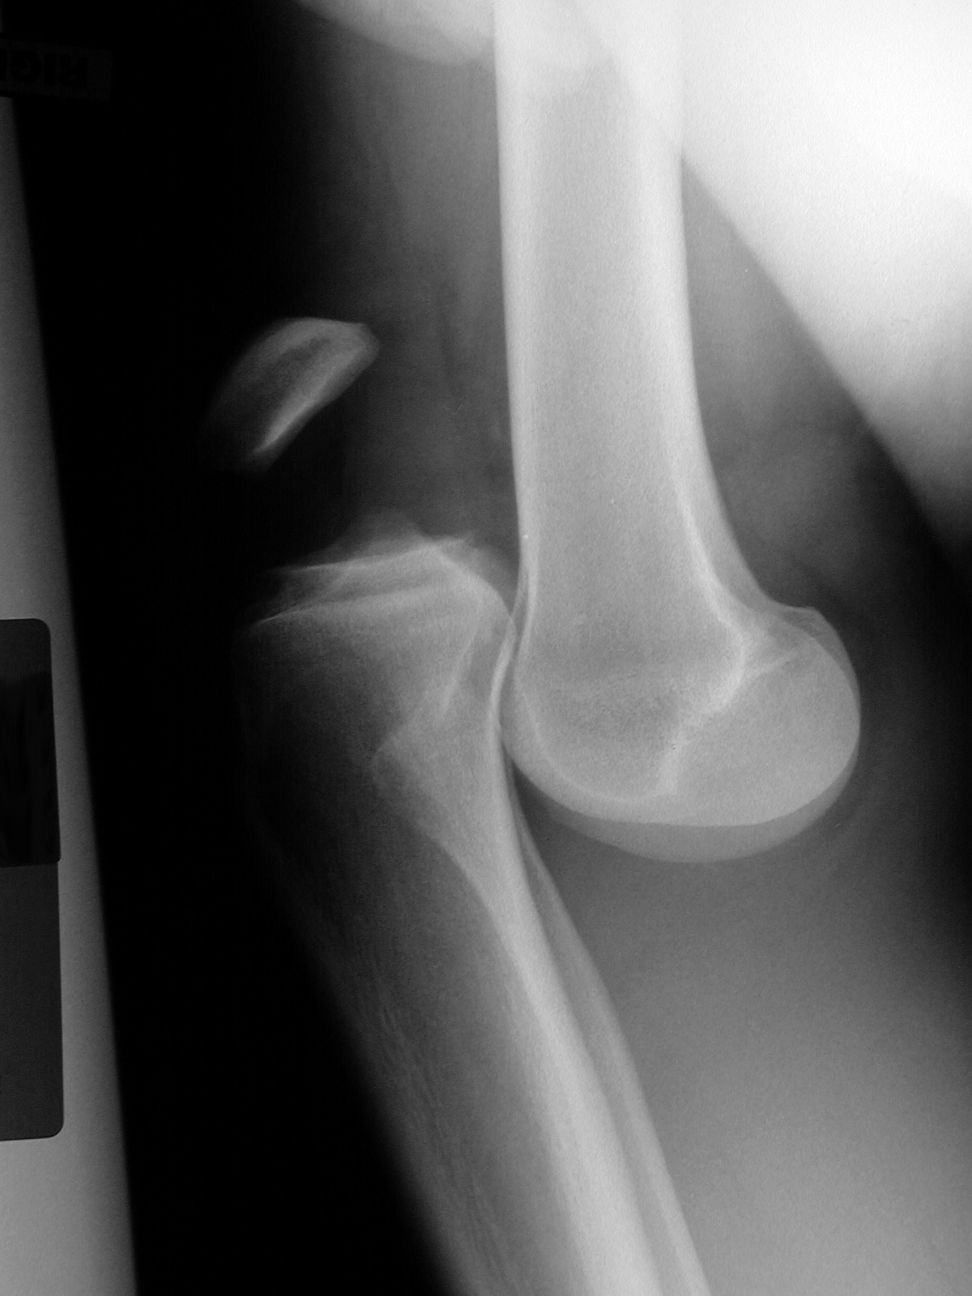
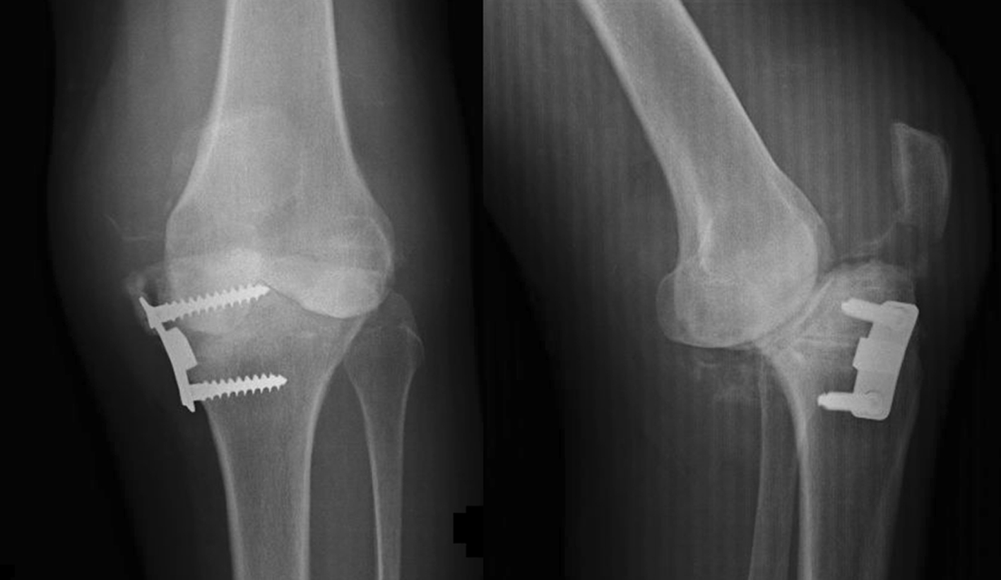
Acute Joint Dislocation
Dislocation:
Total loss of contact between the articular surfaces of the joint
Sublaxation:
partial loss of contact between the articular surfaces of the joint
Acute joint dislocation
Chronic joint dislocation

Slide 34
Acute Joint Dislocation
Diagnosis:
History of a traumatic event ( major trauma or any trauma with the limb in high risk position)
Pain and inability to use the limb
Deformity
Shortening
Malalignment
Malrotation

Slide 35
Clinical Picture
Patient is in pain
Holds the injured limb with other hand close to the trunk
The shoulder is abducted and the elbow is kept flexed
There is loss of the normal contour of the shoulder

Slide 36
Acute Joint Dislocation
Diagnosis:
Should check for other injuries (distracting injury)
Should always check the distal neurovascular status.
Should check for compartment syndrome

Slide 37
Clinical Picture
Loss of the contour of the shoulder may appear as a step
Anterior bulge of head of humerus may be visible or palpable
A gap can be palpated above the dislocated head of the humerus

Slide 38
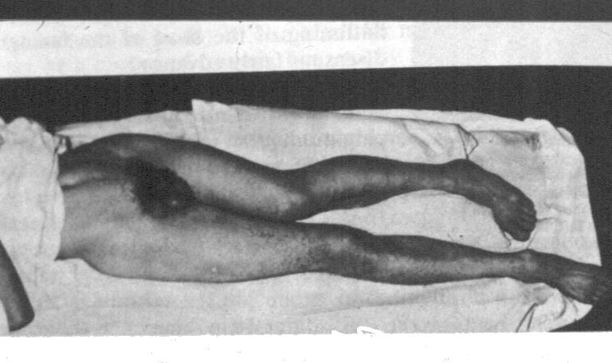
Posterior Hip dislocation: Clinical Picture

Slide 39
Axillary or circumflex nerve injury

Slide 40
Acute Joint Dislocation
Diagnosis:
X-rays:
Should be done urgently without delay if dislocation is suspected
Two perpendicular views of the involved joint
Occasionally, special views are required such as the axillary view for shoulder dislocation
X-rays to the joint above and below

Slide 41
X Ray anterior Dislocation of Shoulder

Slide 42
Acute Joint Dislocation
Management principles:
Must rule out other injuries
Pain relief
Urgent reduction
Check stability and safety zone
Check neurovascular status after reduction
X-rays after reduction
Protect the joint
Rehabilitation
Follow for late complications

Slide 43
Acute Joint Dislocation
Reduction:
Monitor vitals
IV analgesia (opiod)
IV sedation (to relax the muscles)
Gradual traction to distract the joint
Realignment and rotation to reduce the joint based on direction of dislocation
A palpable clunk well be felt
Check ROM and stability of the joint

Slide 44
Acute Joint Dislocation
Reduction:
Once joint is felt to be reduced, check distal NV status
If it was intact before but not after, further urgent management is needed
If it was not present before but intact after, check again later to confirm
Observe patients vitals until medications wear out
Stabilize joint and get X-rays

Slide 45
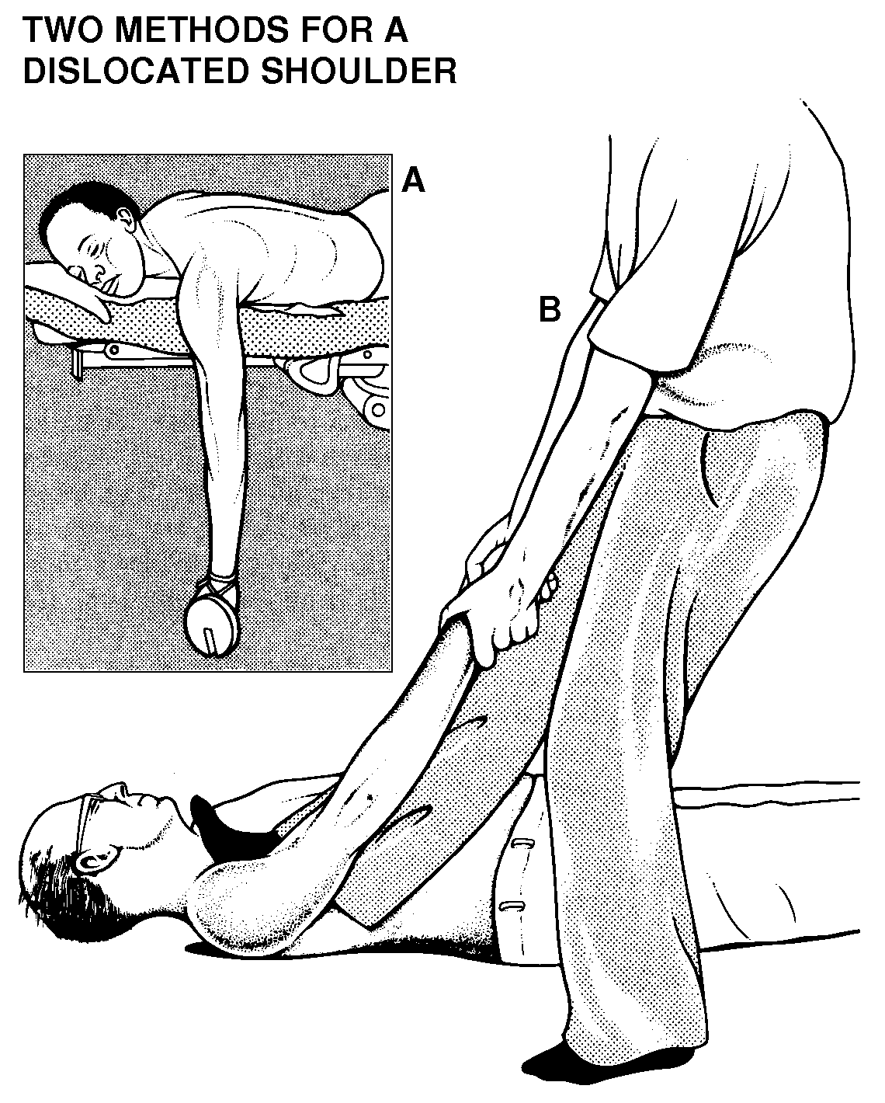
If irreducible or partial reduction only
Urgent closed reduction under general anesthesia and possible open reduction if closed reduction fails
Usually due to
insufficient muscle relaxation
Entrapment of soft tissue

Slide 46
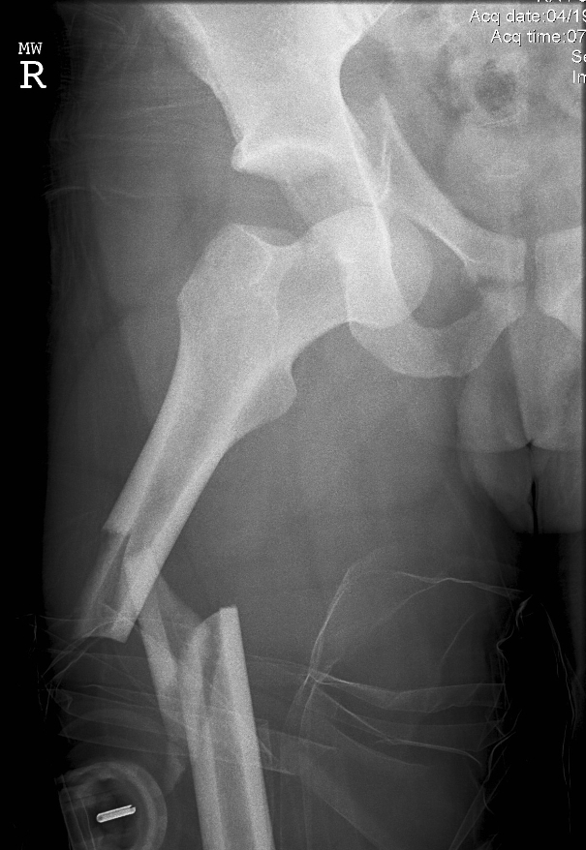
Acute Joint Dislocation
Special considerations:
A fracture dislocation is usually reduced in an open fashion in the operating room
Must confirm concentric reduction on the x-rays, otherwise an open reduction should be performed

Slide 47
Acute Joint Dislocation
Early Complications:
Neurological injury (reversible or irreversible).
Vascular injury.
Compartment syndrome.
Osteochondral fracture/injury.
Heterotopic calcification or ossification.( in the past diagnosed as Myositis Ossificance.

Slide 48
Acute Joint Dislocation
Late complications:
Stiffness
Heterotopic ossification
Chronic instability
Avascular necrosis
Osteoarthritis

Slide 49
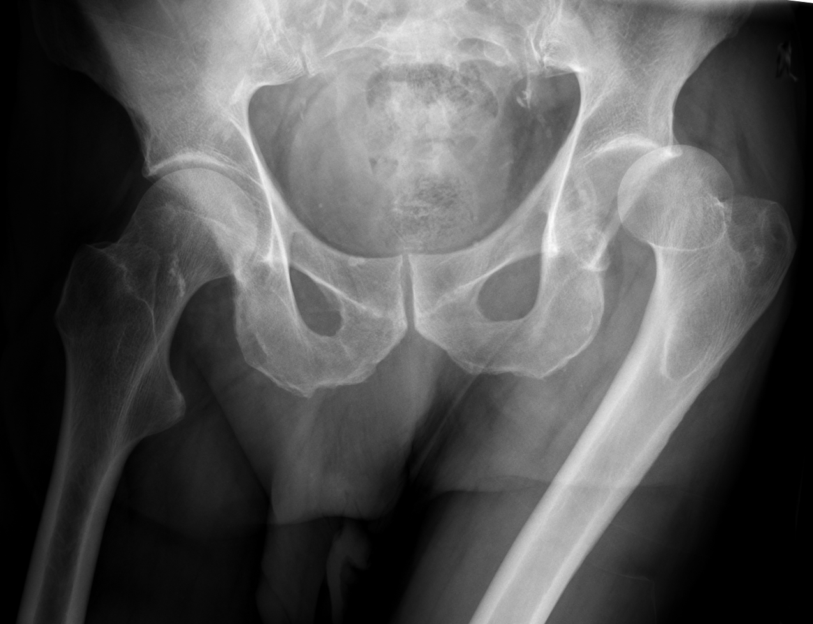
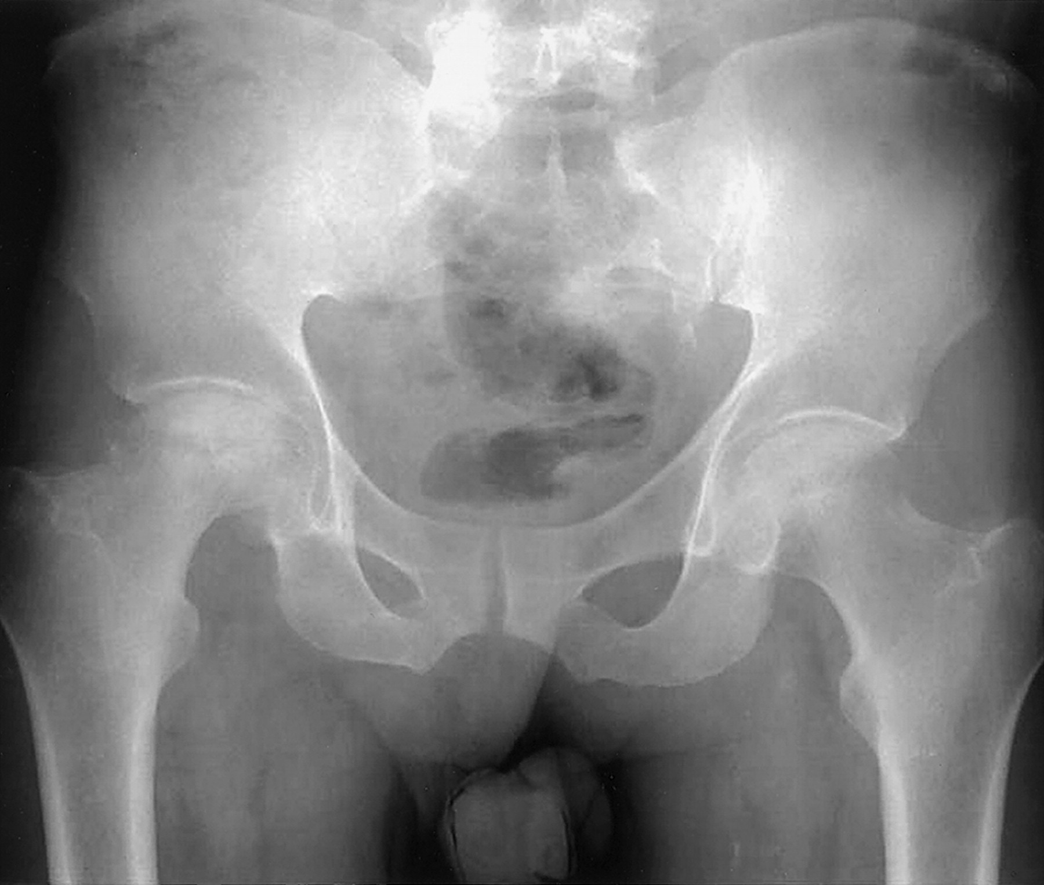
Acute Joint Dislocation
Special considerations:
Hip joint:
Posterior dislocation is commonest
Major trauma with hip flexed (dashboard injury)
Sciatic nerve injury common
High incidence of late avascular necrosis
An orthopedic emergency!!

Slide 50
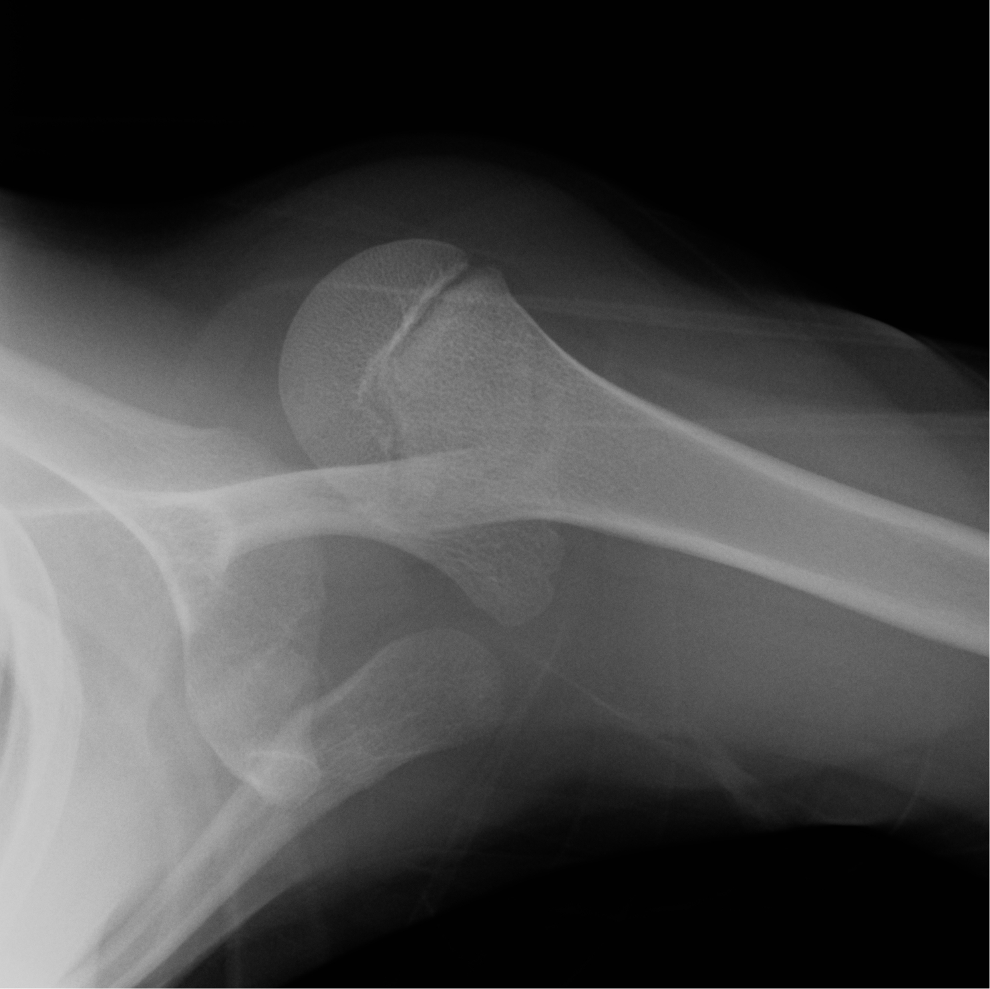
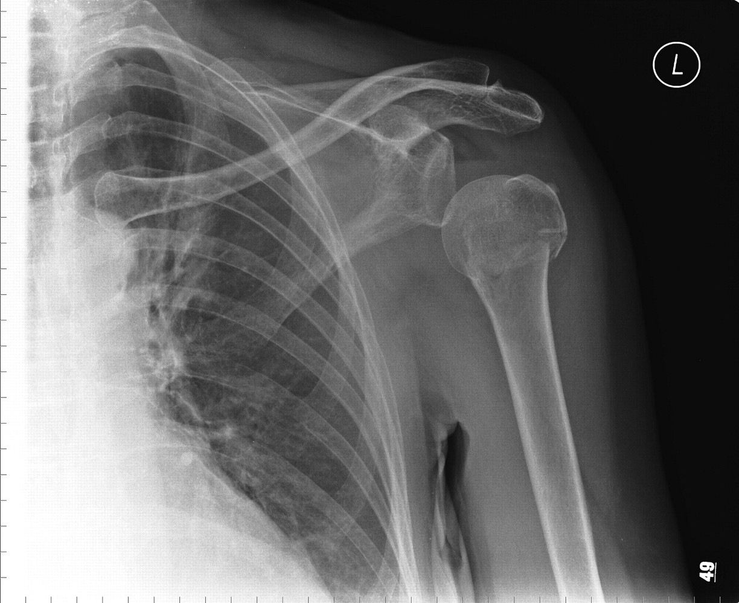
Acute Joint Dislocation
Special considerations:
Shoulder dislocation:
common
Anterior dislocation is more common
Patients with seizures prone to posterior dislocation
May cause chronic instability
Can result in axillary nerve injury

Slide 51
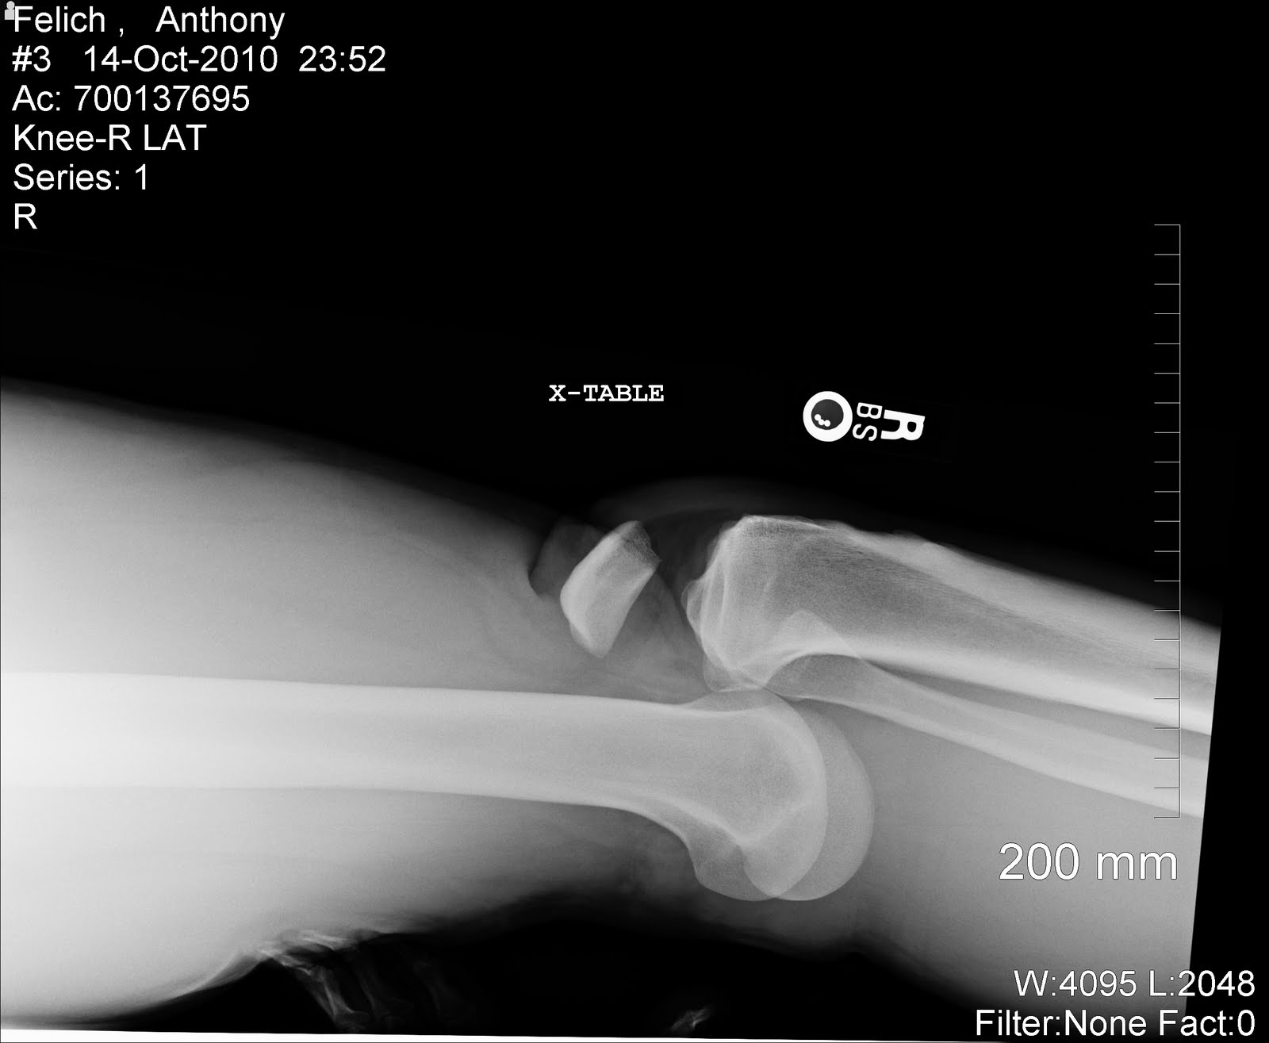
Acute Joint Dislocation: Knee
Special considerations:
Three or more ligaments are damaged
Severe (high energy) trauma
Very serious emergency
Needs accurate vascular assessment May be associated with popletial artery injury---- Limb threatening
May be associate with peroneal nerve injury
May be associated with fracture/ compartment syndrome
Most require surgery either early or late or both

Slide 52
Post-Dislocation Arteriogram

Slide 53
Management of complications
Vascular injury requires immediate attention by vascular surgeon.
Post-reduction Nerve Conduction Studies( NCS) determines the need to do popliteal nerve exploration later.
Management of associated fracture should be carried out after reduction.

