Slide 1
Common Pediatric Fractures and Trauma
Prof. Mohamed Zamzam
Professor and Consultant Pediatric Orthopedic Surgeon

Slide 2
Introduction
Fractures account for ~15% of all injuries in children
Different from adult fractures
Vary in various age groups
( Infants, children, adolescents )

Slide 3
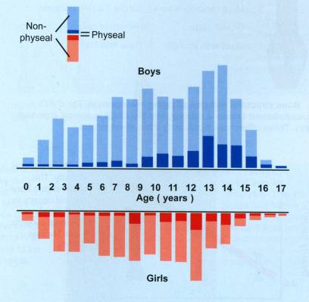
Statistics
Boys > girls
Rate increases with age
Mizulta, 1987

Slide 4
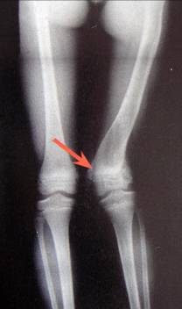
Why are children’s fractures different?
Children have different physiology and anatomy
Growth plate:
Provides perfect remodeling power
Injury of growth plate causes deformity
A fracture might lead to overgrowth

Slide 5
Why are children’s fractures different?
Bone:
Increased collagen : bone ratio
Less brittle
Deformation

Slide 6
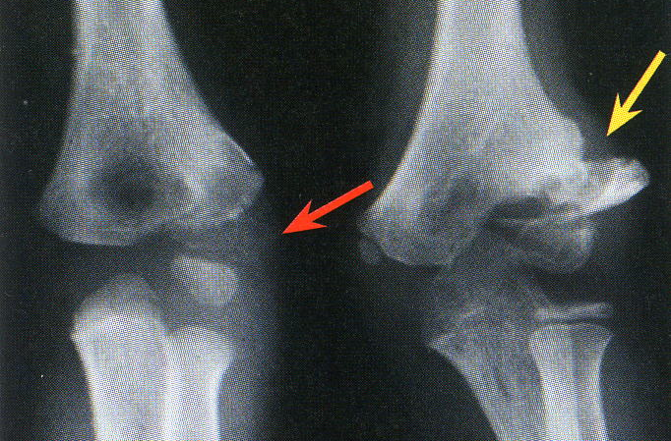
Why are children’s fractures different?
Cartilage:
Difficult x-ray evaluation
Size of articular fragment often under-estimated

Slide 7
Why are children’s fractures different?
Periosteum:
Metabolically active
More callus, rapid union, increased remodeling
Thickness and strength
Intact periosteal hinge affects fracture pattern
May help reduction

Slide 8
Why are children’s fractures different?
Ligaments:
ligaments in children are functionally stronger than bone. Therefore, a higher proportion of injuries that produce sprains in adults result in fractures in children.

Slide 9
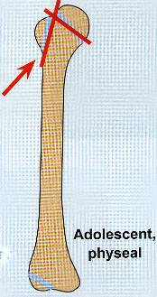
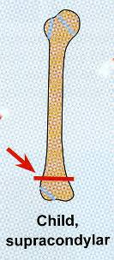
Why are children’s fractures different?
Age related fracture pattern:
Infants: diaphyseal fractures
Children: metaphyseal fractures
Adolescents: epiphyseal injuries

Slide 10
Why are children’s fractures different?
Physiology
Better blood supply
rare incidence of delayed and non-union

Slide 11
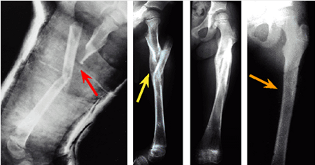
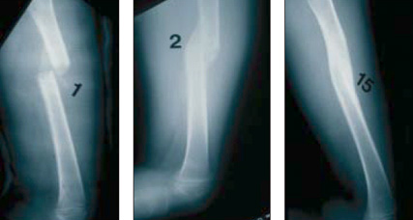

Slide 12
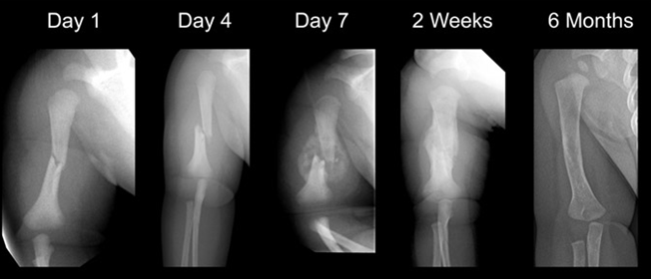

Slide 13
Physeal injuries
Account for ~25% of all children’s fractures.
More in boys.
More in upper limb.
Most heal well rapidly with good remodeling.
Growth may be affected.

Slide 14
Physeal injuries
Classification:
Salter-Harris
Rang’s type VI
Peterson
Ogden

Slide 15
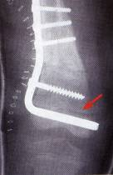
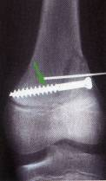
Physeal injuries
Less than 1% cause physeal bridging affecting growth.
Small bridges (<10%) may lyse spontaneously.
Central bridges more likely to lyse.
Peripheral bridges more likely to cause deformity
Avoid injury to physis during fixation.
Monitor growth over a long period.
Image suspected physeal bar (CT, MRI)

Slide 16
General Management
Indications for surgery
Head injury
Multiple injuries
Open fractures
Displaced intra articular fractures (Salter-Harris III-IV)
Adolescence
Failure of conservative means (irreducible or unstable fractures)
Severe soft-tissue injury or fractures with vascular injury
Neurological disorder
Malunion and delayed union
?Compartment syndrome

Slide 17
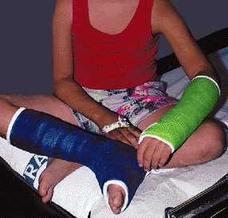
Methods of Fixation
Casting
Still the commonest

Slide 18
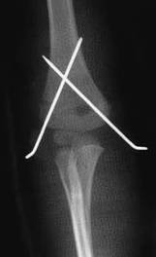
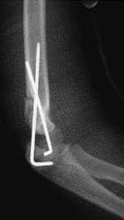
Methods of Fixation
K-wires
Most commonly used IF
Metaphyseal fractures

Slide 19
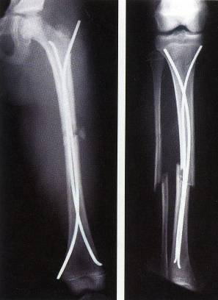
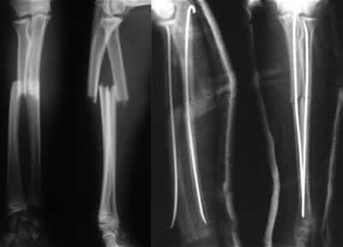
Methods of Fixation
Intramedullary wires, elastic nails

Slide 20
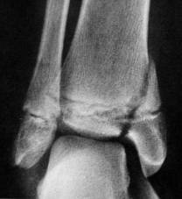
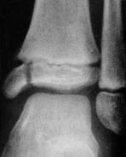
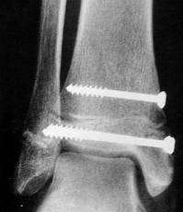
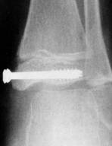
Methods of Fixation
Screws

Slide 21
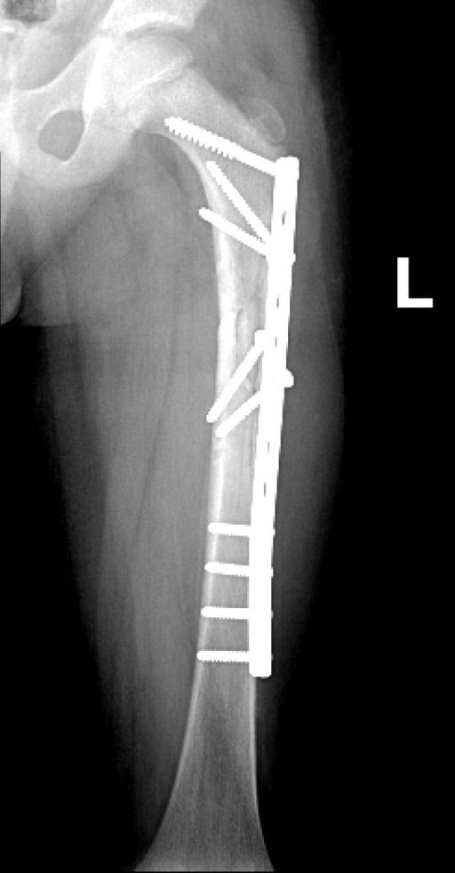
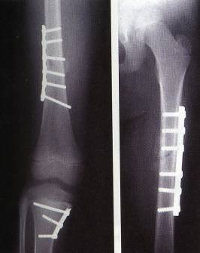
Methods of Fixation
Plates – multiple trauma

Slide 22
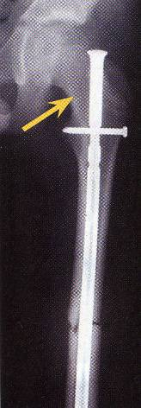
Methods of Fixation
IMN - adolescents

Slide 23
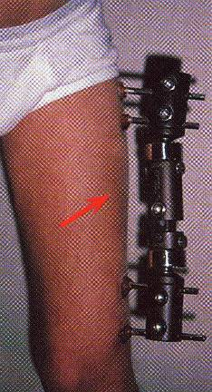
Methods of Fixation
Ex-fix – usually in open fractures

Slide 24
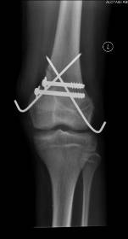
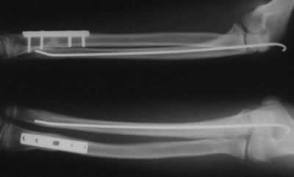
Methods of fixation
Combination

Slide 25
Common Pediatric Fractures
Upper limb
a. Clavicle .
b. Supracondylar Fracture.
c. Distal Radius .
Lower Limbs
a. Femur fractures

Slide 26
Fracture Clavicle
8-15% of all pediatric fractures
0.5% of normal deliveries and in 1.6% of breech deliveries
90% of obstetric fractures
80% of clavicle fractures occur in the shaft
The periosteal sleeve always remains in the anatomic position. Therefore, remodeling is ensured.

Slide 27
Fracture Clavicle
Mechanism of Injury:
Indirect: Fall onto an outstretched hand
Direct: This is the most common mechanism, it carries the highest incidence of injury to the underlying neurovascular and pulmonary structures
Birth injury

Slide 28
Fracture Clavicle
Clinical Evaluation:
Painful palpable mass along the clavicle
Tenderness, crepitus, and ecchymosis
May be associated with neurovascular injury
Pulmonary status must be assessed.

Slide 29
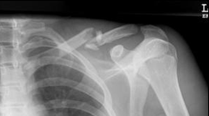
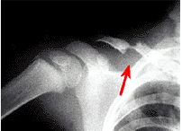
Fracture Clavicle
Radiographic Evaluation:
AP view

Slide 30
Fracture Clavicle
Classification:
Location
Open or closed
Displacement
Fracture type
segmental, comminuted, greenstick

Slide 31
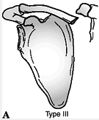
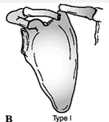
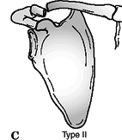
Fracture Clavicle
Allman classification:
Type I: Medial third
Type II: Middle third (most common)
Type III: Lateral third

Slide 32
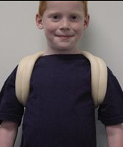
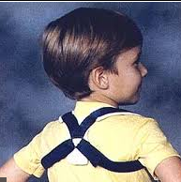
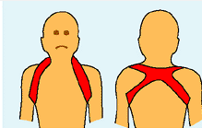
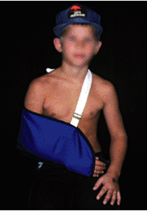
Fracture Clavicle
Treatment:
Newborn:
unite in 1 week
Up to 2 years:
figure-of-eight for 2 weeks
Age 2-12 Years:
A figure-of-eight or sling for 2-4 weeks

Slide 33
Fracture Clavicle

Slide 34
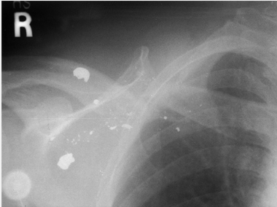
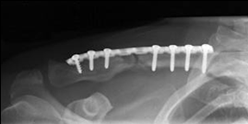
Fracture Clavicle
Indications of operative treatment:
Open fractures
Neurovascular compromise

Slide 35
Fracture Clavicle
Complications: Rare
Neurovascular compromise
Malunion
Nonunion
Pulmonary injury

Slide 36
Supracondylar Humeral Fracture
55-75% of all elbow fractures
The male-to-female ratio is 3:2
5 to 8 years
The left, or nondominant side, is most frequently injured

Slide 37
Supracondylar Humeral Fracture
Mechanism of Injury:
Indirect
Extension type >95%
Direct
Flexion type < 3%

Slide 38
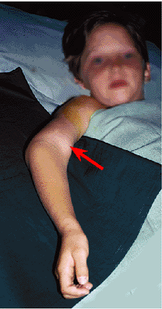
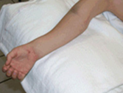
Supracondylar Humeral Fracture
Clinical Evaluation:
Swollen, tender elbow with painful ROM
S-shaped angulation
Pucker sign (dimpling of the skin anteriorly )
Neurovascular examination

Slide 39
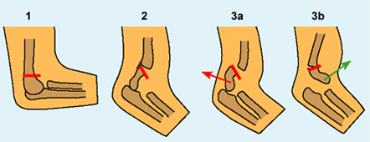
Supracondylar Humeral Fracture Classification (Gartland)
Complete displacement (extension type) may be posteromedial (75%) or posterolateral (25%)

Slide 40
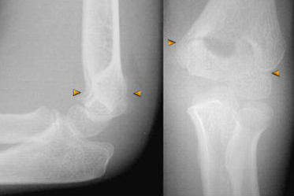
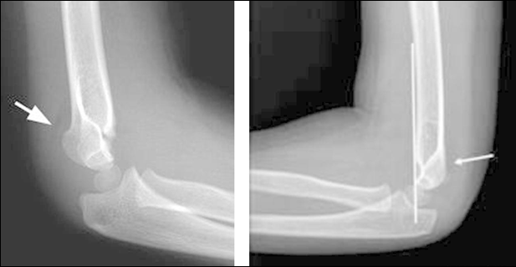
Type 1

Slide 41
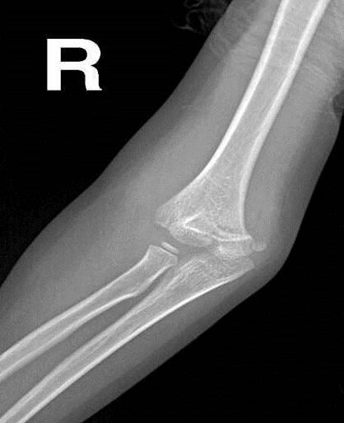
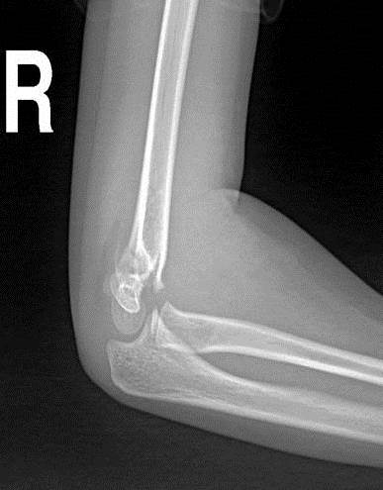
Type 2

Slide 42
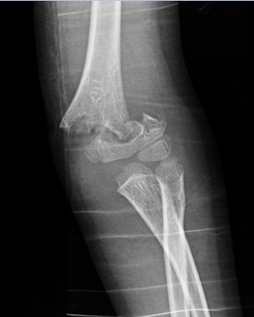
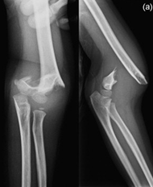
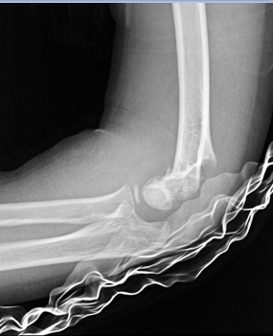
Type 3
Flexion type
Extension type

Slide 43
Supracondylar Humeral Fracture Treatment of extension type
Type I:
Immobilization in a long arm cast or splint at 60 to 90 degrees of flexion for 2 to 3 weeks
Type II:
Closed reduction followed by casting or pinning if unstable or sever swelling

Slide 44
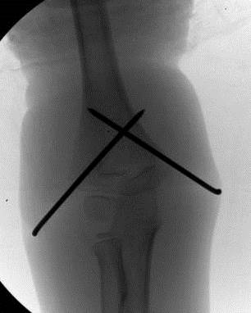
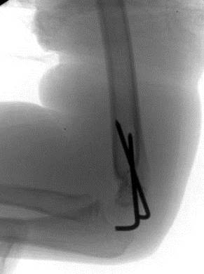
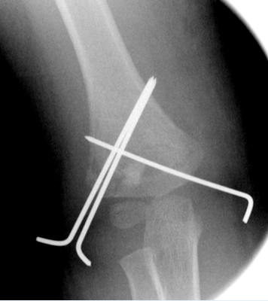
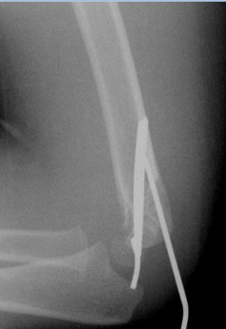
Supracondylar Humeral Fracture Treatment of extension type
Type III:
Attempt closed reduction and pinning
Open reduction and internal fixation may be necessary for unstable fractures, open fractures, or those with neurovascular injury

Slide 45
Supracondylar Humeral Fracture Treatment of flexion type
Type I
Immobilization in a long arm cast in near extension for 2 to 3 weeks.
Type II
Closed reduction followed by percutaneous pinning
Type III
Reduction is often difficult; most require open reduction and internal fixation with crossed pinning

Slide 46
Supracondylar Humeral Fracture Complications
Neurologic injury (7% to 10%)
Most are neurapraxias requiring no treatment
Median and anterior interosseous nerves (most common)
Vascular injury (0.5%)
Direct injury to the brachial artery or secondary to swelling

Slide 47
Supracondylar Humeral Fracture Complications
Loss of motion
Myositis ossificans
Angular deformity (cubitus varus)
Compartment syndrome

Slide 48
Distal Radius Fractures
Distal Radius Physeal Injuries
Type 1

Slide 49
Distal Radius Fractures
Distal Radius Physeal Injuries
Type 2 Type 3

Slide 50
Distal Radius Physeal Injuries Treatment
Salter-Harris Types I and II
Closed reduction followed by long arm cast with the forearm pronated
50% apposition with no angular or rotational deformity is acceptable
Growth arrest can occur in 25% with repeated manipulations
Open reduction is indicated
Irreducible fracture
Open fracture

Slide 51
Distal Radius Physeal Injuries Treatment

Slide 52
Distal Radius Physeal Injuries Treatment
Salter-Harris Type III
Anatomic reduction is necessary
ORIF with smooth pins or screws
Salter-Harris Types IV and V
Rare injuries
Need ORIF

Slide 53
Distal Radius Physeal Injuries Complications
Physeal arrest
Shortening
Angular deformity
Ulnar styloid nonunion
Carpal tunnel syndrome

Slide 54
Distal Radius Metaphyseal Injuries Classification
Direction of displacement
Involvement of the ulna
Biomechanical pattern
Torus (only one cortex is involved)
Incomplete (greenstick)
Complete

Slide 55
Distal Radius Metaphyseal Injuries
Torus fracture
Stable
Immobilized for pain relief
Bicortical injuries should be treated in a long arm cast.

Slide 56
Distal Radius Metaphyseal Injuries
Incomplete (greenstick)
Greater ability to remodel in the sagittal plane
Closed reduction and above elbow cast with supinated forearm to relax the brachioradialis muscle

Slide 57
Distal Radius Metaphyseal Injuries
Complete fracture
Closed reduction
Well molded long arm cast for 3 to 4 weeks

Slide 58
Distal Radius Metaphyseal Injuries
Complete fracture
Indications for percutaneous pinning without open reduction
loss of reduction
Excessive swelling
Floating elbow
Multiple manipulations

Slide 59
Distal Radius Metaphyseal Injuries
Complete fracture
Indications for ORIF
Irreducible fracture
Open fracture
Compartment syndrome

Slide 60
Distal Radius Metaphyseal Injuries Complications
Malunion
Residual angulation may result in loss of forearm rotation
Nonunion
Rare
Refracture
With early return to activity (before 6 weeks)
Growth disturbance
Overgrowth or undergrowth
Neurovascular injuries
With extreme positions of immobilization

Slide 61
Femoral Shaft Fractures
1.6% of all pediatric fractures
Boys > girls
2 to 4 years of age, mid-adolescence
In children younger than walking age, 80% of these injuries are caused by child abuse; this decreases to 30% in toddlers.
In adolescence, >90% due to RTA

Slide 62
Femoral Shaft Fractures
Mechanism of Injury
Direct trauma
RTA, fall, or child abuse
Indirect trauma
Rotational injury
Pathologic fractures
Osteogenesis imperfecta, nonossifying fibroma, bone cysts, and tumors

Slide 63
Femoral Shaft Fractures
Clinical Evaluation
Pain, swelling, inability to ambulate, and variable gross deformity
Careful neurovascular examination is essential
Careful examination of the overlying soft tissues to rule out the possibility of an open fracture

Slide 64
Femoral Shaft Fractures
Radiographic Evaluation
AP and lateral views
Must include hip, knee joints

Slide 65
Femoral Shaft Fractures Classification
Descriptive
Open or closed
Level of fracture:
proximal, middle, distal third
Fracture pattern:
transverse, spiral, oblique, butterfly fragment
Comminution
Displacement
Angulation
Anatomic
Subtrochanteric
Shaft
Supracondylar

Slide 66
Femoral Shaft Fractures Treatment
Less than 6 Months
Pavlik harness
Traction and spica casting

Slide 67
Femoral Shaft Fractures Treatment
6 Months to 6 (4) Years
CR and immediate casting (>95%)
Traction followed by spica casting if there is difficulty to maintain length and acceptable alignment

Slide 68
Femoral Shaft Fractures Treatment
6 to 12 Years
Flexible IMN
Bridge Plating
External Fixation

Slide 69
Femoral Shaft Fractures Treatment
6 to 12 Years
Flexible IMN
Bridge Plating
External Fixation

Slide 70
Femoral Shaft Fractures Treatment
6 to 12 Years
Flexible IMN
Bridge Plating
External Fixation
Multiple injuries
Open fracture
Comminuted #
Unstable patient

Slide 71
Femoral Shaft Fractures Treatment
12 Years to Maturity
Intramedullary fixation with either flexible or interlocked nails

Slide 72
Femoral Shaft Fractures Treatment
Operative Indications
Multiple trauma, including head injury
Open fracture
Vascular injury
Pathologic fracture
Uncooperative patient

Slide 74
Femoral Shaft Fractures Complications
Malunion
Remodeling will not correct rotational deformities
Nonunion (Rare)
Muscle weakness
Leg length discrepancy
Secondary to shortening or overgrowth
Overgrowth of 1.5 to 2.0 cm is common in 2-10 year of age
Osteonecrosis with antegrade IMN <16 year

