Slide 1
Common pediatric Fractures and Trauma
DR. Khalid A Bakarman
Assistant Prof,Pediatric Orthopedic
Consultant

Slide 2
objectives
At the end of this lecture the students should be able to:
know most of the mechanism of injury
make the diagnosis of common pediatric fractures
request and interpret the appropriate x-rays
initiate the proper management of fractures
know which fractures can be treated by conservative or operative methods and the ways of fixation
know the possible complications of different fractures and how to avoid them.

Slide 3
The different between adult and pediatric bones
Pediatric bone has a higher water content and lower mineral content per unit volume than adult bone so less brittle than adult bone.
The physis (growth plate) is a unique cartilaginous structure is frequently weaker than bone in torsion, shear, and bending, predisposing the child to injury through it.
The physis is traditionally divided into four zones that the injury through it can cause shortening, angular deformities.

Slide 4
The periosteum in a child is a thick fibrous structure than adult bone so there is high remodeling rate
ligaments in children are functionally stronger than boneTherefore, a higher proportion of injuries that produce sprains in adults result in fractures in children.

Slide 6
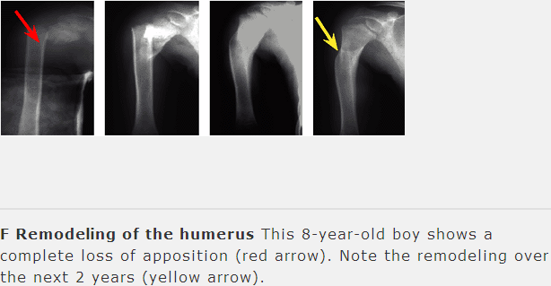

Slide 7
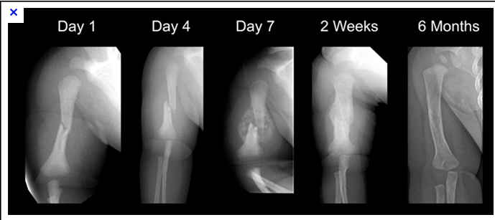
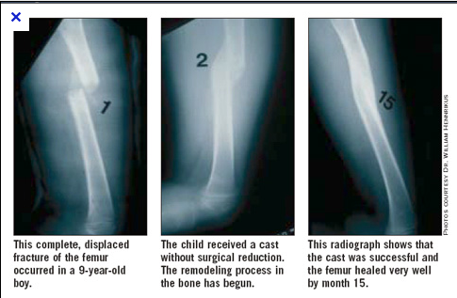

Slide 8
Common Pediatric Fractures
Upper limb
a. Clavicle .
b. Supracondylar Fracture.
c. Distal Radius .
Lower Limbs
a. Femur fractures

Slide 9
CLAVICLE FRACTURES
8% to 15% of all pediatric fractures
0.5% of normal deliveries and in 1.6% of breech deliveries
90% of obstetric fractures
80% of clavicle fractures occur in the shaft
The periosteal sleeve always remains in the anatomic position. Therefore, remodeling is ensured.

Slide 10
Mechanism of Injury
Indirect: Fall onto an outstretched hand
Direct: This is the most common mechanism, it carries the highest incidence of injury to the underlying neurovascular and pulmonary structures
Birth injury

Slide 11
Clinical Evaluation
Birth fractures
an asymmetric, palpable mass overlying the fractured clavicle
typically present with a painful, palpable mass along the clavicle, Tenderness, there may be tenting of the skin, crepitus, and ecchymosis.
Neurovascular ,the brachial plexus and upper extremity vasculature may injured.
Pulmonary status must be assessed.

Slide 12
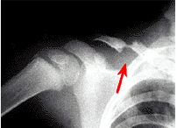
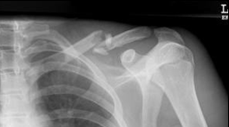
Radiographic Evaluation
AP view

Slide 13
Classification Descriptive
Location
Open versus closed
Displacement
Angulation
Fracture type: segmental, comminuted, greenstick

Slide 14
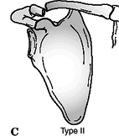
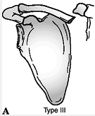
Allman calssificatiom
Type I:
Middle third (most common)
Type II:
Distal to the coracoclavicular ligaments (lateral third)
Type III:
Proximal (medial) third

Slide 15
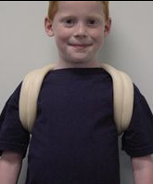
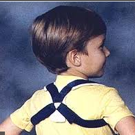
Treatment
Newborn to Age 2 Years
Clavicle fracture in a newborn will unite in approximately 1 week
Infants may be treated symptomatically with a simple sling or figure-of-eight bandage applied for 2 to 3 weeks

Slide 16
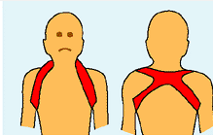
Treatment
Age 2 to 12 Years
A figure-of-eight bandage or sling is indicated for 2 to 4 weeks

Slide 17
X-ray Mid clavicle fracture
Post conservative treatment
Healed completely
With no complications

Slide 18
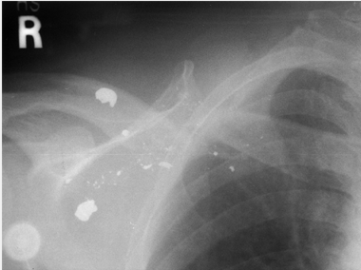
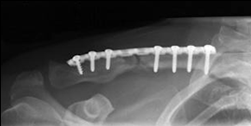
Operative
Treatment Indication
Open fractures
Neurovascular compromise

Slide 19
Complications Rare
Neurovascular compromise
Malunion
Nonunion
Pulmonary injury

Slide 21
Supracondylar Fracture
55% to 75% of all elbow fractures.
The male-to-female ratio is 3:2.
5 to 8 years,
The left, or nondominant side, is most frequently injured

Slide 22
MECHANISM OF INJURY
Indirect
most commonly a result of a fall onto an outstretched upper extremity. (Extension type >95%)
Direct
a fall onto a flexed elbow or from an object striking the elbow (e.g., baseball bat, automobile)---(Flexion type < 3%)

Slide 23
Clinical Evaluation
a swollen, tender elbow with painful range of motion.
S-shaped angulation at the elbow
Pucker sign (dimpling of the skin anteriorly )
Neurovascular examination
the median, radial, and ulnar nerves as well as their terminal branches. Capillary refill and distal pulses should be documented.

Slide 24
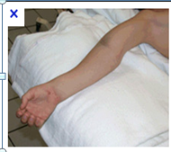
Clinical

Slide 25
Classifiction Gartland

Slide 26
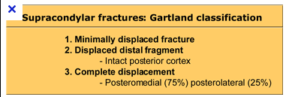

Slide 27
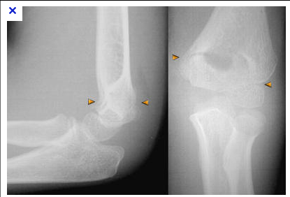
Type 1

Slide 28
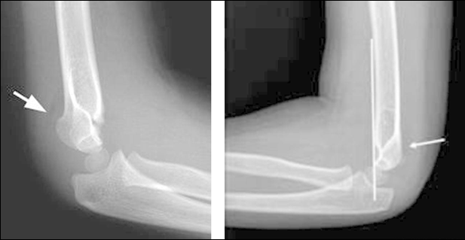
DX

Slide 29
Type 2
Lateral elbow x-ray
AP view

Slide 30
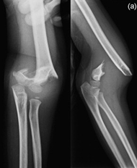
Type 3

Slide 31
Flexion type
AP view elbow
lateral x-ray view

Slide 32
Treatment of extension type
Type I:
Immobilization in a long arm cast or splint at 60 to 90 degrees of flexion is indicated for 2 to 3 weeks
Type II:
reduce by closed methods followed by casting; it may require pinning if unstable ,sever swelling ,tilting,

Slide 33
Type III:
Attempt closed reduction and pinning
Open reduction and internal fixation may be necessary for rotationally unstable fractures, open fractures, and those with neurovascular injury

Slide 34
Intra op fluoroscope lateral view
AP view

Slide 35
AP post CR+ k-wires
lateral view

Slide 36
Treatment of flexion type
Type I
Immobilization in a long arm cast in near extension is indicated for 2 to 3 weeks.
Type II
Closed reduction is followed by percutaneous pinning
Type III
Reduction is often difficult; most require open reduction and internal fixation with crossed pins

Slide 37
Complications
Neurologic injury(7% to 10%)
Most are neurapraxias requiring no treatment
Median nerve/anterior interosseous nerve (most common)
Vascular injury (0.5%)
direct injury to the brachial artery ,or secondary to swelling.

Slide 38
anterior interosseous nerve (most common)

Slide 39
Loss of motion
Myositis ossificans
Angular deformity (varus more frequently than valgus) (10% to 20)
Compartment syndrome (<1%)

Slide 40
Cubitus varus deformity
Angular deformity (varus more frequently than valgus) (10% to 20

Slide 41
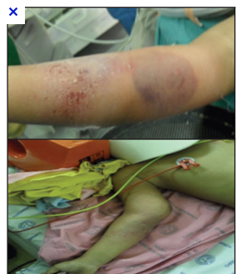
Compartment syndrome

Slide 42
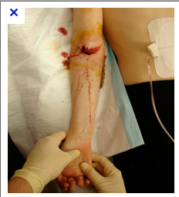

Slide 43
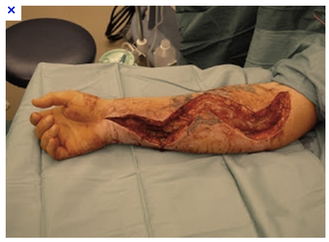

Slide 45
DISTAL RADIUS FRACTURES
A. Physeal Injuries
Salter Harris Classification

Slide 46
Type 1

Slide 47
Type 2 & 3

Slide 48
Treatment
Salter-Harris Types I and II
closed reduction is followed by application of a long arm cast or sugar tong splint with the forearm pronated
50% apposition with no angular or rotational deformity is acceptable. Growth arrest can occur in 25% of patients if two or more manipulations are attempted

Slide 49
Salter-Harris Types I and II treatment
Open reduction is indicated
the fracture is irreducible
open fracture

Slide 50
pre op Salter harris 2
AP and lateral X-ray post OP

Slide 51
Clinical picture and X-ray pre and post op

Slide 52
Salter-Harris Type III
Anatomic reduction is necessary
Open reduction and internal fixation with smooth pins or screws parallel to the physis is recommended if the fracture is inadequately reduced.
Salter-Harris Types IV and V
Rare injuries, need ORIF

Slide 53
Complications
Physeal arrest
lead to shortening , an angular deformity.
Ulnar styloid nonunion
Carpal tunnel syndrome

Slide 54
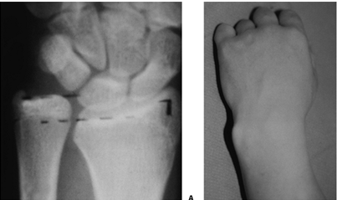
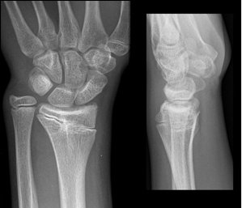

Slide 55
B.Metaphyseal Injuries
Classification
the direction of displacement
involvement of the ulna
biomechanical pattern
a. torus (only one cortex is involved)
b. incomplete (greenstick)
c. complete

Slide 56
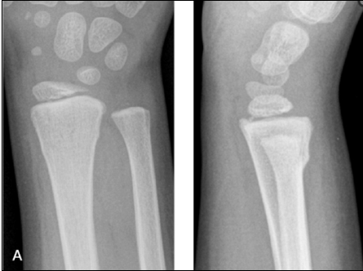
a.Torus fracture
the injury is stable
protected immobilization for pain relief
Bicortical injuries should be treated in a long arm cast.

Slide 57
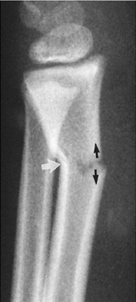
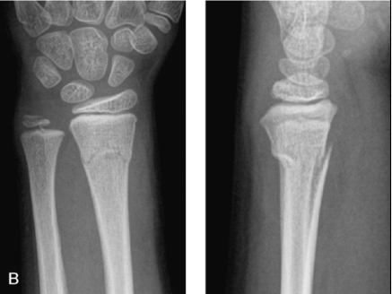
b .incomplete (greenstick)
These have a greater ability to remodel in the sagittal plane than in the frontal plane
Closed reduction and above elbow cast with supination foream to relax the brachioradialis muscle.

Slide 59
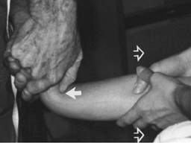
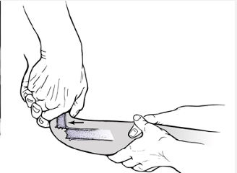
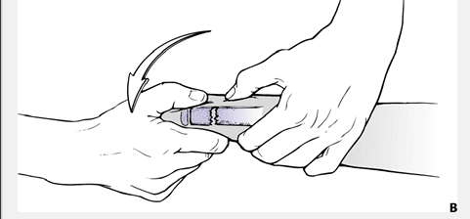
c.Complete fracture
Closed reduction
a well molded long arm cast for 3 to 4 weeks

Slide 60
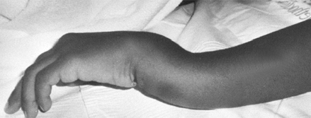
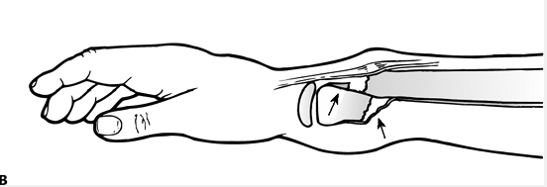
Indications for percutaneous pinning with out open reduction
loss of reduction.
excessive local swelling
floating elbow .
multiple manipulations

Slide 61
Indication for ORIF
irreducible #
Open fracture
Fracture with compartment syndrome.

Slide 62
Complications
Malunion
Residual malangulation of more than 20% may result in loss of forearm rotation.
Nonunion – rare
Refracture
an early return to activity (before 6 weeks)
Growth disturbance
(overgrowth or undergrowth) 3mm/9-12Y
Neurovascular injuries
avoid extreme positions of immobilization.

Slide 64
Pediatric Femoral Shaft
1.6% of all pediatric fractures .
Boys > girls
Bimodal distribution of incidence
2 to 4 years of age, mid-adolescence.
In children younger than walking age, 80% of these injuries are caused by child abuse; this decreases to 30% in toddlers.
In adolescence, >90% due to RTA

Slide 65
MECHANISM OF INJURY
Direct trauma
Motor vehicle accident, pedestrian injury, fall, and child abuse
Indirect trauma
Rotational injury
Pathologic fractures
osteogenesis imperfecta, nonossifying fibroma, bone cysts, and tumors

Slide 66
CLINICAL EVALUATION
an inability to ambulate, with extreme pain, variable swelling, and variable gross deformity
A careful neurovascular examination is essential
a careful examination of the overlying soft tissues to rule out the possibility of an open fracture

Slide 67
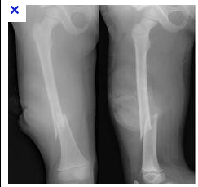
RADIOGRAPHIC EVALUATION
a.Anteroposterior and lateral views
b. x-ray most include hip ,knee joints.

Slide 68
CLASSIFICATION
Descriptive
Open versus closed
Level of fracture: proximal, middle, distal third
Fracture pattern: transverse, spiral, oblique, butterfly fragment
Comminution
Displacement
Angulation
Anatomic
Subtrochanteric
Shaft
Supracondylar

Slide 69
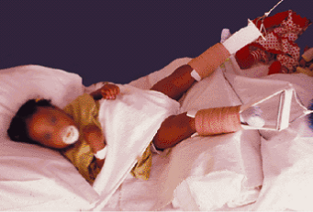
TREATMENT
Age <6 Months
a.Pavlik harness or a posterior splint
b.Traction and spica casting

Slide 70
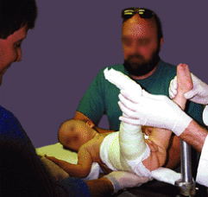
Ages 6 Months to 6 Years
a.Immediate spica casting is the treatment of choice (>95%).
b. Skeletal traction followed by spica casting if there is difficulty to maintain length and acceptable alignment

Slide 71
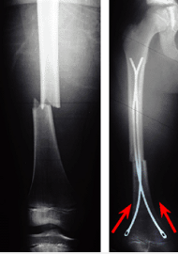
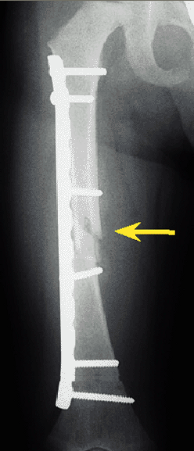
Ages 6 to 12 Years
Flexible intramedullary nails
b. . Bridge plating

Slide 72
c.External fixation
multiple injuries
open fracture
comminuted #
Unstable patient

Slide 74
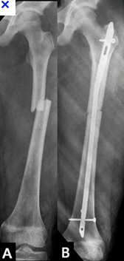
Ages 12 to Maturity
Intramedullary fixation with either flexible or interlocked nails(age>16y) is the treatment of choice.

Slide 75
Operative Indications
Multiple trauma, including head trauma
Open fracture
Vascular injury
Pathologic fracture
Uncooperative patient

Slide 76
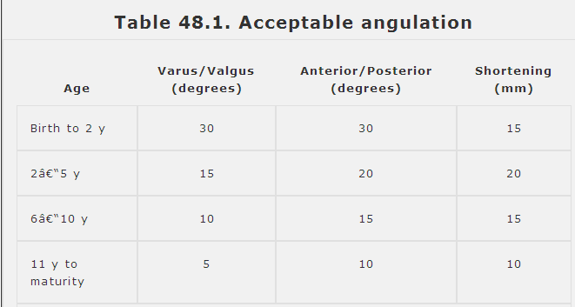

Slide 77
COMPLICATIONS
Malunion
Remodeling will not correct rotational deformities
Nonunion –rare
Muscle weakness
Leg length discrepancy
Secondary to shortening or overgrowth
Overgrowth of 1.5 to 2.0 cm is common in the 2- to 10-year age
Osteonecrosis with antegrade IM nail<16year.

Slide 78
