Slide 1
Bone and Joint Infections
By Hisham A Alsanawi, MD
Assistant Professor
Orthopaedic Surgery

Slide 2
Introduction
This is an overview
Initial treatment → based on presumed infection type → clinical findings and symptoms
Definitive treatment → based on final culture
Glycocalyx
  exopolysaccharide coating
  envelops bacteria
  enhances bacterial adherence to biologic implants

Slide 3
Bone Infection
Osteomyelitis

Slide 4
Bone Infection
Osteomyelitis
infection of bone and bone marrow
Route of infection
  direct inoculation → Open fractures
  blood-borne organisms → hematogenous
Determination of the offending organism
  NOT a clinical diagnosis
  DEEP CULTURE is essential

Slide 5
Classification
Acute hemotagenous OM
Acute OM
Subacute OM
Chronic OM

Slide 6
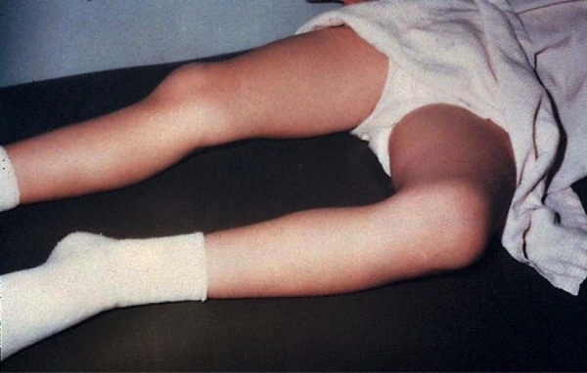
Acute Hematogenous OM
Clinical Features
caused by blood-borne organisms
More common in children
  Boys > girls
  most common in long bone metaphysis or epiphysis
  Lower extremity >> upper extremity
Pain
Loss of function of the involved extremity
Soft tissue abscess

Slide 7
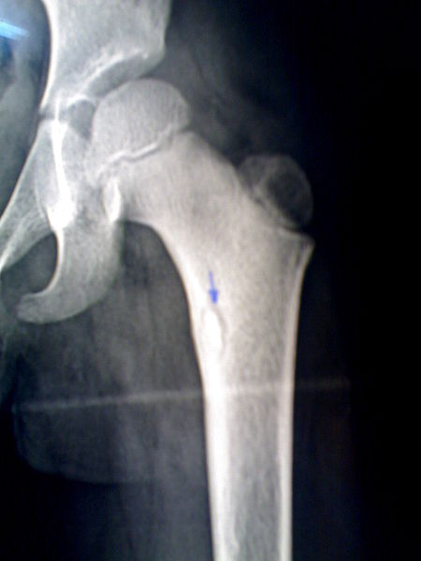
Acute Hematogenous OM
Radiographic Changes
soft tissue swelling (early)
bone demineralization (10-14 days)
sequestra → dead bone with surrounding granulation tissue → later
involucrum → periosteal new bone → later

Slide 8
Diagnosis
Diagnosis
  elevated WBC count
  elevated ESR
  blood cultures → may be positive
  C-reactive protein
    most sensitive monitor of infection course in children
    short half-life
    dissipates in about 1 week after effective treatment
  Nuclear medicine studies → may help when not sure

Slide 9
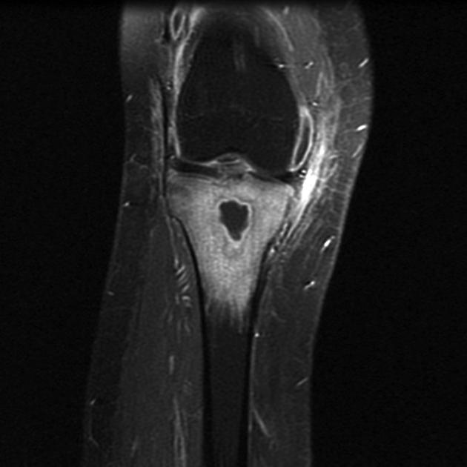
Diagnosis
MRI
  shows changes in bone and bone marrow before plain films
  decreased T₁-weighted bone marrow signal intensity
  increased postgadolinium fat-suppressed T₁-weighted signal intensity
  increased T₂-weighted signal relative to normal fat

Slide 10
Treatment Outline
Take samples for culture
Start empirical broad-spectrum Abx
Observe improvement with clinical parameters and blood tests
Review culture results and proceed accordingly
Decide on duration of Abx (IV vs oral)

Slide 11
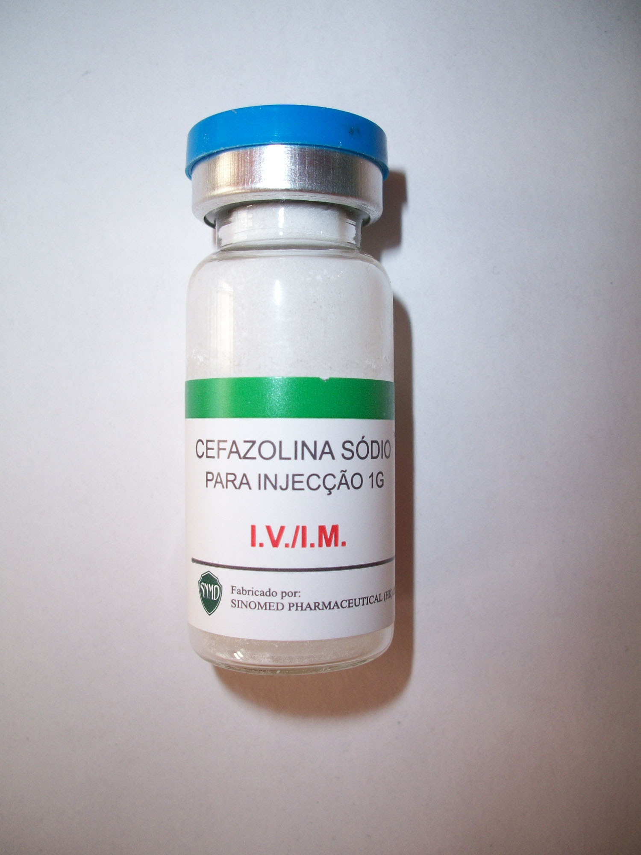
Empirical Treatment
Before definitive cultures become available
based on patient’s age and other circumstances

Slide 12
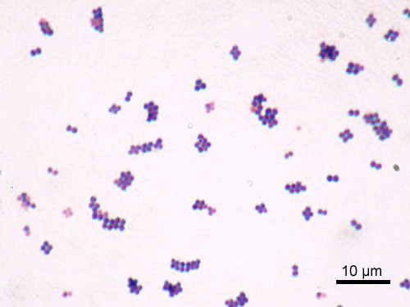
Empirical Treatment
Newborn (0-4months)
The most common organisms
  Staphylococcus aureus
  gram-negative bacilli
  group B streptococcus
Newborns
  may be afebrile
  70% positive blood cultures
Empirical therapy → Broad Spectrum Abx
Remember: immunity is not fully developed

Slide 13
Empirical Treatment
Children >4months
most common organisms
  S. aureus
  group A streptococcus
  coliforms → (uncommon)
empirical treatment → broad spectrum Abx
Haemophilus influenzae bone infections → almost completely eliminated → due to vaccination

Slide 14
Empirical Treatment
Adults 21 years of age or older
Organisms
  most common organism → S. aureus
  wide variety of other organisms have been isolated
Initial empirical therapy → Broad-spectrum Abx

Slide 15
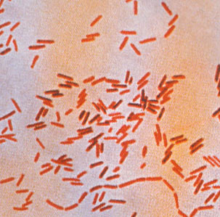
Empirical Treatment
Sickle cell anemia
Salmonella is a characteristic organism – but not the most common
S.aureus is still the most common
The primary treatment → Broad-spectrum Abx

Slide 16
Empirical Treatment
Hemodialysis and IV drug abuser
Common organisms
  S. aureus
  S. epidermidis
  Pseudomonas aeruginosa
Treatment of choice → Empirical → broad spectrum Abx
Remember → Aggressive treatment due aggressive organisms

Slide 17
Operative Treatment
Indications for operative intervention
  drainage of an abscess
  débridement of infected and necrotic tissues → sequestrum → prevent further destruction
  refractory cases that show no improvement after nonoperative treatment

Slide 18
Acute Osteomyelitis
after open fracture or open reduction with internal fixation

Slide 19
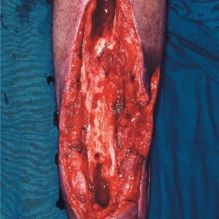
Acute osteomyelitis
Acute OM after open fracture or open reduction with internal fixation
Clinical findings → similar to acute hematogenous OM
Treatment
  radical I&D → SURGERY
  removal of orthopaedic hardware if necessary
  Soft tissue coverage for open wounds → if needed

Slide 20
Acute osteomyelitis
Most common offending organisms are
  S. aureus
  P. aeruginosa
  Coliforms
Empirical therapy → Broad-spectrum Abx

Slide 21
Chronic Osteomyelitis

Slide 22
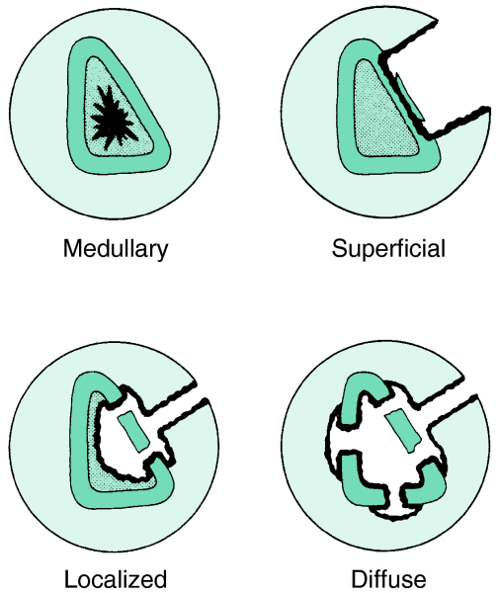
Chronic OM
Can arise from:
  Inappropriately treated acute osteomyelitis
  Trauma
  Soft tissue
Anatomical classification → check fig.

Slide 23
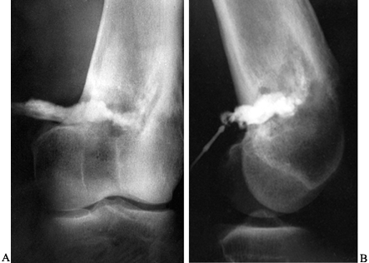
Chronic OM
Population at risk
  Elderly
  Immunosuppressed patients
  Diabetic patients
  IV drug abusers

Slide 24
Chronic OM
Features
  Skin and soft tissues involvement
  Sinus tract → may occasionally develop squamous cell carcinoma
  Periods of quiescence → followed by acute exacerbations
Diagnosis
  Nuclear medicine → activity of the disease
  Best test to identify the organisms → Operative sampling of deep specimens from multiple foci

Slide 25
Chronic OM - Treatment
empirical therapy is not indicated
IV antibiotics → must be based on deep cultures
Most common organisms
  S. aureus
  Enterobacteriaceae
  P. aeruginosa

Slide 26
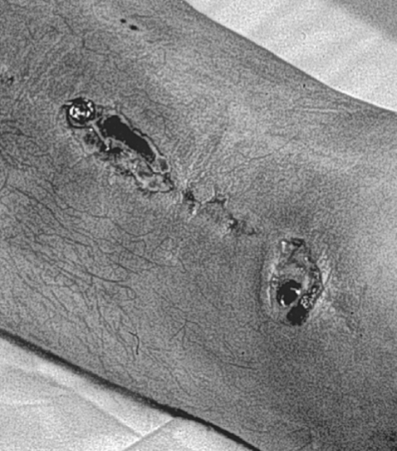
Chronic OM - Treatment
surgical débridement
  complete removal of compromised bone and soft tissue
  Hardware
    most important factor
    almost impossible to eliminate infection without removing implant
    organisms grow in a glycocalyx (biofilm) → shields them from antibodies and antibiotics
  bone grafting and soft tissue coverage is often required
  amputations are still required in certain cases

Slide 27
Subacute Osteomyelitis

Slide 28
Subacute Osteomyelitis
Diagnosis → Usually
  painful limp
  no systemic and often no local signs or symptoms
  Signs and symptoms on plain radiograph
May occur in
  partially treated acute osteomyelitis
  Occasionally in fracture hematoma
Frequently normal tests
  WBC count
  blood cultures

Slide 29
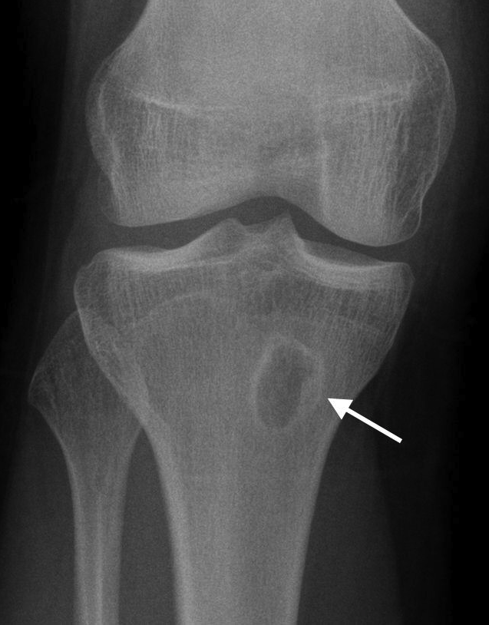
Subacute Osteomyelitis
Usually useful tests
  ESR
  bone cultures
  radiographs → Brodie’s abscess → localized radiolucency seen in long bone metaphyses → difficult to differentiate from Ewing’s sarcoma

Slide 30
Subacute OM - Treatment
Most commonly involves femur and tibia
it can cross the physis even in older children
Metaphyseal Brodie’s abscess → surgical curettage

Slide 31
Septic arthritis

Slide 32
Septic Arthritis
Route of infection
  hematogenous spread
  extension of metaphyseal osteomyelitis in children
  complication of a diagnostic or therapeutic joint procedure
Most commonly in infants (hip) and children.
metaphyseal osteomyelitis can lead to septic arthritis in
  proximal femur → most common in this category
  proximal humerus
  radial neck
  distal fibula

Slide 33
Septic Arthritis
Adults at risk for septic arthritis are those with
  RA →
    tuberculosis → most characteristic
    S. aureus most common
  IV drug abuse → Pseudomonas most characteristic
Empirical therapy
  prior to the availability of definitive cultures
  Based on the patient's age and/or special circumstances

Slide 34
Septic arthritis – Empirical Rx
Newborn (up to 3 months of age)
  most common organisms →
    S. aureus
    group B streptococcus
  less common organisms →
    Enterobacteriaceae
    Neisseria gonorrhoeae
  70% with adjacent bony involvement
  Blood cultures are commonly positive
  Initial abx after sugical wash out → broad-spectrum Abx

Slide 35
Septic arthritis – Empirical Rx
Children (3 months to 14 years of age)
  most common organisms
    S. aureus
    Streptococcus pyogenes
    S. pneumoniae
    H. influenzae → markedly decreased with vaccination
    gram-negative bacilli
  Initial treatment → broad-spectrum Abx

Slide 36
Septic arthritis – Empirical Rx
Acute monarticular septic arthritis in adults
  The most common organisms
    S. aureus
    Streptococci
    gram-negative bacilli
  Antibiotic treatment → broad-spectrum Abx

Slide 37
Septic arthritis – Empirical Rx
Chronic monarticular septic arthritis
  most common organisms
    Brucella
    Nocardia
    Mycobacteria
    fungi
Polyarticular septic arthritis
  most common organisms
    Gonococci
    B. burgdorferi
    acute rheumatic fever
    viruses

Slide 38
Septic Arthritis – Surgical treatment
mainstay of treatment
  Surgical drainage → open or arthroscopic
  daily aspiration
Tuberculosis infections → pannus → similar to that of inflammatory arthritis
Late sequelae of septic arthritis → soft tissue contractures → may require soft tissue procedures (such as a quadricepsplasty)

Slide 39
Infected Total Joint Arthoplasty

Slide 40
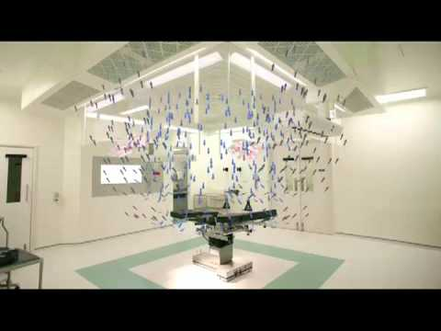
Infected TJA - Prevention
Perioperative intravenous antibiotics → most effective method for decreasing its incidence
Good operative technique
Laminar flow → avoiding obstruction between the air source and the operative wound

Slide 41
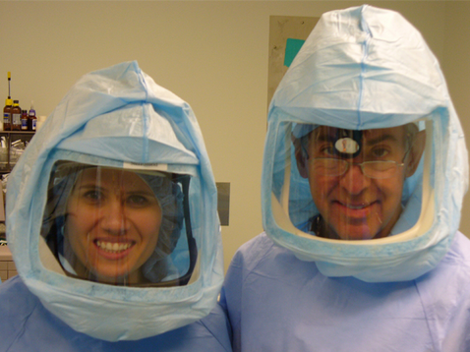
Infected TJA - Prevention
Special “space suits”
Most patients with TJA do not need prophylactic antibiotics for dental procedures
Before TKA revision → knee aspiration is important to rule out infection

Slide 42
Infected TJA - Diagnosis
Most common pathogen →
  S. epidermidis → most common with any foreign body
  S. aureus
  group B streptococcus
ESR → most sensitive but not specific
Culture of the hip aspirate → sensitive and specific
CRP may be helpful
Preoperative skin ulcerations → ⬆ risk
most accurate test → tissue culture

Slide 43
Infected TJA - Treatment
Acute infections → within 2-3 weeks of arthroplasty → Treatment
  prosthesis salvage → stable prosthesis
  Exchange polyethylene components
  Synovectomy → beneficial
chronic TJA infections → >3 weeks of arthroplasty
  Implant and cement removal
  staged exchange arthroplasty
  Glycocalyx
    Formed by polymicrobial organisms
    Difficult infection control without removing prosthesis and vigorous débridement
  Helpful steps
    use of antibiotic-impregnated cement
    antibiotic spacers/beads

Slide 44
Good luck!

