Slide 1
Bone and Joint Infection
Waleed Awwad. MD, FRCSC
Assistant professor and consultant

Slide 2
Objectives
The ability to demonstrate knowledge of the following:
Bone and joints infections presentation
Assessment and work up for bone and joint infections
Differential diagnosis for bone and joint infections
Management of bone and joint infections
Complication of bone and joint infections

Slide 3
Red Flag Conditions
Beware of:
1) Cauda Equina/severe neurologic injury (perianal numbness, decreased rectal tone, loss of movement in the extremeties)
2) Tumour
3) Infection
4) Trauma (open fracture, pelvic fracture)
5) Joint dislocations
6) Compartment syndrome

Slide 4
Acute osteomyelitis
Classification
Duration:
Acute
Subacute
Chronic
Route of Infection:
Hematogenous
Exogenous
Host response:
Pyogenic
Granulomatous

Slide 5
Acute osteomyelitis
Definition:
Osteomyelitis is an inflammation of bone caused by an infecting organism.
It may remain:
Localized
Spread to:
Marrow
Cortex
Periosteum
Soft tissue

Slide 6
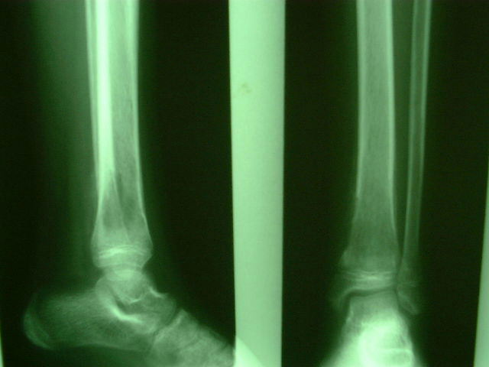
Acute osteomyelitis
Definition:
Osteomyelitis is an inflammation of bone caused by an infecting organism.
It may remain:
Localized
Spread to:
Marrow
Cortex
Periosteum
Soft tissue

Slide 7
Acute osteomyelitis
Organism:
Neonates: Staph aureus, Strep, E coli
Children: Staph aureus, E coli, Serratia, Pseudomona ( Hem. Infl < 4 yrs, rare now)
Sicklers: Staph aureus, Salmonella (most unique)
Drug addicts: Staph aureus, Pseudomonas (most unique)

Slide 8
Acute osteomyelitis
Organism: the commonest is staph. Aureus
Source of infection: Hematogenous, direct extension, direct from outside
Incidence:
Age: more in children
Sex: Boys> Girls
Site of infection: metaphysis
Bones: LE > UE. commonest are tibia and femur

Slide 10
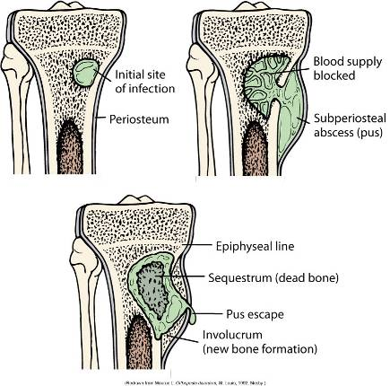

Slide 11
Pathology
Hematogenous colonisation of the bones by bacteria
Stage of inflammation
Spread of infection with pus formation
Formation of subperiosteal abscess
Pus tracks towards skin to form a sinus
Bone infarction (Sequestrum)
Subperiosteal new bone formation (Involucrum)

Slide 12
Involucrum is seen in the distal fibula

Slide 13
Involucrum is seen in the distal fibula

Slide 14
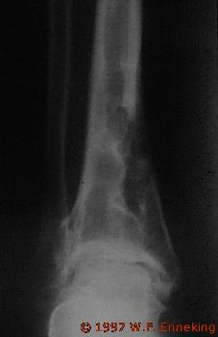
This x-rays show sequestra

Slide 15
Pathology and age variation
Neonates:
Extensive bone necrosis
Increased ability to absorb large sequestrum
Increased ability to remodel
Epiphysio-metaphyseal vascular connection
Secondary septic arthritis
Presence of growth plate → growth disturbance

Slide 16
Pathology and age variation
Adults:
No subperiosteal abscess
Adherent periosteum
Soft tissue abscess
Vascular connection with the joint
Secondary septic arthritis

Slide 17
Clinical Picture
History:
Fever
Psudoparalysis, limping, inability to walk
Identified potential source
Confirm your most likely diagnosis
Exclude other diagnosis

Slide 18
Clinical Picture
Symptoms:
Pain
Fever
malaise
Restlessness
Vomiting
The limb is held still, loss of function

Slide 19
Clinical Picture
General signs:
Looks ill
Fever
Tachycardia
Local signs:
Look, feel and move

Slide 20
Laboratory tests
CBC: raised WBC
ESR: 24-36hrs
C-reactive protein: 4-6hrs (most sensitive)
Blood cultures (positive up to 50 %)
Aspiration (send for Gram stain and C&S)

Slide 21
Radiography
Plain x-rays (Normal in the first ten days, after that resorption of affected bone and sub-periosteal new bone formation)
Bone scan (very sensitive but not specific)
Ultrasound
CT scan
MRI

Slide 22
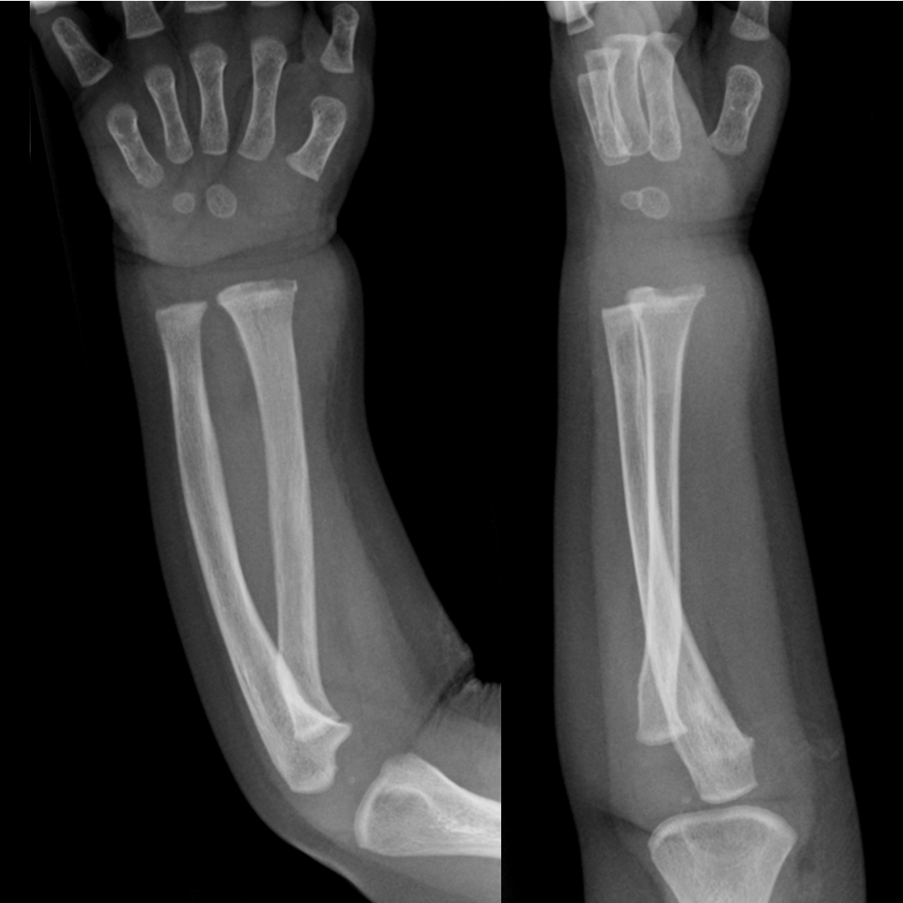
Acute Hematogenous OM Radiographic Changes
soft tissue swelling (early)
bone demineralization (10-14 days)
sequestra → dead bone with surrounding granulation tissue → late
involucrum → periosteal new bone → late
Sequestrum and involucrum are signs of chronic ostemyelitis

Slide 23
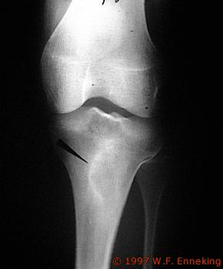
Acute osteomyelitis

Slide 24
Subacute osteomyelitis

Slide 25
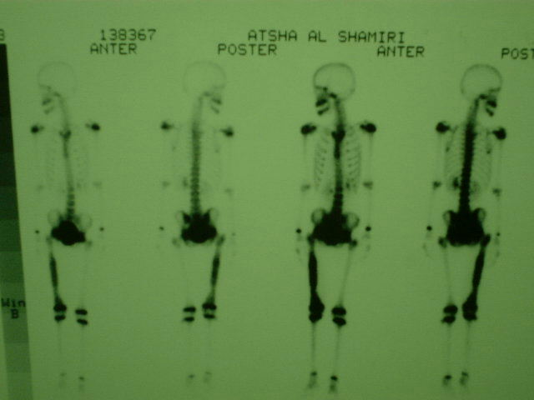

Slide 26
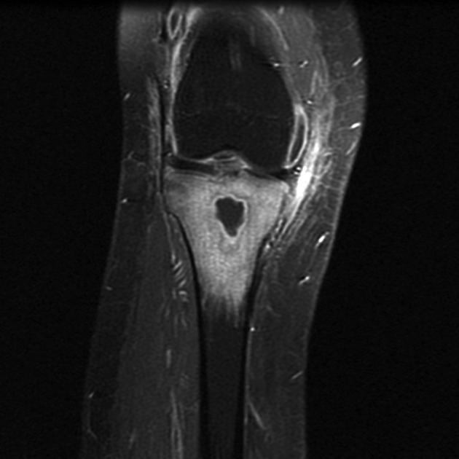
Diagnosis
MRI
shows changes in bone and bone marrow before plain films
decreased T₁-weighted bone marrow signal intensity
increased post gadolinium fat-suppressed T₁-weighted signal intensity
increased T₂-weighted signal relative to normal fat

Slide 27
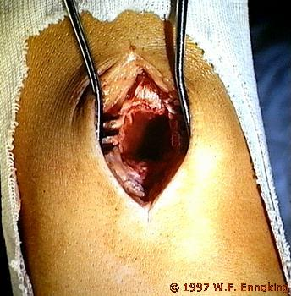
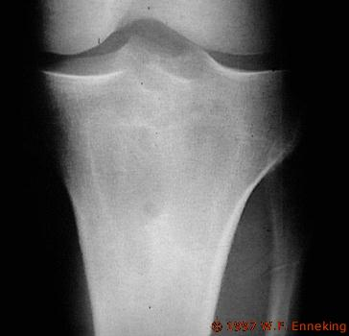

Slide 28
Differential Diagnosis
Acute septic arthritis
Cellulitis
Ewing’s Sarcoma
Sickle cell bone crisis
Acute rheumatoid arthritis

Slide 29
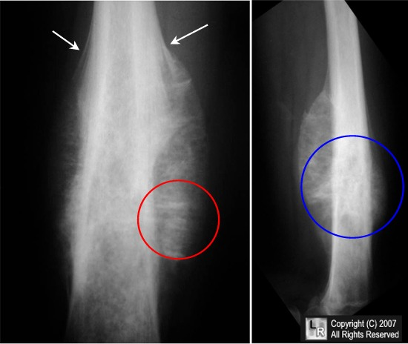
Differential Diagnosis
www.learningradiology.com/archives2007/COW%20279-Ewing%20Sarcoma/ewingscorrect.html

Slide 30
Treatment Outline
Select appropriate empirical antibiotics
Deliver antibiotics to the infected site
Identify the organisms
Halt tissue destruction

Slide 31
Treatment
General:
Admission
Hydration
Correction of electrolyte imbalance
Analgeics
Immobilization
Specific:
Broad spectrum intravenous antibiotic till final culture
Surgery if indicated

Slide 32
Empirical Treatment
Initial treatment based on presumed infection type → clinical findings and patient’s age
Definitive treatment → based on final culture

Slide 33
Operative Treatment
Started after cultures
Indications for operative intervention
Drainage of an abscess
Débridement of infected tissues to prevent further destruction
Refractory cases that show no improvement after nonoperative treatment

Slide 34
Complication
Septicemia and distant abscesses
Septic arthritis
Growth disturbance in skeletally immature
Pathological fracture
Chronic osteomylitis

Slide 35
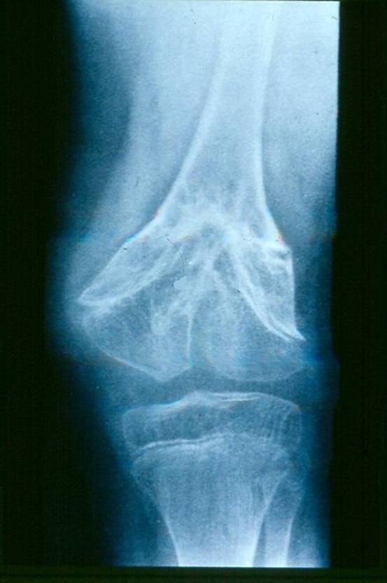
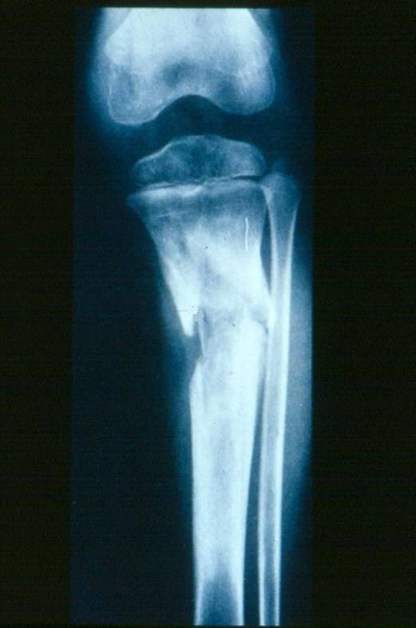
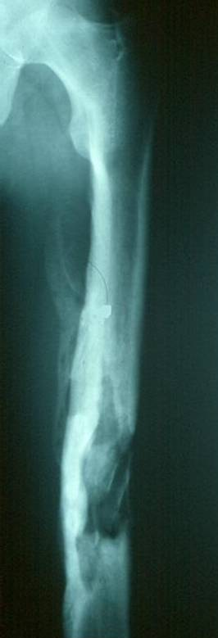
Complication

Slide 36
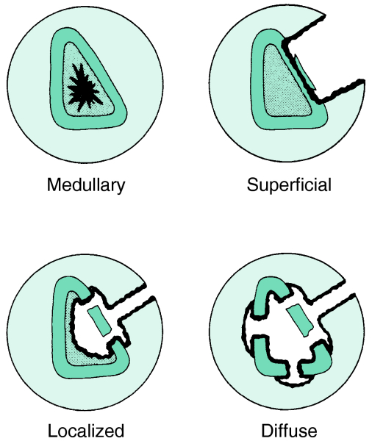
Chronic OM
Common in
Inappropriately treated acute OM
Trauma
Immunosuppressed
Diabetics
IV drug abusers
Anatomical classification →

Slide 37
Chronic OM
Features
Skin and soft tissues involvement
Sinus tract → may occasionally develop squamous cell carcinoma
Periods of quiescence → followed by acute exacerbations
Diagnosis
Nuclear medicine → activity of the disease
Best test to identify the organisms → Operative sampling of deep specimens from multiple foci

Slide 38
Treatment
Empirical therapy is not indicated
IV antibiotics → must be based on deep cultures
Most common organisms
S. aureus
Enterobacteriaceae
P. aeruginosa

Slide 39
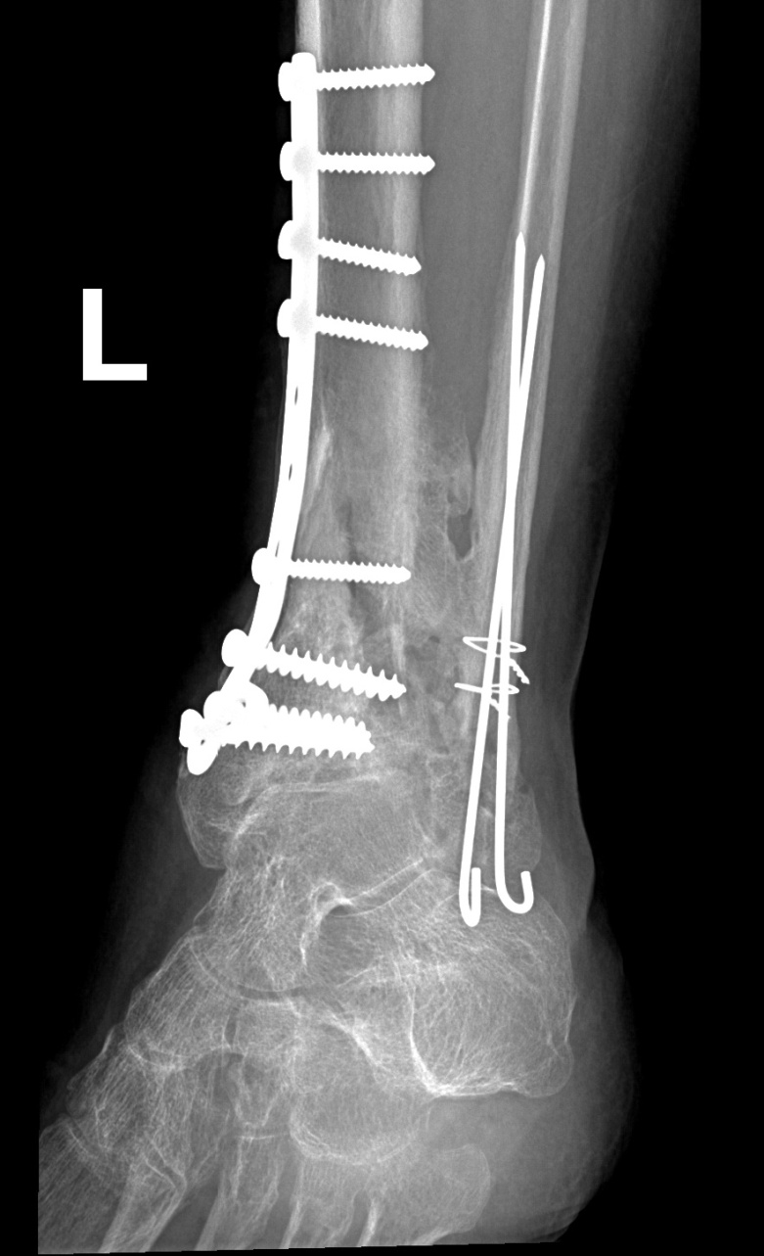
Chronic osteomyelitis
Glycocalyx
exopolysaccharide coating
envelops bacteria
enhances bacterial adherence to biologic implants

Slide 40
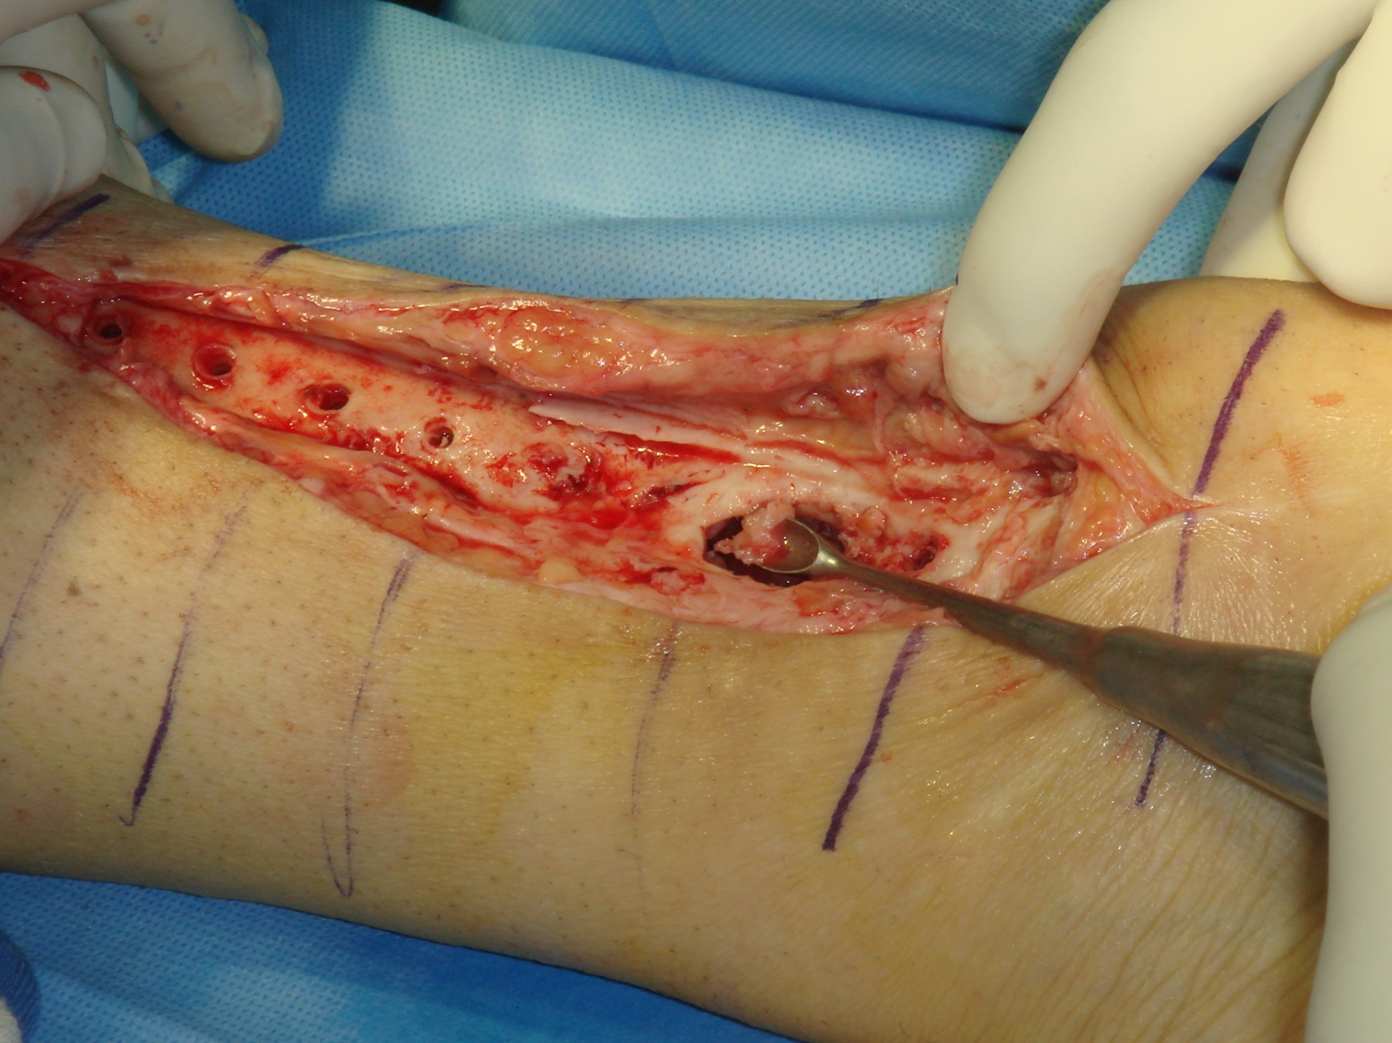

Slide 41
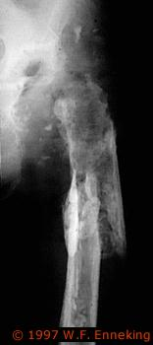
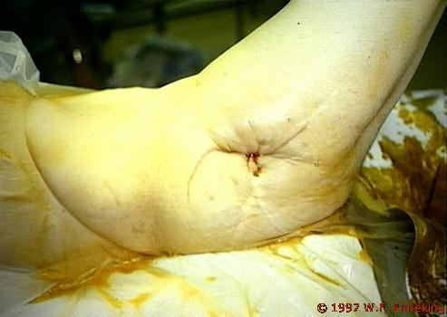
Chronic osteomyelitis

Slide 43
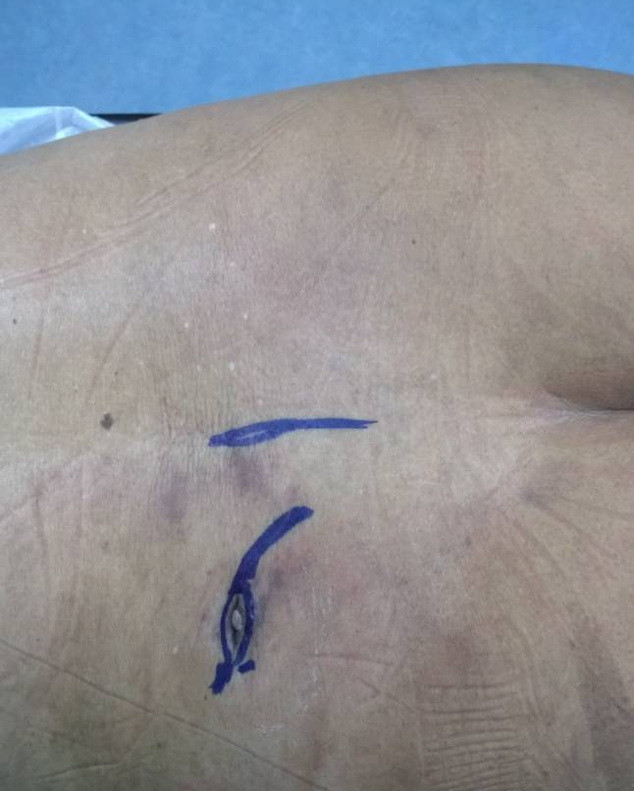
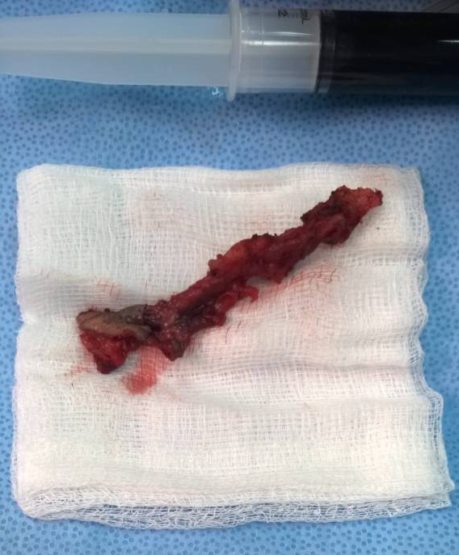

Slide 44
Complications
Recurrence
Pathological fracture
Growth disturbance in skeletally immature
Squamous cell carcinoma transformation (fistula)
Amputation

Slide 45
Septic Arthritis
May affect any age and any joint
The knee and hip are most affected
Pathology: hematogenous or from the bone
In neonates: transphyseal vessels
In joints where the metaphysis is intracapsular (Hip, shoulder, proximal radius and distal fibula)

Slide 46
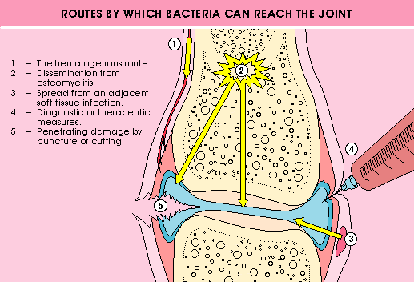

Slide 47
Septic Arthritis
Symptoms : like AO
Signs: hot swollen joint which is painful to any motion, inability to bear weight
Joint is fixed in the position of ease

Slide 48
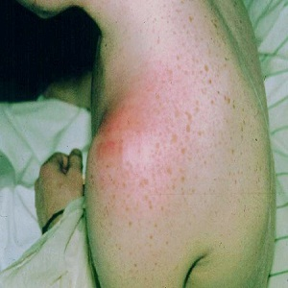
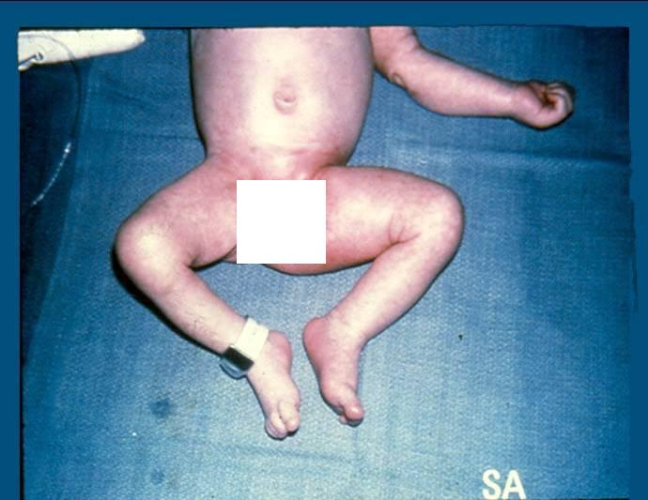
Septic Arthritis

Slide 49
Investigation
Basic lab for infection (CBC,ESR and CRP) and Blood cultures
Plain films and Ultrasound
Joint aspiration: WBC >50,000 (>90%PMNL), damaged WBC and No crystals
Organisms: similar to AO
Rx: Admission for Emergency arthrotomy and washout, broad spectrum IV antibiotics and splintage
Main DDx: transient synovitis of the hip

Slide 50
Acute Monoarthritis
Sepsis workup
Synovial Fluid
Aspiration
Positive B/C :
50-70%
Smear- Culture
Light microscope
Leukocytosis
ESR & CRP
Positive Gram stain:
75% in s. aureus
30-50% in gram (-)
Turbid - Purulent
Leukocyte> 50,000/ml
(> 90% PMN)
Damaged WBC
Crystal (-)
Positive Fluid culture: 90%
PCR: partially treated or culture negative

Slide 52
For simulated cases

Slide 53
Differential diagnosis
Acute osteomylitis
Transient synovitis (<10 years)
Reactive arthritis
Vasculitis eg: Henoch-Schonlein purpura
Traumatic haemoarthrosis
Haemophilic arthritis

Slide 54
Complication
Septicemia
Abscess
Osteomyelitis
Joint destruction
Joint subluxation and dislocation
Ankylosed joint
Avascular necrosis of the femoral head
Growth disturbance

Slide 55
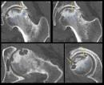
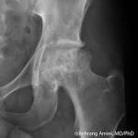
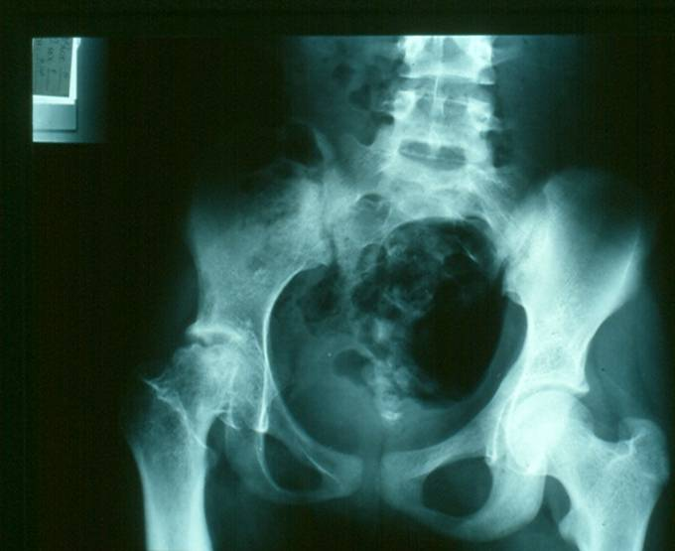
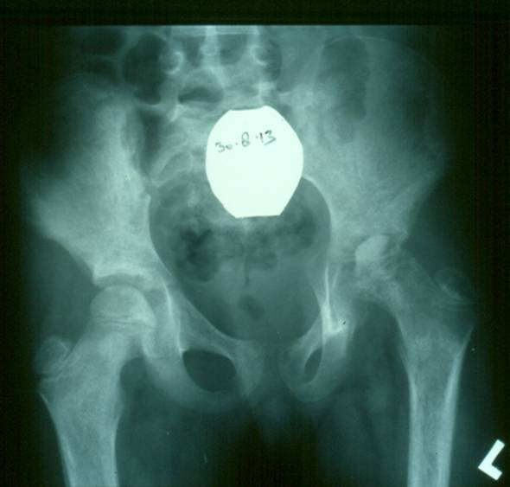
Complication

Slide 56
Reactive arthritis
Sterile inflammation secondary to bacterial infection
80% have HLA type B27
1-3 weeks after bacteria in genitalia eg: Chlamydia, or bowel eg (Shigella, Salmonella)
Oligoarthritis (large joint of lower limb)
Sometimes eye redness and irritation
Synovial fluid: WBC <50,000 (PMNL <60%)
Treatment: NSAID

Slide 57
Transient Synovitis
Benign, self-limited disorder
Associated with recent URI in 32-50% of children
30-40% of all non-traumatic limps
Sterile inflammation causing joint effusion
Lasts 2-7 days without intervention
Male: Female is > 2:1
Ages 2-6 (typically <4)

Slide 58
Transient Synovitis
Sudden onset of hip pain (Don’t forget knee pain!!)
Afebrile/low-grade fever (<38.5)
Usually able to ambulate with a limp
Antalgic gait
Hip is flexed and externally rotated with mildly decreased ROM
5% bilateral presentation
25% with unilateral presentation with effusion on contralateral hip by ultrasound

Slide 59
Transient Synovitis
Laboratory Evaluation
WBC count <12,000
Mildly elevated ESR (<40), CRP (<2)
X-Ray
Joint space widening
Discrepancies >2mm between sides
Ultrasound:
Joint effusion and/or synovial swelling
Bilateral joint effusions in up to 25% of cases of asymtpmatic contralateral hip

Slide 60
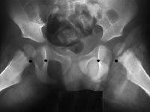
www.emedicine.com/ped/images/1686.JPG

Slide 61
Transient Synovitis
Treatment
Self-limited after 2-7 days
Bed rest
(NSAIDS):Ibuprofen
Mean duration of pain
ibuprofen: 2 days
80% of all patients has resolution by 7 days

Slide 62
Vasculitis
Henoch-Schonlien purpura: systemic IgA vasculitis
Primarily affect children
Classic triad: purpura, arthritis and abdominal pain
Usually able to ambulate, but with antalgic gait
Ankle , knees and elbow mostly affected
Purpura starts at posterior aspect of lower limb, buttocks, but can affect rest of the body

Slide 63
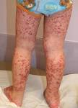
Henoch-Schonlein purpura
Vasculitis: ecchmosis, petechiae
Arthralgia: transient and migratory
Abdominal pain:
Within 8 days of rash (colicky)
20-30% GI bleeding
Inussusception is common
Renal: hematuria and proteinuria

Slide 64
Henoch-Schonlein purpura
High urea and creatinine
Raised IgA
Raised ESR and/or CRP
Diagnosis confirmed by biopsy

Slide 65
Chronic Non-Specific Bone and Joint Infection
Outline:
Tuberculosis
Causative organism
Target
Pathology
Location of infection
Spine T.B
Clinical presentation
Diagnosis
Treatment
Other less common infections
Brucellosis
Syphilis
Fungal infection

Slide 66
Tuberculosis
Causative organism:
Mycobacterium tuberculosis
Mycobacterium Bovine
Mycobacterium africanum

Slide 67
Tuberculosis
Causative organism:
Mycobacterium tuberculosis
Mycobacterium Bovine
Mycobacterium africanum

Slide 68
Mycobacterium Tuberculosis
Thin non-motile rod
Strictly aerobic
Acid fast bacillus
Requires enriched culture medium to grow
Takes as long as 4-6 weeks to see the colonies

Slide 69
Mycobacterium Tuberculosis
Known to affect humans from about 5000 BC
Discovered by Laennic in the early 18th century
Common in our region and other developing countries
Endemic in poor non-developed countries
Increasing in developed countries along with the increase in AIDS

Slide 70
Tuberculosis
Affects:
Anyone at any age!!
More common in the immunocompromised
(AIDS, chronic renal failure, substance abuser)
Usually affects young individuals in developing countries while it affects the older in developed countries

Slide 71
TB Pathology
Inflammation Hyperemia
TB Follicles (tubercle):
LYPHOCYTE – MONOCYTES
ENDOTHELIAL CELLS
LANGHANS GIANT CELLS
Coalesce
Caseation

Slide 72
TB Follicle

Slide 73
Musculoskeletal TB
Secondary to other primary TB lesions
(Pulm.,Renal, LN)
1-8% of all T.B
50% associated with pulmonary primary site
Route of spread:
Hematogenous ****
Direct (much less)
* bone to joint
* soft tissue to bone
The primary lesion
Quiescent
Active: (Apparent, Latent)

Slide 74
Musculoskeletal TB
MSK targets:
Spine (50%)
Thoracic (50%)
Lumbar (25%)
Cervical (25%)
Pelvis
Hip
Knee
Ankle and shoulder

Slide 75
Musculoskeletal TB
MSK targets:
Spine (50%)
Thoracic (50%)
Lumbar (25%)
Cervical (25%)
Pelvis
Hip
Knee
Ankle and shoulder

Slide 76
MSK Tuberculosis
Spine:
Deformity (gibbus, kyphus)
Neurological compromise (motor>sensory)
Muscle spasm
Joints:
Swelling
Stiffness
Locking
Loss of function
Bones:
Ulcers
Sinuses
Swelling
deformity

Slide 77
MSK Tuberculosis
Presentation:
Constitutional symptoms
Fever
Wt loss
Night sweats
Anorexia
Pain
Stiffness
deformity

Slide 78
Diagnosis
Radiology:
Plain x-rays:
Joints: usually monoarticular
Peri-articular osteopenia
Subchondral and peripheral erosions affecting both sides of the joint
Loss of joint space
PHEMISTER’S TRIAD

Slide 79
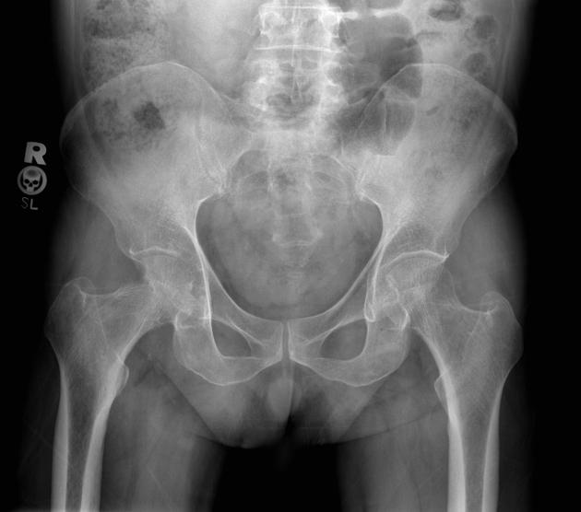

Slide 80
T.B of The Spine: (Pott’s disease)
Usually secondary to hematogenous spread
Can affect two or more adjacent vertebrae
May skip levels
Primarily does not affect the disc but eventually the disc is affected

Slide 81
T.B of The Spine: (Pott’s disease)
Affects most commonly the anterior part of the vertebral endplates
Causing erosion and destruction and finally anterior wedging of the vertebrae
The disc herniates into the weakened and destructed body and narrowing of the disc height follows

Slide 82
T.B of The Spine: (Pott’s disease)
Infection spreads to adjacent level under the longitudinal ligaments and hematologically
Eventually a kyphotic deformity occurs
Para vertebral abscess is common and may be distant as well
Cervical > retropharyngeal abscess
Lumbar > psoas abscess
Compression of the spinal cord is more likely to occur at the thoracic level

Slide 83
T.B of The Spine: (Pott’s disease)
Neurological deficits occur due to the compression secondary to the deformity or compression from the abscess
Paraplegia may occur
Reversible if treated early
Mostly treated non-surgically

Slide 85
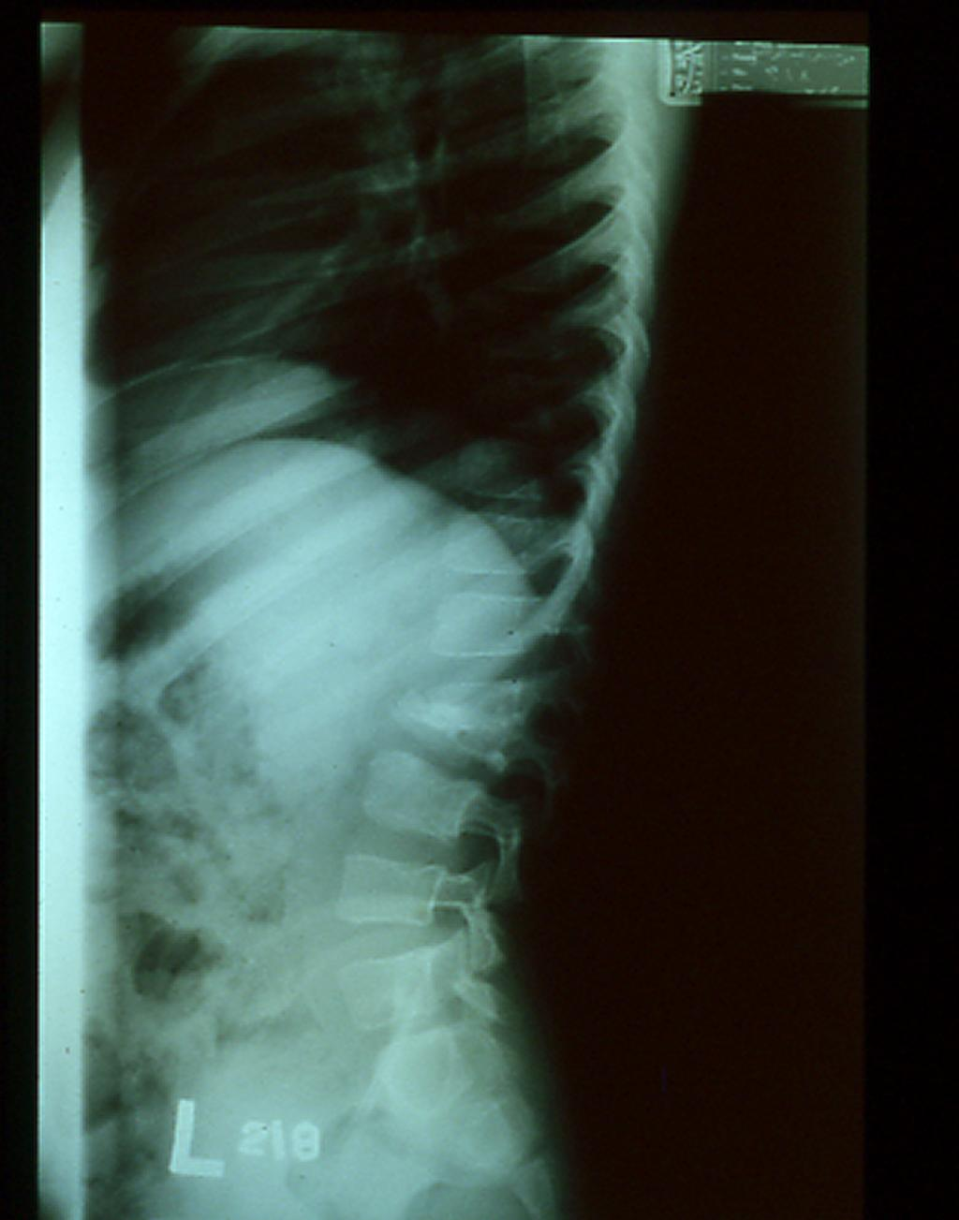

Slide 86
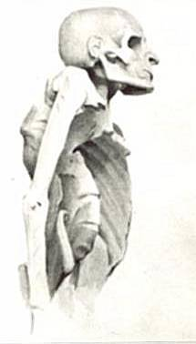

Slide 87
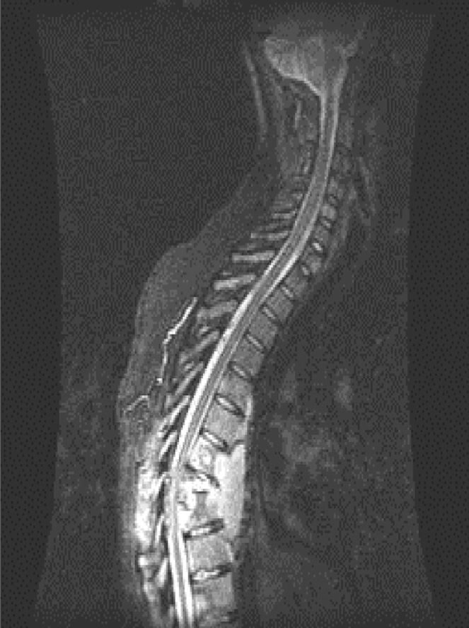

Slide 88
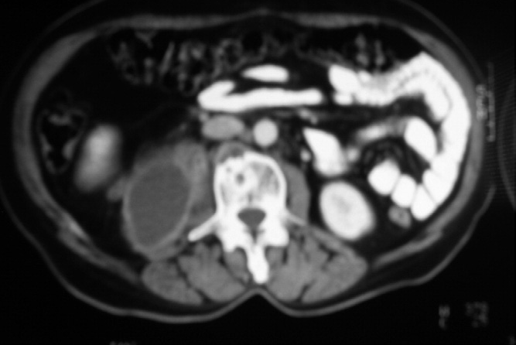

Slide 89
Diagnosis
History and physical
High risk
Constitutional symptoms
Atypical clinical picture
Blood work:
Lymphocytosis
Anemia
Elevated ESR
ELISA
PCR
Brucella titre

Slide 90
Diagnosis
Radiology:
Plain x-rays:
Spine:
Erosion and destruction of end plates
Narrowing of disc space
Soft tissue mass shadow
Anterior wedging of vertebrae
Kyphus deformity

Slide 91
Diagnosis
Radiology:
Computerized tomography:
Further delineate bony destruction and sequestrum
Magnetic resonance imaging with contrast:
Soft tissue mass, abscess
Nerve root, cord status
Distant abscess
Non-enhanced cold abscess with enhanced peripheral ring

Slide 92
Diagnosis
Special tests:
Mantoux skin test
Spine:
CT guided needle biopsy
Joints:
Synovial aspiration---- low yield
Should get bone/soft tissue
Send for aerobic/non-aerobic bacteria, fungal, AFB, enriched culture media
Takes up to 4-6 weeks

Slide 93
Treatment
Mainstay of treatment is combination anti-microbial agents.
Usually 3-4 medications needed
Isniazide, Rifampin, Ethambutol, Pyrazinamide are commonly chosen
Modify according to culture results
Given for prolonged period of time (6 months up-to 18 months)

Slide 94
Treatment
Indications of surgery:
Marked and progressive neurological deficit not responding to medical treatment requiring decompression
Spinal instability requiring stabilization
Tissue biopsy to confirm diagnosis
Joint lavage and removal of rice bodies
Abscess drainage if resistant to conservative treatment

Slide 95
Brucellosis
Milk and milk products
Back pain and stiffness
Muscle spasms
Fever (mild)
Sacro-iliac joint
Less destructive than TB
Brucella titer
Antibiotics:
e.g. Septrin - Oxytetracycline

Slide 96
Take home messages
Be aware about red flags
Acute osteomyelitis: Empirical wide spectrum IV Abx till final culture
Chronic osteomyelitis: IV Abx according to C/S
Septic arthritis:
Joint aspiration under GA for children
Emergency Joint washout
Required Immediate wide spectrum IV Abx till final culture
Bone and joint infection requires prolonged antibiotic

