Slide 1
Approach to Patient with UTI
Mohammed Rabeh Aldhaheri
Hisham Nasser Almutawa

Slide 2
Question 1
What is the most common organism causing UTI?
proteus mirabilis
E.coli
Klibsiella pneumoniae
Pseudomonas aeruginosa

Slide 3
Question 2
Which of the following is considered as a risk factor for complicated UTI?
High grade fever
Severe flank pain
Urinary tract obstruction
Female gender

Slide 4
Question 3
Which one of the following is considered contraindicated in pregnant woman?
Penicillin
Cephalexin
Fosfomycin
Fluoroquinolone

Slide 5
Question 4
How to differentiate between cystitis and pyelonephritis in urinalysis?
Nitrite
WBC Casts
RBC
WBC

Slide 6
Objectives
Types of UTI (Cystitis, Pyelonephritis)
Causes
Common organisms
How patient presents
Diagnosis
When to start full investigations
When to refer to specialist
Management
Prophylaxis
Education

Slide 7
What is UTI
Infection that affect any part of the urinary tract
Types:
Upper
Lower

Slide 8
Cystitis
Infection of the bladder “lower urinary tract“
Complicated
Uncomplicated

Slide 9
Patient demographics
Pregnancy
Advanced age
Comorbidities
Diabetes mellitus
Immunosuppression
Renal failure
Renal transplantation
History of urinary tract infection in childhood
Infection characteristics
Hospital-acquired infection
Uropathogen broadly resistant to antimicrobials
Symptoms for seven or more days before seeking care
Recent antimicrobial use
Recent urinary tract instrumentation
Functional or anatomic abnormality of the urinary tract
Urinary tract obstruction
Prostatic hypertrophy
Urethral stricture
Presence of an indwelling urethral catheter, stent, nephrostomy tube or urinary diversion

Slide 10
Epidemiology of Cystitis
More common in women because of the short urethra.
Acute cystitis has been reported to be the most common bacterial infection.
In a survey of 2000 randomly sampled women > 18 years, 10.8% had experienced it in the last 12 months
Notes:
British medical journal

Slide 11
Causes of Cystitis
The most common cause is bacterial infection.
E.coli in 70% of uncomplicated cases of lower UTI.
Other organisms include proteus mirabilis, klibsiella pneumoniae

Slide 12
Presentation of Cystitis
Dysuria
Frequency
Urgency
Suprapubic pain
Hematuria +/-

Slide 13
Physical Examination
It is often not necessary for diagnosis in patient with typical symptoms of cystitis, but if performed it should include :
Assessment for fever
Costovertebral angle tenderness
Abdominal examination

Slide 14
Differential Diagnosis
Painful bladder syndrome
Bladder lesion (Tumor, calculi)
Pelvic inflammatory disease
Drug induced cystitis (Cyclophosphamide, allopurinol)

Slide 15
Investigation
Urinalysis
Urine culture
Imaging

Slide 16
Urinalysis
Not indicated in patient with typical symptoms.
Dipstick
Microscopic

Slide 17
Dipstick
Leukocyte esterase, nitrites, protein, and blood are the important features in evaluating for UTI.

Slide 18
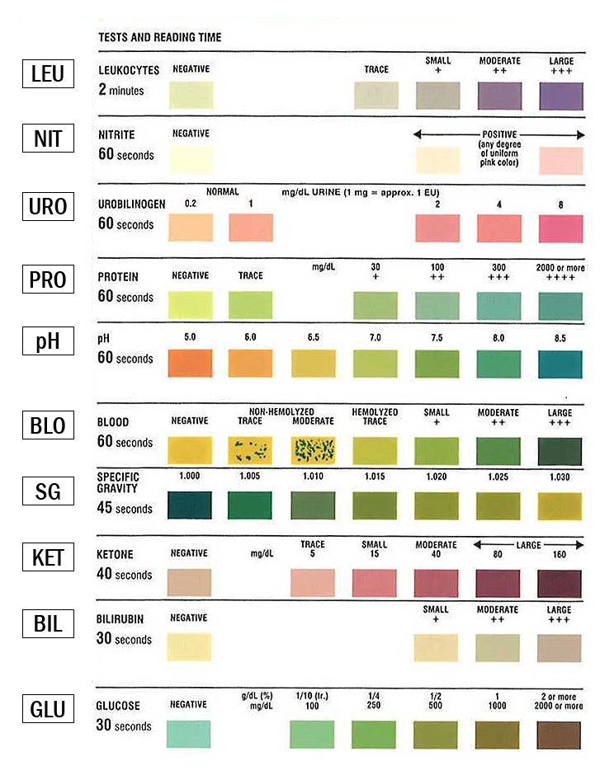

Slide 19
Microscopic
Looks for the presence of white blood cells, red blood cells.

Slide 20
Urine Culture
Urine culture is important when diagnosis is not clear or UTI is recurrent.
The presence of more than one organism may indicate a contaminated urine specimen and collection and testing should be repeated.
The presence of ≥ 10⁵ CFU/mL of bacteria is the traditional diagnostic indicator for UTI. However, in the presence of dysuria and other symptoms for UTI, 10² CFU/mL confirms the diagnosis.

Slide 21
Imaging Studies
Indications:
Persistent symptoms after 48-72 hours of treatment.
Patients with pyelonephritis who are severely ill or with symptoms of renal colic
History of:
Renal stone
Diabetes
Urologic surgery
Renal transplant
Immunosuppression
Recurrent pyelonephritis
Urosepsis
Notes:
Sandberg T, Stokland E, Brolin I, et al. Selective use of excretory urography in women with acute pyelonephritis. J Urol 1989; 141:1290
Kanel KT, Kroboth FJ, Schwentker FN, Lecky JW. The intravenous pyelogram in acute pyelonephritis. Arch Intern Med 1988; 148:2144
http://www.guideline.gov/summary/summary.aspx?doc_id=13683&nbr=007017&string=pyelonephritis (Accessed on September 14, 2009)

Slide 22
Uncomplicated Cystitis: Management
In women:
Nitrofurantoin 100 mg orally twice daily for five days
TMP-SMX; one double strength tablet [160/800 mg] twice daily for three days
Fosfomycin 3 grams single dose
Pivmecillinam 400 mg orally twice daily for three to seven days
Fluoroquinolones are good alternatives
In men:
Trimethoprim-sulfamethoxazole or fluoroquinolones

Slide 23
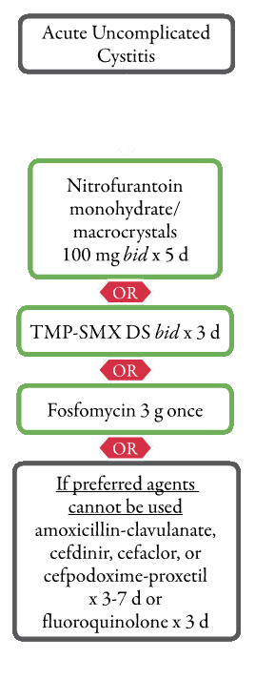

Slide 24
Complicated Cystitis: Management
For patients who can tolerate oral therapy: (5-10 days)
Oral fluoroquinolone
Ciprofloxacin (500 mg orally twice daily or 1000 mg extended release once daily)
Levofloxacin (750 mg orally once daily
For patients who cannot tolerate oral therapy: (5-14 days)
Levofloxacin 500 mg
Ceftriaxone 1 g
Ertapenem 1 g
Aminoglycoside 3 to 5 mg/kg of gentamicin or tobramycin

Slide 25
Pyelonephritis
Inflammation of the kidney parenchyma, calyces, and pelvis
Uncomplicated
Complicated
Notes:
http://www.medilexicon.com/medicaldictionary.php?t=74282

Slide 26
Patient demographics
Pregnancy
Advanced age
Comorbidities
Diabetes mellitus
Immunosuppression
Renal failure
Renal transplantation
History of urinary tract infection in childhood
Infection characteristics
Hospital-acquired infection
Uropathogen broadly resistant to antimicrobials
Symptoms for seven or more days before seeking care
Recent antimicrobial use
Recent urinary tract instrumentation
Functional or anatomic abnormality of the urinary tract
Urinary tract obstruction
Prostatic hypertrophy
Urethral stricture
Presence of an indwelling urethral catheter, stent, nephrostomy tube or urinary diversion

Slide 27
Pyelonephritis: Epidemiology
In the US:
17 cases per 10,000 females/year
4 cases per 10,000 males/year
250,000 new cases/year
Notes:
Czaja CA, Scholes D, Hooton TM, Stamm WE. Population-based epidemiologic analysis of acute pyelonephritis. Clin Infect Dis. Aug 1 2007;45(3):273-80
National Kidney & Urologic Diseases Information Clearinghouse (NKUDIC). Kidney and Urologic Diseases Statistics for the United States. Available at http://kidney.niddk.nih.gov/kudiseases/pubs/kustats/#urologic. Accessed October 31, 2011

Slide 28
Pyelonephritis: Causes
Bacteria | % Uncomplicated | % Complicated
Gram -ve
Escherichia coli | 70-95 | 21-54
Proteus mirabilis | 1-2 | 1-10
Klebsiella spp | 1-2 | 2-17
Citrobacter spp | < 1 | 5
Enterobacter spp | < 1 | 2-10
Pseudomonas aeruginosa | < 1 | 2-19
Other | < 1 | 6-20
Gram +ve
Coagulase-negative staphylococci | 5-10* | 1-4
Enterococci | 1-2 | 1-23
Group B streptococci | < 1 | 1-4
Staphylococcus aureus | < 1 | 1-23
Other | < 1 | 2
Bacterial Etiology of UTIs
Notes:
Adapted from Hooton TM. The current management strategies for community-acquired urinary tract infection.Infect Dis Clin North Am. Jun 2003;17(2):303-32

Slide 29
Pyelonephritis: Presentation
Fever +/- chills & rigors
Flank pain
Nausea/vomiting
Symptoms of cystitis may present
Notes:
Fairley KF, Carson NE, Gutch RC, et al. Site of infection in acute urinary-tract infection in general practice. Lancet 1971; 2:615
Bent S, Nallamothu BK, Simel DL, et al. Does this woman have an acute uncomplicated urinary tract infection? JAMA 2002; 287:2701

Slide 30
Pyelonephritis: Differential Diagnoses
Urethritis
Renal stone
Appendicitis
Vaginitis
PID
Prostatitis

Slide 31
Pyelonephritis: Investigation
Urinalysis
Urine culture
Blood culture
CT
US
MRI
Urography
Renal scintigraphy

Slide 32
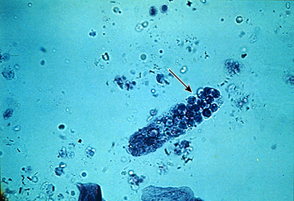
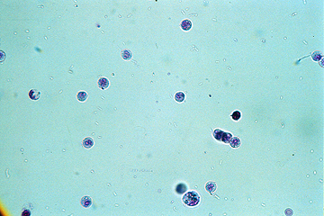
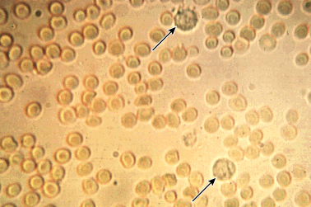
Pyelonephritis: Urinalysis
MSU
Urine dipstick
Leukocyte esterase
Nitrite
Blood
Microscopic examination
RBC
WBC
WBC Casts
Notes:
Stamm WE. Measurement of pyuria and its relation to bacteriuria. Am J Med 1983; 75:53
Wilson ML, Gaido L. Laboratory diagnosis of urinary tract infections in adult patients. Clin Infect Dis 2004; 38:1150
Graff L. A Handbook of Routine Urinalysis, Lippincott, Williams and Wilkins, Philadelphia 1983

Slide 33
Pyelonephritis: Urine culture
Culture and sensitivity
Indications:
Persistence or recurrence of symptoms W/I 3 months
Suspected complicated UTI
Women with acute pyelonephritis
Notes:
Warren JW, Abrutyn E, Hebel JR, et al. Guidelines for antimicrobial treatment of uncomplicated acute bacterial cystitis and acute pyelonephritis in women. Infectious Diseases Society of America (IDSA). Clin Infect Dis 1999; 29:745
Fihn SD. Clinical practice. Acute uncomplicated urinary tract infection in women. N Engl J Med 2003; 349:259
McIsaac WJ, Low DE, Biringer A, et al. The impact of empirical management of acute cystitis on unnecessary antibiotic use. Arch Intern Med 2002; 162:600
Gupta K, Hooton TM, Stamm WE. Increasing antimicrobial resistance and the management of uncomplicated community-acquired urinary tract infections. Ann Intern Med 2001; 135:41

Slide 34
Pyelonephritis: Imaging Studies
Indications:
Persistent symptoms after 48-72 hours of treatment.
Patients with pyelonephritis who are severely ill or with symptoms of renal colic
History of:
Renal stone
Diabetes
Urologic surgery
Renal transplant
Immunosuppression
Recurrent pyelonephritis
Urosepsis
Notes:
Sandberg T, Stokland E, Brolin I, et al. Selective use of excretory urography in women with acute pyelonephritis. J Urol 1989; 141:1290
Kanel KT, Kroboth FJ, Schwentker FN, Lecky JW. The intravenous pyelogram in acute pyelonephritis. Arch Intern Med 1988; 148:2144
http://www.guideline.gov/summary/summary.aspx?doc_id=13683&nbr=007017&string=pyelonephritis (Accessed on September 14, 2009)

Slide 35
Pyelonephritis: CT Scan
More sensitive than US or IVP
Non-contrast CT is the gold standard for renal stone, emphysematous infections, hemorrhage, obstructions, and abscesses
Contrast CT visualizes renal prefusion

Slide 36
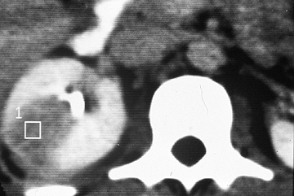
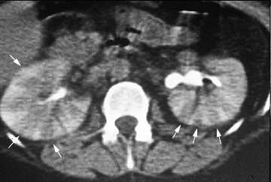
Pyelonephritis: CT Scan

Slide 37
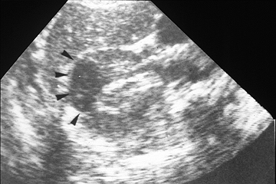
Pyelonephritis: US
Good alternative
No radiation/contrast harms
Good for stones, obstructions, abscesses

Slide 38
Pyelonephritis: Other Investigation
MRI
Urography
Renal scintigraphy
Better in children
Not widely available in acute settings
Notes:
Martina MC, Campanino PP, Caraffo F, et al. Dynamic magnetic resonance imaging in acute pyelonephritis. Radiol Med. Mar 2010;115(2):287-300

Slide 39
Uncomplicated Pyelonephritis: Management
Mild to moderate, not known to be resistant to fluoroquinolones:
Ciprofloxacin 500 mg or 1 g ER orally twice daily for 7 days
Levofloxacin 750 mg orally once daily for 5-7days
Severe, or risk factors for resistance:
IV long-acting, such as:
Ceftriaxone 1 g
24-hour dose of aminoglycoside, i.e. gentamicin 7 mg/kg
Notes:
Talan DA, Stamm WE, Hooton TM, et al. Comparison of ciprofloxacin (7 days) and trimethoprim-sulfamethoxazole (14 days) for acute uncomplicated pyelonephritis pyelonephritis in women: a randomized trial. JAMA 2000; 283:1583
Peterson J, Kaul S, Khashab M, et al. A double-blind, randomized comparison of levofloxacin 750 mg once-daily for five days with ciprofloxacin 400/500 mg twice-daily for 10 days for the treatment of complicated urinary tract infections and acute pyelonephritis. Urology 2008; 71:17
Talan DA, Klimberg IW, Nicolle LE, et al. Once daily, extended release ciprofloxacin for complicated urinary tract infections and acute uncomplicated pyelonephritis. J Urol 2004; 171:734
Sandberg T, Skoog G, Hermansson AB, et al. Ciprofloxacin for 7 days versus 14 days in women with acute pyelonephritis: a randomised, open-label and double-blind, placebo-controlled, non-inferiority trial. Lancet 2012; 380:484
Vellinga A, Tansey S, Hanahoe B, et al. Trimethoprim and ciprofloxacin resistance and prescribing in urinary tract infection associated with Escherichia coli: a multilevel model. J Antimicrob Chemother 2012; 67:2523

Slide 40
Complicated Pyelonephritis: Management
Complicated
Antimicrobial agent | Dose, interval
Mild to moderate pyelonephritis
Ceftriaxone | 1 g every 24 hours
Cefepime | 1 g every 12 hours
Ciprofloxacin | 400 mg every 12 hours
Levofloxacin | 750 mg every 24 hours
Aztreonam* | 1 g every 8 to 12 hours
Severe pyelonephritis with immunocompromise and/or incomplete urinary drainage
Ampicillin-sulbactam | 1.5 g every 6 hours
Ticarcillin-clavulanate | 3.1 g every 6 hours
Piperacillin-tazobactam | 3.375 g every 6 hours
Meropenem | 500 mg every 8 hours
Imipenem | 500 mg every 6 hours
Doripenem | 500 mg every 8 hours
Parenteral regimens for empiric treatment of complicated pyelonephritis
Notes:
MacFadden DR, Ridgway JP, Robicsek A, et al. Predictive utility of prior positive urine cultures. Clin Infect Dis 2014; 59:1265

Slide 41
Complicated Pyelonephritis: Management
5 to 14 days course of ABX
Levofloxacin
Ciprofloxacin
TMP-SMX
Notes:
MacFadden DR, Ridgway JP, Robicsek A, et al. Predictive utility of prior positive urine cultures. Clin Infect Dis 2014; 59:1265

Slide 42
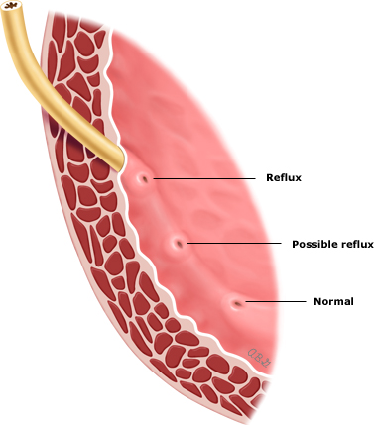
Children and VUR
Vesicoureteral reflux: Retrograde passage of urine from the bladder into the upper urinary tract
1% of newborns
Primary, UVJ
Secondary, bladder
Presentation:
Prenatal:
Hydronehprosis
Male
Postnatal:
UTI
Female
Diagnosis:
VCUG
RNC
Notes:
Dillon MJ, Goonasekera CD. Reflux nephropathy. J Am Soc Nephrol 1998; 9:2377
Shah KJ, Robins DG, White RH. Renal scarring and vesicoureteric reflux. Arch Dis Child 1978; 53:210
Smellie JM, Normand IC, Katz G. Children with urinary infection: a comparison of those with and those without vesicoureteric reflux. Kidney Int 1981; 20:717
Ramage IJ, Schuckett B, McLorie GA, Geary DF. Primary vesicoureteric reflux diagnosed in the 1st month of life. Pediatr Nephrol 1999; 13:716
Willemsen J, Nijman RJ. Vesicoureteral reflux and videourodynamic studies: results of a prospective study. Urology 2000; 55:939
Jaswon MS, Dibble L, Puri S, et al. Prospective study of outcome in antenatally diagnosed renal pelvis dilatation. Arch Dis Child Fetal Neonatal Ed 1999; 80:F135
Brophy MM, Austin PF, Yan Y, Coplen DE. Vesicoureteral reflux and clinical outcomes in infants with prenatally detected hydronephrosis. J Urol 2002; 168:1716

Slide 43
Children and VUR
Grading
Grade I – Reflux only fills the ureter without dilation.
Grade II – Reflux fills the ureter and the collecting system without dilation.
Grade III – Reflux fills and mildly dilates the ureter and the collecting system with mild blunting of the calyces.
Grade IV – Reflux fills and grossly dilates the ureter and the collecting system with blunting of the calyces. Some tortuosity of the ureter is also present.
Grade V – Massive reflux grossly dilates the collecting system. All the calyces are blunted with a loss of papillary impression, and intrarenal reflux may be present. There is significant ureteral dilation and tortuosity
Notes:
Medical versus surgical treatment of primary vesicoureteral reflux: report of the International Reflux Study Committee. Pediatrics 1981; 67:392

Slide 44
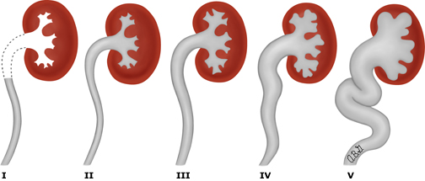
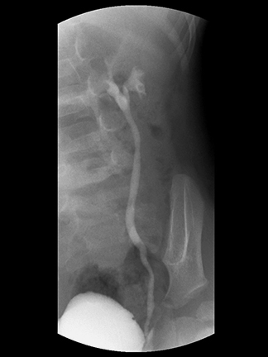
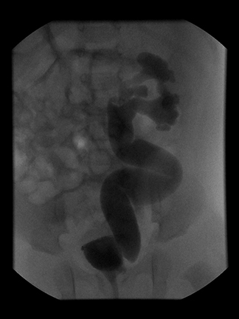
Notes:
Medical versus surgical treatment of primary vesicoureteral reflux: report of the International Reflux Study Committee. Pediatrics 1981; 67:392

Slide 45
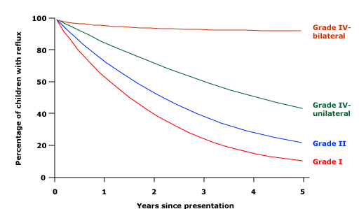
Children and VUR
Treatment of Grade I and II
Prophylactic ABX to:
Non-toilet-trained children
BBD
Surgical correction for children with BTUTI
Treatment of Grade III, IV, and V
Prophylactic ABX
Surgical correction if:
Child older than 3 years
Failure of ABX/ side effects / noncompliance

Slide 46
Asymptomatic Bacteruria in Pregnant Women
ABU in pregnancy is significant because 20-30% of untreated cases progress to acute pyelonephritis.
The US Preventive Services Task Force recommends screening for asymptomatic bacteriuria with urine culture at 12 to 16 weeks’ gestation.
Treatment of ABU in pregnancy consists of oral antibiotics for 14 days. One of the following agents may be used:
Amoxicillin
Amoxicillin-clavulanate
Ampicillin
Treatment of ABU in pregnancy reduces the frequency of acute pyelonephritis to 2-3%.

Slide 47
When to Refer Male UTI Patient to a Specialist
1- Symptoms of upper urinary tract infection (pyelonephritis).
2- Failure to respond to appropriate antibiotic therapy.
3- Frequent episodes of urinary tract infection (UTI) - this is stated as two or more episodes in a 3-month period.
4- Features of urinary obstruction (e.g. in older men, enlarged prostate)
5- History of pyelonephritis, calculi, or previous genitourinary tract surgery
6- Any age with painless macroscopic haematuria:
7- Recurrent or persistent UTI associated with haematuria, in a male aged 40 years or older
8- Unexplained microscopic haematuria, in a male aged 50 years or older
with an abdominal mass identified clinically or on imaging that is thought to arise from the urinary tract
Notes:
(1) SIGN (2006) Management of suspected bacterial urinary tract infection in adults: a national clinical guideline. Scottish Intercollegiate Guidelines Network. (2) CKS (2006). UTI (lower) in men

Slide 48
When to Refer Female UTI Patient to a Specialist
1- Risk factors for complicated UTI.
2- Surgical correction of a cause of UTI.
3- When the diagnosis of recurrent uncomplicated UTI is uncertain.
Notes:
Kodner CM, Thomas Gupton EK. Recurrent urinary tract infections in women: diagnosis and management. Am Fam Physician. 2010;82:638–43

Slide 49
Prophylaxis of UTI
It’s recommended for recurrent UTI patients .
The patient considered if:
1- infected ≥ 2 infections in 6 months.
2- infected ≥ 3 infections in one year .

Slide 50
Prophylaxis of UTI
ANTIMICROBIAL AGENT | CONTINUOUS PROPHYLAXIS (DAILY DOSAGE)* | COST (BRAND)† | POSTCOITAL PROPHYLAXIS (ONE-TIME DOSE)‡ | IN RETAIL DISCOUNT PROGRAMS§
Cephalexin (Keflex) | 125 to 250 mg | $14 ($66); only available in 250-mg capsule | 250 mg | ✓
Ciprofloxacin (Cipro) | 125 mg | $12 ($68); half tablet (250 mg) for 30 days | 125 mg | ✓
Nitrofurantoin (Macrodantin) | 50 to 100 mg | $28 ($68) for 50-mg dose | 50 to 100 mg
Continuous vs. Postcoital Antimicrobial Prophylaxis for Recurrent Urinary Tract Infections

Slide 51
Education
1- Drink plenty of water (six to eight glasses) every day.
2- Do not resist the urgent urination , Bacteria can grow when urine stays in the bladder too long.
3- Women should wipe from front to back to prevent bacteria from entering the vagina or urethra.
4- Cleanse the genital area before and after sexual intercourse.
5- Urinate shortly after sex. This can flush away bacteria that might have entered the urethra during sex.
6- Avoid using feminine hygiene sprays and scented douches, which may irritate the urethra.
7- For women, using a diaphragm or spermicide for birth control can lead to UTIs by increasing bacteria growth.
8- Drink Cranberry juice.

Slide 52
Question 1
What is the most common organism causing UTI?
proteus mirabilis
E.coli
Klibsiella pneumoniae
Pseudomonas aeruginosa

Slide 53
Question 2
Which of the following is considered as a risk factor for complicated UTI?
High grade fever
Severe flank pain
Urinary tract obstruction
Female gender

Slide 54
Question 3
Which one of the following is considered contraindicated in pregnant woman?
Penicillin
Cephalexin
Fosfomycin
Fluoroquinolone

Slide 55
Question 4
How to differentiate between cystitis and pyelonephritis in urinalysis?
Nitrite
WBC Casts
RBC
WBC

Slide 56
References
Uptodate
British medical journal
http://www.medilexicon.com/medicaldictionary.php?t=74282
Czaja CA, Scholes D, Hooton TM, Stamm WE. Population-based epidemiologic analysis of acute pyelonephritis. Clin Infect Dis. Aug 1 2007;45(3):273-80
National Kidney & Urologic Diseases Information Clearinghouse (NKUDIC). Kidney and Urologic Diseases Statistics for the United States. Available at http://kidney.niddk.nih.gov/kudiseases/pubs/kustats/#urologic. Accessed October 31, 2011
Adapted from Hooton TM. The current management strategies for community-acquired urinary tract infection.Infect Dis Clin North Am. Jun 2003;17(2):303-32
Fairley KF, Carson NE, Gutch RC, et al. Site of infection in acute urinary-tract infection in general practice. Lancet 1971; 2:615
Bent S, Nallamothu BK, Simel DL, et al. Does this woman have an acute uncomplicated urinary tract infection? JAMA 2002; 287:2701
Stamm WE. Measurement of pyuria and its relation to bacteriuria. Am J Med 1983; 75:53
Wilson ML, Gaido L. Laboratory diagnosis of urinary tract infections in adult patients. Clin Infect Dis 2004; 38:1150
Graff L. A Handbook of Routine Urinalysis, Lippincott, Williams and Wilkins, Philadelphia 1983

Slide 57
References
Warren JW, Abrutyn E, Hebel JR, et al. Guidelines for antimicrobial treatment of uncomplicated acute bacterial cystitis and acute pyelonephritis in women. Infectious Diseases Society of America (IDSA). Clin Infect Dis 1999; 29:745
Fihn SD. Clinical practice. Acute uncomplicated urinary tract infection in women. N Engl J Med 2003; 349:259
McIsaac WJ, Low DE, Biringer A, et al. The impact of empirical management of acute cystitis on unnecessary antibiotic use. Arch Intern Med 2002; 162:600
Gupta K, Hooton TM, Stamm WE. Increasing antimicrobial resistance and the management of uncomplicated community-acquired urinary tract infections. Ann Intern Med 2001; 135:41
Sandberg T, Stokland E, Brolin I, et al. Selective use of excretory urography in women with acute pyelonephritis. J Urol 1989; 141:1290
Kanel KT, Kroboth FJ, Schwentker FN, Lecky JW. The intravenous pyelogram in acute pyelonephritis. Arch Intern Med 1988; 148:2144
http://www.guideline.gov/summary/summary.aspx?doc_id=13683&nbr=007017&string=pyelonephritis (Accessed on September 14, 2009)
Martina MC, Campanino PP, Caraffo F, et al. Dynamic magnetic resonance imaging in acute pyelonephritis. Radiol Med. Mar 2010;115(2):287-300
Talan DA, Stamm WE, Hooton TM, et al. Comparison of ciprofloxacin (7 days) and trimethoprim-sulfamethoxazole (14 days) for acute uncomplicated pyelonephritis pyelonephritis in women: a randomized trial. JAMA 2000; 283:1583
Peterson J, Kaul S, Khashab M, et al. A double-blind, randomized comparison of levofloxacin 750 mg once-daily for five days with ciprofloxacin 400/500 mg twice-daily for 10 days for the treatment of complicated urinary tract infections and acute pyelonephritis. Urology 2008; 71:17
Talan DA, Klimberg IW, Nicolle LE, et al. Once daily, extended release ciprofloxacin for complicated urinary tract infections and acute uncomplicated pyelonephritis. J Urol 2004; 171:734

Slide 58
Thank You
:)

