Slide 1
Approach To Low Back Pain
Nasser Alsaleh
Mosaed Aldekhayel
Abdullah Alsofyani
Professor. Sulaiman Alshammari

Slide 2
Objectives
Brief introduction.
Common causes and risk factors.
Diagnosis including history, Red Flags, Examination ( Brief comment on Mechanical, Inflammatory, Root nerve compression, Malignancy)
Role of primary health care in management
When to refer to specialist
Prevention and Education
Practical: How to do examination of Back including lower limbs?

Slide 3
MCQ #1
Which of the following is the most common radiculopathy affecting the lumbosacral spine?
L2
L3
L5
S1

Slide 4
MCQ #2
Which of the following is a red flag sign/symptom of back pain?
History of cancer.
Kyphosis.
Age less than 50.
Shingel.

Slide 5
MCQ #3
Which of the following elements is the most important in evaluating back pain?
Lumbar x-ray.
Acupuncture.
Taking a history.
Prescribing a medication and waiting for an effect.

Slide 6
MCQ #4
In a patient with acute low back pain without the presence of red flags or signs of systemic diseases, the most initial investigation is:
X-ray
Computed tomography scan
No need for any investigation.
Magnetic resonance imaging.

Slide 7
MCQ #5
A patient came with lower back pain with morning stiffness, exacerbated by rest and relieved by activity. Which of the following etiologies this presentation considered to be?
Mechanical back pain
Inflammatory back pain
Tumor
Nerve root compression

Slide 8
Introduction
Low back pain is one of the most common reasons for visits to physicians in the ambulatory care setting.
The total cost related to back pain is estimated to be >$100 billion per year in the United States.¹
If approach is not systematic, cost, identification of non-clinically significant lesions and worsening of psychological condition will all be affected.

Slide 9
Epidemiology
A study conducted in Al-Qaseem region, and a response was obtained from 5,743 and Back pain was reported by 1,081 (18.8%). 8.8% were men, and 10% were women. ²
In United Kingdom, around 2.6 million people seeking advice about back pain from their general practitioner each year.³

Slide 10
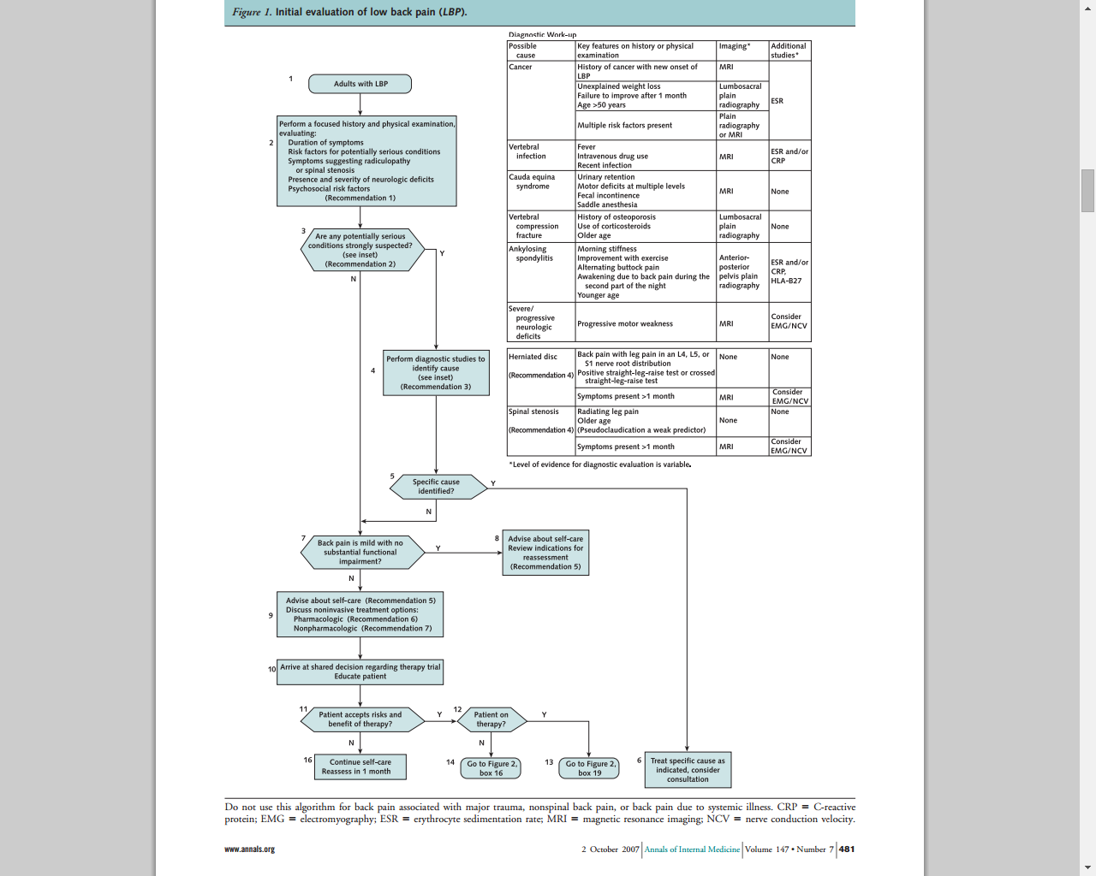

Slide 11
Red flags⁴
Age more than 50 years
History of cancer
Unexplained weight loss
Persistent fever
History of intravenous drug use
Immunocompromised state
Recent bacterial infection
Urinary or stool incontinence
Urinary retention
Extremity weakness
Neurologic deficit
Trauma

Slide 12
Risk factors
Modifiable:
Obesity
Smoking
Occupational hazards
Deformity
Previous injury
Non-modifiable:
Genetics
Aging

Slide 13
Scenario
A 30-year-old engineer man presented to the primary health care clinic complaining of a pain in his back for two days after lifting a heavy object.
The pain is located on the lower back and was sudden in onset. The patient describes the pain as tightness and it was localized. The pain is aggravated by movement and relieved by resting. The severity of the pain is 7 out of 10.Patient denies any history of trauma, malignancy, fever, recent weight loss, intravenous drug use and urinary or stool incontinence

Slide 14
Examination
General inspection:
A young adult male patient with a normal body built. Conscious and oriented. looks in mild pain.
Vitals:
Temperature: 37.3°C
Respiratory rate: 16
Pulse: 80 pulse per minute
Blood pressure: 110/80 mmHg

Slide 15
local examination
Position: Standing
Exposure: trunk and lower extremities.
- Look:
no scars, swelling or deformities.
Gait: -normal gait. -Normal heal and toe walking
- Feel:
Bilateral tenderness over the lumbar paraspinal muscles.
- Move:
limited and painful active range of motion in all directions.
-Special test:
Adams Forward bending test is negative.

Slide 16
Position: supine
Inspection:
no muscle wasting in the lower limbs.
Feel:
negative leg length discrepancy test.
Special test:
negative straight leg raising test.

Slide 17
Neurovascular examination
Neurological examination:
Motor: 5/5
Sensory: no sensory deficit
Tone: normal
Reflexes: normal knee and ankle reflexes
Vascular examination:
Palpable posterior tibial and dorsalis pedis arteries
Normal capillary refill time.

Slide 18
Investigations
No investigation is needed.
Treatment
Conservative: Nonsteroidal anti-inflammatory drugs + muscle relaxant.

Slide 19
Simple back pain
Simple back pain accounts for more the 60% of all causes of back pain.
Causes mostly originate from musculoskeletal.
No signs or symptoms of systemic diseases or presence of red flags.
Treatment usually Nonsteroidal anti-inflammatory drugs and muscle relaxant.

Slide 20
Scenario
A 25-year-old male works as a teacher came to the primary health care clinic complaining of lower back pain for several months.
He reports that his symptoms began gradually several months ago. The pain is located in the lower back and buttock area, alternating in two sides, worse in the morning and is associated with stiffness. It gets better throughout the day and with activity. There is a history of fever 1 month ago. He denies radiation or neurological symptoms. No history of malignancy, weight loss, trauma or intravenous drug use.

Slide 21
Examination
Position: Standing
Exposure: trunk and lower extremities.
- Look:
no scars, swelling or deformities.
Gait: -normal gait. -Normal heal and toe walking
- Feel:
Mild tenderness over the lumbar and sacroiliac joints
- Move:
limited and painful active range of motion in all directions.
- Special test:
Adams Forward bending test is negative.

Slide 22
Position: supine
Look
no muscle wasting in the lower limbs.
Feel:
negative leg length discrepancy test.
Special test:
negative straight leg raising test.

Slide 23
Neurovascular examination
Neurological examination
Motor: 5/5
Sensory: no sensory deficit
Tone: normal
Reflexes: normal knee and ankle reflexes
vascular examination:
palpable posterior tibial and dorsalis pedis arteries
Normal capillary refill time.

Slide 24
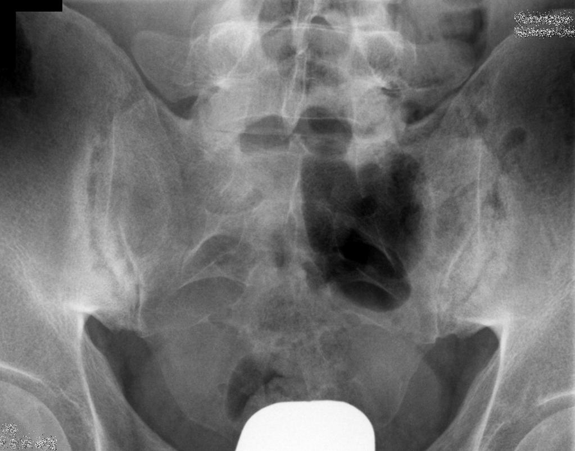
Investigations
Plain x-ray of the sacroiliac joint.
HLA-B27.
Notes:
Bilateral erosions and subchondral sclerosis of the sacroiliac joint

Slide 25
Treatment
Nonsteroidal anti-inflammatory drugs has a dramatic response in patient with Ankylosing spondylitis.
Referral

Slide 26
Complicated back pain without radiculopathy
Accounts for 37% of all causes of back pain.
Presence of systemic signs, symptoms or risk factor e.g. fever, weight loss, history of prior cancer..etc.
Most common causes include:
inflammatory arthritis e.g. ankylosing spondylitis , rheumatoid arthritis.
Neoplastic
Infection: can cause pain when they involve the vertebrae, leading to osteomyelitis.
Plain film and ESR is needed, if either abnormal consider magnetic resonance imaging or computed tomography.

Slide 27
Scenario
A 44-year-old housewife visits the clinic because of mild lower back pain.
She claims that the pain started 6 months ago when she was doing her ‘regular activities’ at home.
The pain is in the lower-back region, sudden in onset and progressing, sharp, radiates down the lateral aspect of the right leg into the foot, aggravated by sitting and bending forward, and relieved by lying down with the knees and hips flexed.
The patient denies any significant trauma or constitutional symptoms. She is otherwise healthy.

Slide 28
Examination
Examination reveals:
Non-distressed, well-looking patient.
Vital signs:Heart rate:95 Beat per minute. Blood pressure: 100/80 mmHg. Respiratory rate:15 Breathe per minute.Temperature:36.8 C
General examination is normal, abdomen is soft, no masses or pulsations felt, costo-vertebral angle is non-tender, pelvic examination is normal.
Local examination:
Look: reduced lumbar lordosis.
Feel: no bone tenderness, skin is normal temperature, no spasm.
Move: extension free, flexion limited mildly.
Special tests: Positive right Straight Leg Raising Test at 50°
Neuro-vascular: palpable pulses in feet, no motor deficit, reduced sensation over dorsum of foot, normal reflexes

Slide 29
Radiculopathy
Lumbosacral radiculopathy is a condition in which a disease process affects the function of one or more lumbosacral nerve roots.
Depending upon the nature and location of intraspinal compression, roots may be injured at any disc level, from the L1-2 level to the level of their exit into their neural foramina

Slide 30
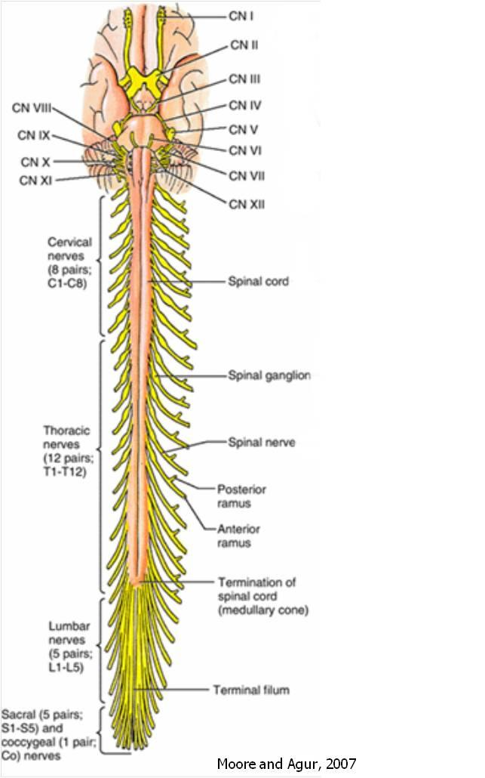

Slide 31
Pathophysiology and etiology:
Disc herniation.
Spondylosis (spinal stenosis due to degenerative arthritis of the spine).
Non-skeletal nerve root compression and noncompressive mechanisms such as infection, inflammation, neoplasm and vascular disease.

Slide 32
Pain:
Classic radiating pain (spinal nerve injury).
Localized lumbosacral pain (Blood vessels, dura mater and longitudinal ligaments).
Nonlocalized, nonradiating pain (muscle, bone and ligaments outside spinal canal).
Referred pain (abdominal viscera).

Slide 33
Degenerative changes
Resulting bony overgrowth (osteophytes) or disc herniation may directly impinge on spinal nerve roots or the spinal cord, or their effect may be primarily to produce instability and misalignment of the spine (ie, degenerative spondylolisthesis) that in turn produces pain and neurologic deficits.

Slide 34
Disc herniation
Depending upon the nature and location of intraspinal compression, roots may be injured at any disc level.
Most frequent presentation is L5 and S1 radiculopathies.

Slide 35
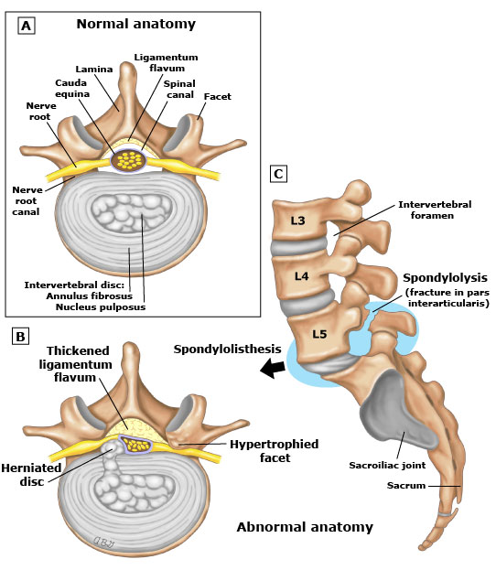

Slide 36
Root | Pain | Sensory loss | Weakness | Stretch reflex loss
L1 | Inguinal region | Inguinal region | Rarely hip flexion | None
L2-L3-L4 | Back, radiating into anterior thigh, and at times medial lower leg | Anterior thigh, occasionally medial lower leg | Hip flexion, hip adduction, knee extension | Patellar tendon
L5 | Back, radiating into buttock, lateral thigh, lateral calf and dorsum foot, great toe | Lateral calf, dorsum foot, web space between first and second toe | Hip abduction, knee flexion, foot dorsiflexion, toe extension and flexion, foot inversion and eversion | Semitendinosus/semibranosus (internal hamstrings) tendon

Slide 37
Root | Pain | Sensory loss | Weakness | Stretch reflex loss
S1 | Back, radiating into buttock, lateral or posterior thigh, posterior calf, lateral or plantar foot | Posterior calf, lateral or plantar aspect of foot | Hip extension, knee flexion, plantar flexion of the foot | Achilles tendon
S2-S3-S4 | Sacral or buttock pain radiating into the posterior aspect of the leg or the perineum | Medial buttock, perineal, and perianal regions | Weakness may be minimal, with urinary and fecal incontinence as well as sexual dysfunction | Bulbocavernosus, anal wink

Slide 38
Disc herniation and foraminal stenosis due to spondylotic degeneration are the most common etiologies for lumbosacral radiculopathy, and clinical symptoms are self-limited in most cases.
Immediate diagnostic testing is not necessary for patients with suspected radiculopathy who are neurologically intact and at low risk for neoplastic, infectious, or inflammatory etiologies

Slide 39
Management
Investigations:
Not needed unless there is a presence of red flags, or the patient at a high risk of neoplasia, inflammation or infection.⁵
If so, magnetic resonance imaging is recommended.

Slide 40
Treatment:
The objectives of treatment are to ameliorate pain and to address the specific underlying process if necessary.
Nonsteroidal anti-inflammatory drugs or acetaminophen and activity modification are the mainstay of treatment.
Physical therapy is often tried for patients with mild to moderate persistent symptoms, but evidence of effectiveness is lacking.
Opioids and muscle relaxant to treat acute, severe pain.
Surgery is preserved for patients who have persistent, disabling radiculopathy due to a herniated lumbar disc

Slide 41
Urgent situations
Bowel or bladder dysfunction may be a symptom of severe compression of the cauda equina, which is a medical emergency. Urinary retention with overflow incontinence is typically present, often with associated saddle anesthesia, bilateral sciatica, and leg weakness.
The cauda equina syndrome is most commonly caused by tumor or a massive midline disk herniation.

Slide 42
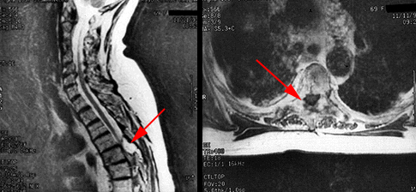
Management
Investigation:
Magnetic resonance imaging.
The scans demonstrate a large epidural lesion compressing the spinal cord

Slide 43
Myelography:
Often combined with computed tomography.
Laterally located lesions.
Patients with mechanical valves, pacemakers, paramagnetic implants, and shrapnel.
Patients in considerable pain, since MRI depends upon the ability of the patient to lie still.
A myelogram permits cerebrospinal fluid (CSF) analysis, which is the cornerstone of the diagnosis of leptomeningeal metastases.

Slide 44
Visceral pain
Pelvic organs
Prostatitis
Endometriosis
Chronic pelvic inflammatory disease
Renal disease
Nephrolithiasis
Pyelonephritis
Perinephric abscess
Aortic aneurysm
Gastrointestinal disease
Pancreatitis
Cholecystitis
Penetrating ulcer

Slide 45
Role of primary health care in management
1-initial evaluation.
2-initial management of simple cases.
3-referal of complicated cases.
4-prevention and education.

Slide 46
When to refer?
Patients with back pain are usually referred to neurosurgery, orthopedics, or psychiatry:
Neuromotor deficit that persists after four to six weeks of conservative therapy.
Persistent sciatica, sensory deficit, or reflex loss after four to six weeks in a patient with positive straight leg raising sign, consistent clinical findings, and favorable psychosocial circumstances (eg, realistic expectations and absence of depression, substance abuse or excessive somatization). (presence of a red flag)

Slide 47
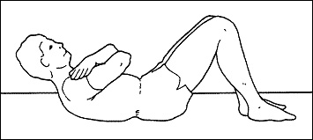
Prevention and education
The best way to prevent back pain is by exercise( stretching and strengthening): e.g:
Partial sit-up. With bent knee, slowly raise your head and shoulders off the floor, and hold for 10 seconds.
Knee-to-Chest Raise. Lie down. Slowly pull knees to chest, relaxing your neck and back, hold for 10 seconds. Repeat 10 times.
Press-up. Lie down with hands near shoulders and pelvis on floor. Press up painlessly, hold for 10 seconds, and repeat 10 times.

Slide 48
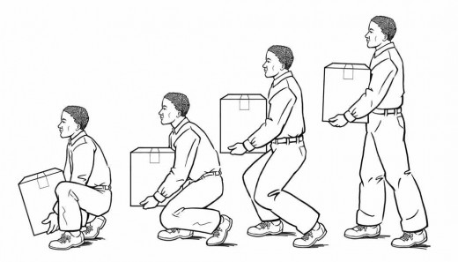
Good Back Techniques
Another way of preventing back and leg pain is by using good back techniques while doing daily activities. Adoption a straight posture, sitting or standing. Back bending should be avoided. Instead, bending the knees or the hips is preferred while lifting objects, tying shoes, putting socks or pants on, etc.

Slide 49
MCQ #1
Which of the following is the most common radiculopathy affecting the lumbosacral spine?
L2
L3
L5
S1

Slide 50
MCQ #2
Which of the following is a red flag sign/symptom of back pain?
History of cancer.
Kyphosis.
Age less than 50.
Shingel.

Slide 51
MCQ #3
Which of the following elements is the most important in evaluating back pain?
Lumbar x-ray.
Acupuncture.
Taking a history.
Prescribing a medication and waiting for an effect.

Slide 52
MCQ #4
In a patient with acute low back pain without the presence of red flags or signs of systemic diseases, the most initial investigation is:
X-ray
CT scan
No need for any investigation.
MRI

Slide 53
MCQ #5
A patient came with lower back pain with morning stiffness exacerbates by rest and relived by activity :
Mechanical back pain
Inflammatory back pain
Tumor
Nerve root compression

Slide 54
References
^{Figure.1} A joint clinical practice guideline from the American College of Physicians and the American Pain Society.
¹ Katz et al. J Bone Joint Surg 2006;88:21-4
²Al-Arfaj AS et al. Saudi Med J. 2003 Feb;24(2):170-3
³Arthritis Research Campaign., 2002.
⁴Treatment: current treatment recommendations for acute and chronic undifferentiated low back pain. Prim Care. 2012 Sep;39(3):481-6. (review article).
5 Chou R, Qaseem A, Owens DK, et al. Diagnostic imaging for low back pain: Advice for high-value health care from the American College of Physicians. Ann Intern Med 2011; 154:181
Chou R, Qaseem A, Snow V, Casey D, Cross JT Jr, Shekelle P, Owens DK, Clinical Efficacy Assessment Subcommittee of the American College of Physicians, American College of Physicians, American Pain Society Low Back Pain Guidelines Panel

