Slide 1
Approach to obese patients
Presented by:
Abdulaziz Mosleh Alonazy
Abdullah Saleh Alkhuraiji
Abdulaziz Bandar Alsuwailem

Slide 2
Our Objectives :
To define and Classify the degree of obesity.
To Highlight the prevalence of obesity in Saudi Arabia.
Discuss how to prevent obesity in the community.
Discuss common causes of obesity in the community.
To know common morbidities caused by obesity.
Discuss evidence based approach to decrease weight.
Discuss role of health team, medical students, and school health in dealing with obesity in the community.

Slide 3
All true about obesity except:
Pre-test
It affects all body systems.
It’s the fifth leading cause of death worldwide.
It’s prevalence is decreasing due to new prevention methods.
80-90% of diabetics are obese.

Slide 4
A patient ,with a weight of 92 Kg and a height of 175 cm, is considered:
Pre-test
Obese class l.
BMI = 24 and it is normal.
Obese class ll.
Overweight and you advice him a healthy diet and exercise.

Slide 5
What causes Obesity ?:
Pre-test
A. Heredity
B. Poor eating habits
C. Lack of physical activity
D. All of the above

Slide 6
Mainstay of treatment for obesity:
Pre-test
Diet and exercise.
Pharmacological.
Restrictive surgery.
Malabsorbative surgery.

Slide 7
All of the following considered as an indication for bariatric surgery, except :
Pre-test
BMI > 40
Age (60 & above).
BMI 30- 30.9 and associated with obesity related health problems.
If all other methods tried and did not work.

Slide 8
Definitions

Slide 9
Abnormal or excessive fat accumulation that may impair health. (WHO)
It is a medical condition in which there is excess accumulation of body fat to the extent that it may have adverse effects on the person’s health and wellbeing.
A condition that is characterized by excessive accumulation and storage of fat in the body and that in an adult is typically indicated by a body mass index of 30 or greater (Medical Dictionary).

Slide 10
Classifications

Slide 11
Case 1
Sultan is a 26 year old man presented to the PHC for routine check up. His weight was 88 Kg and his height was 171 cm. The doctor told him that he’s obese and he should start a diet to reduce his weight.
What are the methods on which the doctor can back up his statement?

Slide 12
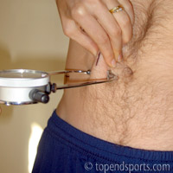
How to classify the degree of obesity ?
Body mass index (BMI).
Waist circumference and Waist/Hip ratio.
Total fat percentage.

Slide 13
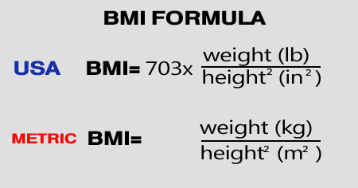
1- BMI
is a simple index of weight-for-height that is commonly used to classify underweight, overweight and obesity in adults.
It is defined as the weight in kilograms divided by the square of the height in meters (kg/m²)
BMI is a fairly reliable indicator of body fatness for most people.

Slide 14
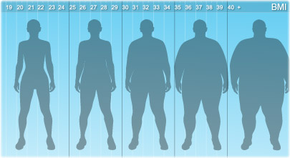
Classification according to BMI
Classification | BMI from | Till BMI of
Underweight | <18.5
Healthy weight | 18.5 | 24.9
Overweight | 25 | 29.9
Obesity I | 30 | 34.9
Obesity II | 35 | 39.9
Obesity III | 40<

Slide 15
The classification is different in children
1- You measure the BMI of the child.
2- If the BMI lies above the 95th percentile on the growth chart, the child is considered obese.

Slide 16
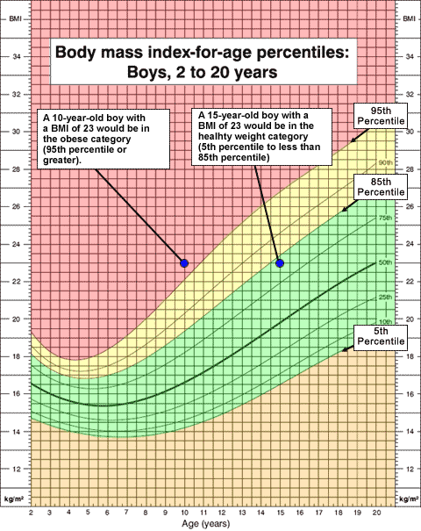
The Growth Chart

Slide 17
BMI
BMI is the measurement of choice for most health professionals.
It is not a diagnostic tool. Health professionals need to do further assessments to fully evaluate health risks.
BMI does not take into account age, gender, or muscle mass. Nor does it distinguish between lean body mass and fat mass.

Slide 18
BMI
As Asian populations develop negative health consequences at a lower BMI than Caucasians, some nations have redefined obesity.
the Japanese have defined obesity as any BMI greater than 25, while China uses a BMI of greater than 28.

Slide 19
2- Waist circumference
Gender | Waist circumference | Complications
Men | > 94cm | Increased risk
 | >102cm | Highly increased risk
Women | > 80cm | Increased risk
 | > 88cm | Highly increased risk
Notes:
Associated with insulin resistance, diabetes, dyslipidemia and coronary heart disease. due to access to liver circulation.

Slide 20
3- Waist To Hip Ratio
Male Waist-to-Hip Ratio | Female Waist-to-Hip Ratio | Health Risk
0.95 or below | 0.80 or below | Low risk
0.96 – 1.0 | 0.81 – 0.85 | Moderate risk
1.0+ | 0.85+ | High risk

Slide 21
Waist To Hip Ratio cont’d

Slide 22
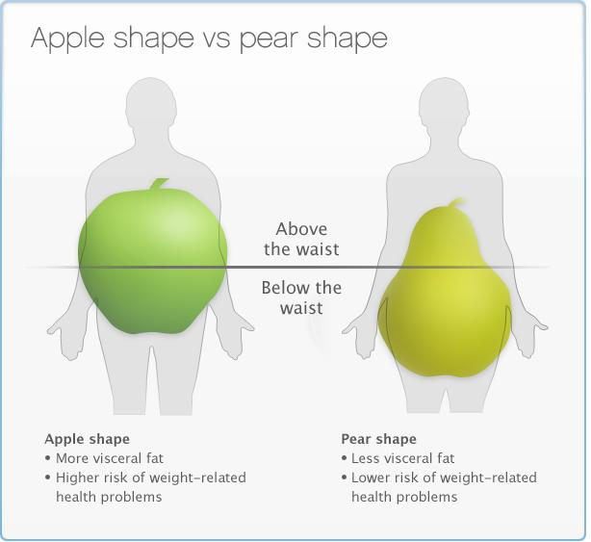
Classification according to Waist/Hip ratio
Gender | Android | Gynoid
Male | W/H ratio >1 | W/H ratio <1
Female | W/H ratio >.8 | W/H ratio <.8

Slide 23
Waist to hip ratio cont’d
Android (or abdominal, or central) poses a greater health risk than Gynoid (excess fat in the hips and thighs).
It is associated with a higher risk of high blood pressure, diabetes, early onset of heart disease, and certain types of cancers (American Dietetic Association).

Slide 24
Importance

Slide 25
Overweight and obesity are the 5th leading risk for global deaths. (preventable !!!)
At least 2.8 million adults die each year as a result of being overweight or obese.
In addition, 44% of the diabetes burden, 23% of the ischemic heart disease burden and between 7% and 41% of certain cancer burdens are attributable to overweight and obesity.

Slide 26
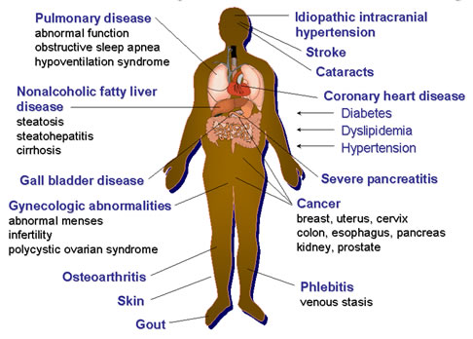
Overweight and obesity are major risk factors for a number of chronic diseases:
Diabetes
CV diseases.
Cancer.
Gallstones.
Osteoarthritis.
Sleep apnea.

Slide 27
Prevalence
Worldwide

Slide 28
WHO
In 2008, 35% of adults aged 20+ were overweight (BMI ≥ 25 kg/m2).
In 2008, 10% of men and 14% of women in the world were obese (BMI ≥30 kg/m2).
An estimated 205 million men and 297 million women over the age of 20 were obese worldwide.

Slide 29
CDC
In 2009–2010:
35.7% of U.S. adults were obese.
16.9% of U.S. children and adolescents were obese.

Slide 30
Prevalence
In KSA

Slide 31
WHO

Slide 32
Local study (2005)
17,232 Saudi subjects from selected households who participated in the study.
The prevalence of overweight was 36.9%. Overweight is significantly more prevalent in males (42.4%) compared to(31.8%)in females.
The overall prevalence of obesity was 35.5% (Females are 44% and males 26.4%).
Severe (gross) obesity was 3.2%.
 | Males | Females | Total
Overweight | 42.4% | 34.8% | 36.9%
Obese | 26.4% | 44% | 35.5%
*Saudi Med J. 2005 May;26(5):824-9,Obesity in Saudi Arabia.

Slide 33
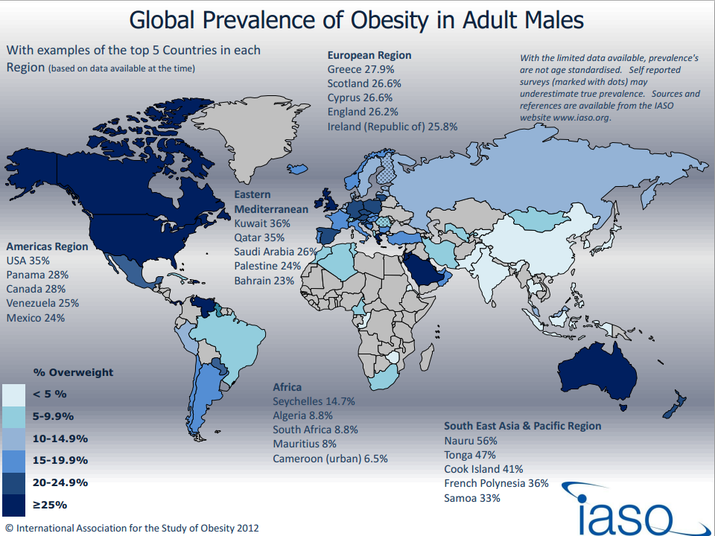
*International Association for the Study of Obesity- IASO- 2012

Slide 34
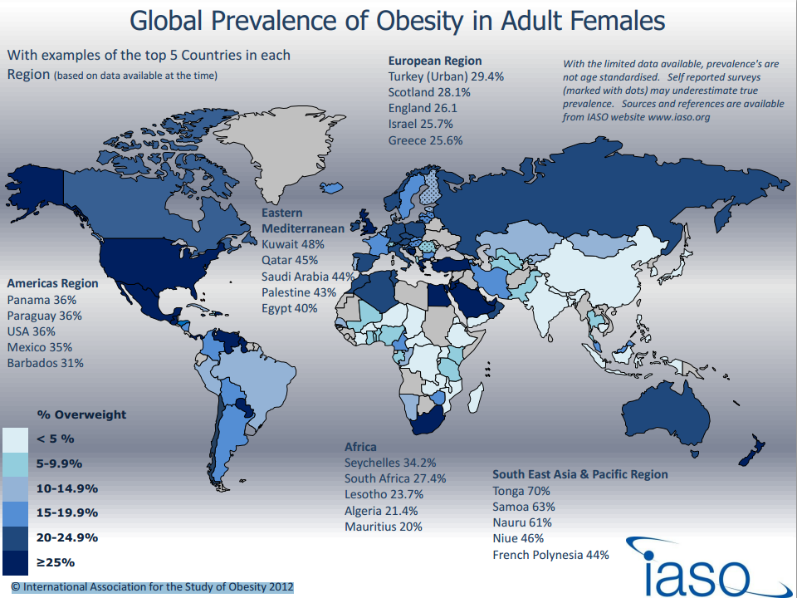
*International Association for the Study of Obesity- IASO- 2012

Slide 35
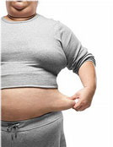
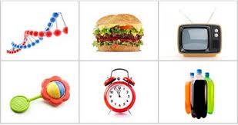
Causes

Slide 36
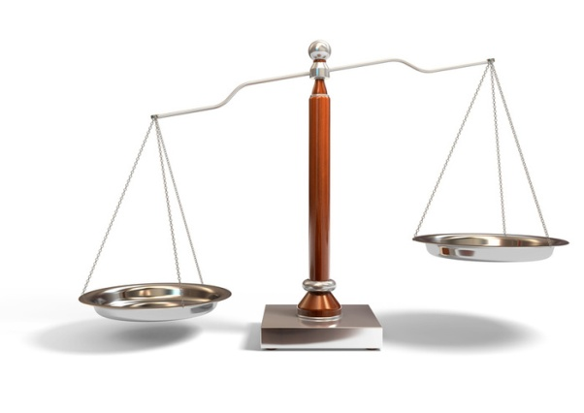
The fundamental cause of obesity and overweight is an energy imbalance between calories consumed and calories expended. Globally, there has been:
an increased intake of energy-dense foods that are high in fat, salt and sugars but low in vitamins, minerals and other micronutrients; and
a decrease in physical activity due to the increasingly sedentary nature of many forms of work, changing modes of transportation, and increasing urbanization.

Slide 37
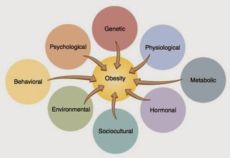

Slide 38
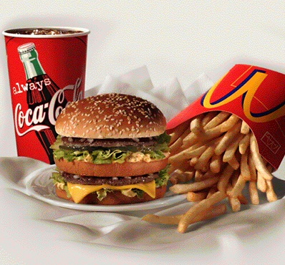
1- Diet
The average calories available per person per day increased in all parts of the world except Eastern Europe.
Total calorie consumption has been found to be related to obesity.

Slide 40
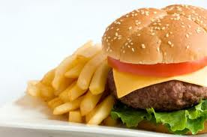
Diet
Settings in which dietary factors become important:
1- Overeating and restrained eating:
Many people have a pattern of conscious limitation of food intake, termed "restrained" eating.
Overeating relative to energy expenditure will uniformly cause obesity; most obese subjects have lost control of their eating.

Slide 41
2- Frequency of eating:
A five meal-a-day pattern was associated with significantly lower risk of overweight and obesity.
Eating breakfast is associated with lower risk of overweight.
One explanation for the effects of frequent small meals versus a few large meals could be the difference in insulin secretion associated with these meal sizes (eg, increased with large meals).

Slide 42
3- Dietary habits:
Epidemiological data suggest that a diet high in fat is associated with obesity.
In contrast, intake of vegetables, whole grains, fruits, nuts, and yogurt was inversely associated with weight gain.
Sugar-sweetened beverages.
4- Fast food:
Comparison between subjects who ate fast food infrequently (<once per week), with subjects who consumed fast food frequently (>twice per week) at baseline and follow-up gained an extra 4.5 kg of weight and had a twofold increase in insulin resistance.

Slide 43
5-Night-eating syndrome:
Night-eating syndrome is defined as consumption of at least 25 percent (and usually more than 50 percent) of energy between the evening meal and the next morning.
Component of sleep apnea, in which daytime somnolence and nocturnal wakefulness are common.
6- Binge-eating disorder:
Binge-eating disorder is a psychiatric illness characterized by uncontrolled episodes of eating that usually occur in the evening.

Slide 44
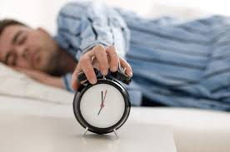
Life Style
1-Physical inactivity:
A sedentary lifestyle lowers energy expenditure and promotes weight gain.
Television — Television viewing is perhaps the best established environmental influence on the development of obesity during childhood.

Slide 45
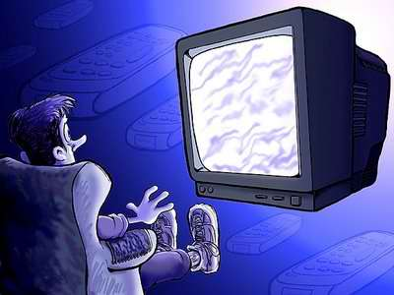
In both children and adults, there is an association between television viewing time and the risk of obesity.
A review found 63 of 73 studies (86%) showed an increased rate of childhood obesity with increased media exposure, with rates increasing proportionally to time spent watching television.
TV

Slide 46
2-Sleep deprivation:
Sleep restriction, when compared to sleep extension, was associated with a decrease in serum leptin , an increase in serum ghrelin and increased hunger and appetite.
Inadequate sleep could result in excessive eating, obesity, and altered response to dietary therapy.
3- Cessation of smoking :
This is thought to be mediated at least in part by nicotine withdrawal. Weight gain of 1 to 2 kg in the first two weeks is often followed by an additional 2 to 3 kg weight gain over the next four to five months.
Notes:
exercise program and decreased caloric intake be recommended to all patients about to stop smoking

Slide 47
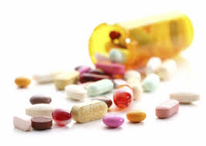
Drugs
1- Antipsychotics:
Conventional (first generation) antipsychotics, like thioridazine.
Atypical (second generation) antipsychotics, clozapine and olanzapine.
2- Antidepressants :
Tricyclic antidepressants, in particular, amitriptyline, clomipramine, doxepin, and imipramine are associated with significant weight gain.
Short-term use of fluoxetine and sertraline has been associated with weight loss

Slide 48
3- Antiepileptic drugs:
The antiepileptic drugs valproate (valproic acid) and carbamazepine, which are commonly used in the management of bipolar disorder, are associated with weight gain.
4- Diabetes drugs:
Insulin stimulates weight gain, possibly through hypoglycemia, and the sulfonylureas that increase insulin release also increase weight.
pioglitazone and rosiglitazone, are also associated with weight gain

Slide 49
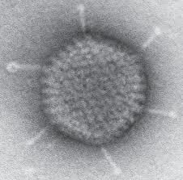
Infections
Human studies, including a small study in twins, have shown an association between adenovirus 36 antibodies and obesity status in adults.

Slide 50
Genetics
Like many other medical conditions, obesity is the result of an interplay between genetic and environmental factors. Polymorphisms in various genes controlling appetite and metabolism predispose to obesity when sufficient food energy present.
People with two copies of the FTO gene (fat mass and obesity associated gene) has been found on average to weigh 3–4 kg more and have a 1.67-fold greater risk of obesity compared to normal people.
Obesity is a feature of at least 24 genetic disorders, most commonly known ones:
Prader-Willi syndrome
Bardet-Biedl syndrome

Slide 51
Prader–Willi syndrome
low muscle tone, short stature, incomplete sexual development, cognitive disabilities, problem behaviors, and a chronic feeling of hunger that can lead to excessive eating and life-threatening obesity.
Prader–Willi syndrome patients have high ghrelin levels.
Notes:
Ghrelin is a hormone produced mainly by P cells lining the fundus of the human stomach and epsilon cells of the pancreas that stimulates hunger

Slide 52
Single-gene cause of obesity:
Leptin and leptin gene deficiency
NB : injection with leptin will decrease the appetite
some obese patients may have resistance to leptin.

Slide 53
Other causes
Hypothyroidism, Cushing's syndrome, growth hormone deficiency.
Eating disorders: binge-eating disorder and Night eating syndrome.

Slide 54
Binge-eating disorder
Binge-eating disorder is a psychiatric illness characterized by Recurrent uncontrolled episodes of eating that usually occur in the evening.

Slide 55
Binge eating disorder
Eating much more rapidly than normal.
Eating until feeling uncomfortably full.
Eating large amount of food when not feeling physically hungry.
Eating alone because of feeling embarrassed by how much one is eating.
Feeling disgusted with oneself, depressed, or very guilty afterward.
Notes:
A. Recurrent episodes of binge eating. An episode of binge eating is characterized by both of the following:
Eating, in discrete period of time (e.g., within any 2-hour period), an amount of food that is definitely larger than what most people would eat in a similar period of time under similar circumstances.
A sense of lack of control over eating during the episode (e.g., a feeling that one cannot stop eating or control what or how much one is eating).
B. The binge-eating episodes are associated with three (or more) of the following:
Eating much more rapidly than normal.
Eating until feeling uncomfortably full.
Eating large amount of food when not feeling physically hungry.
Eating alone because of feeling embarrassed by how much one is eating.
Feeling disgusted with oneself, depressed, or very guilty afterward.
C. Marked distress regarding binge eating is present. D. The binge eating occurs, on average, at least once a week for 3 months.

Slide 56
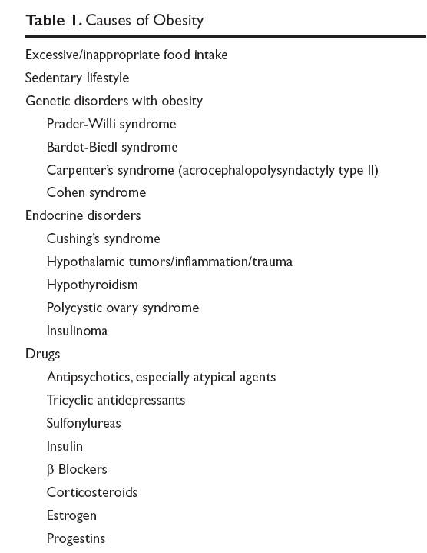

Slide 57
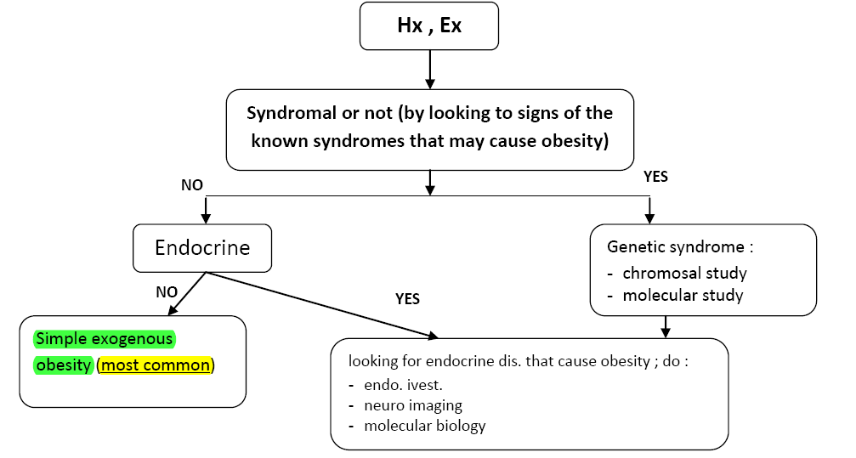
How to assess cause of obesity clinically?

Slide 58
Case :
Salma is a 22 year old female presented to the PHC after months of failed dieting to overcome her obesity. Her weight is 98 Kg and her height is 166 cm.
During that visit, she mentioned that her lower limbs are getting thinner and noticed numerous stretch marks in her trunk. The doctor noticed that she has acne.
What is the most likely cause of her obesity?

Slide 59
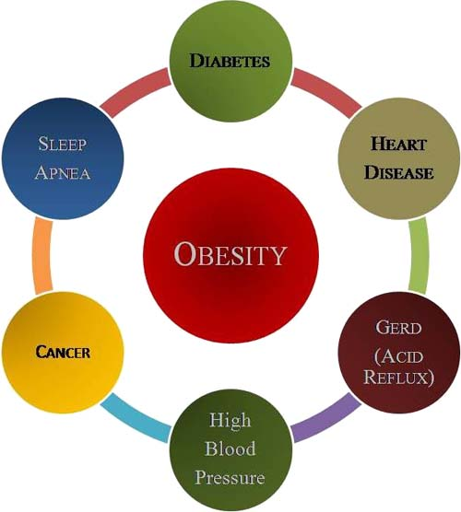
Complications

Slide 60
Mortality: obesity is one of the leading preventable causes of death. Large scale American and European study showed that mortality risk is lowest at a BMI between 20-25 kg\m2 in non-smokers.
Morbidity:
Obesity increases the risk of developing a number of chronic diseases :

Slide 61
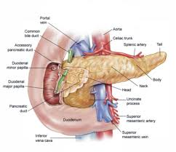
1-Diabetes
More than 80 percent of cases of type 2 diabetes can be attributed to obesity.
At a BMI greater than 35 kg/m2, the relative risk for diabetes adjusted for age increased to 61.
Weight gain after age 18 years in women and after age 20 years in men also increases the risk of type 2 diabetes.

Slide 62
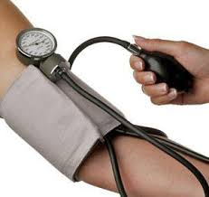
2-Hypertension
The risk of hypertension is greatest in those subjects with upper body and abdominal obesity.
Persistent obesity makes the hypertension more difficult to control by interfering with the efficacy of antihypertensive drugs.

Slide 63
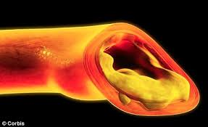
3-Dyslipidemia
The prevalence of obesity-associated dyslipidemia may be decreasing.
Unfavorable obesity-related effects include: high (LDL), (VLDL)and triglycerides.
Reduction in serum (HDL) cholesterol of about 5 percent .

Slide 64
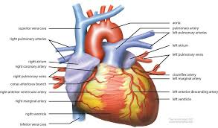
4-Heart Disease
1) Coronary disease.
2) Heart failure.
3) Myocardial Steatosis.
4) Atrial fibrillation/flutter.

Slide 65
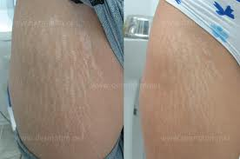
5- Skin changes
Stretch marks (striae). are common and reflect the tension on the skin from expanding subcutaneous deposits of fat.
Acanthosis nigricans (hyper pig.).
Hirsutism
Striae

Slide 66
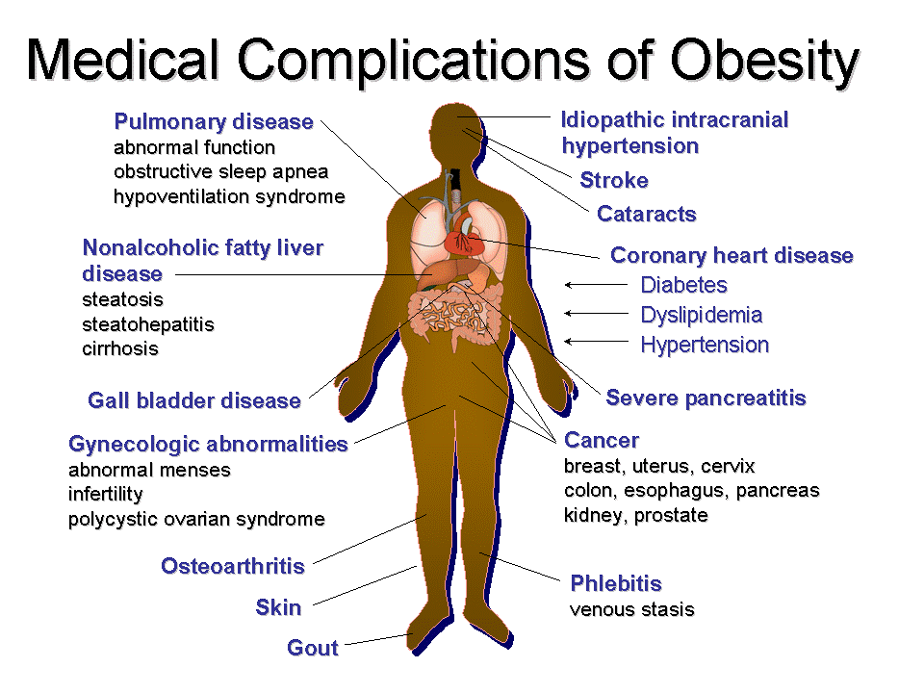
6- Gout.
7-Stroke.
8- Venous thrombosis.
9- Dementia.
10- Obstructive sleep apnoea.
11- Hepatobilliary disease.
12-GERD/ GI cancer.
13- Osteoarthritis.
14- Kidney Disease.
15- Depression.
16- Poor mobility.
Notes:
Depression

Slide 67
Management

Slide 68
How would someone lose weight?
Well, there are 3 ways to do that:
Lifestyle Modification
Medications
Surgery

Slide 69
1\ Lifestyle Modification
Diet
Behavior
Exercise

Slide 70
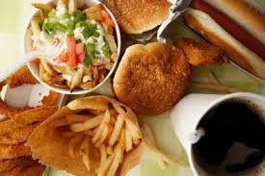
Eat healthy meals and snacks
Focus on
Avoid
low-calorie, nutrient-dense foods, such as fruits, vegetables and whole grains.
saturated fat, alcohol and limit sweets.

Slide 71
10 tips to modify your diet

Slide 72
#1 Set yourself for success and stay motivated
Determine the exact weight you want to reach( better healthy….. Not ideal weight)
Set a specific date to reach that weight.
If you have to, break your goal into several smaller goals.

Slide 73
#1 Set yourself for success and stay motivated
Simplify……. Don’t be so concerned about counting calories or measuring portion sizes. Remember, you are adapting a healthier lifestyle, not crash diet.
Start slow and make the changes over time.

Slide 74
#2 Moderation
To maintain a healthy body, you need balanced portions of carbohydrates, fats, proteins, vitamins, and minerals.
قال تعالى: ( إنا كل شئ خلقناه بقدر)

Slide 75
#2 Moderation
There is no food that is “off limits”. You can still enjoy the food you love but in moderation
Choose healthy foods more often than unhealthy ones.

Slide 76
#2 Moderation
Eat smaller meals throughout the day, instead of large less frequent ones.
قال صلى الله عليه وسلم: (ما ملأ ادمي وعاء شرا من بطن, بحسب ابن ادم أكلات يقمن صلبه, فإن كان لا محالة فثلث لطعامه و ثلث لشرابه و ثلث لنفسه )

Slide 77
#3 Shift from unhealthy to healthy carbs
Healthy carbohydrates give you sustained energy throughout the day.
Studies have shown that people who eat more whole grains have healthier hearts.

Slide 78
#3 Shift from unhealthy to healthy carbs
So, what is a healthy carb??
→ Healthy carbs → whole grains, beans, brown rice, fruits, and vegetables.
→ Unhealthy ones → white flour, pasta, white bread, and refined sugar.

Slide 79
#4 Proteins
These are important for energy, and growth of cells and organs.
Reduction in protein intake is associated with impaired growth, low immunity, and affects the heart and respiratory system.

Slide 80
#4 Proteins
Include different varieties of proteins into your diet ( even if you are a vegetarian)
Types of proteins → plant → beans, nuts → meat → red meat, poultry or fish

Slide 81
#4 Proteins
Choose healthy protein sources like plants, fish, poultry, and eggs
Limit red meat to twice a week.
Don’t let protein to be the center of your diet.

Slide 82
#5 Shift from unhealthy to healthy fats
Types of fat: → Healthy → Monounsaturated fat → polyunsaturated fat → Unhealthy → Saturated → Trans → Cholesterol

Slide 83
#5 Shift from unhealthy to healthy fats
Always try to choose foods that contain more healthy fats → check the nutritional facts.
When cooking your meals, use olive or canola oil instead of butter.

Slide 84
#6 Eat calcium rich foods
Calcium is important to keep your body and bones strong.
We need 1000 mg of it a day ( > 50 years need 1200 mg a day)

Slide 85
#6 Eat calcium rich foods
Foods rich in calcium → Dairy products → low fat
→ Beans → Kidney beans, black beans,and white beans
→ Vegetables and greens → lettuce, celery, and broccoli.

Slide 86
#7 Include more fruits and veggies
They are low in calorie, and rich in nutrients.
They are rich in fiber, antioxidants, vitamins, and minerals.

Slide 87
#8 Limit salt and sugar intake
Sugars → they cause ups and downs in energy → some sources are obvious like: cakes, candy →others are hidden resources like: rice, bread, and ketchup.

Slide 88
#8 Limit salt and sugar intake
Sugars →limit the sweets…… no worries you can still eat the food you like but in moderation. → Limit sugary drinks like: sodas…. Use juice or sparkling water.

Slide 89
#8 Limit salt and sugar intake
Salt → we consume more salt than what we need →recommendation is to consume 1500-2300 mg a day ( which is about 1 teaspoon) → avoid salty snacks like potato chips.

Slide 90
#8 Limit salt and sugar intake
salt
→choose reduced sodium products.
→eat more fresh foods
→ be careful when you dine out.

Slide 91
#9 Drink plenty of water
Sometimes your body mistakes thirst for hunger

Slide 92
#10 Beware of emotional eating
Recognize the situations which trigger you to eat.
Is it when you are stressed, depressed, bored, or tiered.

Slide 93
#10 Beware of emotional eating
Try to deal with these situations using other means like: calling a friend, taking a walk, or curling up with a book.
Just stay away from the refrigerator.

Slide 94
2\ Medications
Medications are another way to lose weight.
When to use? → Failure of diet and exercise → BMI > 30 → BMI > 27 and associated with medical problems related to obesity

Slide 95
Drug | Action | Side Effects
Diethylpropion (Tenuate) | Decreases appetite, increases feeling of fullness | Increased blood pressure and heart rate, insomnia, dizziness
Lorcaserin (Belviq) 2013 | Decreases appetite, increases feeling of fullness | Headache, dizziness, fatigue, nausea, dry mouth, constipation
Phentermine (Adipex) | Decreases appetite, increases feeling of fullness | Increased blood pressure and heart rate, insomnia, dizziness
Orlistat (Xenical) | Blocks absorption of fat | Intestinal cramps, gas, diarrhea, oily spotting
Phentermine and extended-release topiramate (Qsymia) | Decreases appetite, increases feeling of fullness | Increased heart rate, birth defects, tingling of hands and feet, insomnia, dizziness, constipation, dry mouth

Slide 96
Surgery

Slide 97
Bariatric Surgery
This is the last resort.
Only when all else fails.
Basically, the surgeons change the anatomy of the digestive system to help the person lose weight.

Slide 98
Indications: → BMI > 40 → BMI 30- 30.9 and associated with obesity related health problems. → All else has failed

Slide 99
The classification of surgery → Malabsorptive → Biliopancreatic surgery → Restrictive → Adjustable Gastric Band → Mixed → Gastric Bypass
The Gastric Bypass is the most common.

Slide 100
Complications: → short term → Bleeding, Infection, or Anesthesia complications. → long term → Hypoglycemia → Anemia → malnutrition → vitamin deficiency → ulcers → Death,,,,, this is rare

Slide 101
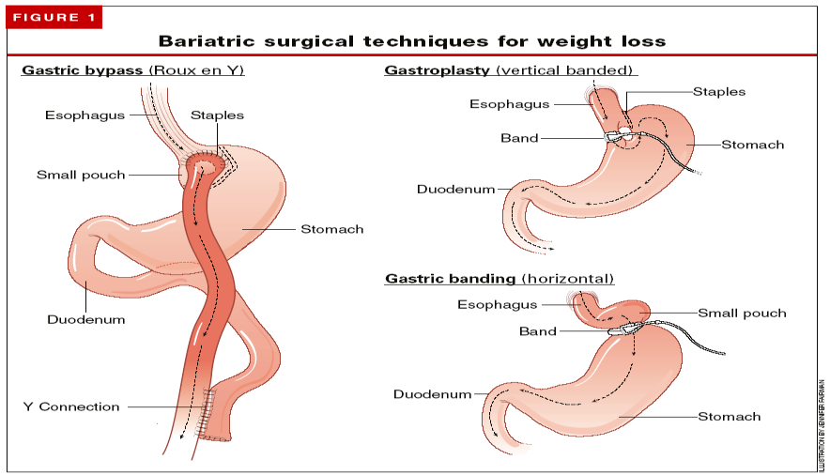

Slide 102
How to Prevent ?
The steps to prevent weight gain are the same as the steps to lose weight:
Daily exercise
Healthy diet, and a long-term commitment to watch what you eat and drink

Slide 103
Exercise regularly
According to the American College of Sports Medicine, you need to get 150 to 250 minutes of moderate-intensity activity a week to prevent weight gain.
Moderately intense physical activities include fast walking and swimming

Slide 104
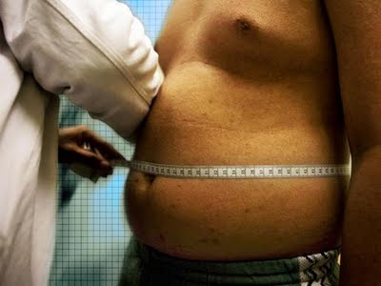
Monitor your weight regularly
Monitoring your weight can tell you whether your efforts are working and can help you detect small weight gains before they become big problems.

Slide 105
Children
Be a role model. Parents who eat healthy foods and participate in physical activity set an example so that a child is more likely to do the same.
Encourage physical activity.
Reduce "screen" time in front of TV and computer to less than two hours daily.
Avoid using food as a reward.
Encourage children to drink water rather than beverages with added sugar, such as soft drinks.

Slide 107
Role of health team, medical students, and school health in dealing with obesity in the community

Slide 108
Health team
Education
Education
Education

Slide 109
Health team
- health professionals have an important role in promoting preventive measures and encouraging positive lifestyle
Behaviors.
- also have a role in counseling patients about safe and effective weight loss and weight maintenance programs.

Slide 110
Role of schools
1- health education
2- physical education
3- health services
4- nutrition services
5- staff health promotion
6- health educations for family

Slide 111
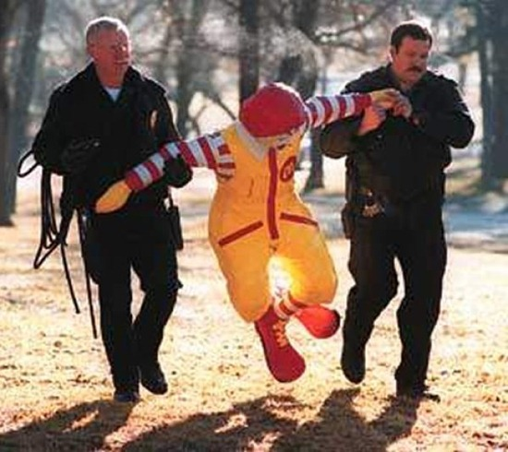

Slide 112
All true about obesity except:
Pre-test
It affects all body systems.
It’s the fifth leading cause of death worldwide.
It’s prevalence is decreasing due to new prevention methods.
80-90% of diabetics are obese.

Slide 113
A patient ,with a weight of 92 Kg and a height of 175 cm, is considered:
Pre-test
Obese class l.
BMI = 24 and it is normal.
Obese class ll.
Overweight and you advice him a healthy diet and exercise.

Slide 114
What causes Obesity ?:
Pre-test
A. Heredity
B. Poor eating habits
C. Lack of physical activity
D. All of the above

Slide 115
Mainstay of treatment for obesity:
Pre-test
Diet and exercise.
Pharmacological.
Restrictive surgery.
Malabsorbative surgery.

Slide 116
All of the following considered as an indication for bariatric surgery, except :
Pre-test
BMI > 40
Age (60 & above).
BMI 30- 30.9 and associated with obesity related health problems.
If all other methods tried and did not work.

Slide 117
Take Home Message
BMI, Waist Circumference and Waist To Hip Ratio can all be used to identify and classify obesity.
The local studies suggest an increase in the prevalence of obesity.
Diet, Life Style, Neuroendocrine diseases, Drugs, Psychological influenses ,Genetics, Socioeconomics and some Infections can lead to obesity.

Slide 118
Take Home Message
Diabetes, Hypertension, Dyslipidemia, Gout, Heart Diseases, Stroke, Sleep apnoea and specific Skin Changes are well known complications of obesity.
Obesity should be managed initially with diet and life style modification followed by pharmacotherapy and surgery as a last option.

Slide 119
References

Slide 120
World Health Organization. “Obesity and overweight - fact sheet”
Centers of Disease Control and Prevention “Prevalence of Obesity in the United States, 2009–2010”
Al-Nozha MM, Al-Mazrou YY, Al-Maatouq MA, Arafah MR, Khalil MZ, Khan NB, Al-Marzouki K, Abdullah MA, Al-Khadra AH, Al-Harthi SS, Al-Shahid MS, Al-Mobeireek A, Nouh MS. Obesity in Saudi Arabia. Saudi Med J. 2005 May;26(5):824-9.
"Why Extreme Dieting Sometimes Leads To Eating Disorder Treatment" http://www.casapalmera.com/articles/relationship-between-dieting-and-eating-disorders
“Questions and Answers on Prader-Willi Syndrome". Prader-Willi Syndrome Association. Retrieved February 2, 2012.
http://www.mayoclinic.com/health/obesity/DS00314/DSECTION=prevention
http://www.stjohnprovidence.org/HealthInfoLib/swArticle.aspx?85,P07863
"EarthTrends: Nutrition: Calorie supply per capita". World Resources Institute. Retrieved Oct. 18, 2009
Rosenheck R (November 2008). "Fast food consumption and increased caloric intake: a systematic review of a trajectory towards weight gain and obesity risk". Obes Rev 9 (6): 535–47. doi:10.1111/j.1467-789X.2008.00477.x. PMID 18346099.
"WHO | Physical Inactivity: A Global Public Health Problem". World Health Organization. Retrieved February 22, 2009.
Dixon JB, Jones K, Dixon M. Medical versus surgical interventions for the metabolic complications of obesity in children. Semin Pediatr Surg. 2009. Aug;18(3):168-75. PubMed PMID: 19573759.
Our Colleagues previous presentations.

Slide 121
Questions ?

