Slide 1
Changes in Bowel Movement
Presented by:
Rayan AlZuhairi
Abdullah AlRajhi
Abdullah Aldubaib
Supervised by :
Prof. Riaz Qureshi

Slide 2
Objectives
To differentiate between normal and abnormal bowel movements ( constipation and diarrhea )
To know the definition, clinical features, diagnosis and management of Irritable bowel syndrome (IBS).
To know the definition, clinical features, diagnosis, management and complications of :
Inflammatory bowel disease (crohn and ulcerative colitis)
Coeliac disease
Lactose intolerance

Slide 3
Test
1-For a 25 - year - old female complaining of chronic constipation for 4 months, the first line treatment is:
A- oral laxatives
B- refer to GI specialist
C-change life style and diet
D-IV fluid administration

Slide 4
Test
2- The following are typical symptoms of IBS except :
A- abdominal pain improves with defecation.
B- onset of abdominal discomfort is associated with changes in normal stool
C- progressive abdominal pain
D- Change in frequency of stool

Slide 5
Test
3. Which of the following causes symptoms in celiac disease :
Gluten protein
Lactose
Glucose
Fats

Slide 6
Test
4. Which of the following diseases has this endoscopic appearance ( vascular marking is lost , petchiae, exudate, touch friability , frank hemorrhage , and the colonic involvement is continuous
Ulcerative colitis
Crohn disease
Celiac disease
Lactose intolerance

Slide 7
Test
5. The most common site involved in crohn disease is ?
Terminal ileum
Colon
First part of Duodenum
Jejunum

Slide 9
Normal bowel movement
Definition :
Body wastes passed through the rectum and anus.
Normally “consist of brown stools, not too hard, not too loose”
The fact is that there is no one definition of a normal bowel movement.
Many people believe that the definition of a normal bowel movement is having 1 movement each day, but that is not true for everyone.

Slide 10
Frequency of bowel movements
There is no rule for frequency of bowel movements, but the general range is from 3 times a day to 3 times a week. “ each person has his own pattern ”
Less than 3 movements a week may indicate constipation, and more than 3 watery stools a day could indicate diarrhea.

Slide 11
Pathology of the bowel movement

Slide 12
Constipation

Slide 13
Constipation
The definition of constipation includes the following:
Infrequent bowel movements (less than three times per week)
Difficulty during defecation (straining and a sensation of hard stools that are difficult or painful to pass)

Slide 14
Causes of constipation
Insufficient dietary fiber intake or a diet high in fats.
Inadequate fluid intake or dehydration.
Decreased physical activity.
Irritable bowel syndrome.
Hypothyroidism.
Obstruction by colorectal cancer.
Side effects of medications :
Pain medications (especially narcotics)
Blood pressure medications (calcium channel blockers)

Slide 15
Alarm symptoms (Red flags)
Especially in patients over the age of 50:
New-onset constipation
Anemia
Weight loss
Rectal bleeding
Positive occult blood test
Abdominal masses
Rectal masses
Recommended test: colonoscopy

Slide 16
Management
Lifestyle and diet changes (Patient Education):
Drinking enough water each day prevents dehydration.
exercise is recommended for better overall health
There should be enough fiber in your diet
Change medications which cause constipation
Treat the cause (e.g. Hypothyroidism )
Consider drugs only if above measures fail (laxatives )

Slide 17
When to refer to specialist?
Constipation which last for three weeks or more.
Never been constipated before, especially 50 years and above
Have severe stomach pain.
Noticed blood in stool.
Losing weight without trying to.

Slide 18
Diarrhea

Slide 19
Diarrhea
The definition of diarrhea includes the following:
frequent bowel movements (three times or more per day)
loose or watery stools

Slide 20
Classification of diarrhea
Osmotic diarrhea:
means that something in the bowel is drawing water from the body into the bowel such as excessive sugar or excessive salt.
Secretory diarrhea:
occurs when the body is releasing water into the bowel when it's not supposed to or if there is an inhibition of absorption.
Exudative diarrhea:
refers to the presence of blood and pus in the stool. This occurs with inflammatory bowel diseases

Slide 22
Diagnostic Tests
Stool analysis (Occult blood)
Blood tests (CBC)
Celiac antibodies
Colonoscopy in some cases
Occasionally, Imaging tests such as X-rays or CT scans

Slide 23
Alarm symptoms (Red flags)
Rectal bleeding.
Nocturnal or progressive abdominal pain.
Weight loss.
Laboratory abnormalities such as anemia, elevated inflammatory markers, or electrolyte disturbances.
Patients with one of these alarm symptoms require further imaging studies and/or colonoscopy

Slide 24
Management
Replacing lost fluids and electrolytes to prevent dehydration
Continuing to eat is recommended
Antibiotics
Anti motility agents

Slide 25
Complications
Dehydration
Hypotension and syncope in moderate or sever cases
Electrolytes imbalance
Weakness
kidney failure
coma

Slide 27
1- Irritable bowel syndrome
Definition:
It is a gastrointestinal syndrome characterized by chronic abdominal pain and altered bowel habits in the absence of any organic cause.
It is the most commonly diagnosed gastrointestinal condition.

Slide 28
Epidemiology
Prevalence of IBS in North America estimated from population-based studies is approximately 10 to 15 %
In Europe found an overall prevalence of 11.5 %
A study done in Riyadh (2011) revealed that the prevalence of IBS was 11.4% with a significant difference between male and female (8.51% : 14.28%, respectively).

Slide 29
Causes of IBS
The causes of IBS are not well understood.
Researchers believe a combination of physical and mental health problems can lead to IBS.
The possible causes of IBS include the following:
Brain-gut signal problems (thalamic activity).
Mental health problems (such as anxiety and depression).
Gastrointestinal infections.

Slide 30
Clinical Manifestations
Chronic abdominal pain or discomfort
Altered bowel habits (diarrhea and constipation)
Other gastrointestinal symptoms (as Nausea)
Abdominal bloating or distention

Slide 31
Diagnostic Approach
“nice guidelines”
Consider assessment for IBS if the person reports having had any of the following symptoms for at least 6 months:
Abdominal pain or discomfort
Bloating
Change in bowel habit.

Slide 32
The Rome Criteria
Rome III diagnostic criteria:
Recurrent abdominal pain or discomfort for at least 3 days per month in the last 3 months, plus 2 or more of the following:
  Improvement by defecation.
  Onset associated with change in stool frequency.
  Onset associated with change in form (appearance) of the stool.

Slide 33
Cont.
Symptoms Support The Diagnosis.
  Altered stool passage (straining, incomplete evacuation “tenesmus”)
  Symptoms made worse by eating
  Passage of mucus.

Slide 34
Diagnostic tests
In people who meet the IBS diagnostic criteria, the following tests should be undertaken to exclude other diagnoses:
  Complete blood count (CBC)
  erythrocyte sedimentation rate (ESR)
  c-reactive protein (CRP)
  antibody testing for coeliac disease (endomysial antibodies [EMA] or tissue transglutaminase [TTG]).

Slide 35
Alarm symptoms (Red flags)
History :
  unintentional and unexplained weight loss
  rectal bleeding
  a family history of bowel or ovarian cancer
clinically examined :
  anaemia
  abdominal masses
  rectal masses
  inflammatory markers for inflammatory bowel disease.
should be referred to secondary care for further investigation if any are present.

Slide 36
Management
The main goal of treatment is to decrease the severity of the symptoms and improve quality of life.
Non pharmacological
Pharmacological

Slide 37
Non pharmacological
Patient education:
  People with IBS should be given information about the importance of lifestyle and dietary modifications in effectively managing their IBS.
  Healthcare professionals should encourage people with IBS to create relaxation time and to avoid stressful situations.
Physical activity :
  Give people with low activity levels brief advice and counseling to increase their activity.

Slide 38
Dietary modification :
  Have regular meals and take time to eat.
  Avoid missing meals or leaving long gaps between eating.
  Drink at least eight cups of fluid per day, especially water.
  Reduce intake of alcohol and soft drinks.
  Possible precipitating substances, such as caffeine, lactose, or fructose, may need to be eliminated from the diet.
  Symptom monitoring can be helpful to identify precipitating substances and factors.

Slide 39
First-line pharmacological treatment
Choose single or combination medication based on the predominant symptom(s) :
  Consider offering antispasmodic agents(Mebeverine). These should be taken as required alongside dietary and lifestyle advice.
  Consider offering laxatives for constipation
  Offer loperamide as the first choice of antimotility agent for diarrhea

Slide 40
Second-line pharmacological treatment
Tricyclic antidepressant (TCAs) and Selective serotonin re-uptake inhibitors (SSRIs) :
Consider TCAs for their analgesic effect if first-line treatments do not help.
Consider SSRIs only if TCAs are ineffective.

Slide 41
Psychological Interventions
Should be considered for people with IBS who do not respond to pharmacological treatments after 12 months
  Cognitive behavioural therapy
  Hypnotherapy

Slide 42
Prognosis
Patients with IBS have an excellent prognosis in the sense that they have a normal life expectancy, and there are no long-term complications of their disease

Slide 43
When to refer to a specialist?
Family history of bowel cancer.
Uncertainty of diagnosis.
Abnormality on examination or investigation.
Anemia
Constant abdominal pain.
Constant diarrhoea.
Constant distension.
Rectal bleeding.
Weight loss or malaise.
Nocturnal pain or diarrhea

Slide 45
Inflammatory Bowel Disease

Slide 46
What are the main types of inflammatory bowel disease ?
Inflammatory Bowel Diseases
Crohn’s Disease
Ulcerative colitis

Slide 47
Crohn disease
Definition :
is a chronic transmural inflammatory disease that can affect any part of the GI tract (mouth to anus ) but most commonly involves the small bowel ( terminal ileum ) .
Clinical features :
It depend on the region involved
Diarrhea ( usually without blood )
Malabsorption
Abdominal pain (usually right lower quadrant ) , nausea , vomiting
Fever , malaise
Extra intestinal manifestations ( uveitis , arthristis, akylosis spondylitis , apthatous, ulcer erythema nodosom )

Slide 48
Diagnosis of crohn’s disease
Crohn’s disease diagnosis is established with endoscopic findings in a patient with a compatible clinical history
Colonoscopy : aphtous ulcers , cobblestone appearance , pseudopolyps , skip lesions .
In biopsy :Transmural lesion
Stool analysis : fecal calproctein to help distinguish between inflammatory bowel diseases and non-inflammatory bowel diseases (IBS)
Antibody tests :, Anti-Saccharomyces cerevisiae antibodies (ASCA) , Antineutrophil cytoplasmic antibodies (pANCA)

Slide 49
Diagnosis of crohn’s disease
Inflammatory markers : ESR , CRP
Barium enema
Upper GI with small bowel follow through
Wireless capsule endoscopy

Slide 50
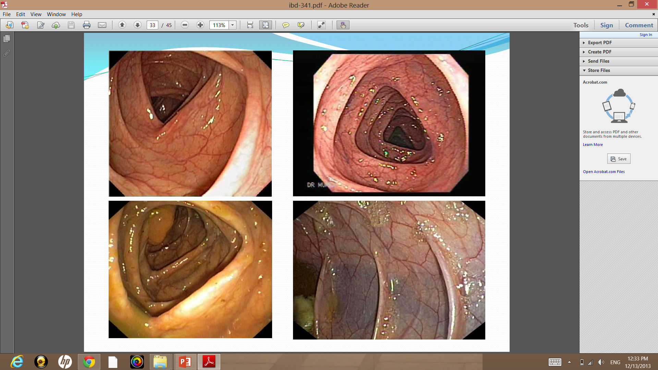
Normal Endoscopic appearance of the bowel

Slide 51
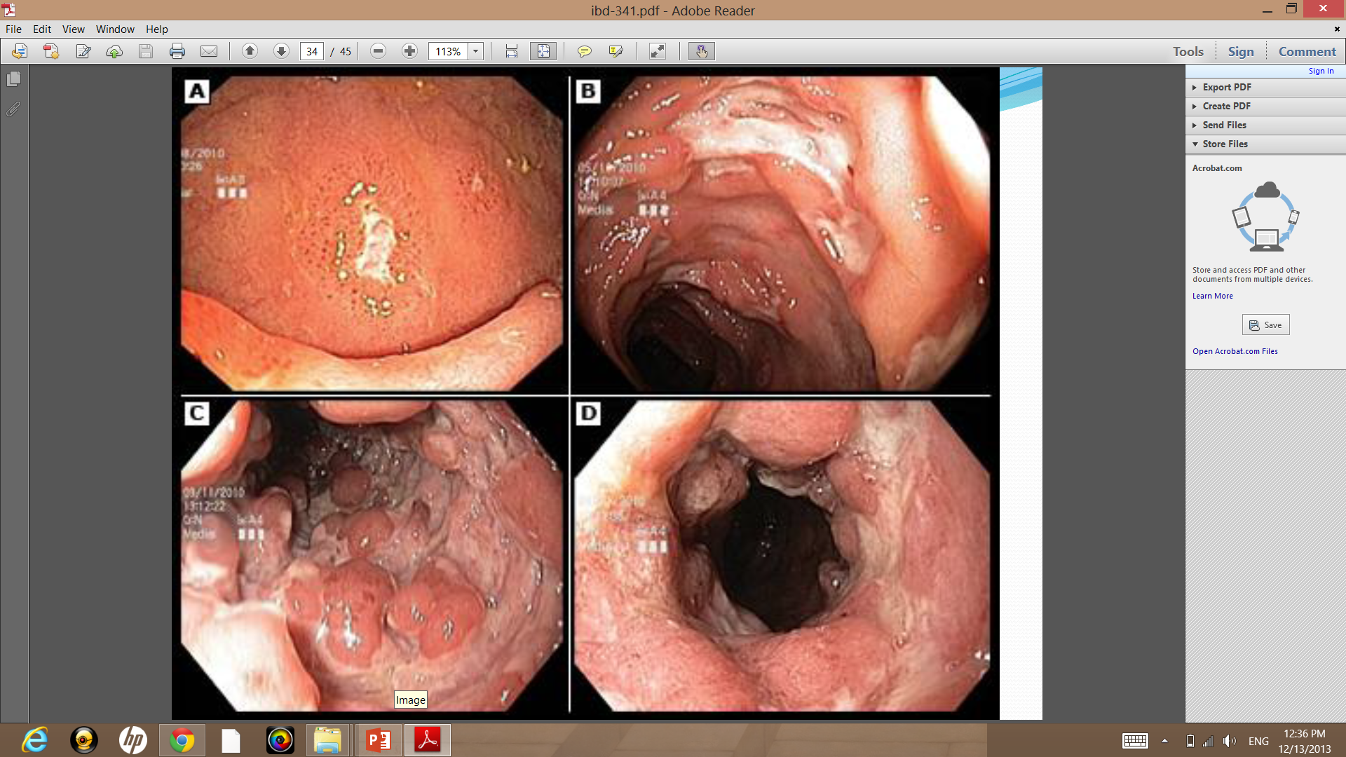
Endoscopic Appearance in crohn’s disease

Slide 52
Complication:
Fistulae ( with intestine ,bladder, vagina ,skin )
Anorectal diseases ( fissures, abscess)
Small bowel obstruction
Malabsorption of Vit b12

Slide 53
Management of crohn’s disease
During relapse: | During remission :
1. Corticosteroid ( prednisone .. ) : for acute exacerbation 2. Aminosalicylate (Sulfasalazine)5ASA : reduce inflammation More effective in ulcerative colitis 3. Immunosuppresnt (azathioprine ) : not as monotherapy in (combination with steroid ) 4. Methotrexate : not as monotherapy ( in combination with steroid ) 5. Metronidazole 6. Infliximab: for adults with severe active Crohn's disease whose disease has not responded to conventional therapy | Corticosteroid ( prednisone.. ) Immunosuppressant (azathioprine ) Methotrexate: in patient who cannot tolerate azathioprine.
Surgey :
For complication ( ex. Small bowel obstruction )

Slide 54
Admit patient if :
Sever abdominal pain associated with tenderness
Severe diarrhea more than 8 day
Dramatic weight loss
Bowel obstruction
Fever or signs of systemic disease

Slide 55
Ulcerative colitis
Definition :
chronic inflammatory disease of the colon or rectal mucosa (almost involve rectum in all cases )
Clinical features :
Hema tochezia (bloody diarrhea )
abdominal pain
bowel movement are frequent but small
fever , anorexia , weight loss
extra intestinal manifestations : ( jaundice ,uveitis , arthritis .. )

Slide 56
Diagnosis of ulcerative colitis
Diagnosis is based on clinical picture , endoscopy and laboratory
Colonoscopy : the vascular marking is lost , petchiae, exudate, touch friability , frank hemorrhage , colonic involvement is continuous in contrast to crohn .
Biopsy : crypt abscess ,branching of crypts , atrophy of glands and loss of mucin in goblet cells . Lesion is just in the mucosa .
Antibody tests : Antineutrophil cytoplasmic antibodies (pANCA), Anti-Saccharomyces cerevisiae antibodies (ASCA)

Slide 57
Diagnosis of ulcerative colitis
Stool culture : to rule out infection ( ova ,parasite, colistriduim difficle )
Fecal leucocyte
Inflammatory markers : ESR , CRP
Stool analysis : fecal calproctein to help distinguish between inflammatory bowel diseases and non-inflammatory bowel diseases(IBS).

Slide 58
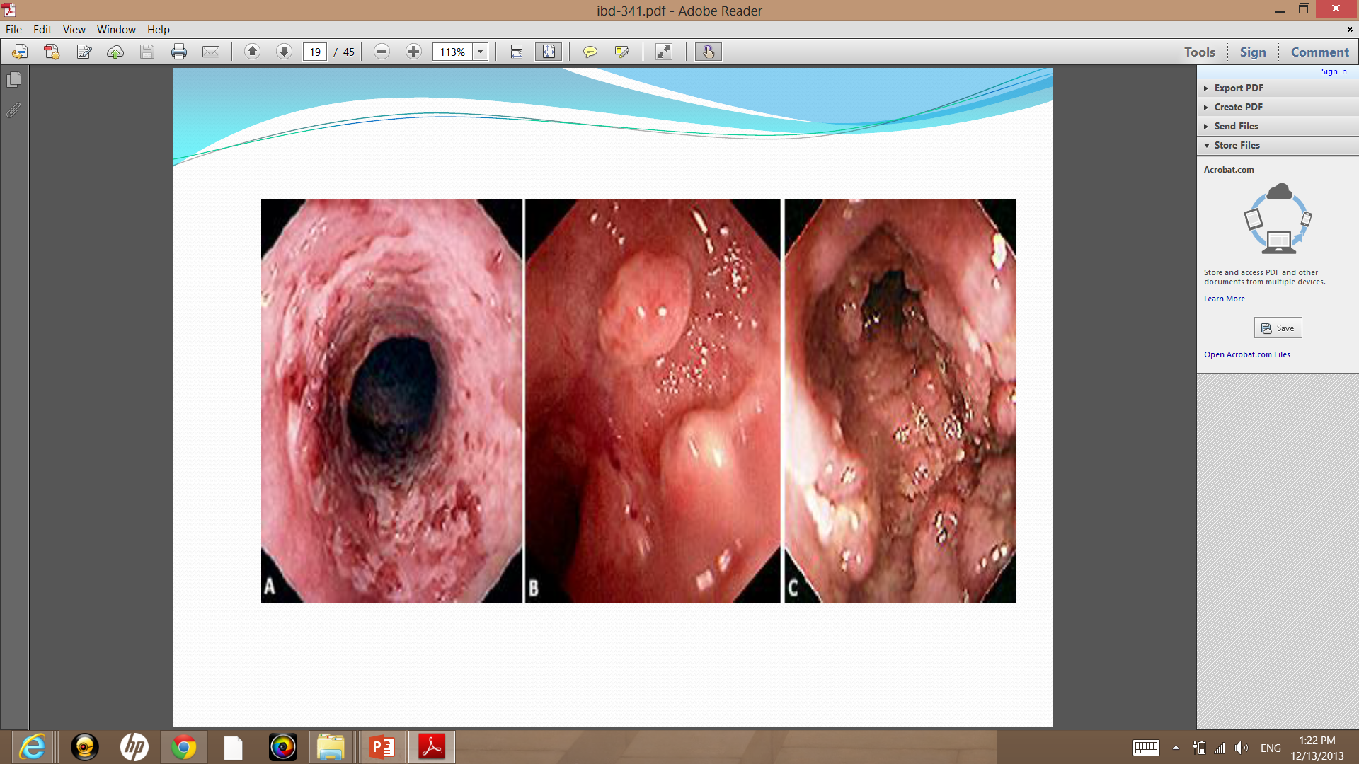
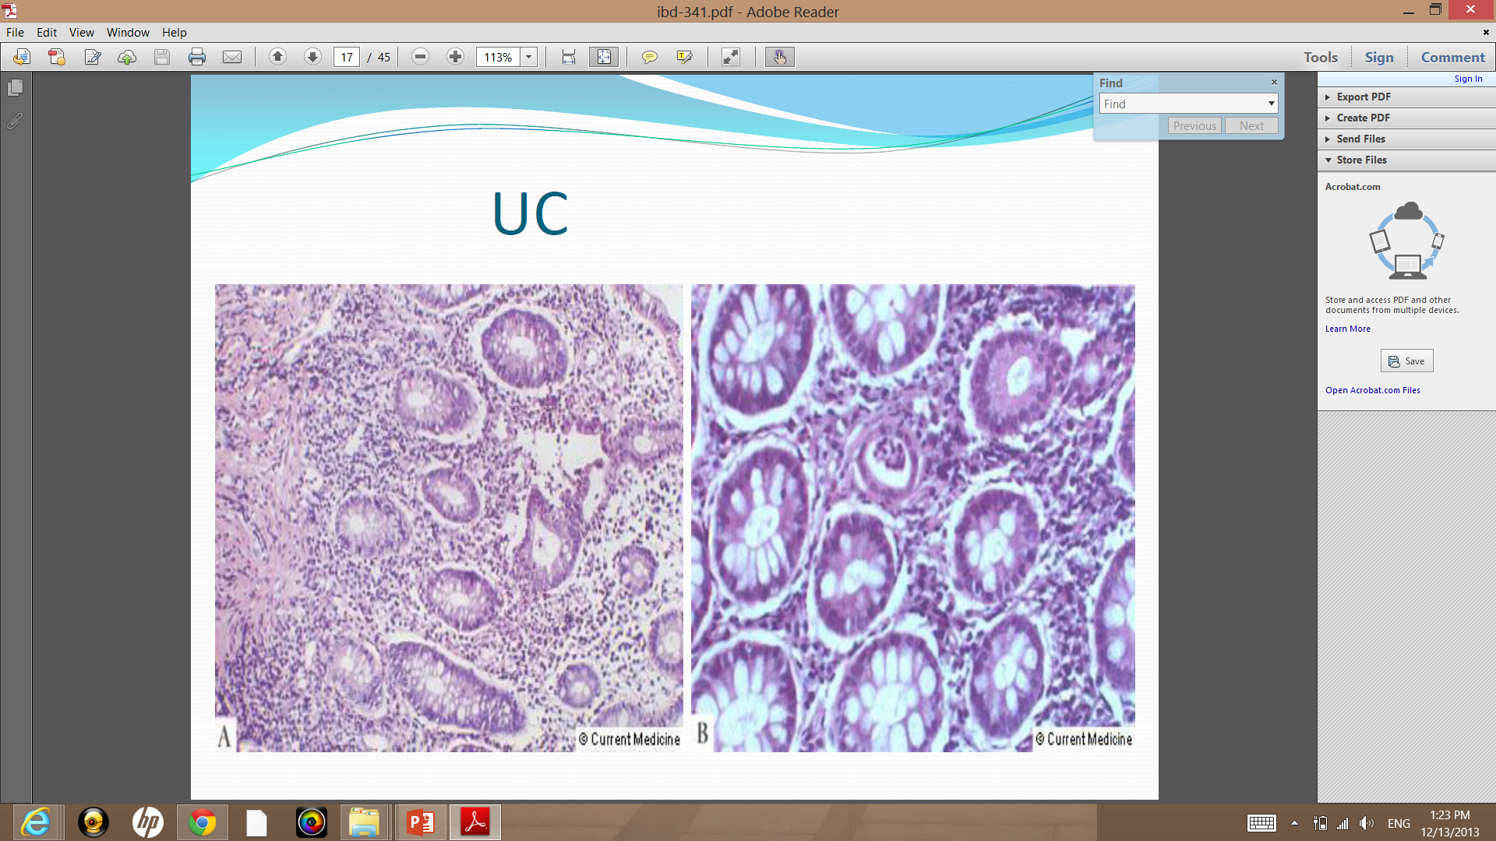
Endoscopic and Microscopic appearance of bowel in ulcerative colitis

Slide 59
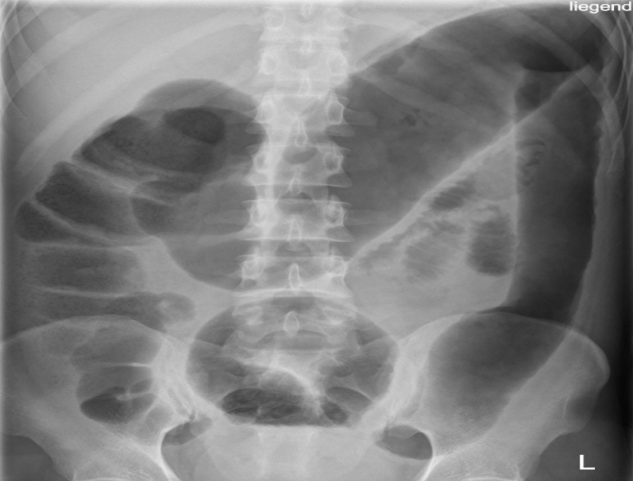
Complication
Iron deficiency anemia
Hemorrhage
Electrolyte disturbance and dehydration due to diarrhea
Colon cancer :ulcerative colitis has higher risk than crohn
Sclerosing cholangitis : obstructive jaundice
Toxic megacolon : leading cause of death in ulcerative colitis , increase risk of perforation .

Slide 60
Management of ulcerative colitis
During relapse :
Aminosalicylate (Sulfasalazine) is the main stay for treatment
corticosteroid for acute exacerbations
During remission :
Aminosalicylate (Sulfasalazine)
Immunosuprissive agent (azathioprine) if remission is not maintained by aminosalicylates
Surgery : for
1. debilitating unresponsive to medical therapy
2. toxic megacolon , perforation , hemorrhages .

Slide 61
Admit if
Sever abdominal pain associated with tenderness
Severe diarrhea more than 8 times a day
Dramatic weight loss
Fever more than 37.5 tachycardia more than 90bpm or other signs of systemic disease

Slide 62
Coeliac disease

Slide 63
Coeliac Disease
Definition :
Is an autoimmune condition characterized by an abnormal jejunal mucosa that improves when gluten ( contained in wheat ,rye and barley ) is withdrawn from diet . Can happen at any age
Clinical features :
Chronic diarrhea
Failure to thrive or faltering growth in children
Nausea , vomiting
Tiredness
Abdominal pain, distention cramping weight loss

Slide 64
Coeliac Disease
Diagnosis
serological testing: IgA tissue transglutaminase (tTGA) as a first-choice
Biopsy : definitive diagnosis (villous atrophy and crypt hyperplasia )
Complication :
Malignancy ( intestinal t cell lymphoma, small bowel and esophageal cancer )
Osteoporosis
But sticking to gluten free diet decrease complication risk

Slide 65
Management of coeliac disease
Diet :
gluten free diet
add supplements if the patient has deficient nutrient (iron , folic acid , calcium …)
Pneumococcal Vaccination:
all patient with celiac disease have degree of hyposplenism which make them more prone to pneumococcal infections
Follow up :
Every 6 -12 month with routine check of symptoms , weight and blood test ( HB , folate , iron ….)

Slide 66
Lactose Intolerance

Slide 67
Lactose intolerance
Definition :
Lactose intolerance is an inability to digest lactose, the main sugar in milk, that gives rise to gastrointestinal symptoms.
is caused by a deficiency of the intestinal enzyme lactase .
Can be :
Primary : as Normal result of aging for some people
Secondary: Result of illness or injury ( celiac , crohn … )
congenital : complete absence of lactase activity in newborn (rare )

Slide 68
Clinical features :
The signs and symptoms of lactose intolerance usually begin 30 minutes to two hours after eating or drinking foods that contain lactose.
Diarrhea
Nausea, and sometimes, vomiting
Abdominal cramps
Bloating
flatulence

Slide 69
Diagnosis of lactose in tolerance
Hydrogen breath test: the most convenient and reliable test. requires drinking lactose containing liquid. Then the amount of hydrogen in breath is tested.
Lactose tolerance test: Two hours after drinking a lactose containing liquid, blood tests are done to measure the amount of glucose in your bloodstream.
Stool acidity: For infants and children who can't undergo other tests

Slide 70
Management of lactose intolerance
Diet: the most obvious means of treating lactose intolerance is by reducing the amount of lactose (dairy products) in the diet.
Lactase enzyme: Tablets of lactase are available to take with milk-containing food.
Calcium and Vit D supplement

Slide 71
HOME MESSAGES:
Irritable bowel syndrome is a chronic condition characterised by abdominal pain associated with bowel dysfunction.
The patient will typically have recurrent abdominal pain or discomfort that is associated with a change in stool frequency or form. The pain or discomfort may be relieved by defecation.
It is important to determine whether there are any dietary associations such as lactose-containing foods or fructose-containing foods.

Slide 72
HOME MESSAGES:
Mind and body often combine to increase the distress of IBS patients.
The diagnosis is based on the patient's history, and there are no specific diagnostic tests.
Treatment should be individualized and is dependent on the patient's predominant symptoms.

Slide 73
HOME MESSAGES:
Psychological intervention worth considering.
IBS patients can be managed well by family physicians.
Don’t forget “red flags” for referral to GI specialist is a must !

Slide 74
Answers of the Test

Slide 75
Test
1-For a 25 - year - old female complaining of chronic constipation for 4 months, the first line treatment is:
A- oral laxatives
B- refer to GI specialist
C-change life style and diet
D-IV fluid administration

Slide 76
Test
1-For a 25 - year - old female complaining of chronic constipation for 4 months, the first line treatment is:
A- oral laxatives
B- refer to GI specialist
C-change life style and diet
D-IV fluid administration

Slide 77
Test
2- The following are typical symptoms of IBS except :
A- abdominal pain improves with defecation.
B- onset of abdominal discomfort is associated with changes in normal stool
C- progressive abdominal pain
D- Change in frequency of stool

Slide 78
Test
2- The following are typical symptoms of IBS except :
A- abdominal pain improves with defecation.
B- onset of abdominal discomfort is associated with changes in normal stool
C- progressive abdominal pain
D- Change in frequency of stool

Slide 79
Test
3. Which of the following causes symptoms in celiac disease :
Gluten protein
Lactose
Glucose
Fats

Slide 80
Test
3. Which of the following causes symptoms in celiac disease :
Gluten protein
Lactose
Glucose
Fats

Slide 81
Test
4. Which of the following diseases has this endoscopic appearance ( vascular marking is lost , petchiae, exudate, touch friability , frank hemorrhage , and the colonic involvement is continuous
Ulcerative colitis
Crohn disease
Celiac disease
Lactose intolerance

Slide 82
Test
4. Which of the following diseases has this endoscopic appearance ( vascular marking is lost , petchiae, exudate, touch friability , frank hemorrhage , and the colonic involvement is continuous
Ulcerative colitis
Crohn disease
Celiac disease
Lactose intolerance

Slide 83
Test
5. The most common site involved in crohn disease is ?
Terminal ileum
Colon
First part of Duodenum
Jejunum

Slide 84
Test
5. The most common site involved in crohn disease is ?
Terminal ileum
Colon
First part of Duodenum
Jejunum

Slide 85
Abdominal Examination
https://www.youtube.com/watch?v=rKlSK4628mI

Slide 86
References
http://www.nice.org.uk/guidance/topic
Oxford Hand book of general practice 3rd edition – Simon / Everitt / Dropp
Step up to medicine -2d edition – Agabegi
Essential of clinical medicine – 5th edition – Kumar & Clarks
http://www.mayoclinic.com
http://www.etlibrary.org/?m=fbook&a=details&aid=4272
http://ibdcrohns.about.com/od/dailylife/a/normalbm.htm
http://www.romecriteria.org/assets/pdf/19_RomeIII_apA_885-898.pdf

