Slide 1
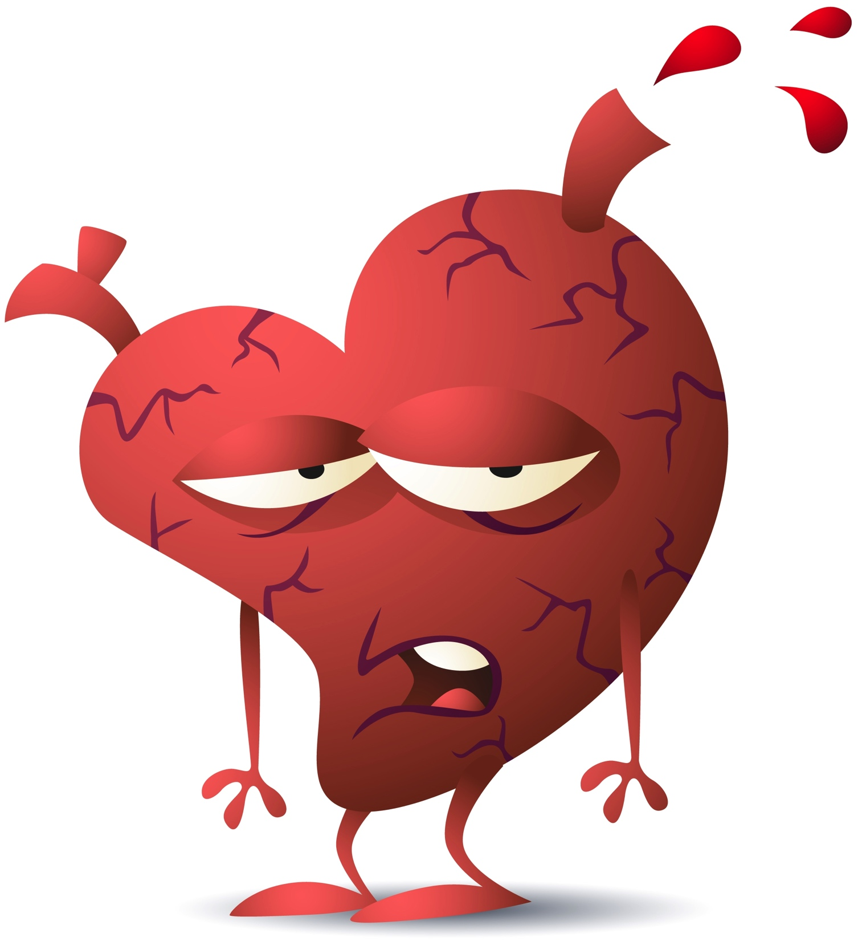
Risk Assessment of Cardiovascular Diseases and Dyslipidemia
Done by:
Faisal AlFayyadh
Nawaf AlAmiri

Slide 2
Objectives
Risk factors for CVD (Traditional and emerging ones)
How to assess risk factors like Framingham risk score “Risk Assessment”
Highlight on patient with chest pain “Angina” and how is presented
Highlight on management of post MI
Primary prevention of CVD
Highlight on role of Dyslipidaemia in CVD and its management (to achieve goals according to risk)
What are goals of LDL and HDL have to be achieved for CVD, DM,
ATP guidelines “ATP III and IV”, Risk categorization, Statins, Fibrates, Omega-3, Ezetimibe, Goals of management

Slide 3
Questions

Slide 4
Questions
1- In which of the following groups of patients does the LDL-cholesterol goal have to be < 70 mg/dl :
In all metabolic syndrome patient .
Diabetic patient who smoke and are hypertensive .
Hypertensive patient >140/90 mm Hg .
Person with ≥ 2 major risk factors but with no DM or CHD.

Slide 5
Questions
2- Which one of the following is the most likely factor to increase the risk of coronary artery disease in assessing patient using FRS ?
Old Age
Female Gender
Stress
Physical exercise

Slide 6
Questions
3- A 65‐year‐old man had been admitted because of attack of MI Coronary artery bypass graft had been done and discharged on list of medications including statins. Which one of the following is acceptable goal to reach for this man?
Total cholesterol of 5.6 mmol/L (215mg/dl)
HDL‐C of 0.8 mmol/L (32mg/dl)
LDL--‐C of 1.7 mmol/L ( 68 mg/dl)
Triglyceride of 2.2 mmol/L ( 195 mg/dl)

Slide 7
Questions
4- A man who is smoker, his goal of LDL is:
Less than 100 mg\dl
Less than 130 mg\dl
Less than 160 mg\dl
Less than 190 mg\dl

Slide 8
Questions
5- Which of the following scoring systems is used in assessing the risk of developing cardiovascular diseases?
Framingham score
Apgar score
CHADS2 score
Alvarado score

Slide 9
Coronary Artery Disease

Slide 10
CAD
Prevalence:
Leading cause of death for both men and women in the US, with approximately 1 million people dying from it each year
Pathogenesis:
CAD is the narrowing of the coronary artery, decreasing the blood supply to the heart, leading to ischemia of the heart muscle cells

Slide 11
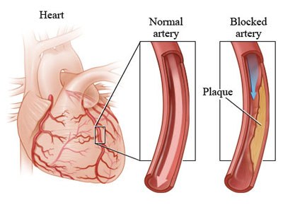
CAD
Etiology:
CAD is mostly due to Atherosclerosis
Atherosclerosis and thrombosis are the most important pathogenic mechanisms

Slide 12
Objectives
Risk factors for CVD (Traditional and emerging ones)
How to assess risk factors like Framingham risk score “Risk Assessment”
Highlight on patient with chest pain “Angina” and how is presented
Highlight on management of post MI
Primary prevention of CVD
Highlight on role of Dyslipidaemia in CVD and its management (to achieve goals according to risk)
What are goals of LDL and HDL have to be achieved for CVD, DM,
ATP guidelines “ATP III and IV”, Risk categorization, Statins, Fibrates, Omega-3, Ezetimibe, Goals of management

Slide 13
CAD risk factors
Modifiable
Non-Modifiable
Cigarette and tobacco smoke
High blood cholesterol
High blood pressure
Physical inactivity
Obesity
Diabetes
Age
Gender
Family history of CVD

Slide 14
Emerging risk factors for CAD
Table 2. Emerging Risk Factors According to ATP III Final Report Update 2004
1. Elevated high-sensitivity C-reactive protein
2. Coronary artery calcification
3. Elevated lipoprotein (a)
4. Homocysteine
5. Fibrinogin

Slide 15
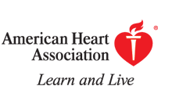
C-reactive protein
A person's baseline level of inflammation, as assessed by the plasma concentration of CRP, predicts the long-term risk of a first myocardial infarction.
In patient with chest pain and C-reactive protein level:
Figure 4. clinical interpretation of hs-CRP for cardiovascular risk prediction.
Ridker P M Circulation 2003;108:e81-e85
Copyright © American Heart Association

Slide 16
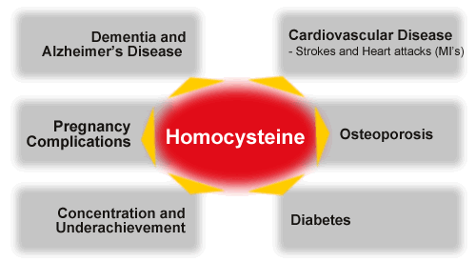
Homocysteine
Normal < 13 umol/L
Moderate 13-16 umol/L
Severe >16 umol/L
A non-protein amino acid.
Elevated levels have been may cause:
Atherosclerosis.
Venous thrombosis.
Homocysteine
Management:
B6, B12 & folate supplementation decrease homocysteine levels.
Notes:
Test: Fasting homocysteine level.

Slide 17
Objectives
Risk factors for CVD (Traditional and emerging ones)
How to assess risk factors like Framingham risk score “Risk Assessment”
How to reduce incidence of development of CVD
Primary prevention of CVD
Highlight on patient with chest pain “Angina” and how is presented
Highlight on management of post MI
Highlight on role of Dyslipidaemia in CVD and its management (to achieve goals according to risk)
What are goals of LDL and HDL have to be achieved for CVD, DM,
ATP guidelines “ATP III and IV”, Risk categorization, Statins, Fibrates, Omega-3, Ezetimibe, Goals of management

Slide 18
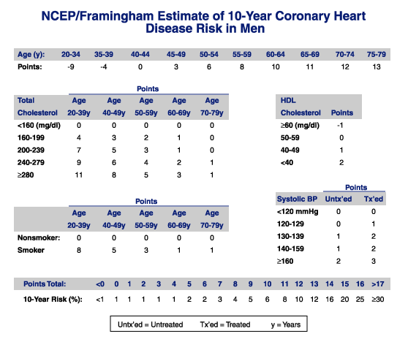
The Framingham risk score
Scoring system used to calculate a pt’s risk of coronary events
The Framingham Heart Study first introduced the term risk factor to medical literature
The following risk factors are used to assess cumulative risk:
Age
Smoking Status
Systolic BP
HTN treatment
Total cholesterol levels
HDL-C levels

Slide 20
FRS
Table 3. Classification of Patients based on The Framingham Risk Score
Low risk | <10% coronary heart disease risk at 10 years
Intermediate risk | 10-20% risk of coronary event at 10 years
High risk | >20% risk of coronary event at 10 years

Slide 21
Case
A 42-year-old male who smokes. His current blood pressure is 125/80 he doesn’t take any anti-hypertensive medication, his total cholesterol reading is 245 mg/dL, while his HDL reading is 49 mg/dL.
Assess his 10 year risk of developing CVD based on FRS ?Case

Slide 22
Cases in which you don’t need FRS ?
Patients who already have a high risk due to other diseases

Slide 23
Metabolic Syndrome
Metabolic syndrome increases the risk for cardiovascular diseases and diabetes
Pathophysiology:
Increase visceral fat lead to increased the level TNFα which lead to insulin resistance

Slide 24
Metabolic Syndrome
According to the WHO and ATP III, the diagnosis was based on the presence of 3 of the following;
Dyslipidemia
Hypertension
Impaired glucose tolerance
Obesity
Insulin resistance

Slide 25
Metabolic Syndrome
Clinical Identification of the Metabolic Syndrome
Risk Factor | Defining Level
Abdominal Obesity Men Women | Waist Circumference >102 cm (>40 in) >88 cm (>35 in)
Triglycerides | ≥150 mg/dL
HDL cholesterol Men Women | <40 mg/dL <50 mg/dL
Blood pressure | ≥130/≥85 mmHg
Fasting blood glucose | ≥100 mg/dL

Slide 26
Objectives
Risk factors for CVD (Traditional and emerging ones)
How to assess risk factors like Framingham risk score “Risk Assessment”
Highlight on patient with chest pain “Angina” and how is presented
Highlight on management of post MI
Primary prevention of CVD
Highlight on role of Dyslipidaemia in CVD and its management (to achieve goals according to risk)
What are goals of LDL and HDL have to be achieved for CVD, DM,
ATP guidelines “ATP III and IV”, Risk categorization, Statins, Fibrates, Omega-3, Ezetimibe, Goals of management

Slide 27
Major CAD types
Stable Angina; due to atheroma
Acute Coronary Syndrome:
Unstable Angina
Myocardial Infarction
STEMI
NSTEMI

Slide 28
Myocardial infarction
Signs & findings:
Table 4. Findings Indicating Myocardial Infarction According to JAMA 1998; 280: 1256-63 (N=200)
Positive Signs | Negative Signs
ST-segment elevation | Normal ECG
New Q-wave | Pleuritic, sharp or stabbing chest pain
Chest pain radiating to both the right and left arm simultaneously | Pain reproduced on palpation
Added heart sound “S3” | Positional chest pain
Hypotension
Notes:
Positive VS Negative

Slide 29
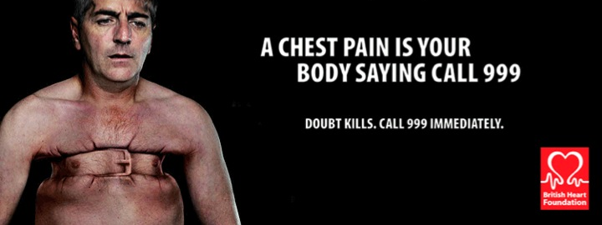
Angina
Severe, acute chest pain (unilateral mostly), present at rest
Pain lasting for more than 20 mins
SOB severe
Tachycardia and Palpitations
Cyanosis
Notes:
(also can present with bradycardia)

Slide 30
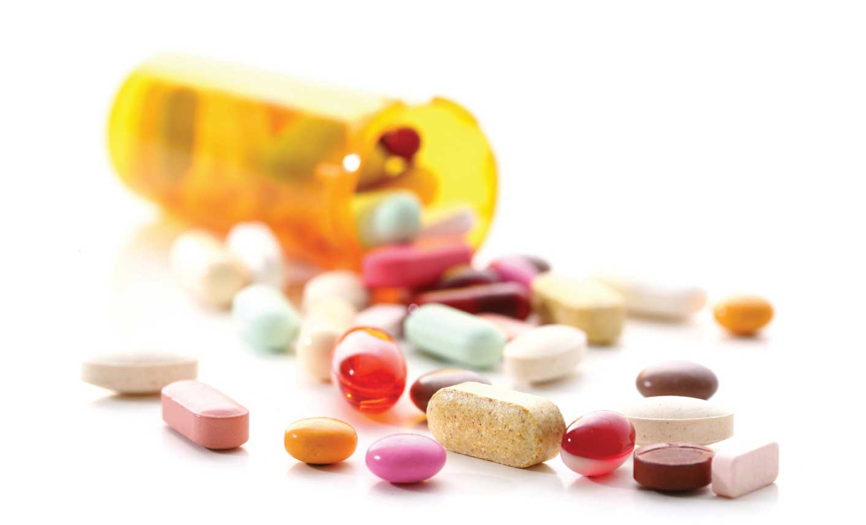
Treatment of Acute Coronary Syndrome
Medical Management of UA and NSTEMI
Aspirin (ideally should be continued indefinitely)
Clopidogrel
Prasugrel
Glycoprotein IIb/IIIa
Antithrombotic therapy (Heparin/LMWH)
β- blockers
Nitrate
Ca+2 channel blockers
Statins

Slide 31
Treatment of Acute Coronary Syndrome
Medical Management of STEMI
Aspirin (proven to prevent recurrent infarction and decreases mortality)
Clopidogrel
β- blockers
ACE inhibitors & ARBs (should be used if there is intolerance of ACE inhibitors)
Nitroglycerin
Heparin
Statins

Slide 32
Care following MI
Risk factor modification
Physical Rehabilitation and exercise
Long-term medications:
Aspirin
Clopidogrel
β- blockers
ACE inhibitors
Aldosterone blockers
Statins (See slide 49 for ATP IV guidelines on Statin use)
Notes:
Lifestyle Modification
Cessation of smoking.
Regular exercise.
Weight control and healthy diet.
Control blood sugar and blood pressure

Slide 33
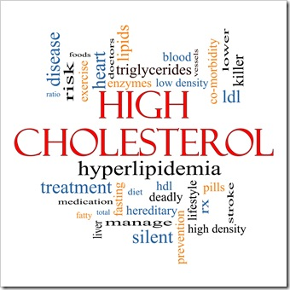
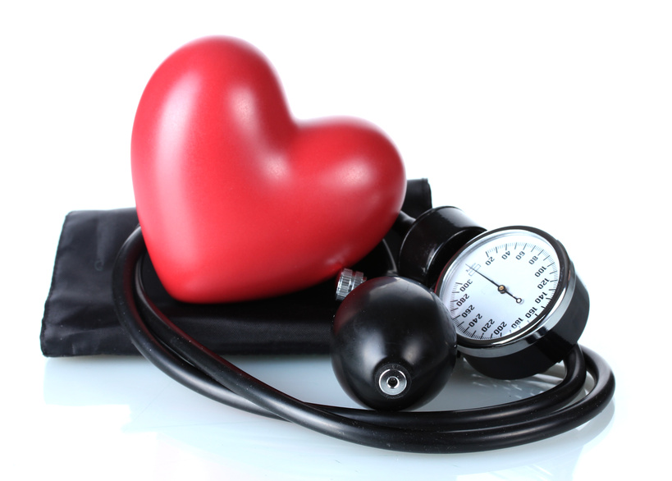
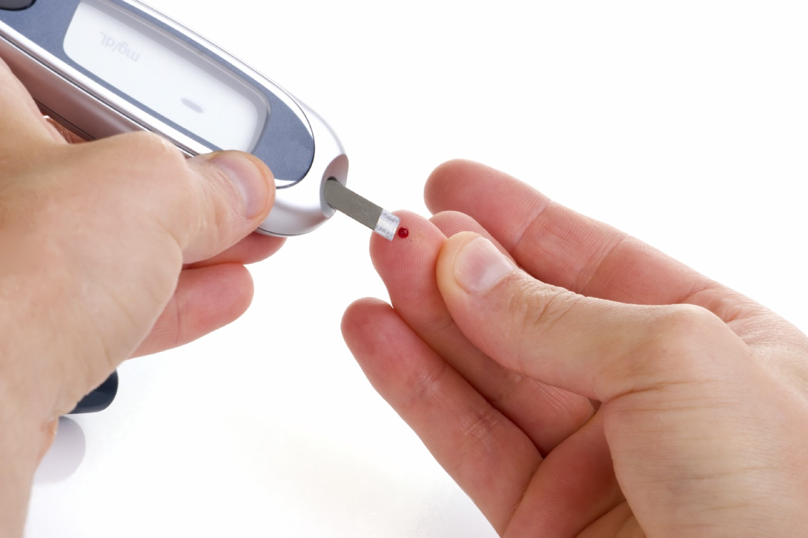
Diseases increasing risk for CAD
Notes:
the achievement and maintenance of good health is being emphasized in programs from The American Heart Association that promote seven ideal cardiovascular health metrics, including :
Not smoking
Being physically active
Having a normal blood pressure
Having a normal blood glucose level
Having a normal total cholesterol level
Being normal weight
Eating a healthy diet
-Lloyd-Jones DM, Hong Y, Labarthe D, et al. Defining and setting national goals for cardiovascular health promotion and disease reduction: the American Heart Association's strategic Impact Goal through 2020 and beyond. Circulation 2010; 121:586.

Slide 34
Objectives
Risk factors for CVD (Traditional and emerging ones)
How to assess risk factors like Framingham risk score “Risk Assessment”
Highlight on patient with chest pain “Angina” and how is presented
Highlight on management of post MI
Primary prevention of CVD
Highlight on role of Dyslipidaemia in CVD and its management (to achieve goals according to risk)
What are goals of LDL and HDL have to be achieved for CVD, DM,
ATP guidelines “ATP III and IV”, Risk categorization, Statins, Fibrates, Omega-3, Ezetimibe, Goals of management

Slide 35
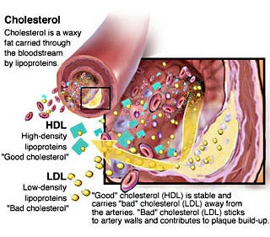
Dyslipidemia
Notes:
Dyslipidemia refers to the condition of abnormal lipid levels in the bloodstream and is a major risk factor for coronary heart disease .
Lipids include not only cholesterol but also phospholipids , triglycerides and cholestreryl-esters.

Slide 36
Dyslipidemia
Table 7. Normal Lipid Profile Values
Total Cholesterol | < 200 mg/dl (5.18mmol/L)
LDL-Cholesterol | < 100 mg/dl (2.59mmol/L)
HDL-Cholesterol | ≥ 60 mg/dl (1.55mmol/L)
Triglycerides | < 150 mg/dl (1.7mmol/L)

Slide 37
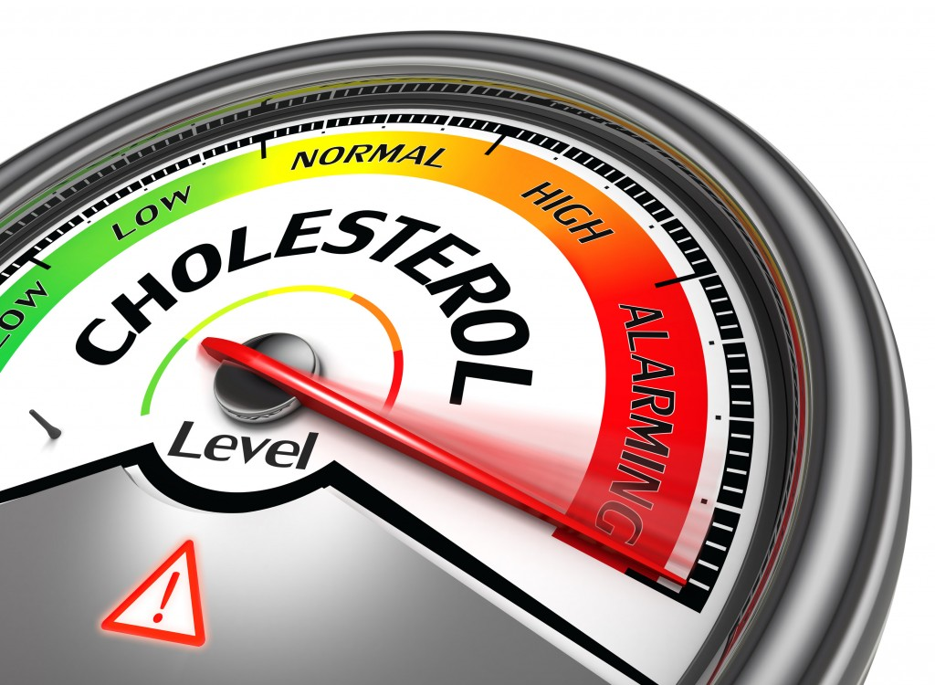
Screening for dyslipidemia
Fasting lipid profile:
Total Cholesterol
LDL
HDL
TGs
The ratio of total cholesterol/HDL-C has been shown to be the optimal predictor of CVD risk.
Notes:
While in non-fasting state you can measure only :
Total cholesterol
HDL
According to the American Heart Association (AHA), you should keep your cholesterol ratio at or below 5:1. The ideal cholesterol ratio is about 3.5:1.

Slide 38
Screening for dyslipidemia
High risk
Male
Lipid screening at age 25
Female:
Lipid screening at age 35
Low risk
Male
Lipid screening at age 35
Female:
Lipid screening at age 45

Slide 39
Prevention of dyslipidemia
Notes:
Primary prevention:
Preventive measures in patients without diagnosed cardiovascular disease.
First presentation of CVD could be sudden cardiac death
Aims to prevent new onset CVD via reducing risk factors
Secondary prevention:
Preventive measures in patients with diagnosis of cardiovascular disease
Lowering LDL-C reduces recurrent events

Slide 40
How do I lower LDL-C ?
Diet low in saturated fat and cholesterol
Avoid fried foods
Increase fiber intake
Keep total cholesterol under 200mg/day to lower LDL
Exercise
Statins

Slide 41
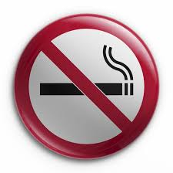
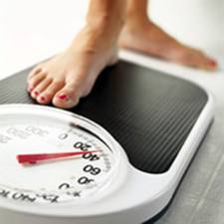
How can I raise my HDL-C ?
Notes:
Aerobic exercise increase HDL levels. The more the exercise the higher HDL
Weight loss increase HDL
Quitting smoking raises HDL

Slide 42
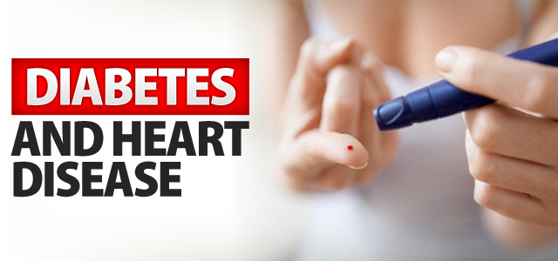
Primary prevention in patients with diabetes
Use of moderate-intensity statin therapy in people with diabetes 40 to 75 years of age
Notes:
These individuals are at substantially increased lifetime risk for ASCVD events and death
Greater morbidity and worse survival following the onset of clinical ASCVD

Slide 43
Management of ASCVD
ATP III & IV Guidelines

Slide 44
Objectives
Risk factors for CVD (Traditional and emerging ones)
How to assess risk factors like Framingham risk score “Risk Assessment”
Highlight on patient with chest pain “Angina” and how is presented
Highlight on management of post MI
Primary prevention of CVD
Highlight on role of Dyslipidaemia in CVD and its management (to achieve goals according to risk)
What are goals of LDL and HDL have to be achieved for CVD, DM,
ATP guidelines “ATP III and IV”, Risk categorization, Statins, Fibrates, Omega-3, Ezetimibe, Goals of management

Slide 45
Goals of Management
First Goal: Target LDL level
Second Goal: Non-HDL cholesterol (VLDL & LDL)
Third Goal: Triglycerides
Forth Goal: HDL level

Slide 46
LDL, HDL, Total Cholesterol levels
According to ATP III Guidelines:
Table 12. ATP III Classification of LDL, Total and HDL Cholesterol (mg/dL)
LDL Cholesterol | <100 | Optimal
 | 100-129 | Near optimal/above optimal
 | 130-159 | Borderline high
 | 160-189 | High
 | ≥190 | Very High
Total Cholesterol | <200 | Desirable
 | 200-239 | Borderline high
 | ≥240 | High
HDL Cholesterol | <40 | Low
 | ≥ 60 | High

Slide 47
Risks for LDL-C Goal Modification
Table 13. Major Risk Factors (Exclusive of LDL-C) That Modify LDL Goals
Cigarette smoking
Hypertension (BP ≥140/90 mmHg or on antihypertensive medication)
Low HDL Cholesterol (<40 mg/dL)
Family history of premature CHD (CHD in male 1st degree relative <55 yrs; CHD in female 1st degree relative <65 yrs)
Age (men ≥45 yrs; women ≥55 yrs)
Notes:
According to ATP III Guidelines; Major risk factors that can modify LDL goals are as following;

Slide 48
Modified LDL Goals
Table 14. Three Categories of Risk That Modify LDL-C Goals
Risk Category | LDL Goal (mg/dL)
CHD and CHD risk equivalents* | <70
Multiple (2+) risk factors | <130
Zero to one risk factor | <160
Special Consideration
Notes:
CHD Risk Equivalents are mentioned in both ATP III and IV guidelines to be as following; Clinical CHD, Symptomatic carotid artery disease, Peripheral arterial disease, Abdominal aortic aneurysm and Diabetes Mellitus
Special Considerations:
If triglycerides 200-499mg\dL after LDL goal is reached, consider adding drug if needed to reach non HDL goal.
If triglycerides >500 mg\dL :-
1- Triglycerides
2- LDL
3- non HDL
4- HDL

Slide 49
Medications for Hyperlipidemia
Drug Class | Agents | Effects (% change)
HMG CoA reductase inhibitors | Statins | ↓LDL (18-55),↑ HDL (5-15) ↓ Triglycerides (7-30)
Cholesterol absorption inhibitor | Ezetimibe | ↓ LDL( 14-18), ↑ HDL (1-3) ↓Triglyceride (2)
Fibric Acids | Gemfibrozil Fenofibrate | ↓LDL (5-20), ↑HDL (10-20) ↓Triglyceride (20-50)
Omega 3 fatty acid ethyl ester | Lovaza | ↓Triglyceride

Slide 50
Adult Treatment Panel IV Guidelines
Patient characteristics
Identify
Type of therapy
Intensity of therapy
Notes:
ATP IV guidelines mainly focused on the treatment of blood cholesterol to reduce ASCVD risk
Identification of Patient characteristics, Type of therapy and Intensity of therapy
Identification of high- and moderate-intensity statin therapy for the use of 2ndry and 1ry prevention of ASCVD events
EBM indicated a consistent reduction in ASCVD events from Statin therapy in 2ndy and 1ry prevention populations

Slide 51
ATP IV Guidelines
Table 11. ASCVD Risk Reduction: 4 statin benefits groups
1. Individuals with clinical ASCVD
2. Individuals with 1ry elevations of LDL-C >= 190 mg/dL
3. Individuals 40-75 yrs of age with diabetes with LDL-C 70-189 mg/dL
4. Individuals without clinical ASCVD or diabetes who are 40-75 yrs with LDL-C 70-189 mg/dL
Notes:
ASCVD risk reduction in those most likely to benefit where the potential for ASCVD risk reduction benefit clearly exceeds the potential for adverse effects in adults

Slide 52
ATP IV Guidelines Key Points
All patients (≥21 yrs) with any form of CVD or LDL-C ≥ 190 mg/dL
Treat with high-intensity statin therapy
All patients with diabetes (age 40-75 yrs) with LDL-C 70-189 mg/dL, without any evidence of CVD
Treat with moderate-intensity statin therapy
All patients must undergo intensive lifestyle modifications

Slide 53
Intensity of statin treatment
Table 15. High-, Moderate- and Low-Intensity Statin Therapy According to ATP IV Guidelines
High-intensity Statin Therapy | Moderate-intensity Statin Therapy | Low-intensity Statin Therapy
Daily doses lowers LDL-C on average, by approximately ≥ 50% | Daily doses lowers LDL-C on average, by approximately 30% to <50% | Daily doses lowers LDL-C on average, by <30%
Atorvastatin (40-80 mg) Rosuvastatin (20-40 mg) | Atrovastatin (10-20 mg) Rosuvastatin (5-10 mg) | Simvastatin (10 mg) Pravastatin (10-20 mg)

Slide 54
Video
Notes:
https://www.youtube.com/watch?v=afYCN3Upy_w

Slide 55
Questions

Slide 56
Questions
1- In which of the following groups of patients does the LDL-cholesterol goal have to be < 70 mg/dl :
In all metabolic syndrome patient .
Diabetic patient who smoke and are hypertensive .
Hypertensive patient >140/90 mm Hg .
Person with ≥ 2 major risk factors but with no DM or CHD.
Answer: B

Slide 57
Questions
2- Which one of the following is the most likely factor to increase the risk of coronary artery disease in assessing patient using FRS ?
Old Age
Female Gender
Stress
Physical exercise
Answer: A

Slide 58
Questions
3- A 65‐year‐old man had been admitted because of attack of MI Coronary artery bypass graft had been done and discharged on list of medications including statins. Which one of the following is acceptable goal to reach for this man?
Total cholesterol of 5.6 mmol/L (215mg/dl)
HDL‐C of 0.8 mmol/L (32mg/dl)
LDL--‐C of 1.7 mmol/L ( 68 mg/dl)
Triglyceride of 2.2 mmol/L ( 195 mg/dl)
Answer: C

Slide 59
Questions
4- A man who is smoker, his goal of LDL is:
Less than 100 mg\dl
Less than 130 mg\dl
Less than 160 mg\dl
Less than 190 mg\dl
Answer: C

Slide 60
Questions
5- Which of the following scoring systems is used in assessing the risk of developing cardiovascular diseases?
Framingham score
Apgar score
CHADS2 score
Alvarado score
Answer: A

Slide 61
Home Message
CRP predicts the long-term risk of a first myocardial infarction
Framingham is a scoring system used to calculate a patients' risk of coronary events
Some cases we don’t need FRS in which patients already having HIGH RISK to develop CHD
The diagnosis of Metabolic Syndrome is based on the presence of 3 of the following; dyslipidemia, hypertension, Impaired glucose tolerance, and obesity, with insulin resistance as the link
LDL level in patient with CHD or CHD risk equivalents is >70mg\dl.
If triglyceride more than or equal 500 start treatment targeting triglyceride First then LDL.

Slide 62
References
National Heart, Lung, and Blood Institute [homepage on the Internet]. US: The Institute [updated Oct 2012]. NHLBI; Clinical practice guidelines; Cholesterol; ATP III Final Report. Available from: https://www.nhlbi.nih.gov/guidelines/cholesterol/atp3_rpt.htm
World Heart Federation [homepage on the Internet]. Geneva: The Federation; 1978. WRF; Cardiovascular health; Cardiovascular disease risk factors; Cholesterol. Available from: http://www.world-heart-federation.org/cardiovascular-health/cardiovascular-disease-risk-factors/cholesterol/
Medscape. F Brian Boudi, MD; Coronary Artery Atherosclerosis. Available from: http://emedicine.medscape.com/article/153647-overview
American Heart Association [homepage on the Internet]. Dallas: The Association; 1924 [updated 2013]. AHA; Smoking and cardiovascular diseases. Available from: http://www.heart.org/HEARTORG/GettingHealthy/QuitSmoking/QuittingResources/Smoking-Cardiovascular-Disease_UCM_305187_Article.jsp
UpToDate [Database]. Sandeep Vijan, MD; Screening for lipid disorders. Last update; Nov 14, 2013. Available from: http://www.uptodate.com/contents/screening-for-lipid-disorders

Slide 63
References
Neil J. Stone, Jennifer Robinson, Alice H. Lichtenstein, C. Noel Bairey Merz, Conrad B. Blum, et al. 2013 ACC/AHA Guideline on the Treatment of Blood Cholesterol to Reduce Atherosclerotic Cardiovascular Risk in Adults; A report of the American College of Cardiology/ American Heart Association Task Force on Practice Guidelines
American Diabetes Association [homepage on the Internet]. Alexandria. ADA; Diabetic Basics; Diagnosis. Available from: http://www.diabetes.org/diabetes-basics/diagnosis/
Johns Hopkins Hospital; Department of Internal Medicine; Ashar B.H, Miller R.G, Sisson S.D, The John Hopkins Internal Medicine Board Review. 4th ed. Baltimore; 2012

Slide 64
THANK YOU ☺
QUESTIONS?

