Slide 1
UPPER RESPIRATORY TRACT INFECTIONS
Tareq Aljurf
Abdulrahman Alsehly
Tareq Al Tuwaijiri

Slide 2
Objectives
How can we differentiate between viral and bacterial infections?
Sore throat (clinical features, differential diagnosis, complications, management)
Sinusitis including allergic rhinitis (Clinical features and management)
Otitis media in children (AOM and Secretory OM, Features, management)
How can we modify help seeking behavior of patients with flu illness?

Slide 3
Pre MCQ Test
Q1- A 3-year-old boy brought by his mom to the ER with difficulty in breathing and drooling for 3 hours, most likely diagnosis is:
a) CROUP
b) Acute epiglottis
c) Laryngomalacia
d) Candidiasis

Slide 4
Pre MCQ Test
Q2- A 4 year old child with bilateral decreased hearing for a few months. There is no ear
discharge. Examination of the ear revealed retracted tympanic membranes. What is the
most probable diagnosis ?
a) Chronic suppurative otitis media.
b) Chronic otitis externa.
c) Otitis media with effusion.
d) Tympanosclerosis

Slide 5
Pre MCQ Test
Q3- What is the management of uncomplicated acute suppurative sinusitis:
a) Antibiotics for 24 hours, then surgery
b) Surgery then antibiotics
c) Antihistamines and steam inhalation
d) Analgesic, antibiotic & decongestant nasal drops

Slide 6
Pre MCQ Test
Q4- A 7 years old boy has developed right ear pain and ipsilateral facial weakness for three days. On examination he has tempreture of 38 C. right congested bulging tympanic membrane and partial right facial paresis what is the most likely cause of facial paresis ?
a) acute otitis media
b) bell's palsy
c) herpes zoster oticus
d) otitis media with effusion

Slide 7
Pre MCQ Test
Q5- Patient presents with a 5-day history of headache, facial pain over the forehead and maxilla, purulent nasal discharge, what is the most likely diagnosis?
Acute sinusitis
Trigeminal Neuralgia
Allergic rhinitis
Nasal polyposis

Slide 8
Otitis Media

Slide 9
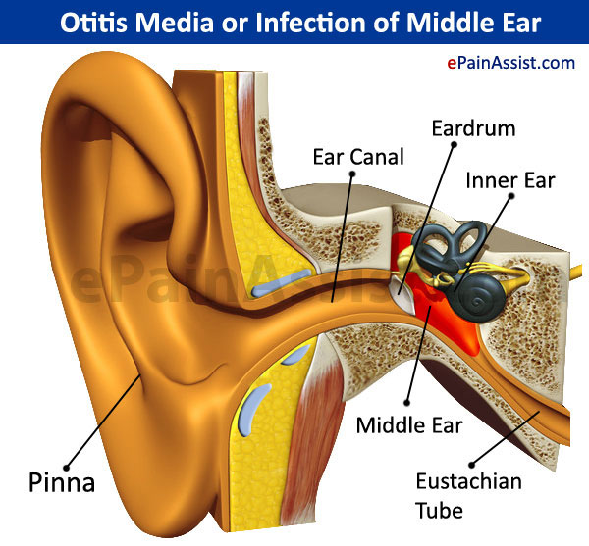
Otitis Media

Slide 10
Definition
Acute otitis media (AOM) is defined by the presence of fluid in the middle ear accompanied by acute signs of illness and signs or symptoms of middle ear inflammation
Bulging of the tympanic membrane (TM) is considered the most important sign that distinguishes AOM from otitis media with effusion and a normal Tympanic Membrane.
Notes:
Peak incidence in the first two years of life (esp. 6-12 months)
Occurs more frequently in the winter months
One of the most common reason for visit to pediatrician

Slide 12
Timeline
- Acute OM
< 3 weeks
- Subacute OM
3 weeks to 3 months
- Chronic OM
3 months or longer

Slide 13
Predisposing Factors
Age (children)
Sex (girls)
Seasons (winter)
Breast-feeding
Smoke exposure
Other Medical conditions
Use of Q-tips
Notes:
Associated conditions: cleft palate, immunodeficiency, ciliary dyskinesia, Down syndrome, and cystic fibrosis

Slide 14
Associated Comorbidities
Cleft palate
Craniofacial disorders
Down’s syndrome
Ciliary dysfunction
Immune dysfunction
Obstruction

Slide 15
Etiology
Bacteria:-
S. pneumoniae - 30-35%
H. influenzae - 20-25%
M. catarrhalis - 10-15%
Group A strep - 2-4%
Viruses:-
Respiratory syncytial virus (RSV)
Rhinovirus
Parainfluenza virus
Influenza virus

Slide 16
Route of infection
Eustachian tube
External auditory canal
Blood borne

Slide 17
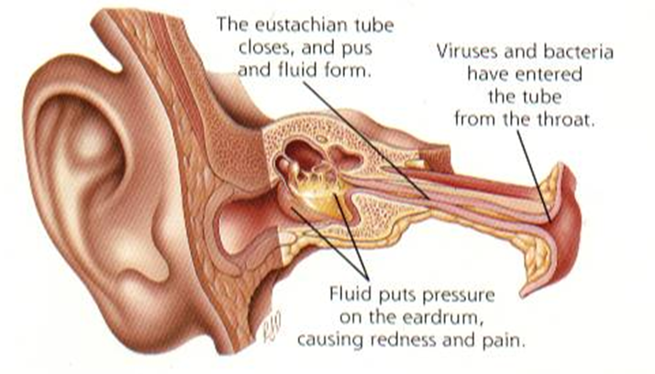

Slide 18
Case
3 year old female complaining of right earache, fever and decrease of hearing on the same ear.
She had a history of URTI one week ago.
What is your most likely diagnosis ?

Slide 19
Diagnosis
Main Symptoms:
Otalgia
Fever
deafness
facial paralysis

Slide 20
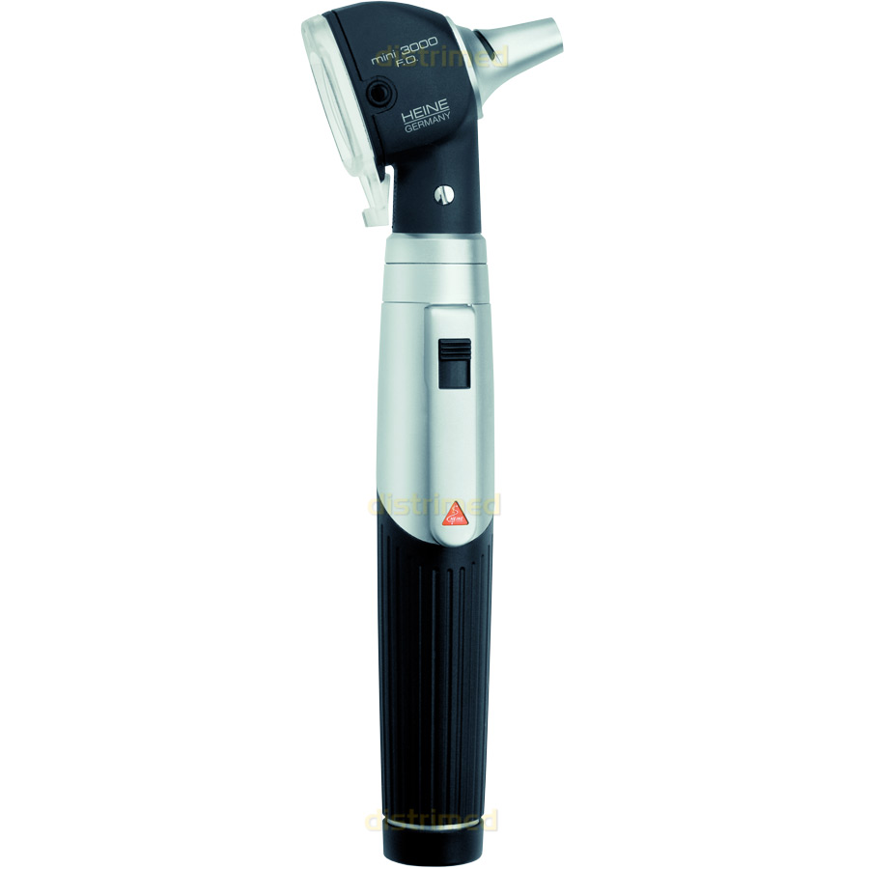
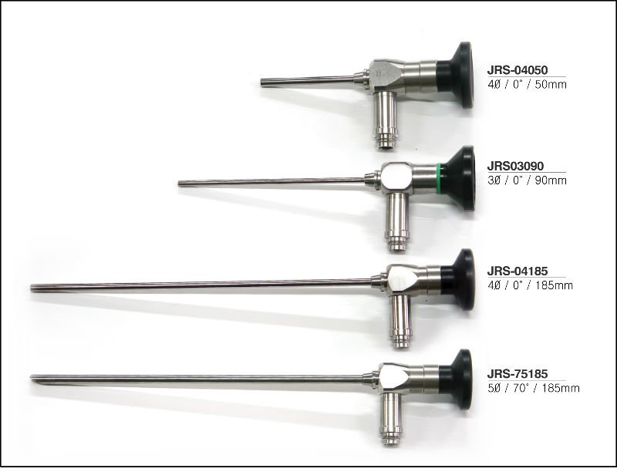
Physical Examination
Erythematic, opaque, bulging tympanic membrane with loss of anatomic landmarks including an absent light reflex.

Slide 21
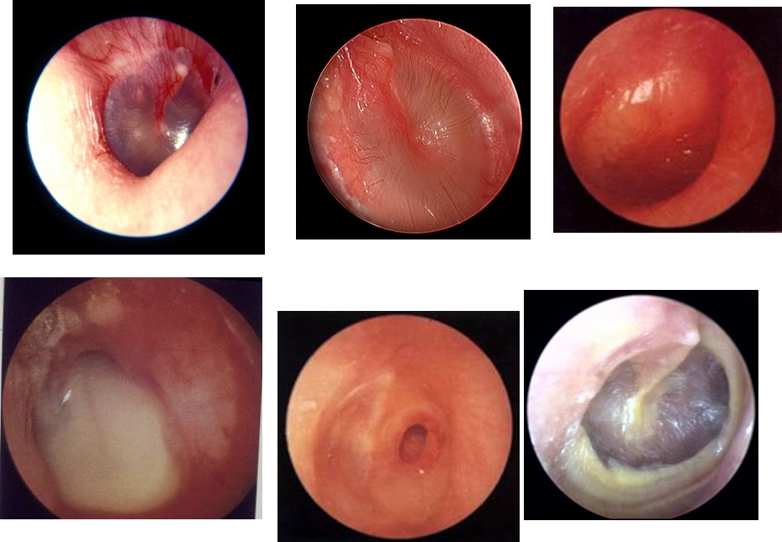
Physical Examination

Slide 22
Investigations
When?
Treatment is not working
Complications develop
Tests include:
Tympanometry
Tympanocentesis
CT scans

Slide 23
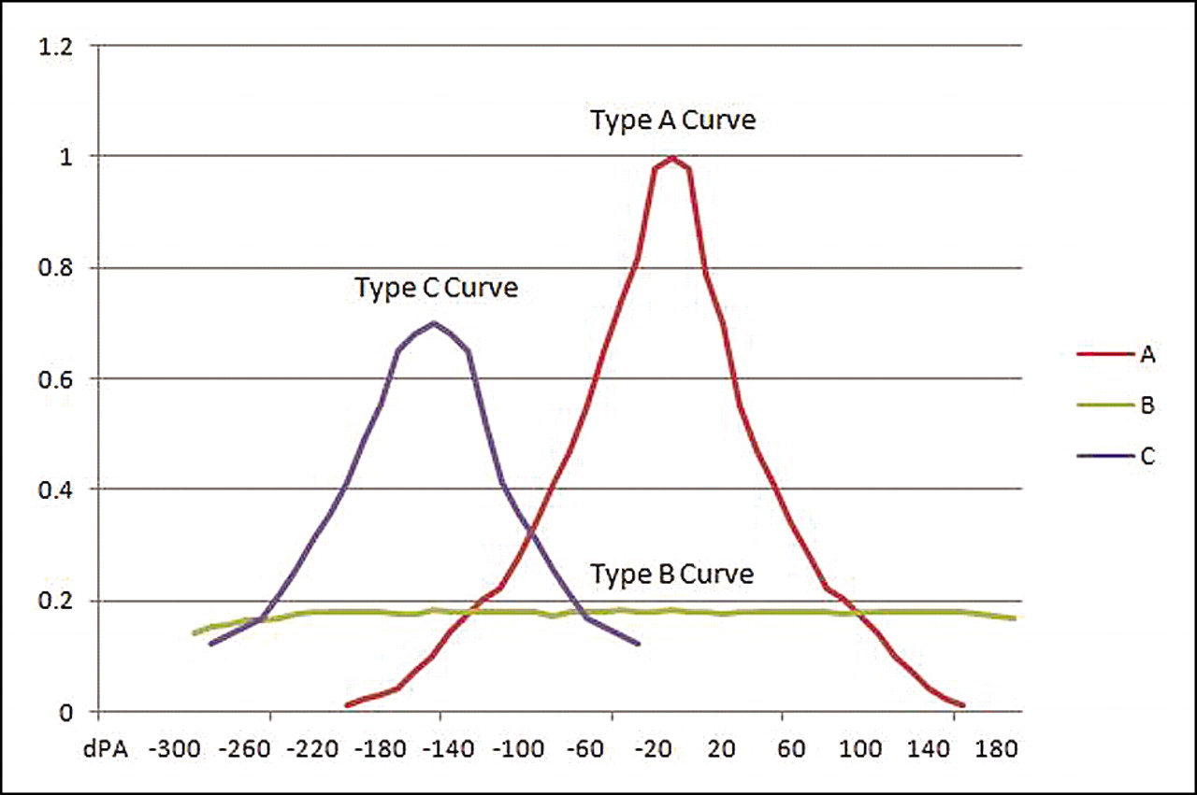
Tympanometry

Slide 24
Tympanocentesis

Slide 25
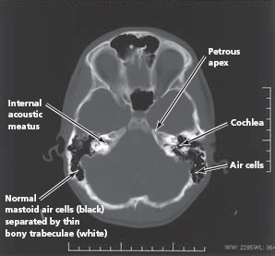
CT Scan

Slide 26
Treatment
Observation, most cases resolve within 2-3 days
Symptomatic treatment with Paracetamol
Antibiotics undicated:
A child has a serious health condition that makes them more vulnerable to infection.
A child is under the age of three months
A child’s symptoms show no signs of improvement after four days
Recurrent OM (Three or more attacks over a 6-months period)

Slide 27
Antibiotics**
Amoxicillin : is the drug of choice
under 2 years, 125mg three times daily
10 years, 250 mg three times daily
over 10 years, 500 mg three times daily
However, Amoxicillin-clavulanate should be considered for patients with severe otalgia or elevated temperature to cover the possibility of beta-lactamase producing H. influenzae.
If your child is allergic to amoxicillin, alternative antibiotics such as Erythromycin can be used

Slide 28
Surgery
Tympanostomy tube:
unresponsive >3 months
Recurrent MEE w/effusion
Myringotomy ( Repairs the Tympanic Membrane only ) and aspiration (to equalize the pressure)
Causative factors (adenoidectomy, cleft palate)

Slide 29
Sinusitis

Slide 30
Definition
Inflammation of the lining of the paranasal sinuses.

Slide 31
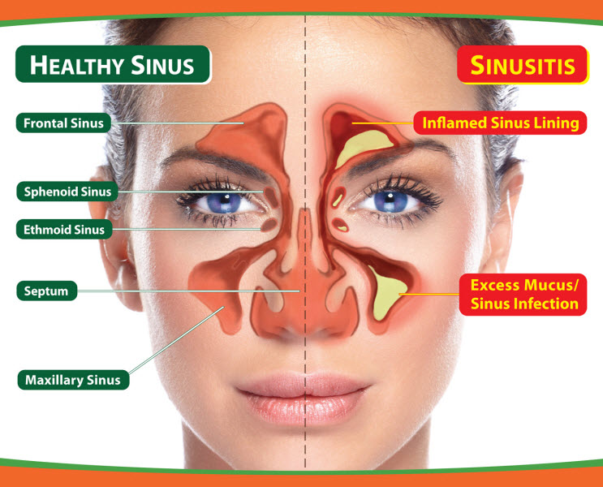

Slide 32
Classification
Acute sinusitis
< 4 Weeks
Subacute sinusitis
> 4 Weeks and < 3 months
Chronic sinusitis
> 3 Months
Recurrent acute sinusitis
Diagnosed when 2-4 episodes of infection occur per year.

Slide 33
Etiology
Infection
Viral ( rhinovirus, influenza virus)
Bacterial (Streptococcus pneumonia)
Fungal ( Rare )
Cilia in the sinuses do not work properly due to some medical conditions (kartegner syndrome).
Colds and allergies may cause too much mucus to be made or block the opening of the sinuses.
A deviated nasal septum, nasal bone spur, or nasal polyps may block the opening of the sinuses.

Slide 34
Clinical Presentaion
• Day and night cough
• Purulent nasal discharge (v. imp) (diagnostic )
• Nasal airway obstruction
• Headache, irritability, or facial pain
• Fever
• Postnasal drip.

Slide 35
Physical Examination
Press the over the air sinuses to check for:
Tenderness
Yellow to yellow-green nasal discharge.
Check the inside of the nasal passages by torch to check the mucus and look for any structural abnormalities.

Slide 36
Investigations
Usually not necessary:
Diagnosis- Sinus Aspiration
Mucus culture
Nasal endoscopy
X-ray
Allergy testing
CT
Blood work
Notes:
Patients in intensive care or with immunocompromise
Children not responding to appropriate medical management
Patients with complications of sinusitis

Slide 37
Management
Abx
Amoxicillin/potassium clavunate (Augmentin)
• Erythromycin-sulfisoxazole
Other Medications (facilitate drinage):
• Antihistamines if there is allergy
• Decongestants
• Anti-inflammatory agents ex. Steroids which will decrease the edema.

Slide 38
Non-pharmacological
Humidifier to relieve the drying of mucous membranes associated with mouth breathing
Increase oral fluid intake
Saline irrigation of the nostrils
Moist heat over affected sinus

Slide 39
Surgery
• Rarely required
• Consider if orbital or central nervous system complications or
• Failure of maximal medical therapy
Functional endoscopic sinus surgery

Slide 40
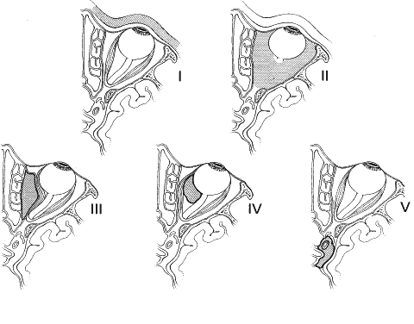
Complications (orbital)
Chandler's criteria (orbital)
Preseptal cellulitis
Orbital cellulitis
Subperiosteal abscess
Orbital abscess
Cavernous sinus
thrombosis

Slide 41
Intracranial Complications
Meningitis (the most imp)
Epidural abscess
Subdural abscess
Intracerebral abscess
Cavernous sinus, venous sinus thrombosis

Slide 42
Case
35 year male came to PHC complaining of several episodes of headache associated with fever, nasal congestion and discharge, The headache concentrated in front of the head aggravated by bending forward.
What is the most likely diagnosis ?

Slide 43
Sore Throat

Slide 44
Causes of sore throat
viral
common cold
flu
bacterial
strep throat
tonsillitis
thyroiditis
persistent cough
GERD
foreign body
smoking

Slide 45
Differential diagnosis
•Infectious pharyngitis
oBacterial pharyngitis
•GABHS 10% in adults
•Others <1% each
oViral pharyngitis
•Rhinovirus, coronovirus, parainfluenza virus (common cold) 25%
•Influenza types A and B (influenza) 4%
•Adenovirus (phryngoconjunctival fever) 4%
•Others
•Non infectious causes
(physical irritation, inflammation secondary to radiotherapy or chemotherapy).
•Pharyngeal abscess
•Epiglottitis

Slide 46
Red Flags
•Epiglottitis
•If suspected, do not examine the throat, immediately take the patient to the O.R unless there are facilities for immediate intubation/tracheotomy because of the possibility of precipitating complete airway obstruction or cardiopulmonary arrest
•Progress very fast secure airway first
•Pathogen: H,influenza
•Clinical feature: high grade fever , toxic very bad stridor , drooling of saliva, difficulty of breathing

Slide 47
When to Admit ?
•Stridor or respiratory difficulty
•Upper airway obstruction
•Dehydration
•Severe suppurative complications
•Immunocompromised patient
•Diphtheria

Slide 48
Pharyngitis
One of the commonest conditions encountered by family physicians.
It can be difficult to determine whether you have a viral or bacterial infection because the symptoms are often similar
Identifying the cause of pharyngitis, especially group A beta-hemolytic streptococcus (GABHS), is important to prevent potential life-threatening complications

Slide 49
Viral:
the most common cause of sore throat
Clinical features:
o Coryza.
o Conjunctivitis.
o Malaise or fatigue.
o Hoarseness.
o Low-grade fever
Children with viral pharyngitis also can present with atypical symptoms, such as:-
o Mouth-breathing.
o Vomiting.
o Abdominal pain.
o Diarrhea.

Slide 50
Pharyngitis
Bacterial:
o Patients generally do not have rhinorrhea, cough, or conjunctivitis.
o There is often a history of streptococcal throat infection within the past year.
o Group A beta-hemolytic streptococcus (GABHS) is the most common bacterial cause of pharyngitis.
•GABHS infection:
- Signs of strep throat may include
o Pharyngeal erythema.
o Tonsillar exudate.
o Edematous uvula.
o Palatine petechiae.
o Anterior cervical lymphadenopathy .

Slide 51
GABHS Pharyngitis Complications
Suppurative:-
peritonsillar abscess
retropharyngeal abscess
cervical lymphadenitis
bacteremia
otitis media
sinusitis
mastoiditis
nonsuppurative:-
rheumatic fever
acute poststreptococcal glomerulonephritis

Slide 52
Diagnosis
GENERAL APPROACH
- When a patient presents with sore throat, physician must consider a wide range of illnesses. Infectious range from generally benign viruses to GABHS. Inflammatory presentations may be the result of allergy.
- In determining the underlying cause the physician must integrate information from the history and physical examination. Environmental and epidemiologic factors may need to be assessed

Slide 53
History
o Onset.
o Duration.
o Progression.
o Severity of the associated symptoms (e.g., fever, cough, respiratory difficulty, swollen lymph nodes).
o Exposure to infections.
o Presence of comorbid conditions (e.g. diabetes).

Slide 54
Physical examination
examine the pharynx for:-
erythema
hypertrophy
foreign body
exudates
masses
petechiae
adenopathy
also assess the patient for:-
fever
rash
cervical adenopathy

Slide 55
Laboratory
1- THROAT CULTURE
Sensitivity: 97 percent; Specificity: 99 percent
It takes approximately 24 hours for the culture results to become available
2- RAPID ANTIGEN DETECTION TESTS
Detects presence of group A streptococcal carbohydrate
results available within minutes
Specificity: > 95 percent; sensitivity: 80 to 97 percent, depending on the test
3-Monospot test
for mononucleosis
sensitivity: 86 percent; specificity: 99 percent

Slide 56
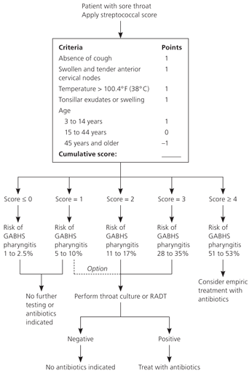
Clinical Decision Rule for Management of Sore Throat

Slide 57
ANTIBIOTICS
Penicillin, penicillin congeners (ampicillin or amoxicillin), clindamycin (Cleocin), and certain cephalosporins and macrolides are effective against GABHS.
First line treatment is penicillin.
Oral amoxicillin suspension is often substituted for penicillin

Slide 58
Question
How can we modify help seeking behavior of patients with flu illness?

Slide 59
MCQ’s (again)

Slide 60
Post MCQ Test
Q1- A 3-year-old boy brought by his mom to the ER with difficulty in breathing and drooling for 3 hours, most likely diagnosis is:
a) CROUP
b) Acute epiglottis
c) Laryngomalacia
d) Candidiasis

Slide 61
Post MCQ Test
Q2- A 4 year old child with bilateral decreased hearing for a few months. There is no ear
discharge. Examination of the ear revealed retracted tympanic membranes. What is the
most probable diagnosis ?
a) Chronic suppurative otitis media.
b) Chronic otitis externa.
c) Otitis media with effusion.
d) Tympanosclerosis

Slide 62
Post MCQ Test
Q3- What is the management of uncomplicated acute suppurative sinusitis:
a) Antibiotics for 24 hours, then surgery
b) Surgery then antibiotics
c) Antihistamines and steam inhalation
d) Analgesic, antibiotic & decongestant nasal drops

Slide 63
Post MCQ Test
Q4- A 7 years old boy has developed right ear pain and ipsilateral facial weakness for three days. On examination he has tempreture of 38 C. right congested bulging tympanic membrane and partial right facial paresis what is the most likely cause of facial paresis ?
a) acute otitis media
b) bell's palsy
c) herpes zoster oticus
d) otitis media with effusion

Slide 64
Post MCQ Test
Q5- Patient presents with a 5-day history of headache, facial pain over the forehead and maxilla, purulent nasal discharge, what is the most likely diagnosis?
Acute sinusitis
Trigeminal Neuralgia
Allergic rhinitis
Nasal polyposis

Slide 65
References
American Academy of Pediatrics - Subcommittee on Management of Sinusitis and Committee on Quality Management. Clinical practice guideline: management of sinusitis. Pediatrics. Sep 2001;108(3):798-808.
Lanza DC, Kennedy DW. Adult rhinosinusitis defined. Otolaryngol Head Neck Surg. Sep 1997;117(3 Pt 2):S1-7.
ENT Course Lecture Slides
http://www.aafp.org/afp/2004/0315/p1465.html
http://articles2day.org/2012/11/gabhs-pharyngitis-diagnosis-complications-and-treatment.html
http://www.bhchp.org/BHCHP%20Manual/pdf_files/Part1_PDF/Strep.pdf
http://www.ncbi.nlm.nih.gov/pmc/articles/PMC153141/

Slide 66
Thank You
☺

Slide 67
Role Playing Cases
Complaint
History
Examination and Investigations
Management
Follow-up

