Slide 1
Screening for Common Cancers
Presented by:
Saud AlOmair
Mohammad AlEnezi
Abdullah AlShalan

Slide 2
Q1) Which of the following are the most important and clinically useful risk factors for breast cancer? .
Fibrocystic disease, age, and gender.
Cysts, family history in immediate relatives, and gender.
Age, gender, and family history in immediate relatives.
Obesity, nulliparity, and alcohol use

Slide 3
Q2) Which one of the following is the best screening method for breast cancer in a 45 year old lady ?
Clinical breast examination
Ultrasound
Self Breast examination
Mammography

Slide 4
Q3) The most important risk factor regarding cervical cancer is…………?
HPV (16, 18) infection.
HPV (31, 32, 33) infection.
Family history.
Smoking

Slide 5
Q4) What is the race most associated with prostate cancer?
Indians
Asians
African Americans
European Americans

Slide 6
Q5) Which of the following could reduce the risk of developing colorectal cancer?
Physical exercise
Increasing dietary fibers
Avoiding NSAIDs
All the above

Slide 7
Screening and Surveillance
Screening: involves one or more tests performed to identify whether a person with no symptoms has a disease or condition that may lead to cancer. The goal is to identify the potential for disease or the condition early when it is easier to prevent or cure.
Surveillance: involves testing people who have previously had cancer or are at increased risk. Because their chance of having cancer is higher, more extensive or more frequent tests are recommended.

Slide 8
Criteria for screening
Knowledge of disease:
The condition should be important.
There must be a recognizable latent or early symptomatic stage.
The natural course of the condition, including development from latent to declared disease, should be adequately understood.
Knowledge of test:
Suitable test or examination.
Test acceptable to population.
Case finding should be continuous.
Treatment for disease:
Accepted treatment for patients with recognized disease.
Facilities for diagnosis and treatment available.
Agreed policy concerning whom to treat as patients.
Cost considerations:

Slide 9
Breast Cancer

Slide 10
Epidemiology
It is the most commonly diagnosed cancer in women
It is the second leading cause of death among women
In 2010, there were 1,643,000 estimated new cases of breast cancer worldwide
60% of breast cancer deaths, occur in women in developing countries
Worldwide, there were over 508,000 breast cancer deaths in women in 2011

Slide 11
Estrogen role in breast cancer
Estrogen is essential for the normal functioning of a woman's reproductive system and for normal breast development. Lifetime exposure to estrogen is thought to increase a woman's risk for breast cancer
Estrogen may be implicated in breast cancer risk because of:
1) its role in stimulating breast cell division.
2) its work during the critical periods of breast growth and development.
3) its effect on other hormones that stimulate breast cell division.
4) its support of the growth of estrogen-responsive tumors.

Slide 12
Risk Factors (Non modifiable)
Gender (100 times more common in females)
Age (increase with age)
Race (overall more in whites)
Menstrual periods
Family history
Genetic factor
Dense breast tissue

Slide 13
Risk Factors (Modifiable)
Parity
Birth controls
Hormone therapy after menopause
Breastfeeding
Alcohol consumption
Obesity
Physical inactivity(a study showed a 2.5 hour per week of brisk walking reduce breast cancer risk by 18%)

Slide 14
Screening for breast cancer
Mammogram:
is an X-ray of the breast. Mammograms are the best way to find breast cancer early, when it is easier to treat and before it is big enough to feel or cause symptoms. Having regular mammograms can lower the risk of dying from breast cancer.
It is recommended for women over the age of 40 to do mammogram yearly

Slide 15
Clinical Breast Exam (CBE):
A clinical breast exam is an examination by a doctor or nurse, who uses their hands to feel for lumps or other changes.
Recommended to be done every 3 years for women in their 20s and 30s and every year for women 40 and over

Slide 16
Breast Self Exam (BSE):
A breast self-exam is when a women checks her own breasts for lumps, changes in size or shape of the breast, or any other changes in the breasts or armpit.
Women should know how their breasts normally look and feel and report any breast change promptly to their health care provider. Breast self-exam (BSE) is an option for women starting in their 20s.

Slide 17
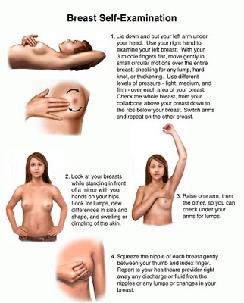

Slide 18
Benefits and harms of breast cancer screening
Mammogram
Benefits:
Decrease in breast cancer mortality
A study showed that for women aged 40 to 74 years, screening with mammography has been associated with a 15% to 20% relative reduction in mortality due to breast cancer.
Harms:
Over diagnosis and Resulting in Treatment of Insignificant Cancers
False-Positives with Additional Testing and Anxiety
On average, 10% of women will be recalled from each screening examination for further testing, and only 5 of the 100 women recalled will have cancer
False-Negatives with False Sense of Security
Radiation-Induced Breast Cancer
Theoretically, annual mammograms in women aged 40 to 80 years may cause up to one breast cancer per 1,000 women

Slide 19
Clinical Breast Examination
Benefits:
has not been tested independently it was used in conjunction with mammography and showed equivalent benefit for both modalities
Harms:
False-Positives with Additional Testing and Anxiety
False-Negatives with Potential False Reassurance

Slide 20
Breast Self Examination
Benefits:
Breast self examination has been compared to usual care (no screening activity) and has not been shown to reduce breast cancer mortality
Harms:
Based on solid evidence, formal instruction and encouragement to perform BSE leads to more breast biopsies and diagnosis of more benign breast lesions.

Slide 21
Cervical Cancer

Slide 22
Epidemiology
Worldwide, cervical cancer is both the fourth most common cause of cancer, and fourth most common cause of deaths from cancer in women
More than one-half of women who develop cervical cancer have not been screened appropriately
It is estimated that over 6 million people are infected with genital HPV in the United States each year
Approximately 80% of cervical cancers occur in developing countries
The majority of cases are squamous cell carcinoma, and adenocarcinomas are less common

Slide 23
Cervical Cancer in Saudi Arabia
Saudi Arabia has a population of 6.51 millions women ages 15 years and older who are at risk of developing cervical cancer
Cervical cancer ranks as the 11th most frequent cancer among women in Saudi Arabia, and the 8th most frequent cancer among women between 15 and 44 years of age
Current estimates indicate that every year 152 women are diagnosed with cervical cancer and 55 die from the disease in Saudi Arabia

Slide 24
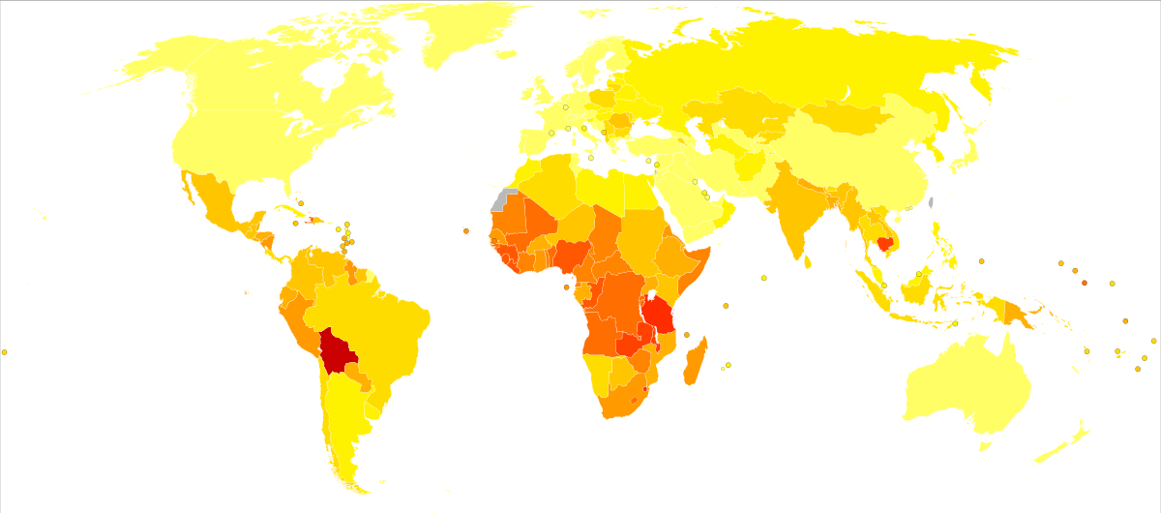
Death from cervical cancer per 100,000 inhabitants in 2004.

Slide 25
Risk Factors
HPV (16, 18)
HPV Exposure
HPV (31,32,33)…less important
Smoking
Oral Contraceptives
Parity
15% higher in women who have had 1 full-term pregnancy
64% higher in those with 7+ full-term pregnancies
Age at first full-term pregnancy
77% higher in those under 17 years old
Immunosuppression
Family History (First degree relative)
squamous cell carcinoma risk is 74-80%
adenocarcinoma risk is 39-69%
Age (25 – 65)

Slide 26
HPV Vaccination
Gardasil is used in the national NHS cervical cancer vaccination program. Gardasil protects against HPV type (6,11,16 and 18)
The incidence and mortality rates are related to the presence of screening and HPV vaccination programs

Slide 27
1-Advisory Committee on Immunization Practices 2-The American Congress of Obstetricians and Gynecologists 3-American Academy of Family Physicians 4-American College Health Association

Slide 28
Special Cases for HPV Vaccine
Immunosuppression
Can be vaccinated (not live)
Lactating women
Can receive vaccine
Pregnant women
Should be initiated after the pregnancy
If found pregnant after the initiation of the vaccine, completion should be delayed until after the pregnancy

Slide 29
Benefits
Prevent anal, vulvar, and vaginal cancers and pre-cancers linked to these types of HPV
Prevent genital and anal warts
Issues
Side effects
Research show that the vaccine is not beneficial for previously infected patients

Slide 30
Screening for Cervical Cancer
Rates of cervical cancer have fallen by approximately 75% since the introduction of Pap screening programs
The five-year survival rate for women with invasive cervical cancer is 68%. When detected at an early stage, the five-year survival rate is 91%.
Pap smear is the most common screening test for cervical cancer, however liquid based-cytology is the standard screening method in the UK.
Liquid based cytology is more specific and more sensitive than the conventional Pap test.

Slide 31
Papanicolaou Test (Pap Smear)

Slide 32
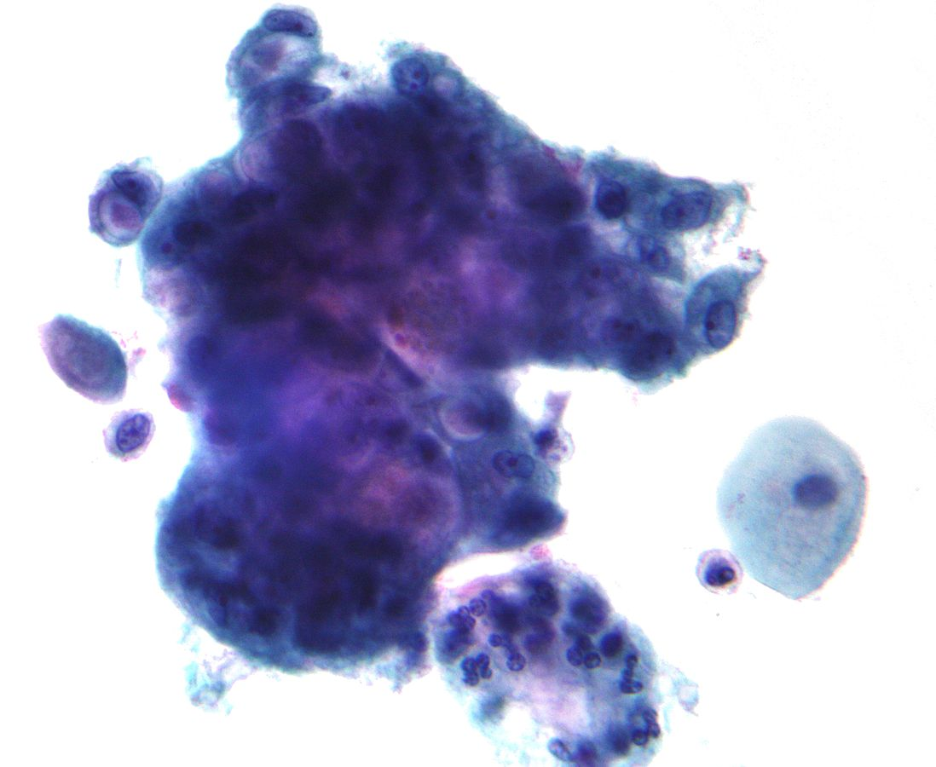
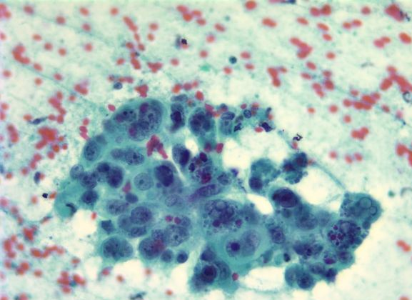
Papanicolaou Test (Pap Smear)

Slide 33
Cotesting
Cotesting is using pap test and HPV test as screening for cervical cancer.
There is a research that suggests testing HPV alone as screening for cervical cancer.
The research followed women with negative pap test and negative HPV for three years, to see how many develop cervical cancer
20 out of 100,000 developed cervical cancer following a negative Pap test
11 out of 100,000 developed cervical cancer following a negative HPV test.

Slide 34
Age group (years) | Frequency of screening
25 | First invitation
25 - 49 | 3 yearly
50 - 64 | 5 yearly
65+ | Only screen those who have not been screened since age 50 or have had recent abnormal tests

Slide 35
Benefits of screening
Decrease the incidence of cervical cancer
Decrease the cervical cancer mortality
Harms of screening
Over diagnosis
Cost
anxiety

Slide 36
Prostate Cancer

Slide 37
Epidemiology
Prostate cancer is the second most common cancer in men worldwide
Estimated 1,100,000 cases and 307,000 deaths in 2012
The lifetime risk of prostate cancer for men living in the United States is estimated to be approximately one in six

Slide 38
Age-standardized incidence of prostate cancer (per 100,000) in the world
Africa | Congo | 29.0
 | Kenya | 16.6
 | Senegal | 7.5
 | Uganda | 38.0
 | Zimbabwe | 27.4
North America | Canada | 78.2
 | US | 124.8
 | US, White | 107.8
 | US, Black | 185.4
Asia | China | 1.7
 | Taiwan | 3.0
 | Israel | 47.5
 | Japan | 12.6
 | Korea | 7.6
 | Thailand | 4.5
Europe | Austria | 71.4
 | Austria, Tyrol | 100.1
 | Austria, Vorarlberg | 66.4
 | France | 59.3
 | Hungary | 34.0
 | Iceland | 75.2
 | Norway | 81.8
 | Spain | 35.9
 | Sweden | 90.9
 | Switzerland | 77.3
 | UK | 52.2
Oceania | Australia | 76.0
 | New Zealand | 100.9

Slide 39
Autopsy prevalence of prostate cancer in the world
Age | US White³ | US Black³ | Japan¹⁹ | Spain²⁸ | Greece²⁹ | Hungary³⁰
21-30 | 8 | 8 | 0 | 4 | 0 | 0
31-40 | 31 | 31 | 20 | 9 | 0 | 27
41-50 | 37 | 43 | 13 | 14 | 3 | 20
51-60 | 44 | 46 | 22 | 24 | 5 | 28
61-70 | 65 | 70 | 35 | 32 | 14 | 44
71-80 | 83 | 81 | 41 | 33 | 31 | 58
81-90 |  |  | 48 |  | 40 | 73

Slide 40
Age-standardized mortality of prostate cancer (per 100,000) in the world
Africa | South Africa | 22.6
 | Uganda | 32.5
 | Senegal | 6.5
 | Zimbabwe | 23.5
Asia | China | 1.0
 | Israel | 13.4
 | Japan | 5.7
Europe | Austria | 18.4
 | France | 18.2
 | Germany | 15.8
 | Hungary | 18.4
 | Iceland | 23.0
 | Italy | 12.2
 | Norway | 28.4
 | Spain | 14.9
 | Sweden | 27.7
 | UK | 17.9
North America | US | 15.8
 | Canada | 16.6
Oceania | Australia | 17.7
 | New Zealand | 20.3

Slide 41
Risk Factors
Age
Race
Genetics (BRCA1 – BRCA2)
Family history
Smoking

Slide 42
Screening for Prostate Cancer
The standard screening method is PSA level, however it is not specific.
Digital rectal exam is another screening test done by the doctor to detect enlargement and masses.

Slide 43
PSA
There is no specific normal or abnormal level of PSA in the blood
PSA levels of 4.0 ng/mL and lower were considered normal. However, more recent studies have shown that some men with PSA levels below 4.0 ng/mL have prostate cancer and that many men with higher levels do not have prostate cancer

Slide 44
PSA
Age | PSA cut-off (ng/ml)
50-59 | ≥ 3
60-69 | ≥ 4
70 and over | > 5

Slide 45
PSA vs Digital rectal exam
An American multicenter clinical trail compared the two methods in 6,630 men
The results showed that 15% of the men had a PSA level of greater than 4 micrograms/l, 15% had a suspicious digital rectal examination and 26% had suspicious findings on either or both tests.
Of 1,167 biopsies performed cancer was detected in 264. PSA detected significantly more tumors (82%, 216 of 264 cancers) than digital rectal examination (55%, 146 of 264, p = 0.001).

Slide 46
Detecting prostate cancer early may not reduce the chance of dying from prostate cancer
The PSA test may give false-positive or false-negative results

Slide 47
Colorectal Cancer

Slide 48
Epidemiology
Colorectal cancer is the third most common cancer worldwide and the fourth most common cause of death
Accounts for over 9% of all cancer incidence
Has geographical variation
Mainly a disease of developed countries
Sex: male = female

Slide 49
Risk Factors
Modifiable risk factors:
Nutrition and diet
Physical inactivity and obesity
Smoking
Alcohol intake
Non-modifiable:
Age
Personal history of adenomatous polyps
IBD
Family history of colorectal cancer or adenomatous polyps

Slide 50
Screening
The main aim of screening is discovering precancerous polyps to prevent progression to cancer
Should begin at the age of 50 in average risk individuals
Screening methods include:
Colonoscopy
Sigmoidoscopy
CT colonography
Fecal occult blood test

Slide 51
Colonoscopy
Advantages:
High sensitivity and specificity
Allows visualization of the entire colon
Possible removal of polyps (polypectomy)
Disadvantages:
Requires sedation
Requires a bowel preparation
Time consuming
Expensive

Slide 52
Sigmoidoscopy
Advantages:
Safer and more convenient than colonoscopy
Takes less time to perform than colonoscopy
Disadvantages:
Moderate sensitivity and specificity
Does not allow visualization of the entire colon
Colonoscopy might be needed

Slide 53
CT Colonography
Advantages:
High sensitivity and specificity
Allows visualization of the entire colon
Sedation is not required
Non-invasive
Disadvantages:
Sensitivity is variable based on technique
Requires bowel preparation
Exposure to radiation

Slide 54
Fecal Occult Blood Test
Advantages:
Easy, safe, and more convenient
Cheap
Disadvantages:
Low sensitivity
May require colonoscopy

Slide 55
Cost Effectiveness

Slide 56
Cost Effectiveness
-Anything effective and productive in relation to its cost is cost effective
-Cost effectiveness analysis in health care compares the costs and health effects of an intervention to assess the extent to which it can be regarded as providing value for money

Slide 57
Which of the aforementioned screening tests is most cost effective for each cancer?

Slide 58
Cost Effective Screening Tests
Breast cancer: Mammography is the most cost effective test
Cervical cancer: Primary HPV test is the most cost effective test for non-vaccinated females
Prostate cancer: PSA screening is the most cost effective test
Colorectal cancer: 10-yearly colonoscopy is the most cost effective test

Slide 59
Q1) Which of the following are the most important and clinically useful risk factors for breast cancer? .
Fibrocystic disease, age, and gender.
Cysts, family history in immediate relatives, and gender.
Age, gender, and family history in immediate relatives.
Obesity, nulliparity, and alcohol use

Slide 60
Q2) Which one of the following is the best screening method for breast cancer in a 45 year old lady ?
Clinical breast examination
Ultrasound
Self Breast examination
Mammography

Slide 61
Q3) The most important risk factor regarding cervical cancer is…………?
HPV (16, 18) infection.
HPV (31, 32, 33) infection.
Family history.
Smoking

Slide 62
Q4) What is the race most associated with prostate cancer?
Indians
Asians
African Americans
European Americans

Slide 63
Q5) Which of the following could reduce the risk of developing colorectal cancer?
Physical exercise
Increasing dietary fibers
Avoiding NSAIDs
All the above

Slide 64
Thank You

Slide 65
References
Up to date
NICE guidelines
Cancer.gov
CDC.gov

Slide 66
References
http://www.cancer.gov/cancertopics/pdq/screening/breast/healthprofessional/page1
http://www.cdc.gov/cancer/breast/basic_info/screening.htm
http://www.cancer.org/cancer/breastcancer/detailedguide/breast-cancer-risk-factors
http://www.uptodate.com/contents/screening-for-breast-cancer-strategies-and-recommendations?source=machineLearning&search=screening+for+common+cancer&selectedTitle=1~150&sectionRank=1&anchor=H313584321#H313584321
http://www.cancer.org/healthy/findcancerearly/cancerscreeningguidelines/american-cancer-society-guidelines-for-the-early-detection-of-cancer

Slide 67
References
Catalona WJ1, Richie JP, Ahmann FR, Hudson MA, Scardino PT, Flanigan RC, deKernion JB, Ratliff TL, Kavoussi LR, Dalkin BL. Comparison of digital rectal examination and serum prostate specific antigen in the early detection of prostate cancer: results of a multicenter clinical trial of 6,630 men
http://www.cancer.net/cancer-types/cervical-cancer/diagnosishttp://www.cancer.net/cancer-types/cervical-cancer/prevention
http://www.cancerresearchuk.org/cancer-info/cancerstats/types/cervix/riskfactors/cervical-cancer-risk-factors
http://en.wikipedia.org/wiki/Cervical_cancer#Worldwide
http://www.medscape.com/viewarticle/828565
http://www.medscape.com/viewarticle/829568
http://www.uptodate.com/contents/screening-for-cervical cancer?source=search_result&search=cervical+cancer&selectedTitle=6~150
http://www.cancerscreening.nhs.uk/cervical/lbc.html

Slide 68
References
http://www.ncbi.nlm.nih.gov/pmc/articles/PMC2706483/
http://www.uptodate.com/contents/risk-factors-for-prostate-cancer?source=search_result&search=prostate+cancer+screening&selectedTitle=6~30
http://www.uptodate.com/contents/measurement-of-prostate-specific-antigen?source=search_result&search=prostate+cancer+screening&selectedTitle=5~30
http://www.uptodate.com/contents/clinical-presentation-and-diagnosis-of-prostate-cancer?source=search_result&search=prostate+cancer+screening&selectedTitle=9~30
http://www.cancer.gov/cancertopics/factsheet/detection/PSA

Slide 69
References
http://www.who.int/cancer/detection/breastcancer/en/
http://www.ncbi.nlm.nih.gov/pmc/articles/PMC2796096/
http://www.cmaj.ca/content/182/12/1307.abstract
https://www.rmf.harvard.edu/Clinician-Resources/Guidelines-Algorithms/2014/CRC-pros-cons-screening-options

