Slide 1
Sexually Transmitted disease
Mohammad Mahasin
Saleh AlKurini
Faisal AlDawood

Slide 2
Questions

Slide 3
Question 1
Most common STIs in KSA ?
HIV
Chlamydia
Gonorrhea
Syphilis

Slide 4
Question 2
A 34 year old female presented to you at the clinic complaining of a frothy yellowish vaginal discharge and local irritation. On examination you notice that the cervix has multiple small hemorrhagic areas which is often described as “strawberry cervix”. Which of the following organisms is the most likely cause?
Chlamydia trachomatis
Niesseria gonorrhea
Trichomonas Vaginalis
HPV type 11

Slide 5
Question 3
Which of the following HPV types is known to caue cervical cancer?
HPV 6
HPV 11
HPV 16
HPV 33

Slide 6
Question 4
Which of the following is required to diagnose a patient with AIDS?
A CD4 count of less than 200 cells/mm3
A CD4 count of less than 1000 cells/mm3
A CD4 count of less than 2000 cells/mm3
A CD4 count of less than 100 cells/mm3

Slide 7
Question 5
A woman presented to the clinic complaining of multiple painless bumps on her genital area. After history and examination she was diagnosed with having Genital Warts. What test would you like to order?
ELISA
PCR
Pap smear
Vaginal swab

Slide 8
Definition
“Sexually transmitted infections (STIs) are infections that are spread primarily through person-to-person sexual contact. There are more than 30 different sexually transmissible bacteria, viruses and parasites.” World Health Organization

Slide 9
Most common infections
Bacterial infections :
Chlamydia trachomatis (causes chlamydial infections)
Neisseria gonorrhoeae (causes gonorrhoea or gonococcal infection)
Treponema pallidum (causes syphilis)
Haemophilus ducreyi (causes chancroid)
Klebsiella granulomatis (causes granuloma inguinale or donovanosis).

Slide 10
Viral infections:
Human papillomavirus (causes genital warts and certain subtypes lead to cervical cancer in women)
Herpes simplex virus type 1 and type 2 (causes genital herpes)
Human Immunodeficiency Virus (causes AIDS)
Hepatitis B virus (causes hepatitis and chronic cases may lead to cancer of the liver)
Parasitic infections:
Trichomonas vaginalis (causes trichomoniasis)

Slide 11
Chlamydia trachomatis
It is the most common bacterial STI in the world.
It is the most common STI in KSA
Etiology:
It is caused by the bacterium Chlamydia trachomatis.
It has an incubation period of 1–3 weeks.
Mode of transmission:
Sexual contact
It is mostly asymptomatic ( 80% of women, 50% of men)

Slide 12
Clinical presentation
Males | Females
Painful urination
Burning Sensation on the genitalia
Cloudy or clear discharge from the penis | Abnormal vaginal discharge
Painful and swollen testicles | Pain during intercourse
 | Abdominal pain with fever
 | Intermenstrual bleeding

Slide 13
Diagnosis and Treatment
Diagnosis: Using the following methods after a urine sample (specimen of choice) or swab is obtained:
Nucleic acid amplification test (NAAT)
Direct fluorescent antibody test
EIA
Treatment:
Tetracyclines or Macrolides antibiotics such as Azithromycin or Doxycycline .
In pregnancy, Erythromycin is the drug of choice.

Slide 14
Complications
Women
Pelvic inflammatory disease
Cervicitis
Salpingitis (causing ectopic pregnancy)
Men
Urethritis
Epididymitis
Reactive arthritis

Slide 15
Mucopurulent discharge in Cervix Proctitis

Slide 16
Trichomoniasis
Etiology:
Trichomonas Vaginalis (Flagellated protozoa), it can attach to the squamous epithelium infecting the vagina and urethra.
Mode of transmission:
Sexual contact.
Perinatally, from mother to child.

Slide 17
Signs and symptoms
Men:
usually present as the asymptomtic sexual partners of infected women.
They may complain of urethral discharge, irritation or urinary frequency.
Women:
The major complaint are vaginal discharge
Local irritation.
Examination often reveals a frothy yellowish vaginal discharge and erythematous vaginal walls.
The cervix may have multiple small hemorrhagic areas which lead to the description ‘strawberry cervix’.

Slide 18
Strawberry cervix

Slide 19
Diagnosis and Treatment
Diagnosis:
Dark-ground microscopy.
Positive in 40-80% of women.
Positive in 30% of men.
Culture techniques are good and confirm the diagnosis.
Treatment:
Metronidazole is the treatment of choice.

Slide 20
Complications
Genital inflammation, making it easier to get infected with other STIs
During pregnancy
Preterm delivery
Low birth weight

Slide 21
Gonorrhea
Etiology:
Neisseria gonorrhea (Gram -ve intracellular diplococcus) infecting the epithelium particularly of the urogenital tract, rectum, pharynx and conjunctivae.
Incubation period is 2-14 days.
Modes of transmission:
Sexual contact (most symptoms present between 2-5 days)
Mother to child transmission

Slide 22
Presentation
 | Men | Women
Asymptomatic | 10% | 50%
Signs and symptoms | Dysuria Urethral discharge In MSM rectal infection may produce proctitis. | Dysuria Pelvic pain vaginal discharge Intermenstrual bleeding Conjunctival infection: seen in neonates born to infected mothers.

Slide 23
Diagnosis and Treatment
Diagnosis
Gram stain of discharge (intracellular pathogen)
Culture and treat empirically
Blood culture and synovial fluid investigations should be performed in cases of disseminated GC
Treatment
Ceftriaxone: one dose IM (also effective against syphilis)
Azithromycin or Doxycycline to cover Chlamydia

Slide 24
Complications
Women
Bartholin’s abscess
Pelvic inflammatory disease
Infertility
Perihepatitis (rare)
Men
Epididymitis
Prostatitis

Slide 25
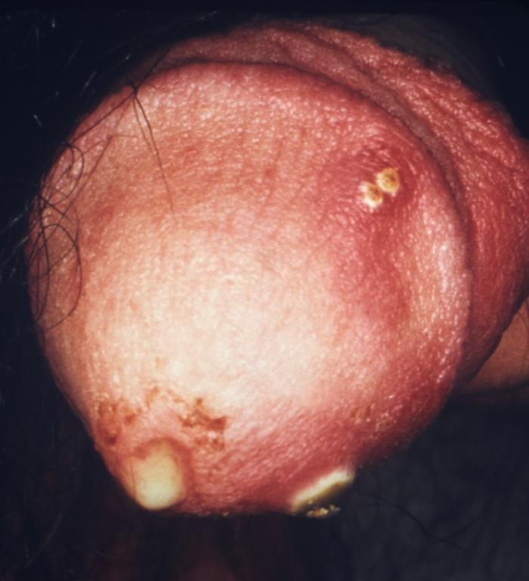
purulent penile discharge due to gonorrhea with an overlying penile pyodermal lesion.

Slide 26
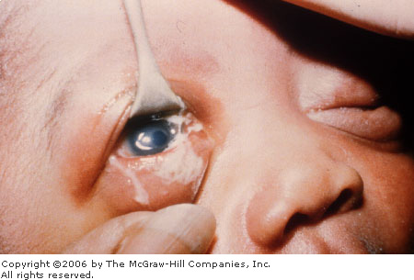
Conjunctival gonorrhea

Slide 27
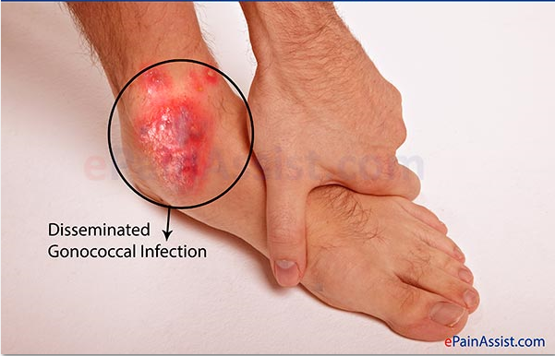
Disseminated gonococcal infection
Arthritis caused by disseminated gonococcal gonorrhea (More common in women)

Slide 28
Syphilis
Etiology
Syphilis is infection with the bacteria Treponema pallidum which spread through broken skin or mucous membranes.
Modes of transmission
Sexual intercourse.
Skin contact.
Transplacentally, causing congenital syphilis.

Slide 29
Primary Syphilis
The first stage present with chancre (a firm, painless, non-itchy skin ulceration) form at the site of infection about 2-3 weeks after you are first infected.
Patient may not notice the sores or any symptoms, particularly if the sores are inside the rectum or cervix.
The sores disappear in about 4-6 weeks, even without treatment. The bacteria become dormant (inactive) in the system at this stage.

Slide 30
Primary syphilis

Slide 31
Secondary Syphilis
Occurs about 2-8 weeks after the first sores form.
About 33% of those who do not have their primary syphilis treated will develop this second stage.
These symptoms (diffuse rash which frequently involves the palms of the hands and soles of the feet) will often also go away without treatment and again, the bacteria become dormant (inactive) in your system.

Slide 32
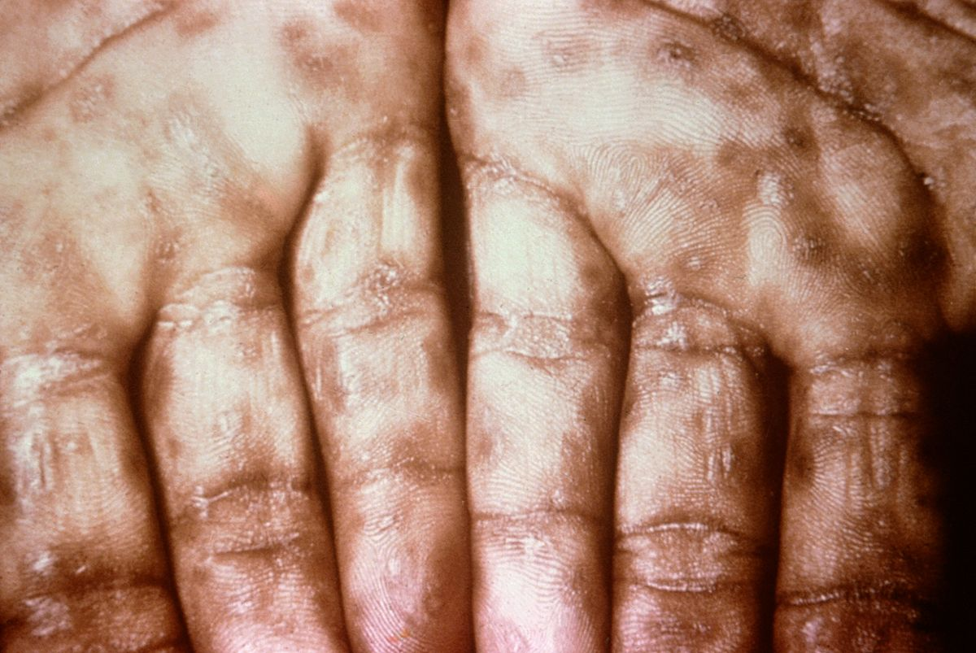
Secondary syphilis

Slide 33
Latent syphilis
Latent syphilis is defined as having serologic proof of infection without symptoms of disease
It can be:
Early:
less than 1 year after secondary syphilis.
Early latent syphilis may have a relapse of symptoms.
Late:
more than 1 year after secondary syphilis.
Late latent syphilis is asymptomatic.
not as contagious as early latent syphilis.

Slide 34
Tertiary Syphilis
Final stage of syphilis.
The infection generally involves the skin and bones but can also spreads to the brain, nervous system, heart.
The dormant bacteria may be detectable either by seeing the damage they cause to a part of the body, or through a blood test for syphilis.
Appearance of Gumma (charactaristic granulomatous lesions) commonly found on skull and legs.

Slide 35
Tertiary Syphilis

Slide 36
Treatment
Antibiotics: effective early
Benzathine penicillin (1 dose, IM), if allergic: doxycycline (2 weeks)
If latent/tertiary: Benzathine penicillin (3 doses, IM)

Slide 37
HIV
Etiology:
Retrovirus, either HIV-1 or HIV-2
HIV-2 is almost entirely confined to West Africa
Modes of Transmission:
Sexual intercourse (Vaginal or Anal)
Mother-to-child (transplacental, perinatal, breastfeeding).
Contaminated blood, blood products and organ transplantation
Contaminated needles

Slide 38
Risk factors and stages
Risk factors:
STIs (due to open sores)
Unprotected sex
Multiple sexual partners
Uncurcumcised males
Stages of HIV infection
Acute HIV infection
Chronic HIV infection
AIDS

Slide 39
Acute HIV infection
Acute HIV infection generally develops within 2 to 4 weeks after a person is infected with HIV.
During acute stage, many people have flu-like symptoms.
In the acute stage, HIV multiplies rapidly and spreads throughout the body. The virus attacks and destroys the infection-fighting CD4 cells of the immune system.
HIV can be transmitted during any stage of infection, but the risk is greatest during acute HIV infection

Slide 40
Chronic HIV infection
HIV continues to multiply in the body but at very low rate.
People with chronic HIV infection may not have any HIV-related symptoms, but they can still spread HIV to others.
Without treatment, chronic HIV infection usually advances to AIDS in 10 to 12 years.

Slide 41
AIDS
AIDS is diagnosed when a person with HIV has a CD4 count of less than 200 cells/mm3 and/or one or more opportunistic infections.
Without treatment, people with AIDS typically survive about 3 years.
Mortality in HIV patients is mostly due to infections, cancers, or wasting.

Slide 42
Diagnosis
ELISA
Screening
High sensitivity
PCR
Measure the viral load
Western Blot
Confiramtory test

Slide 43
Treatment
Antiviral Therapy
Triple therapy HAART:
2 nucleoside reverse transcriptase inhibitors
Zidovudine, Nevirapine
Protease inhibitor
Saquinavir, Indiniavir
Opportunistic infection prophylaxis
TB
PCP
Toxoplasmosis

Slide 44
Genital Warts
Etiology:
Over 90% are caused by HPV types 6 and 11.
HPV types 16 and 18 are known to cause cancer
In females, warts occur around mostly in the vagina, anus, and cervix. In males, genital warts are less common but might present on the tip of the penis
Mode of transmission:
Sexual contact
Direct skin contact

Slide 45
Signs, Symptoms and Complications
Signs and symptoms:
Genital warts present as soft, moist, pink/flesh-colored bumps.
Usually painless.
Complications
HPV is the main risk factor for cervical cancer, as such we have to perform a Pap smear screening test for early detection of cervical cancer in females

Slide 46
Treatment and prevention
Podofilox topical solution
Can be applied at home
Podophylin resin
Applied under medical supervision
Cryotherapy
Electro-cauterization
Surgical removal
Laser ablation

Slide 47
Vaccines
There are two vaccines currently in use:
Gardasil: the FDA approved vaccine for prevention of HPV types 6, 11, 16, 18. It is therapeutic and it has to be used prophylactically.
Cervarix: Protects against HPV types 16 and 18.

Slide 48
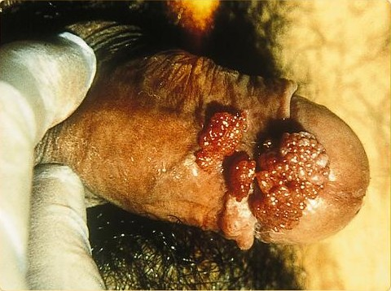
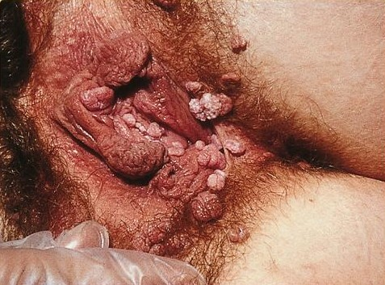
Genital warts

Slide 49
Genital Herpes
Etiology
Genital Herpes caused by Herpes Simplex Virus type 2 (HSV-2)
Oral Herpes caused by HSV-1
HSV-1 can cause genital lesions
Mode of transmission
Contact with person who is shedding (either sexual contact of regular physical contact)
Vertical transmission (very rare)
Through the birth canal

Slide 50
Signs and symptoms
It is a lifelong infection with exacerbations and remissions
Primary Herpes Infection:
Painful shallow ulcers (Around the mouth or on genitalia)
In Immunocompromised patients, symptoms are more severe with increased instances of shedding
Herpes encephalitis
Herpes viral meningitis
Herpes esophagitis

Slide 51
Diagnosis and Complications
Diagnosis:
Clinical presentation and history
Swab is taken from the base of the lesions
PCR
Complications:
Rectal infection may lead to proctitis
Aseptic meningitis
Involvement of sacral autonomic plexus leading to urine retention

Slide 52
Treatment and management
Primary
Acyclovir for 5 days when new lesions are still forming
Treatment will do little to change clinical course if lesions are already crusting
Recurrence
Caring for patients mental health
Long term suppressive therapy (Acyclovir 6-12 months) therapy should be discontinued after 12 months

Slide 53
Consultation
Patient must be advised that they are infectious when lesions are present.
Sexual intercourse must be avoided during times of exacerbations
Condoms may not be effective (Lesions may be present outside the covered area)
Partners must be tested
Mothers who are expecting are encouraged to give birth via Caesarean section

Slide 54
Genital Herpes

Slide 55
Oral Herpes

Slide 56
Prevention
Abstinence.
Mutual monogamy.
Consistent use of latex condom.
Using condoms are highly effective in reducing STIs transmission, but they do not guarantee 100% prevention. (e.g. Herpes, HPV)
Reduce number of sex partners.

Slide 57
Vaccination
Vaccines are a recommended way to prevent hepatitis B, and HPV
Regular testing for sexually active individuals .
To avoid and limit the spreading of STIs.

Slide 58
Screening
Screening and prompt treatment can help prevent the complications of some STIs. Since many people in the early stages of an STI experience no symptoms.
Patients complaining of any of these symptoms must have their sexual history taken and have screening done for STIs.
Sores or bumps anywhere on the body
Recurrent genital sores
Generalized skin rash
Pain during intercourse
Scrotal pain, redness and swelling
Pelvic pain

Slide 59
Population at Risk
Young age (15-35)
Racial and ethnic minorities
Recent travel history
Sexual practices:
New partner
Multiple partners
Partner with multiple partners

Slide 60
Why Sexual History is Important?
Diagnosis and treatment
Detection of asymptomatic disease
Prevent serious sequelae (i.e. infertility, PID…)
Promote behavior changes to prevent future infections

Slide 61
Taking sexual history
Open with reassuring statement to put patient at ease, reassuring that everything is confidential.
Reassure the patient that they don’t have to answer questions that they don’t want to answer.
History must cover the 5Ps:
Past STIs
Sexual Partners(men, women, or both+number)
Sexual Practices(vaginal, anal, oral)
Prevention of STIs and HIV.
Pregnancy history and plans

Slide 62
Method of taking history
Use open ended questions.
Relieve pressure off patients.
Avoid medical jargon.
Encourage patients.
Don’t make assumptions: e.g. if he is married that doesn’t mean he doesn’t have extramarital sex.
Specific sexual practices: ask about anal, oral, or vaginal sex.
Condom use is NOT a yes/no question.

Slide 63
Physicians attitude
Maintain non judgmental attitude.
Avoid value laden language “You should..”..etc
Recognize our own biases
Nonjudgmental ≠ Condoning the behavior
Patient is coming for medical consultation NOT for religious guidance

Slide 64
Examination
General examination must include the mouth, throat, skin and lymph nodes in all patients
The inguinal, genital and perianal areas should be examined with a good light source.
The groins should be palpated for lymphadenopathy and hernias.
The pubic hair must be examined for lice

Slide 65
The external genitalia must be examined for signs of erythema, fissures, ulcers, chancres, pigmented or hypopigmented areas and warts.
The urethral meatus is located and the presence of discharge noted
The cervix should be inspected for ulceration, discharge, bleeding and ectopy and the walls of the vagina for warts.

Slide 66
Investigation
Discharge
Men
Urethral swabs: microscopy, GC culture, Chlamydia NAAT
Women
Cervical swabs: microscopy and culture for GC and Chlamydia NAATs
Vaginal swabs: microscopy and culture for Candida, Trichomonas and bacterial vaginosis.
NAATS for Chlamydia and GC if no other material available
For both
Serology for syphilis.
HIV: EIA

Slide 67
Investigation
Ulcers
Material from the ulcer:
microscopy for evidence of early syphilis (dark ground microscopy), chancroid or LGV
PCR techniques where available, for herpes, syphilis and LGV
Culture for herpes simplex, Haemophilus ducreyi ( the main cause of Chanchroid )
Blood tests
Syphilis: EIA (IgM & IgG),TPPA and cardiolipin tests
Herpes simplex virus: IgG by type-specific EIA, Immunoblot or Western blot

Slide 68
Clinical presentation and DDx
Vaginal discharge
Trichomonas Vaginalis
Neisseria gonorrhoea
Chlamydia trachomatis
Bacterial vaginosis
Urethral discharge
Neisseria gonorrhoea
Trichomonas Vaginalis (rare in men)
Chlamydia trachomatis

Slide 69
Genital ulcers
Syphilis
Herpes
Chancroid
Pelvic pain
Untreated STIs ( ex. chlamydia )
Past physical or sexual abuse
Prostatitis
Urinary tract infection
Pelvic Inflammatory Disease

Slide 70
Case 1
Sarah, a 32 year old female presents to the out patient clinic with 4 days history of vaginal discharge.
The discharge is associated:
with discomfort
foul smell

Slide 71
Differential diagnosis
Infectious
Candida albicans
Trichomonas vaginalis
Bacterial vaginosis
N. gonorrhea
Herpes simplex virus
Non-infectious
Chemical irritation
Foreign body
Neoplasm
Cervical Polyps

Slide 72
Examination & investigation
Physical examination
No apparent lesion were available
Investigation
Examination of the discharge
Thin, greyish discharge with a fishy odor
Wet prep
Microscopic examination of the discharge
Can detect Trichomonas or yeast
Culture the discharge

Slide 73
Discharge overview
Yeast | Trichomonas | Bacterial Vaginosis
thick, whitish, and having a cottage-cheese-like appearance | thin, frothy, and has a greenish-yellow tint. | thin, frothy, and has a greenish-yellow tint.

Slide 74
Diagnosis & treatment
Diagnosis
A diagnosis of bacterial vaginosis was reached based on history, examination, and negative lab results.
Bacterial vaginosis is a form of vaginitis that results from an imbalance of the normal bacteria present in the vagina and an overgrowth of certain bacterial types
Treatment
Metronidazole or applied as a vaginal gel by vaginal
clindamycin cream (Cleocin)

Slide 75
Case 2
Khalid a 25 year old came to the hospital complaining of an ulcer in his genital area for the past 5 days
It Is associated with:
Pain
Itching
Burning
fever
Khalid gave history of frequent travelling and unprotected sexual relations

Slide 76
Differential diagnosis
Infectious
Herpes Simplex virus
Syphilis
Chancriod
Candida
Non-infectious
Sexual trauma
Fixed drug eruptions
Wegner’s granulomatosis

Slide 77
Examination & investigation
Physical examination
the patient had 4 round ulcers around the penis and the scrotum and palpable lymph nodes in the inguinal area.
Investigation
Lab test confirmed the diagnosis of Herpes
What further information from the history would support your diagnosis?
Multiple Ulcers
Painful ulcers
Palpable lymph nodes

Slide 78
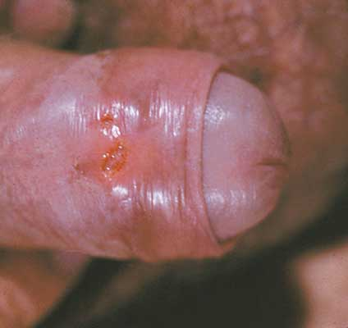
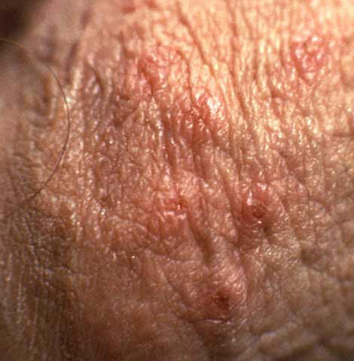
Example

Slide 79
Question 1
Most common STIs in KSA ?
HIV
Chlamydia
Gonorrhea
Syphilis

Slide 80
Question 2
A 34 year old female presented to you at the clinic complaining of a frothy yellowish vaginal discharge and local irritation. On examination you notice that the cervix has multiple small hemorrhagic areas which is often described as “strawberry cervix”. Which of the following organisms is the most likely cause?
Chlamydia trachomatis
Niesseria gonorrhea
Trichomonas Vaginalis
HPV type 11

Slide 81
Question 3
Which of the following HPV types is known to caue cervical cancer?
HPV 6
HPV 11
HPV 16
HPV 33

Slide 82
Question 4
Which of the following is required to diagnose a patient with AIDS?
A CD4 count of less than 200 cells/mm3
A CD4 count of less than 1000 cells/mm3
A CD4 count of less than 2000 cells/mm3
A CD4 count of less than 100 cells/mm3

Slide 83
Question 5
A woman presented to the clinic complaining of multiple painless bumps on her genital area. After history and examination she was diagnosed with having Genital Warts. What test would you like to order?
ELISA
PCR
Pap smear
Vaginal swab

Slide 84
References
Chlamydia trachomatis UK Testing Guidelines http://www.bashh.org/documents/3352.pdf
Kumar and Clark's Clinical Medicine (8th Ed)
CDC website
AVERT.org
Madani, T. A. (2006). Sexually transmitted infections in Saudi Arabia. BMC Infectious Diseases .
World Health Organization
AVERT. (2011). STD Pictures. Retrieved 2012, from AVERT: http://www.avert.org/std-pictures.htm

