Slide 1
B r e a k i n g B a d N e w s
Abdullah aldughaither, ziad thekry and abdulrahman abaalkhail

Slide 2
Objectives
Definition of bad news.
Importance and difficulty of breaking bad news.
To know what to do, how to do it, and what not to do as a future physician.
Role of primary care physicians.
Example of breaking bad news.
Scenarios & Videos.

Slide 3
What is Bad News?
“Any news that drastically and negatively alters the patients view towards his future.”
-Buckman R. BMJ1984

Slide 4
Quotes about breaking bad news:
It alters one’s self-image : “I left my house as one person & came home another.
-Professional cyclist Lance Armstrong’s recollection
“There’s no way to tell you the bad news without saying it, so I’ll say it with body language.”
-jarod Kintz

Slide 5
Examples of conditions requiring breaking bad news:
Cancer related diagnosis.
Intra uterine foetal demise.
Life long illness: Diabetes, Epilepsy
Poor prognosis of chronic diseases
Child’s mental/physical handicap.
STDs.
Congenital anomalies.
Infertility.

Slide 6
Why is it important ?
“It is not an isolated skill but a
Particular form of communication.”
- Frank A. Eur J of Palliat care 1997
“Delivering bad news influences
patient adjustment to illness, anxiety,
depression, hope, and decision making.”
-Anthony L Back, J Randall Curtis West J Med. 2002 May.

Slide 7
Why is it important ?
“A difficult & an essential task for all health care professionals.”
Prof.Riaz Qureshi.Family Medicine, King Saud University.
“ The patient can recall in detail how his/her diagnosis was revealed.”
Tony Back, MD. Medical Ethics, University of Washington.
“ Patient-doctor trust , gathering data, and applying a treatment plan are all
based on that.”
Richard T.Penson et al. Breaking Bad News: A Patient’s Perspective 2003

Slide 8
Why is it difficult ?
It is an unpleasant task.
Doctor’s don’t generally like taking away patients’ hopes.
Doctors may fear a patient or family’s reaction to the news, or may be uncertain how to deal with an intense emotional response.

Slide 9
It is more difficult when the clinician:
Has a long-standing relationship with the patient.
When the patient is young.
When strong optimism had been expressed for a successful outcome.
- Vijayakumar Narayanan, Bibek Bista, and Cheriyan Koshy, Indian J Palliat Care. 2010 May-Aug.

Slide 10
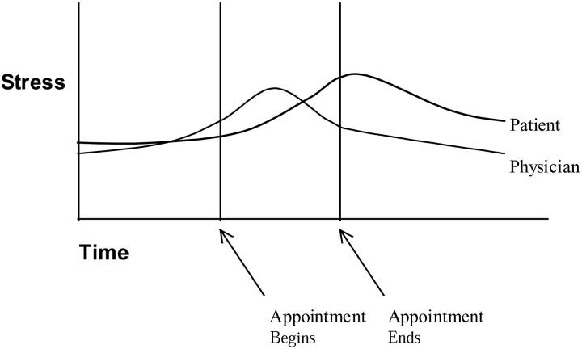
Why is it difficult ? [Common Barriers to effective disclosure]
Physician’s fears of:
Being blamed by patient.
Not knowing all the answers.
Inflicting pain & sufferings.
Own illness & death.
Lack of training
Lack of time.
Multiple physicians
[who should perform the task].

Slide 11
Psychosocial Context
How a patient responds to bad news can be influenced by the patient’s psychosocial context. It might be:
1- Diagnosis that comes at an inopportune time:
e.g. unstable angina requiring angioplasty during the week of a daughter’s wedding.
2- Diagnosis incompatible with one’s employment:
e.g. coarse tremor developing in a cardiovascular surgeon.
3- Varying needs of patient & family:
e.g. Patient asks not tell the family about the diagnosis and vice versa

Slide 12
Enjoy .. And give us your feedback
Video
http://www.youtube.com/watch?v=xCBQUGvZU7k

Slide 13
What do you think ?

Slide 14
Steps of breaking bad news:
Rabow & Mcphee (West J. Med 1999):
Synthesized comprehensive model from multiple resources that uses a simple mnemonic of
Advance Preparation
Build a therapeutic environment/relationship
Communicate well
Deal with patient & family reactions
Encourage and validate emotions
ABCDE

Slide 15
Advance Preparation:
Familiarize yourself with the relevant clinical information (investigations, hospital report)
Arrange for adequate time in private, comfortable environment
Instruct staff not to interrupt
Be prepared to provide at least basic information about prognosis and treatment options
(so do read it up)
Mentally rehearse how you will deliver the news. You may wish to practice out loud.
Script specific words & phrases to use or to avoid
Be prepared emotionally

Slide 16
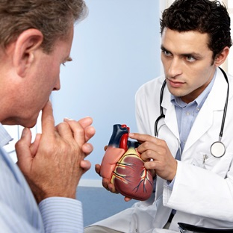
Build a Therapeutic Environment/Relationship
Introduce yourself to everyone present.
Determine the patient’s preferences for what and how much he/she wants to know.
When possible, have family members or other supportive persons present.
Foreshadow the bad news, “I'm sorry, but I have bad news.”
Use touch where appropriate.
Avoid inappropriate humour.
Assure the patient you will be available
In the patients with breastcancer or melanoma, 57% wanted to discuss life expectancy, although only 27%of physicians actually did.
63% wanted to discuss the effects of cancer on other aspects of life, yet only 35% reported having these discussions.
-Anthony L Back, J Randall Curtis. West J Med. 2002 May

Slide 17
Communicate Well
Speak frankly but compassionately.
Avoid medical jargon.
Allow silence & tears; proceed at patient’s pace.
Have the patient describe his/her understanding of the information given.
Encourage questions.
Write things down & provide written information.
Conclude each visit with a summary & follow up plan.

Slide 18
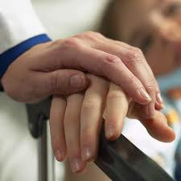
Deal With Patient and Family Reactions
Assess & respond to emotional reactions.
Be aware of cognitive coping (denial, blame, guilt, disbelief, acceptance, intellectualization).
Be empathetic; it is appropriate to say: “I’m sorry”
or “I don’t know”.
Don’t argue or criticize colleagues.

Slide 19
Encourage and Validate Emotions
Offer realistic hope.
Give adequate information to facilitate decision making.
Inquire about the support systems in place.
Attend to your own needs during and following the delivery of bad news (counter-transference can be harmful).
Use interdisciplinary services to enhance patient care (e.g., hospice), but avoid using these as a means of disengaging from the relationship.

Slide 20
What to do?
Introduce yourself.
Look to comfort and privacy.
Determine what the patient already knows.
Determine what the patient would like to know.
Warn the patient that bad news is coming.
Break the Bad News.
Ask if the pt, has something to share and LISTEN.
Identify the patient’s main concern
Summarize and check understanding.
Offer realistic hope.
Arrange follow up and ensure that there is some one with the patient when he leaves.

Slide 21
What not to do ?
Hurry.
Give all the information in one go.
Give too much information.
Use medical jargon or unclear language/words.
Lie or be economical with the truth.
Be blunt.
Guess the prognosis (She has got 6 months, may be 7).

Slide 22
How to do it ?
Be sensitive.
Be empathic.
Maintain eye contact.
Give information in small chunks.
Repeat and clarify.
Regularly check understanding.
Give the patient time to respond. Do not be afraid of silence or tears.
Explore patient’s emotions.
Use physical contact if appropriate.
Be honest if you are unsure about something.
Summarize.

Slide 23
Patient reaction toward terminal illnesses
Patient\Relative reaction | Stage
It can't be true It's a mistake It's not really happening | 1- Denial
How could this happen to me? What have I done to deserve it? Someone’s to blame probably the doctor | 2- Anger
Perhaps if I had prayed regularly’ ‘Perhaps if I had taken those tablets’ ‘Perhaps if I had given up smoking’ | 3- Bargaining

Slide 24
Patient reaction toward terminal illnesses
Patient\Relative reaction | Stage
It really is true What am I going to do? What is going to happen to my family I do not matter anymore | 4- Depression
Life goes on I must prepare for my family | 5- Acceptance

Slide 25
Patient’s Perspective
Patients prefer:
Physician’s competence, honesty & attention.
Time for questions.
Straightforward & understandable diagnosis.
The use of clear language.
Parker PA, Baile WF j.clinical onc 2001

Slide 26
Family’s Perspective
Family members prefer:
Privacy.
Good attitude from the bearer.
Clarity of the information given.
Physician competency.
Time for questions.
Jurkovich GJ, et al. J Trauma 200

Slide 27
Role of primary care physicians in breaking bad news:
Breaking bad news is a sentinel skill of the family physician. Family physicians who provide continuity care to patients are in an ideal position to compassionately, yet clearly, convey devastating news. The importance of the physician-patient relationship in such engagements is critical. Having already developed a sense of mutual trust, the family physician is often in the position to break such news.

Slide 29
Perception and Attitude towards Breaking Bad News in the Saudi Population (by Prof. Mohammed O. Alrukban and others)
A cross sectional community based survey was conducted in Riyadh city during the month of April, 2009.
The study included 1086 participants. 48% males
Almost two-third of them defined bad news as related to the diseases that are highly fatal.
Most of the participants (71.1%) want detailed information about the disease. Most of the them also (88.2%) appreciates more those who tell them the truth.
The acceptance of the bad news was significantly different between older (35.0%) and younger (17.0%) participants. ( male 28% > female 17% )
the younger participants showed significantly more sadness and depression compared to the older participants. ( females > males )

Slide 30
Preferences and attitudes of the Saudi population toward receiving medical bad news: A primary study from Riyadh city (by Prof. Mohammed O. Alrukban and others)
A cross sectional community based survey was conducted in Riyadh city during the month of April, 2009.
The study included 1013 participants. 53% were females
Almost two-third of the participants preferred to be the first to receive the bad news.
Almost 70% of the participants preferred to be told the bad news at a private place.
Approximately half of the participants would like
the one who breaks the bad news to remain with them
to give them some more information about the disease

Slide 32
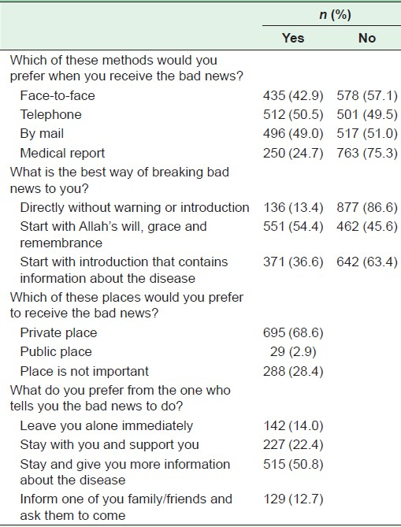

Slide 33
References:
BREAKS’ Protocol for Breaking Bad News, Vijayakumar Narayanan, Bibek Bista, and Cheriyan Koshy, Indian J Palliat Care. 2010 May-Aug
Communicating bad news, Anthony L Back, J Randall Curtis, West J Med. 2002 May
Prof. Riaz Qureshi Presentation, Breaking Bad News
Breaking Bad News: The Many Roles of the Family Physician http://www.aafp.org/afp/2001/1215/p1946.html
Preferences and attitudes of the Saudi population toward receiving medical bad news: A primary study from Riyadh city (by Prof. Mohammed O. Alrukban and others)
Perception and Attitude towards Breaking Bad News in the Saudi Population (by Prof. Mohammed O. Alrukban and others)

Slide 34
Thank you
=D

