Slide 1
Approach to Patient with Headache
Mohammed Al Arabi 431104498
Abdullah Al Turki 431101446

Slide 2
Question 1:
Which of the following is true about headache?
  Headache is overdiagnosed and over-treated.
  Headache is more commonly a symptom of another systemic disease.
  All headache cases are referred to specialists.
  Headache is under-recognized and under-treated.

Slide 3
Question 2:
Which of the following investigations is indicated in a patient with headache, nausea/vomiting, and papilledema once an intracranial mass lesion is ruled out?
  Electroencephalogram.
  Blood culture.
  Cerebrospinal Fluid analysis.
  PET scan.

Slide 4
Question 3:
Which of the following features presenting with headache does NOT indicate the need of neuroimaging?
  History of cancer.
  Altered level of consciousness.
  Rythmical recurrence.
  Immunocompromised state

Slide 5
Objectives:
Common types of headache “Migraine, Tension headache, Cluster headache”.
How to approach a patient with headache.
Red Flags and indications for further investigations like CT brain, MRI.
Brief comment on Migraine, Tension Headache, Cluster headache, benign intracranial hypertension, temporal arteritis, space occupying headaches.
What is the role of primary health care physician in management “Drug treatment and Prophylaxis”.
What investigations could be requested if needed
When to refer to specialist.

Slide 6
Definition and Epidemiology:
Headache is pain in any part of the head and neck, including the scalp, face (including the orbitotemporal area), and interior of the head.
Headache disorders are among the most common disorders of the nervous system.
It has been estimated that 47% of the adult population have headache at least once within last year in general.

Slide 7
Definition and Epidemiology:
Headache disorders are associated with personal and societal burdens of pain, disability, damaged quality of life and financial cost.
A minority of people with headache disorders worldwide are diagnosed appropriately by a health-care provider.
Headache has been underestimated, under-recognized and under-treated throughout the world.
[WHO, http://www.who.int/mediacentre/factsheets/fs277/en/]

Slide 8
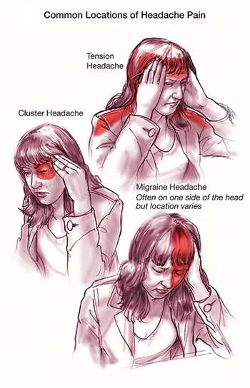
Etiology:
Primary Causes:
  Tension Headache
  Cluster Headache
  Migraine Headache

Slide 9
Etiology:
Secondary Causes:
Cause | Examples
Extracranial disorders | Glaucoma, Sinusitis, …
Intracranial disorders | Brain tumors and other masses, Hemorrhage, Idiopathic intracranial hypertension, Infections, Vascular disorders,…
Systemic disorders | Acute severe hypertension, Fever, Giant cell arteritis,…
Drugs and toxins | Analgesic overuse, Caffeine withdrawal,…

Slide 10
Aim of Approach:
Determining whether a secondary headache is present and checking for symptoms that suggest a serious cause.
If no cause or serious symptoms are identified, evaluation focuses on diagnosing primary headache disorders.
[http://www.merckmanuals.com/professional/neurologic_disorders/headache/approach_to_the_patient_with_headache.html]

Slide 11
History:
History of present illness:
Site.
Onset (eg, sudden, gradual) and duration
Character (eg, throbbing, constant, intermittent, pressure-like).
Radiation.
Associated symptoms.
Timing of the day/week/month/year.
Exacerbating & relieving factors (eg, position, light, activity, odors, chewing).
Severity
Recurrence (Age at onset, previous diagnosis, whether current headache is similar, frequency of episodes, temporal pattern, response to treatments)

Slide 12
History: Associated Symptoms 1 :
Vomiting: Migraine or increased intracranial pressure
Fever: Infection (eg, encephalitis, meningitis, sinusitis)
Red eye and/or visual symptoms (halos, blurring): Acute angle-closure glaucoma
Visual field deficits, diplopia, or blurring vision: Ocular migraine, brain mass lesion, or idiopathic intracranial hypertension
Lacrimation and facial flushing: Cluster headache
Rhinorrhea: Sinusitis

Slide 13
History: Associated Symptoms 2 :
Pulsatile tinnitus: Idiopathic intracranial hypertension
Preceding aura: Migraine
Focal neurologic deficit: Encephalitis, meningitis, intracerebral hemorrhage, subdural hematoma, tumor, or other mass lesion
Seizures: Encephalitis, tumor, or other mass lesion
Syncope at headache onset: Subarachnoid hemorrhage
Myalgias and/or vision changes (in people > 50 yr): Giant cell arteritis

Slide 14
History:
Past medical history :
Drugs.
Substances (particularly caffeine).
Toxins.
Recent lumbar puncture.
Immunosuppressive disorders or IV drug use.
Hypertension.
Cancer.
Dementia, trauma, coagulopathy, or use of anticoagulants or ethanol.
Family and social history.

Slide 15
Physical Examination
A general examination, with a focus on the head and neck, and a full neurologic examination are done:
General appearance: Whether restless or calm in a dark room.
Vital signs.
Head: Swelling or tenderness on scalp, palpable temporal artery, tenderness and crepitance in temporomandibular joints.

Slide 16
Physical Examination
Eyes: Lacrimation, conjunctiva, pupillary size, light responses, extraocular movements, visual fields, fundus examination (eg, papilledema).
Nose and Mouth: Discharge, swellings, and tenderness.
Neck: Stiffness, palpable or tender cervical spine.
Full neurological examination: Motor or sensory deficits, and cognitive impairment.

Slide 17

Red Flags
Neurologic symptoms or signs (altered mental status, weakness, diplopia, papilledema, focal neurologic deficits).
Immunosuppression or cancer.
Meningism.
Onset of headache after age 50.
Thunderclap headache (severe headache that peaks within a few seconds).
Vomiting without other obvious cause.
Symptoms of giant cell arteritis (eg, visual disturbances, jaw claudication, fever, weight loss, temporal artery tenderness, proximal myalgias).
Systemic symptoms (eg, fever, weight loss).
Progressively worsening headache.
Red eye and halos around lights.
Recent head trauma
https://www.nice.org.uk/guidance/cg150/resources/guidance-headaches-pdf
http://www.merckmanuals.com/professional/neurologic_disorders/headache/approach_to_the_patient_with_headache.html

Slide 18
Red Flags
Suggestive Findings | Causes
Neurologic symptoms or signs. | Subdural hematoma, subarachnoid or intracerebral hemorrhage, intracranial mass, increased intracranial pressure
Immunosuppression or cancer | CNS infection, metastases
Meningismus | Meningitis, subarachnoid hemorrhage.
Onset of headache after age 50 | Risk of a serious cause (tumor, giant cell arteritis)
Thunderclap headache | Subarachnoid hemorrhage
Fever, weight loss, visual disturbances, jaw claudication, temporal artery tenderness. | Giant cell arteritis
Systemic symptoms (eg, fever, weight loss) | Sepsis, hyperthyroidism, cancer
Progressively worsening headache | Secondary headache
Red eye and halos around lights | Acute angle-closure glaucoma

Slide 19
Tests:
Most patients can be diagnosed without testing. However, some serious disorders may require urgent or immediate testing.
Non-imaging investigations:
Tonometry: if findings suggest acute narrow-angle glaucoma.
ESR: if symptoms suggesting giant cell arteritis.
Lumbar puncture and CSF analysis: if suspecting meningitis, subarachnoid hemorrhage, idiopathic intracranial hypertension.

Slide 20
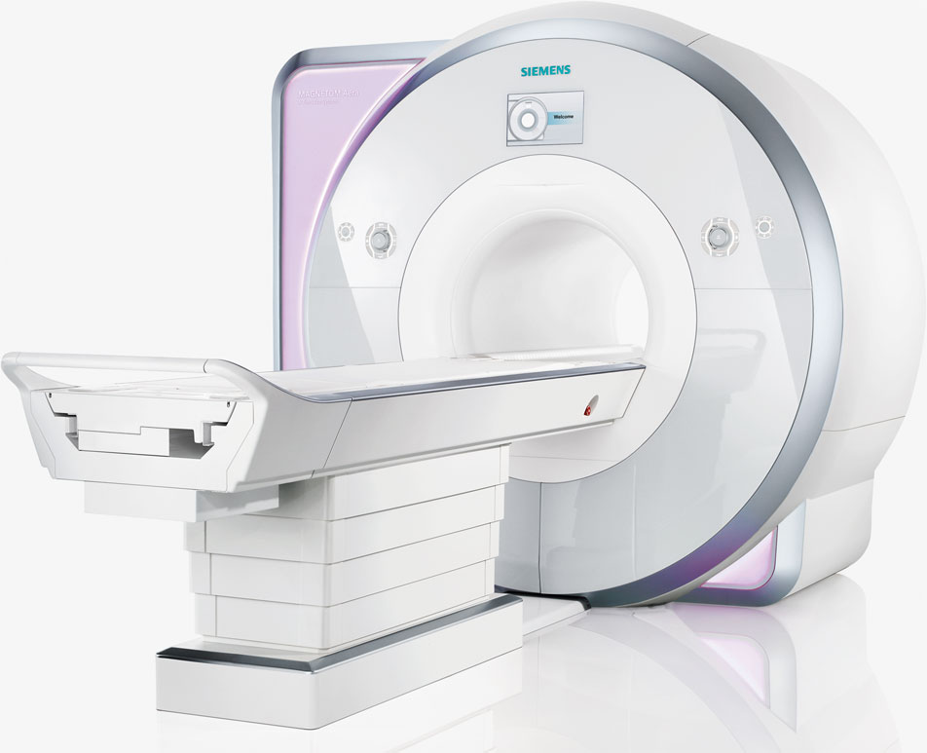
Imaging Investigations:
CT or MRI should be done in patients with any of the following findings:
Altered mental status
Thunderclap headache
Meningism
Papilledema
Vomiting
Signs of sepsis (eg, rash, shock)
Focal neurologic deficit
Severe hypertension
Weight loss
History of cancer
Immunocompromised state

Slide 21
Case 1:
A 27 year old woman presented to the PHC with longstanding episodic headache that interferes with her work.
How would you approach this patient?

Slide 22
Case 1: History:
Pain is usually on one side of the head, starts suddenly and intensifies over a period of an hour, then lasts for about 2 days, it is throbbing, associated with seeing lights flickering (lasting about 30 minutes) and high sensitivity to noise, exacerbated by movement and noise, relieved by sitting in a dark room alone, and has an intensity of 8/10.
Last episode was two weeks ago, and similar episodes have occurred at least 7 times.

Slide 23
Case 1: History:
Past medical history is insignificant.
No allergies or drugs, except failed attempts to relieve headache with paracetamol.
She is single, works as a teacher in a primary school, and her episodic headache significantly affects her job.

Slide 24
Case 1: Physical Examination:
General inspection:
The patient is sitting comfortably on the chair and doesn't seem to be in any distress.
Vital Signs:
HR:80, RR:18, BP:119/70, Temp:37, and her BMI was 23 kg/m2.
Head & Neck:
There doesn't seem to be any tenderness or swellings.
Ear, Nose, and Mouth:
Nothing significant
Eye:
Nothing significant
Neurological examination:
A full Neurological examination was carried out but with no significant findings, and her visual symptoms (lights flickering) and phonophobia were abscent.

Slide 25
Case 1: Investigations:
No investigations were done.
Neuroimaging is not necessary in patients with a history of recurrent migraine headaches and a normal neurologic examination.

Slide 26
Case 1: Diagnosis:
Most likely diagnosis:
  Migraine Headache with Aura
How would you manage this patient?

Slide 27
Case 1: Management:
  Using a “headache diary” .
  Oral triptan (almotriptan 6.25 mg) combined with an NSAID (Ibuprofen 400 mg) to abort the headache episode. (Acute Treatment)
  Oral Topiramate (dose of 25 mg once at night, and gradually increased over the course of 4 weeks to 50 mg once at night and once in the morning) to prevent episodes of migraine. (Prophylactice Treatment)
  Educating patient about the nature of the disease and the adverse effects of drugs used, specially that topiramate is associated with a risk of fetal malformations and can impair the effectiveness of hormonal contraceptives

Slide 28
Migraine:
A complex disorder characterized by recurrent episodes of headache, often unilateral and may be associated with visual or sensory symptoms (aura).
Most common in women and has a strong genetic component.
The diagnosis of migraine is based on patient history. Patients must have headache attacks that last 4-72 hours and are characterized by unilateral location, pulsating quality, moderate or severe pain intensity.
Patients’ headache is also commonly aggravated by or causes avoidance of routine physical activity.

Slide 29
Migraine cont.:
Other symptoms include:
  Unusual sensitivity to light and/or sound or nausea and/or vomiting
  Aura: Symptoms can occur with or without headache and are fully reversible, develop over at least 5 minutes, last 5−60 minutes. Typical aura symptoms include visual symptoms such as flickering lights, spots or lines and/or partial loss of vision; sensory symptoms such as numbness and/or pins and needles; and/or speech disturbance.
Management plan includes:
  Headache diary
  Acute Treatment: oral triptan and an NSAID, or an oral triptan and paracetamol
  Prophylactic Treatment: topiramate, propranolol, or amitriptyline.
  Education and Support.
  Follow-up.

Slide 30
Case 2:
A 32 year old woman presented to the PHC with headache for the past 3 months.
How would you approach this patient?

Slide 31
Case 2: History:
Pain is all around the head, was gradual in onset, dull in character, comes and goes irregularly, slightly relieved by taking paracetamol, and its severity is reported to be 6/10.
She also reported having frequent pulsatile tinnitus, nausea and vomiting.
Past medical history is insigificant.
She takes oral contraceptive pills.
Mother to three children and works in a bank.

Slide 32
Case 2: History:
Pain is all around the head, was gradual in onset, dull in character, comes and goes irregularly, slightly relieved by taking paracetamol, and its severity is reported to be 6/10.
She also reported having frequent pulsatile tinnitus, nausea and vomiting.
Past medical history is insigificant.
She takes oral contraceptive pills.
Mother to three children and works in a bank.

Slide 33
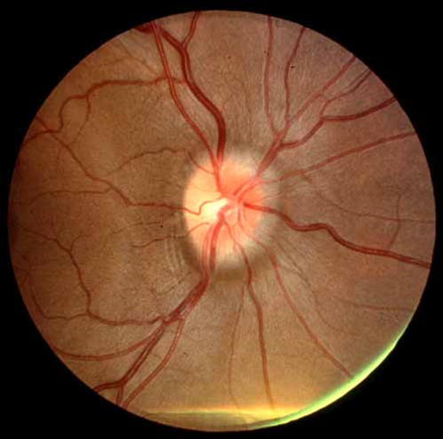
Case 2: Physical Examination:
General inspection:
The patient is sitting comfortably on the chair and doesn't seem to be in any distress.
Vital Signs:
HR:65, RR:17, BP:126/75, Temp:36.4, and her BMI was 32 kg/m².
Head & Neck:
There doesn't seem to be any tenderness or swellings.
Ear, Nose, and Mouth:
Nothing significant
Eye:
Horizontal diplopia on ocular motility test, decrease peripheral vision on confrontation test, and papilledema on Fundoscopy.
Neurological examination:
A full Neurological examination was carried out but with no significant findings.

Slide 34
Case 2: Physical Examination:
General inspection:
The patient is sitting comfortably on the chair and doesn't seem to be in any distress.
Vital Signs:
HR:65, RR:17, BP:126/75, Temp:36.4, and her BMI was 32 kg/m².
Head & Neck:
There doesn't seem to be any tenderness or swellings.
Ear, Nose, and Mouth:
Nothing significant
Eye:
Horizontal diplopia on ocular motility test, decrease peripheral vision on confrontation test, and papilledema on Fundoscopy.
Neurological examination:
A full Neurological examination was carried out but with no significant findings.

Slide 35
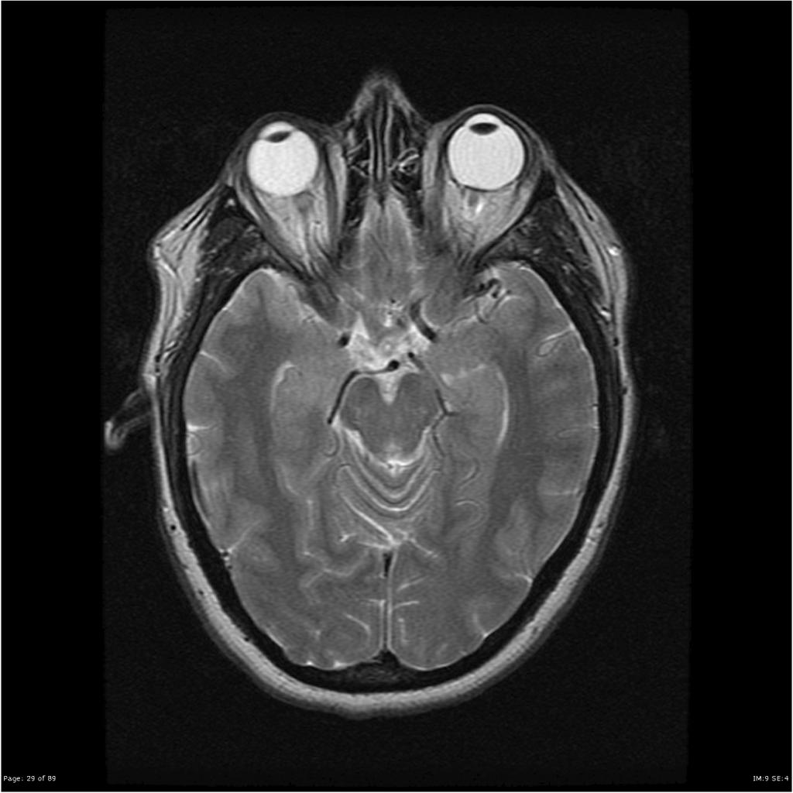
Case 2: Investigations:
An MRI was done.
Lumbar Puncture:
  Pressure: 27 CmH2O
  Clear in apperance
  Protein: 0.35 g/L
  Glucose: 3 mmol/L
  Glucose CSF/Serum Ratio: 0.6
  WBC: <3

Slide 36
Case 2: Other routine investigations:
Complete blood count (CBC)
Erythrocyte sedimentation rate (ESR)
Serum iron and iron-binding capacity
Antinuclear antigen (ANA) profile (eg, anti-dsDNA and anti-ssDNA)
Full procoagulant profile

Slide 37
Case 2: Diagnosis :
Most likely diagnosis:
  Ideopathic Intracranial Hypertension,
  A.K.A Pseudotumor Cerebri or Benign Intracranial Hypertension
How would you manage this patient?

Slide 38
Case 2: Management:
  Referral to neurologist
  Educate patient regarding:
    Nature of the disease
    Avoiding possible causative drug
    Weight loss benefit
    Ophthalmic complications

Slide 39
Ideopathic Intracranial Hypertension:
Common in obese women of childbearing age.
Patients usually present with symptoms related to increased ICP and papilledema.
Symptoms & Signs may include:
  Headaches, typically nonspecific and varying in type, location, and frequency,
  Diplopia, usually horizontal but rarely vertical,
  Pulsatile tinnitus,
  Transient visual obscurations, Progressive loss of peripheral vision in one or both eyes, Blurring and distortion of central vision, Sudden visual loss,
  Other symptoms like dizziness, nausea, vomiting, photopsias, and retrobulbar pain.

Slide 40
Ideopathic Intracranial Hypertension cont.:
MRI is study of choice, and when a mass is ruled out LP is indicated. Other routine test and procoagulant profile is recommended.
Patients should be referred to Neurologist for management and follow-up
Patients should be educated about:
  Causative agents (e.g Drugs, Systemic Diseases)
  The role of weight loss in managing the disease
  Ophthalmic complication (i.e. irreversible optic neuropathy with accompanying constriction of the visual field and loss of color vision, and even involvement of central visual acuity in end-stage papilledema.

Slide 41
Case 3:
A 65 year old man came to PHC clinic for his usual check-up, he asked the doctor to prescribe a good medication for a headache that started five months ago.
How would you approach this patient?

Slide 42
Case 3: History:
He is 65 year old Saudi man.
His pain is usually felt on the side of his head, it was gradual in onset, throbbing, associated with fatigue, no relieving or exacerbating factors, and it has an intensity of 4/10.
He also reported having muscle aches, and notices recent discomfort on chewing firm food.

Slide 43
Case 3: History:
He is 65 year old Saudi man.
His pain is usually felt on the side of his head, it was gradual in onset, throbbing, associated with fatigue, no relieving or exacerbating factors, and it has an intensity of 4/10.
He also reported having muscle aches, and notices recent discomfort on chewing firm food.

Slide 44
Case 3: History:
He is hypertensive controlled on maximum dose of diuretic and ACE inhibitor and regularly visits his doctor.
Past medical history includes one past admissions for anal fistula surgery.
He is retired and lives with his wife. He smokes half a pack of cigarettes every day, and has been doing so for the past 20 years.

Slide 45
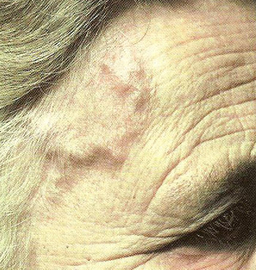
Case 3: Physical Examination:
General inspection:
The patient is sitting comfortably on the chair and doesn't seem to be in any distress.
Vital Signs:
HR:70, RR:18, BP:140/85, Temp:38.4, and his BMI was 26 kg/m².
Head & Neck:
Tenderess on scalp and over the temporal artery, with palpable temporal artery. No tenderness on neck examination.
Ear, Nose, and Mouth:
Nothing significant.
Eye:
Mild hypertensive retinopathy on fundoscopy and no sign of arteritic anterior ischemic optic neuropathy.
Neurological examination:
A full Neurological examination was carried out but with no significant findings.
Cardiovascular examination:
Normally positioned PMI, and no murmurs.

Slide 46
Case 3: Physical Examination:
General inspection:
The patient is sitting comfortably on the chair and doesn't seem to be in any distress.
Vital Signs:
HR:70, RR:18, BP:140/85, Temp:38.4, and his BMI was 26 kg/m².
Head & Neck:
Tenderess on scalp and over the temporal artery, with palpable temporal artery. No tenderness on neck examination.
Ear, Nose, and Mouth:
Nothing significant.
Eye:
Mild hypertensive retinopathy on fundoscopy and no sign of arteritic anterior ischemic optic neuropathy.
Neurological examination:
A full Neurological examination was carried out but with no significant findings.
Cardiovascular examination:
Normally positioned PMI, and no murmurs.

Slide 47
Case 3: Investigations:
CBC:
ESR: 70 mm/h
C-reactive protein : 2.5 mg/dl
LFT:
  AST: 250
  ALP:200
Autoantibodies:
  ANCA +
CBC:
Hb: 11.5 g/dL
WBC: 10 k/uL
RBC: 4.5 m/uL
MCV: 85 fL
MCH: 30 pg
PLT: 600 k/uL

Slide 48
Case 3: Investigations:
Histology:
  Superficial temporal artery biopsy shows vasculitis with giant cell infiltration
Duplex ultrasonography:
  Halo sign: hypoechoic region around the lumen of the artery.
CT:
  No Large vessel aneurysms.

Slide 49
Case 3: Diagnosis:
Most likely diagnosis:
  Giant Cell (temporal) Arteritis
How would you manage this patient?

Slide 50
Case 3: Management:
  Referral to Rheumatologist
  Patient Education:
    Nature and seriousness of the disease.
    Disease complications, specially ophthalmic (sudden painless vision loss)
    Therapy adverse effects (high dose corticosteroids)

Slide 51
Giant Cell (Temporal) Arteritis:
Giant cell arteritis (temporal arteritis) is a systemic vasculitis categorized as a medium/large vessel vasculitis.
GCA is the most common form of systemic vasculitis in adults, and may lead to blindness if not treated.
Symptoms & Signs reflect the involvement of the temporal artery and other medium-sized arteries of the head and the neck and include:
  Headache,
  Visual disturbances,
  Jaw claudication,
  Neck pain,
  Scalp tenderness.

Slide 52
Giant Cell (Temporal) Arteritis cont.:
Constitutional manifestations, such as fatigue, malaise, and fever, may also be present.
Investigations (including ESR, Duplex US, and temporal artery biopsy) play an important role in diagnosis.
Patients should be referred to Rheumatologist for treatment (high dose corticosteroid) and follow-up.
Patients should also be educated regarding the nature of the disease and its complications, the importance of adhering to steroid therapy and its possible side effects.

Slide 53
Case 4:
35 year old male came to your clinic complaining of a headache.
How would you approach this patient?

Slide 54
Case 4 : History:
Ahmed is a 35 year old teacher who has been complaining of headaches for the past 2 months, he says the pain is felt around his head in a band like fashion. The character of the pain was described as something tightening around his head. The headaches happen around 2 time per week and last anywhere from 30 min to 10 hours. He doesn't report anything that makes the headaches worst but says the pain is relieved slightly when he lays down. He rates the pain as a 5/10.

Slide 55
Case 4 : History:
He is not taking any medications.
Past medical history is insignificant.
He is married, and is happy with his job. He doesn’t smoke or drink alcohol.

Slide 56
Case 4: Physical Examination:
General inspection:
The patient is sitting comfortable on the chair and doesn't seem to be in any distress.
Vital Signs:
BP 110/80
Heart Rate 72 bpm
Temperature 37.2°C
Head & Neck:
There doesn't seem to be any tenderness or swellings around the scalp.
Ear, Nose, and Mouth:
Nothing significant
Eye:
Nothing significant
Neurological examination:
A full Neurological examination was carried out but with no significant findings that would suggest neurological issues.

Slide 57
Case 4: Investigations:
In the case of this patient no investigations were ordered as the history and physical examination did not raise any red flags.

Slide 58
Case 4: Diagnosis:
Most likely diagnosis:
  Episodic Tension headache
How would you manage this patient?

Slide 59
Case 4: Management:
  Using a “headache diary”.
  Paracetamol prescription for the acute treatment of tension type headache.
  Educating the patient about the commonness of the condition.

Slide 60
Tension headache
Tension headaches are the most common type of headaches among adults.
An episodic tension headache may be described as a mild to moderate constant band-like pain, tightness, or pressure around the forehead or back of the head and neck.
Tension headaches usually don't keep a person from performing daily tasks.

Slide 61
Tension headache cont.:
A tension headache may appear periodically ("episodic," <15 days per month) or daily ("chronic," >15 days per month).
Management plan:
  Acute treatment: Consider aspirin, paracetamol or an NSAID for the acute treatment of tension-type headache, taking into account the person's preference, comorbidities and risk of adverse events.
  Do not offer opioids for the acute treatment of tension-type headache.
  Prophylactic treatment: Consider a course of up to 10 sessions of acupuncture over 5–8 weeks for the prophylactic treatment of chronic tension-type headache.

Slide 62
Case 5
A 46-year-old man comes to your office with a 5-week history of recurrent headaches.
How would you approach this patient.

Slide 63
Case 5: History:
Abdullah is a 46-year-old male who came to your office with a 5-week history of recurrent headaches that wake him up in the middle of the night. The headaches have been occurring twice daily and have been lasting approximately 1 hour. The headaches are described as a deep burning sensation centered behind the left eye. The headaches are excruciating (he rates them as a 12 on a 10-point scale) and are associated with watery left eye. Before the onset of these headaches 5 weeks ago, the patient describes no more than occasional tension headache.

Slide 64
Case 5: History:
Past medical history is insignificant.
He is not using any drugs.
The patient describes no recent life changes and no major life stresses. He is happily married, has three children, and has a secure job that he enjoys.

Slide 65
Case 5: Physical Examination:
General inspection:
The patient appears to be in some distress and seems to be restless.
Vital Signs:
BP 120/70
Heart Rate 82 bpm
Temperature 36.6°C
Head & Neck:
There doesn't seem to be any tenderness or swellings.
Ear, Nose, and Mouth:
Nothing significant
Eye:
Tearing coming from Left eye, along with nasal discharge.
Neurological examination:
A full Neurological examination was carried out but with no significant findings that would suggest neurological issues.

Slide 66
Case 5: Investigations:
No neuroimaging was done.
It was discussed with the patient that if other symptoms appear it is preferred to do certain tests to exclude other diseases.

Slide 67
Case 5: Diagnosis:
Most likely diagnosis:
  Cluster headache (Episodic cluster headache)
How would you manage this patient?

Slide 68
Case 5: Management:
  Using a “headache diary”.
  Nasal triptan for acute treatment.
  Oral verapamil for prophylaxis.
  Educating patient about the nature of the disease, the inefficasy of using paracetamol or NSAIDs for acute treatment, and the adverse effects of the drugs prescribed to him.

Slide 69
Cluster Headache:
Cluster headache is a primary neurovascular primary headache disorder, and is far less common than migraine headache or tension headache.
Cluster headaches begin usually around the eye and along the side of the head/face. The headache exhibits a clustering of painful attacks over a period of many weeks.
The pain of a cluster headache peaks in about 5 minutes and lasts 15 to 180 minutes. It is usually severe and associated with the following symptoms on the same side:
  red and/or watery eye
  nasal congestion and/or runny nose
  swollen eyelid
  forehead and facial sweating
  constricted pupil and/or drooping eyelid

Slide 70
Cluster Headache cont.:
Someone with a cluster headache may get several headaches a day for weeks at a time - perhaps months - usually interrupted by a pain-free period of variable length.
Management Plan:
  Acute treatment:
    Consider neuroimaging for people with a first bout of cluster headache..
    Offer oxygen and/or a subcutaneous or nasal triptan for the acute treatment of cluster headache.
    Do not offer paracetamol, NSAIDS, opioids, ergots or oral triptans for the acute treatment of cluster headache.
  Prophylactic treatment
    Consider verapamil for prophylactic treatment during a bout of cluster headache. If unfamiliar with its use for cluster headache, seek specialist advice before starting verapamil, including advice on electrocardiogram monitoring.

Slide 71
Case 6
56 year old male came to your clinic complaining of headache for the past 8 months.
How would you approach this patient?

Slide 72
Case 6: History:
Ali is a male, 56-year-old university professor who has experienced constant headache for the past 8 months. Location of the headache cannot be identified, it started gradually, and is dull in character, associated with nausea and vomiting, constant and wakes him from sleep at times, not relieved by anything, and its severity is reported as 4/10.

Slide 73
Case 6: History:
Ali is a male, 56-year-old university professor who has experienced constant headache for the past 8 months. Location of the headache cannot be identified, it started gradually, and is dull in character, associated with nausea and vomiting, constant and wakes him from sleep at times, not relieved by anything, and its severity is reported as 4/10.

Slide 74
Case 6: History:
He also reported difficulty in walking and numbness in the left leg.
Past medical history is insignificant, except for one admission for appendectomy 30 years ago,
He is diabetic controlled on oral hypoglycemic drugs.
He is married with four children, works in a university as a lecturer. No history of smoking or alcohol abuse.

Slide 75
Case 6: History:
He also reported difficulty in walking and numbness in the left leg.
Past medical history is insignificant, except for one admission for appendectomy 30 years ago,
He is diabetic controlled on oral hypoglycemic drugs.
He is married with four children, works in a university as a lecturer. No history of smoking or alcohol abuse.

Slide 76
Case 6: Physical Examination:
General inspection:
The patient appears to be well, sitting comfortably on the chair.
Vital Signs:
BP 137/80
Heart Rate 82 bpm
Temperature 36.8°C
Head & Neck:
There doesn't seem to be any tenderness or swellings.
Ear, Nose, and Mouth:
Nothing significant
Eye:
Fundoscopy shows papilledema.
Neurological examination:
A full Neurological examination was carried out, showing weakness in the left leg (Power 4), and hyperreflexia (+3), decrease sensation, and positive Babinski sign.

Slide 77
Case 6: Physical Examination:
General inspection:
The patient appears to be well, sitting comfortably on the chair.
Vital Signs:
BP 137/80
Heart Rate 82 bpm
Temperature 36.8°C
Head & Neck:
There doesn't seem to be any tenderness or swellings.
Ear, Nose, and Mouth:
Nothing significant
Eye:
Fundoscopy shows papilledema.
Neurological examination:
A full Neurological examination was carried out, showing weakness in the left leg (Power 4), and hyperreflexia (+3), decrease sensation, and positive Babinski sign.

Slide 78
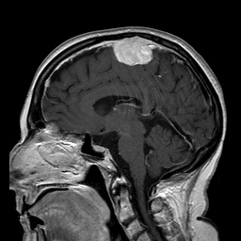
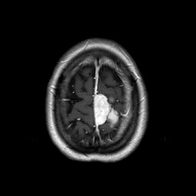
Case 6: Investigations:
MRI was done:

Slide 79
Case 6: Diagnosis:
Most likely diagnosis:
  Headache due to space occupying lesion.
How would you manage this patient?

Slide 80
Case 6: Management:
  Referral to neurosurgery.
  Education about the nature of the disease and its seriousness.
  Provide information and support.

Slide 81
Space Occupying Lesion Headache:
Space occupying headaches occur in patients with cerebral masses. A space-occupying lesion of the brain is usually due to malignancy but it can be caused by other pathology such as an abscess or a hematoma.
Almost half of intracerebral tumors are primary but the rest have originated outside the CNS and are metastases.

Slide 82
Space Occupying Lesion Headache cont.:
Symptoms & Signs usually include:
  Headache, Nausea & Vomiting, and Papilledema
  Focal Neurological defects
  Seizures
  Behavioral or mental changes
Imaging is imperative for diagnosis or etiology, MRI is preferable to CT.
Management plan includes:
  Referral to specialists.
  Education
  Support

Slide 83
Role of Primary Health Care Physician
Assess patient complaining of headache.
Establish a differential diagnosis.
Manage headaches which can be managed by PHC clinics.
Referring cases to appropriate specialists.
Educate patients regarding their headache, what affects it, and how to manage it.
Follow-up.

Slide 84
Treat or Refer?
PHC Physicians usually treat primary headaches (Tension, Migraine, and Cluster Headaches)
  Acute Treatment
  Prophylaxis.
Patients who need further assessment or have any red flags (e.g. vomiting, history of cancer, impaired level of consciousness) are referred to specialists.

Slide 85
Question 1:
Which of the following is true about headache?
  Headache is overdiagnosed and over-treated.
  Headache is more commonly a symptom of another systemic disease.
  All headache cases are referred to specialists.
  Headache is under-recognized and under-treated.

Slide 86
Question 2:
Which of the following investigations is indicated in a patient with headache, nausea/vomiting, and papilledema once an intracranial mass lesion is ruled out?
  Electroencephalogram.
  Blood culture.
  Cerebrospinal Fluid analysis.
  PET scan.

Slide 87
Question 3:
Which of the following features presenting with headache does not indicate need of neuroimaging?
  History of cancer.
  Altered level of consciousness.
  Rythmical recurrence.
  Immunocompromised state

Slide 88
References:
[http://www.nice.org.uk/guidance/cg150/chapter/guidance#assessment]
[http://emedicine.medscape.com]
[http://www.merckmanuals.com/professional/neurologic_disorders/headache/approach_to_the_patient_with_headache.html]
[WHO, http://www.who.int/mediacentre/factsheets/fs277/en/]

Slide 89
THANK YOU!

