Slide 1
Approach to patient with Arthritis
Done By:
abdullah alsulimani
abdulmohsen alghamdi
Supervised By:
Prof. Mohammed Al-Rukban

Slide 2
Case #1
PRESENTATION
Ruth is a healthy and active 59-year-old retired executive secretary who suffers from daily joint stiffness and pain in her knees with minimal exertion. Acetaminophen 4 g daily provides only partial relief from pain and stiffness, leaving her unable to participate in the physical activities she enjoys.

Slide 3
MEDICAL HISTORY
Aside from an appendectomy at age 26 years, Ruth’s medical history is unremarkable. Her current medications are vitamin D and a calcium supplement.
PHYSICAL EXAMINATION
Uneventful except for pain when Ruth is asked to rise from a sitting position or to bend over and straighten up.

Slide 4
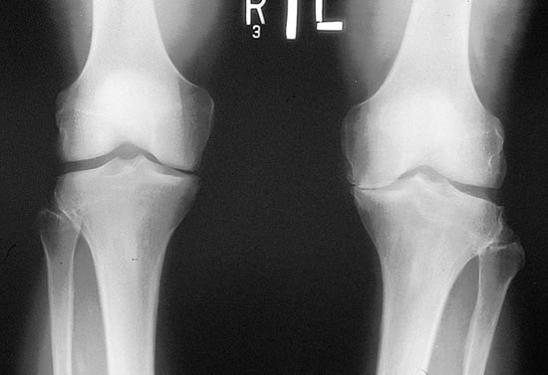

Slide 5
LABORATORY FINDINGS
Standard blood chemistry and lipid profile values are within the normal range. Radiography of the knees reveal irregular joint space narrowing and slightly increased radiologic density of subchondral bone, signs that are consistent with a diagnosis of osteoarthritis.

Slide 6
TREATMENT
Because Ruth has none of the established risk fac- tors for GI complications of NSAIDs, ibuprofen 600 mg 3 times daily is recommended as initial therapy. She is instructed to report any GI symptoms.

Slide 7
Case #2
Sarah is 30, presented with diffuse joint pain.
She recalled falling in the parking lot at work
Abrasions to hands and R knee
3 weeks later R knee pain
4-6 weeks later L knee, R 2nd toe, and later
multiple joints pain and swelling developed

Slide 8
Case #2
Psoriasis of scalp since 2001
No other extra articular features
Generally well, no features of systemic illness except for am stiffness and fatigue
Denies previous illness

Slide 9
Case #2
Psoriasis of the scalp was present, no nail involvement
Joints: L elbow, both wrists,R ring and small mcp’s, index and small pip’s, L all mcp’s,long pip, both knees, L ankle, and R 2nd toe all swollen, tender and warm.

Slide 10
Case #2
Laboratory Findings:
Hb N, Platelets 413, ESR 99, ANA -ve
Rh. Factor -ve
X rays -ve

Slide 11
Case #2
Psoriatic Arthritis, Asymmetric, Polyarthritis
Possibly triggered by the fall.
Managment:
• NSAIDs can be administered for the relief of musculoskeletal signs and symptoms
• Treatment with disease-modifying agents—eg, methotrexate, sulfasalazine, and leflunomide—should be considered at an early stage for patients with active disease

Slide 12
Arthropathy and Arthritis
Arthropathy : any disease or abnormal condition affecting a joint.
Arthritis : any inflammatory condition of the joints, characterized by pain, swelling, heat, redness, and limitation of movement.

Slide 13
Facts about Arthritis
NHIS 2010-2012 data analysis showed that 50 million US adults had reported doctor-diagnosed arthritis. [1]
a complex family of musculoskeletal disorders consisting of more than 100 different diseases or condition that can affect people of all ages, races and genders.
In 2007, CDC estimated that 294,000 U.S. children under age 18 have been diagnosed with arthritis or other rheumatic conditions. [2]

Slide 14
Importance of History
Duration of Complaints
Number of Joints Involved
Distribution of Joints Involved
Pattern of Involvement
Morning Stiffness

Slide 15
Importance of History
History of Joint Swelling
Extra-articular Complaints
Associated Medical Illness
Significant Past History
Family History of Rheumatic Disease

Slide 16
Importance of Physical Examination
Joint effusion
Local Warmth
Redness
Range of Motion
Any Deformity

Slide 17
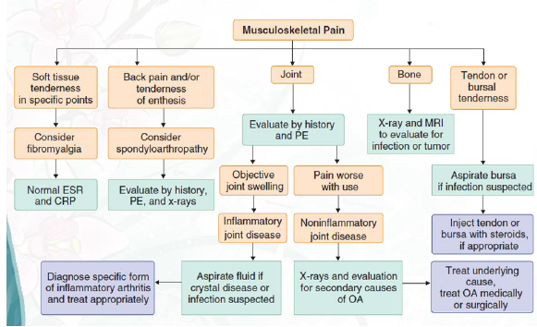
Diagnostic Approach to Musculoskeletal Pain

Slide 18
Symptoms of joint disease
Pain
Inflammatory joint disease
pain is present both at rest and with motion
worse at the beginning than at the end of usage.
Non-inflammatory
pain occurs mainly or only during motion and improves quickly with rest
Pain that arises from small peripheral joints
more accurately localized than pain arising from larger proximal joints.

Slide 19
Continue ..
Stiffness
sensation of tightness when attempting to move joints after a period of inactivity
subsides over time
Inflammatory arthritis
present upon waking
typically lasts 30-60 minutes or longer.
Non-inflammatory arthritis
experienced briefly (eg, 15 min) upon waking in the morning
following periods of inactivity.

Slide 20
Continue ..
Swelling
Inflammatory arthritis
synovial hypertrophy
synovial effusion
inflammation of periarticular structures
Non-inflammatory arthritis
formation of osteophytes
synovial cysts
Thickening
effusions

Slide 21
Continue ..
Limitation of motion
structural damage
Inflammation
contracture of surrounding soft tissues

Slide 22
Continue ..
Weakness
result of disuse atrophy
Weakness with pain
musculoskeletal cause (eg, arthritis, tendonitis)

Slide 23
Temporal pattern of arthritis
Abrupt onset
symptoms develop over minutes to hours
occur in trauma, crystalline synovitis, or infection.
Insidious pattern
symptoms develop over weeks to months
rheumatoid arthritis (RA) and osteoarthritis.

Slide 24
Duration of symptoms:
Acute <6 weeks in duration;
chronic is 6 or more weeks in duration.
Number of involved joints:
Monoarthritis - one joint.
Oligoarthritis - 2-4 joints.
Polyarthritis -5 or more joints.

Slide 25
Temporal Patterns in Polyarthritis
Migratory pattern
joints are sequentially affected where, as one joint settles, another becomes inflamed (e.g., acute rheumatic fever, disseminated gonococcal infection).
Additive pattern
subsequent joints are involved while preceding ones are still inflamed (e.g. RA )
Intermittent pattern
the same joint is involved in different episodes of inflammation, but the joint is quiescent during intervening periods (e.g., gout).

Slide 26
Symmetry of joint involvement
Symmetric arthritis
involvement of the same joints on each side of the body.
RA and SLE.
Asymmetric arthritis
psoriatic arthritis, reactive arthritis (Reiter syndrome), and Lyme arthritis.

Slide 27
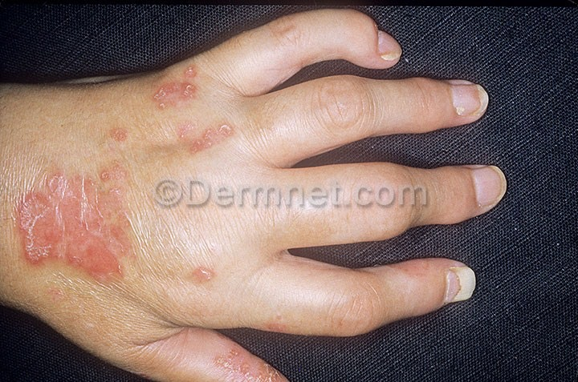

Slide 28
Distribution of affected joints
The DIP joints of the fingers
involved in psoriatic arthritis, gout, or osteoarthritis
spared in RA.
Joints of the lumbar spine
involved in ankylosing spondylitis
spared in RA.

Slide 29
Extra-articular manifestations
Constitutional symptoms
underlying systemic disorder.
include fatigue, fever, and weight loss.
Skin lesions
SLE, dermatomyositis, scleroderma, Lyme disease, psoriasis and Henoch-Schönlein purpura.
Ocular symptoms or signs
Episcleritis and Keratoconjunctivitis sicca -RA.
Anterior uveitis - ankylosing spondylitis,
Conjunctivitis -reactive arthritis

Slide 30
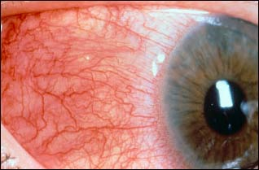
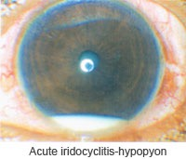
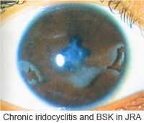
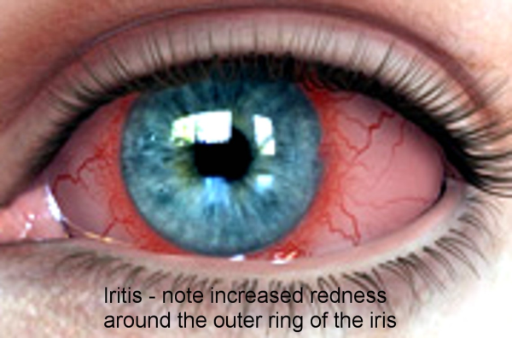
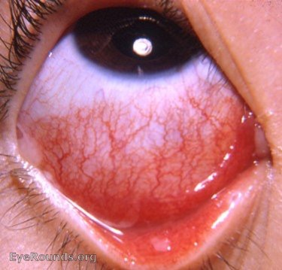
Ocular signs
Episcleritis and scleritis
Iridocyclitis
Anterior uveitis
Conjunctivitis

Slide 31
Signs of inflammatory joint disease
Joint effusions
Erythema and warmth
Joint tenderness
Bony overgrowth of the joints (osteophytes)
At the DIP joints - Heberden nodes.
At the PIP joints are called Bouchard nodes.
Limited range of motion:
Crepitus during active or passive range of motion
Joint deformity

Slide 32
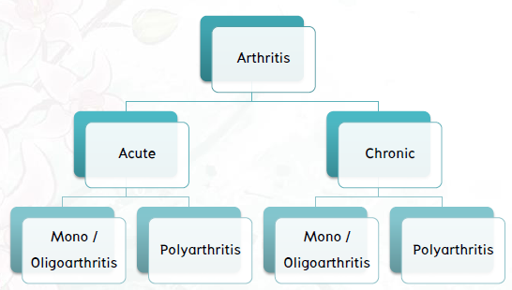
Diagnostic Approach

Slide 33
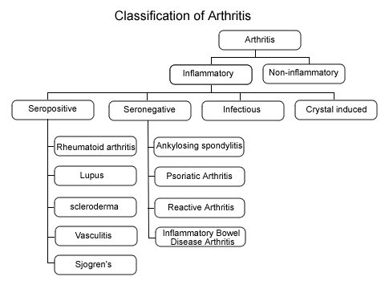

Slide 34
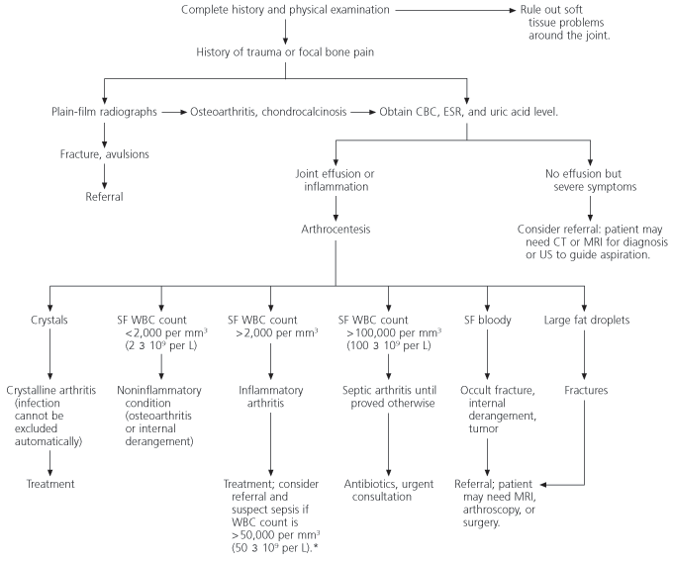

Slide 35
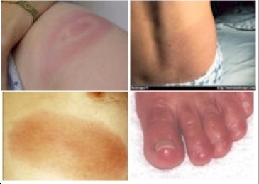

Slide 37
Topics
Septic Arthritis
Rheumatoid Arthritis
Gout
Osteoarthritis

Slide 38
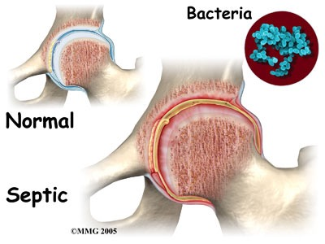
Septic Arthritis

Slide 39
Septic Arthritis
Septic arthritis is an infection, usually bacterial, in the joint cavity. Since septic arthritis can lead to rapid joint destruction, immediate accurate diagnosis is essential. The joint cavity is normally sterile, with synovial fluid and cellular matter, including a few white blood cells. The majority of patients with bacterial septic arthritis will present with acute monoarthritis.
The incidence of septic arthritis has been estimated at 2 to 10 cases per 100,000 in the general population and as high as 30 to 70 cases per 100,000 in patients with rheumatoid arthritis.The most common mode of spread is hematogenous, with predisposing factors including intravenous drug use, presence of indwelling catheters, and underlying immunocompromised states [3]

Slide 40
Septic Arthritis
Neisseria gonorrhoeae remains the most common pathogen (75% of cases) among younger sexually active individuals,Staphylococcus aureus infection is the cause of the vast majority of cases of acute bacterial arthritis in adults and in children older than 2 years.The increased incidence of staph infections parallels the increase use of prosthetic joints and in the administration of immunosuppressive agents. This pathogen is the cause in 80% of infected joints affected by rheumatoid arthritis.

Slide 41
Septic Arthritis
80-90% monoarticular
Most develop from hematogenous spread
Most common:
Gram positive aerobes (80%)
Majority with Staph aureus (60%)
Gram negative (18%)

Slide 42
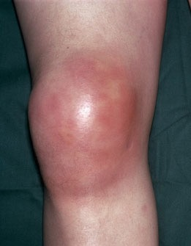

Slide 43
Continue..
Pay attention to the following symptoms:
Acuteness of onset of the joint pain
Whether the pain is superimposed on chronic pain
Previous history of joint disease or trauma.
Whether the process is monoarticular or polyarticular and which joints are involved
The presence of extra-articular symptoms

Slide 44
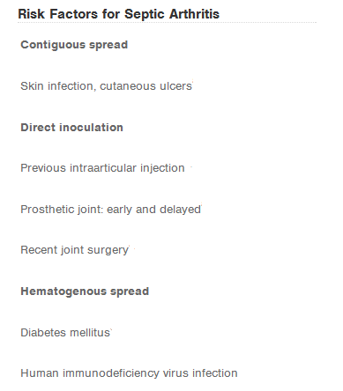
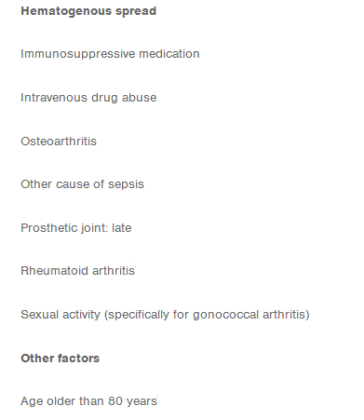
History continue..
Patients presenting with acute joint swelling, pain, erythema, warmth, and joint immobility should be screened for risk factors associated with septic arthritis.

Slide 45
Septic Arthritis
The most commonly involved joint in septic arthritis is the knee (50% of cases). [4]
A classic presentation for septic arthritis is a febrile patient who has rigors, an increased leukocyte count, and elevated sedimentation rate. However, none of these is highly sensitive or specific for septic arthritis. In one series, only 40% to 60% of patients with septic arthritis were febrile, only 25% to 60% had an elevated leukocyte count, and only 60% to 80% had a sedimentation rate greater than 50 mm/hr. [5]
Signs and symptoms of infection may be muted in elderly, those who are immunocompromised (especially those with rheumatoid arthritis) and who abuse intravenous drugs.

Slide 46
Investigations
Joint Fluid Analysis and Culture :
Normal synovial fluid is clear and colorless.
Culture results in patients with nongonococcal septic arthritis are almost always positive. Cultures of the joint fluid in gonococcal infections yield positive results in only about 25-50% of cases.

Slide 47
Synovial Fluid Analysis
Septic | Inflammatory | Non-inflammatory | Normal
Cloudy | Cloudy | Transparent | Transparent | Clarity
Yellow | Yellow | Yellow | Clear | Color
>25000 | 200-50000 | <200-2000 | <200 | WBC*/microliter
>90 | >50 | <25 | <25 | PMNs (%)*
>50% positive | Negative | Negative | Negative | Culture
None | Multiple or None | None | None | Crystals
Nongonococcal/gonococcal septic arthritis | Gout, rheumatoid arthritis, SLE | Osteoarthritis, trauma, rheumatic fever | ---- | Associated conditions

Slide 48
Investigations continue..
Blood Cultures :
By Obtaining at least 2 sets of blood cultures to rule out a bacteremic origin of the septic joint.
Polymerase chain reaction :
For detection of bacterial DNA in joint fluid and synovial tissue.

Slide 49
Investigations continue..
Radiography and Ultrasonography :
Plain radiography is of limited value in evaluating a joint for infection; Although it is most useful in ruling out underlying osteomyelitis caused by the joint infection itself.
Ultrasonography may be used to diagnose effusions in chronically distorted joints (secondary to trauma or rheumatoid arthritis).

Slide 50
Investigations cont..
CT and MRI scanning :
More sensitive for distinguishing osteomyelitis, periarticular abscesses, and joint effusions.
most helpful in patients with sacroiliac or sternoclavicular joint infection to rule out extension into the mediastinum or pelvis.

Slide 51
Treatment and Management
Medical management of infective arthritis focuses on adequate and timely drainage of the infected synovial fluid, administration of appropriate antimicrobial therapy, and immobilization of the joint to control pain.

Slide 52
Treatment and Management cont..
Synovial Fluid Drainage :
Aspirating the joint 2-3 times a day may be necessary during the first few days

Slide 53
Treatment and Management cont..
Joint Immobilization and Physical Therapy :
Usually, immobilization of the infected joint to control pain is not necessary after the first few days.
Initial physical therapy consists of maintaining the joint in its functional position and providing passive range-of-motion exercises.
The joint should bear no weight until the clinical signs and symptoms of synovitis have resolved.

Slide 54
Treatment and Management cont..
Antibiotic Therapy :
In native joint infections, antibiotics usually need to be administered parenterally for at least 2 weeks. However, each case must be evaluated independently. Infection with either methicillin-resistant S aureus (MRSA) or methicillin-susceptible S aureus (MSSA) requires at least 4 full weeks of intravenous antibiotic therapy. Orally administered antimicrobial agents are almost never indicated in the treatment of S aureus infections. [6]

Slide 55
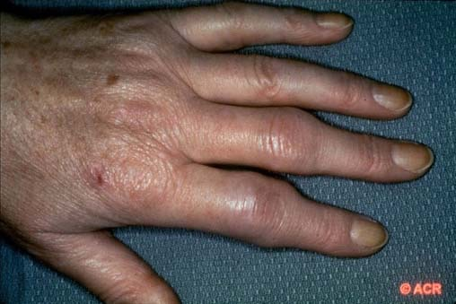
Rheumatoid Arthritis

Slide 56
Rheumatoid Arthritis
Symmetric, inflammatory polyarthritis, involving large and small joints
The annual incidence of rheumatoid arthritis (RA) has been reported to be around 40 per 100,000. Women are affected two to three times more often than men. The peak onset is between the ages of 50 and 75, and, because of the consistently higher rates in females, the prevalence of RA in females over age 65 is up to 5 percent. [7]

Slide 57
Rheumatoid Arthritis
Characterized by:
synovial inflammation and hyperplasia (“swelling”),
autoantibody production (rheumatoid factor and Anti-cyclic citrullinated peptide [ACCP]),
cartilage and bone destruction (“deformity”),
Systemic features, including :
cardiovascular, pulmonary, psychological, and skeletal disorders.

Slide 58
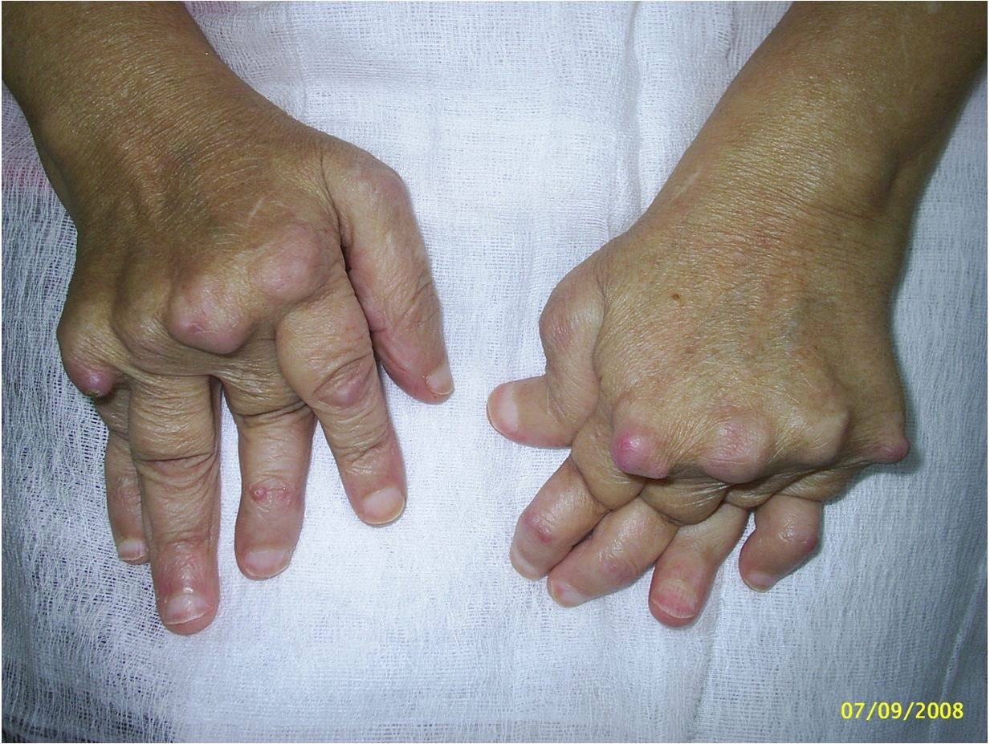

Slide 59
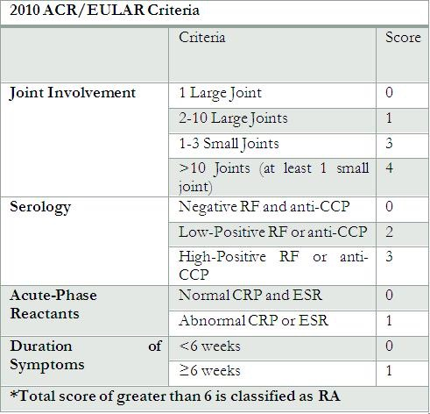
Criteria of Diagnosis

Slide 60
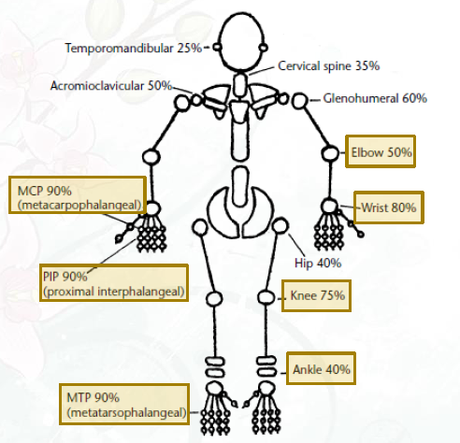

Slide 61
Physical Examination
During the physical examination, it is important to assess the following:
Stiffness (may improve with heat and active exercise, but they do not prevent the return of stiffness).
Tenderness
Pain on motion
Swelling
Deformities (ulnar deviation, boutonniere and swan-neck deformities, hammer toes, and joint ankylosis)
Limitation of motion
Extra-articular manifestations
Rheumatoid nodules (occur in approximately 25% of patients with RA and most commonly found on extensor surfaces [proximal ulna])

Slide 62
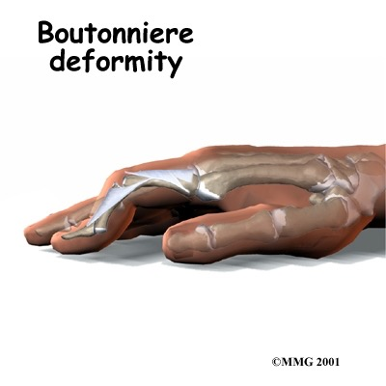
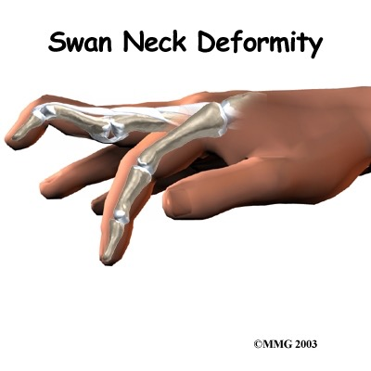
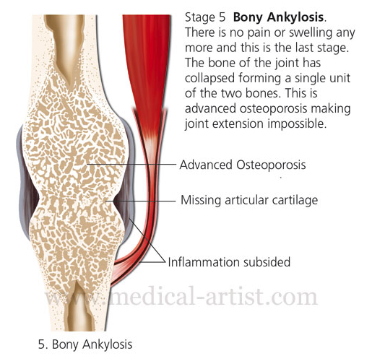
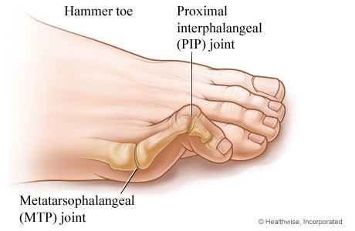
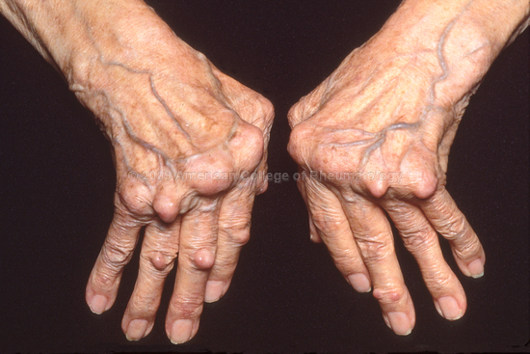

Slide 63
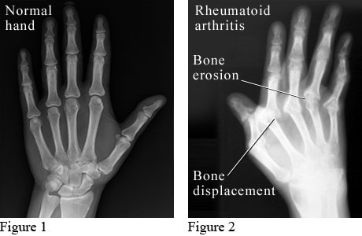

Slide 64
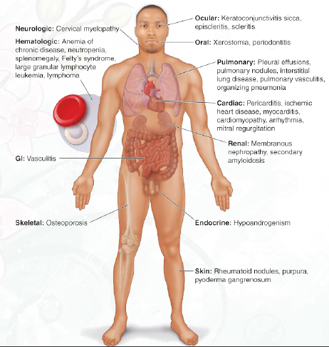
Extra-articular manifestations of rheumatoid arthritis

Slide 65
Rheumatic Diseases with Positive RF
RA 80%
Juvenile RA 20%
SLE 20%
Sjogren’s 90%
Scleroderma 20-30%

Slide 66
Non-Rheumatic Diseases with Positive RF
Hepatitis C < 70%
Mixed cryoglobulinemia 90%
Sarcoidosis 5-30%
Pulmonary Fibrosis 20%

Slide 67
RF: Clinical Significance
May be absent at the onset of disease in up to half of patients with typical clinical picture of RA
Best used to confirm RA for typical presentation
Not useful to follow course of illness
generally not helpful to repeat after diagnosis

Slide 68
Anti-CCP Antibody Assay
Accuracy (Anti-CCP Assay) [8] Specificity (90-95%)
Sensitivity (50-75%)
Diagnosis more accurate when combined with RF+
Present in 50-60% early RA patients
Can be seen 1.5 -9 yrs pre-diagnosis of RA
Predictive for progressive joint damage

Slide 69
Management For Primary care Physicians
Establish Diagnosis of Rheumatoid Arthritis Early Document Baseline Disease Activity and Damage Estimate Prognosis
Start Treatment
1.Patient Education 2.Start DMARD(s) within 3 months 3.Consider NSAIDs 4.Consider Local / Low-dose Steroid
5.Physical / Occupational Therapy
Assess Disease Activity

Slide 70
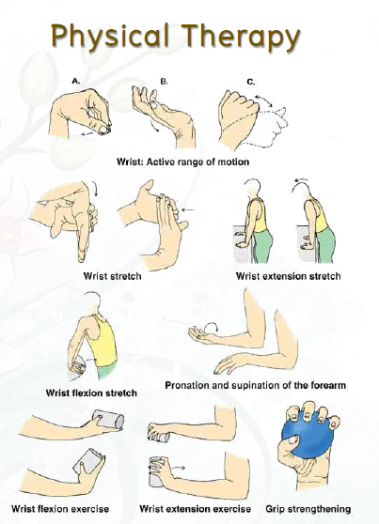

Slide 71
Baseline Evaluation
Laboratory
ESR/CRP levels
RF
CBC
Electrolyte levels and Creatinine level
Hepatic enzyme levels (AST, ALT, and albumin)
Urinalysis
Synovial fluid analysis

Slide 72
Baseline Evaluation
Other
Radiographs of selected involved joints
Functional status or quality of life assessments

Slide 73
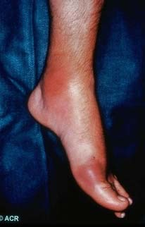
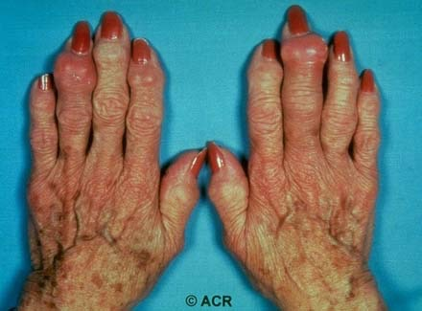
Gouty Arthritis

Slide 74
Highlight on Gout
Is an inflammatory arthritis that results from phagocytosis of monosodium urate, mono-hydrate crystals within the joint and is usually associated with an elevated concentration of uric acid in the blood, i.e., hyperuricemia.
Gout affects 8.3 million people in the United States; prevalence among adults is estimated to be 3.9%, on the basis of data from the 2007-2008 National Health and Nutrition Examination Survey (NHANES). [9] Prevalence is approximately 20% in patients with a family history of gout. It is estimated that more than 2 million people in the United States take medication to decrease serum uric acid levels.

Slide 75
Gout continue..
The spontaneous onset of excruciating pain, edema, and inflammation in the metatarsal-phalangeal joint of the great toe (podagra) is highly suggestive of acute crystal-induced arthritis. Podagra is the initial joint manifestation in 50% of gout cases; eventually, it is involved in 90% of cases.
Arthritis in other sites – foot, ankle, wrist, finger joints, and knee.

Slide 76
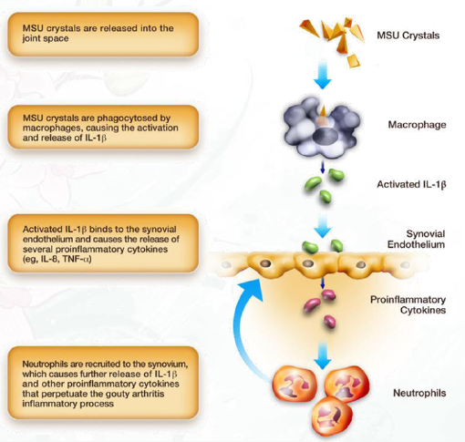
Pathophysiology

Slide 77
Risk Factors of Gout
Avoidable risk factors include diet and medications. Foods that have been implicated in causing gout are red-organ meats, seafood, and foods containing high-fructose corn syrup. Fructose has been recognized as a cause of hyperuricemia. Choi et al conducted a small prospective study that investigated the ability of diets high in fructose to induce higher serum urate levels relative to diets high in glucose or low in carbonates. High alcohol intake, especially beer, is also a risk factor. [10]

Slide 78
Clinical Phase
Asymptomatic hyperuricemia
Acute gouty arthritis
Intercritical gout
Chronic tophaceous gout

Slide 79
History
ACUTE GOUT:
Mostly involve single joint.
Severe pain:
Often cannot wear socks.
Peak within 24 to 48 hours.
Swelling.
Redness.
CHRONIC GOUT:
Frequent, recurrent acute attacks.

Slide 80
Examination
ACUTE GOUT:
Mostly involve single joint.
Most commonly the first metatarsophalangeal joint "podagra".
Severe pain.
Erythema.
Cellulitis.
Acute bursitis or Tenosynovitis.
Fever
Chronic Gout:
Tophaceous gout. "deposits of monosodium urate crystals in soft tissue"

Slide 81
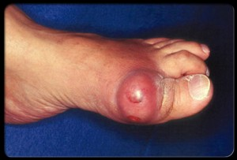
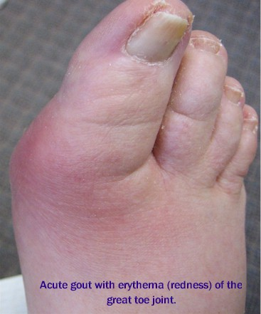
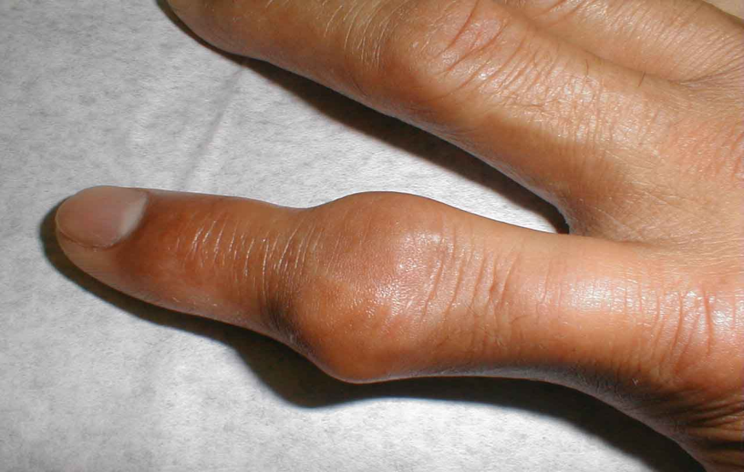
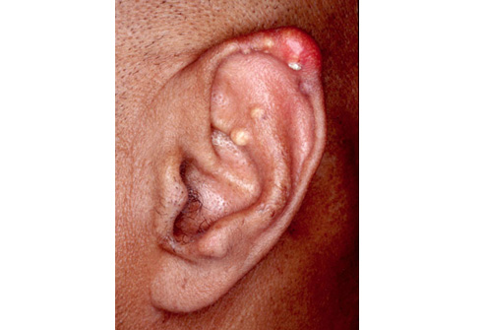

Slide 82
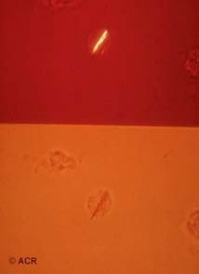
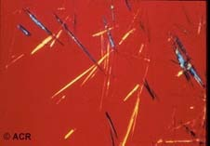
Urate Crystals
bright needle-shaped urate crystals

Slide 83
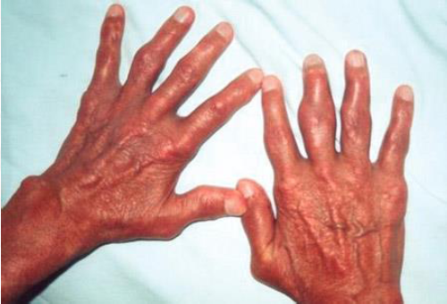
Chronic tophaceous gout

Slide 84
Diagnosis (Definite Dx)
synovial fluid or tophus aspiration with identification of:
light microscopy ; needle shape crystal
compensated polarized light microscopy ;positive birefringence with negative elongation

Slide 85
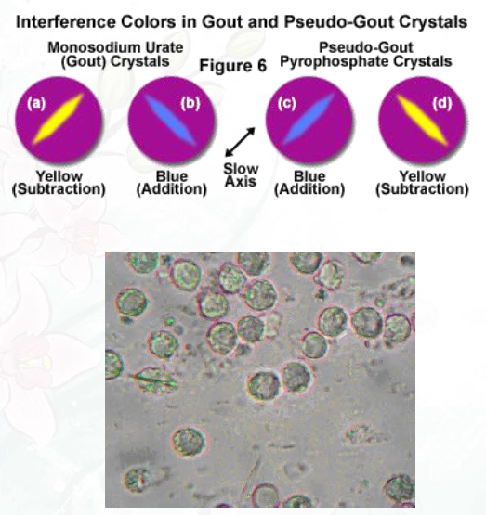

Slide 86
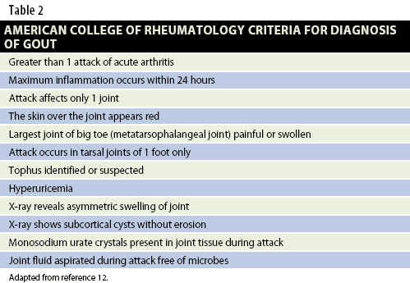
Criteria Diagnosis from American college of Rheumatology (6 in 12)

Slide 87
Complications
Acute uric acid nephropathy
most commonly in patients treated with cytotoxic agents, especially for lymphoproliferative disorders and large tumour burdens
Chronic urate or gouty nephropathy
Accumulated in medullary interstitium induced inflammation process
Uric acid stone
Uric acid calculi constitute 10% of the renal stones

Slide 88
Management of Acute gout attack
Gout is managed in the following 3 stages:
• Treating the acute attack
• Providing prophylaxis to prevent acute flares
• Lowering excess stores of urate to prevent flares of gouty arthritis and to prevent tissue deposition of urate crystals

Slide 89
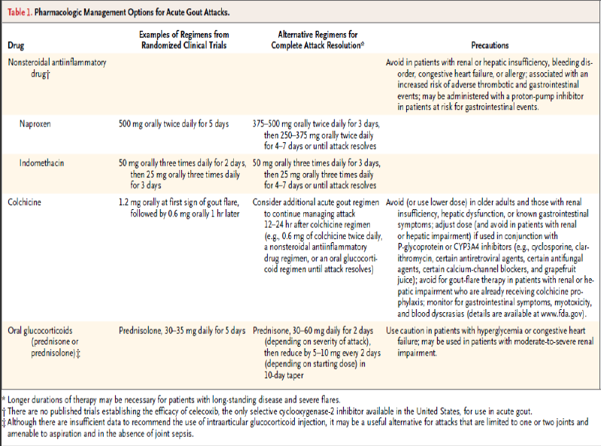

Slide 90
What follow up is recommended after an acute attack of gout?
Follow up the person 4–6 weeks after an acute attack of gout has resolved, and:
Check the serum uric acid level.
Measure their blood pressure and take blood for fasting glucose, renal function, and lipid profile.
Identify underlying conditions such as hypertension, diabetes, or renal impairment, and assess the person's overall cardiovascular risk.
Assess and provide advice on risk factors such as obesity, diet, excessive alcohol consumption, and exercise.
Consider the need to start prophylactic medication if the person is having two or more attacks of gout in a year.

Slide 91
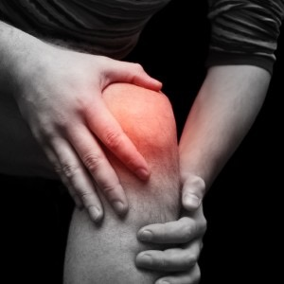
Osteoarthritis

Slide 92
Highlight on Osteoarthritis
Degenerative disorder of the articular cartilage associated with hypertropic bone changes.
Osteoarthritis (OA) is the most common joint disorder in the United States. Among adults 60 years of age or older the prevalence of symptomatic knee OA is approximately 10% in men and 13% in women . [11]
It is divided into:
Primary.
Secondary: trauma, congenital joint abnormalities, metabolic defects (eg, hemochromatosis, Wilson disease), infections (causing postinfectious arthritis), endocrine and neuropathic diseases, and disorders that alter the normal structure and function of hyaline cartilage (eg, RA, gout, chondrocalcinosis).

Slide 93
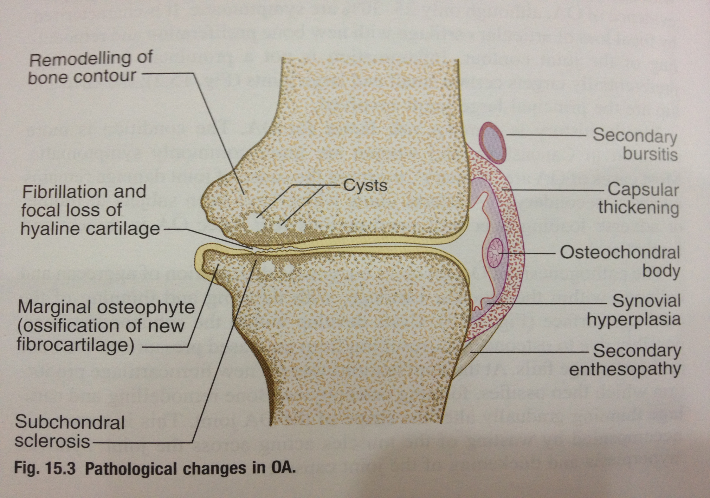

Slide 94
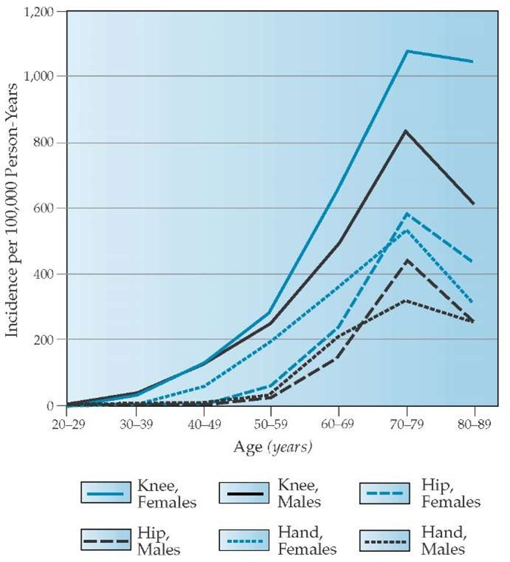
Incidence of OA of the hand, hip, and knee in members of the Fallon Community Health Plan, 1991-1992, by age and sex.

Slide 95
Highlight on Osteoarthritis
Risk Factors:
Age: Incidence of OA increase as you age “wear and tear”.
Obesity.
Genetics or heredity.
Injury.

Slide 96
History
Pain and functional restriction.
Pain worsened by movement and relieved by rest.
Morning stiffness less than 30 mins.
Insidious onset of symptoms over months or years.
Usually only one joint ( Monoarthritis ) .
Patient limiting their activities of daily living because of pain and stiffness.

Slide 97
Physical Examination
Bony swellings and deformity around joint margins.
Joint-line tenderness.
Restricted range of movement.
Palpable coarse crepitus.

Slide 98
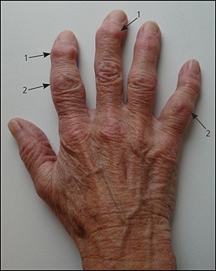
Heberden nodes

Slide 99
Diagnosis
Osteoarthritis is typically diagnosed on the basis of clinical and radiographic evidence. No specific laboratory abnormalities are associated with osteoarthritis.

Slide 100
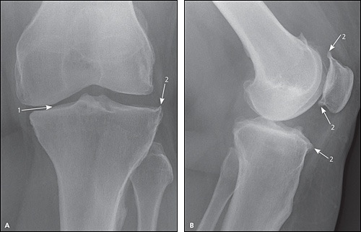
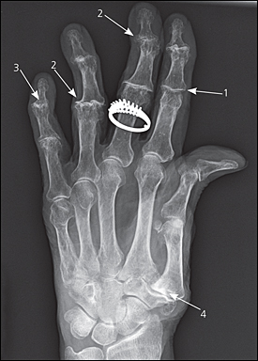
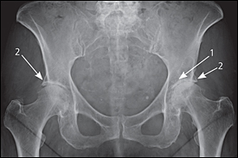
2/ Plain radiography:
A/ anteroposterior (B) lateral views
(1) joint space narrowing (2) osteophyte formation
1/ joint space narrowing
2/ osteophytes
3/ joint destruction
4/ carpometacarpal joint
(1) joint space narrowing (2) osteophyte formation.

Slide 101
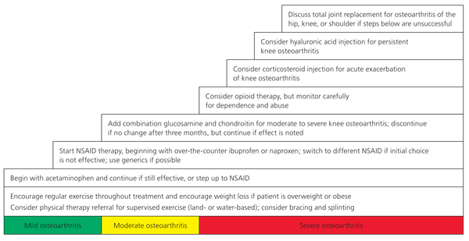
Management
Clinical practice guidelines have been recommended by American and British specialty societies. [12]

Slide 102
RA is characterized by which of the following patterns of joint involvement?
a) Episodic monoarthritis
b) Symmetrical polyarthritis
c) Migratory oligoarthritis
d) Spondylitis

Slide 103
Which one of the following is a characteristic x-ray finding in case of osteoarthritis ?
a) chondrocalcinosis
b) osteopenia
c) Narrowing of joint space
d) sequestra

Slide 104
The most common offending organism in septic arthritis in adults is:
a) S. aureus
b) Streptococcus pyogenes
c) S. pneumoniae
d) H. influenzae

Slide 105
The most specific test used in diagnosis
of gout:
a) MRI
b) x-ray
c) synovial fluid analysis
d) serum uric acid

Slide 106
Prevalence of Doctor-Diagnosed Arthritis and Arthritis-Attributable Activity Limitation United States .
National and State Estimates of Childhood Arthritis and Other Rheumatic Conditions.
Kaandorp CJ, van Schaardenburg D, Krijnen P, et al: Risk factors for septic arthritis in patients with joint disease: A prospective study. Arthritis Rheum. 1995, 38: 1819-1825.
Dubost JJ, Fis I, Denis P, et al: Polyarticular septic arthritis [review]. Medicine (Baltimore). 1993, 72: 296-310.
Pioro MH, Mandell BF. Septic arthritis [review]. Rheum Dis Clin North Am. 1997, 23: 239-258.
Wise CM, Morris CR, Wasilauskas BL, et al. Gonococcal arthritis in an era of increasing penicillin resistance. Presentations and outcomes in 41 recent cases (1985-1991). Arch Intern Med. Dec 12-26 1994;154(23):2690-5
Spector TD. Rheumatoid arthritis. Rheum Dis Clin North Am 1990; 16:513.
Jansen AL et al. J Rheumatol 2002;29:2074-6.
Zhu Y, Pandya BJ, Choi HK. Prevalence of gout and hyperuricemia in the US general population: The National Health and Nutrition Examination Survey 2007-2008. Arthritis Rheum. Oct 2011;63(10):3136-41.
Choi JW, Ford ES, Gao X, Choi HK. Sugar-sweetened soft drinks, diet soft drinks, and serum uric acid level: the Third National Health and Nutrition Examination Survey. Arthritis Rheum. 2008;59:109-116.
Felson DT, Lawrence RC, Dieppe PA, et al. Osteoarthritis: new insights. Part 1: the disease and its risk factors. Ann Intern Med. 2000;133(8):635–46.
Am Fam Physician. 2012 Jan 1;85(1):49-56.

