Slide 1
KSU-College of Medicine
Psychiatry Department
--------------------------
Course 462 - Psych
Course Objectives

Slide 2
Negative vs. Positive Attitude
 | Negative attitude | Positive attitude
Etiology | Vague/due to poor adherence to religion/always due to supernatural causes. | Many aspects have been scientifically explored & approved >>> good Rx.
Diagnosis | Subjective / unscientific. | Objective criteria & Scales.
Medications | Deleterious / addictive. | Benefit > risk in general.
Prognosis | Always bad. | There are many disorders with good prognosis.
Patients | Mad / bad / sad / aggressive / not easy to like / have low faith in Allah. | Human beings deserve respect.
Clinicians | Mentally unstable because of patients. | Like other clinicians but some may.. !?
Psychiatry | Unscientific & unappealing. | Scientific / Biopsychosocial approach.

Slide 3
Importance of Psychiatry Clerkship
One of the essential qualities of the clinician is interest in humanity.
Training in psychiatry will expand your understanding of the spectrum of human perception, thinking, emotion, and c behavior.
This will serve you well in self-awareness, interpersonal relationships, and patients' care.
Whatever medical specialty you choose in the future, training in psychiatry will upgrade your clinical skills in:
Putting the patient at ease.
Recognizing the patient's state of mind.
Understanding the patient's suffering.
Expressing empathy for the patient's suffering.
Establishing good rapport with you patient.

Slide 4
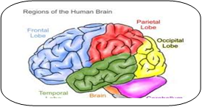
Before Psychiatry Clerkship
Neuroanatomy
Neurophysiology
Neurotransmitters
It is advisable to review these basics.
Clinical Psychology
See Basic Psychiatry chapter 1.

Slide 5
Self-assessment
Mention the 3 objectives of this course.
1- Knowledge (psychiatric disorders: classification, features, etiology, epidemiology, course, treatment, & prognosis).
2- Attitude (to adopt a positive attitude toward psychiatry as a specialty, patients, psychotropic treatment, …).
3- Skills (psychiatric history, MSE, interview skills, eliciting signs & symptoms).

Slide 6
Diagnosis
& Classification
in Psychiatry

Slide 7
Self-assessment
1- J. A. is a 48-year-old woman brought by her husband to the emergency department with 4-day-history of insomnia, agitation, and headache. Her husband insisted on having brain CT scan done for her.
Would you request brain CT scan for her or not? explain why.
No, because nothing so far justify ordering CT scan;
no clues of organic cause, her features can be explained by a non-organic mental cause (e.g. depressive disorder, anxiety disorder, …).

Slide 8
Self-assessment
2- Mention the main clinical clues of organic cause.
1- Disturbed consciousness .
2-Disturbance in cognitive mental functions.
3-Abnormal vital signs (e.g. fever, high BP..).
4-Presence of physical diseases (e.g. DM. HTN. BA. SLE….).
5-Presence of neurological deficit (e.g. nystagmus, hemiparesis, numbness, ….).

Slide 9
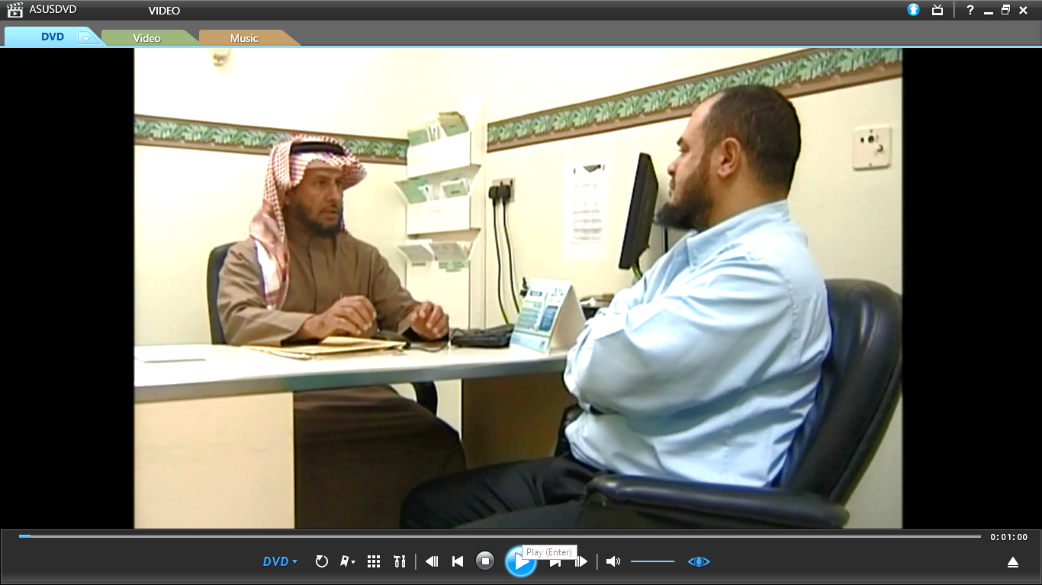
Clinical Interview
in Psychiatry
2- Interview Proper
1- Opening
3- Closure

Slide 10
Self-assessment
1.Mention the items of history taking in psychiatry.
Identification data.
Source of referral.
Chief complaint.
History of present illness.
Family history.
Personal history.
Medical history.
Past psychiatric history.
Premorbid personality traits.

Slide 11
Self-assessment
2. Mention the items of mental state examination.
Appearance /Behavior / Attitude.
Speech.
Affect.
Perception.
Thoughts /Abstract thinking.
Judgment.
Insight.
Cognitive Functions.

Slide 12
Self-assessment
3. A psychiatrist asked a patient to express his current feelings during the interview. What was the psychiatrist assessing?
Concrete thinking.
Self-awareness.
Subjective affect.
Objective mood.
Answer >>> C

Slide 13
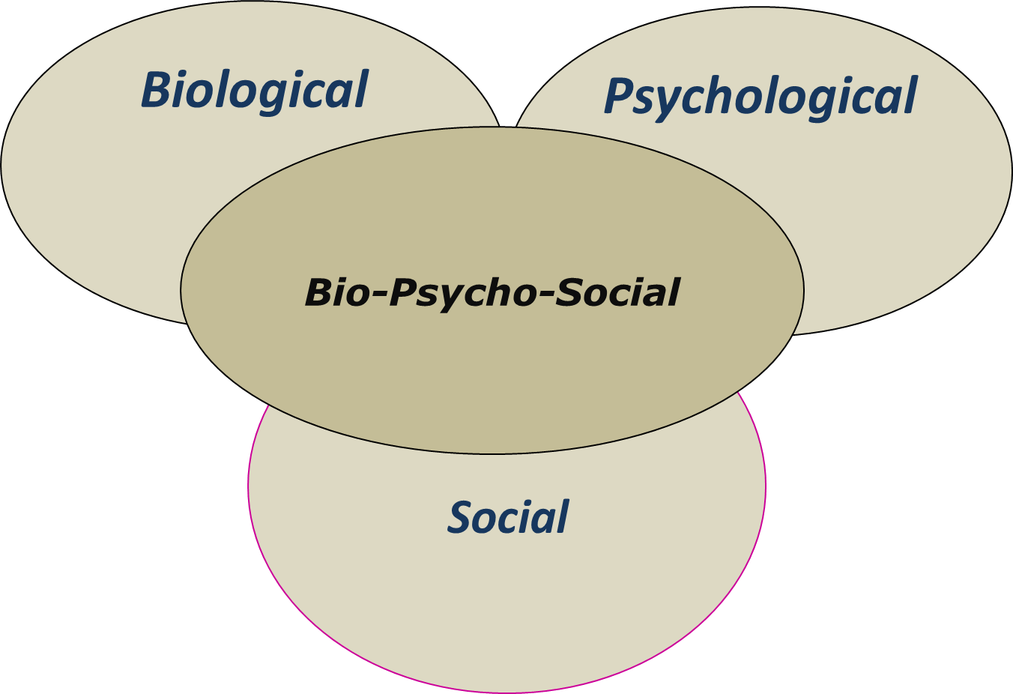
Etiology in Psychiatry

Slide 14
Self-assessment
Mention the main causative factors of mental disorders.
A- Biological
Genetic : e.g. in schizophrenia , mood disorders , panic disorder and agoraphobia.
Neuro-pathological: e.g. dementias ,delirium.
Endocrino-pathological: e.g. hyperthyroidism / hypothyroidism.
Pharmacological: side effects of medications e.g. steroids > mood changes.
B-Psychological: behavioral ,cognitive , or psychodynamic problems.
C- Social: e.g. marital discord /occupational problems/financial difficulties.
Bio – Psycho – Social Causes

Slide 15
Dealing with patients' beliefs about supernatural causal attributions
Black Magic
Devil Possession
Evil Eye

Slide 16
Self-assessment
J. E. is a 42-year-old mother of 8 children has bronchial asthma and hyperthyroidism. Her parents separated since her childhood. She has several weeks' history of irritability, tremor, and insomnia. She is worried about the cause of her problem. Her aunt told her that:" your illness is due to an evil eye". What would be your next step?
Convince her that evil eye is not the cause of her problem.
Inform her that parental separation is the precipitating factor.
Take detailed psychosocial history and ask about current medications.
Explain how bronchial asthma has precipitated her illness.
Answer >>> C

Slide 17
History taking in psychiatry
1-See the demonstration model in the video clip below.
2- See and play the role of the psychiatrist in the practice part in the video clip below.
3- Practice with a colleague.
Proper practice makes perfect

Slide 18
Self-assessment
Mention the items of “history of present illness”.
Onset.
Nature of symptoms.
Severity.
Etiological factors.
Course.
Duration.
Effect on the patient’s life.

Slide 19
How to assess personality traits
1-See the demonstration model in the video clip below.
2- See and play the role of the psychiatrist in the practice part in the video clip below.
3- Practice with a colleague.
Proper practice makes perfect

Slide 20
Self-assessment
A psychiatrist asked a patient about the patient's reaction to usual life stresses. What was the psychiatrist assessing?
Thinking process.
Personality traits.
Judgment.
Personal history.
Answer >>> B

Slide 21
How to assess obsessions
1-See the demonstration model in the video clip below.
2- See and play the role of the psychiatrist in the practice part in the video clip below.
3- Practice with a colleague.
Proper practice makes perfect

Slide 22
Self-assessment
H. M. is a 23-year-old newly married woman has recurrent persistent images in her mind about harming her husband with a knife. She knows that these images are senseless, silly, and should be resisted, but she cannot make them go away. What is this psychopathology?
Compulsions.
Hallucinations.
Obsessions.
Delusions.
Answer >>> C

