Slide 1
Substance Use Disorders
By: Dr. Majid Al-Desouki
Consultant and Clinical Assistant Professor

Slide 3
Introduction
Many implications for brain research & clinical psychiatry.
Affect mental state and behavior.
Sx similar to the psychiatric disorders.

Slide 4
What is addiction?
In Aug 2011, The American Society of Addiction Medicine (ASAM) has officially recognized Addiction as mostly:
a social problem
a moral problem
a criminal problem
a primary chronic brain problem
a behavioral disorder occur as the result of other causes such as emotional or psychiatric problems.
Addiction is not a choice, but choice still plays an important role in getting help.
Notes:
Addiction def August 31, 2011 — For the first time, the American Society of Addiction Medicine (ASAM) has officially recognized that addiction is not solely related to substance misuse and is, in fact, a chronic brain disease. "At its core, addiction isn't just a social problem or a moral problem or a criminal problem. It's a brain problem whose behaviors manifest in all these other areas," ASAM Past President Michael Miller, MD, said in a news release. "The disease is about brains, not drugs. It's about underlying neurology, not outward actions," added Dr. Miller, who oversaw the development of the new addiction definition. Findings from brain circuitry studies prompted more than 80 experts to come together 4 years ago to begin the process of developing a new definition of addiction. Previous research has shown that addiction affects neurotransmission in the reward area of the brain, triggers craving of addictive behaviors based on memories of previous experiences, and alters areas that govern impulse control and judgment. Chronic Condition Although ASAM adopted aspects of its new definition internally in April, it was recently released to the public with final tweaks based on subsequent discussion by board members. Highlights include its description of addiction as a primary disease, which means "it's not the result of other causes such as emotional or psychiatric problems." ASAM also notes that addiction is a chronic condition, and so should be "treated, managed, and monitored over a life-time." Raju Hajela, MD, chair of the ASAM new definition committee and past president of the Canadian Society of Addiction Medicine, said in the release that this disease drives behaviors that others might not understand. "Simply put, addiction is not a choice[, but] choice still plays an important role in getting help. Because there is no pill which alone can cure addiction, choosing recovery over unhealthy behaviors is necessary," added Dr. Hajela. David Kupfer, MD, chair of the American Psychiatric Association's Task Force for the upcoming Diagnostic and Statistical Manual of Mental Disorders, Fifth Edition (DSM-5), told Medscape Medical News that "a number of mental disorders" that are currently in the DSM-4 and that will be in the DSM-5 are considered chronic and persistent. "Addictive disorders, anxiety disorders, certainly depressive or bipolar disorders, schizophrenia, some of the neurocognitive disorders such as Alzheimer's — they are disorders that are no different than cardiovascular disease, or diabetes, or even asthma in many ways," said Dr. Kupfer. "Thinking about it that way has helped a lot of people trying to revise the current DSM to realize that what we are seeking to do is try and find out the underlying physiology and the underlying psychopathology and etiology of these disorders. There's no question that you have this interaction of what's going on in the brain and what's going on in terms of expression of behavior," he added. Definition Reduces Stigma He noted that the new definition is consistent with "parallel developments" currently going on in other areas of psychiatry. "We're running into the same exciting areas. It doesn't mean we have the answers. It means we have our work cut out for us in terms of how to integrate what we're learning about how the brain functions with what we learn about behavior," said Dr. Kupfer. "It's very nice to see this society endorsing the fact that in many ways addiction may very well be a chronic brain disorder, and not simply a behavioral disorder. And that I totally agree with." Overall, he said, it is important to get this information out to the public, to let those affected know that it is okay to come in for treatment. "The only way that we will really get rid of stigma is to continue to point out and show again and again, hopefully with more science, that these disorders are no different than any of the other disorders that we are treating throughout the rest of medicine. So anything like this new definition helps." The new, full definition of addiction is available on the ASAM Web site

Slide 5
Introduction (cont.)
DSM-5:
Substances + substance related disorders
Substance vs. drug
Legal & illegal substances
Chemicals with brain-altering properties (e.g. organic solvents)

Slide 6
Terminology
Abuse: self-administration of any substance in a culturally disapproved manner that causes adverse consequences.
Intoxication: the transient effect (physical and psychological) due to recent substance ingestion, which disappears when the substance is eliminated.
Withdrawal: a group of symptoms and signs occurring when the drug is withdrawn or reduced in amount.

Slide 7
Terminology (cont.)
Dependence: the physiological state of neuroadaptation produced by repeated administration of a drug, necessitating continued administration to prevent appearance of withdrawal state.
Addiction: a nonscientific term that implies dependence and associated deterioration of physical mental health as well as high tendency to relapse after discontinuation.

Slide 8
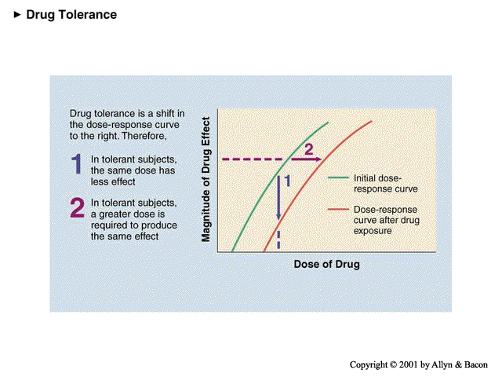

Slide 9
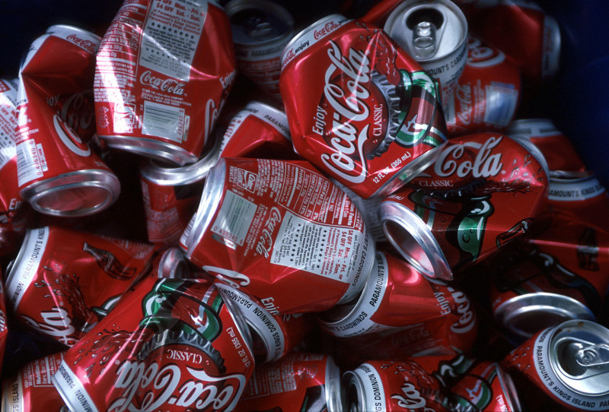

Slide 10
Authorianism;
coercive parent-
child interactions
Family/neighborhood
disorganization
Aggression and/or
anxiety problems
Parental
substance use
Elementary-age
rejected or isolated
peer relationships
Low parental
monitoring
Deviant peer
associations in
early youth
Early experimenting
with substance use
Substance abuse
and dependence

Slide 11
Psychopharmacological model of dependence

Slide 12
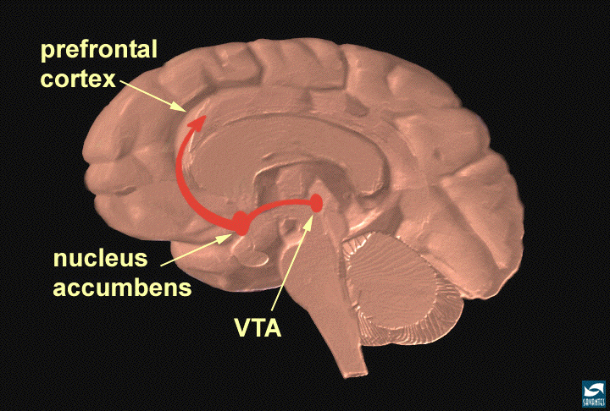
Reward Circuitry of the Brain

Slide 14
Complications
Psychological
Drugs
Social
Medical

Slide 15
Assessement
Collateral history.
Urine screening tests.
blood screening tests (alcohol, barbiturates).
Pattern of Abuse:
What? (type, dose, route, effect: nature and duration).
How? (frequency, duration, how long, source, and situation)
Why? (? psychosocial problems).
Dependence?
Complications :
Psychosocial…..
Physical…..
Notes:
Patients usually fear the consequences of acknowledging the problem, are manipulating, and prone to denial. They are often difficult to detect and evaluate and are unreliable. Therefore, it is necessary to obtain information from other sources, such as family members, because these patients are usually unreliable.
Urine and blood screening tests are useful in confirming suspected substance use. Most drugs are well detected in urine and are often positive for up to 2 days after taking most drugs. However, some drugs (e.g. alcohol, barbiturates) are best detected in blood. Screening urine and blood tests, though confirmatory and sensitive, are not specific; many false positives can occur, e.g. in patients using antipsychotics. Substance abusers often abuse multiple substances (e.g. amphetamine, cannabis and alcohol).
For each psychoactive substance consider the following:
What? (type, dose, route, effect: nature and duration).
How? (frequency, duration, how long, source, and situation)
Why? (? psychosocial problems).
Dependence :
persistent abuse despite harmful effects
tolerance
withdrawal on abstinence
reinstatement after abstinence
feeling compelled to abuse substance.
Complications of substance abuse should be carefully considered:
Psychosocial: social isolation, depression, anxiety, psychosis…etc
Physical: concomitant medical conditions are often substance-related, e.g. thrombophlebitis, bacterial endocarditis, acquired immune deficiency syndrome (AIDS), infectious hepatitis, abscesses.

Slide 16
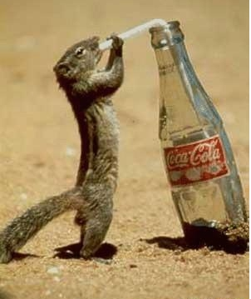

Slide 17
Alcohol and Related Mental Disorders

Slide 18
Alcohol Kills More Than AIDS, TB or Violence-WHO report (Feb 2011)
Alcohol causes nearly 4% of deaths worldwide, more than AIDS, tuberculosis or violence.
Alcohol is the world's leading risk factor for death among males aged 15-59
Alcohol is a causal factor in 60 types of diseases and injuries.
Now we have strong evidence of a causal relationship between drinking and breast cancer.

Slide 19
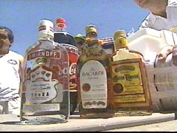
Epidemiology
dependence is most common in
those aged 40 – 55 years.
In USA :
13 % men and 4 % women
age ≥18
20-40% hospital admissions
Alcoholics who continue drinking have a shortened life-span of 15 years why?
Notes:
SLIDE 4. Before we discuss these three categories, I would like to start with a few brief words about the scope of the problem of alcohol abuse and dependence; that is, what kind of disorder are we talking about when we talk about alcoholism.
First of all, there are approximately ____ students in this classroom, and if you look around, know that ___ of you (15%, 1/7) roughly will develop alcohol abuse or dependence. So we are talking about a very common illness that affects more people than does diabetes, lung cancer, breast cancer, heart attacks, and is about as common as hypertension is in the general population.
In addition to this relatively high prevalence, alcoholism causes a great amount of morbidity and mortality. First, up to 40% of all general hospital admissions in the U.S. are related to alcohol or drug problems in some way. So the next time you see a patient with an upper GI bleed in the hospital, for example, wonder whether heavy alcohol use has played a role.
Also, alcoholics are twice as likely to be seen by their primary care provider than nonalcoholics, so there is a particular need for you as young physicians-in-training to recognize sequelae of alcoholism in this arena in order to better identify an alcohol dependent person. In fact, a recent study found that physicians are actually not very good at recognizing alcoholics in the outpatient setting (there’s a link to the news story on the web site).
And if alcoholics aren’t recognized and appropriately treated, or even if they are identified but maintain a severe course with few substantial abstinence periods, these people will die – alcoholism is a lethal illness. Over 100,000 people die per year of alcohol or drug related causes in the U.S., and chronic alcoholics will lose roughly 15 years off their average life span.
And here’s what will kill you: accidents (MVAs, overdose), acts of violence (suicide, homicide), and today’s subject, major medical illnesses (like esophageal varices, cancers, heart failure/MIs, cirrhosis).
15% ( 1/7) on people in this room will become alcohol dependent
In the outpatient setting, alcoholics are twice as likely to consult a PCP than nonalcoholics
Here’s what will kill you: accidents (MVAs, OD), major medical illnesses (cirrhosis, MI-CHF, varicies), acts of violence (suicides/homicides)
Alcohol abuse may mean any one of the following specific terms:
Excessive consumption: harmful use.
Problem drinking: drinking that has caused disability, but not dependence.
Alcohol dependence: which usually denotes alcoholism.
Alcohol-related disability: physical, mental and social.
Alcohol is the major substance of abuse all over the world. Mixed abused of alcohol and other substances is very common. Recreational alcohol drinking gradually grades into problem drinking and dependence.
Most alcohol abusers go unrecognized by clinicians until their physical health and psychosocial life have been significantly harmed; therefore, early recognition is important. Many people go through prolonged periods (average 15 – 20 years) of gradual dependence on alcohol before clinical symptoms or signs are evident.
Alcohol depresses the central nervous system. Clinically, it may appear to be a stimulant because of early disinhibition due to suppression of inhibitory control mechanisms.
Alcohol drinking may occur in the late teens but dependence is most common in those aged 40 – 55 years.

Slide 20
Clinical presentation
Alcohol intoxication: early intoxication includes sense of well-being, emotional lability, irritability and incoordination → to ataxia and slurred speech
Heavy intoxication (bl > 300 mg/ml) → alcoholic coma & death

Slide 21
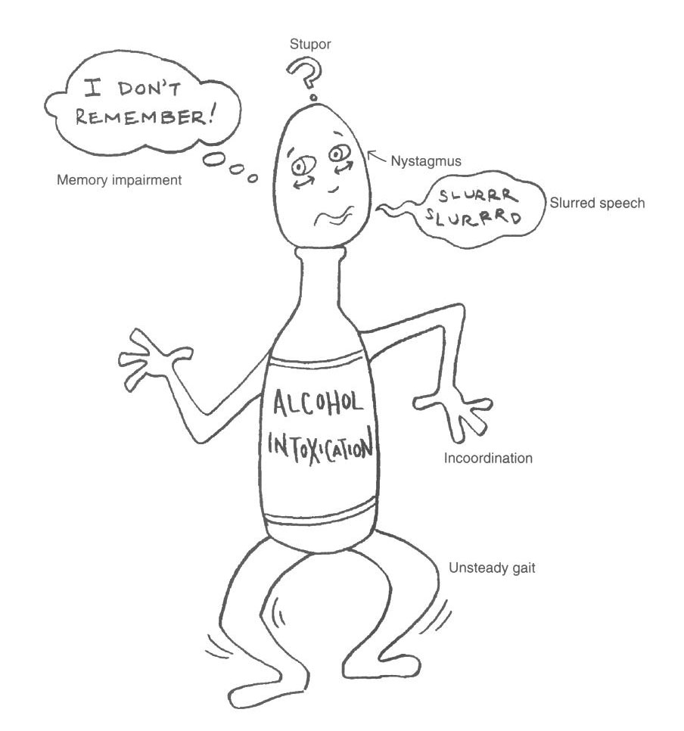

Slide 22
Alcohol Dependence
Current rate of alcohol dependence is 5%.
Common symptoms: need for daily use of larger amounts of alcohol for adequate functioning, and inability to cut down or stop the drinking.

Slide 23
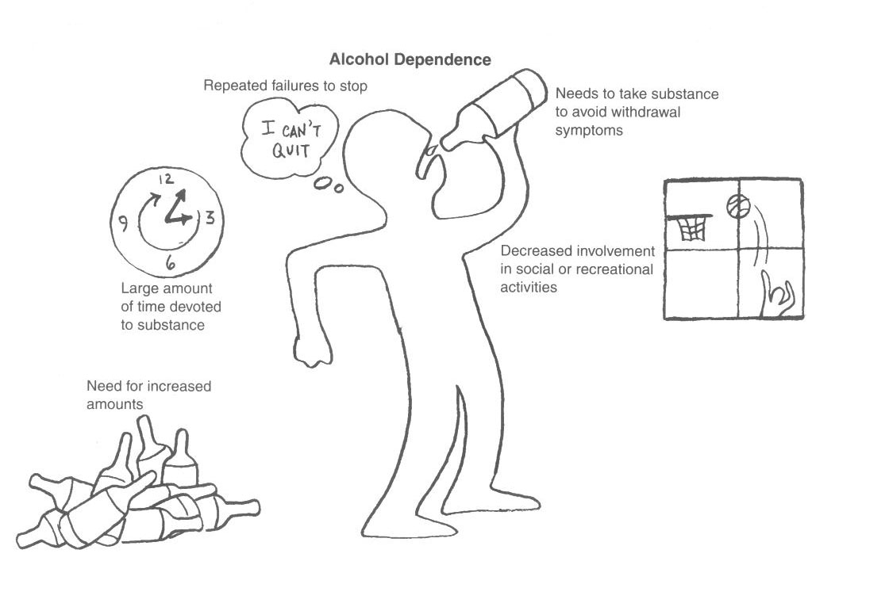

Slide 24
Clinical presentation (cont)
Alcohol withdrawal: Sx may begin after 6 hours of cessation or reduction of alcohol and peak by 48 hours, they follow a drop in blood concentration, symptoms subside over the course of 6-7 days
epileptic tonic clonic seizures may develop within 12-24 hours after cessation of alcohol intake
Delirium tremens may develop after about 48 hours

Slide 25
DSM-5 criteria for Alcohol withdrawal :
- Cessation or reduction in heavy alcohol use.
- two or more of the following (several hours – few days):
- autonomic hyperactivity
- increased hand tremor
- insomnia
- nausea or vomiting
- transient hallucinations or illusions
- psychomotor agitation
- anxiety
- grand mal seizures
- impairment in function
Not due to a general medical condition or mental disorder

Slide 26
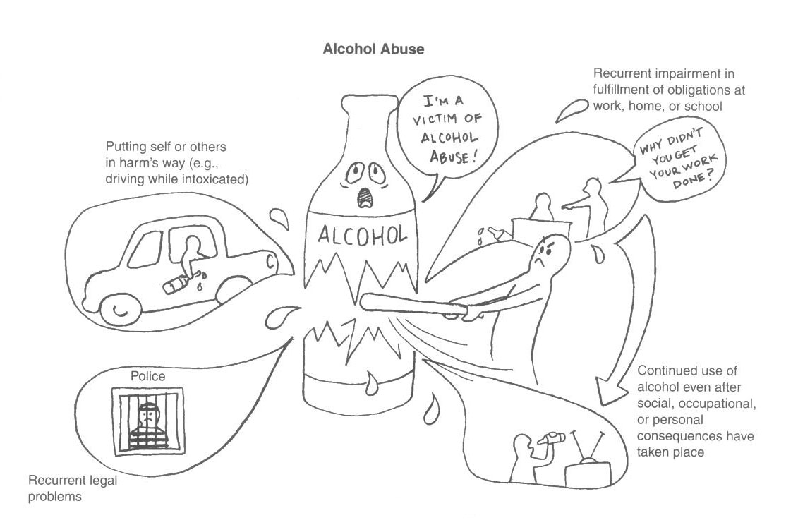

Slide 27
Delirium Tremens (DTs):
Severe form of alcohol withdrawal after 2-3 days:
- gradual onset of delirium, fluctuating consciousness, disorientation, agitation, hallucinations, illusions and delusions.
- gross tremors
- autonomic disturbance
- dehydration and electrolyte disturbance
- marked insomnia

Slide 28
Peaks on 3rd or 4th day and lasts 3-5 days, worsens at night and followed by a period of prolonged deep sleep from which the person awakes with no symptoms and has amnesia for the period of the delirium.
Complications include:
Seizures
Chest infection & aspiration
Violent behavior
Coma
Death (mortality rate: 5-15%)
Causes:
Volume depletion
Cardiac arrhythmias
Electrolyte imbalance
Infections
DT is a serious MEDICAL emergency → detection and treatment

Slide 29
Alcohol-Induced Persisting Amnestic disorder
Wernicke-Korsakoff syndrome
Prolonged heavy use of alcohol
Wernicke’s encephalopathy is an acute reversible syndrome characterized by ataxia, vestibular dysfunction, confusion and ocular motility abnormalities, it may resolve spontaneously in a few days or progress to:
Korsakoff’s syndrome: a chronic amnestic syndrome that can follow Wernicke’s encephalopathy, characterized by impaired mental syndrome (esp. recent memory) and anterograde amnesia in an alert and responsive pt.
Only 20% of Korsakoff’s syndrome fully recover
Treated by thiamine 100mg two – three times daily for 1 to 2 weeks (if the case develops to Korsakoff’s syndrome treatment should be continued for 3 to 12 months)

Slide 30
Complications of chronic alcohol abuse
Medical | Psychiatric | Social
Neurological Cerebral degeneration Seizures Peripheral neuropathy Optic nerve atrophy Alimentary Tumors (esophagus, liver) Gastritis, peptic ulcer Pancreatitis Hepatitis, liver cirrhosis Cardiomyopathy Anemia Gynaecomastia | Amnestic disorder Delirium Dementia Psychosis Depression Reduced sexual desire Insomnia Personality deterioration Increased risk of suicide Morbid jealousy | Social isolation Job loss Marital conflicts Family problems Legal troubles Social stigma

Slide 31
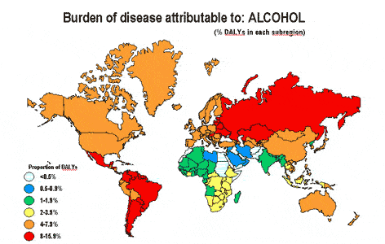

Slide 32
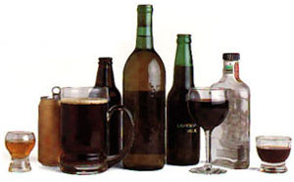

Slide 33
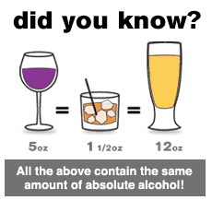
How much is too much?

Slide 34
Alcohol intoxication Ethanol plasma concentrations Vs. CNS effects
Ethanol plasma concentration (per mill) | Effect
0.2 | Feeling of relaxation
0.3 | Slight euphoria
0.5 | Slight motor incoordination
1 | ataxia
3 | stupor
>4 | Coma, death due to the respiratory failure
Notes:
alcohol potentiate the effects of other drugs with central depressant effects – barbiturates, benzodiazepines, H₁-anithistamines
Alcohol intoxication:
Early intoxication includes a sense of well-being, liveliness and a smell of alcohol on the breath, grading into emotional lability, irritability, and incoordination, which grades into apathy, ataxia, and slurred speech. Heavy intoxication (blood alcohol level above 300 mg/ml) can lead to alcoholic coma. Alcohol acute intoxication may mimic many psychiatric conditions (panic attacks, depression, acute psychosis with delusions and / or hallucinations).

Slide 35
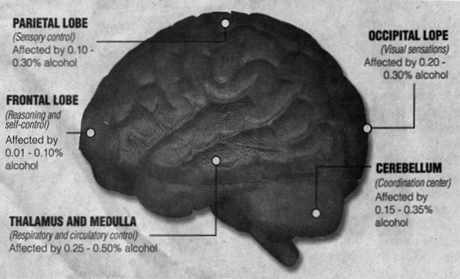

Slide 36
Alcohol withdrawal
70 % of AD patients &↑ Rate in the elderly.
No gender/ethnic differences
85% mild-to-moderate
15% severe and complicated:
Seizures
Delirium Tremens
Features :
Tremulousness (hands, legs and trunk).
Nausea, retching and vomiting.
Sweating, tachycardia and fever.
Anxiety, insomnia and irritability.
Cognitive dysfunctions.
Thinking and perceptual disturbances.
Notes:
Alcohol withdrawal:
Occurs in the dependent state, in those who have been drinking heavily for years and who have a high intake of alcohol for weeks at a time. The symptoms (see table 7 – 4) may begin after six hours of cessation or reduction of alcohol and peak by 48 hours. They follow a drop in blood concentration, characteristically appear on waking from sleep, after the fall in concentration during sleep. The symptoms subside over the course of 5 - 7 days. Epileptic generalized tonic clonic seizures may develop within 12 - 24 hours after cessation of alcohol intake. Delirium tremens may develop after about 48 hours.

Slide 37
Course of AW
Stages
I (24 – 48 hours):
II (48 – 72 hours):
III (72 – 105 hours):
IV (> 7 days):
Symptoms
Peak severity at 36 hours
90% of AW seizures
Most cases self-limited
↑ Stage I symptoms
“Delirium Tremens”
Protracted withdrawal

Slide 38
Risk factors of Alcohol abuse
Vulnerable personality: impulsive, gregarious, less conforming, isolated or avoidant persons.
Vulnerable occupation: senior businessmen, journalists, doctors.
Psychosocial stresses: social isolation, financial, occupational or academic difficulties, and marital conflicts.
Emotional problems: anxiety, chronic insomnia depression.
Notes:
Substance abuse frequently coexists with personality disorders (e.g. borderline, antisocial), and with other psychiatric disorders such as depression, anxiety or psychotic conditions

Slide 39
Is your patient ETOH dependent? CAGE questionnaire
C = Have you ever felt you must Cut down your drinking?
A = Have people Annoyed you by criticizing your drinking?
G = Have you ever felt Guilty about your drinking?
E = Have you ever had a drink first thing in the morning as an “Eye opener”?

Slide 40
Laboratory Tests
Identify acute and/or heavy drinking (> 5 drinks/day):
Blood Alcohol Levels (BAL).
Gamma-glutamyltransferase (GGTP > 35 IU/L)
Carbohydrate Deficient Transferrin (CDT > 20 IU/L)
Erythrocyte mean corpuscular volume (MCV >91.5 μ³)
High AST/ALT
*** CDT + GGTP best diagnostic combination.
Notes:
Before we proceed, I wanted to talk a little bit about some strategies to detect a potential problem with alcohol (or drugs) in your patients in your office or in the hospital. First and foremost, TAKE A HISTORY – ASK about life problems (e.g. family/marital, job, accidents, legal – DUIs), and transition into nonthreatening, nonjudgmental questions about alcohol, drug and nicotine use. While the issue of detection of substance problems is a whole lecture unto itself, this is just a reminder that the best diagnosis is obtained through taking a history, and then doing a physical exam.
In addition, some blood tests for state markers of heavy drinking can be useful if you are suspicious of alcohol related problems. GGT has good sensitivity and specificity (around 70-80% sensitive and specific), and generally is the first of the liver enzymes to elevate with heavy drinking (i.e., 6-12 drinks/day for several weeks).
Besides GGT, the CDT (carbohydrate deficient transferrin) test is a more expensive alternative for detecting high levels of drinking, and it is about as sensitive and specific as the GGT .
Reflecting alcohol’s effect on red blood cells, MCV (mean corpuscular volume), a measure of how big the RBCs are, also increases with heavy drinking.
The other liver enzymes are not very helpful if you are suspicious of alcohol dependence, since they only elevate when hepatocytes are damaged, which usually is at a fairly advanced stage of alcoholism. Nevertheless, suspect alcohol related causes in patients with high AST and ALT.
Lastly, a urine toxicology screen is useful in detecting acute intoxication with alcohol or drugs, but in the case of alcohol, only relevant if the patient has ingested alcohol in the last 6-8 hours or so.
Alimentary/stomach – gastritis, PUD – acute GI bleed, Mallory-Weiss tears, cancers
Thus, next time someone comes into your office with GI symptoms
Liver – fatty liver, alcoholic hepatitis, cirrhosis (15%) - > portal HTN - > varices/acute bleeds; hepatocellular cancer
Pancreas – pancreatitis, cancer
CV – can lead to arrhythmias
Thus, the next time a patient comes into your office with chest pain/SOB, among the things that you should consider in the differential is alcoholism. However, cardiac effects not likely detected early.

Slide 41
Treatment
Treating Alcohol Intoxicated Patient:
Conscious : supportive, antipsychotic if agitated. Unconscious: ABC
Treating Alcohol Withdrawal:
Supportive, thiamine & long acting BDZ ± anticonvulsants for seizure.
Maintaining Abstinence:
Medications:
Disulfiram – blockade of aldehydedehydrogenase → cummulation of acetaldehyde - nausea, flushing, tachycardia, hyperventilation, panic…
Naloxone – reduces alcohol-induced reward.
Acamprosate – anti-craving effects .
Psychological: group Tx, AA, relapse prevention.
Notes:
The conscious patient:
observation, with protective and supportive approach
In case of agitation, hyperactivity or risk of violence: restrain the patient and give antipsychotic drugs (e.g. haloperidor or droperidol 5 – 10 mg im)
Sedatives are better avoided because they may potentiate depressant effects of alcohol on the central nervous system.
Wait for the alcohol to be metabolized.
The unconscious patient:
hospitalization is required: protection of the airways, vital signs monitoring, prevention of further loss of body heat, correction of hypovolemia, and forced diuresis with maximal alkalinization of the urine. In extreme situation haemadialysis is necessary
Maintaining Abstinence:
Disulfiram – blockade of aldehydedehydrogenase → cummulation of acetaldehyde - nausea, flushing, tachycardia, hyperventilation, panic…
Aim: to make alcohol consumption unpleasant and intolerable
Naloxone – reduces alcohol-induced reward.
Acamprosate – anti-craving effects .
The drugs used to alleviate the acute abstinence syndrome: benzodiazepines, clonidine (inhibits exaggerated neurotransmitter release) and propranolol (blocks excessive sympathetic activity).
To explore the reasons for drinking, alternative ways are worked out. For instance, instead of using alcohol in social situations to reduced anxiety, learn anxiety management and assertiveness techniques.
Provision of information about the hazards of alcohol
Group therapy: about 7-12 patients and a staff member in a specialist unit attend regular meetings. It provides an opportunity for frank feedback from other members of the group concerning the problems that the patient faces and to work out better ways of coping with their problems.
Alcoholics Anonymous (AA) is a voluntary supportive self-help organization of persons with alcohol-related problems. Members attend group meetings (1-2 / week) and obtain support from one another. The meetings involve repeated emotional confession of each person’s problems. The organization works on the firm belief that total abstinence is the aim.

Slide 42
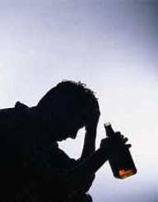

Slide 43
Sedatives, Hypnotics, and Anxiolytics
Similar clinical manifestations to alcohol.
withdrawal from short-acting substances (e.g. triazolam) can begin within 4 - 6 hours.
Alcohol and all drugs of this class are brain depressants any risk? - are cross-tolerant and cross-dependant.
withdrawal can be accomplished safely using diazepam, phenobarbital, and pentobarbital, dose reduced in steps (about 1/4 - 1/10 of daily benzodiazepine dose, every two weeks).
BDZ have a large margin of safety & less addiction potentials.
Flumazenil is a BDZ receptor antagonists used in BDZ overdose.
Notes:
This class of substances includes all controlled antianxiety and sleeping medications:
Benzodiazepines ( e.g. diazepam, lorazepam )
Benzodiazepine - like drugs ( e.g. zolpidem, zopiclone )
Barbiturates ( e.g. secobarbital )
Barbiturates - like hypnotics ( e.g. methaqualone )
Carbamates ( e.g. meprobamate )
These substances are brain depressants. Like alcohol, they can produce very significant levels of physiological dependence, marked by both tolerance and withdrawal.
often taken with other brain depressants, like alcohol, which can produce additive serious effects (e.g. respiratory depression).
Abrupt withdrawal may produce seizures, delirium, or psychosis.

Slide 44
OPIOIDS

Slide 45
Introduction
Opioids have been used for at least 3500 years
Mostly in the form of crude opium
Morphine was the first to be isolated in 1806 and codeine in 1832
Opium comes from the juice of the opium poppy (papaver somniferum) which contains about 20 opium alkaloids including morphine

Slide 46
This group includes several narcotic substances
Opium
Heroin
Morphine
Codeine
Pethidine
Methadone
Pentazocain
Some of these compounds are naturally occurring (e.g. opium, codeine) while others are synthetic or semi-synthetic
Some of these substances are for medical use like pethidine while others are solely substance of abuse like heroin
The medical use of opioids are mainly for there powerful analgesic effect - while they are abused for they are euphoriant effect

Slide 47
Neuropharmacology
The primary effects of opioids mediated through the opioids receptors
There is three type of receptors, and they are responsible for regulating and mediating analgesic effect, respiratory depression, constipation, sedation and dependence
Opioids have an effect on the dopaminergic and noradrenergic neurotransmitters system
Heroin is the most commonly abused opioid and is more potent and lipid soluble than morphine
It crosses the BBB faster and has more rapid of onset than morphine

Slide 48
Clinical effects
Psychological | Physical
Euphoria Relaxation Hyperactivity Drowsiness Analgesia | Small pupil Bradycardia Reduced appetite Constipation Respiratory depression

Slide 49
Intoxication
Significant maladaptive behavior
Including : dysphoria, agitation, retardation, impaired judgment …
Papillary constriction or dilatation (in OD)
Or one or more of the following: drowsiness or coma, slurred speech, impairment in attention or memory.
Symptoms are not due to a medical condition.

Slide 50
Opioid withdrawal ..
The symptoms due to withdrawal from opiods are flulike including:
Lacrimation
Dysphoric mood
Insomnia
Muscle and joint pain
Cold and hot flushes
Nausea, vomiting and diarrhea
Intense craving for the drug is a recognized feature of the drug - it begins about 6 hours after the last dose and peaks after 36-48 hours - then wanes
Untreated withdrawal result in no serious medical sequence - but they cause great distress
Tolerance can develop very rapidly (esp. in IV use) leading to increasing dosage - then it diminishes very rapidly

Slide 51
TX. Opioids OD,,
Opioids overdose can be very dangerous (due to respiratory depression) therefore they should be treated carefully in the ICU
- Naloxone is a short acting antidote that is used to normalize respiration and to restore consciousness
- open airway, O2, IV fluids
- vital signs monitoring.
Opioid withdrawal
- Assess the severity and give symptomatic treatment: pain killer and sedatives
- Treatment of complications; counseling; individual and group therapy

Slide 52
Psychostimulants and Hallucinogens

Slide 53
Commonly used Stimulants
Nicotine
Caffeine
Cocaine – Freebase/crack
Amphetamine/Methamphetamine
Methylenedioxymethamphetamine (MDMA)
Appetite suppressants
(e.g. phentermine and diethylpropion)

Slide 54
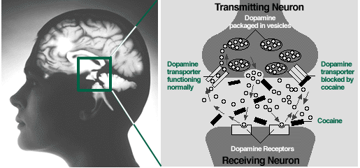
Psychostimulants
The most common psychostimulants (cocaine, MDMA and amphetamine) act on the synapse to increase the activity of dopamine, noradrenaline and serotonin.
Cocaine blocks pre-synaptic reuptake
Notes:
Graphics reference to follow.

Slide 55
Psychological FX of non dependent use
Recurrent intoxication
Some users may self-medicate with antidepressants and/or benzodiazepines
After-effects: termed ‘crash’ or ‘come down’
Dysphoria
Depressed mood
Anxiety
Reduced appetite
Restlessness

Slide 56
Dependent user
Defining criteria (need >2):
Desire to use; difficulty ceasing or reducing use; evidence of withdrawal syndrome; tolerance; increased time spent searching out substance; and continued use despite negative consequences
Often polysubstance use
Marginalised, with high levels of morbidity
Withdrawal: acute and prolonged

Slide 57
Clinical effects of stimulants
Psychological | Physical
Enhanced cognitive function Elevated mood Over activity Increased confidence, self-esteem and sociability Overtalkativeness Insomnia In high doses/prolonged use: Restlessness, irritability Paranoid psychosis Aggressiveness, hostility | Reduced sense of fatigue Reduced appetite (anorexia) Dilated pupils Tremors In high doses/prolonged use: Nausea, vomiting, hyperthermia, cardiac arrhythmias, severe hypertension, CVA, seizures Dizziness, respiratory distress, Cyanosis

Slide 58
Stimulant-induced psychosis
Now one of the most common causes for presentation to hospital with psychosis
There is some evidence of neurobiological vulnerability to low dose amphetamine psychosis (Poole et al 1996)
Typically, symptoms settle within a few days without specific treatment

Slide 59
Social complications
Consequence of intoxication, illicit nature and dependence
Problems in 4 domains
Forensic
Relationships
Financial
Occupational
Notes:
Photograph acknowledgement to follow.

Slide 60
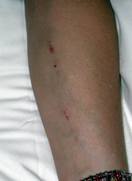
Complications of injecting
Bacterial, local and systemic
Blood-borne viruses
Vascular damage
In this case:
Track marks
Early cellulitis
Multiple injections over a short period suggests cocaine use
Notes:
Clinical photograph taken by P. Haber.

Slide 61
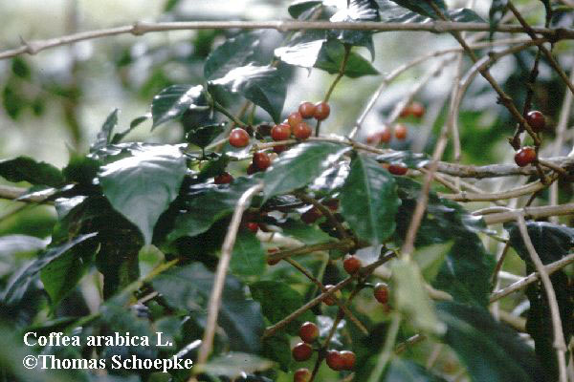
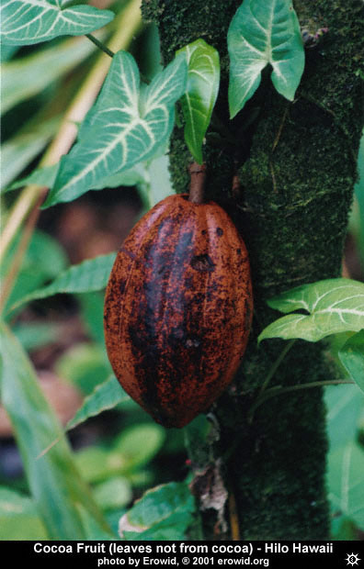

Slide 62
Caffeine
Coffee is the second largest commodity traded in the world after oil!
Highly caffeinated soft drinks (eg Red Bull)
Adverse effects
Raised cholesterol
Insomnia
Anxiety
SVT
Dependence syndrome is recognised (withdrawal headaches) but is this addiction?

Slide 63
Caffeine – Dosage Forms
150-200mg Strong coffee, espresso
100-150mg High caffeine soda (e.g. Power Horse)
50-75mg Normal soda (e.g. Coke, Pepsi)
25-75mg Tea
<25 Chocolate

Slide 64
Use and Abuse
Alert, competent, reduced fatique
Caffeine is clearly addictive, although the addiction is relatively benign
Withdrawal reactions include fatigue, sedation, headaches and nausea

Slide 65
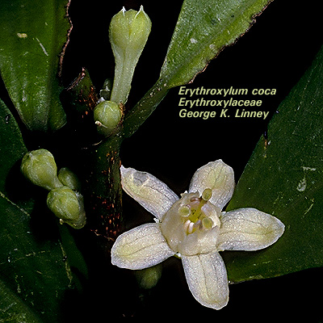

Slide 66
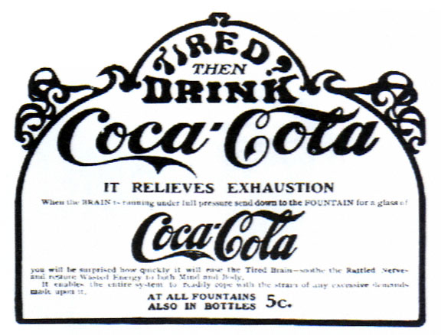
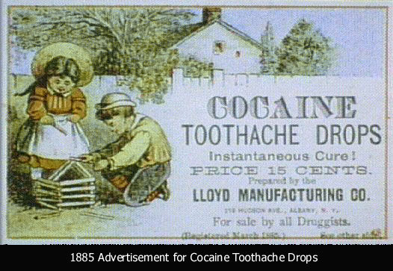

Slide 67
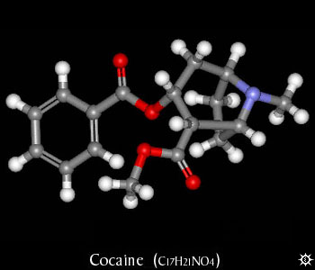
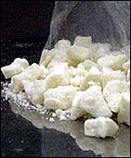
Cocaine
Forms of cocaine:
Free base
Crack
Routes of use:
Intranasal
Intravenous/SC
Crack cocaine
Notes:
Top photograph taken from www.erowid.com
Second photograph reference to follow.

Slide 68
Cocaine
History: Derived from Erythoxylum coca
Dates back almost 2000 years
Exported to Europe in 1580
Isolated as the active ingredient in 1860
Use became widespread by the end of the nineteenth century (Sigmund Freud amongst others)

Slide 69
Cocaine - recent trends
Use among IDU has sharply increased:
41% in 1996
67% in 1999
Cocaine supplanting amphetamines as the stimulant drug of choice
Recent inner city trend to inject 20+ times per day (due to short half-life) with high risk of viral infections:
Hep C, HIV
Notes:
References to follow.

Slide 70
Cocaine users - patterns of use
Typically aged in the twenties
Two common patterns of cocaine users:
Lower SES, unemployed, with low levels of education. Inject cocaine, use it as often as possible and inject other drugs
Higher SES, employed and use intra-nasally

Slide 71
Cocaine: Acute toxicity
Resembles that of amphetamines
Respiratory
includes non-cardiac pulmonary oedema
Vasoconstriction:
Myocardial infarction: a common cause of MI in young people
CNS: seizure, stroke, other
Rhabdomyolysis

Slide 72
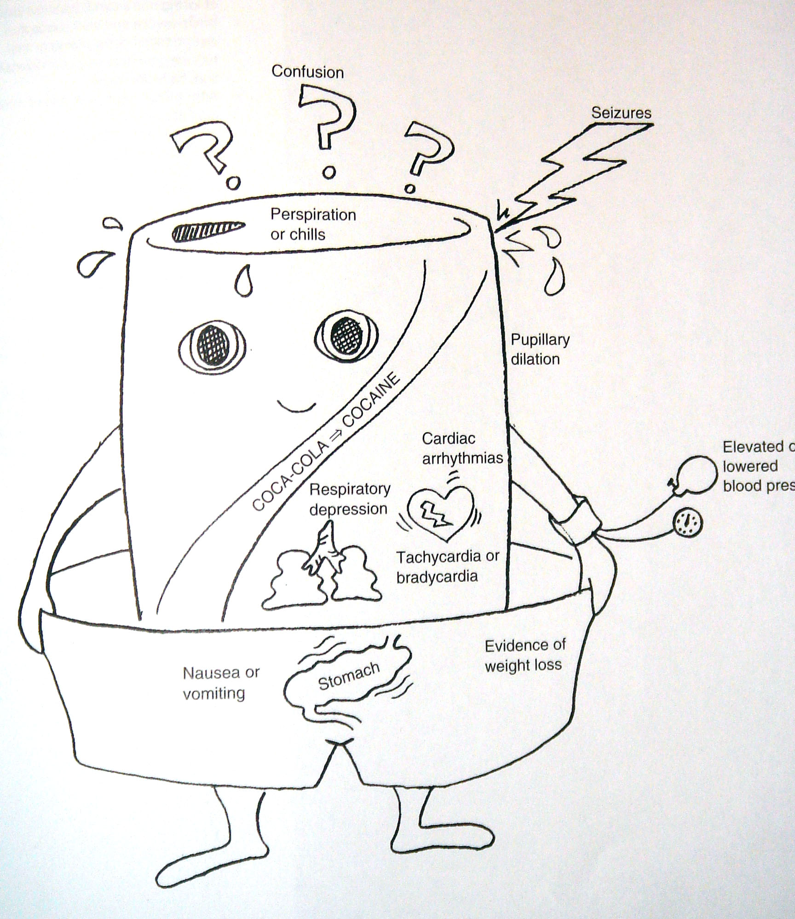

Slide 73
Cocaine
Mechanism of action: Cocaine is an effective blocker of dopamine, serotonin and norepinephrine uptake. It is also a local anesthetic.
Effects: Release of dopamine in the critical reward centers in the basal ganglia.
It produces a rapid euphoria, a strong sense of reward, decreased fatigue, and the enhancement of a variety of sensations including sexual arousal.
Cocaine is frequently included with other drugs of abuse, especially heroin

Slide 74
Cocaine
Clinical Uses: Cocaine is still used as a topical anesthetic in opthalmic applications.
Toxicity: Death occurs from hypertensive crisis, arrhythmias, seizures or respiratory depression. Cocaine use is associated with profound dependence and tolerance.

Slide 75
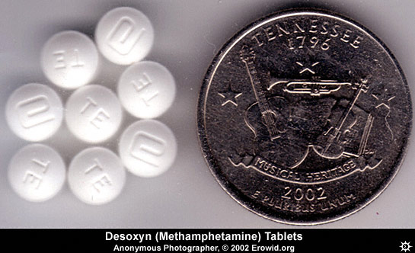
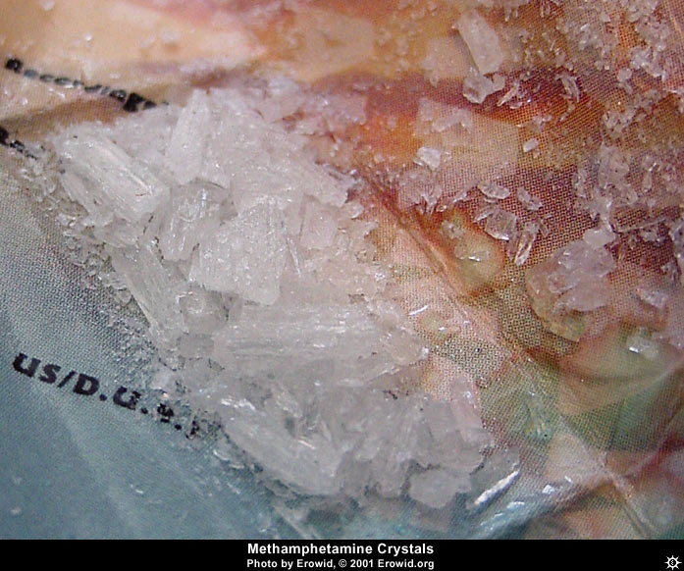

Slide 76
Introduction
4% of the U.S population used psychostimuants in 2000
Age group - 18 to 25 then 12 to17
Occurs in all socioeconomic groups
DSM-VI lifetime prevalence of amphetamine dependence is 1.5 percent
Classic Amphetamine drugs include >>> dextroamphetamine, methamphetamine and methylphenidate
Other amphetamine like substances include >>> ephedrine, psuedoephidrine and phenylpropanolamine (PPA)

Slide 77
Methamphetamine/Amphetamine
History
Amphetamine was synthesized in 1887, but not introduced commercially until 1932. Methamphetamine was synthesized in the 1920's and introduced into clinical practice a decade later.
The inclusion of dexamphetamine in nasal decongestants lead to abuse, becoming apparent in the 1940's.
Amphetamines were also widely used as appetite suppressants
Amphetamine was used by the military in several wars for the stimulant effects, and this propagated the use and abuse.

Slide 78
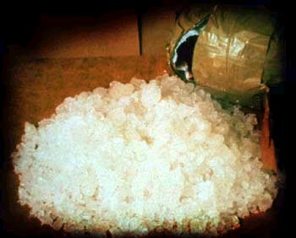
Amphetamines
Ice
L-amphetamine Benzedrine; Speed
D-amphetamine Dexedrine; Speed
Methamphetamine Methedrine; Shabu, Crystal, Ice
MDMA Ecstasy, Pills
Notes:
Photograph acknowledgement to follow.

Slide 79
Captagon (Fenethylline)

Slide 80
Neuropharmacology
Amphetamines are absorbed rapidly orally, and have a rapid onset of action, usually within 1 hour
Can also be taken intravenously and inhaled (snorting)
Amphetamines produce their effect by the release of catecholamine, particularly dopamine from presynaptic terminals
Amphetamine causes the release of catecholamine (dopamine and norepinephrine) and serotonin

Slide 81
Use and toxicity
Uses: Amphetamines have been used as stimulants and diet aids. Some are still used in attention deficit disorder (e.g. methylphenidate, or Ritalin).
Toxicity: Neurochemically, amphetamines have been shown to damage dopaminergic neurons, manifested by a prolonged depletion of neurotransmitter. This has been shown in humans as well. Hyperthermia is a consequence of amphetamine injection, and seems to be necessary for the expression of injury. Fatalities from amphetamine overdose are rare.
Other agents: There are a number of amphetamine-like agents. Khat is a natural product with amphetamine-like properties.

Slide 83
Amphetamine, pemoline and methylphenidate have certain therapeutic uses:
ADHD
Narcolepsy
Depression
Obesity
These substances are abused to increase performance and achievement and to induce euphoria - they are commonly abused by people who desire attentiveness and wakefulness:
Students studying for exams
Long-distance truck drivers
Athletes in competition
Business people with important deadlines

Slide 84
Other uses for amphetamines
Globally and historically, probably most common use crosses social and occupational boundaries
 | Driver | Student | Women | Sports
Euphoria | + | + | + | +
Energy | ++ | ++ |  | ++
Concentration | ++ | ++ |  | ++
Reduction of hunger |  |  | ++
Sexual function/ libido |  |  | ++

Slide 85
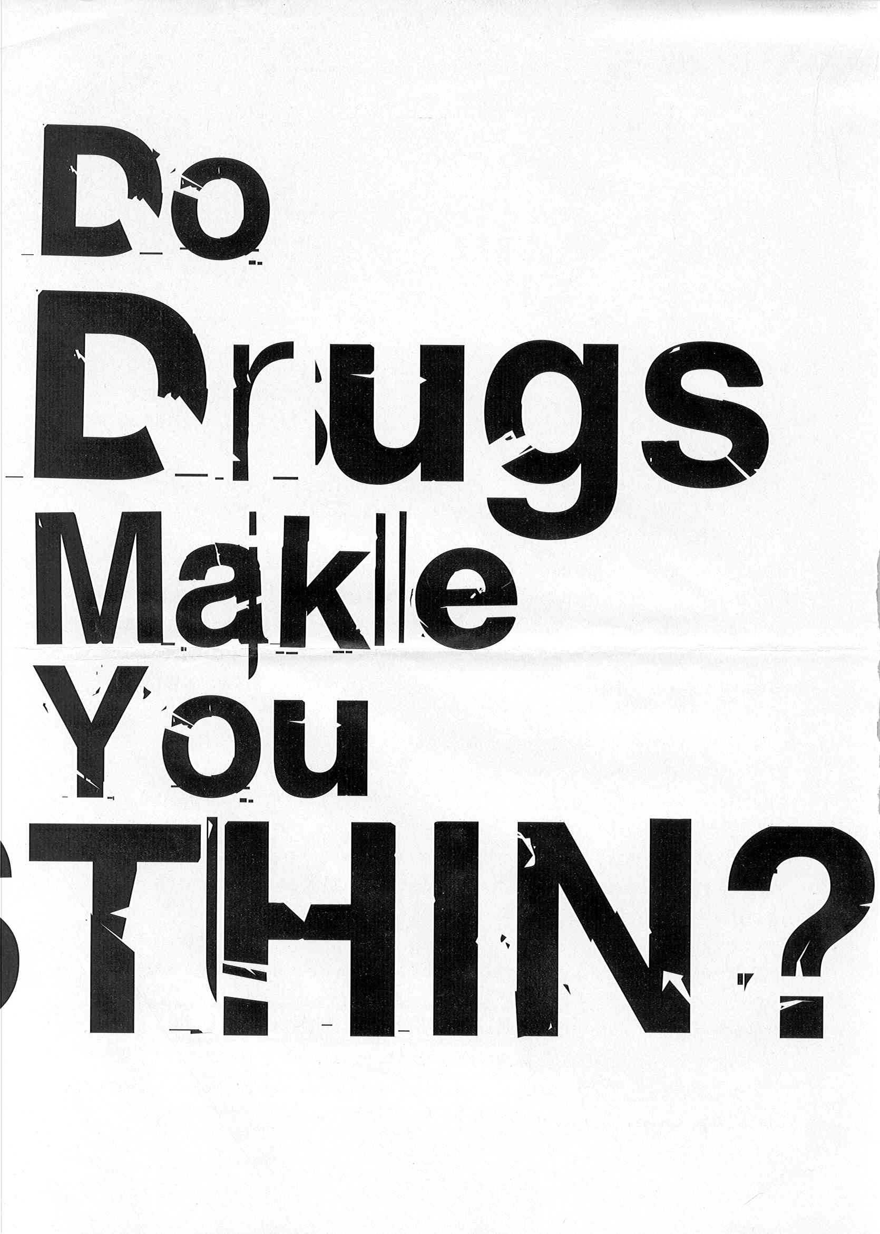
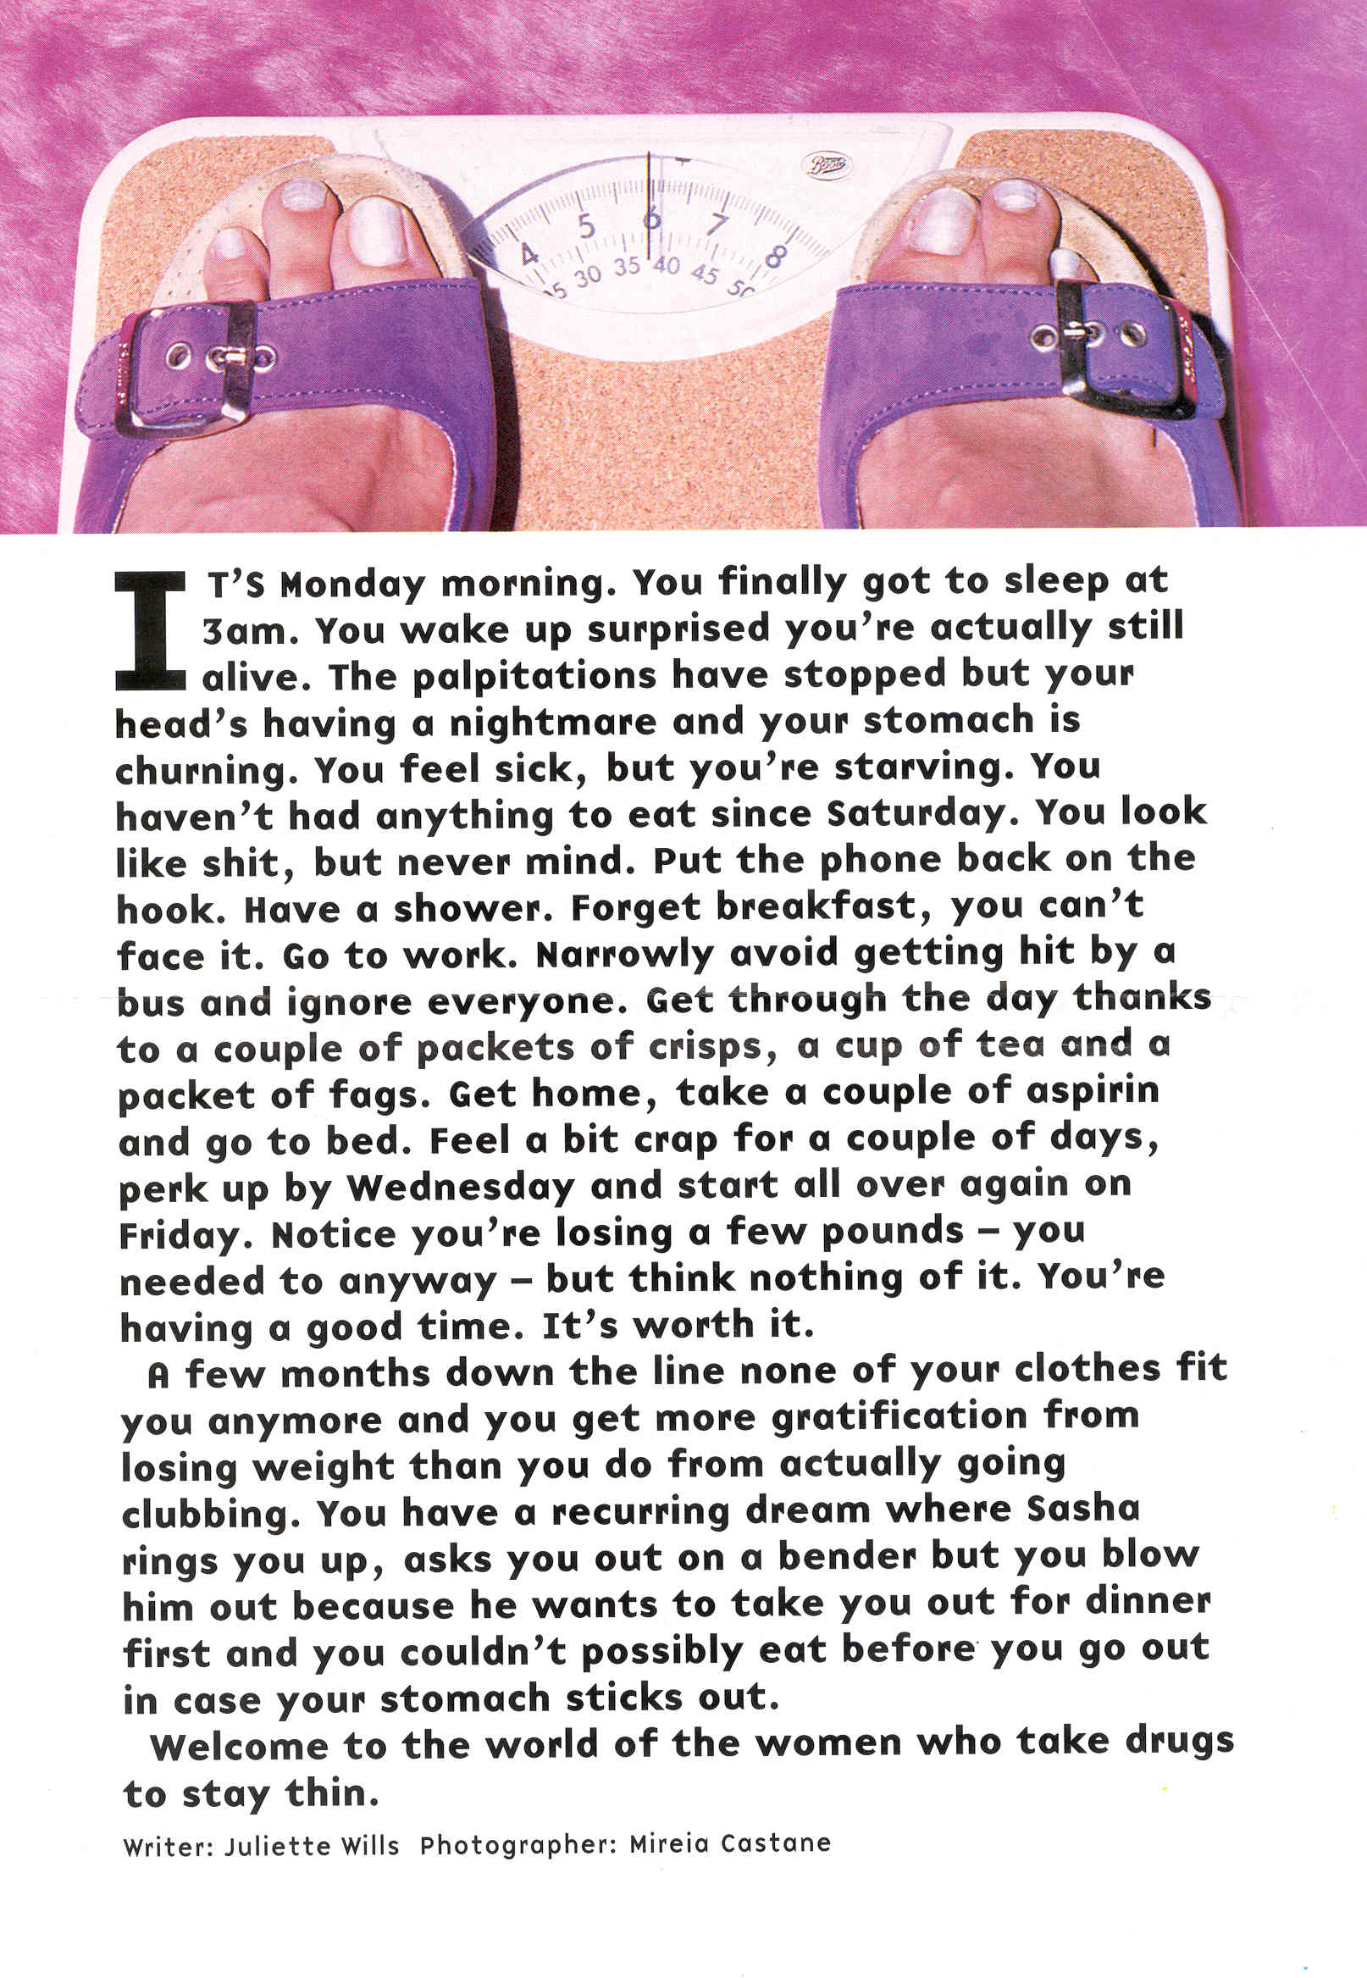
Notes:
Reference to follow.

Slide 86
Mechanism of action
Mechanism of action: Drugs of this class are indirectly acting sympathomimetics that appear to act by releasing catecholamines from nerve terminals.
Peripheral effects are probably attributable to norepinephrine release, while the profound behavioral effects result from dopamine release.

Slide 87
Behavioral effects
Amphetamines produce an initial rush (sometimes described as an “orgasm-like” reaction) followed by euphoria and mental alertness that is quite sustained (more so than cocaine). There is a pattern of repeated self-administration that can culminate in a paranoid schizophreniform psychosis. The typical prolonged high is followed by a rebound depressive effect.

Slide 88
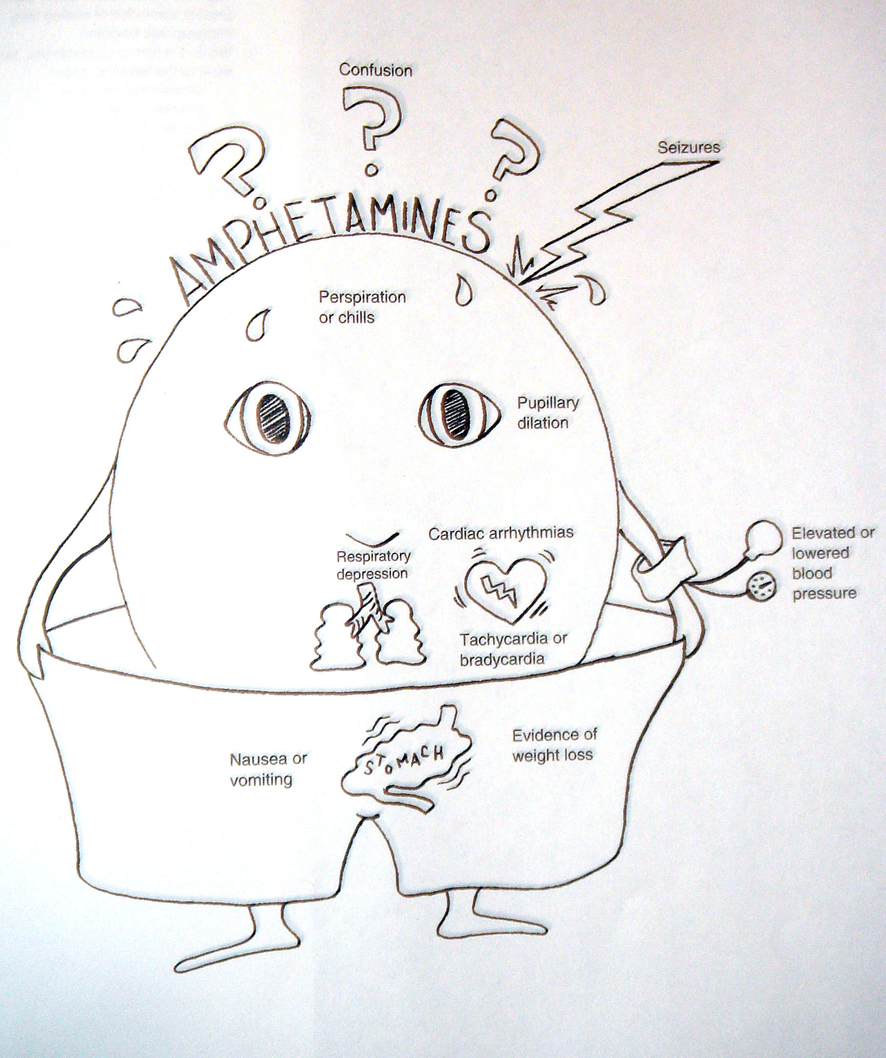

Slide 89
Amphetamine withdrawal
Cessation or reduction of amphetamine after prolonged use
Dysphoric mood and two or more of the following, within few hours to several days:
Fatigue
Vivid unpleasant dreams
Insomnia or hypersomnia
Increased appetite
Pychomotor agitation or retardation
Impairment in function
- Not due to general medical condition or other mental disorder

Slide 90
Symptoms of intoxication usually resolved in 24 hours and are completely resolved in 48 hours
Withdrawal symptoms peak in 2-4 days and are resolved in 1 week
The most serious withdrawal symptom is depression that can be associated with suicidal ideation
Other symptoms include, anxiety, headaches, nightmares and muscle cramps

Slide 91
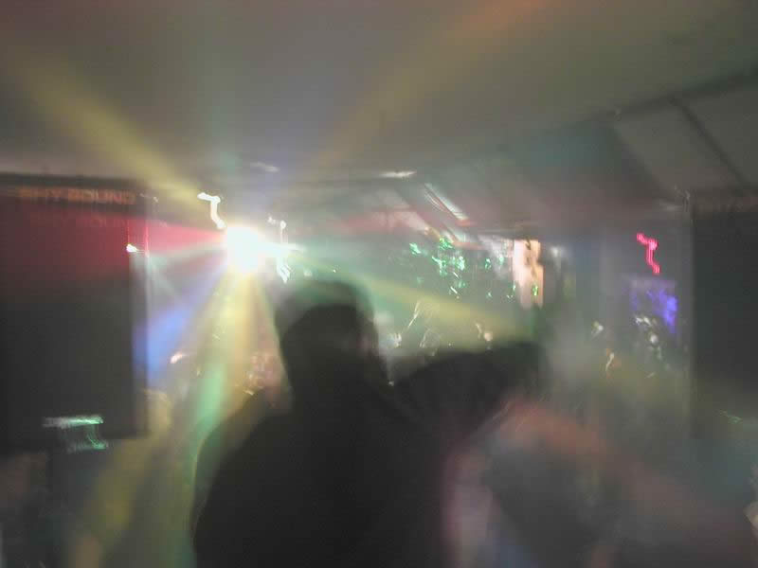
Why do people take party drugs?
Achieve desired effects:
Stimulants: sense
of energy, euphoria,
alertness, increased
libido
Hallucinogens: altered mood or perception
Other reasons: risk factors (eg psychiatric illness), peer pressure, curiosity, rebelliousness
Notes:
Photograph acknowledgement to follow.

Slide 92
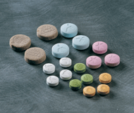
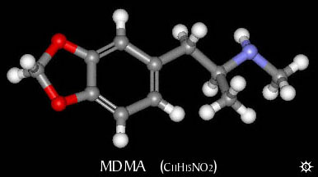
MDMA (‘Ecstasy’)
Notes:
Graphic taken from www.erowid.com
Acknowledgement for photograph to follow.

Slide 93
Management of acute intoxication
Uncomplicated intoxication may only require observation and monitoring of temperature and agitation
Strategies to promote cooling are recommended
Sedation may be necessary if cooling measures fail or if the patient is showing signs of psychosis or is highly agitated
The use of benzodiazepines has been recommended for the management of psychostimulant toxicity

Slide 94
Rx. of intoxication:
Sedation
Antiarrhythimic drugs
Management of hyperpyrexia
Antipsychotics (to control psychosis)
Urine identification
Rx of withdrawal:
Psychosocial intervention
Sedatives to reduce distress associated with severe withdrawal and agitation
Antidepressants may be needed
Physician should establish therapeutic alliance with patient to deal with underlying depression or personality traits.

Slide 95
Summary: Rx of psychostimulant misuse
Infrequent use is widespread and increasing, mostly no major harms result
More frequent, harmful and dependent use can result in harm across several domains
Brief intervention can be useful
Psychological treatment modestly effective
Co-morbid disorders need identifying and treating
New pharmacotherapies may offer future benefits

Slide 96
Hallucinogens
These are group of substances that induce hallucination and produce loss of contact with reality
Natural and synthetic substances that are also called psychedelics or psychotomimetics
Natural e.g. psilocybin (magic mushroom) or synthetic like lysergic acid diethylamide (LSD)
No medical use and high abuse potential

Slide 97
Different Types of Psychedelics
Serotonergic
LSD
Psilocybin/Psilocin
DMT - Ayahuaca
Bufotenine
Ololiuqui
Catecholamine-like
Mescaline
MDMA (ecstasy)
MDA
MDE
DOM
Myristin and Elemicin
Cholinergic
Muscarine
Scopolamine
Glutamatergic
PCP
Ketamine
Dextromethorphan
Opioid
Salvinorin A

Slide 98
Neuropharmacology
Most are well absorbed after oral ingestion, although some can be ingested by inhalation, smoking or IV injection.
Act on the serotonergic system, either antagonist or agonist.

Slide 99
Clinical effects
Psychological | Physical
Marked perceptual distortion (changing shapes and colors) Hallucination (visual and tactile) False sense of achievement and strength Euphoria, anxiety, panic Paranoid ideation Homicide and suicide tendencies Flashbacks Delirium | Tachycardia Hypertension Cerebellar signs Wide pupils Hyperemic conjunctiva Blurred vision Hyperthermia

Slide 100
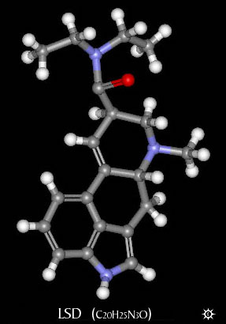
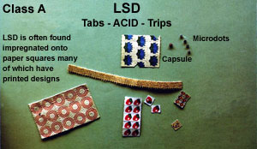
Lysergic Acid Diethylamide (LSD)

Slide 101
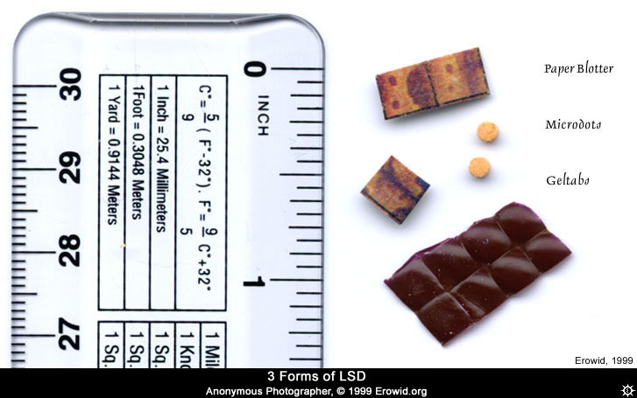

Slide 102
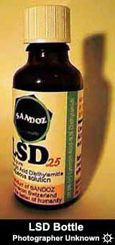
Pharmacology of LSD
Pharmacological Effects
Effects heavily dependent on dose taken
not just intensity of effects, but type of effects
Low doses = mild perceptual alterations
comparable to effects of marijuana use, but greater clarity

Slide 103
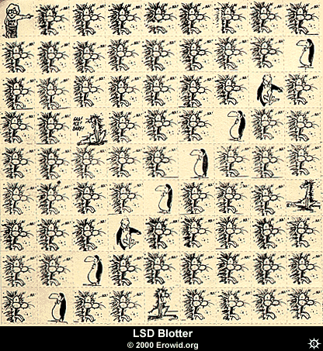
LSD & Neurotransmission
Binds to 5-HT2_{A} receptors
agonist effect
Increases amount of sensory information getting to cortex through overriding filter mechanisms
This is how the drug influences perception, especially for vision

Slide 104
Effects of LSD
Effects of drug come on in about 30 min
first signs are autonomic activation
followed by overt behavioral signs - loosening of emotional inhibitions
giddiness, laughter for no reason
mood euphoric and expansive, but labile mood swings notable
abnormal color sensations, luminescence
colors reported as more brilliant

Slide 105
Effects of LSD
space and time disorders
added depth with loss of perspective - up/down altered
close in space influenced more than distant
general slowing of time reported

Slide 106
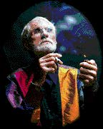
Effects of LSD
High Doses
progression through mental and emotional experiences
6-12 hrs duration
Each trip unique, highly dependent upon setting and personal expectations
Can alter subjects’ emotional feelings during trip by experimenter’s previous behavior
warm and supportive or suspicious and nonsupportive

Slide 107
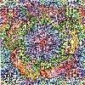
LSD Hallucinations
gratings, latticework, honeycomb, chessboard,
tunnels, funnels, alleys, cones, vessels, and spirals
can be present with eyes open or closed
involve bright light in center with figures moving in from periphery
forms appear to move in depth and take on color shades, red common
Sounds can take on visual forms
music may take on enhanced meaning or intensity

Slide 108
LSD & Bad Trips
Psychological impact - traumatizing, imagery dark, insights appalling
Usually occur in novice users, feel out of control
Generally negative set and setting are key contributing factors
Can lead to suicide or prolonged psychotic reaction
Can usually be talked down from a bad trip

Slide 109
LSD & Flashbacks
Spontaneous recurrence of trip after period of normalcy
can occur after long periods of abstinence
more common after multiple high dose use
prolonged afterimages for days and weeks after
tripping mechanism unknown
can be brought on by other drugs or setting
most commonly reported in low light situations
not intrinsically dangerous and usually go away

Slide 110
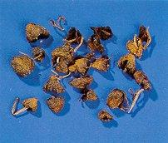
Psilocybin/Psilocin
Magic Mushrooms, Liberty Caps
Central America and northwestern U.S.
Last about 6-10 hours
Need a lot to get same effect as LSD
5-HT2_{A} agonist
Same basic effects as LSD
Mushrooms occasionally toxic

Slide 111
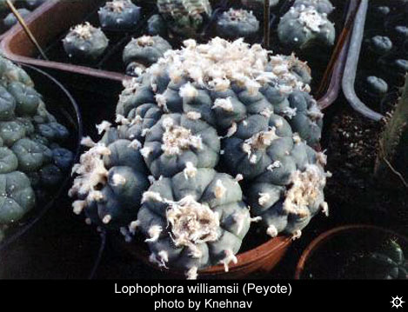
Mescaline
Active drug in peyote
Structurally similar to NE
However, most of the effect is mediated by 5-HT2_{A} agonist action
Legal for members of the Native American Church

Slide 112
Phencyclidine (PCP)
NMDA receptor antagonist
Blocks the function of glutamate
Used as an analgesic and anesthetic
Can be administered by any route
Induces amnesia and true psychosis
Hallucinations, paranoia, agitation, dissociation
Higher doses lead to stupor, coma seizures, death

Slide 113
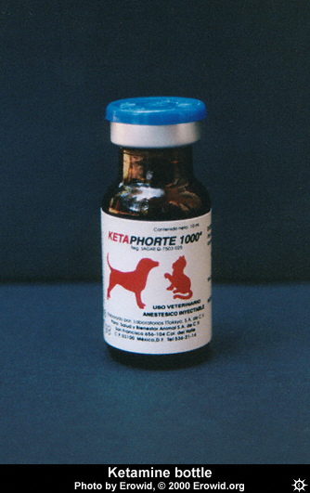
Ketamine
Special K
Very similar to PCP, not as powerful
Liquid, but can be powdered for snorting or smoking

Slide 114
Subjective Effects of PCP/Ketamine
Sensations of light coming through the body and/or colorful visions
Complete loss of time sense
Bizarre distortions of body shape or size
Altered perception of body consistency
Sensations of floating or hovering in space
Feelings of leaving one’s body
Visions of spiritual or supernatural beings
Emotions ranging from euphoria to hositlity
Dalgarno & Shewan (1996)

Slide 115
Dextromethorphan
Active ingredient in most OTC cough medicine
NMDA receptor blockade at high doses
Mostly teenage males abuse it
Like PCP and K at 20-30 X OTC dose

Slide 116
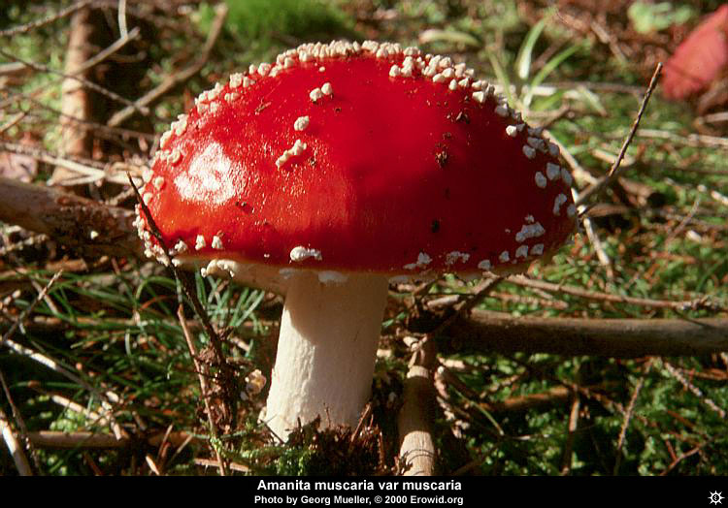
Muscarine
Acetylcholine agonist (muscarinic receptors)
Found in mushrooms (Amanita Muscaria)
Trance-like, dreamy state with visual hallucinations
peripheral effects: sweating, limb twitching, seizure activity
potent hallucinogen, induces actual hallucinations

Slide 117
Tolerance/Dependence
Not significant producers of tolerance or dependence
No withdrawal either
Problems related to the things people do while under the influence
Accidents
Suicide
Aggression/violence
Toxic reactions

Slide 118
Hallucinogen intoxication
DSM-IV criteria:
Recent use
Significant maladaptive behavior and psychological changes
Perceptual changes in full wakefulness and alertness.
Two or more of the following, during use :
- pupillary dilation - tachycardia
- sweating - palpitation
- blurred vision - tremors
- incoordination
Not due to a general medical condition or other mental disorder

Slide 119
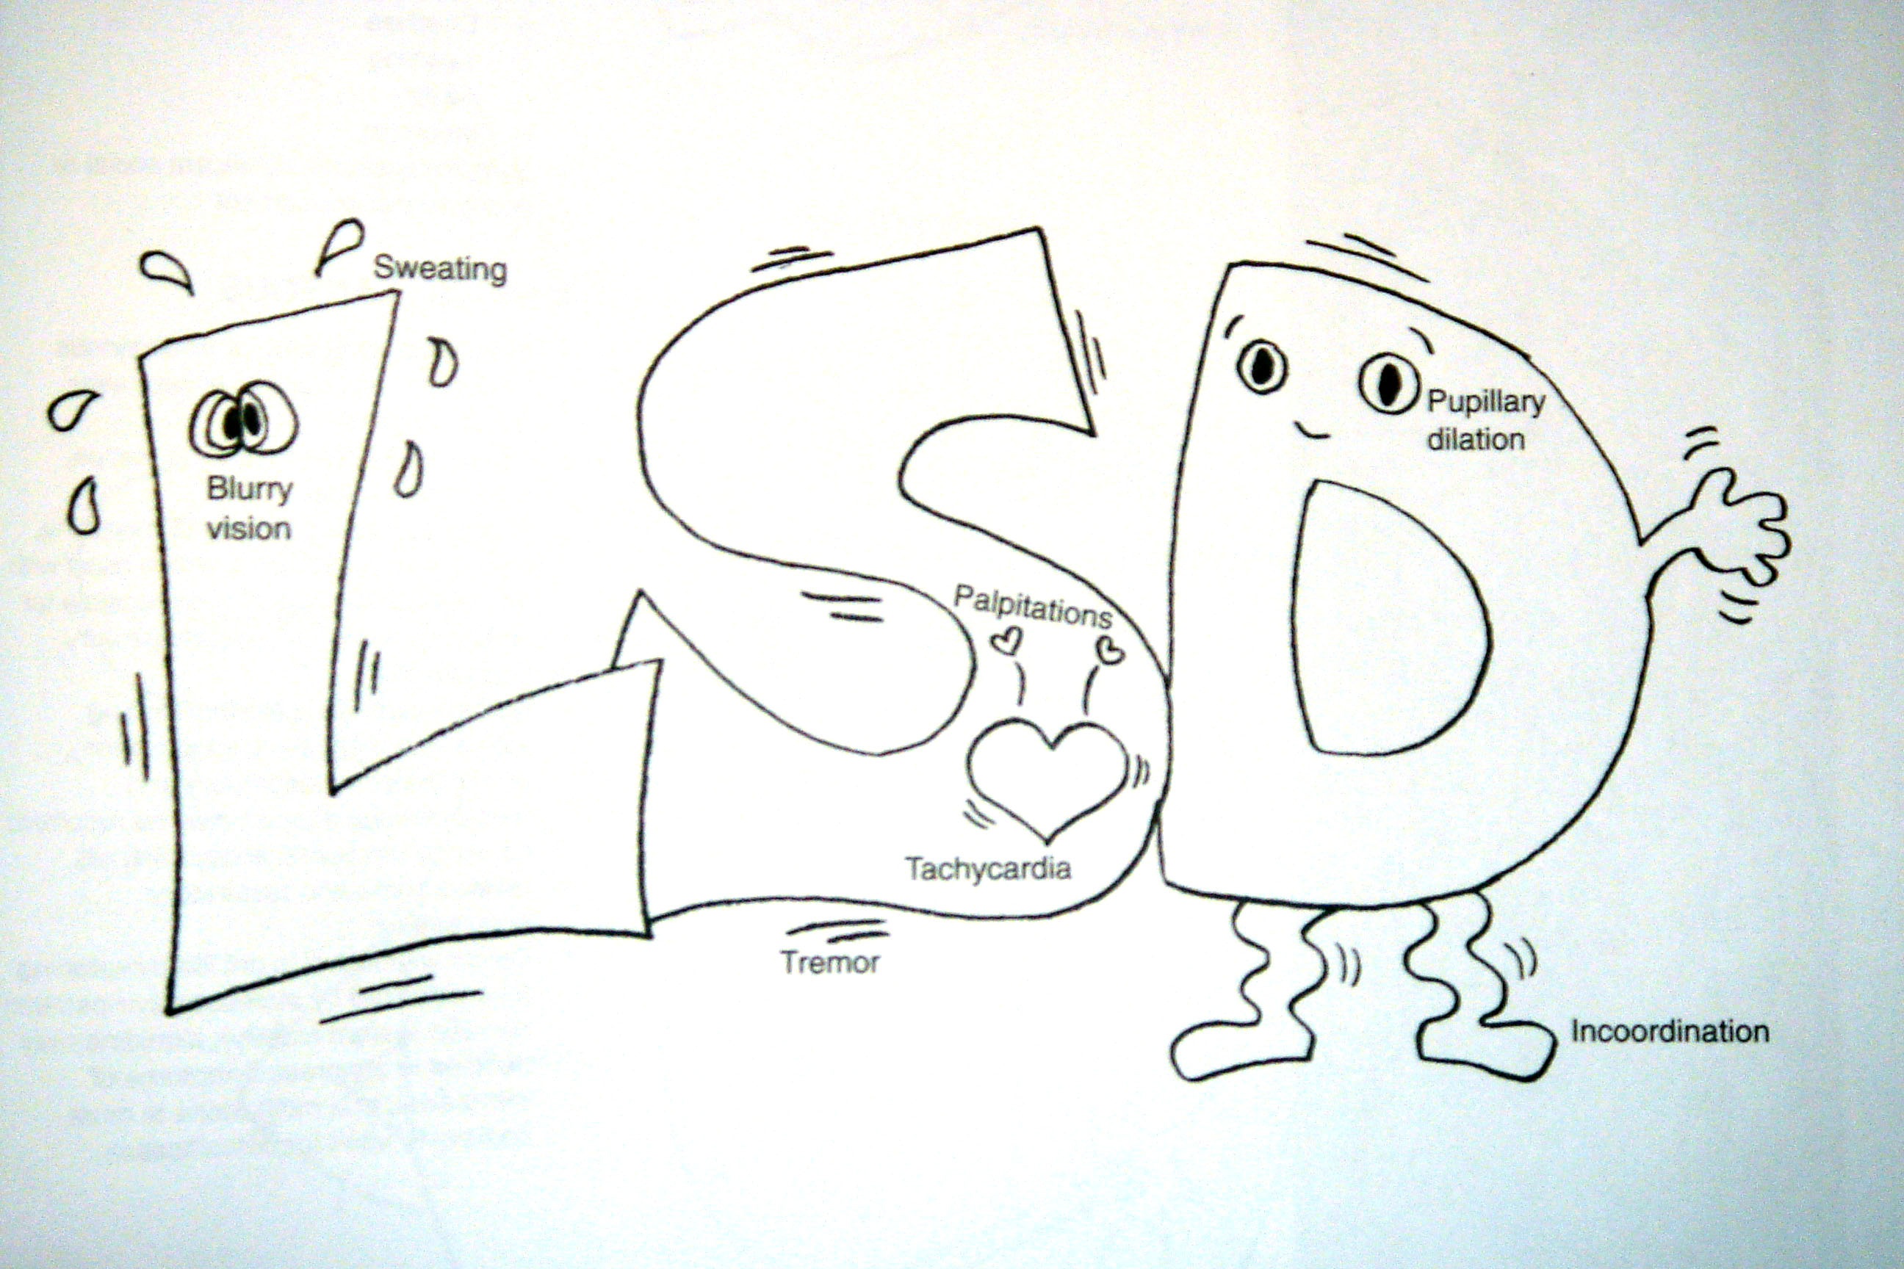

Slide 120
Treatment of intoxication:
Talking down the patient, where guides can reassure the patient that symptoms are drug induced and he is not going crazy
Dopaminergic antagonist, eg. Haldol, can be used for a limited time.
Benzo, diazepam 20 mg can bring the LSD experience down and bring the associated panic into a halt

Slide 121
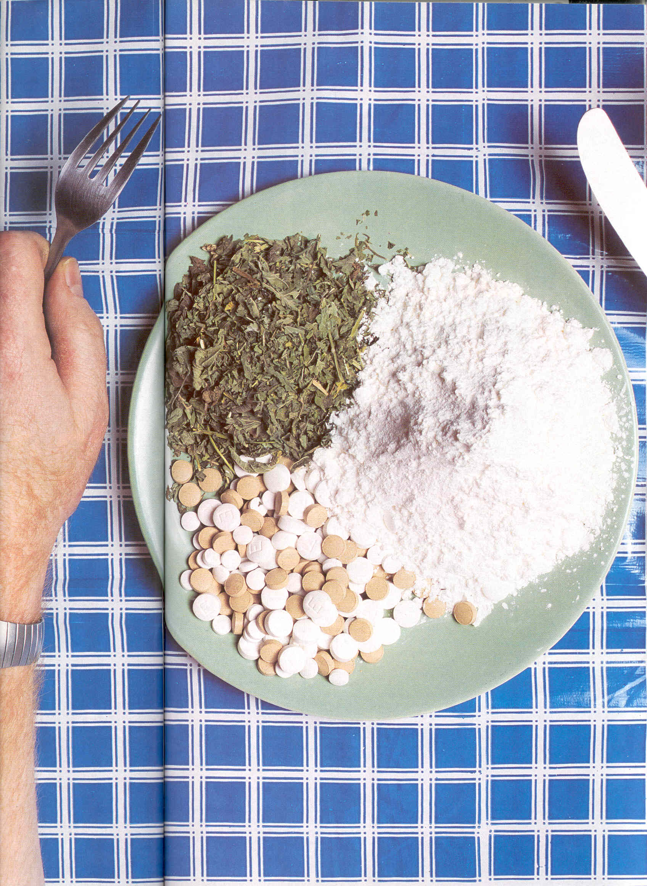

Slide 122
NICOTINE

Slide 123
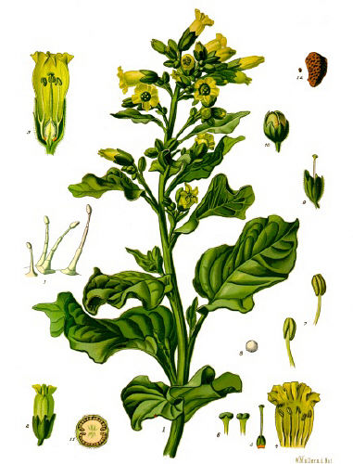
Nicotine
Source: Tobacco
Stimulates nicotinic Ach receptors
Enhances cortical activity, memory and attention
Activates neuromuscular junction
Stimulates DA activity in Nucleus Accumbens
Is clearly addictive

Slide 124
Introduction
In 1988, The Surgeon General Report: stated that nicotine is an addicting drug
Decreased from 44% in 1964 to 29% in 1995.
The fact that 29% of those people continue to smoke in spite of the data showing dangerousness and addictive properties of nicotine.
About 60% of the direct health care costs in USA go to treat tobacco-related illnesses.

Slide 125
Epidemiology
WHO estimates 1 billion smokers worldwide.
Tobacco is the most common form..
Kills more than 3 million people each year.
Age:12-17y about 20% (4.5 million)
Race & Ethnicity: no significant differences.
Gender: men higher than women (among adults); similar in ages 12-17y.

Slide 126
Epidemiology
Region & Urbanicity: similar
Education:
37% of adults who had not completed high school smoked cigs.;
only 17% of college graduates.
*Psychiatric Patients:
50% of all psych. outpatients
70% of BPI
90% of schizophrenics
Anxiety & depressive patients…

Slide 127
Physical health affect
Death is the primary adverse effect.
Approximately 400,000 premature deaths each year in USA. (25% of all deaths)
The causes; chronic bronchitis, emphysema, bronchogenic cancer, MI, CVA, CVD
App. 30% of all cancer in USA.

Slide 128
Nicotine
CNS stimulants, agonist at the nicotinic subtype of Ach receptors and activating DA and NE. & a skeletal muscle relaxant.
Why people like smoking? improved attention, learning, reaction time, and problem - solving ability.
Withdrawal features ( peak in 1-2 days, few weeks):
irritability * frustration * poor concentration
insomnia * dysphoric mood * increase appetite.
Smoking causes cancer of the lung, upper respiratory tract, bladder, pancreas, oesophagus and probably kidney and stomach.
Cigarette smoking can induce liver microsomal enzymes and reduce plasma concentrations of antipsychotic agents.

Slide 129
Neuropharmacology
Psychoactive component → nicotine ↔ CNS agonist at nicotinic subtype of ACh receptors
About 25% of nicotine inhaled reach the brain in 15 sec.
Half life → 2 hours.
Positive reinforcing and addictive properties due to activating the dopaminergic pathway.
Activation of reward system.
Nicotine → ↑conc. of circulating Norep. & Epine also its ↑ the release of vasopressin, β-endorphin, adrenocorticotropic (ACTH) & cortisol.

Slide 130
DSM-IV Nicotine Withdrawal
A-Daily use (weeks).
B-Abrupt cessation (24hrs) followed at by least 4 of following:
1-dysphoric or depressed mood.
2-insomnia.
3-irritability.
4-anxiety.
5-difficulity concentrating.
6-restlessness.
7-decrease heart rate.
8-increase appetite or weight.
C-The signs significantly cause impairment in social ….
D-Symptoms not due to general medical illness.

Slide 131
Adverse Effects
Highly toxic alkaloid.
Doses of 60mg fatal.
Average cig. delivers 0.5 mg.
In low doses toxicity cause nausea, vomiting, salivation, pallor…...
Weakness, abd. pain …..
Diarrhea, dizziness, headache, increase HR, tachycardia, tremor and cold sweats.
Also associated with confusion , sensory disturbance.

Slide 132
Treatment
A) Psychosocial Therapy:
Behavior therapy is the most widely accepted & well-proven psychological therapy.
B) Psychopharmacological therapy:
1- Nicotine Replacement:
a) nicotine gum.
b) nicotine patches.
c) nicotine nasal spray.
d) nicotine inhaler.

Slide 133
Treatment
2- Non-nicotine medications:
a) Bupropion.
b) Clonidine.
c) Nicotine vaccine.
C) Combined psychosocial & pharmacological therapy:
- Increases quit rates over either therapy alone.

Slide 134
CANNABIS

Slide 135
What is Cannabis (marijuana)?
Cannabis sativa.
psychoactive cannabinoids, (delta9-THC) is most abundant.
From flowering tops of the plants or from the dried, black- brown, resinous exudates from the leaves (hashish).
Common names: marijuana, grass, pot, weed, tea, and Mary Jane.

Slide 136
Epidemiology
In 1995, about 9.8 million people in the USA
4.7% of the population 12 years and older
Most common illicit drug used
Similar trends among both boys & girls, Whites, Blacks and Hispanics
In 2001, a contributing factor in more than 110,000 ER cases
Frequently combined with other drugs, such as crack, cocaine, PCP & formaldehyde, without the user being aware

Slide 137
Epidemiology
High School Seniors and Drugs
During the past 12 months….
85% drank alcohol
40% smoked marijuana
25% used “stimulants”
10% used cocaine
10% used hallucinogens or tranquilizers, or both
5% used barbiturates…
…AND ONLY 5- 10% DIDN’T USE ANYTHING AT ALL

Slide 138
Recent studies
Cannabis Use Linked to Earlier Onset of Psychotic Disorders
Arch Gen Psychiatry. ;February 7, 2011.
Cannabis Use Increases Psychosis Risk and Persistence of Subclinical Psychosis
23rd European College of Neuropsychopharmacology (ECNP) Congress: Abstract S.27.04. September 1, 2010
Casual Cannabis, Alcohol Use Reduces Treatment Efficacy in Adolescents With Major Depression
American Academy of Child & Adolescent Psychiatry 56th Annual Meeting: Abstract 1.41. October 26, 2009.

Slide 139
What are the acute effects?
When smoked, euphoric effects appear within minutes, peak in about 30 minutes, and last 2 to 4 hours.
If ingested, short term effects begin more slowly, usually 0.5 to1h.
After few min. heart begins beating, the bronchial passages relax and became enlarged, and the blood vessels in the eyes look red.
THC activates the reward system - releasing dopamine.

Slide 140
What are the acute effects?
A pleasant sensation, color and sounds may seem more intense, and time appears to pass very slowly, mouth feels dry and he or she become very hungry and thirsty.
After, feels sleepy or depressed.
Impairs ability to form memories, recall events & shift attention from one thing to anther.
THC disrupts coordination and balance.
High doses may cause acute toxic psychosis.

Slide 141
Effect on physical health?
Increases difficulty in trying to quit smoking tobacco.
Red eyes, tachycardia. At high doses: orthostatic hypotension, increased appetite & dry mouth.
Heavy users are at risk for chronic respiratory disease
Also associated with: cerebral atrophy, seizure susceptibility, chromosomal damage, birth defects, impaired immune reactivity, alterations in testosterone conc. & dysregulation of menstrual cycles.
Same carcinogenic hydrocarbons in conventional tobacco.

Slide 142
Treatment and Rehabilitation
Same principles as Rx of other substances of abuse-abstinence and support
Support through individual, family, and group psychotherapies.
Education is cornerstone for both abstinence & support.
Anti-anxiety drug may be useful.
Antidepressant treatment.

Slide 143
Therapeutic use of cannabis
Medical uses found in Chinese medical texts dating to 2500 BC.
In 1941 prescribed legally as an analgesic, anticonvulsant, and muscle relaxant.
Rx in certain cases of neuraesthenia. Recently to treat nausea 2ry to chemotherapy.
Appetite stimulant for AIDS patients & treatment of glaucoma.

