Slide 1
Perioperative Fluid therapy & Blood Components Transfusion
Competent perioperative fluid management is of the utmost importance because Intravascular fluids affect all physiological and biochemical processes essential for life.
The goals of fluid management are
to provide adequate delivery of oxygen to tissues (Fig. 25-1)
and to maintain the environment necessary for proper function of cells and organ systems (Table 25-1).

Slide 2
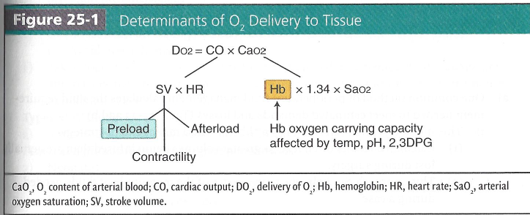
Perioperative Fluid therapy & Blood Components Transfusion

Slide 3
Perioperative Fluid therapy & Blood Components Transfusion
Determinants of O2 delivery to tissue
Generation of flow (cardiac output)
O2 content of blood
Preload and hemoglobin (Hb) are most often manipulated by intravascular fluid therapy (Fig.
A Key assumption is that the vascular system (i.e., vascular auto-regulation and normal endothelial permeability) is intact.
2. FIuid compartments
Circulating blood volume makes up a small percentage of body weight and total body water (Fig. 25-2).)
Yet, one should appreciate the profound influence this small fraction has on homeostasis.
Estimated circulating blood volume should be compared with blood loss during surgery or trauma.
The type and amount of fluid therapy used to treat blood/fluid loss have a greater physiologic effect as the proportion of fluid therapy to circulating blood volume increases.

Slide 4
Perioperative Fluid therapy & Blood Components Transfusion
3) Classical calculation of fluid requirements
a. One common method of perioperative fluid management calculates the fluid requirement needed to meet estimated demands and losses (Table 25-2a and b).
This method is often referred to as a "liberal" fluid management strategy.
(I) Calculated results often lead to greater volumes being infused than are actually lost during surgery.
(2) This approach can help one gain a sense of the magnitude of fluids needed during a case.

Slide 5
Perioperative Fluid therapy & Blood Components Transfusion
(2) This approach can help one gain a sense of the magnitude of fluids needed during a case.
However, evidence from many different surgical populations suggests that following a "liberal" fluid infusion strategy may lead to higher cardiac, pulmonary, renal, gut, and wound complications than more "restrictive" fluid strategies (2).
Thus, the use of classical fluid management results should be done with caution.

Slide 6
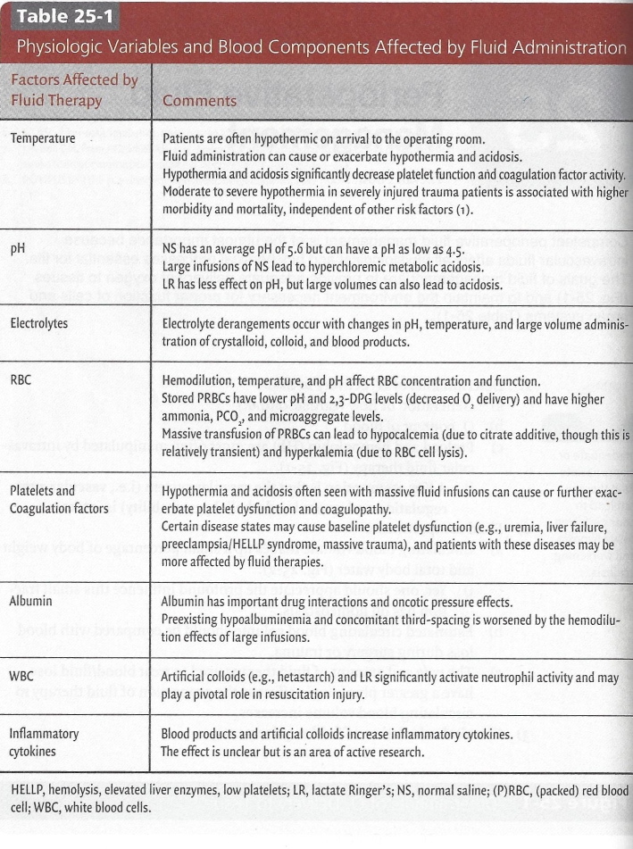

Slide 7
Perioperative Fluid therapy & Blood Components Transfusion
Temperature
Patients are often hypothermic on arrival to the operating room.
Fluid administration can cause or exacerbate hypothermia and acidosis.
Hypothermia and acidosis significantly decrease platelet function and coagulation factor activity.
Moderate to severe hypothermia in severely injured trauma patients is associated with higher morbidity and mortality, independent of other risk factors (1).

Slide 8
Perioperative Fluid therapy & Blood Components Transfusion
pH
NS has an average pH of 5.G but can have a pH as low as 4.5. Large infusions of NS lead to hyperchloremic metabolic acidosis.
LR has less effect on pH, but large volumes can also lead to acidosis

Slide 9
Perioperative Fluid therapy & Blood Components Transfusion
Electrolytes
Electrolyte derangements occur with changes in pH, temperature, and large volume administration of crystalloid, colloid, and blood products

Slide 10
Perioperative Fluid therapy & Blood Components Transfusion
RBC Hemodilution, temperature, and pH affect RBC concentration and function.
Stored PRBCs have lower pH and 2,3-DPG levels (decreased 0, delivery) and have higher ammonia, PCO2,, and microaggregate levels.
Massive transfusion of PRBCs can lead to hypocalcemia (due to citrate additive, though this is relatively transient) and hyperkalemia (due to RBC cell lysis)

Slide 11
Perioperative Fluid therapy & Blood Components Transfusion
Platelets and coagulation factors
Platelets and Hypothermia and acidosis often seen with massive fluid infusions can cause or further exacerbate platelet dysfunction and coagulopathy.
Certain disease states may cause baseline platelet dysfunction (e.g., uremia, liver failure, preeclampsia/HELLP syndrome, massive trauma), and patients with these diseases maybe more affected by fluid therapies

Slide 12
Perioperative Fluid therapy & Blood Components Transfusion
HELLP, hemolysis, elevated liver enzymes, low platelets;
LR, lactate Ringer's;
NS, normal saline;
(P)RBC, (packed) red blood cell;
WBC, white blood cells

Slide 13
Perioperative Fluid therapy & Blood Components Transfusion
Albumin
Albumin has important drug interactions and oncotic pressure effects.
Preexisting hypoalbuminemia and concomitant third-spacing is worsened by the hemodilution effects of large infusions

Slide 14
Perioperative Fluid therapy & Blood Components Transfusion
WBC
Artificial colloids (e.g., hetastarch) and LR significantly activate neutrophil activity and may play a pivotal role in resuscitation injury

Slide 15
Perioperative Fluid therapy & Blood Components Transfusion
Inflammatory cytokines
Blood products and artificial colloids increase inflammatory cytokines.
The effect is unclear but is an area of active research

Slide 16
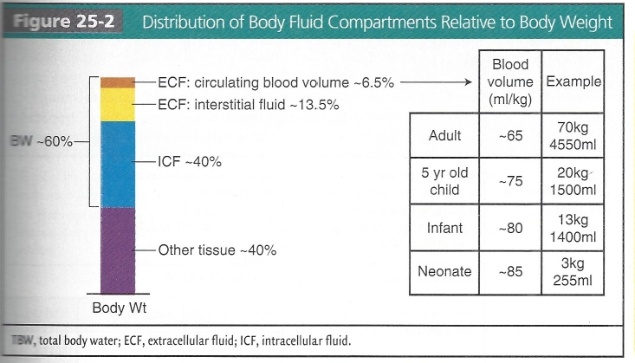
Perioperative Fluid therapy & Blood Components Transfusion

Slide 17
Perioperative Fluid therapy & Blood Components Transfusion
Modern perioperative fluid management
a) The current intraoperative environment requires a sophisticated, individualized approach to fluid management.
b) Clear goals should be used to determine the typea of fluid, the amount, and the method in which it should be given (Fig. 25-3 and Table 25-3).

Slide 18
Perioperative Fluid therapy & Blood Components Transfusion
Modern perioperative fluid management
c) Fixed and dynamic variables influence fluid requirements and include:
Patient
Anesthetic technique and intraoperative course
Type of surgery
d) Different data streams should be used as necessary to gather information.
Functional reserve
Tissue oxygenation
Fluid responsiveness
Other hemodynamic variables

Slide 19
Perioperative Fluid therapy & Blood Components Transfusion
Modern perioperative fluid management
e) One must learn the strengths and weaknesses associated with each monitor.
Avoid over reliance on any one.
f) Taken together, "goal-directed," patient and procedure-oriented fluid management approaches have been shown to decrease morbidity and mortality in a wide range of populations (2-6).

Slide 20
Perioperative Fluid therapy & Blood Components Transfusion
Types of IV fluids
a) See next chapter "Crystalloids and Colloids".

Slide 21
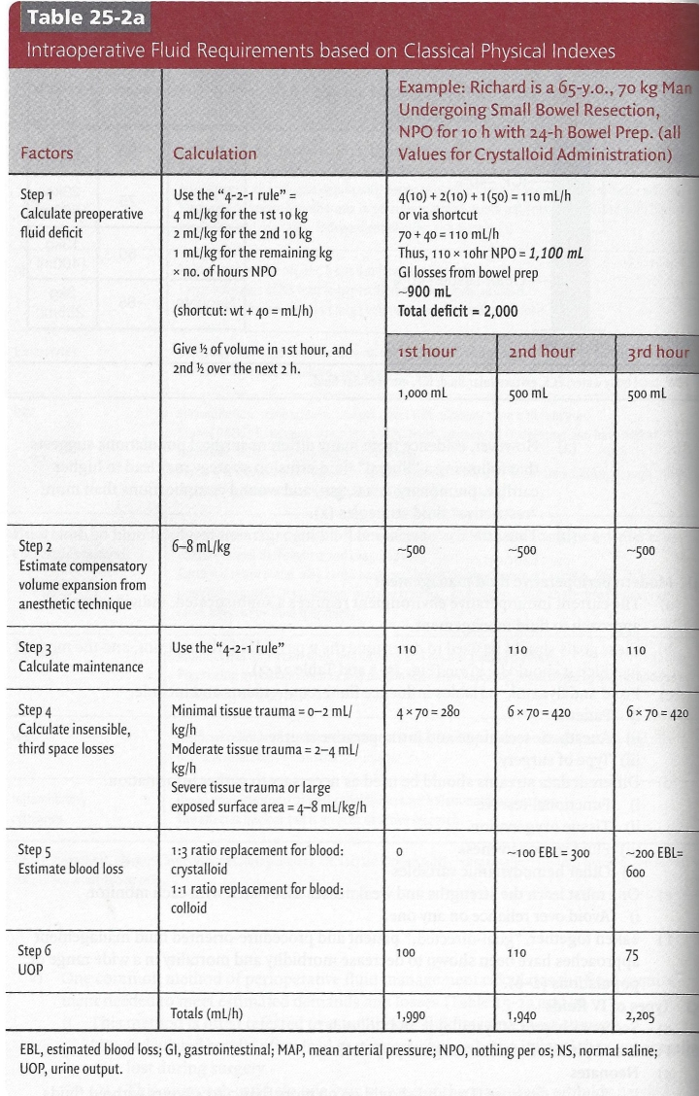
Perioperative Fluid therapy & Blood Components Transfusion

Slide 23
Perioperative Fluid therapy & Blood Components Transfusion
Pearl, and pitfalls for select surgical populations
Neonates
Requires Dextrose (D5) and should go no more than 3 to 4 hours without fluids
Monitor blood glucose level
Limit fluid with a mini-infusion device
Remove all air bubbles from lines to prevent any possibility of air emboli

Slide 24
Perioperative Fluid therapy & Blood Components Transfusion
Pearl, and pitfalls for select surgical populations
Preeclampsia
Patients usually have notable fluid deficits and decreased uretoplacental blood flow .
Despite intravascular volume depletion, these patients are at risk for pulmonary edema.
Randomized-controlled trials to guide fluid management are lacking.
Most practitioners limit crystalloid administration to 1 to 2 L. (
Some use colloid prior to spinal anesthesia.
Arterial BP monitoring should be considered in patients with severe preeclampsia.
Other invasive monitoring (e.g. PA catheter, TEE) may be helpful to guide fluid management in patients with renal failure in the setting of severe preeclampsia.

Slide 25
Perioperative Fluid therapy & Blood Components Transfusion
Pearl, and pitfalls for select surgical populations
Cerebral edema and/or intracranial neurosurgical patients
Dextrose containing fluids are contraindicated because of worse neurological outcome (t0).
Hyperglycemia and oxidative stress leads to increased glycolytic metabolism and toxic derivative production
The optimal level of glucose is unknown, but it is generally accepted that values >18o mg/ dL should be treated with insulin.

Slide 26
Perioperative Fluid therapy & Blood Components Transfusion
Pearl, and pitfalls for select surgical populations
Congestive heart failure (CHF)
Judicious fluid management should be the rule in CHF patients.
Expect third space redistribution to stress the heart in the first 96 hours post surgery.
Consider invasive monitoring and Intensive Care Unit (ICU) post-operative care.

Slide 27
Perioperative Fluid therapy & Blood Components Transfusion
Pearl, and pitfalls for select surgical populations
Acute respiratory distress syndrome (ARDS)
Patients with ARDS may need emergency surgical services.
Fluid restrictive therapy has been shown to reduce morbidity in these patients in the ICU setting (10). However, this study had goals of CVP < 4 mm Hg or PAOP < 8 mmHg, which may be difficult to achieve.
A fluid restrictive approach may be beneficial, but this may be complicated by other factors and conditions.
For example, a septic patient with ARDS who needs an emergent exploratory laparotomy due to necrotic bowel may necessitate more fluid resusciation.
Invasive monitoring should be considered to guide fluid therapy.

Slide 28
Perioperative Fluid therapy & Blood Components Transfusion
Pearl, and pitfalls for select surgical populations

Slide 29
Perioperative Fluid therapy & Blood Components Transfusion
Pearl, and pitfalls for select surgical populations
Lung resection
Although multifactorial in origin, postpneumonectomy pulmonary edema (PPE) rates increase with excessive fluid therapy (3).
Minimize fluids to approximately 1.5 L for an entire case.
Use vasopressors intraoperatively as needed.
Fluid restriction may also be beneficial during the first 72 hours post-operatively.
Blood transfusion should be avoided.
It is linked to worse perioperative pulmonary inflammatory changes and increased risk for PPE.

Slide 30
Perioperative Fluid therapy & Blood Components Transfusion
Pearl, and pitfalls for select surgical populations
Anuric renal failure
These patients are unable to compensate for fluid overload and are often challenging.
Consider invasive BP monitoring with an arterial line.
Central venous access
If deemed necessary, consider consultation with a vascular surgeon before cannulating upper body central veins as these maybe sites for future arteriovenous fistulae (AVF).
No IV catheters or BP cuffs on should be placed on same side as an arteriovenous fistula unless absolutely necessary.
Every effort should be made to protect patients' fistula when anesthetized.

Slide 31
Perioperative Fluid therapy & Blood Components Transfusion
Pearl, and pitfalls for select surgical populations
Liver failure/hepatic transplantation
i)Patients often have multisystem organ dysfunction.
ii) A wide variety of possible complications and comorbidities may be present:
Cerebral edema
Hyperdynamic ventricular function
Cardiomyopathy
Pulmonary hypertension
Hepatopulmonary syndrome
Hepatorenal syndrome
Effective circulating volume depletion
Electrolyte perturbations
Anemia
Coagulopathy

Slide 32
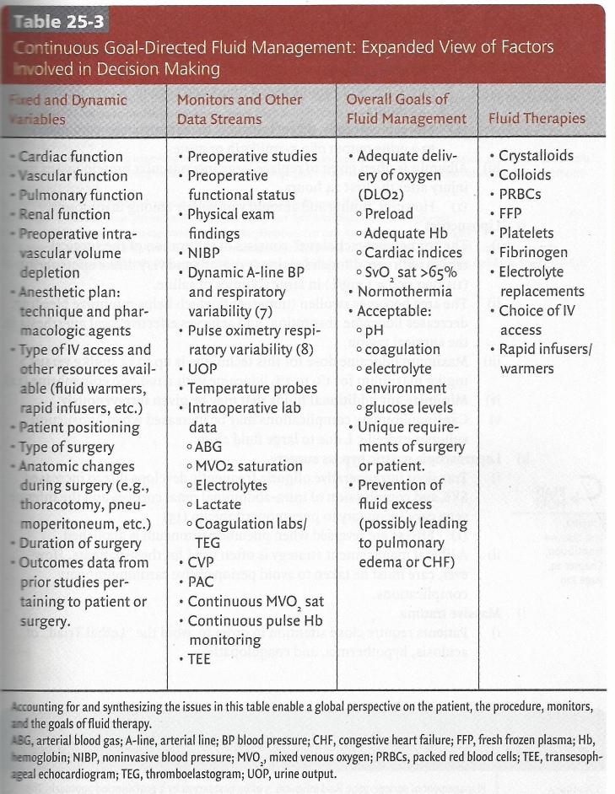
Pearl, and pitfalls for select surgical populations

Slide 33
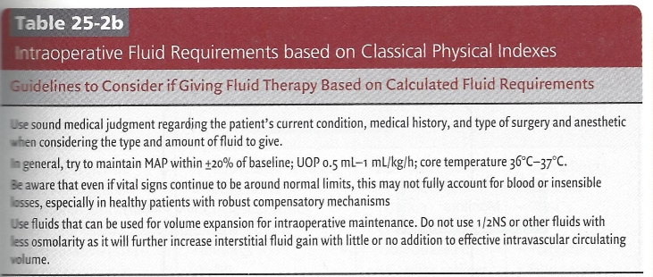
Pearl, and pitfalls for select surgical populations

Slide 34
Perioperative Fluid therapy & Blood Components Transfusion
Pearl, and pitfalls for select surgical populations
Burns
These patients often have massive fluid requirements due to wide-spread loss of epidermal barrier and circulating oncotically active proteins
The Parkland formula is frequently used as an initial guide for fluid requirements for burns >3o% total body surface area:
BSA (use % as whole number not as fraction) x wt (kg) x 4 = total mL over 24 hours.
(a) Give 1/z of volume over 8 hours and second 1/2 over next r6 hours.
More importantly, titrate infusions to hemodynamic parameters or to a urine output of 0.5-1ml/kg/h or more.
Albumin is often given to replace large intravascular protein losses from injury after the first 24 hours.
However, timing and amount vary widely among institutions.

Slide 35
Perioperative Fluid therapy & Blood Components Transfusion
Pearl, and pitfalls for select surgical populations
Liposuction
The "tumescent technique" consists of infiltration of the surgical region with very dilute lidocaine (1 mg/ml) and very dilute epinephrine (1:1,000,000 = 1 mg/L) in large volumes of saline.
The area becomes swollen (tumescent) which helps minimize bleeding, decreases lidocaine absorption, and achieves effective local anesthesia in the surgical region.
Maximum lidocaine dose for this technique is up to 55 mg/kg versus 7mg/kg maximum for 1% to 2% lidocaine with 1:1,000,000 epinephrine .
Minimize any additional fluids that may be given intravenously
Cardiopulmonary complications may be increased when liposuction volumes exceed 5 L due to large fluid shifts.

Slide 36
Perioperative Fluid therapy & Blood Components Transfusion
Pearl, and pitfalls for select surgical populations
Laparoscopic gastric bypass surgery
Transient intraoperative oliguria frequently develops due to increased SVR and compression of intra-abdominal renal cortices and the inferior vena cava secondary to pneumoperitoneum (13)
Effects are reversed when pneumoperitoneum is abolished.
A liberal management strategy is often used for these patients. However, care must be taken to avoid perioperative cardiopulmonary complications.

Slide 37
Perioperative Fluid therapy & Blood Components Transfusion
Pearl, and pitfalls for select surgical populations
Massive trauma
Patients require close attention in order to avoid the "Lethal Triad" of acidosis, hypothermia, and coagulopathy.

Slide 38
Perioperative Fluid therapy & Blood Components Transfusion
Crystalloids and Colloids
Crystalloids and colloids should be thought of not only as volume replacements but also as pharmacologic agents, each with a different composition and physiological effects.
It is these unique properties that have led to decades of research and often heated debates.

Slide 39
Perioperative Fluid therapy & Blood Components Transfusion
Crystalloids commonly used for resuscitation
Crystalloids commonly used for resuscitation (Tables 26-1 and 26-2).
i) Normal saline (NS)
Lower pH, higher osmolarity, and higher chloride content than plasma
Large volume administration (>2 to 3 L) leads to hyperchloremic metabolic acidosis.
This can take hours to days to resolve in patients with acute and/or chronic renal failure.
Lactated Ringers (LR) and Normosol cause less perturbation to chloride and acid-base homeostasis.

Slide 40
Perioperative Fluid therapy & Blood Components Transfusion
Crystalloids commonly used for resuscitation
ii) Lactated Ringers (LR)
The lactate in LR is rapidly converted into pyruvate and shuttled into the Krebs cycle mostly by liver cells.
During severe liver failure or overwhelming lactic acidosis, net conversion is diminished.
(2) LR contains a small amount of potassium.

Slide 41
Perioperative Fluid therapy & Blood Components Transfusion
Crystalloids commonly used for resuscitation
iii) Normosol
Currently, more expensive than other crystalloids but less expensive than colloids.
A reasonable, balanced choice for resuscitation crystalloid for critically ill patients who have severely diminished compensatory mechanisms
Normosol also contains a small amount of potassium.
.

Slide 42
Perioperative Fluid therapy & Blood Components Transfusion
Crystalloids commonly used for resuscitation
iv) Replacement of intravascular volume with crystalloid
Classically, it has been taught that approximately three to four liters of crystalloid (versus only one liter of colloid) should be replaced for every liter of blood loss .
Recent human data has shown that tissue equilibration may be slower than previously thought (20 to 30 minutes after infusion) and that this process is complex and dynamic.
.

Slide 43
Perioperative Fluid therapy & Blood Components Transfusion
Crystalloids commonly used for resuscitation
iv) Replacement of intravascular volume with crystalloid
(iii) Furthermore, robust clinical trial data have shown that titrating crystalloids and colloids to similar hemodynamic goals leads to a crystalloid:colloid ratio of only 1.3 to 1.6:1.0
This ratio is stable over hours to days
.

Slide 44
Perioperative Fluid therapy & Blood Components Transfusion
Additional forms of crystalloid
b) Additional forms of crystalloid are available and have a diverse array of uses.
i) Various mixtures of ¹/2 NS
D5 or 20 mEq/L of KCl may be added.
Used as maintenance fluids before and after surgery
These hypotonic forms provide minimal intravascular volume effect and are usually not used intraoperatively
ii) Isotonic sodium bicarbonate (300 mEq/L) in D5W plus n-acetylcysteine.
May be used to prevent contrast-induced nephropathy
May be superior to saline plus n-acetylcysteine .

Slide 45
Perioperative Fluid therapy & Blood Components Transfusion
Additional forms of crystalloid
iii) Hypertonic 3% or 7.5% Saline
Commonly administered to patients with brain injury to decrease intracranial pressure (ICP).
Thought to osmotically promote outflow of brain interstitial fluid from the enclosed calvaria.
May be more effective than mannitol and has a good safety profile .
Imaging and autopsy studies have not shown evidence of central pontine myelinolysis from this therapy.
Hypertonic saline may be given through a central line as a 250 mL bolus every 6 hours as needed.
Gradually achieve a plasma sodium goal of 145 to 155 mEq/L and an osmolarity of 310 to 320 mOsm/L.
Increase plasma sodium no more than 10 to 20 mEq/ L/24 h.

Slide 46
Perioperative Fluid therapy & Blood Components Transfusion
Additional forms of crystalloid
iv) Highly concentrated 23.4% sodium chloride
May emergently reverse transtentorial herniation and temporize the situation until more invasive interventions can be performed (e.g., craniectomy).
Mechanism of action is similar to lower concentration hypertonic saline administration.

Slide 47
Perioperative Fluid therapy & Blood Components Transfusion
Additional forms of crystalloid
iv) Highly concentrated 23.4% sodium chloride
3) May lead to transient hypotension after initial bolus (i.e., seconds to minutes).
However, heart rate, mean arterial pressure, and cerebral perfusion pressure generally remain stable.
ICP may continue to decrease for up to 24 hours.
4) Given centrally in 30 or 60 mL boluses over 15 to 20 minutes.

Slide 48
Perioperative Fluid therapy & Blood Components Transfusion
Cristalloids

Slide 49
Perioperative Fluid therapy & Blood Components Transfusion

Slide 50
Perioperative Fluid therapy & Blood Components Transfusion
Colloids
Colloids
a) Provides oncotic pressure effects in addition to volume.
b) Can be further classified as protein or nonprotein colloids.
Protein colloids
Human serum albumin
Modified gelatin solutions
Nonprotein colloids
Dextrans
Hydroxyethyl starches (HES)

Slide 51
Perioperative Fluid therapy & Blood Components Transfusion
Colloids
Colloids commonly used for resuscitation (Table 26-3)
i) Albumin
The most expensive resuscitation fluid with the exception of blood products.
Well tolerated, and not associated with anaphylaxis, increased infection, or coagulopathy (aside from hemodilution effects) even at high volumes
ii) Gelatins
Not sold in the United States
Similar in safety to albumin but with much shorter effects (3-6 hours)

Slide 52
Perioperative Fluid therapy & Blood Components Transfusion
Colloids
Dextrans
Have plasma expanding volume effects.
Also have robust anticoagulant properties.
They have a low but relatively higher association with anaphylactoid reactions than other colloids .
Currently not used for resuscitation
Dextrans may be used during vascular cases such as free muscle flap transfers to potentially improve perfusion and decrease risk of graft thrombosis.

Slide 53
Perioperative Fluid therapy & Blood Components Transfusion
Colloids
iv) Hydroxyethyl Starch
Available in the United States as medium molecular weight pentastarch (200 kDa) and high molecular weight hetastarch (450 kDa).
Pentastarch is less commonly available due to concerns regarding increased risk of acute kidney injury in diabetic patients.

Slide 54
Perioperative Fluid therapy & Blood Components Transfusion
Colloids
iv) Hydroxyethyl Starch
3. Hetastarch: Generally safe for most patients, although there have been some safety concerns
Clinically idiosyncratic anticoagulant effects may occur in some patients receiving hetastarch in doses >20 mL/kg/d (approximately 1.5 L for a 75 kg patient)
Hetastarch molecules are thought to bind to factor VIII, von Willebrand factor, and fibrinogen.
This leads to decreased function among these factors and a reduction in platelet aggregation
v) Blood products
Have oncotic effects that expand intravascular volume similar to colloids

Slide 55
Perioperative Fluid therapy & Blood Components Transfusion
Colloids
d) Possible benefits of colloids
Require less volume than crystalloids to maintain the same effective arterial circulating volume.
Remain intravascularly for a much longer time period than crystalloids
May lead to less total body and organ edema
Possible greater improvement than crystalloids in myocardial contractility, tissue oxygen tension, and microcirculation in organs such as bowel after anastomosis.
Possible better clinical outcomes during resuscitation, although demonstrating a beneficial effect of colloids on morbidity and mortality has proven difficult.

Slide 56
Perioperative Fluid therapy & Blood Components Transfusion
Colloids

Slide 57
Perioperative Fluid therapy & Blood Components Transfusion
Crystalloids and Colloids
3) Crystalloids versus colloids in primary resuscitation
a) Controversy and the emergence of meta-analyses
Risk and benefit analyses regarding crystalloids vs. colloids are controversial despite more than sixty clinical trials over three decades.
Three issues stand out from the key meta-analyses of trial data
The majority of trials available for analysis were of poor methodological quality. Most are underpowered, poorly randomized, lacking allocation concealment, and/or not double-blinded.
A large percentage of trials analyzed from the literature were performed before 1980 and used outmoded fluid resuscitation strategies. For example, titrating albumin boluses to plasma albumin levels.
Different meta-analyses authors reached different conclusions and recommendations despite overall similar findings.

Slide 58
Perioperative Fluid therapy & Blood Components Transfusion
Crystalloids and Colloids
4) The saline versus albumin fluid evaluation (SAFE) trial
High quality, well powered, multicenter, double-blinded randomized, controlled study.
Designed to address the safety of albumin administration .
Albumin did not confer overall mortality benefit or harm to a large representative group of critically ill patients.
Did not increase or decrease the risk of organ failure, duration of mechanical ventilation, or duration of renal replacement therapy.
A statistically significant increase in mortality in traumatic brain injury patients was observed.
An ad hoc follow-up study showed that this increase involved only the most severely injured (GCS 3-8) patients.

Slide 59
Perioperative Fluid therapy & Blood Components Transfusion
Crystalloids and Colloids
5) Rational use of crystalloids and colloids
a) Crystalloids should usually be the initial fluids used for resuscitation.
i) They are inexpensive, readily available, safe, and effective for intravascular volume replacement in a wide variety of surgical and critically ill populations.
b) Nonprotein colloids maybe considered second line volume agents due to cost and possible anticoagulant effects.
c) Albumin may be considered a third-line agent.

Slide 60
Perioperative Fluid therapy & Blood Components Transfusion
Crystalloids and Colloids
d) Despite being equivalent in terms of mortality and other major endpoints, there continues to be a large gap in our knowledge on what indication is best suited for colloid.
Colloid may be considered if a large amount of crystalloid (>3 to 4 L) has already been given and the patient still appears intravascularly depleted.
Elderly or extremely frail patients (with plasma albumin <2.5 g/dL) might not tolerate large volumes of fluid resuscitation and may benefit from early colloid administration.
Giving albumin in special situations may provide benefits to certain patients such as:
After paracentesis with >4 L of ascites removed.
After plasmapheresis
Resuscitation in the setting of nephrotic syndrome or severe diarrhea with albumin <2 g/dL
The choice to give crystalloid or colloid is only one factor among many other considerations when administering fluid therapy.

Slide 61
Perioperative Fluid therapy & Blood Components Transfusion
Blood Component Therapy
Administration of blood components is often necessary in the perioperative period. Blood component therapy should be used to treat specific indications, bearing in mind the potential complications associated with transfusion. Vigilance is absolutely critical as complications are most often due to human error.

Slide 62
Perioperative Fluid therapy & Blood Components Transfusion
Blood Component Therapy
Pretransfusion testing
When preparing to transfuse blood, draw a blood sample from the patient and send it to the blood bank.
Type and screen
Determines the ABO type and Rhesus (Rh) factor and screen the sample for common antibodies.
ABO type
Determined by cell surface glycoprotein antigens present on the RBC surface
Patients may be type A, B, AB, or O.
Type 0 patients lack type A and B antigens.

Slide 63
Perioperative Fluid therapy & Blood Components Transfusion
Blood Component Therapy
Rh factor
85% of patients have the D antigen from the Rh group and are Rh positive.
Patients who are Rh negative are at risk of alloimmunization (synthesis of antibodies against foreign antigens) when exposed to the D antigen.
Antibody screen
Commercially available RBC are mixed with the patient's blood in order to detect antibodies with the potential to cause hemolysis.

Slide 64
Perioperative Fluid therapy & Blood Components Transfusion
Blood Component Therapy
Type and cross
Cross-matching the blood involves mimicking the transfusion by
mixing the donor's RBC with the recipient's blood.
Ensures compatibility of donor and recipient blood samples.

Slide 65
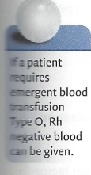
Perioperative Fluid therapy & Blood Components Transfusion
Blood Component Therapy
Time to obtain blood
Type and screen can usually be done within 45 minutes and the cross-match within an additional 15 minutes.
If antibodies are present, these steps can take much longer, especially if the antibodies are uncommon.
Autologous blood donation
If time permits, patients may donate their own blood preoperatively.
Patients who elect to do autologous blood donation may become anemic and require iron and erythropoeitic agents.
Autologous blood should be meticulously handled as human errors still occur with its administration.

Slide 66
Perioperative Fluid therapy & Blood Components Transfusion
Blood Component Therapy
Directed donor blood donation
A family member or friend may be designated by the patient to donate blood which may be used if needed, provided compatibility can be assured.
This technique does not decrease the incidence of transfusion-transmitted infection as the patient may not be aware of the donor's infection status.

Slide 67
Perioperative Fluid therapy & Blood Components Transfusion
Blood Component Therapy
Packed red blood cells (PRBCs)
The purpose of PRBC transfusion is to increase the O2 carrying capacity of the blood.
The decision whether to transfuse PRBC is multifactorial. The patient's coexisting disease and risk of ongoing blood loss should be considered.
For example, a patient with coronary artery disease will likely require transfusion at a lower threshold due to the need to maintain myocardial oxygen delivery.

Slide 68
Perioperative Fluid therapy & Blood Components Transfusion
Blood Component Therapy
c) PRBC transfusion parameters
There is no absolute laboratory value that necessitates blood transfusion.
Transfusion is rarely indicated for hemoglobin concentrations >10 g/ g/dL (I).
Transfusion is usually indicated for hemoglobin concentrations <6 g; dL.
Within the range of 6 to 10 g/dL, the risk of ongoing blood loss and patient's coexisting disease must be considered.
For example, patients with coronary artery disease probably should be transfused at a higher hemoglobin than a young, healthy patient.

Slide 69
Perioperative Fluid therapy & Blood Components Transfusion
Blood Component Therapy
d) In the absence of continued blood loss, one unit of PRBCs should increase the hemoglobin concentration by 1 g/ and the hematocrit by 3%.
e) ABO compatibility
i)ABO blood type is determined by the presence or absence of A and/or B antigens on the surface of the RBC.
Patients who lack either antigen are Type O.

Slide 70
Perioperative Fluid therapy & Blood Components Transfusion
Blood Component Therapy
Patients have circulating antibodies to RBC antigens that they lack.
For example, Type 0 patients have circulating anti-A and
anti-B antigens and Type A patients have anti-B antibodies.
Type specific transfusion is essential. This is because ABO incompatility leads to immediate and potentially life-threatening hemolysis.
Type AB patients are universal recipients, and type O donors are universal donors.
If type specific blood is not available, Type 0, usually Rh negative, blood maybe given.

Slide 71
Perioperative Fluid therapy & Blood Components Transfusion
Blood Component Therapy
Fresh frozen plasma (FFP)
FFP contains all plasma proteins and clotting factors.
Stored at -18°C to -30°C and must be thawed prior to administration
Indications for FFP
Rapid reversal of warfarin therapy
Correction of known coagulation factor deficiencies when factor concentrates are unavailable
Antithrombin III deficiency in patients receiving heparin
Correction of microvascular bleeding in patients who have been transfused greater than one blood volume
Correction of microvascular bleeding in patients with abnormal coagulation parameters (PT > 1.5 times normal. INR> 2.0, aPTT > 2 times normal)

Slide 72
Perioperative Fluid therapy & Blood Components Transfusion
Blood Component Therapy
Indications for FFP
Recent studies in trauma patients who require massive transfusion have shown decreased morbidity and mortality with earlier administration of FFP.
The goal of FFPadministration is to achieve 30% of clotting factor concentration. The starting dose is I0-15 mL/kg.

Slide 73
Perioperative Fluid therapy & Blood Components Transfusion
Blood Component Therapy
FFP
ABO compatibility
Compatibility requirements are different than with RBC because the plasma contains anti-A and/or anti-B antibodies in patients who lack these antigens.
FFP should be ABO compatible.
For instance, a patient with type AB blood should receive only type AB plasma, but a patient with type 0 blood can receive types 0, A, B, or AB plasma.

Slide 74
Perioperative Fluid therapy & Blood Components Transfusion
Blood Component Therapy
Platelets
Platelets are usually available in 6 to g unit equivalents from pooled donors or from apheresis from a single donor.
Must be stored at room temperature, which increases the likelihood of bacterial contamination and decreases shelf life.
One unit usually increases the patient's platelet count by 5 to 10,000 cells/ mm3, while one single donor aphoresis unit increases the platelet count by 30 to 60,000 cells/mm³ in the absence of platelet destruction.

Slide 75
Perioperative Fluid therapy & Blood Components Transfusion
Blood Component Therapy
Platelets
Platelets are rarely indicated if a patient's platelet count exceeds 1,000,000 cells/mm3.
Platelet transfusion should be considered in the presence of excessive microvascular bleeding with platelet counts <50,000 cells/mm.
May also be necessary in the presence of platelet dysfunction (anti-platelet therapy, uremia, post-cardiopulmonary bypass) and microvascular bleeding.
ABO compatibility
Although you can transfuse ABO-incompatible platelets, these cells may have a shorter lifespan than ABO-compatible platelets .

Slide 76
Perioperative Fluid therapy & Blood Components Transfusion
Blood Component Therapy
) Cryoprecipitate
a) Made from slowly thawing FFP
b) Contains high levels of Factor VIII, von Willebrand factor, and fibrinogen
c) Indications
Treatment of microvascular bleeding in the presence of fibrinogen deficiency, which most commonly occurs due to disseminated intravascular coagulation (DIC) or massive transfusion

Slide 77
Perioperative Fluid therapy & Blood Components Transfusion
Blood Component Therapy
) Cryoprecipitate Indications:
Treatment of congenital fibrinogen deficiencies or bleeding in patients with Von Willebrand disease, where factor concentrates are unavailable (I)
Ideally, a fibrinogen level should be obtained before administering cryoprecipitate.
Patients whose fibrinogen concentrations exceed 150 mg/ dL usually do not require cryoprecipitate.
When fibrinogen concentrations are <80 to 100 mg/dL, cryoprecipitate is usually indicated (I).
ABO compatibility
Because cryoprecipitate has only a small amount of plasma, ABO compatibility is not necessary .

Slide 78
Perioperative Fluid therapy & Blood Components Transfusion
Blood Component Therapy
Complications of transfusion
a) Human error
Due to recent advances in detecting potentially infectious agents, complications due to human error are significantly more common than transfusion-related infections.
Catastrophic outcomes during blood product administration are usually associated with multiple errors during the process (5,6).
In order to prevent errors, it is critical that all persons involved in administering blood products exercise extreme caution, including verifying blood samples sent to the lab against a patient's armband and verifying blood prior to transfusion.

Slide 79
Perioperative Fluid therapy & Blood Components Transfusion
Blood Component Therapy
Complications of transfusion
Acute hemolytic reaction
The most serious complication of blood product administration
Usually caused by ABO incompatibility, resulting in an immune reaction by the recipient to the transfused RBC
Signs/symptoms of acute hemolytic reaction
Anxiety, fever, urticaria, nausea, chest and flank pain, hyperkalemia, hypotension, DIC, hemoglobinemia, and acute renal failure.
Many symptoms are masked by general anesthesia.

Slide 80
Perioperative Fluid therapy & Blood Components Transfusion
Blood Component Therapy
Complications of transfusion
Acute hemolytic reaction
If you suspect an acute hemolytic reaction
Immediately stop the transfusion
Begin supportive care, which includes
BP support with pressors and inotropes as needed
Preservation of renal function with fluid administration and diuresis
Alkalinize the urine with sodium bicarbonate
Obtain urine and plasma hemoglobin, an antibody screen, coagulation parameters, and blood counts
Send the blood being infused to the blood bank with a sample of the patient's blood to confirm or rule out incompatibility

Slide 81
Perioperative Fluid therapy & Blood Components Transfusion
Blood Component Therapy
Delayed hemolytic reaction
Caused by extravascular hemolysis of donor erythrocytes
Due to the presence of antibodies from previous transfusions or pregnancy in recipient serum at levels too low to be detected during the cross-match.
Signs/symptoms of delayed transfusion reaction.
Occur approximately one week after a seemingly compatible transfusion
Include anemia, mild fever, increased unconjugated bilirubin, jaundice, hemoglobinuria, decreased haptoglobin, and spherocytosis on the blood smear
Because the hemolysis is extravascular, the reaction is much less severe than in an acute hemolytic reaction, and the symptoms are self-limited.

Slide 82
Perioperative Fluid therapy & Blood Components Transfusion
Blood Component Therapy
Transfusion related acute lung injury (TRALI)
An acute respiratory distress syndrome occurring within 2 to 6 hours after transfusion

Slide 83
Perioperative Fluid therapy & Blood Components Transfusion
Blood Component Therapy
Transfusion related acute lung injury (TRALI)
Characterized by noncardiogenic pulmonary edema manifesting as hypoxia and bilateral infiltrates on chest radiograph.
Its true incidence is unknown, because it is difficult to distinguish from other forms of acute lung injury, and it often occurs in patients with multiple coexisting illnesses.
TRALI is not rare; its estimated occurrence is 1 in 2,000 to 1
in 5,000 transfusions of blood or blood products (9).
According to the Food and Drug Administration, TRALI is the leading cause of death from transfusions in the United States.

Slide 84
Perioperative Fluid therapy & Blood Components Transfusion
Blood Component Therapy
Transfusion related acute lung injury (TRALI)
Treatment
Supportive care with most patients requiring mechanical ventilation.
Small tidal volumes are recommended.
Hypotension is generally responsive to IV fluid.
Despite the presence of pulmonary edema, diuretic administration can worsen the patient's condition.

Slide 85
Perioperative Fluid therapy & Blood Components Transfusion
Blood Component Therapy
Infectious risks
Bacterial contamination
Bacterial contamination of blood products is most common with platelets because platelets are stored at room temperature.
Incidence of 1 in 12,000 platelet transfusions
The most frequent contaminating organism is Yersinia entercolitica for RBC and Staphylococcus aureus for platelets.
The clinical presentation ranges from mild fever to acute sepsis leading to death.
Suspect bacterial contamination and consider antibiotic therapy in patients who develop a fever within 6 hours after platelet transfusion.

Slide 86
Perioperative Fluid therapy & Blood Components Transfusion
Blood Component Therapy
Viral transmission
The incidence of viral transmission has decreased substantially over the past 20 years.
Currently, the estimated risk per unit of blood transfused of acquiring human immune deficiency virus is 1 in 1,780,000 and 1 in 1,6000,000 for hepatitis C virus.
Other viral pathogens that can be transmitted via transfusions are cytomegalovirus, B19 parvovirus, human T-lymphotrophic virus, West Nile virus, and hepatitis B virus.
Other
Other potentially transmissible infectious diseases include malaria, variant Creutzfeldt-Jakob disease, and Chagas disease.

Slide 87
Perioperative Fluid therapy & Blood Components Transfusion
Alternatives to Blood Product Replacement
There are occasions where transfusion of blood products is not possible or practical due r extreme difficulty in obtaining blood or patient refusal. Alternative techniques may be employed bearing in mind that these may only be temporizing measures. The inability to treat coagulopathy and/or increase oxygen carrying capacity when indicated may result r re-altering morbidity and/or death.

Slide 88
Perioperative Fluid therapy & Blood Components Transfusion
Alternatives to Blood Product Replacement
Overview
a) Difficult cross-match
)Occasionally, the situation arises where obtaining cross-matched blood is difficult or nearly impossible due to the development of anti-red blood cell (RBC) antibodies (alloimmunization).
Patients at risk for alloimmunization (1).
(1) Alloimmunization in transfusion medicine refers to the development of antibodies to human RBC antigens.
(2) Patients who are at high risk are those who have had multiple blood transfusions or pregnancies.

Slide 89
Perioperative Fluid therapy & Blood Components Transfusion
Alternatives to Blood Product Replacement
b) Patient refusal of blood products
i) Informed consent
(I) Patients should be informed about blood transfusion when appropriate and the consequences (including ) of blood product refusal.
)A thorough discussion of alternatives to blood transfusion, including the limitations of each technique, should be undertaken.
The alternatives that are acceptable to patient should be clearly documented.

Slide 90
Perioperative Fluid therapy & Blood Components Transfusion
Alternatives to Blood Product Replacement
2) Maintenance of normovolemia
)One of the primary goals of any anesthetic should be maintenance of normovolemia.
IV crystalloid or colloid should be given as volume replacement, using urine output or possibly central venous pressure as a guide.

Slide 91
Perioperative Fluid therapy & Blood Components Transfusion
Alternatives to Blood Product Replacement
3) Intraoperative cell salvage ("Cell Saver")
a) Procedure (1,2)
)Blood is suctioned from the operative field and usually is then anticoagulated.
RBCs are separated from other elements by centrifuge.
Cells are then washed, suspended in saline, and reinfused to the patient
(1) Reinfusion is usually via bagged aliquots with a hematocrit of 45% to 65%

Slide 92
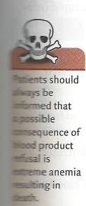
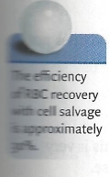
Perioperative Fluid therapy & Blood Components Transfusion
Alternatives to Blood Product Replacement
3) Intraoperative cell salvage ("Cell Saver")
a) Procedure (1,2)
)Blood is suctioned from the operative field and usually is then anticoagulated.
RBCs are separated from other elements by centrifuge.
Cells are then washed, suspended in saline, and reinfused to the patient
(1) Reinfusion is usually via bagged aliquots with a hematocrit of 45% to 65%

Slide 93
Perioperative Fluid therapy & Blood Components Transfusion
Alternatives to Blood Product Replacement
b) Indications (3)
)Procedures where blood loss is expected to be high
Common procedures include cardiovascular surgeries, liver transplantation, spinal

Slide 94
Perioperative Fluid therapy & Blood Components Transfusion
Alternatives to Blood Product Replacement
Contraindications (3)
i) Generally related to the presence of cells or other substances that have the potential to cause harm if reinfused to the patient. They include
(I) Malignancy
)Infection
Pharmacologic agents such as methyl methacrylate or clotting agents
Urine, bone chips, fat, or bowel contents in surgical field
Presence of amniotic fluid (relative)
Cell salvage has been used for cesarean section without complications and maybe considered in certain high risk situations (2).

Slide 95
Perioperative Fluid therapy & Blood Components Transfusion
Alternatives to Blood Product Replacement
ii) Potential complications (1,2)
(i) Coagulopathy from the anticoagulants used during blood processing
(a) Substantially reduced with modern cell salvage equipment
)Dilution of clotting factors and platelets can occur since only RBC are returned
to the patient.
)Contamination of the cell salvage device with bacteria or debris from the surgical field resulting in systemic infection
Air embolism if blood is directly returned from the machine or a rapid infusion device and not properly monitored

Slide 96
Perioperative Fluid therapy & Blood Components Transfusion
Alternatives to Blood Product Replacement
iii) Advantages
(I) Compatiblity testing not required
(2) Little risk for human error, unless the machine is not properly operated
iv) Disadvantages
(I) Requires specialized equipment and trained personnel
(2) Not applicable in all surgeries

Slide 97
Perioperative Fluid therapy & Blood Components Transfusion
Alternatives to Blood Product Replacement
) Normovolemic hemodilution (1,₄)
a) Involves collection of autologous blood immediately prior to surgery and maintenance of normovolemia by IV fluid administration with colloid or crystalloid.
)The volume of colloid administered should be equal to the volume of blood with‑
drawn.
)When crystalloid is administered, the volume should be three times the volume of
blood removed (3,4)

Slide 98
Perioperative Fluid therapy & Blood Components Transfusion
Alternatives to Blood Product Replacement
b) When blood is subsequently lost, it has less RBC mass, and the blood removed can be returned to the patient as needed.
c) Candidates for this procedure include (4)
)Patients who have a high likelihood of transfusion
Preoperative Hgb of at least 12 g/dL
Absence of coronary, pulmonary, renal, or liver disease
Absence of severe hypertension
Absence of infection and low risk of bacteremia

Slide 99
Perioperative Fluid therapy & Blood Components Transfusion
Alternatives to Blood Product Replacement
d) Advantages
)Virtually, no potential for ABO incompatibility, provided that the blood does not leave the operating room
No need for compatibility testing
Lower cost than banked blood.
e) Disadvantages (4)
i) Decreased oxygen delivery may result in organ ischemia, although this is very unlikely in patients without cerebrovasuclar or coronary artery disease.

Slide 100
Perioperative Fluid therapy & Blood Components Transfusion
Alternatives to Blood Product Replacement
5) Pharmacologic alternatives
a) Erythropoietic agents (5,6)
)Recombinant human erythropoietin (Procrit or Epogen) with folate and iron supplementation can be used preoperatively or postoperatively to increase RBC production.
Advantages
(I) May be used in patients at high risk for anemia and blood loss
(a) Examples include chronic renal failure and anemia.
(2) Accepted by many patients who otherwise refuse blood transfusion
)Disadvantages
(1) Effect takes approximately 2 weeks.
(a) Not helpful in the acute situation or when blood loss is unexpected
(2) Expensive

Slide 101
Perioperative Fluid therapy & Blood Components Transfusion
Alternatives to Blood Product Replacement
b) Recombinant activated factor VII (rFVIIa) (7-g)
i) rFVIIa is identical in structure and function to human factor VIIa.
ii) Developed to prevent or control bleeding in patients with Hemophilia A or B with inhibitors to factors VIII and IX
iii) rFVIIa acts by binding with tissue factor to augment the intrinsic clotting pathway by directly activating factors IX and X.
iv) It is now used in many different clinical situations and is effective for treatment of life-threatening hemorrhage.

Slide 102
Perioperative Fluid therapy & Blood Components Transfusion
Alternatives to Blood Product Replacement
b) Recombinant activated factor VII (rFVIIa) (7-g)
v) There are no specific guidelines for rFVIIa therapy, but it is often given for
life-threatening coagulopathy when other measures have failed.
(I) The dose is 50 to 100 mg/kg IV, with most patients responding to the
drug within 3o minutes.
)It can be repeated every 2 hours until hemostasis is achieved,
but the vast majority of patients require only one dose.
)Less effective in the presence of acidosis, hypothermia, and
inadequate clotting factors (g).

Slide 103
Perioperative Fluid therapy & Blood Components Transfusion
Alternatives to Blood Product Replacement
b) Recombinant activated factor VII (rFVIIa) (7-g) vi) Advantages
(I) rFVIIa is a pharmacologic agent and not a blood product.
)Does not carry risk of transfusion-transmitted disease.
Accepted by many patients who object to blood transfusion
vii) Disadvantages
(I) Thrombotic events are the most commonly reported problems associated complications and include cerebrovascular accidents, myocardial infarction, pulmonary embolism, and clotting of indwelling devices (to).
(2) Very expensive

Slide 104
Perioperative Fluid therapy & Blood Components Transfusion
Alternatives to Blood Product Replacement
6) Management strategies for patients who refuse blood transfusion
a) Minimize blood loss
)Meticulous surgical technique should be discussed with the physician performing the procedure.
Minimizing phlebotomy and using point-of-care laboratory testing can significantly reduce blood loss.
b) Minimize O2 consumption
)Mechanical ventilation with or without muscle paralysis reduces the work of breathing (II).
Other strategies include hypothermia, analgesics, and sedation (5,11).

Slide 105
Perioperative Fluid therapy & Blood Components Transfusion
Alternatives to Blood Product Replacement
c) Maximize O2, delivery
)Tissue O2 delivery can be increased by increasing inspired oxygen (FiO2,), maintaining normovolemia, and increasing cardiac output, using inotropes if necessary (5).
(1) A pulmonary artery catheter with the capability to measure
cardiac output and mixed venous SpO2 can be helpful (5).
)Hyperbaric O2 can also be used to increase blood O_{2 content if available (12).}

Slide 106
Perioperative Fluid therapy & Blood Components Transfusion
Alternatives to Blood Product Replacement
7) The Jehovah's Witness (JW)
a) Definition
)JW are patients who object to receiving blood or blood product on religious grounds.
There are over one million JW in the United States and over six million worldwide (13)

Slide 107
Perioperative Fluid therapy & Blood Components Transfusion
Alternatives to Blood Product Replacement
b) Preoperative informed consent
)Whenever possible, discuss patient's wishes alone (i.e., without the presence of family or religious personnel).
Patients should be informed about blood transfusion when appropriate and the consequences (including death) of blood product refusal.
Some patients will accept intraoperative cell salvage, normovolemic hemodilution, or fractionated products.
These options need to be discussed thoroughly and the patient wishes understood prior to the operative procedure.

Slide 108
Perioperative Fluid therapy & Blood Components Transfusion
Alternatives to Blood Product Replacement
c) Alternative techniques and the JW patient (Table 28-1)
)Many techniques have variable acceptance in JW patients.
Therefore, preoperative discussion and documentation of acceptance or refusal of various techniques is absolutely essential.

Slide 109
Perioperative Fluid therapy & Blood Components Transfusion
Alternatives to Blood Product Replacement

Slide 110
Perioperative Fluid therapy & Blood Components Transfusion
Massive Transfusion and Resuscitation
Massive bleeding in the operating room can be expected, as in the case of liver transplant or abdominal aortic aneurysm repair, or unexpected, as in the case of trauma, vascular injury or postpartum.
Hemorrhage can cause decreased tissue perfusion, cellular injury, and death if not treated appropriately.
Significant bleeding may result in the need for transfusion of large amounts of blood products.

Slide 111
Perioperative Fluid therapy & Blood Components Transfusion
Massive Transfusion and Resuscitation
Definition
Massive hemorrhage has been described as the loss of one's entire blood volume in a 24-hour period or half of the entire blood volume a 3-hour period.
Massive transfusion is defined as transfusion of 10 units of PRBC or blood products in 24 hours.

Slide 112
Perioperative Fluid therapy & Blood Components Transfusion
Massive Transfusion and Resuscitation
Causes
Causes of massive hemorrhage requiring massive transfusion are variable. Any time of the day or night one can be faced with the potential for massive bleeding in most major centers and community hospitals

Slide 113
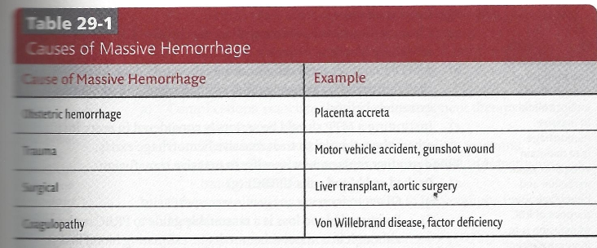
Perioperative Fluid therapy & Blood Components Transfusion
Massive Transfusion and Resuscitation

Slide 114
Perioperative Fluid therapy & Blood Components Transfusion
Massive Transfusion and Resuscitation
Management goals in massive hemorrhage
The primary goal is maintenance of adequate perfusion and cellular function.
Prevention of microvascular bleeding is a secondary goal

Slide 115
Perioperative Fluid therapy & Blood Components Transfusion
Massive Transfusion and Resuscitation
Management goals in massive hemorrhage
Lines and monitors
Standard ASA monitors plus invasive monitors are usually required.
Central venous access
Large bore central lines are extremely beneficial for volume replacement and can be used in conjunction with a rapid infusion device.
Central venous pressure can be used as a guide for volume replacement.
Ultrasound guidance should be used when placing central venous lines whenever possible.
While placement of central access can aid in management, it can also draw attention and personnel resources away from treatment of the patient. Ensure that the patient is being adequately resuscitated while the line is being placed, or defer placement to focus on volume replacement.

Slide 116
Perioperative Fluid therapy & Blood Components Transfusion
Massive Transfusion and Resuscitation
Management goals in massive hemorrhage
Intra-arterial blood pressure monitoring
(1)Offers the ability for close monitoring of BP and frequent blood draws for laboratory analysis
(2) Should be placed early in a hemorrhagic emergency because placement may be difficult once significant peripheral vasoconstriction is present
(3) Radial artery is the most common cannullation site, but femoral is often used in emergent or difficult situations.

Slide 117
Perioperative Fluid therapy & Blood Components Transfusion
Massive Transfusion and Resuscitation
Management goals in massive hemorrhage
Adequate IV access is essential in the bleeding patient. The flow of a fluid through a catheter is proportional to the fourth power of the radius, so large bore peripheral IV access allows for rapid transfusion.
Recommended IV access includes two large bore (14 to 16 g) IVcannullae.

Slide 118
Perioperative Fluid therapy & Blood Components Transfusion
Massive Transfusion and Resuscitation
Management goals in massive hemorrhage
Urine output
Monitoring urine output is an effective indicator of the patient's intravascular volume status.
(a) Urine output <15 mL/kg/h is indicative of severe volume depletion.

Slide 119
Perioperative Fluid therapy & Blood Components Transfusion
Massive Transfusion and Resuscitation
Management goals in massive hemorrhage
Temperature monitoring
(I) Monitoring core temperature is essential in patients with hemorrhage.
(2) Hypothermia is extremely problematic in the massively bleeding patient because acidosis and coagulopathy are worsened by decreased temperature.

Slide 120
Perioperative Fluid therapy & Blood Components Transfusion
Massive Transfusion and Resuscitation
Airway management and maintenance
Massively bleeding patients may arrive in the operating room or emergency department with an endotracheal tube in place.
Severe blood loss significantly alters consciousness. The airway should be protected and managed by endotracheal intubation and ventilation.

Slide 121
Perioperative Fluid therapy & Blood Components Transfusion
Massive Transfusion and Resuscitation
Maintenance of adequate perfusion
In order to assure organ perfusion, intravascular volume must be maintained by large amounts of IV fluid, appropriate amounts of colloid, and potentially blood products.
Blood products should be replaced with appropriate indications.
Mobilization of resources
Call for help of anesthesia technicians and additional anesthesia personnel.
Mobilize necessary equipment.
Notify blood bank and clinical laboratory.
Activate massive transfusion protocol (MTP), if applicable.

Slide 122
Perioperative Fluid therapy & Blood Components Transfusion
Massive Transfusion and Resuscitation
Massive transfusion protocol
Clear communication among all parties involved in caring for the massively bleeding patient is essential.
A MTP that gives clear directions on laboratory data, blood products availability and transport, as well as equipment and personnel is extremely helpful.
Instituting a MTP should be seriously considered in every institution where the potential to treat massive hemorrhage exists.

Slide 123
Perioperative Fluid therapy & Blood Components Transfusion
Massive Transfusion and Resuscitation
Blood product replacement specific to massive transfusion
Packed red blood cells (PRBC)
i)Given to increase oxygen carrying capacity
ii) Estimated blood loss is a reasonable guide to PRBC replacement, although in a massive hemorrhage, estimating blood loss is often difficult. In this situation, RBC are often given in response to clinical events or laboratory values such as hemoglobin with consideration of the patient's acid/base status.

Slide 124
Perioperative Fluid therapy & Blood Components Transfusion
Massive Transfusion and Resuscitation
Often in a hemorrhagic emergency, type-specific, cross-matches blood is not available.
Type specific, un-cross-matched blood may be given in emergency as the risk of a hemolytic transfusion reaction with un-cross-matched blood in patients who have not been previously transfused or pregnant is very low.
If no blood is available and the patient requires blood emergently, type 0 blood can be given.

Slide 125
Perioperative Fluid therapy & Blood Components Transfusion
Massive Transfusion and Resuscitation
Type O, Rh negative, blood is preferred, especially in women of childbearing age.
Once a large volume of Type O blood is given in an emergency, caution must be taken when subsequently administering type specific blood due to the presence of anti-A and anti-B antigens in the circulating Type O blood leading to hemolysis in the type-specific blood.
Although the exact amount of transfused Type O blood that
may cause this problem is unknown, it is prudent to consider avoiding type specific-blood when approximately one
blood volume of Type 0 blood has been given.

Slide 126
Perioperative Fluid therapy & Blood Components Transfusion
Massive Transfusion and Resuscitation
Large volume PRBC administration is associated with coagulopathy due to dilution of clotting factors and platelets (dilutional thrombocytopenia).

Slide 127
Perioperative Fluid therapy & Blood Components Transfusion
Massive Transfusion and Resuscitation
Fresh frozen plasma (FFP)
Current ASA guidelines state that FFP should be given in the presence of microvascular bleeding in patients who have been transfused one blood volume or when INK is >2.0
Recent data suggest that early transfusion of FFP and platelets aids in prevention of coagulopathy associated with trauma-related massive transfusion.
It is unclear if this data can be extrapolated to other situations. This is an active area of research.

Slide 128
Perioperative Fluid therapy & Blood Components Transfusion
Massive Transfusion and Resuscitation
Platelets
Current guidelines recommend a platelet count prior to platelet transfusion and state that platelet transfusion is typically not indicated for platelet counts >50,000 cells/mm3

Slide 129
Perioperative Fluid therapy & Blood Components Transfusion
Massive Transfusion and Resuscitation
Recent information in massively bleeding trauma patients suggests that platelet and plasma transfusion early in resuscitation with an attempt to approximate whole blood is associated with lower mortality.

Slide 130
Perioperative Fluid therapy & Blood Components Transfusion
Massive Transfusion and Resuscitation
Complications of massive transfusion
Complications associated with blood component therapy also apply to massive transfusion.
These include acute and delayed hemolytic reactions, transfusion-related acute lung injury (TRALI), transfusion-transmitted infectious disease.
Other complications are more specific to large volume transfusion.

Slide 131
Perioperative Fluid therapy & Blood Components Transfusion
Massive Transfusion and Resuscitation
Hypothermia
Hypothermia with a core temperature <35°C significantly affects coagulation.
(i) The more hypothermic the patient becomes, the higher the risk of microvascular bleeding.
(2) Every effort should be made to prevent the lethal triad of hypothermia, acidosis, and coagulopathy.
In trauma patients, hypothermia is associated with an increased risk of developing disseminated intravascular coagulation.
Trauma patients often arrive in the OR hypothermic. Rewarming requires substantial effort, but the difference in outcome can be significant.
Every effort to maintain normothermia, including using warming devices for all IV fluids and blood products and forced-air heating devices if possible

Slide 132
Perioperative Fluid therapy & Blood Components Transfusion
Massive Transfusion and Resuscitation
Hypocalcemia
Due to citrate anticoagulant in the blood products binding calcium.
May manifest as decreased cardiac contractility and ECG abnormalities.
Contributes to coagulopathy (calcium is Factor IV in the clotting cascade).
Carefully monitor calcium levels and treat hypocalcemia with IV calcium chloride.

Slide 133
Perioperative Fluid therapy & Blood Components Transfusion
Massive Transfusion and Resuscitation
Hyperkalemia
Increased potassium is due to RBC lysis during storage.
Potassium should be carefully monitored and hyperkalemia treated appropriately.

Slide 134
Perioperative Fluid therapy & Blood Components Transfusion
Massive Transfusion and Resuscitation
Volume overload
Care must be taken to avoid excess volume replacement as circulatory overload can lead to pulmonary edema and other potential complications.
Furthermore, excessive crystalloid administration may lead to abdominal compartment syndrome and potentially other cardiopulmonary complications.

Slide 135
Perioperative Fluid therapy & Blood Components Transfusion
Massive Transfusion and Resuscitation
Dilutional coagulopathy
Administration of large volumes of products that do not contain clotting factors or platelets results in decreased circulating clotting factors and platelets, which may result in coagulopathy.
Clotting factors and platelets should be administered either based on an MTP that attempts to approximate whole blood, laboratory values, or microvascular bleeding in the situation of large volume resuscitation.

Slide 136
Perioperative Fluid therapy & Blood Components Transfusion
Massive Transfusion and Resuscitation
Decreased 2,3-diphosphoglycerate
2,3-Diphosphoglycerate is a compound that binds deoxyhemoglobin and increases oxygen delivery to cells.
Transfusion of large volumes of stored RBCs can lead to decreased 2, 3 Diphosphoglycerate thereby decreasing oxygen delivery to tissues.

Slide 137
Perioperative Fluid therapy & Blood Components Transfusion
Massive Transfusion and Resuscitation
Disruptions in acid base balance
The addition of citrate-phosphate-dextrose solution during RBC storage decreases the pH to approximately 7.0.
In the normally perfused liver, the citrate is metabolized to bicarbonate, which should mitigate the acidic pH of the transfused blood.
In situations where the liver is not adequately perfused, this process may be altered which the potential for exacerbation of metabolic acidosis.
The clinical significance of the low pH associated with stored RBC is unclear, but it is possible that transfusion of large volumes may significantly contribute to metabolic acidosis.

