Slide 1
UNDER GRADUATE ANESTHESIA COURSE (ORIENTATION AND OUTLINE)
DR. JUMANA BAAJ
ASSISSTANT PROFFESOR , ANESTHESIA CONSULTANT
COURSE ORGANIZER KKUH-KSU

Slide 2
TABLE OF CONTENTS:
Introduction
Welcome
The roles of the Anesthesiologist
Orientation
Hours of attendance
Code of conduct
Learning Resources
Objectives

Slide 3
Introduction
This is a guide for the Undergraduate Electives Course in Anesthesia.
Its purpose is to provide a course outline for 4th year medical students.
By creating a structured approach we hope to provide a consistent experience for students learning the basics of anesthesia.

Slide 4
Welcome
Welcome to this two week introduction to Clinical Anesthesiology.
During your short exposure to this specialty we hope to give you some idea of the true scope of anesthesia; it encompasses many areas of medicine as well as clinical physiology and pharmacology.
Anesthesiologists learn to use technical and analytical skills to look after patients in many situations – some are routine and others very challenging.
The course will be relevant to many medical specialties and is not solely aimed at students considering anesthesia residency.

Slide 5
Clinical Objectives for Medical Students in (045) Anesthesia and CPR Course
At the end of the course the student will be able to understand and practice:
Pre-anesthesia assessment and evaluation
Able to take history from patient
Able to open PAC System to get information and investigation.
Interpretation of preoperative data relevant to anaethetic plan.
Consultations

Slide 6
Clinical Objectives for Medical Students in (045) Anesthesia
At the end of the course the student will be able to understand and practice:
Pre-anesthesia assessment and evaluation
  Able to take history from patient
  Able to open PAC System to get information and investigation.
  Interpretation of preoperative data relevant to anaethetic plan.
  Consultations
Orientation with anesthesia equipment in O.R
  Anesthesia machine
  Anesthesia circuits
  Laryngoscopes – tubes – LMA – Airways
  Epidural set &Spinal set
  Monitors- Anesthesia Record
  Anesthetics Drugs- I.V. Inhalational & Muscle Relaxants
  Resuscitation Drugs During Anesthesia
  fluids (Crystalloids & Colloids Fluids)

Slide 7
Clinical Objectives for Medical Students in (045) Anesthesia and CPR Course
Peri arrest arrhythmias session
Detection of common arrhythmias associated or preceeded cardiac arrest
Orientation with defibrillator and indication for use
Drugs used during resuscitation session interactive discussion about drugs indicators and pharmacology.
Advanced Life Support Algorism
Color code
Student running scenario as a team leader and rotation between them

Slide 8
Code of conduct
Professionalism and Respectful Workplace
  All students are expected to demonstrate respect for the patients and staff encountered during the rotation.
  We also expect all students to be treated with respect during their rotation.
  Health has clear policies regarding:
      Maintenance of patient confidentiality.
      Mutual respect in the workplace.
  If you have concerns regarding lapses in these areas, please address them with your site coordinator.

Slide 9
Code of conduct
Professionalism cont’d
  Attendance and punctuality are mandatory.
  Students are expected to be aware of the limitations of their role in the operating room and to be diligent in the OR environment.

Slide 10
Code of conduct
Dress code
  When in the OR, students must respect the rules of the sterile environment and wear greens, mask, gloves and bootes.
  If you have not previously been in the OR, please notify us so we can make you aware of appropriate protocol.
  You are expected to bring your stethoscope to the OR. Other medical instruments are not mandatory.

Slide 11
LEARNING RESOURCES FOR undergrad Anesthesia course
Exposure to anesthesia learning in the following areas:
  Adult OR
  Pediatric OR
Teaching at the bedside in the OR:
  Clinical teaching modules to cover basic anesthesia knowledge.
  Enabling objectives for technical skills.
  Case based clinical teaching
Independent learning:
  Reference material- texts and web-based
Simulator based learning:
  Low and high fidelity simulation to facilitate technical skills, crisis resource management, and critical anesthesia events.

Slide 12
Goals and objectives
Academic and Clinical skills:
  Preoperative evaluation and clinical skills
  Airway and ventilation
  Fluid and volume resuscitation, electrolyte balance and acid-base
  Pharmacology of anesthetic drugs
  Principles of general anesthesia
  Principles of regional anesthesia
  Pain management
  Monitoring in anesthesia
  Post operative management

Slide 13
Preoperative evaluation and Clinical skills
Students should be able to:
  Obtain a relevant medical, surgical and anesthetic history and perform a focused pre-operative examination on the patient. ( Airway assessment, and awareness of factors predisposing to difficult intubation are of particular importance.)
  Provide a summary of pre-operative assessment and formulate a relevant problem list.
  Have some understanding of the indications for both routine and special pre-operative investigations.
  Understand the basis of an anesthetic plan and how it relates to the clinical work-up of the patient, and the ASA classification of pre-operative physical status.

Slide 14
Airway and ventilation
Know the anatomy of the airway and basic airway assessment.
Be familiar with the various techniques of airway management and equipment involved in routine and difficult intubation.
Review basic respiratory physiology in the context of anesthesia.
Be familiar with the principles of manual and mechanical ventilation.

Slide 15
fluid and electrolyte balance
Know the main principles of:
  Fluid replacement and volume resuscitation (crystalloid, colloid, blood transfusion)
  Electrolyte and acid-base balance

Slide 16
Pharmacology of anesthetic drugs
Have a basic knowledge of the pharmacokinetic and pharmacodynamic principles of drugs commonly involved in anesthesia including:
  Intravenous agents (sedative/ hypnotics, narcotics, muscle relaxants)
  Volatile agents.
  Local anesthetics

Slide 17
Principles of general Anesthesia
Understand the principles of general anesthesia and the delivery of volatile anesthetics.
Have a basic understanding of the structure, function and safety features of the anesthesia machine.

Slide 18
Regional anesthesia and
Pain management
Be familiar with the concept of local and regional anesthesia and commonly used local anesthetic agents.
Be familiar with perioperative pain management techniques and drugs.
Local anesthesia toxicity

Slide 19
Monitoring In anesthesia
Be familiar with the major international monitoring standards and be able to interpret basic information gained from the monitoring of:
  Blood pressure
  Pulse oximetry
  ECG
  Capnography
  Ventilation (parameters, spirometry)
  Temperature
  Invasive pressure monitoring ( CVP, arterial line)
  Bispectral index

Slide 20
Intra and post operative management
Gain an appreciation for the basic management of common intra-operative problems such as:
  Hypoxia, hypercarbia,
  Hyper/hypotension, cardiac arrhythmias,
  High and low airway pressure alarm.
Have an understanding of the requirements for safe emergence from general anesthesia and common problems and complications in the PORR.
  Post –op nausea and vomiting, pain etc

Slide 21
The anesthetic plan

Slide 22
The anesthetic plan
Type of anesthesia
  General
    Airway management
    Induction
    Maintenance
    Muscle relaxation
  Sedation
  Supplemental oxygen
  Agents
  Local or regional anesthesia
    Technique
    Agents

Slide 23
The anesthetic plan
Intraoperative management
  Monitoring
  Positioning
  Fluid management
  Special techniques
Postoperative
  Pain control
  Complication management
  Intensive care
    Postoperative ventilation
    Hemodynamic monitoring

Slide 24
Stages of the Peri-Operative Period
Pre-Operative
From time of decision to have surgery until admitted into the OR theatre.

Slide 25
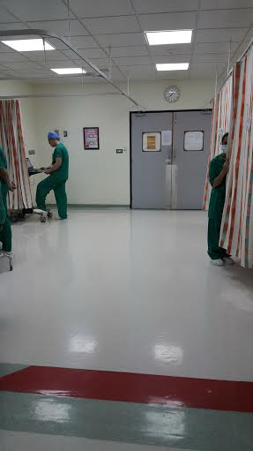

Slide 26
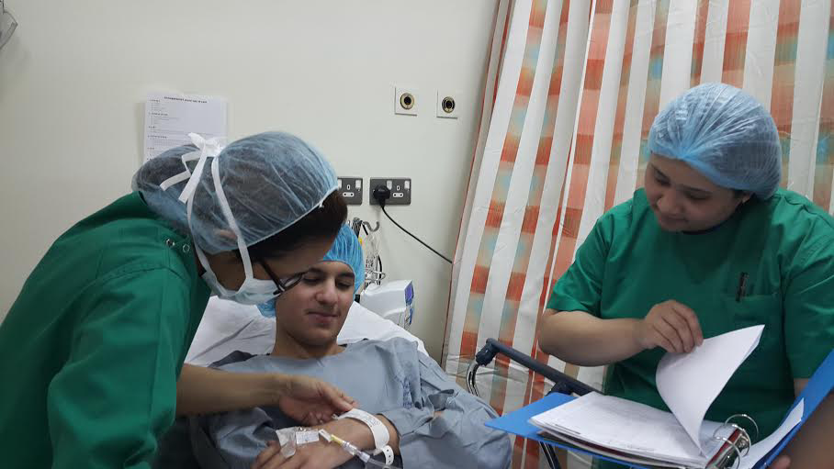

Slide 27
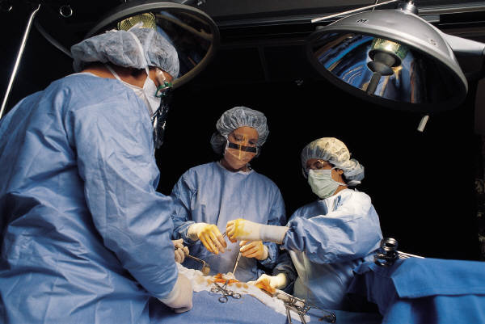
Stages of the Peri-Operative Period
Intra-Operative
Time from entering the OR theatre to entering the Recovering Room or Post Anesthetic Care Unit (PACU)

Slide 28
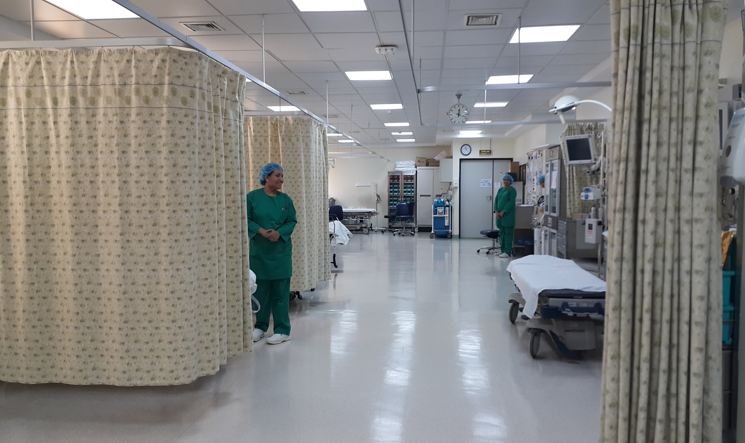

Slide 29
Stages of the Peri-Operative Period
Post-Operative
Time from leaving the RR or PACU until time of follow-up evaluation (often as out-patient)

Slide 30
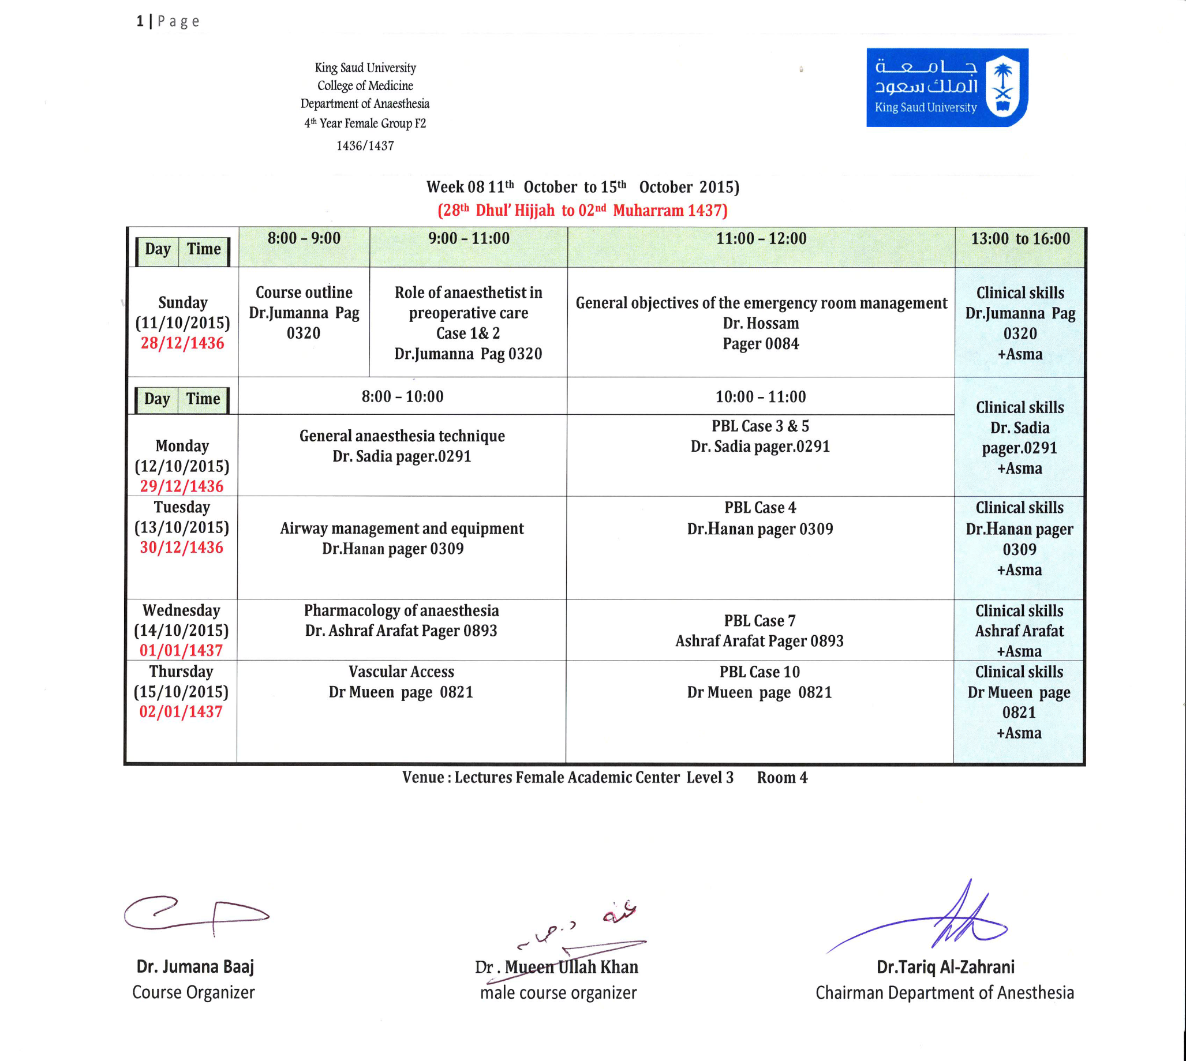

Slide 31
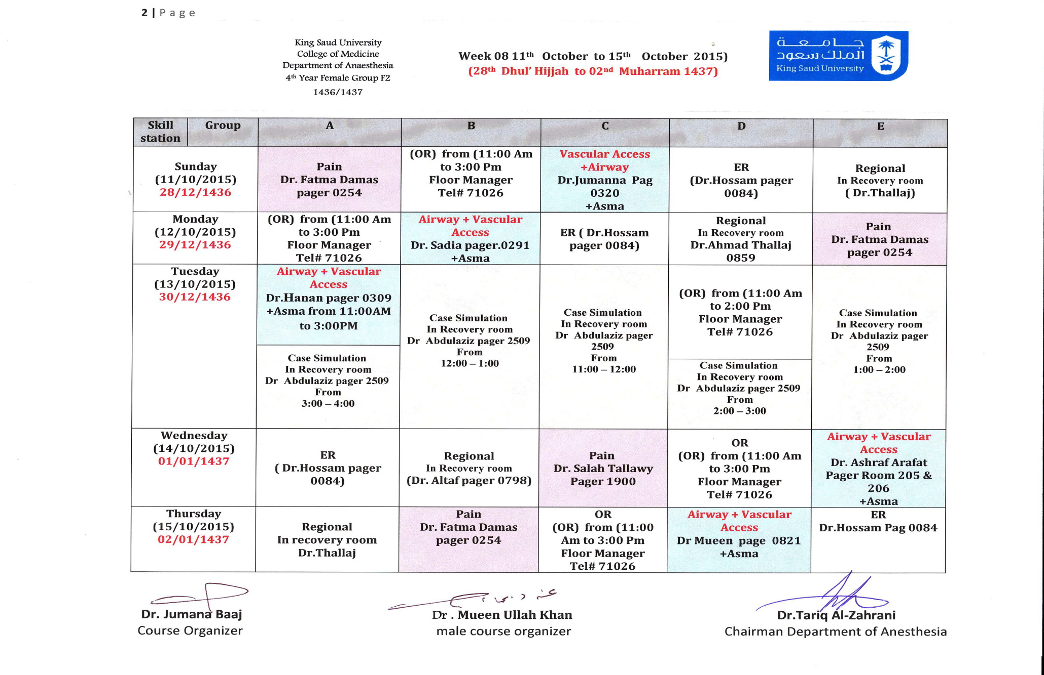

Slide 32
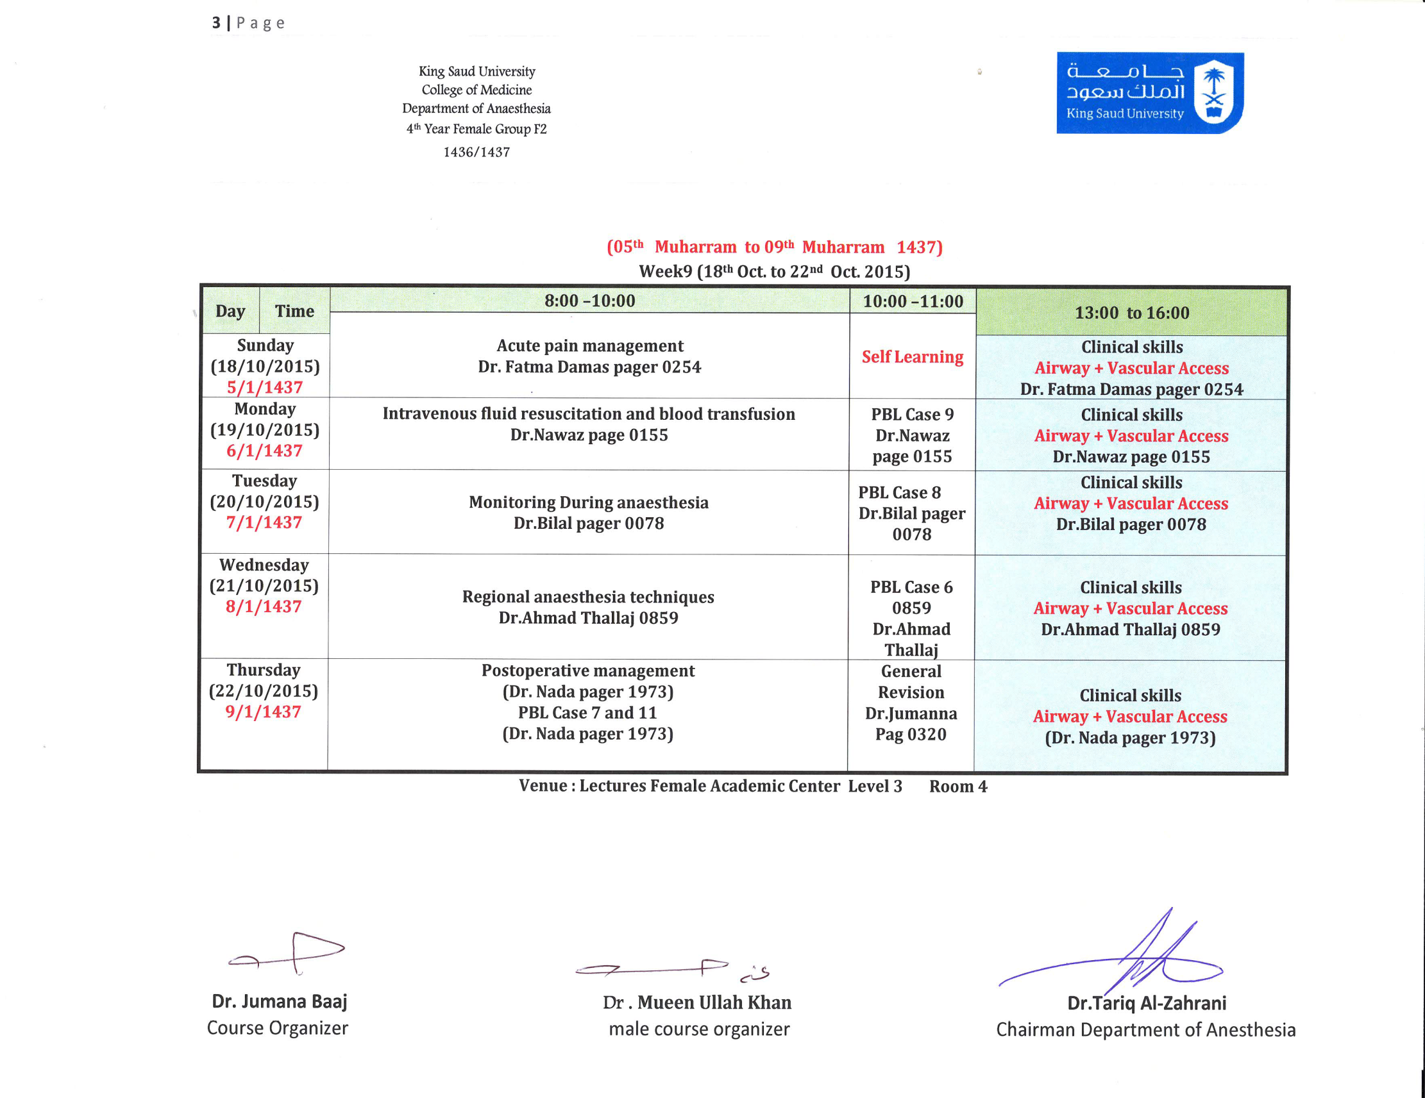

Slide 33
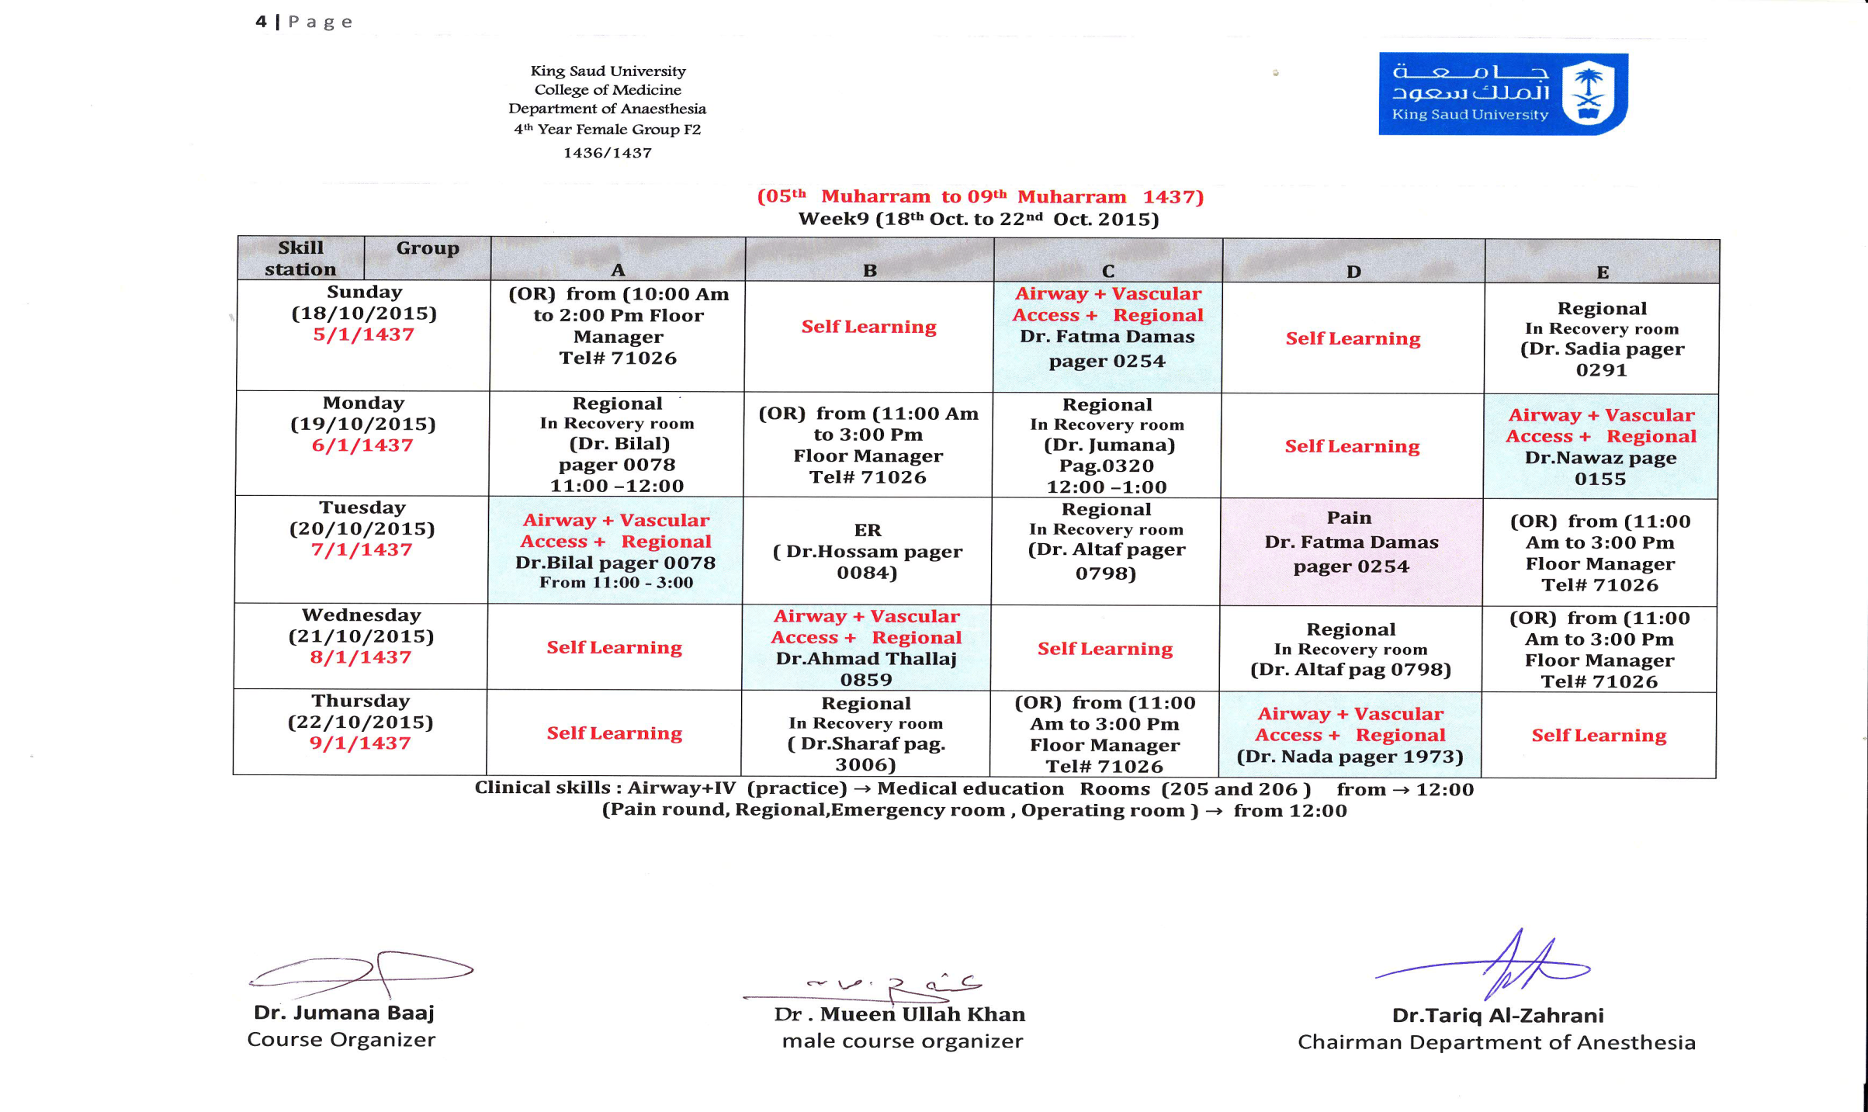

Slide 34
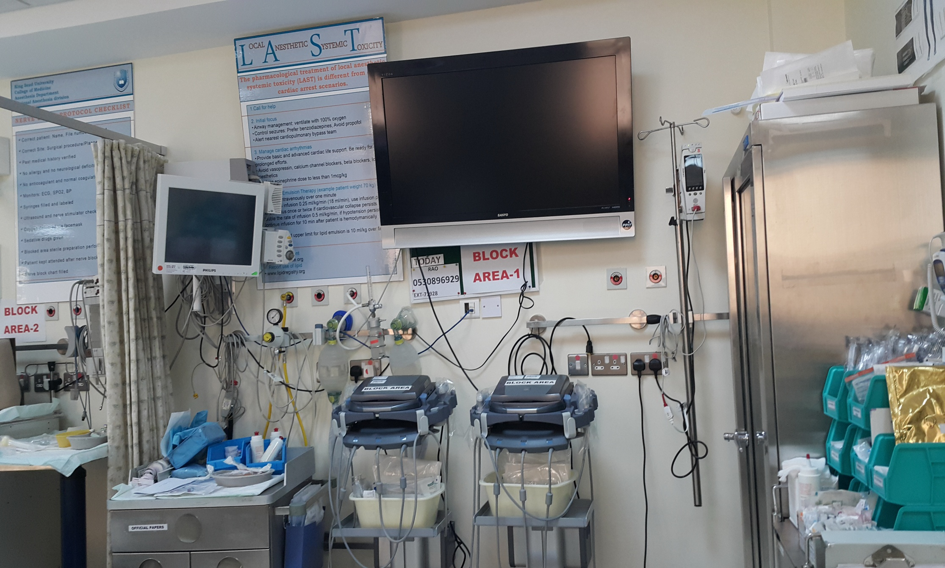

Slide 35
Key Success Factors
Attendance
Realistic Expectations
Maintains communication with the faculty member
Good organizational skills
Expect to work beyond the classroom
Stay on track/understand commitment required
Ask questions

Slide 36
Books recommended.
Morgan and Mekhails clinical anesthesiology fifth edition .5th Edition .
John Butterworth,
G. Morgan,
John Wasnick,
Mikhail Maged,
David C. Mackey,
Hans-Joachim Priebe
Anesthesia for medical students Literature & manual provided by DEPT. of ANESTHESIA

Slide 37
CONTACT INFORMATION
DEPARTMENT 92019
Dr jumana tel. 4692184 BLEEP 0320
Dr Waleed 4692356 BLEEP 1258
SIS NINA 4692359

Slide 38
At the end of the course
  EXAMINATION PRACTICAL
  EXAMINATION OSCE
  EXAMINATION WRITTEN

Slide 39


