Slide 1
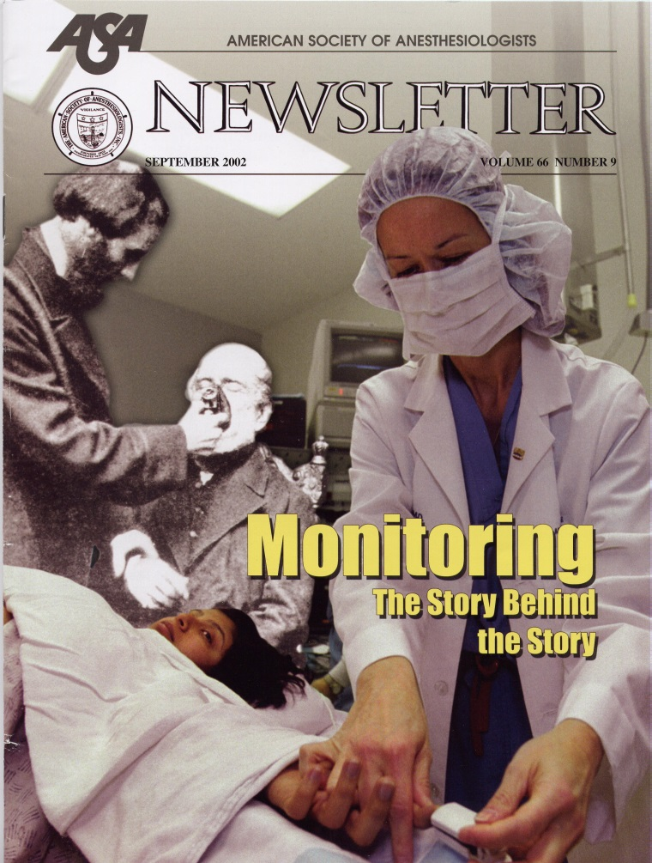
MONITORING “THE STORY BEHIND THE STORY”

Slide 3
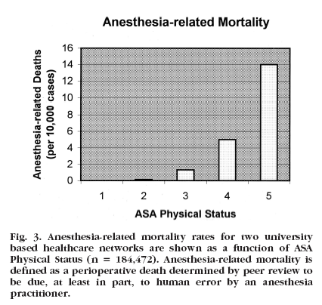
Human error…...
ASA Status

Slide 4
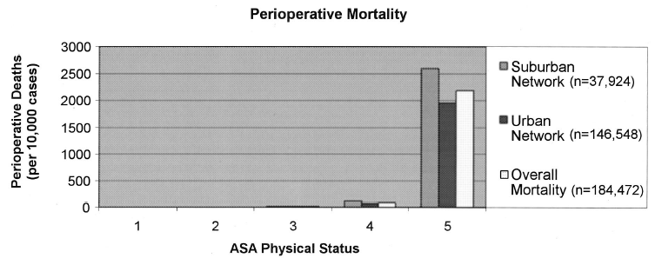

Slide 5
Arbous MS, Grobbee DE, et al. Anaesthesia 2001;56:1141-53
869483 anesthesia
769 pts died within 24 hours after anesthesia
42 pts comatose
Inadequate monitoring → 10% anesthesia related deaths
Postop monitoring: inadequately 8% pts
unavailable 5% pts

Slide 6
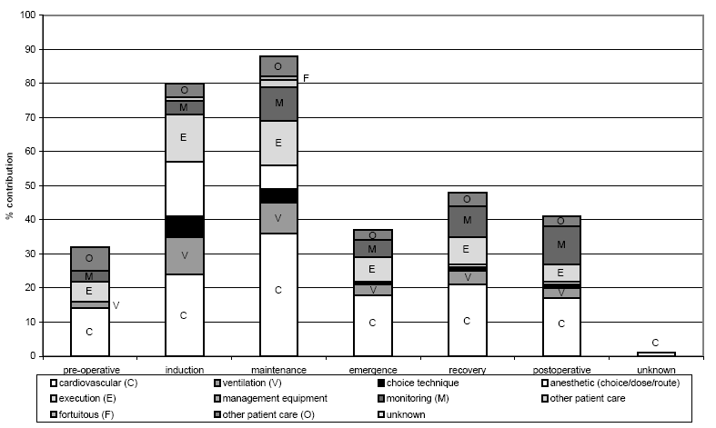
Arbous MS, Grobbee DE, et al. Anaesthesia 2001;56:1141-53

Slide 7
“Vital Signs” Monitoring
Guidelines
Cardiovascular
Respiratory
Others

Slide 8
ASA standards for basic anesthetic monitoring 2001
Standard 1:
Qualified anesthesia personnel shall be present in the room throughout the conduct of all general anesthetics, regional anesthetics and monitored anesthesia care
Standard 2:
During all anesthetics, the patient's oxygenation, ventilation, circulation, and temperature shall be continually evaluated

Slide 9
ASA standards for basic anesthetic monitoring 2001
Oxygenation:
Oxygen analyzer for inspired gases-Observation of the patient Pulse oximetry
Ventilation:
Auscultation of breath sounds-Observation of the patient Observation of the reservoir bag Capnography (Carbon dioxide monitoring)
Circulation:
Continuous ECG display Heart rate and BP recorded every 5 minutes Evaluation of circulation Auscultation of heart sounds Palpation of pulse Pulse plethysmography Pulse oximetry Intrarterial pressure tracing
Temperature:
Monitor temperature when changes are intended, anticipated, or suspected

Slide 10
Buhre W and Rossaint R. The Lancet 2003; 362:1839-46

Slide 11
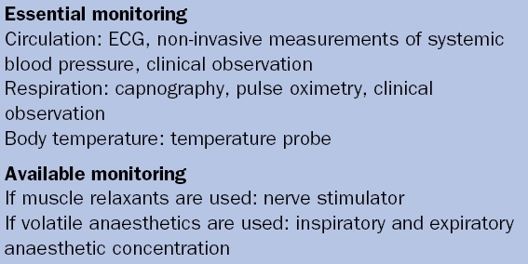
Buhre W and Rossaint R. The Lancet 2003; 362:1839-46
Monitoring recommendations of the Association of Anesthetists of Great Britain and Ireland

Slide 12
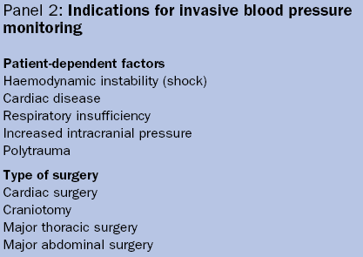
Buhre W and Rossaint R. The Lancet 2003; 362:1839-46

Slide 13
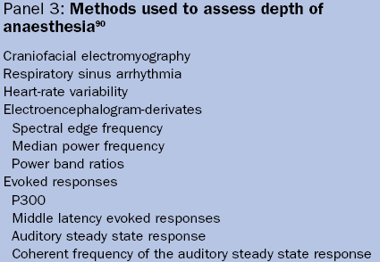
Buhre W and Rossaint R. The Lancet 2003; 362:1839-46

Slide 14
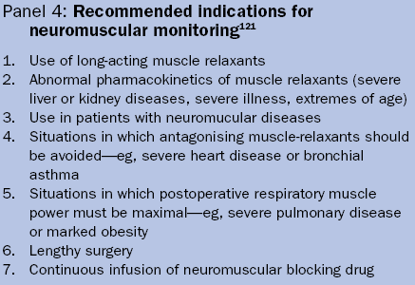
Buhre W and Rossaint R. The Lancet 2003; 362:1839-46
“There is growing evidence that no single monitoring device can improve outcome in the OR or in the ICU.

Slide 15
ECG
blood pressure
pulse oximetry
capnography + anesthetic gas concentrations + FiO2
temperature

Slide 16
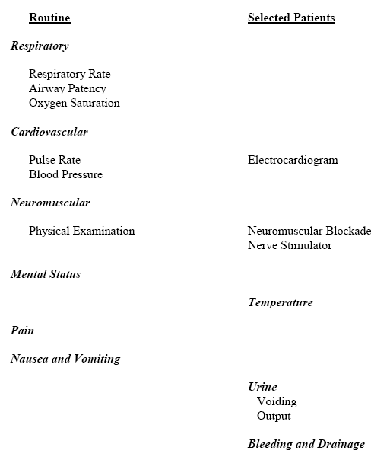
Immediately available
Anesthesiology
2002;96:742-52

Slide 17
Periop monitoring
Guidelines
Cardiovascular
Respiratory
Others

Slide 18
The electricity of the heart

Slide 19
What to expect from the ECG
Essential monitor
Rate, rhythm, propagation of the excitation wave, heart position, muscle hypertrophy, regional ischemia
NO information about pump function

Slide 20
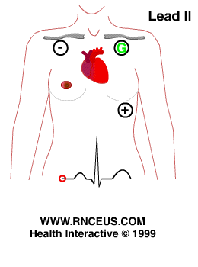
Lead Selection
Lead II is the same as standard lead two as seen in a 12 lead ECG.
It is the most common monitoring lead.
It is not the optimal monitoring lead.

Slide 21
Lead Selection
V5 = the best lead to detect ST-T change

Slide 22
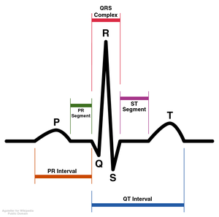
The shape of the ECG
P
T
QR S

Slide 23
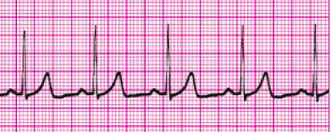
Normal ECG

Slide 24
ECG interpretation
Rate
Rhythm
Intervals
QRS complexes
ST segments & T waves

Slide 25
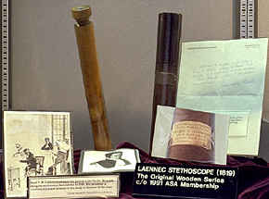
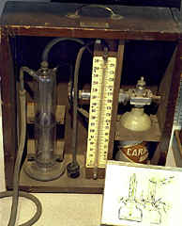
Intraoperative Monitoring
invasive
- invasive AP
Swan Ganz cath
PiCCO System
Advanced PAC:
SVO₂, CCO, REF, EDV
…………………TEE

Slide 26
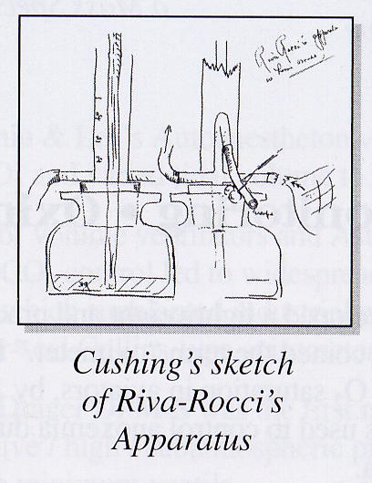
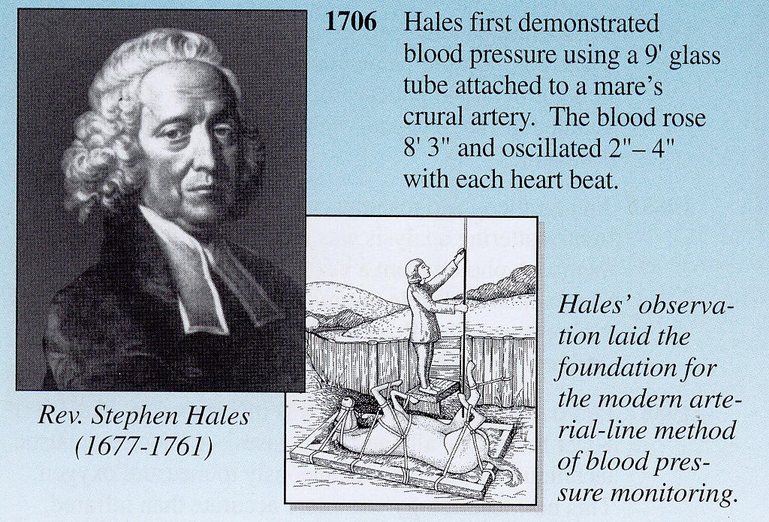
Intraoperative Monitoring
invasive

Slide 27
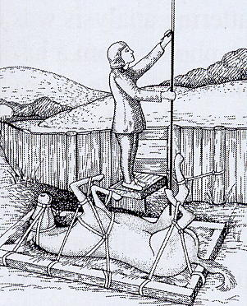
Intraoperative Monitoring
invasive
8’ 3’’ + oscill 2-4’’

Slide 28
NIBP vs. Arterial Cannulation
NIBP (auscultatory / oscillometric)
Pros
Healthy patients
Short case
Cons
Bladder cuff size
Flow dependent
Motion
Interruption of IV infusion
Injury
Cuff deflation rate
Hydrostatic errors
Arterial Cannulation
Pros
Continuous BP
Sick patients
Difficult cases
ABG monitoring
Cons
Nerve dysfunction
Thrombosis / Ischemia
Hematoma formation
Infection
Hydrostatic errors

Slide 29
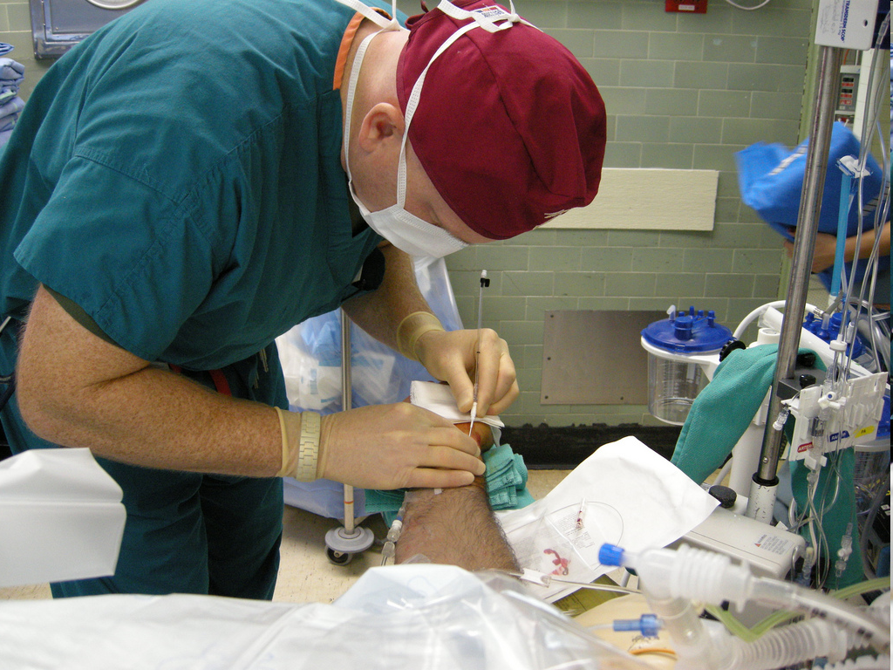

Slide 30
Art Line Complications
Thrombus formation
Arterial laceration
Hematoma
Loss of distal perfusion to hand…ouch!
Nerve dysfunction from dissection
Infection
Errors in monitoring
Failed attempt. Always consider failure as a potential complication.

Slide 31
Arterial Waveform Evaluation
Tf – Foot
Onset of ejection
Systole
T1 - First Shoulder
Peak flow
T2 - Second Shoulder
Peak pressure
Ti – dichotic notch
End of ejection
Closure of aortic valve
Precedes the onset of diastole
Tt – Pulse Duration

Slide 32
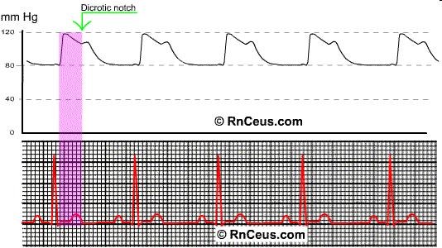
Arterial Line Tracing

Slide 33
Central Line Indications
Peripheral venous access is required for:
Administration of fluids
Administration of drugs
Central venous access is required for:
Parenteral nutrition
Anticipated Inotropic medication infusion
Anticipated large volume resuscitation
Monitoring of central venous pressure (CVP)
Cardiac pacing
Difficult peripheral access

Slide 34
Central Line Contraindications
Patient refusal?
Severe Coagulopathy
Bundle Branch Blocks relative contraindication
Infection at site
Previous failed attempts at specific site
Hematoma
Unusual anatomy

Slide 35
Central Line Techniques
Sterile techniques should be used for all central line cannulation
Surgical scrub with Sterile gown and gloves
Sterile prep of skin and surgical drapes.
Local anesthetic should be used for central catheters in awake patients
Success may be improved by using ultrasound guidance
Techniques of gaining access include:
Catheter over needle
Catheter through needle
Seldinger technique
Surgical cut-down is surgical technique as last resort.

Slide 36
Anatomy of Central Assess
Internal jugular vein
Right sided access preferred. Why?
Apical pleura does not rise as high on right and avoids thoracic duct
Patient positioned head down
In the low approach triangle formed by two heads of sternomastoid and clavicle identified
Cannula aimed down and lateral towards ipsilateral nipple
Subclavian vein
Usually approached from below clavicle
Patient positioned head down
Needle inserted below junction of medial 2/3 and lateral 1/3 of the clavicle
Needle aimed towards suprasternal notch
Passes immediately behind clavicle
Vein encountered after 4-5 cm

Slide 37
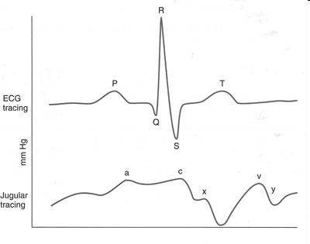
Normal CVP Waveform

Slide 38
Waveform Interpretation
+ a wave : This wave is due to the increased atrial pressure during right atrial contraction. It correlates with the P wave on an EKG.
+ c wave : This wave is caused by a slight elevation of the tricuspid valve into the right atrium during early ventricular contraction. It correlates with the end of the QRS segment on an EKG.
- x descent : This wave is probably caused by the downward movement of the ventricle during systolic contraction. It occurs before the T wave on an EKG.

Slide 39
Waveform Interpretation
+ v wave : This wave arises from the pressure produced when the blood filling the right atrium comes up against a closed tricuspid valve. It occurs as the T wave is ending on an EKG.
- y descent : This wave is produced by the tricuspid valve opening in diastole with blood flowing into the right ventricle. It occurs before the P wave on an EKG.

Slide 40
Periop monitoring
Guidelines
Cardiovascular
Respiratory
Others

Slide 41
Monitoring Devices (Types)
Stethoscope
Used with placement of the endotracheal (ET) tube
Will hear breath sounds clearly with the delivery of oxygen into the ET tube with correct placement
Can use in placement of nasogastric (NG) tube
Notes:
Explain difference between the two

Slide 42
Respiratory monitoring
AwP (peak-plateau)
Peep
compliance
P/V e flow slope
Fi -FeO₂
Fi-Fe volatile an.
SpO₂
EtCO₂

Slide 43
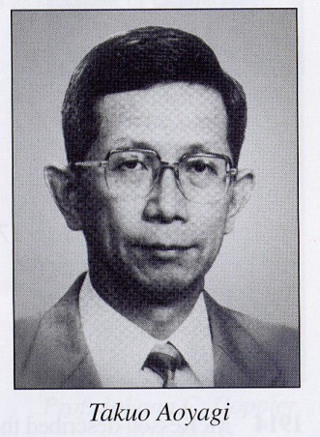
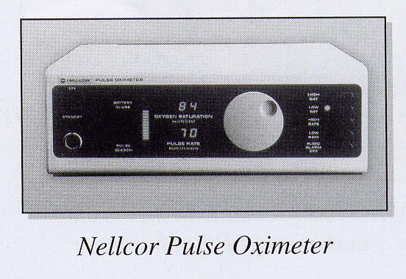
AwP (peak-plateau)
Peep
compliance
P/V e flow slope
Fi -FeO₂
Fi-Fe volatile an.
SpO₂
EtCO₂

Slide 44
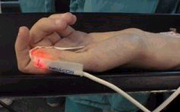
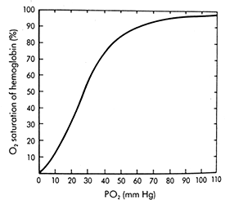
PULSE OXIMETRY

Slide 45
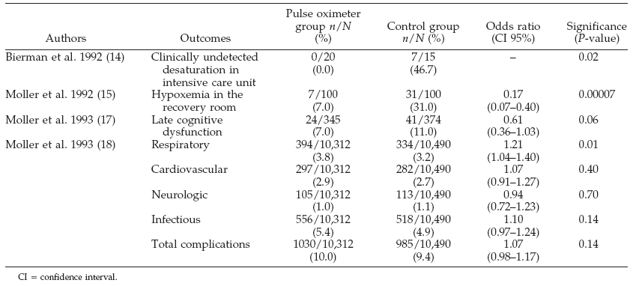
During observation in the recovery room, the incidence of hypoxemia in the pulse oximetry group was 1.5-3 time less.

Slide 46
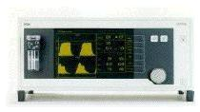
AwP (peak-plateau)
Peep
compliance
P/V e flow slope
Fi -FeO₂
Fi-Fe volatile an.
SpO₂
EtCO₂

Slide 47
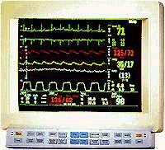
EtCO₂ CAPNOGRPHY
mmHg
80-
40-
0-
Time in sec

Slide 48
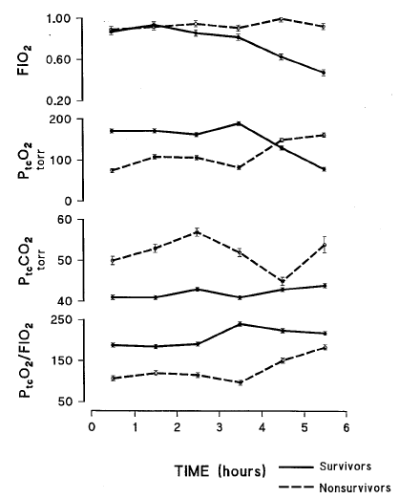
Tetevossian RG, Wo CC, Shoemaker WC. Crit Care Med 2000;28:2248-53
48 pts whit blunt and hemodynamic instability

Slide 49
Tetevossian RG, Wo CC, Shoemaker WC. Crit Care Med 2000;28:2248-53
PtcO₂ and PtCO₂ early indicators of tissue hypoxia, subclinical hypovolemia, and hemodynamic shock in ER severely ill patients.
Ptc-gas values reflect local skin perfusion during normal conditions and in period of circulatory dysfunction and shock.

Slide 50
Periop monitoring
Guidelines
Cardiovascular
Respiratory
Others: Temperature
Depth of GA
NMT
Glycemia
Lactate

Slide 51
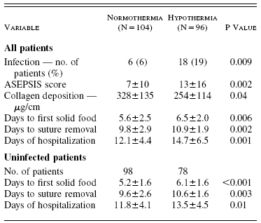
Kurz A, Sessler I, Lenhardt R. NEJM 1996;334:1209-15
80 pts elective colon surgery
Normotermia 37±0.3 °C
Ipotermia 34.4±0.4 °C
“Intraoperative core temperatures approximately 2°C below normal triple the incidence of wound infection and prolong hospitalization by about 20%.”

Slide 52
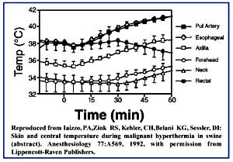
TEMPERATURE

Slide 53
Periop monitoring
Guidelines
Cardiovascular
Respiratory
Others: Temperature
Depth of GA
NMT
Glycemia
Lactate

Slide 54
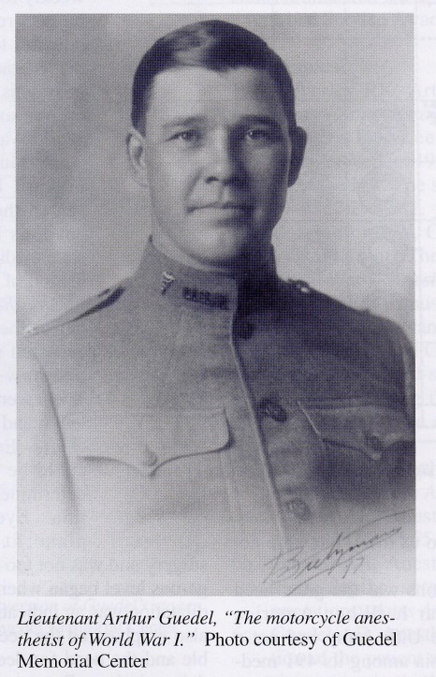
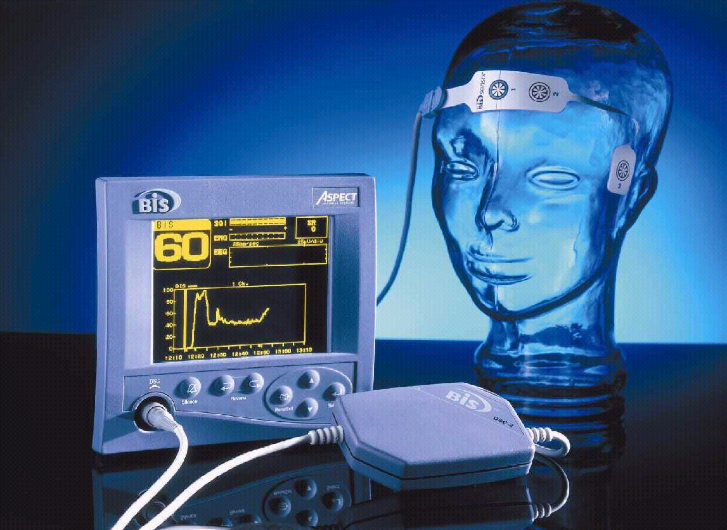
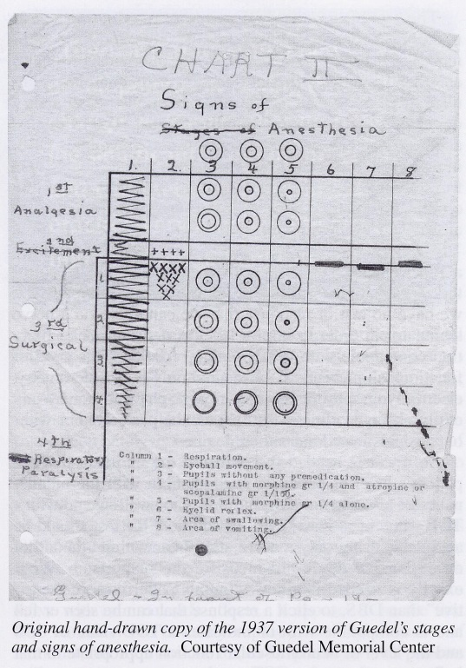
BIS…..PSA 4000 and AEP

Slide 55
BIS
100
70
60
40
0
HYPNOSIS STATE
Awake / moderate sedation
Mild hypnosis state
Low probability of awareness < 70
Moderate hypnosis state
Not awareness <60
Deep hypnosis state
EEG suppression
BIS

Slide 58
13 AWARENESS:
11 CTRL
2 BIS

Slide 59
49 Possible AWARENESS:
27 CTRL
22 BIS

Slide 61
Conclusions:
BIS cost = 16USD
To prevent 1 case of awerenwss: 2200 USD

Slide 62
Periop monitoring
Guidelines
Cardiovascular
Respiratory
Others: Temperature
Depth of GA
NMT
Glycemia
Lactate

Slide 63
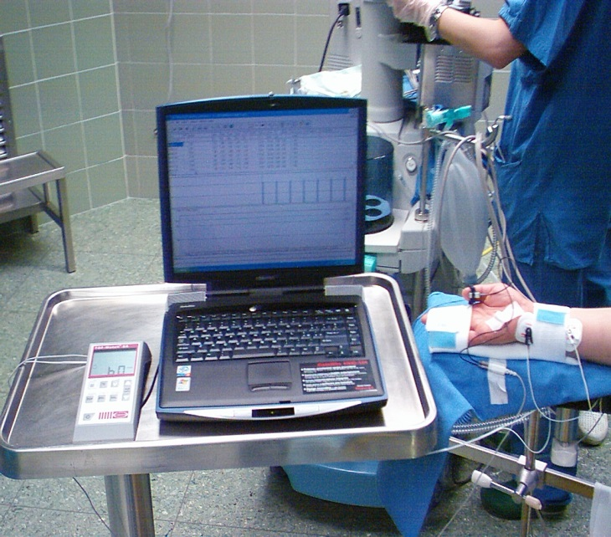
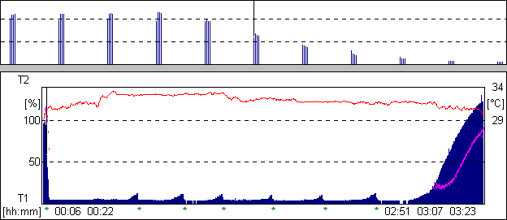
NMT MONITORING IN ANESTHESIA
_{TOF WATCH}
Reversal:
M.R. Chelant

Slide 64
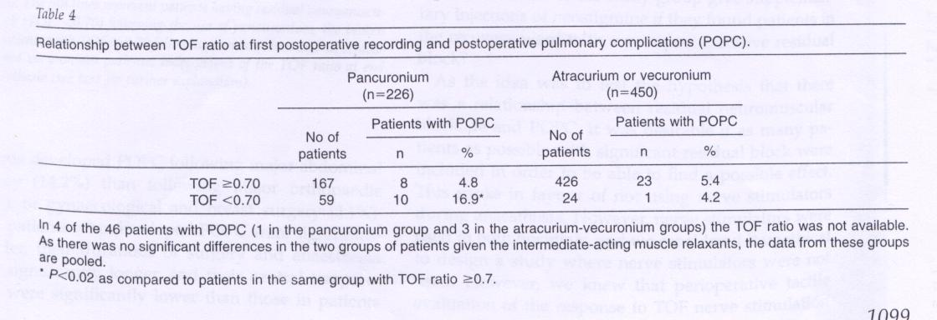
Residual neuromuscolar block is a risk factor for postoperative pulmonary complication.
Berg H, Viby-Mogensen J, Roed J et al. Acta Anaesthesiol Scand 1997;41:1095-03
691 pz →PANC-ATR-VEC
Intraop TOF ogni 12 sec
Postop TOF+Meccanomiografia
Postop Pulm Complications → ch generale maggiore
>durata
<T°C
>età
PANC se ↓ TOF

Slide 65
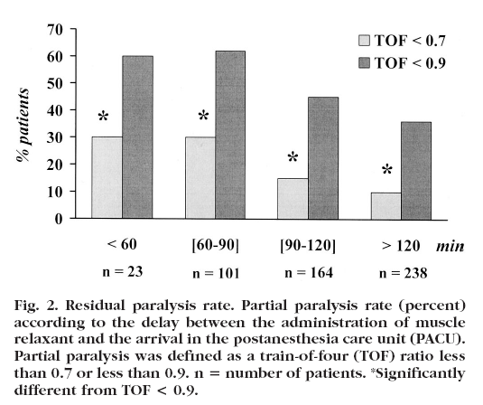
526 pz
VEC-ROC-ATR
No reveral
Anesthesiology 2003;98(5):1042-7

Slide 66
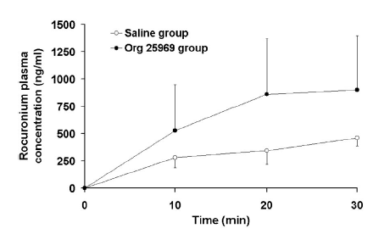
1 hour 12-19 nmol/kg/min ROC c.i. in guinea pigs
after 30 min Org 25969 c.i 50 nmol/kg/min o NS
Anesthesiology 2003;99(3):632-7

Slide 67
Periop monitoring
Guidelines
Cardiovascular
Respiratory
Others: Temperature
Depth of GA
NMT
Glycemia
Lactate

Slide 68
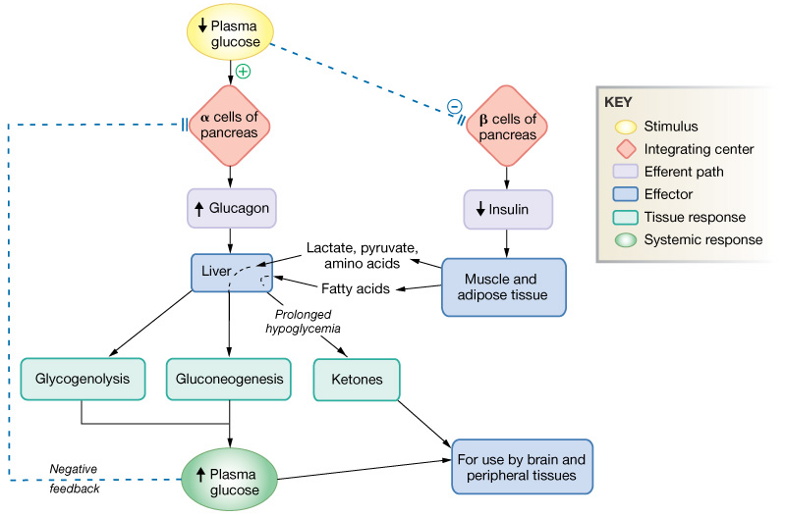
GLYCEMIC CONTROL
Splachnic perfusion

Slide 69
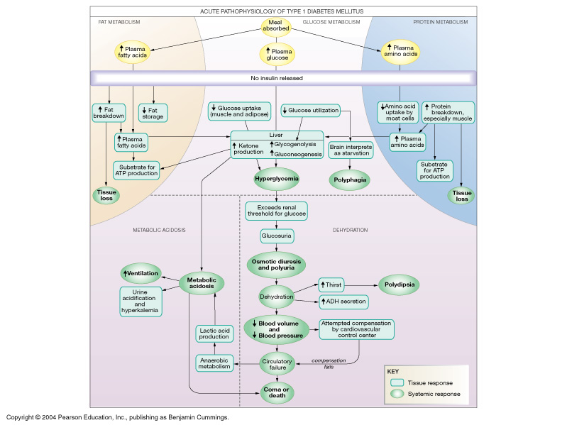
RESPONSE TO HYPERGLYCEMIA
Splachnic perfusion

Slide 70
Anesthesiology 2003; 98:774-779

Slide 71
Anesthesiology 2003; 98:774-779

Slide 72
Anesthesiology 2003; 98:774-779

Slide 73
Periop monitoring
Guidelines
Cardiovascular
Respiratory
Others: Temperature
Depth of GA
NMT
Glycemia
Lactate

Slide 74
“Lactate metabolism: a new paradigm for the third millenium”
Tissue hypoperfusion, hypoxia and resulting anaerobic glycolysis are probably not the only causes of increased La⁻ production during shock
Lactate plays an important role as intermediatory in numerous metabolic process, a mobile fuel for aerobic metabolism, perhaps a mediator of redox state among various compartment both within and between cells
Gladden JB. J Physiol 2004; 558: 5-30

Slide 75
“Lactate metabolism: a new paradigm for the third millenium”
Lactate can no longer be considered the usual suspect for metabolic crimes, but is instead a central player in cellular, regional and whole body metabolism”
Gladden JB. J Physiol 2004; 558: 5-30

Slide 76
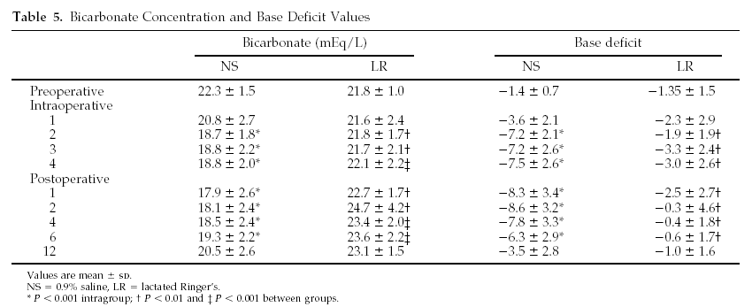
Anesth Analg 2002; 95: 294-8

Slide 77
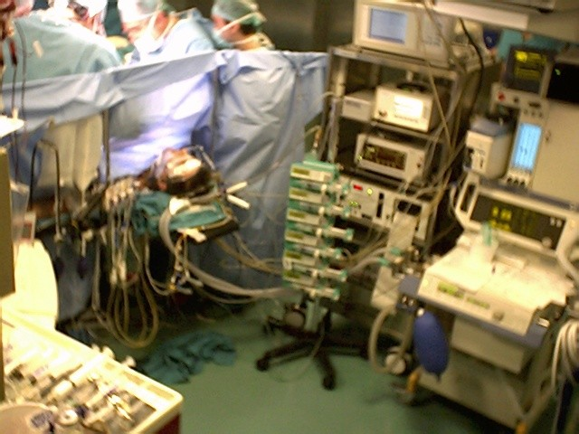
CONCLUSIONS

Slide 78
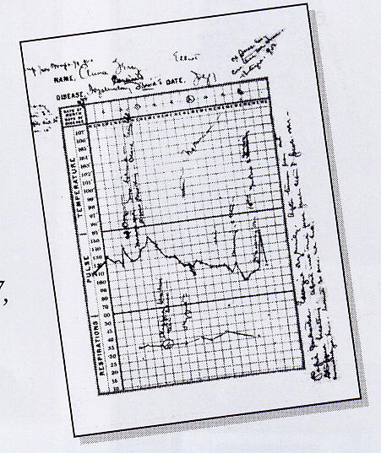
COMPUTERIZED CHART KEEPING IS AN ESSENTIAL PART OF MONITORING

Slide 79
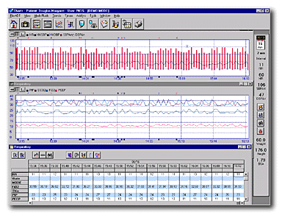
DATA CAN ACCESSEDBY:
On line
Trends
Snap Shots

Slide 80
“Vital signs” monitoring:
When ?
Where ?
How ?
Why ?
type of surgery and pt condition
OR and/or ICU / PACU / Ward
…….. “several” techniques
to manage….to improve outcome

Slide 81
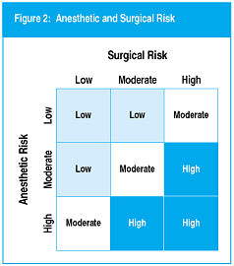
ASA News Letter 2002

Slide 82
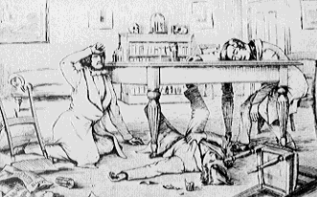
Conclusion:
YOU ALL ARE EXHAUSTED

