Slide 1
Lecture Title : General Anesthesia
Lecturer name: Dr. Sadia Qureshi
Lecture Date: October 12, 2015

Slide 2
Lecture Objectives.. Students at the end of the lecture will be able to:
Define general Anesthesia
Learn about several agents used for induction of general anesthesia including intravenous agents, inhalation agents, neuromuscular blocking agents and reversal agents.
Understand basic advantages and disadvantages of these agents.
Complications commonly encountered during general anesthesia

Slide 3
Role of Anesthetists
Preoperative evaluation and patient preparation
Intraoperative management
- General anesthesia
Inhalation anesthesia
Total IV anesthesia
- Regional anesthesia & pain management
Spinal, epidural & caudal blocks
Peripheral never blocks
Pain management (acute and chronic pain)
Post anesthesia care (PACU management)
Anesthesia complication & management

Slide 4
General anesthetics have been used since 1846 when Morton demonstrated the first anesthetic (using ether) in Boston, USA.
Local anesthetics arrived later, the first being scientifically described in1884.

Slide 5
General anesthesia is described as a reversible state of unconsciousness with inability to respond to a standardized surgical stimulus.
In modern anesthetic practice, this involves the triad of: unconsciousness, analgesia, muscle relaxation.

Slide 6
The primary goal is the maintenance of physiologic homeostasis. This includes monitoring and treatment of cardiovascular, pulmonary, neurological and renal functions and changes during perioperative period to minimize adverse outcomes. Optimizing intraoperative physiology may help speed recovery & perioperative organ system protection.

Slide 7
Objectives of Anesthesia
Unconsciousness
Amnesia
Analgesia
Oxygenation
Ventilation
Hemostasis
Airway Management
Reflex Management
Muscle Relaxation
Monitoring

Slide 8
General Anesthesia
Assessment
Planning I: Monitors
Planning II: Drugs
Planning III: Fluids
Planning IV: Airway Management
Induction
Maintenance
Emergence
Postoperative care

Slide 9
Preoperative anesthetic evaluation
Risks of Anesthesia

Slide 10
Physical status classification
Class I: A normal healthy patient.
Class II: A patient with mild systemic disease (no functional limitation)
Class III: A patient with severe systemic disease (some functional limitation)
Class IV: A patient with severe systemic disease that is a constant threat to life (functionality incapacitated)
Class V: A moribund patient who is not expected to survive with or without the operation.
Class VI: A brain-dead patient whose organs are being removed for donor purposes
Class E: Emergent procedure

Slide 11
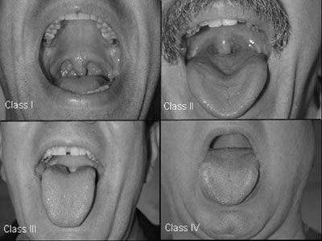
Airway examination
Mallampati classification
Class I:
uvula, faucial pillars, soft and hard palate visible
Class II:
faucial pillars, soft and hard palate visible
Class III:
soft and hard palate visible
Class IV:
hard palate visible

Slide 12
NPO status
NPO, Nil Per Os, means nothing by mouth
Solid food: 8 hrs before induction
Liquid: 4 hrs before induction
Clear water: 2 hrs before induction
Pediatrics: stop breast milk feeding 4 hrs before induction

Slide 13
Anesthetic plan
Premed
Intraop. management Postop. management
General Monitoring Pain control
PONV
Airway Management Positioning Complications Induction Fluid management postop.ventilation Maintenance Special techniques Hemodynamic mont.
Muscle relaxation

Slide 14
General Anesthesia
Monitor
Pre-oxygenation
Induction ( including RSI & cricoid pressure)
Mask ventilation
Muscle relaxants
Intubation & ETT position confirmation
Maintenance
Emergence

Slide 15
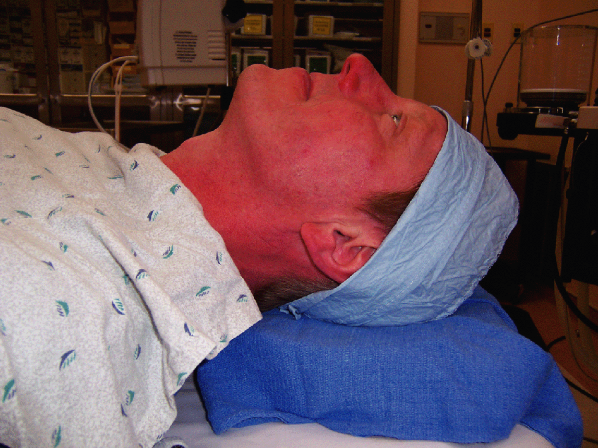
Sniffing position

Slide 16
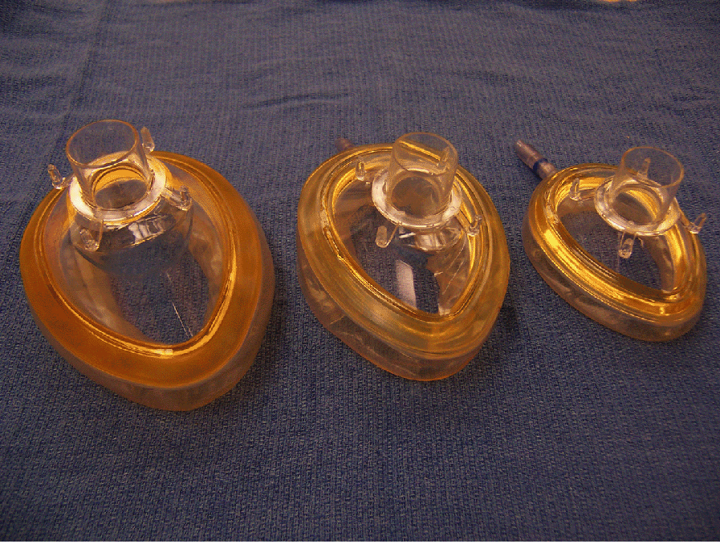
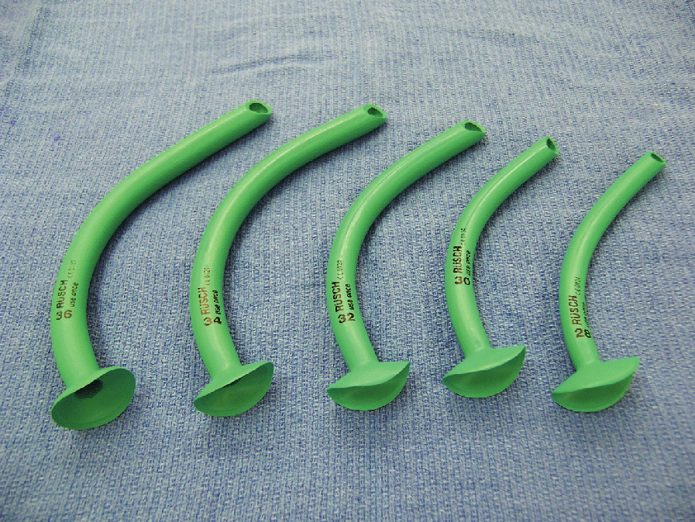
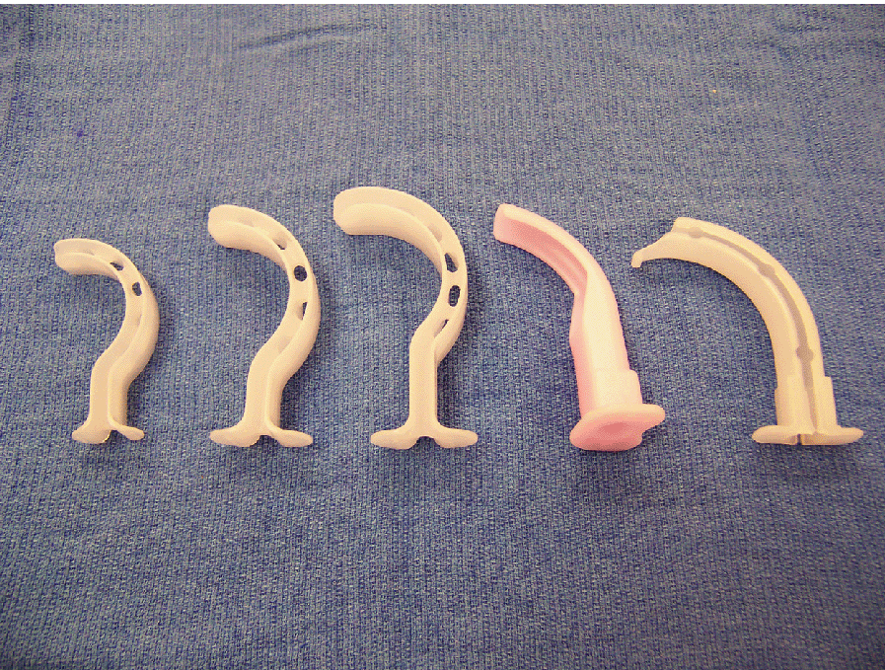
Mask and airway tools

Slide 17
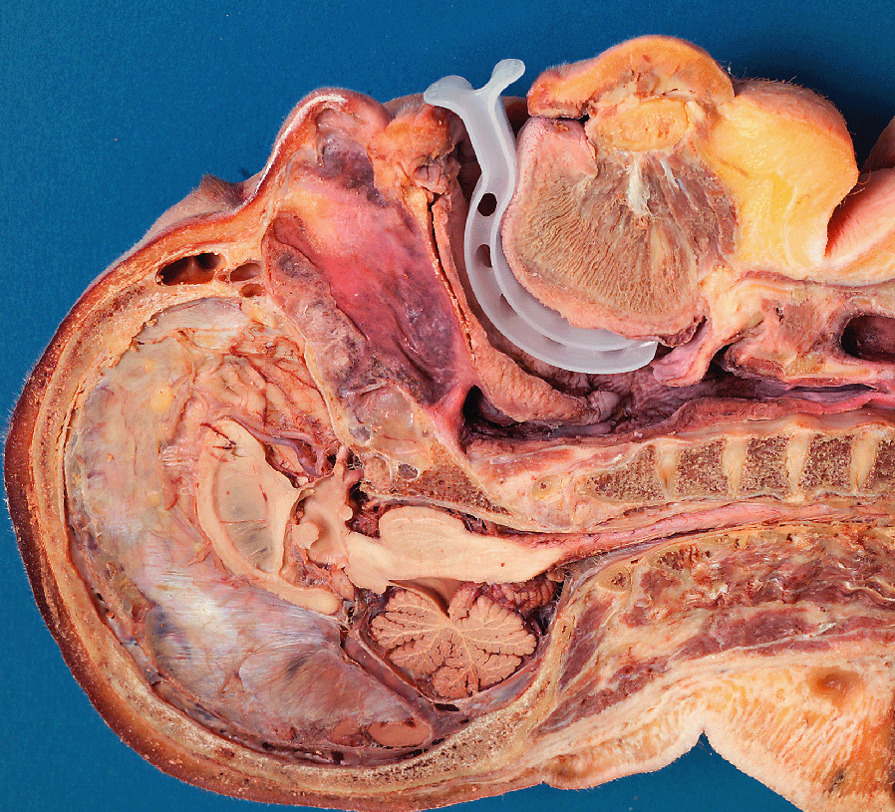
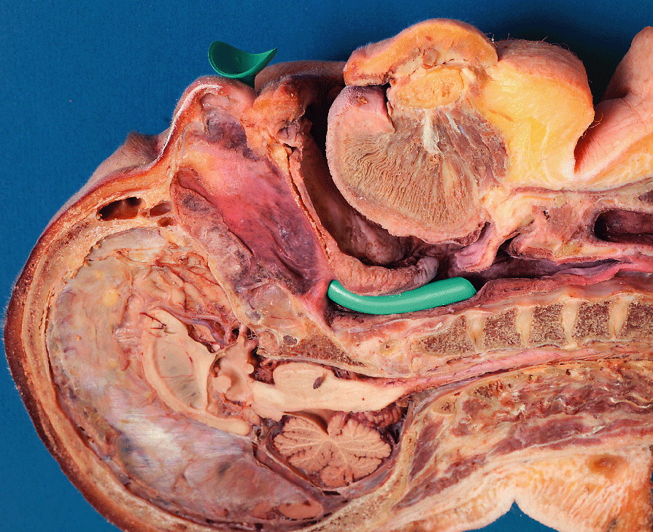
Oral and nasal airway

Slide 18
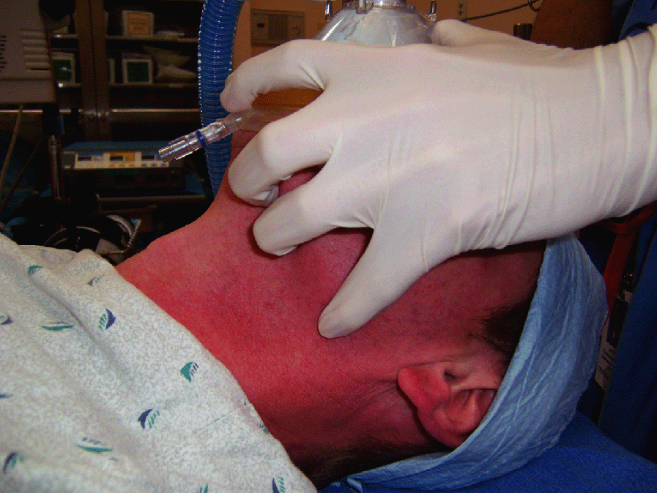
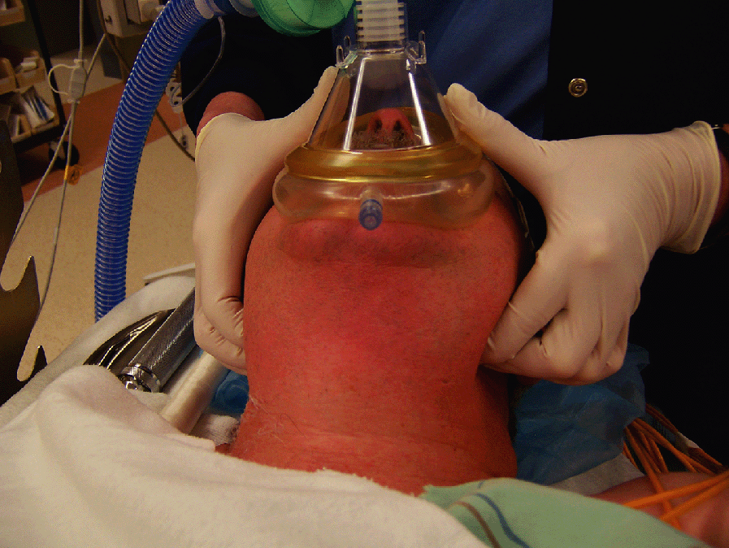
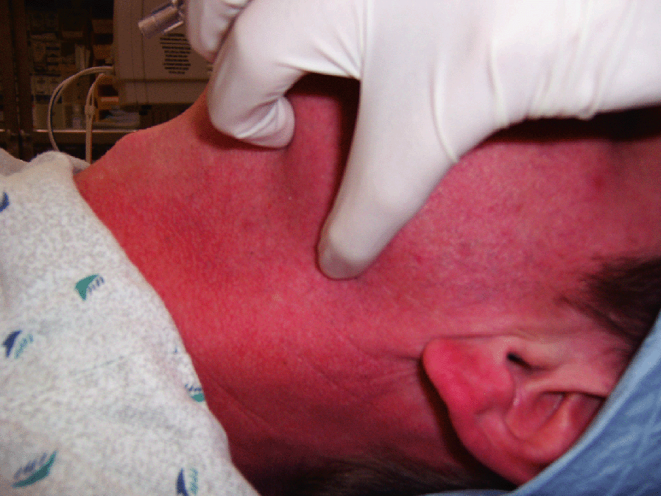
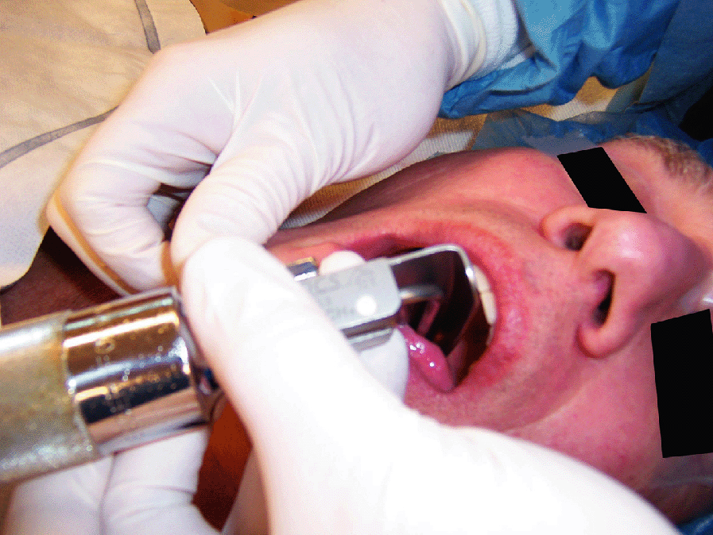
Mask ventilation and intubation

Slide 19
Difficult BMV- MOANS
MASK SEAL: mask seal requires normal anatomy, absence of facial hair, lack of interfering substances like vomitus or bleeding & ability of apply mask with pressure.
OBSTRUCTION/ OBESITY: Obstruction of upper airway, obesity (BMI greater than 26) is an independent marker. Redundant upper airway tissue, chest wall weight & resistance from abdominal contents impede airflow.
AGE: General loss of elasticity & increased incidence of restrictive /obstructive lung disease with increasing age.
NO THEETH: Edentulous creates difficulty.
STIFFNESS: Resistance to ventilation with COPD, Asthma, Pulmonary edema.

Slide 20
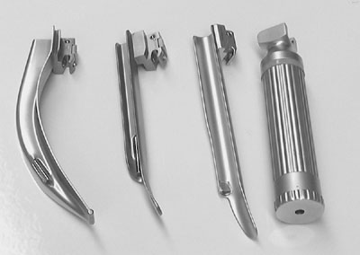
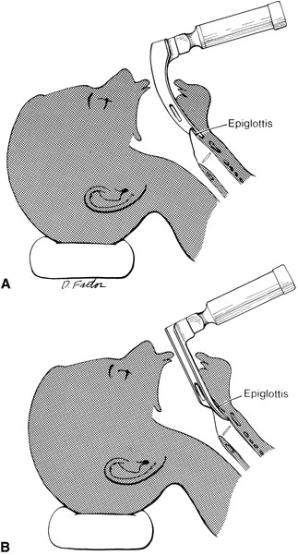
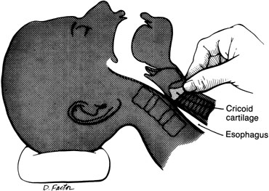
Intubation

Slide 21
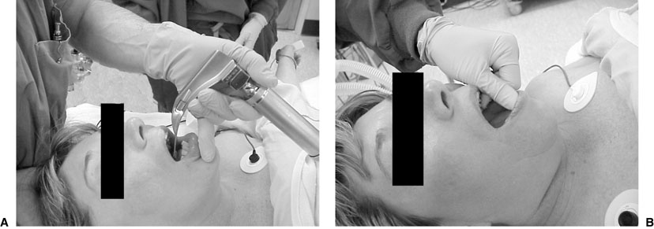
Intubation

Slide 22
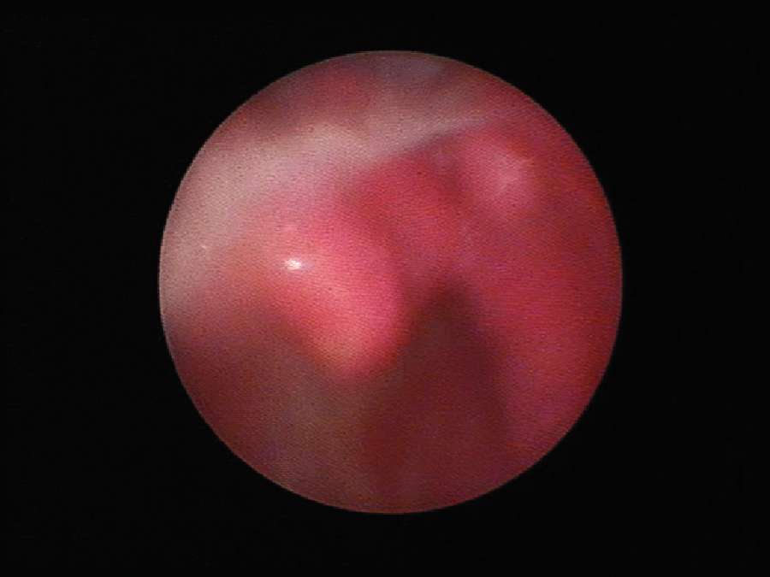
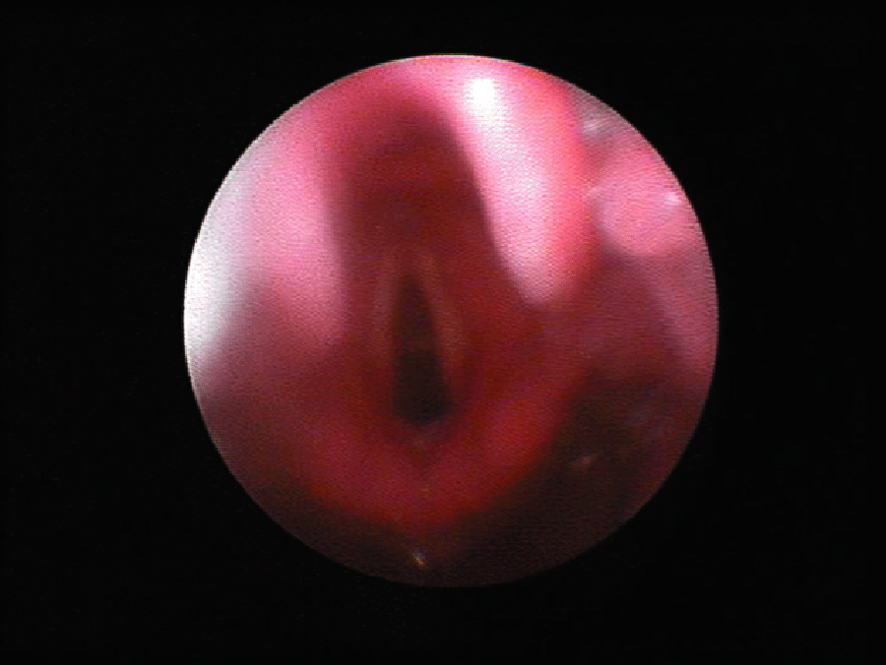
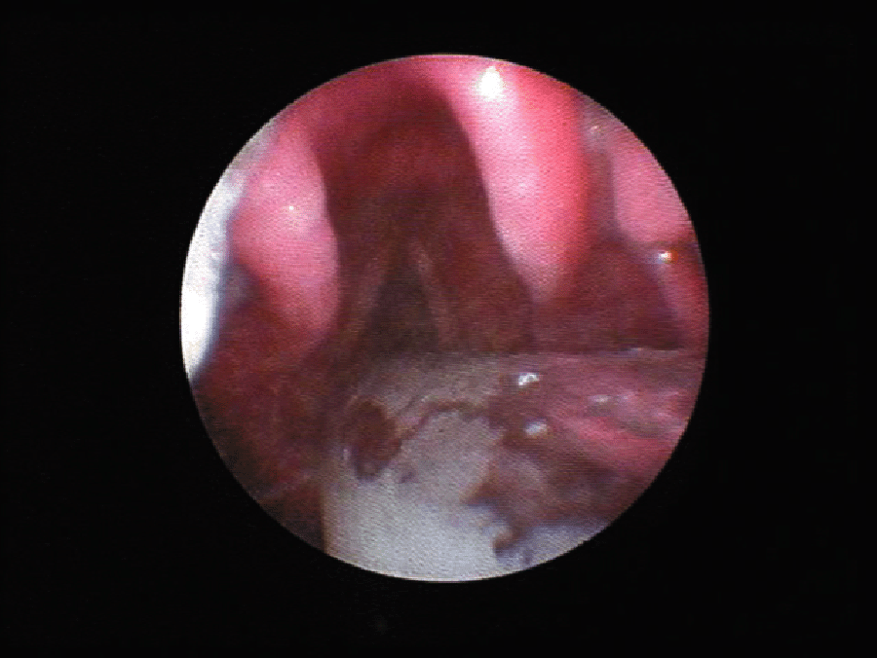
Laryngeal view

Slide 23
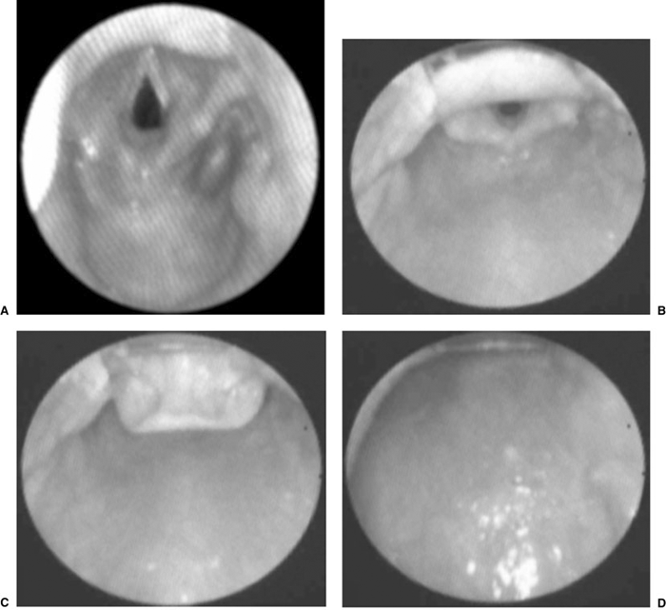
Laryngeal view scoring system

Slide 24
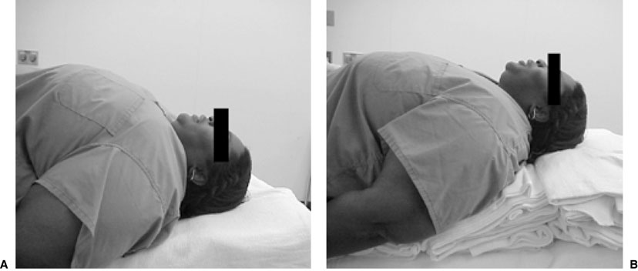
Difficult airway

Slide 25
The LEMON Approach
LOOK EXTERNALLY: Abnormal facies, unusual anatomy or facial Trauma.
EVALUATE (3-3-2 rule):3 fingers between the incisors, 3 fingers along the floor of the mandible b/w the mentum and the neck mandible junction & 2 fingers in the superior laryngeal notch. This predicts difficulty in visualizing the glottis.
MALLAMPATTI SCORE:III predicts difficulty and IV predicts extreme difficulty.
OBSTRUCTION/ OBESITY.
NECK MOBILITY.

Slide 26
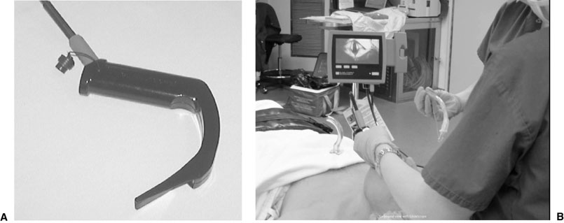
Glidescope

Slide 27
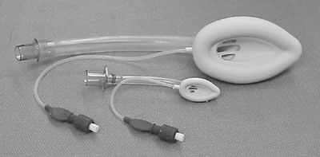
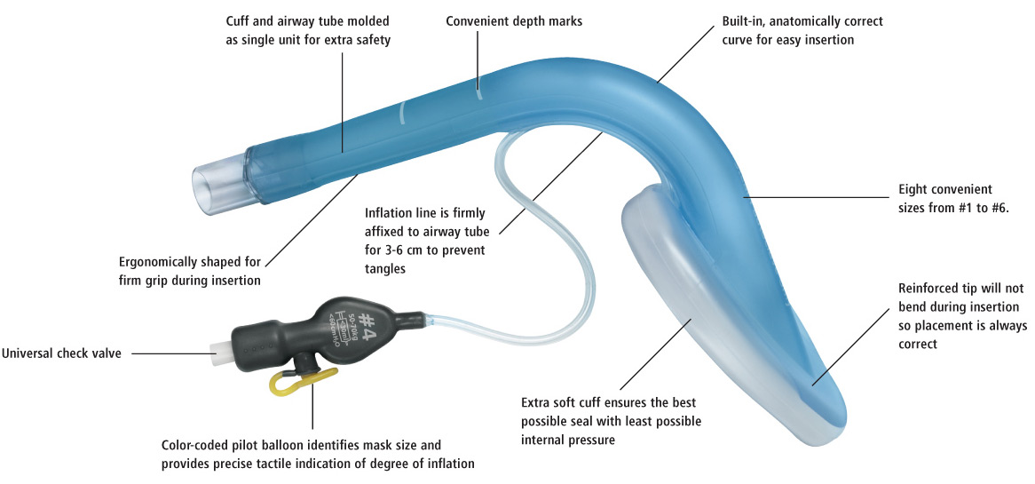
LMA

Slide 28
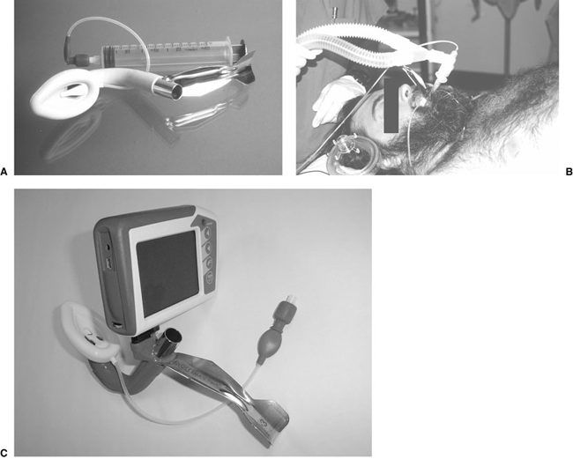
Fast track LMA

Slide 29
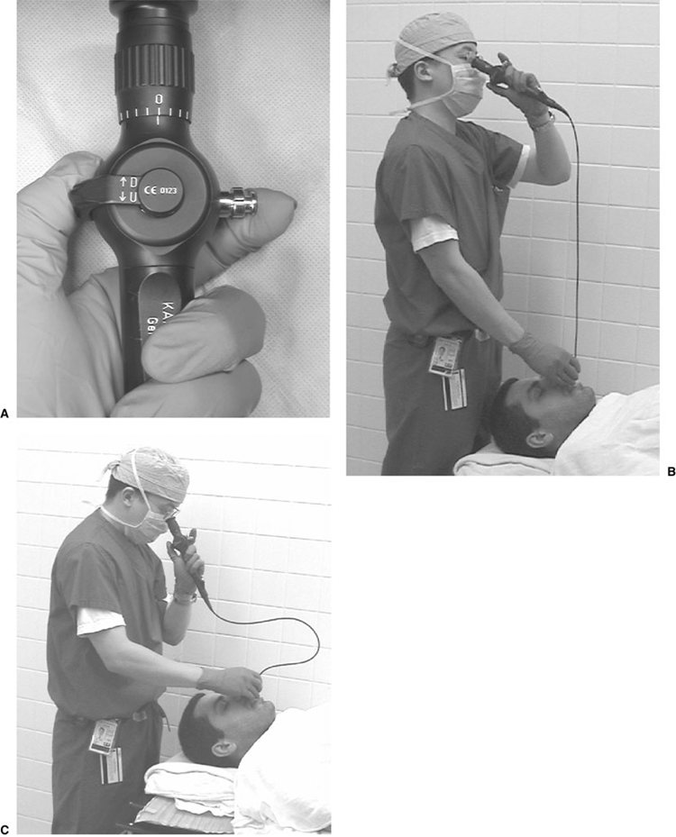
Fiberoptic intubation

Slide 30
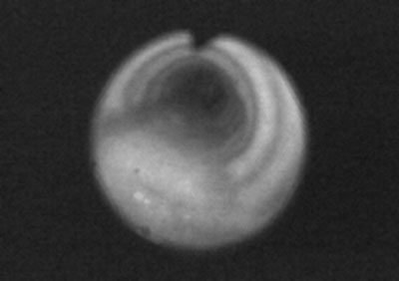
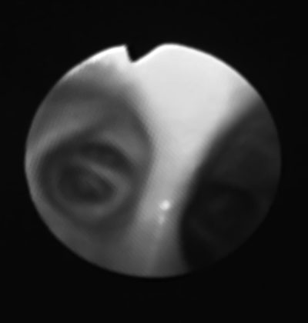
Trachea view Carina view

Slide 31
Induction agents
Opioids – fentanyl
Propofol, Thiopental and Etomidate
Muscle relaxants:
Depolarizing
Nondepolarizing

Slide 32
Induction
IV induction
Inhalation induction

Slide 33
General Anesthesia
Reversible loss of consciousness
Analgesia
Amnesia
Some degree of muscle relaxation

Slide 34
Intraoperative management
Maintenance
Inhalation agents: N2O, Sevo, Deso, Iso.
Total IV agents: Propofol
Opioids: Fentanyl, Morphine
Muscle relaxants
Balance anesthesia

Slide 35
Intraoperative management
Monitoring
Position –supine, lateral, prone, sitting, lithotomy
Fluid management
- Crystalloid vs colloid
- NPO fluid replacement:
1st 10kg weight-4ml/kg/hr,
2nd 10kg weight-2ml/kg/hr and 1ml/kg/hr thereafter
- Intraoperative fluid replacement:
minor procedures 1-3ml/kg/hr,
major procedures 4-6ml/kg/hr,
major abdominal procedures 7-10ml/kg/hr

Slide 36
Intraoperative management Emergence
Waking up is a crucial time where there is short period when the patient’s body is aware of emergence without a full return to consciousness.
Turn off the agent (inhalation or IV agents)
Reverse the muscle relaxants
Return to spontaneous ventilation with adequate ventilation and oxygenation
Suction upper airway
Wait for patient to wake up and follow command
Hemodynamically stable

Slide 37
Postoperative management
Post-anesthesia care unit (PACU)
- Oxygen supplement
- Pain control
- Nausea and vomiting
- Hypertension and hypotension
- Agitation
Surgical intensive care unit (SICU)
- Mechanical ventilation
- Hemodynamic monitoring

Slide 38
General Anesthesia Complications
Respiratory complications
- Aspiration – airway obstruction and pneumonia
- Bronchospasm
- Atelectasis
- Hypoventilation
Cardiovascular complications
- Hypertension and hypotension
- Arrhythmia
- Myocardial ischemia and infarction
- Cardiac arrest

Slide 39
General Anesthesia Complication and Management
Neurological complications
- Slow wake-up
- Stroke
Malignant hyperthermia

Slide 40
Case Report Arterial oxygen desaturation following PCNL

Slide 41
The Patient
Patient : 73 y/o Female
BW 68 kg, BH 145 cm (BMI 32)
Chief complaint :
Right flank pain (stabbing, frequent attacks)
General malaise and fatigue

Slide 42
The Patient
Past history : Hypertension under regular control
Senile dementia (mild)
Preoperative diagnosis : Right renal stone (3.2 cm)
Operation planned : Right PCNL
(percutaneous nephrolithotomy)

Slide 43
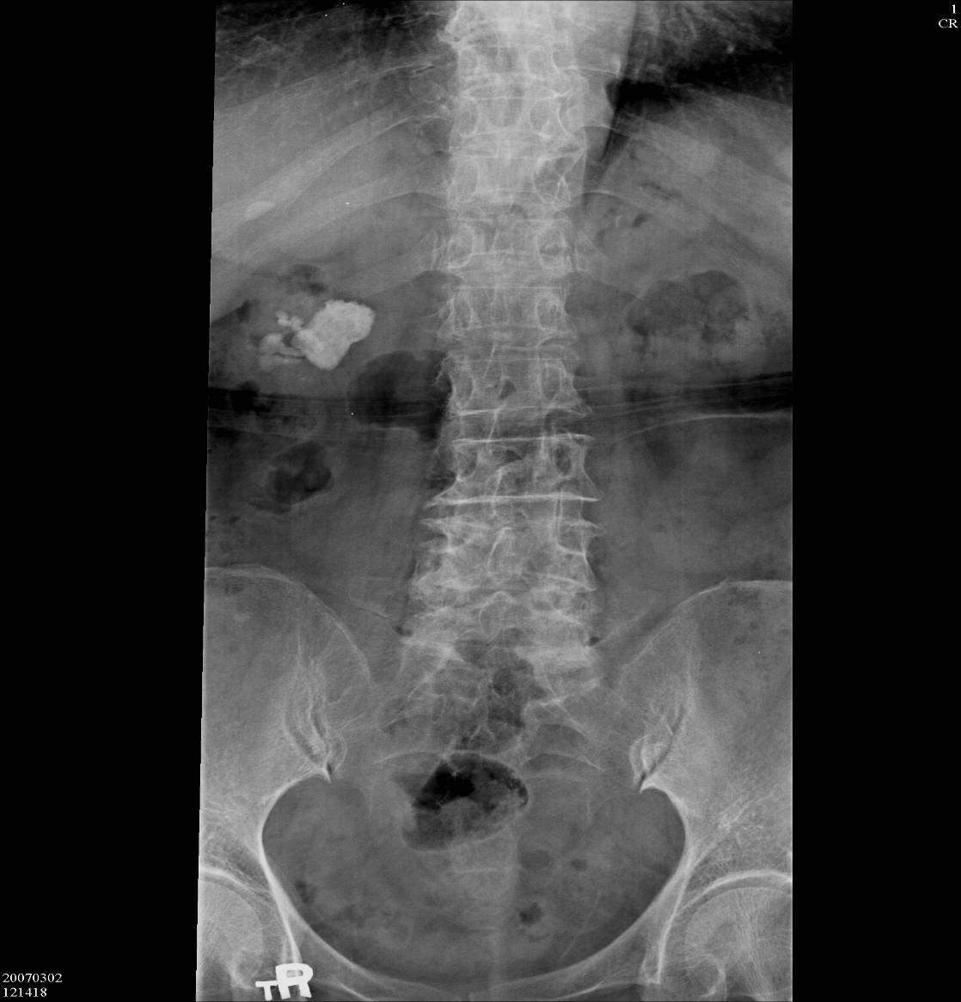

Slide 44
Pre-anesthetic Assessment
EKG : Normal sinus rhythm
CXR : Borderline cardiomegaly & tortous aorta
Lab data : Hb 10.5 / Hct 33.2
BUN 24 / Creatinine 1.1
GOT 14
PT, aPTT WNL

Slide 45
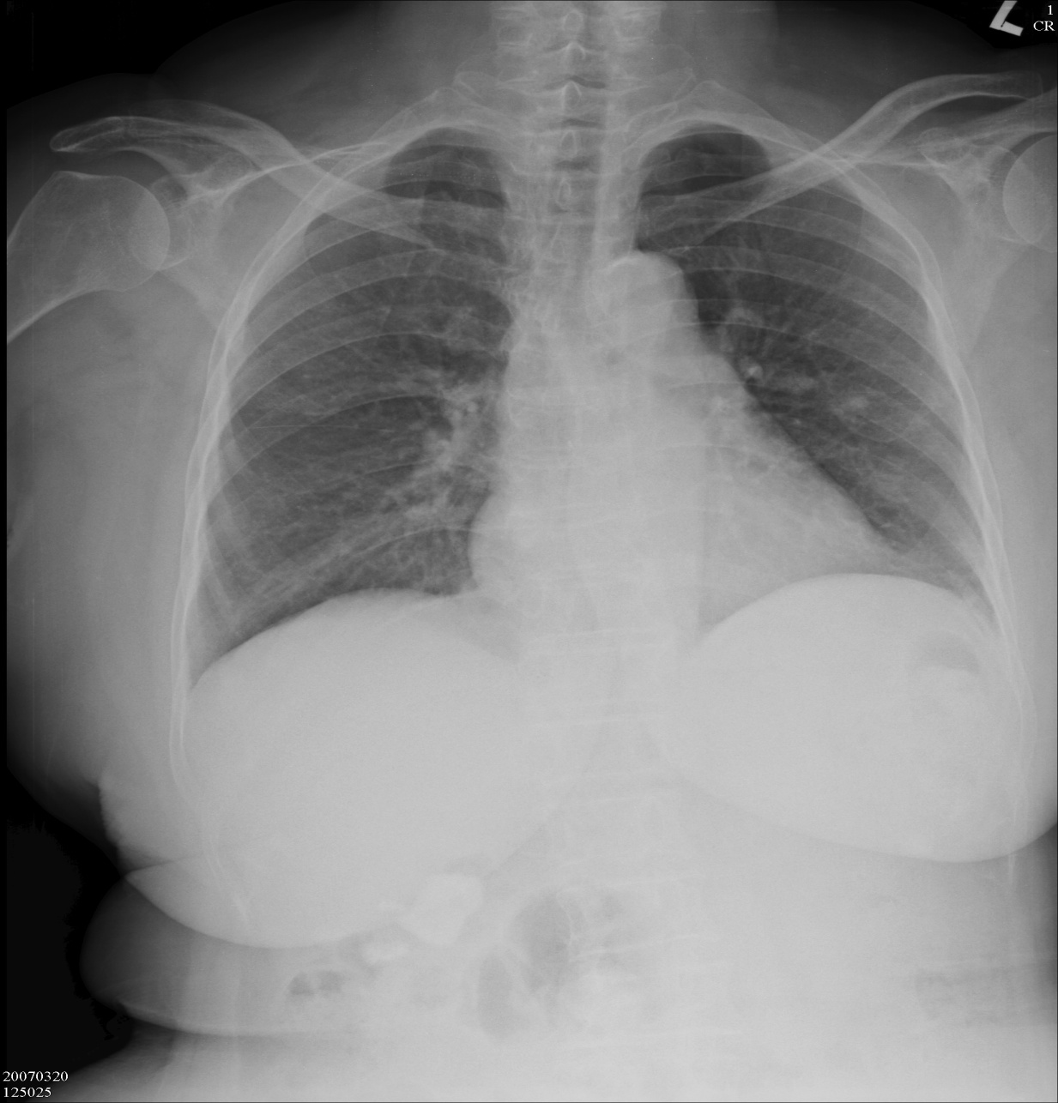
Preop

Slide 46
Anesthetic Technique
General anesthesia with endotracheal intubation
Standard monitoring apparatus for ETGA
Induction : Fentanyl 1ug/kg
propofol 2mg/kg
Succinylcholine 80 mg
Atracurium 25 mg
Endotracheal tube reinforced (ID 7.0-mm) @ 19cm
Maintenance: Isoflurane 2~3% in O2 0.5 L/min
Position: prone
Blood loss : 300 mL → PRBC 2U

Slide 47
Intra-operative Events
Stable hemodynamics
Abnormal findings 30 minutes after surgery started
Increased airway pressure 35~40 mmHg
SpO2 dropped to 90~95%
Bilateral breathing sounds were still audible then
Management : Solu-cortef 100 mg IV stat
Aminophylline 250 mg IV drip
Bricanyl 5 mg inhalation

Slide 48
Intra-operative Events
pH | 7.2
PaO₂ | 90.5
PaCO₂ | 66.8
HCO₃⁻ | 26.0
BE | -2.4
Na⁺ | 143.0
K ⁺ | 4.0
Ca² ⁺ | 1.1
Hb/Hct | 11.4/36.1
ABG data

Slide 49
Post-operative Course
The patient’s condition continued until the end of surgery
SpO₂ 90~92% after the patient was placed in the supine position again with diminished breathing sound over right lower lung
The patient was transferred to SICU for further care (*)
Chest X-ray was followed in SICU

Slide 50
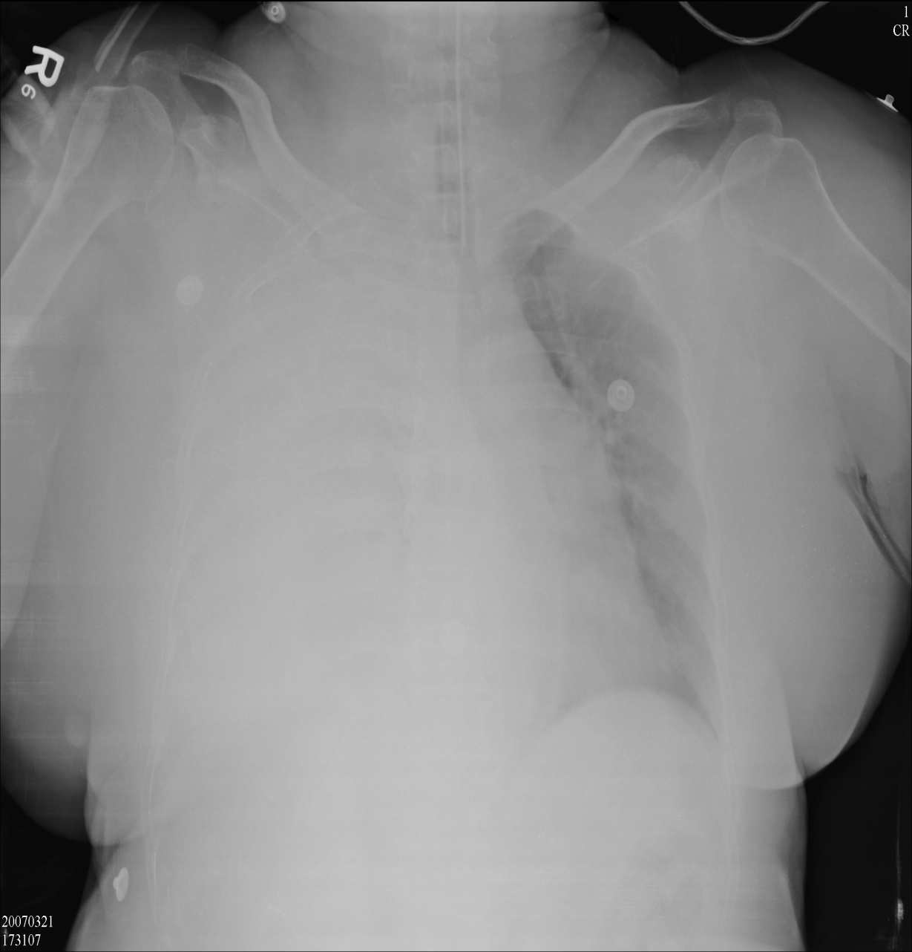
Immed.
Postop

Slide 51
Preop
Immed. Postop

Slide 52
Postoperative Course
Pigtail drainage in SICU
Pleural effusion : bloody
RBC numerous
WBC 7800 (Seg 94%)
Gram stain (-)
Impression : Right hydrothorax and hemothorax

Slide 53
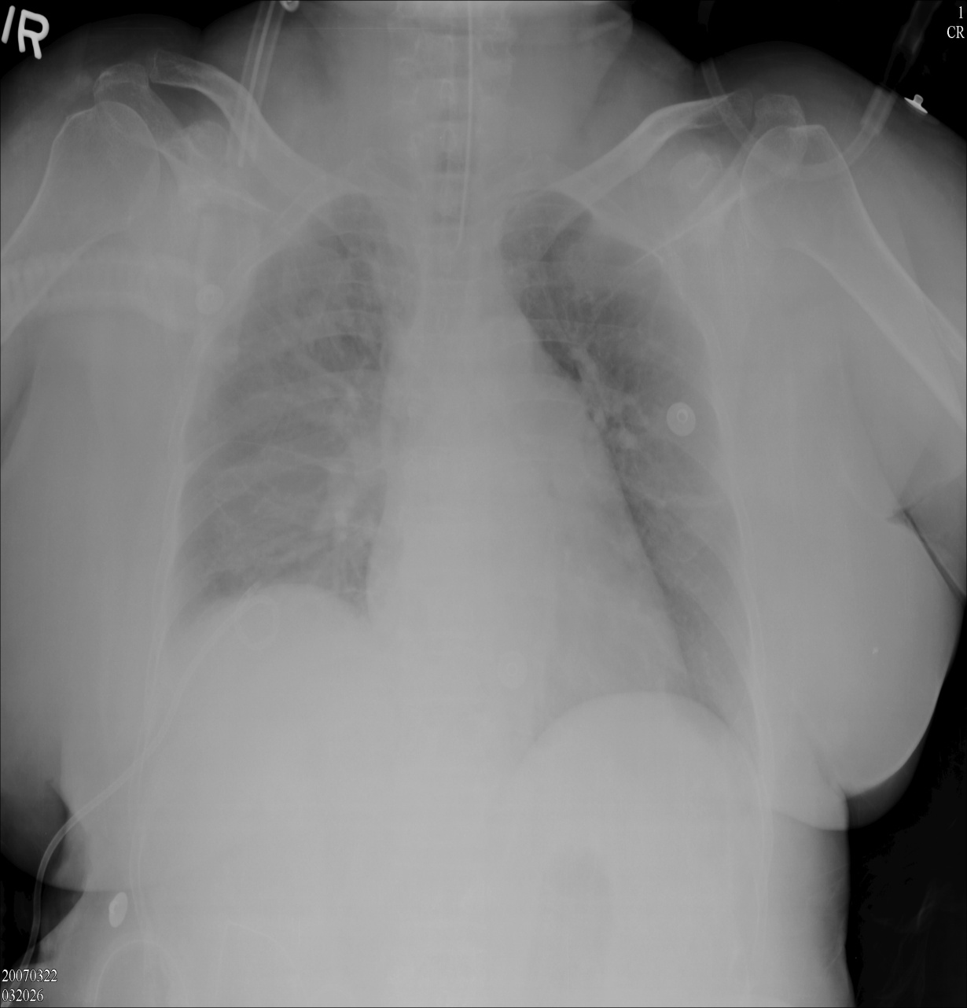
s/p pigtail

Slide 54
Immed. Postop
s/p pigtail

Slide 55
Postoperative Course
Extubation and transfer to ordinary ward
Pigtail removed

Slide 56
Thank You

