Slide 1
Case 8 Approach To Patient Monitoring
Group B

Slide 2
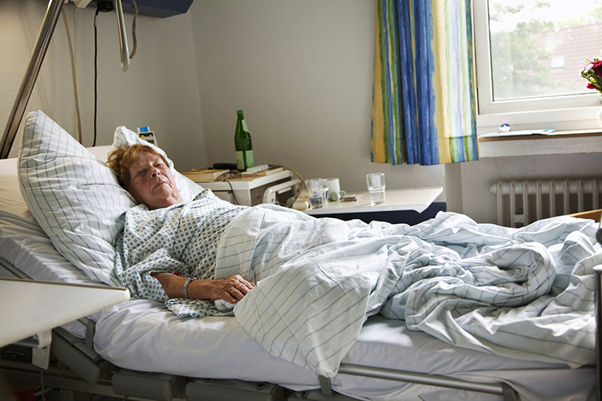
Case Scenario
The surgeons have requested a brief general anesthetic for change of dressing to an open infected wound. They suggest that the procedure can be performed in the patient’s bed on the hospital floor.
Notes:
Pic Source: http://safepatientstandard.com/overworked-staff-leads-to-patients-spending-too-much-time-in-bed/

Slide 3
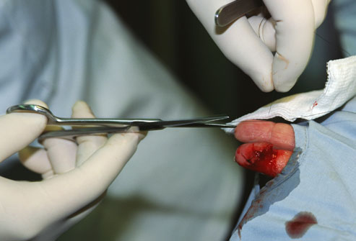
Does this patient need special monitoring for this procedure?
Yes, he does.

Slide 4
What this patient’s monitoring must adhere to ?
The standards for basic monitoring published by the ASA
STANDARD I :
Qualified anesthesia personnel shall be present in the room throughout the conduct of all general anesthetics, regional anesthetics and monitored anesthesia care.
STANDARD II :
During all anesthetics, the patient’s oxygenation, ventilation, circulation and temperature shall be continually evaluated.

Slide 5
1. Oxygenation
2. Ventilation
3. Circulation
4. Temperature
5. Urine Output
6. Invasive Monitoring
7. Monitoring of Neurological Function
8. Monitoring of Neuromuscular Function

Slide 6
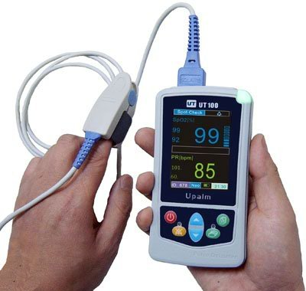
Oxygenation
Pulse oximeter.
Notes:
http://theladdermn.org/2013/03/02/february-ladder-meeting-recap-the-lungs/

Slide 7
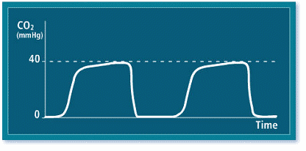
Ventilation
Capnogram + Chest Excursion + breath sounds and observation of the reservoir breathing bag.
Notes:
http://www.chsbuffalo.org/files/videos/alvarispump/etco2/t1/p07.htm

Slide 8
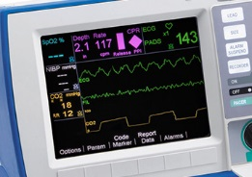
Circulation
Non-invasive blood pressure and heart rate.
Notes:
http://www.zoll.com/au/medical-products/defibrillators/r-series/etco2/

Slide 9
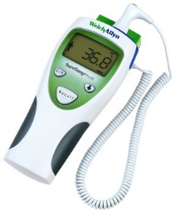
Temperature
Temperature probe
Notes:
http://www.mortonmedical.co.uk/Welch_Allyn_SureTemp_Plus_Electronic_Oral_Thermometer~p~462.htm

Slide 10
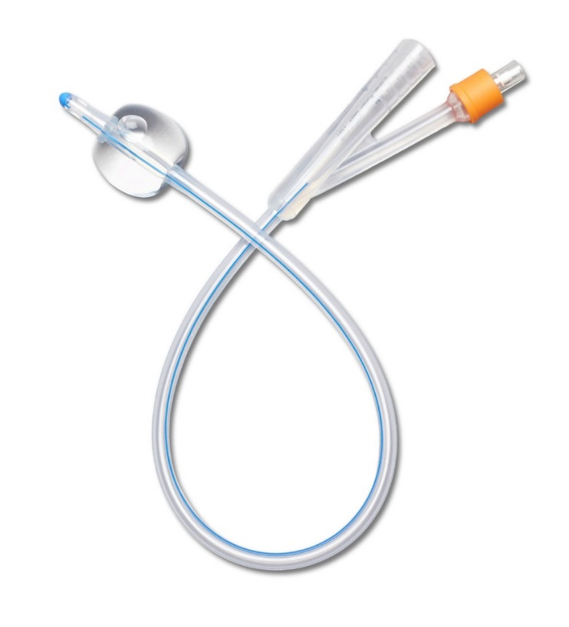
Urine Output
Catheter
Notes:
http://www.courseyenterprises.com/images/uploaded_images/kit/1203046350514ca91689c75..jpg

Slide 11
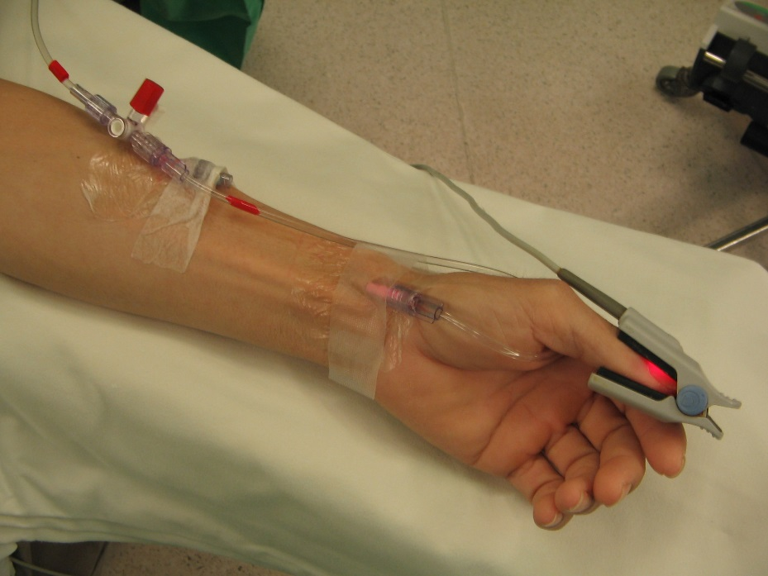
Invasive Monitoring
Intra-arterial blood pressure.
Notes:
http://137.189.150.13/site/ana/Reference.asp?topic=INTRA-OPERATIVE%20MONITORING

Slide 12
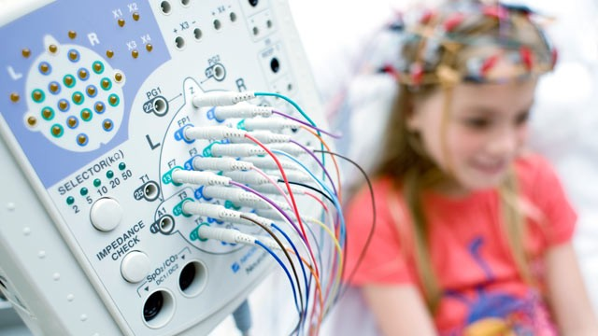
Monitoring of Neurological Function
Electroencephalogram (EEG)
Notes:
http://qeegsupport.com/

Slide 13
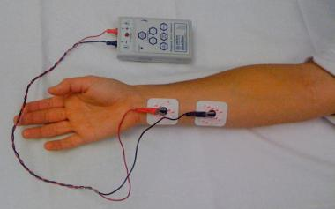
Monitoring of Neuromuscular Function
Peripheral nerve stimulation
Notes:
http://emedicine.medscape.com/article/2009530-overview

Slide 14
References
STANDARDS FOR BASIC ANESTHETIC MONITORING (Approved by the ASA House of Delegates on October 21, 1986 , and last amended on October 20, 2010 with an effective date of July 1, 2011).

Slide 15
Thank You

