Slide 1
PBL case 4 group C
Maha alghofaily Maryam fawaz
Malak alghamdi Najla alromaih
Malak alsanea Raghad almotlaq
Manar aleid Modi sattam
Marwah zummo Noor alzahrani
Nourah alajmi Nourah alzaidy

Slide 2
Case 4 : Difficult Airway
A 35-year-old woman presents for laparoscopic lysis of adhesions. Her first laparotomy occurred 10 years prior to this admission. At that time, the process of tracheal intubation consumed 1 hour. She awakened with a very sore throat, but does not know the details of the intubation.

Slide 3
What are the predictors of difficult mask ventilation?
Five factors were found to be independently associated with difficult mask ventilation
Age > 55
BMI > 26
A reduced posterior airway space behind the base of the tongue is associated with an increased BMI
Lack of teeth
Presence of beard
Poor mask fit and gas leak are the intuitive anatomical pathology relating presence of a beard and grade 3 MV. A beard is the only easily modifiable risk factor for DMV

Slide 4
What are the predictors of difficult mask ventilation?
History of snoring
Snoring is due to the reduced posterior airway space behind the base of the tongue which impairs the airway patency during sleep and an upper airway obstruction can occur after induction of general anesthesia.
Patient with active airway obstruction (tumor, abscess, laryngeal edema) will also likely be difficult to ventilate

Slide 5
Discuss the risk factors for difficult intubation?
1. Mallampati Evaluation:
The basis of the Mallampati evaluation is to judge the size of the tongue in relation to the oral cavity as the tongue must be displaced for adequate laryngoscopic view.
2. Thyromental Distance
Thyromental distance (TMD) can be used to estimate mandibular space. During laryngoscopy the tongue is displaced into the mandible and a short TMD suggests inadequate space for the tongue.
3. Interincisor Gap
4. Atlanto-occipital extension (facilitates visualization of the cords, less than 35 degrees may be predictive of difficult intubation

Slide 6
How is the anticipated difficult intubation approached?
If a difficult airway is known or suspected, the anesthesiologist should
1. Inform the patient (or responsible person) of the special risks and procedures pertaining to management of the difficult airway.
2. Ascertain that there is at least one additional individual who is immediately available to serve as an assistant in difficult airway management.

Slide 7
How is the anticipated difficult intubation approached?
3. Administer face mask preoxygenation before initiating management of the difficult airway. The uncooperative or pediatric patient may impede opportunities for preoxygenation.
4. Actively pursue opportunities to deliver supplemental oxygen throughout the process of difficult airway management. Opportunities for supplemental oxygen administration include (but are not limited to) oxygen delivery by nasal cannulae, face mask, laryngeal mask airway (LMA), insufflation, or jet ventilation during intubation attempts; and oxygen delivery by face mask, blow-by, or nasal cannulae after extubation of the trachea.

Slide 8
Describe the management options for a patient who, after induction of anesthesia, unexpectedly cannot be intubated with a Macintosh blade. This patient has a good mask airway.

Slide 9
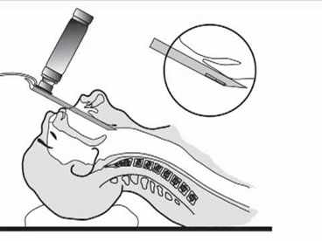
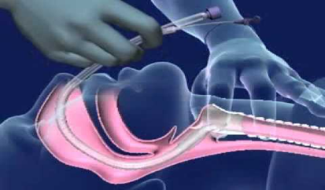
A facemask and 100% oxygen.
Miller blade
Can elevate the epiglottis
Affect the teeth
it hard to use a straight blade if the patient can’t tilt their head back.
Flexible fiber optic laryngoscopy
Reduced weight for improved balance and maneuverability facilitates even the most difficult intubations to help improve patient care
Nasotracheal intubation
When orotracheal intubation is not feasible (eg, patients with limited mouth opening)

Slide 10
Following induction of anesthesia, ventilation by facemask and intubation are impossible. What maneuvers may help?

Slide 11
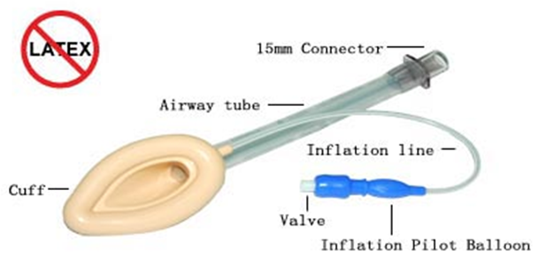
Supraglottic devices
Laryngeal mask airway (LMA)
Advantage :
Used in an emergency setting
Easy to apply by providers who are not trained in tracheal intubation
Management of a difficult airway where intubation has been unsuccessful.
Disadvantage :
It is not a definitive airway
limited protection, only from gastric aspiration.

Slide 13
How is successful endotracheal intubation is vitrified?
During intubation, direct visualization of the endotracheal tube passing through the vocal cords into the trachea constitutes firm evidence of correct tube placement
End-tidal carbon dioxide detection is the most accurate technology to evaluate endotracheal tube position in patients who have adequate tissue perfusion.

Slide 14
Other ways
auscultation of chest and epigastrium
visualization of thoracic movement
Fiber-optic observation of trachea

Slide 15
Following difficult intubation, how’s postoperative extubation managed?
before extubating the patient with a difficult airway:
one should call for assistance, have an emergency airway cart in the room (with equipment checked)
perform aggressive suctioning of the oro/hypopharynx to remove blood and secretions.
ensure adequate muscle paralysis reversal
return the patient to spontaneous ventilation and make sure that he’s hemodynamically stable
Administration of 100 percent oxygen (O2) and positive end- expiratory pressure or continuous positive airway pressure in order to maximize the safe apneic period if problems occur.
ensure the patient is sufficiently awake to protect their airway.

Slide 17
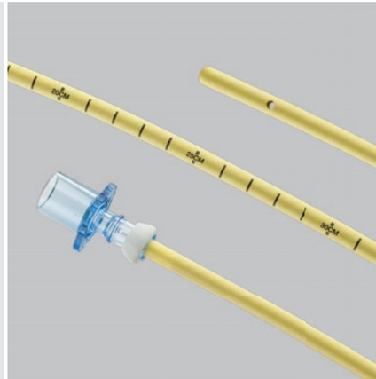
Airway Exchange Catheter
Uses: replacement of an endotracheal, when one is already in place.
Airway exchange catheter (AEC) is a Long, thin, flexible catheter.
passed through the existing ET tube into the airway
the new ETT is placed and The old tube is removed
A laryngoscope can be used to optimise the view of the larynx, ensure that the AEC is not dislodged and to displace soft tissues that might resist passage of the new tube.

