Slide 1
Case 7-Muscle Relaxants (Neuromuscular Junction Blockers)

Slide 2
Case 7
A 47-year-old patient is undergoing the clipping of an intracranial aneurysm of the anterior communicating artery under general anesthesia The surgery is being performed under a microscope, so even the smallest movement by the patient could have devastating consequences.

Slide 3
(1)
How can the patient be protected and the surgery allowed to
proceed?
For induction we do not use any IV agents that could raise intracranial pressure like ketamine. However we use thiopental, etomidate or propofol that has no significant effect on CSF
propofol an anticonvulsant and decreases the cerebral metabolic rate of oxygen consumption (CMRO₂), cerebral blood flow (CBF), and intracranial pressure (ICP); thus, it can be advantageous in patients with brain injury
Like propofol, etomidate decreases CMRO₂, CBF, and ICP.
• As for maintenance we use fentanyl and its derivatives fentanyl, remifentanil, or sufentanil) is often administered to suppress airway reflexes (eg, coughing, bronchospasm) and attenuate the stress response to laryngoscopy and endotracheal intubation that would otherwise result in tachycardia and hypertension [50-52]. Opioids supplement sedation and reduce the dose requirement of the selected (intravenous (IV) induction agent (eg, propofol

Slide 4
(2)
What are the Clinical Pharmacology of the Neuromuscular Blockers?

Slide 5
Applicatons : skeletal muscle relaxation ,facilitating intubation
 | Depolarizing blocking agents | Non-depolarizing blocking agents
Mechanism of action | depolarizing the sarcolemma of the skeletal muscle fiber , makes the muscle fiber resistant to further stimulation by ACh. | competitively blocking the binding of ACh to its receptors
examples | succinylcholine | Rocuronium
onset | Rapid onset | Slow
Duration of action | Short duration: < 8 minutes | Intermediate-duration; 20-35 minutes
Reversal of action | - | acetylcholinesterase inhibitor drugs ,ex:neostigmine
Side effects | -hypertension -trismuA -bradycardia | -tachycardia -hypertension -hypersensitivity and anyphlaxis
contraindication | -malignant hyperthermia -stroke -hyperkalemia | hypersensitivty

Slide 6
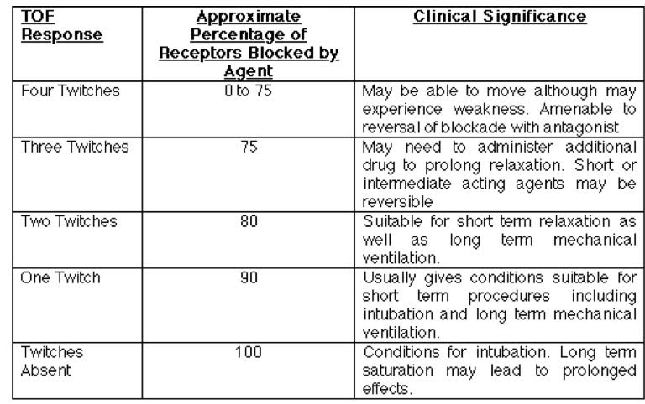
(3)
Maintenance of Blockade: How Much is Enough?

Slide 7
(4)
Reversal of the Neuromuscular Blockade and Emergence
Steps of emergence:
• Turn off the agent
• Reverse the muscle relaxants
• Return to spontaneous ventilation with adequate ventilation and oxygenation
• Suction upper airway
• Wait for pts to wake up and follow command
• Hemodynamically stable
Reversal: Is used for non Non depolarizing muscle relaxants and they are neostigmine glycopirolate or atropine.

