Slide 1
Language of Dermatology
Mohammed Al-Haddab, MD, FRCPC
Assistant Professor, Dept. of Dermatology
College of Medicine, King Saud University

Slide 2
Objectives
To be familiar with common dermatological terms.
To differentiate between primary and secondary skin lesions.
To be able to describe skin lesions and communicate with other dermatologists.
To have a methodological approach to skin lesions.

Slide 3
Cutaneous Lesions
Primary skin lesions:
macule, patch, papule, nodule, tumor, cyst, weal, vesicle, bulla, pustule, plaque, purpura, and telangiectasia.
Secondary skin lesions:
scale, crust, excoriation, fissure, ulcer, scar, lichenification.

Slide 4
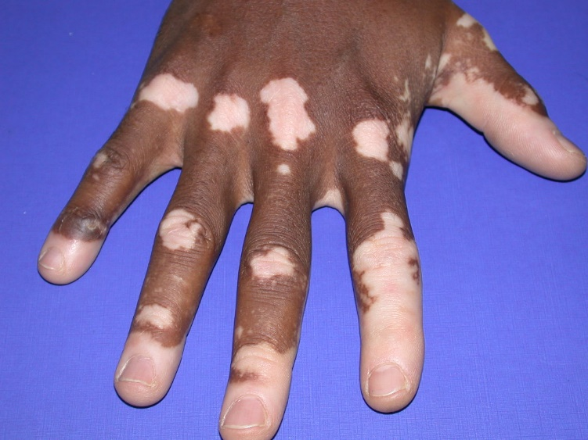
Macule
A flat circumscribed area of altered skin color less than 1 cm in size.
Vitiligo.
Freckle.

Slide 5
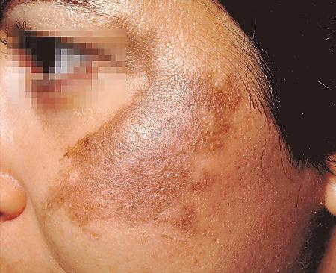
Patch
A flat circumscribed area of altered skin color more than 1 cm in size.
Vitiligo.
Melasma.

Slide 6
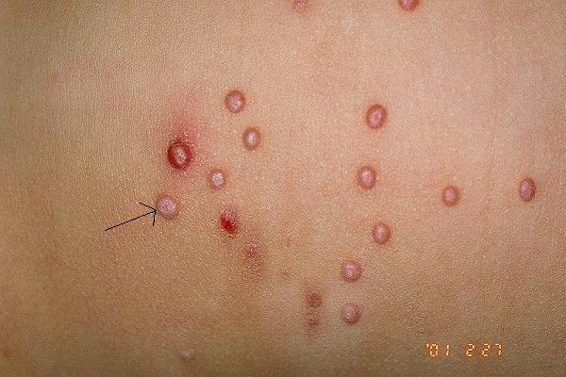
Papule
A small, circumscribed elevation of the skin less than 1 cm.
Molluscum Contagiosum.
Acne.

Slide 7
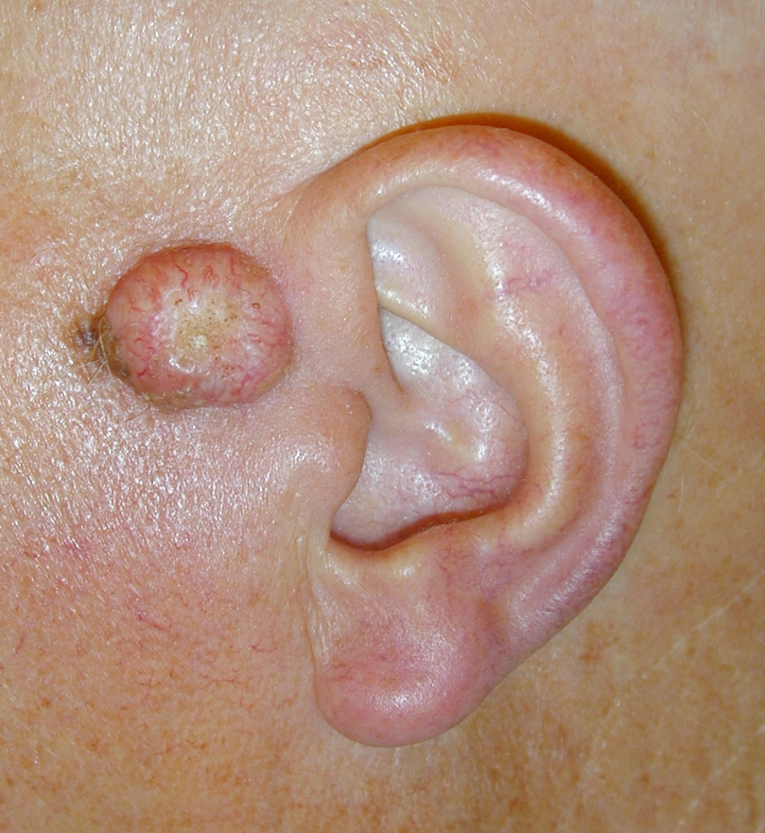
Nodule
A solid, circumscribed elevation whose greater part lies beneath the skin surface.
Erythema Nodosum.
Basal cell carcinoma.

Slide 8
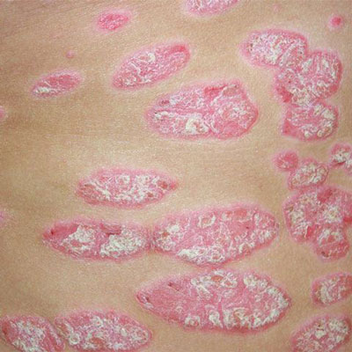
Plaque
A flat topped palpable lesion more than 1 cm in size.
Psoriasis.

Slide 9
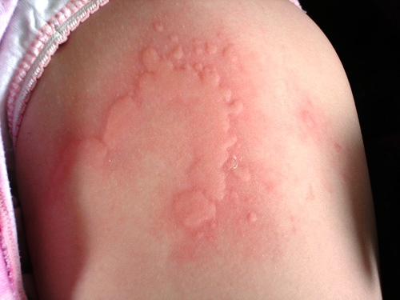
Weal
A transient, slightly raised lesion, characteristically with a pale center and a pink margin.
Urticaria.

Slide 10
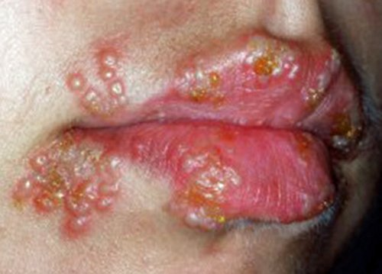
Vesicle
A small less than 5 mm in diameter circumscribed fluid containing elevation.
Dermatitis Herptiformis.
Herpes.

Slide 11
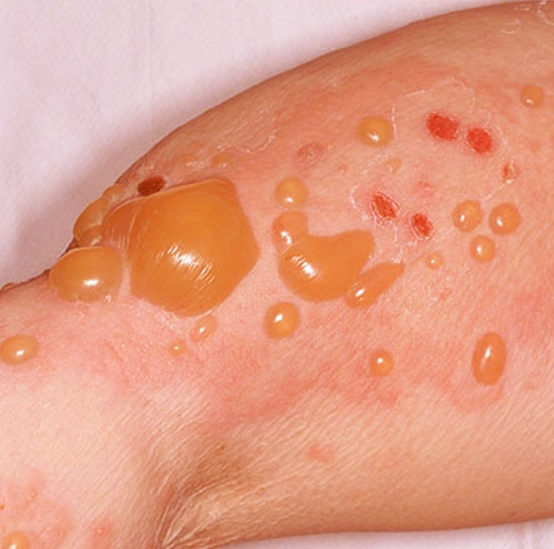
Bulla
Large vesicle more than 5 mm in diameter.
Bullous Pemphigoid.

Slide 12
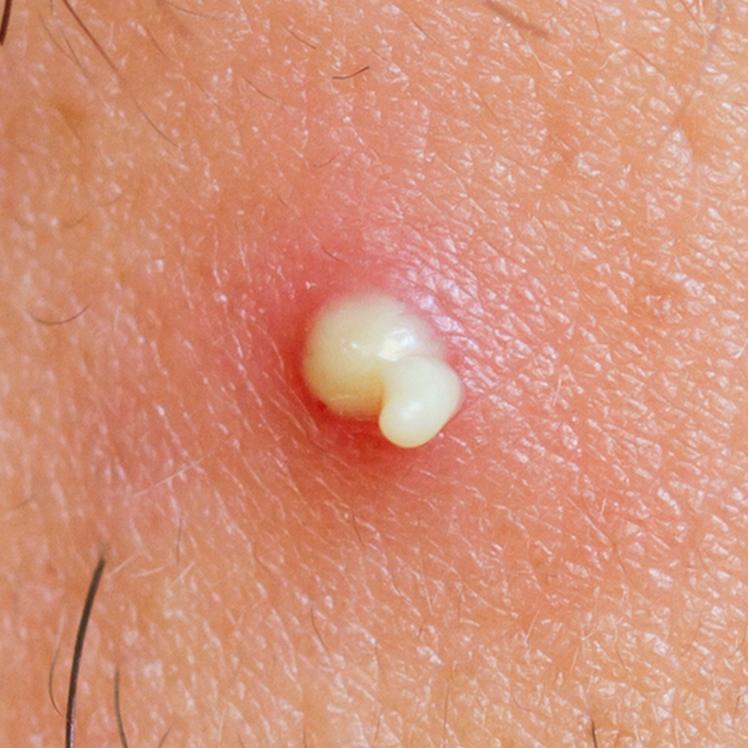
Pustule
Collection of pus or vesicle and bulla that contain pus.
Pustular Psoriasis.
Acne.

Slide 13
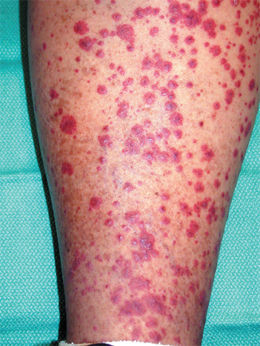
Purpura
Visible collections of free red blood cells.
Vasculitis.

Slide 14
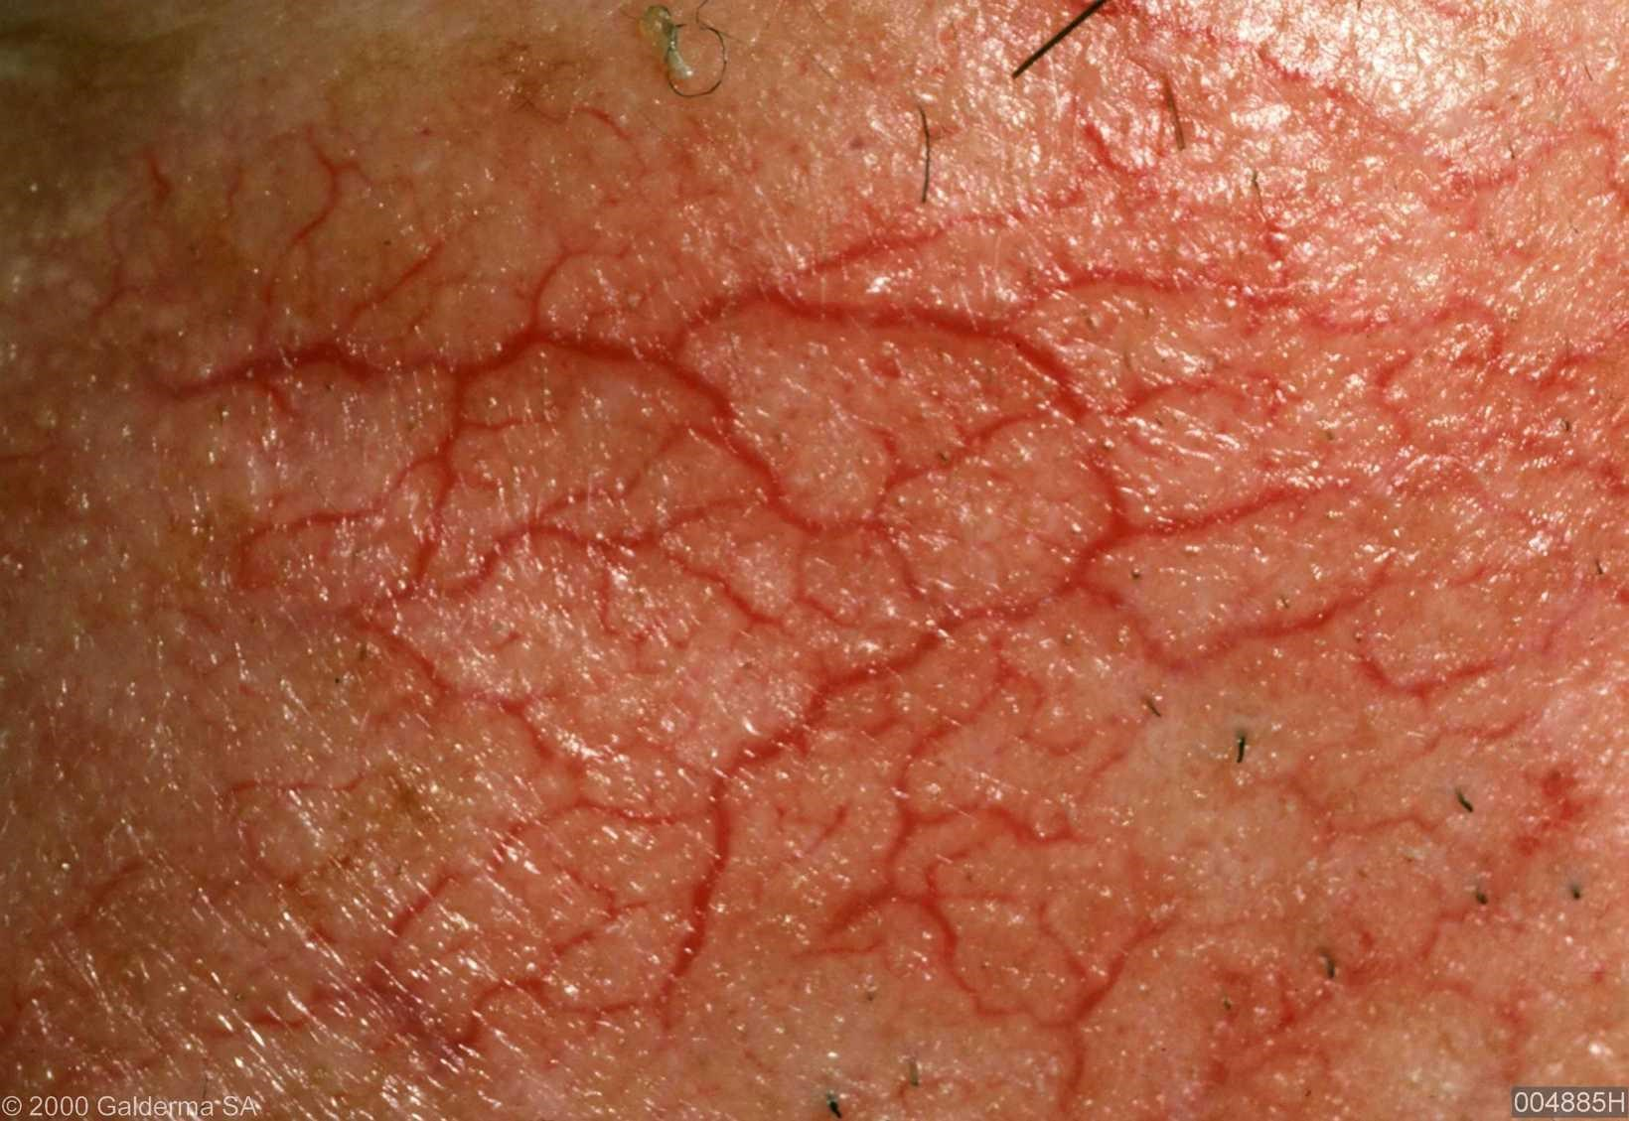
Telangectasia
Dilated capillaries visible on the skin surface.
Rosacea.

Slide 15
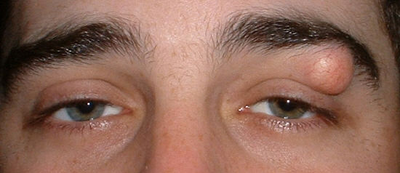
Cyst
Closed sac-like lesion that contain liquid or semi-solid substance. Usually soft and has depth.
Epidermal cyst.

Slide 16
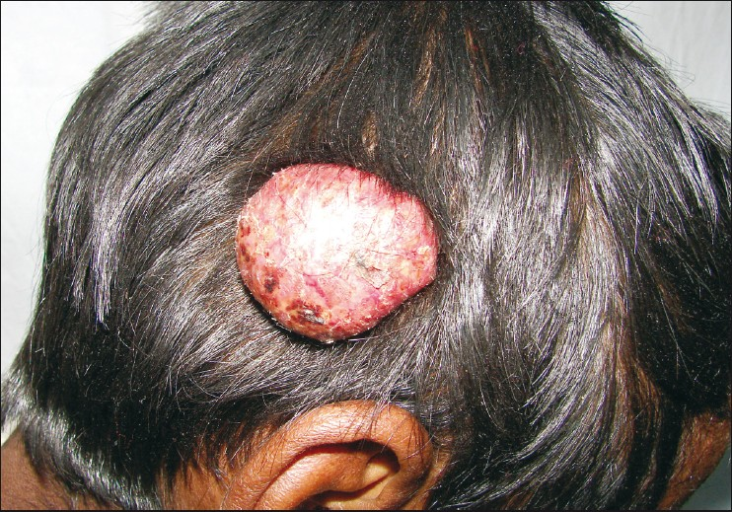
Tumor
Solid elevation of the skin more than 2 cm in diameter and has depth. Like large nodule.

Slide 17
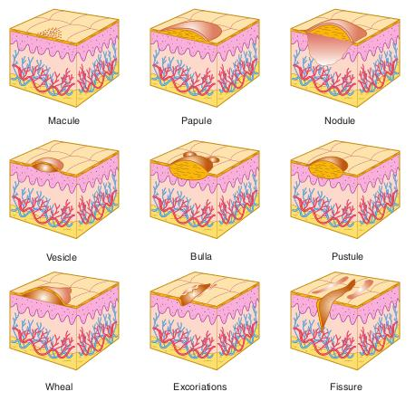

Slide 18
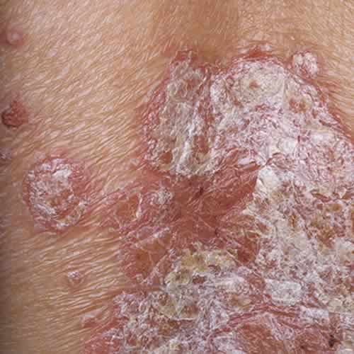
Scale
Thickened, loose, readily detached fragments of stratum corneum.
Psoriasis.

Slide 19
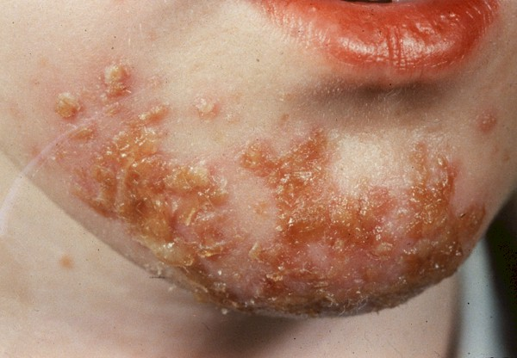
Crust
Dried exudate.
Eczema.
Impetigo.

Slide 20
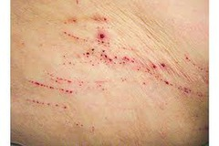
Excoriation
A shallow abrasion often caused by scratching.
Atopic dermatitis.

Slide 21
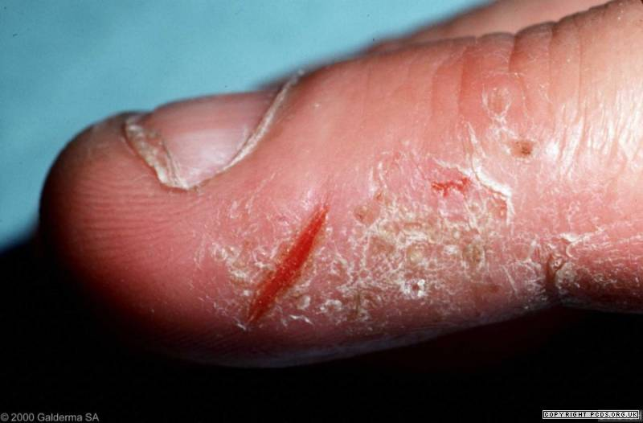
Fissure
Linear-like or crack-like cleavage of the skin.
Chronic eczema.

Slide 22
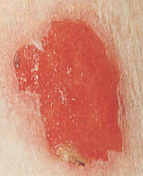
Erosion
a moist, circumscribed, usually depressed lesion that result from loss of all or a portion of the epidermis.
Ruptured vesicle or bulla.

Slide 23
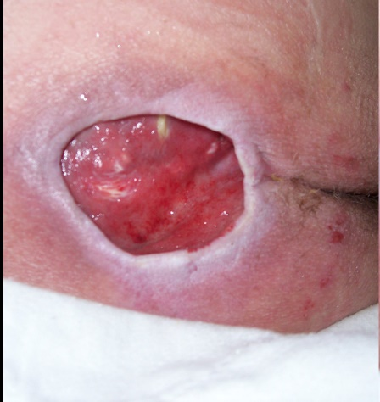
Ulcer
A hole in the skin in which there has been destruction of the epidermis and at least the upper papillary dermis.
Leg ulcers.
Pyoderma gangrenosum.

Slide 24
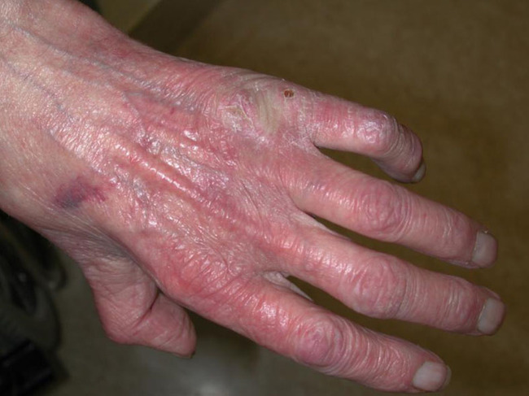
Atrophy
Thinning of the skin. Could be epidermal or dermal or both.
Epidermal atrophy present as thin transparent wrinkled epidermis.
Dermal atrophy present as depression of the skin.

Slide 25
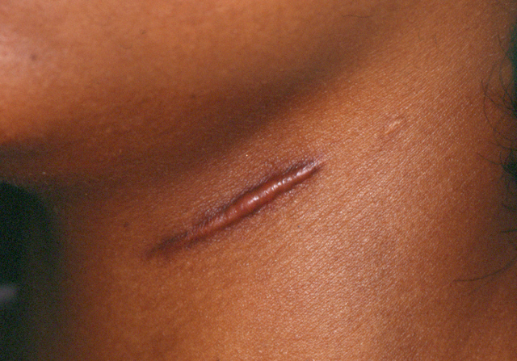
Scar
A permanent lesion that results from the process of repair by replacement with fibrous tissue.
Surgical scar.

Slide 26
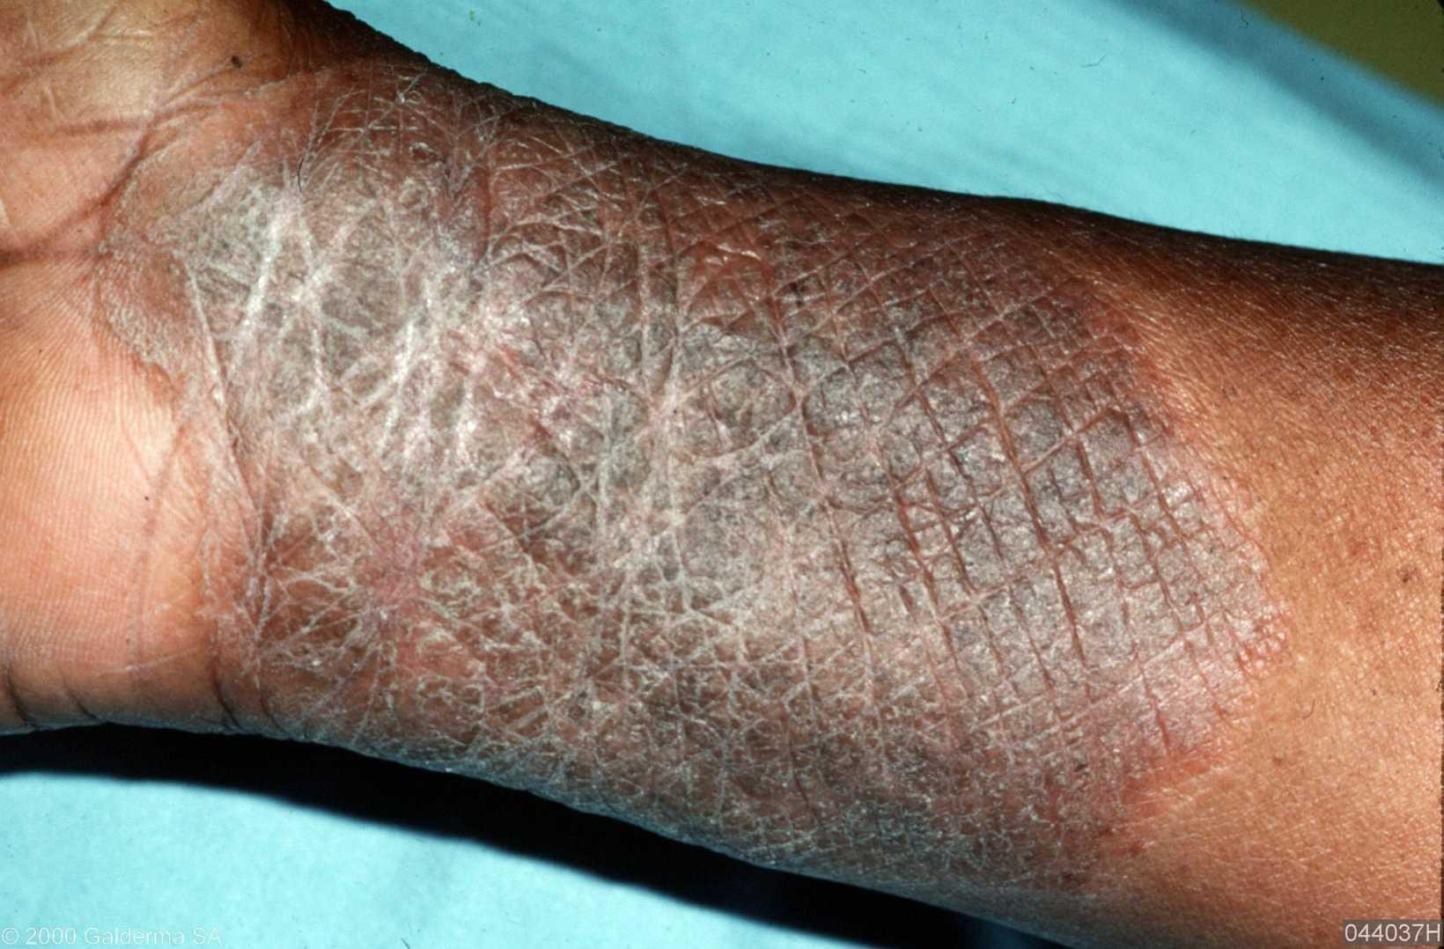
Lichenification
Patches of increased epidermal thickening with accentuation of skin markings and pigmentation.
Lichen simplex chronicus.
Atopic dermatitis.

Slide 27
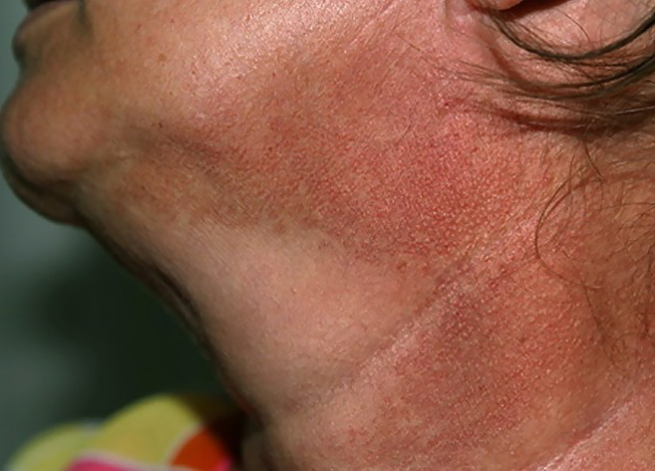
Poikiloderma
A morphologic descriptive term, refer to the combination of atrophy, telangiectasia, and pigmentary changes ( hypo or hyperpigmentation)
Dermatomyositis.
Radiodermatitis.
Mycosis fungoides.

Slide 28
Other Terms Used in Dermatology
Acantholysis: a rounding up of epidermal cells resulting from a loss of adhesion between these cells. Pemphigus vulgaris.
Acanthosis: histological term used to describe epidermal thickening due to increase keratinocytes in the spinous layer.
Atopy: triad of atopic dermatitis, asthma, and allergic rhinitis.
Balloon degeneration: gross swelling of keratinocytes seen in epidermal viral infection like herpes simplex.
Hyperkeratosis: excessive formation of normal keratin.
Hypertrichosis: excessive growth of non-androgen dependent hair.
Hirsutism: excessive growth of male pattern hair in women.

Slide 29
Other Terms Used in Dermatology
Intertrigo: dermatitis in body folds like axilla and groin.
Koebner phenomenon: the tendency for certain skin diseases like psoriasis to develop on sites of trauma.
Nikolsky’s sign: the shearing of epidermis from dermis produced by lateral pressure on the epidermal surface. Pemphigus vulgaris, TEN.
Parakeratosis: abnormal or incomplete keratinization resulting in the presence of nucleated, flattened squamous cells in the stratum corneum.
Spongiosis: edema of the epidermis mainly intracellular.

Slide 30
Other Terms Used in Dermatology
Rhinophyma: gross hypertrophy of sebaceous gland tissue resulting in increase in volume of nasal soft tissue. Rosacea.
Wickham’s striae: white linear markings on the surface of the violaceous papules of lichen planus.
Auspitz sign: appearance of punctate bleeding spots when psoriasis scales are scraped off.
Dermatographism: skin becomes raised and inflamed forming weals when stroked, scratched or rubbed. Urticaria.
Pathergy test: erythematous induration of the site of the needle stick with a small sterile pustule at the center. Behcet’s disease. Pyoderma gangrenosum.

Slide 31
History
How long have skin lesions been present. Acute, subacute, chronic.
Where did the problem first appeared.
Progression of the problem.
Any other symptoms like pruritus.
Treatment history.
General relevant medical history.
Occupational and recreational history.
Travel.
Family and household contact history.

Slide 32
Examination
Full skin examination should be carried out to determine the full extent of the problem and possible unrelated conditions.
Examination should be done in a good light, better natural sun light.
Skin, nails, hair, mucous membranes should all be examined.
General appearance of the patient must be assessed.
Lymph node exams in selected diseases like mycosis fungoides and skin cancers.
Wood’s lamp, dermoscope, photography and other office based test like KOH preparation could help in diagnosis and follow up.

Slide 33
Description of Skin Lesions
Type (primary or secondary), shape, size, color, arrangement of lesions, distribution and configuration of the lesions all must be addressed while describing a lesion.
Distribution: symmetrical, asymmetrical, unilateral, bilateral, diffuse, universal.
Site of involvement: flexor, extensor, inverse, seborrheric, acral, photodistributed.
Configuration: linear, grouped, reticular, annular, circular, arciform, dermatomal, koebneraization.

Slide 34
Questions?

