Slide 1
Skin Manifestations of Connective Tissue Diseases
Prof. Khalid M. AlGhamdi
Professor and Consultant
Dermatology and Cutaneous Laser Surgery
King Saud University
www.dralghamdi.net

Slide 2
Objectives
At the conclusion of these lectures the student will be able to:
differentiate between the various types of Lupus
recognize how Lupus affects the various systems of the body
identify all of the current treatment options available for Lupus
recognize the psychosocial effects that Lupus has on the patient and their family

Slide 3
Objectives
To learn how to diagnose and investigate dermatomyositis.
How to manage dermatomyositis.
To learn the presentation of morphea and systemic sclerosis and ways to manage them.
To recognize other diseases like Rheumatoid nodules and mixed CTD.
This lecture is not meant to be inclusive of all the information about these diseases but to highlight important aspects in their diagnosis and management.

Slide 5
Lupus Erythematosus
LE is as an autoimmune diseases associated with antibodies directed against components of cell nuclei.
Lupus may affect any tissue, skin, kidneys, CNS, lungs and others.

Slide 6
LUPUS
Discoid lupus erythematosus
Subacute lupus erythematosus
Neonatal lupus erythematosus
Lupus tumidus
Lupus profundus
Chilblain lupus erythematosus
Drug-induced lupus erythematosus
Systemic Lupus Erythematosus

Slide 7
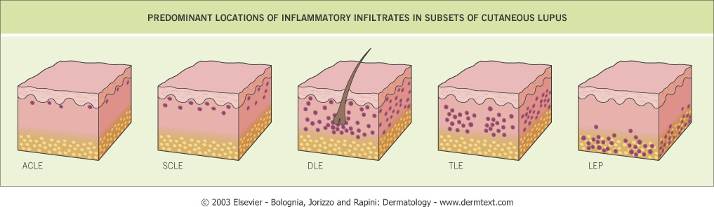

Slide 8
Discoid Lupus Erythematosus
It is the commonest form of cutaneous lupus usually presents as red scaly patches or plaques that leave dyspigmentation and scarring
mostly Hypopigmented or depigmented scars.
It may be localized or widespread.

Slide 9
DLE
Usually affects the cheeks, nose and ears, but sometimes involves the upper back, V of neck, and backs of hands.
Involvement of hair follicles will lead to scarring alopecia
10% of DLE patients develop SLE.

Slide 10
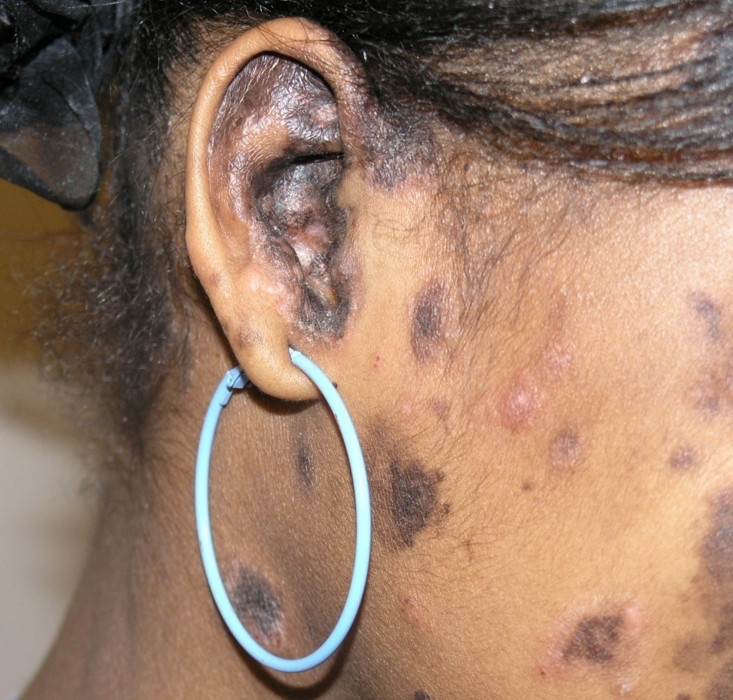
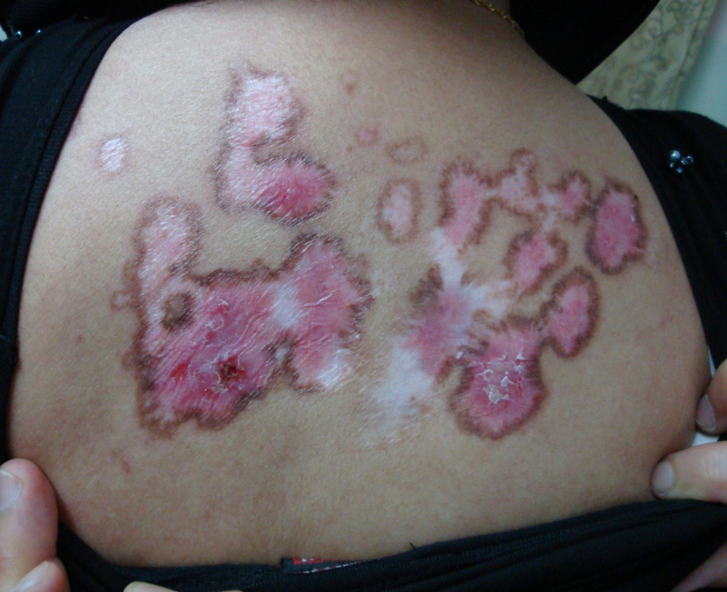
Discoid Lupus Erythematosus

Slide 11
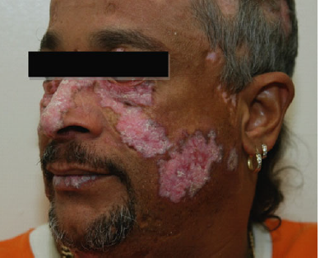
DLE

Slide 12
Subacute lupus erythematosus
Non-itchy dry rash appears on the upper back and chest, often following sun exposure.
Subacute LE does not scar.
Systemic involvement is not usually severe.
Annular or polycyclic (ring-shaped) or as papulosquamous (scaly patches and plaques)

Slide 13
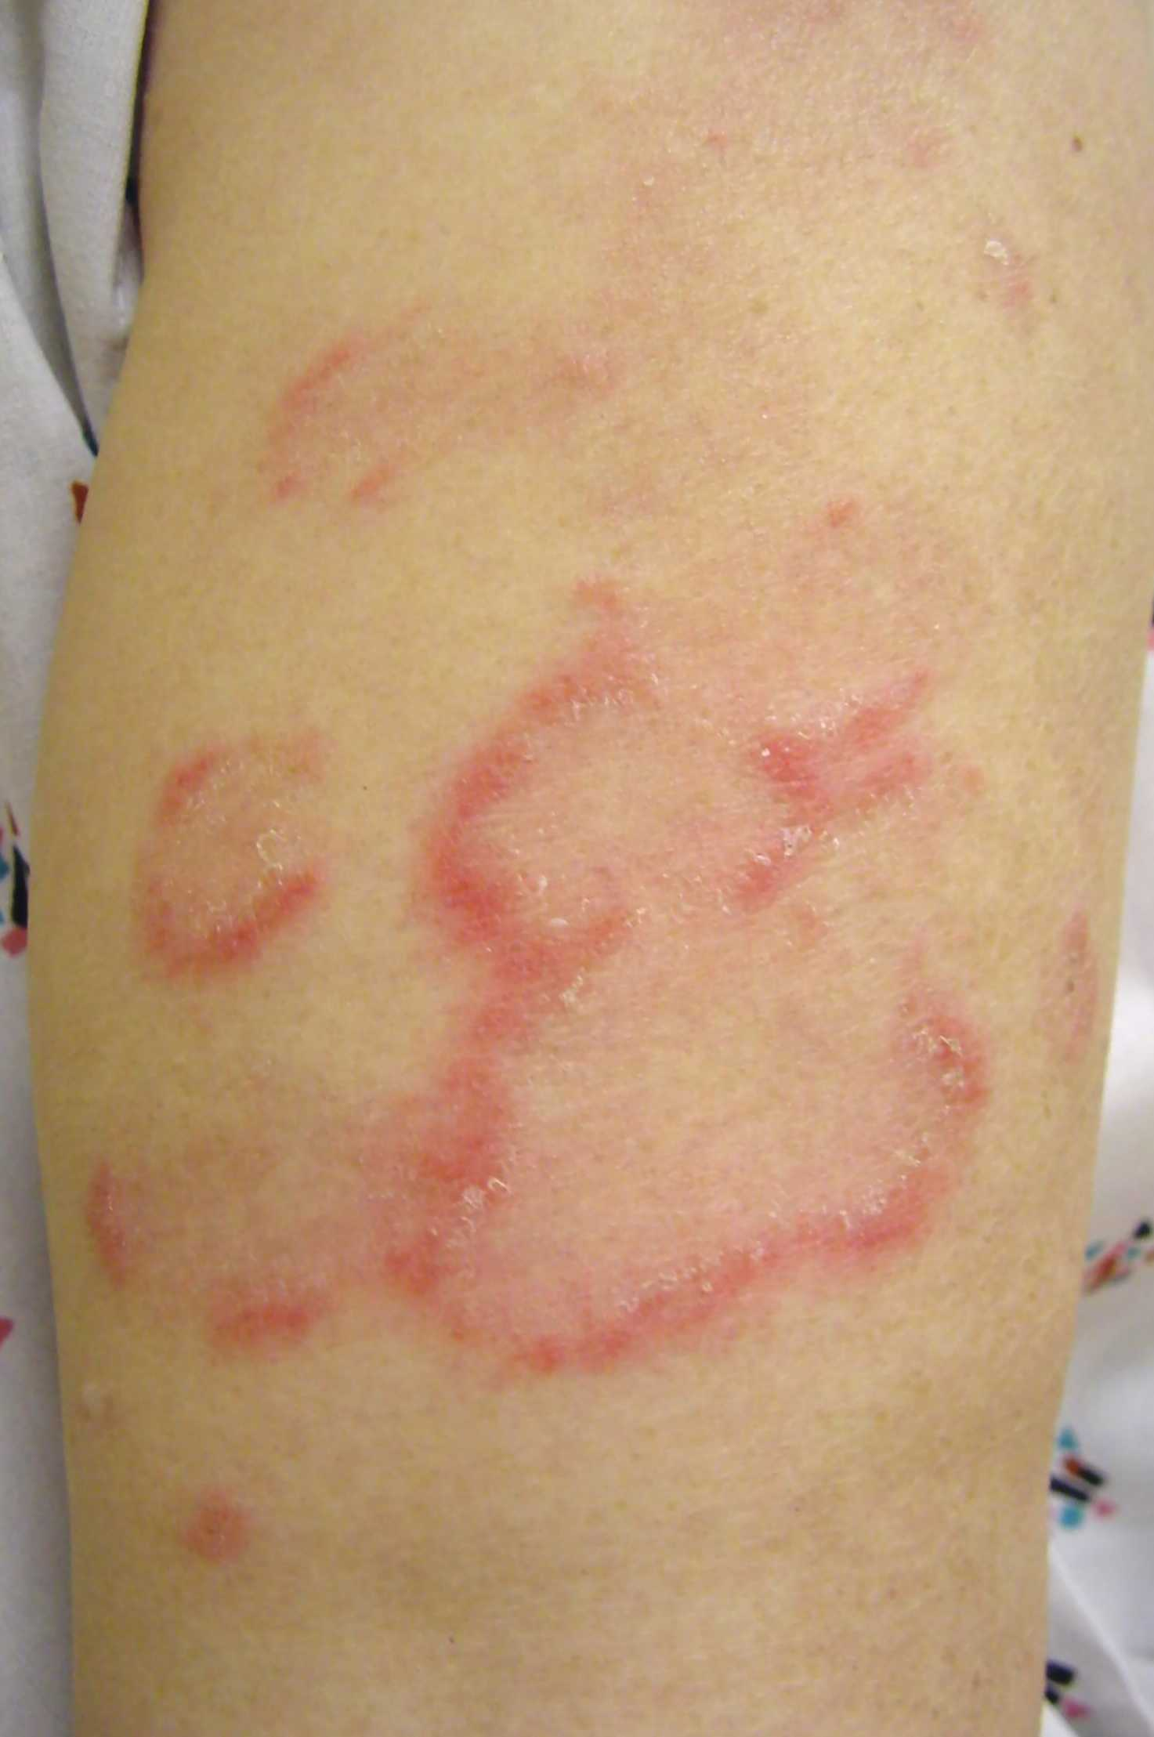
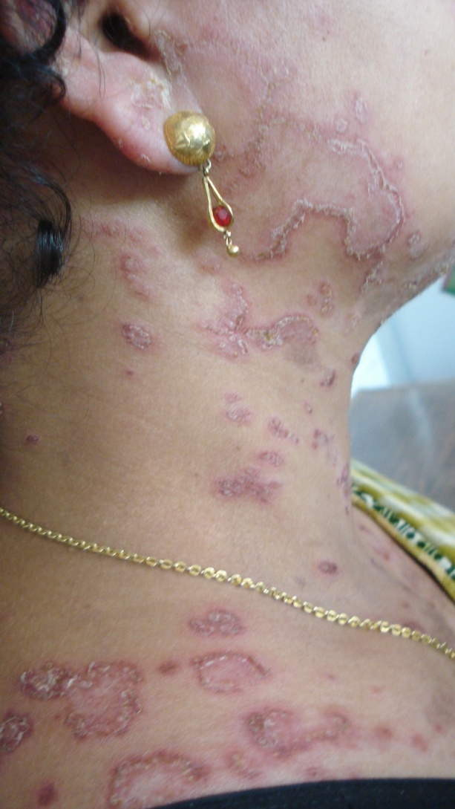
Subacute lupus erythematosus

Slide 14
Neonatal lupus erythematosus
Newborn babies born to mothers with subacute LE may develop annular rash, that resolve spontaneously.
The neonates could be at risk of complete heart block.

Slide 15
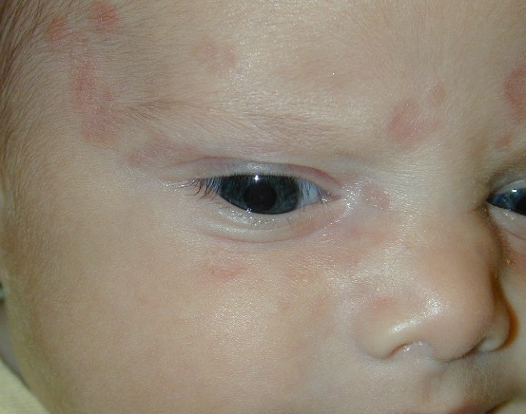
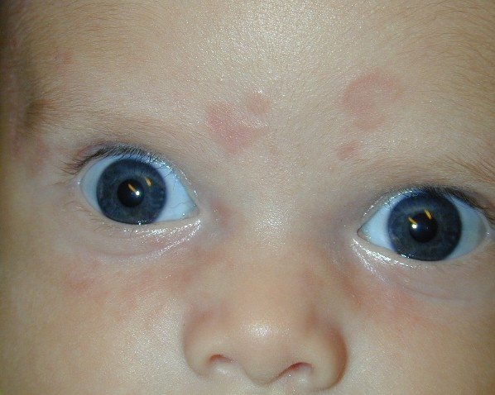
Neonatal lupus erythematosus

Slide 16
Lupus Tumidus
Dermal form of lupus.
The rash is characteristically photosensitive, so it affects sun-exposed sites.
Red, swollen, urticaria-like bumps and patches or swelling.

Slide 17
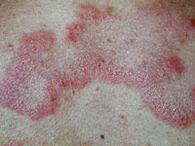
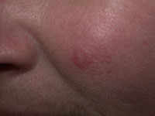
Lupus Tumidus

Slide 18
Lupus Profundus
lupus affecting the fat underlying skin lupus panniculitis.
it may develop at any age, including children. The face is the most common area to be affected.

Slide 19
Lupus Profundus
Inflammation of the fat results in firm deep nodules for some months.
The end result is deep scars on fat layer or lipodystrophy.

Slide 20
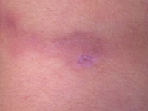
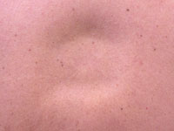
Lupus Profundus

Slide 21
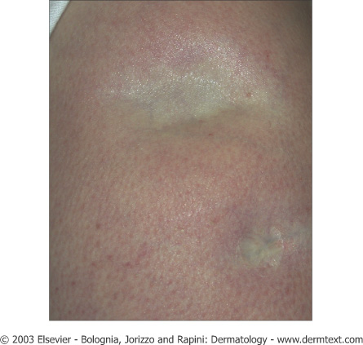

Slide 22
Chilblain Lupus Erythematosus
Itchy and/or tender red or purple bumps that usually come on from cold exposure but can sometimes be precipitated by sun exposure or smoking.
They are considered to be a form of skin vasculitis (blood vessel inflammation).
Usually they have no circulating antibodies.
And the main treatment is to avoid precipitating factors.

Slide 23
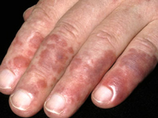
Chilblain Lupus Erythematosus

Slide 24
Drug-Induced Lupus Erythematosus
Drug induced lupus does not usually affect the skin. The most frequent drugs are:
  Hydralazine , Carbamazepine , Lithium , Phenytoin , Sulphonamides , Minocycline.

Slide 25
Systemic Lupus Erythematosus
Only a few patients with cutaneous LE also have SLE.
The most common presentation is with a malar eruption or butterfly.

Slide 26
SLE
Other skin changes in SLE are photosensitivity, mouth ulcers, and diffuse hair loss.
SLE may also affect joints, kidneys, lungs, heart, liver, brain, blood vessels and blood cells

Slide 27
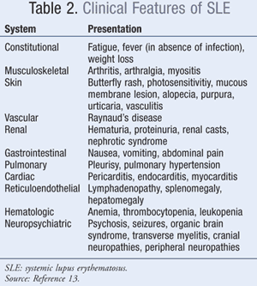

Slide 28
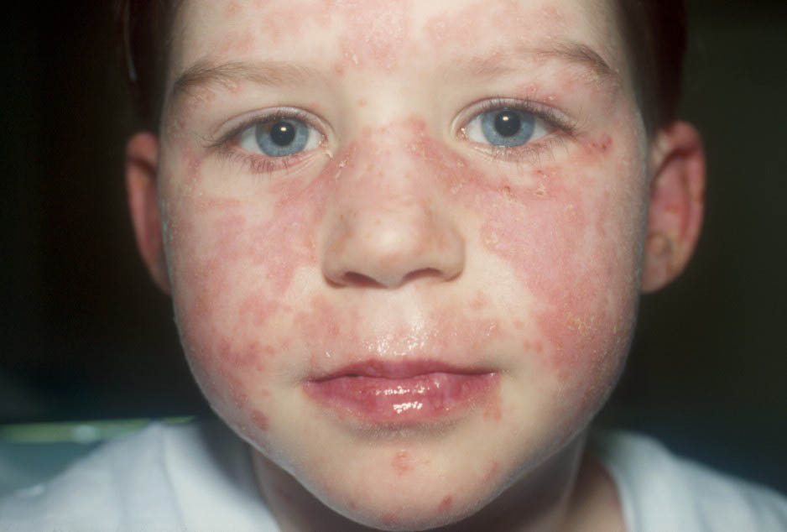
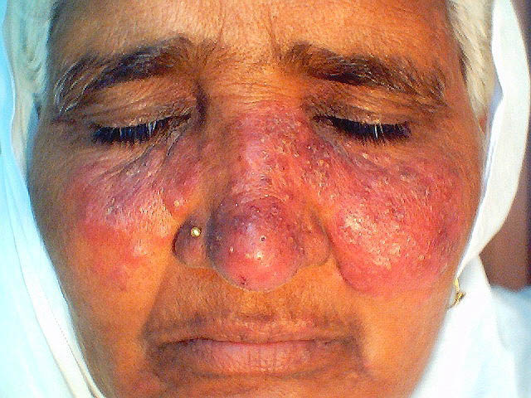
Systemic Lupus Erythematosus

Slide 29
Investigations
SLE is always with positive ANA.
antiRo/La antibodies, is nearly always present in patients with subacute LE.
Leucopenia tends to be more pronounced in patients with systemic LE

Slide 30
LUPUS
Skin biopsy may be diagnostic especially in discoid lupus erythematosus.
Direct immunofluorescence tests may show positive antibody deposition along the basement membrane (lupus band test).

Slide 31
Treatment of Cutaneous Lupus Erythematosus
The aim of treatment for cutaneous LE is to alleviate symptoms and to prevent scarring.
Smoking cessation will help Raynaud's phenomena and chilblain lupus .
Sun protection.

Slide 32
Treatment
Potent topical steroids, Intra lesional steroids.
Oral antimalarial drugs.
Oral steroids.
Methotrexate, azathioprin, mycophenolate mofetil, cyclosporine, cyclophosphamide, IVIG, and Rituximab.

Slide 33

Be cool!

Slide 35
Dermatomyositis
An uncommon inflammatory disease affects adults between 40-60 (females mainly) and children 5-15.
Skin changes.
A violet-colored or dusky red rash on face and eyelids and on areas around nails, knuckles, elbows, knees, chest and back.
The rash, which can be patchy with bluish-purple discolorations, is often the first sign of dermatomyositis.

Slide 36
DM
Heliotrope rash : a violaceous -to-dusky erythematous rash with or without edema in a symmetrical distribution involving periorbital skin.

Slide 37
Muscle weakness.
Progressive proximal muscle weakness involves the hips, thighs, shoulders, upper arms and neck.
The weakness is symmetrical and more in the extensor muscles.

Slide 38
Dermatomyositis
Other signs and symptoms include:
Photosensitivity
Raynaud's phenomenon
Dysphagia, gastrointestinal ulcers
Muscle pain or tenderness
Fatigue, fever and weight loss
Calcinosis cutis especially in children
Interstitial lung disease.

Slide 39
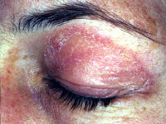
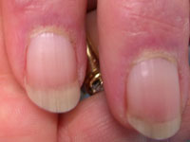
Dermatomyositis

Slide 40
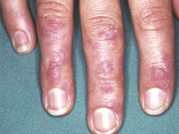
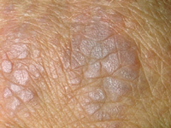
Dermatomyositis

Slide 41
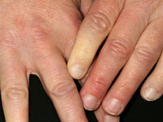
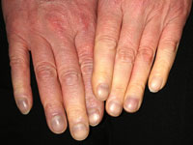
Dermatomyositis

Slide 42
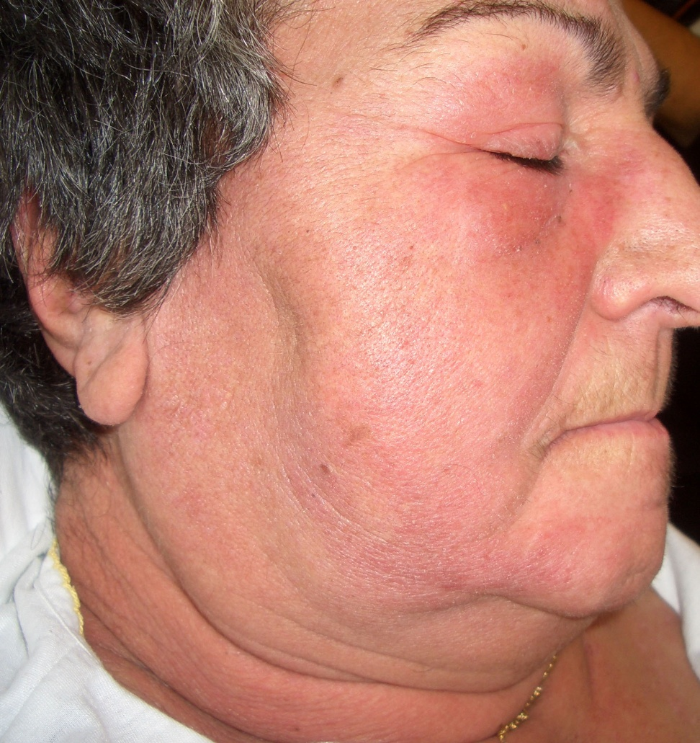
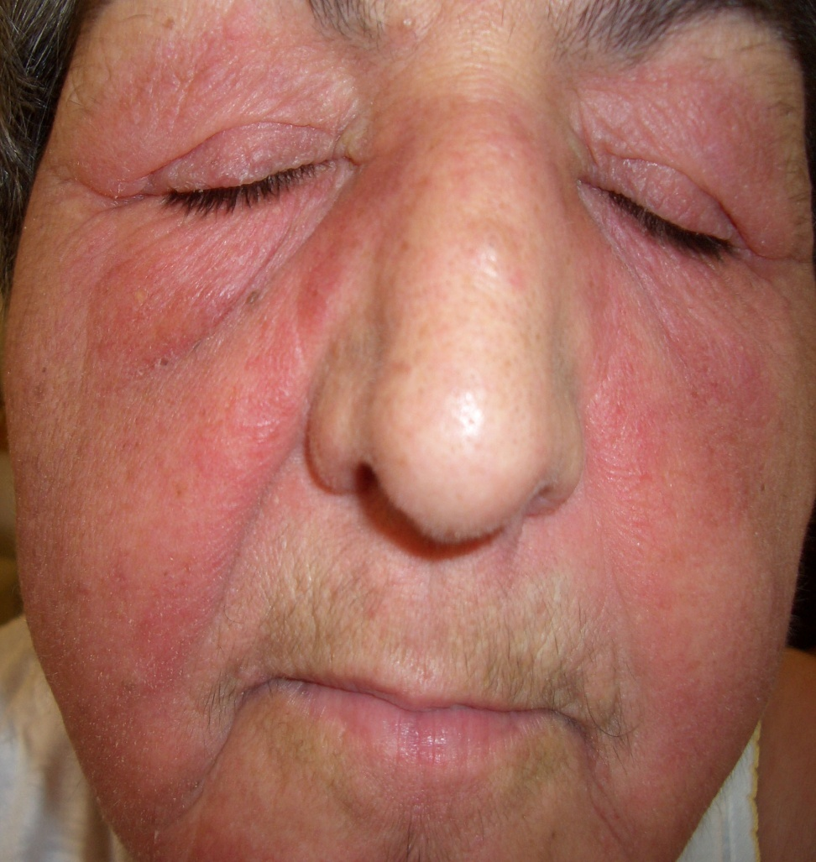
Dermatomyositis

Slide 43
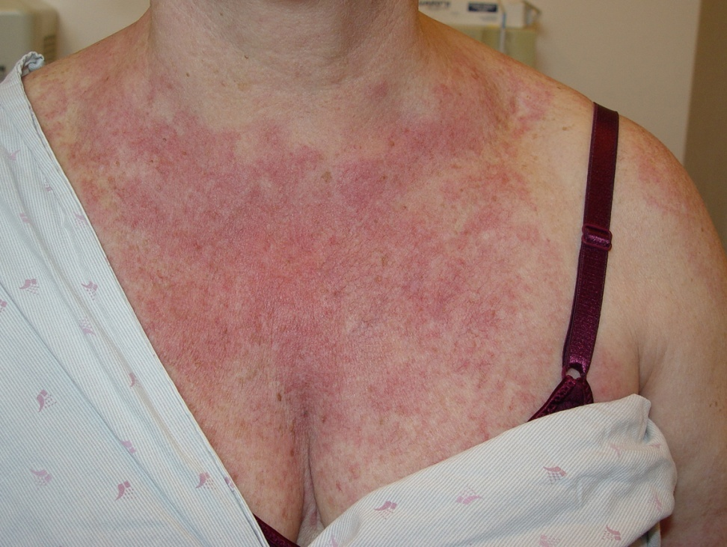
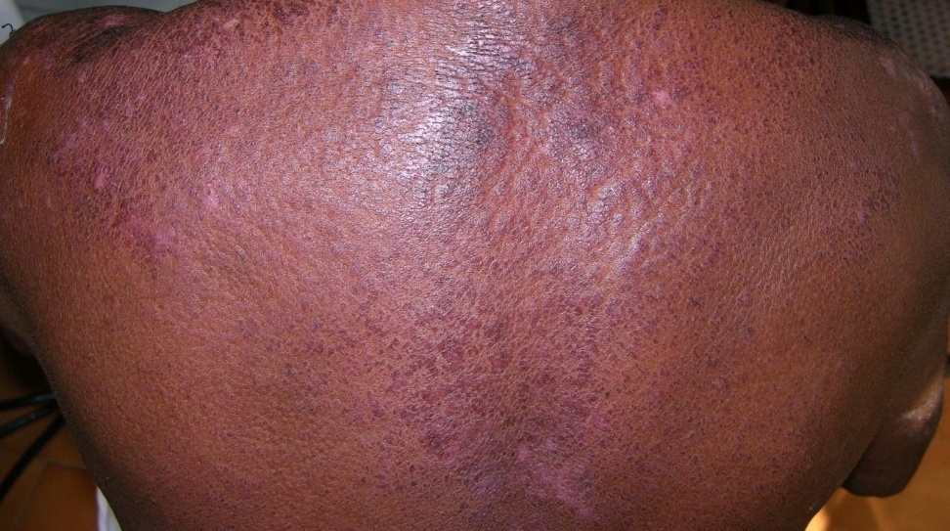
Dermatomyositis

Slide 44
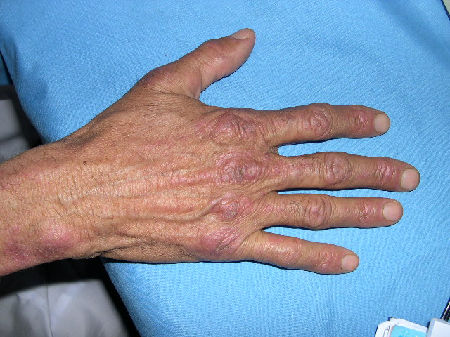
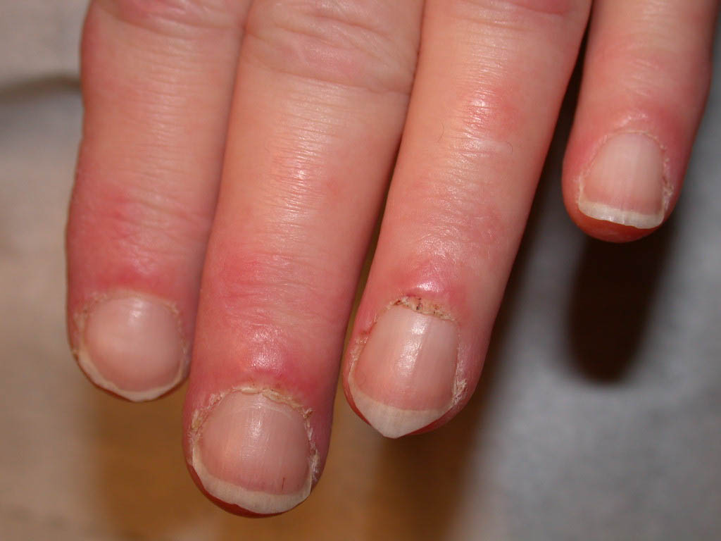
Dermatomyositis

Slide 45
Dermatomyositis
It can be associated with:
Other connective tissue diseases such as lupus, rheumatoid arthritis, scleroderma and Sjogren's syndrome.
Cancer, Especially in older patients, particularly of the cervix, lungs, pancreas, breasts, ovaries and gastrointestinal tract.
Cancer could precede, coincide or follow the diagnosis of DM.

Slide 46
Investigations
Magnetic resonance imaging (MRI).
Electromyography.
Muscle biopsy.
Blood tests: creatine kinase (CK) and aldolase. Increased CK and aldolase levels can indicate muscle damage and CK is useful to monitor the treatment of DM.
autoantibodies
Skin biopsy is suggestive but not diagnostic that shows interface dermatitis.

Slide 47
Treatment
Oral steroids are the mainstay treatment.
Steroid sparing agents are:
Methotrexate, azathioprin, mycophenolate mofetil, cyclosporine, cyclophosphamide, IVIG, and Rituximab.
Topical steroids and antimalarial medications are used to improve the cutaneous rashes.

Slide 48
Treatment
Physiotherapy to improve strength and flexibility of the muscles.
Surgical excision or Co2 laser could be utilized to remove tender calcium deposits .

Slide 50
Scleroderma
A group of rare diseases that involve the hardening and tightening of the skin and connective tissues
Scleroderma affects women more often than men and most commonly occurs between the ages of 30 and 50.

Slide 51
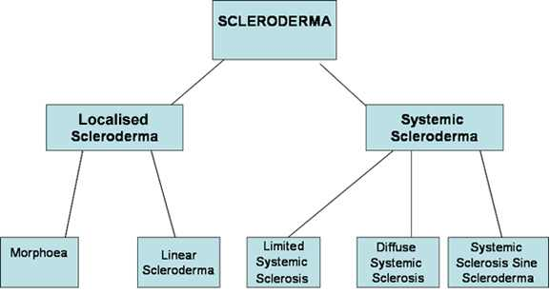

Slide 52
Morphea
a rare skin condition that causes oval reddish or purplish patches and plaques on the skin.
Sometimes in linear distribution on face and extremities.
It subsides on its own over time leaving dyspigmentation and scars.

Slide 53
Confirmed by skin biopsy which usually shows thickening of collagen bundles and loss of skin appendages like sweat glands and hair follicles.

Slide 54
Morphea
No known cure.
Treatment of morphea focuses on controlling signs and symptoms and slowing spread.
Topical and intralesional steroids , phototherapy, systemic steroids, azathioprine, methotrexate, and cyclosporine might be used in severe cases.
Physical therapy could be of help if the involvement is close to joints and cause contracture and difficulty movement.

Slide 55
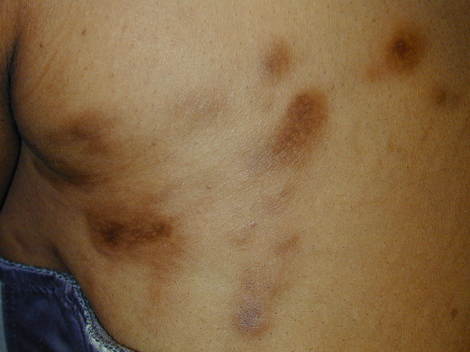
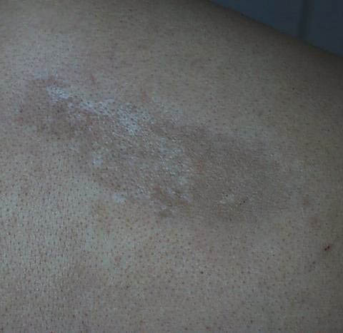
Morphea

Slide 56
Linear Scleroderma
Linear lesions extend to length of arms or leg
Begin first decade of life
May also occur parasagitally down the forehead, known as en coup de sabre

Slide 57
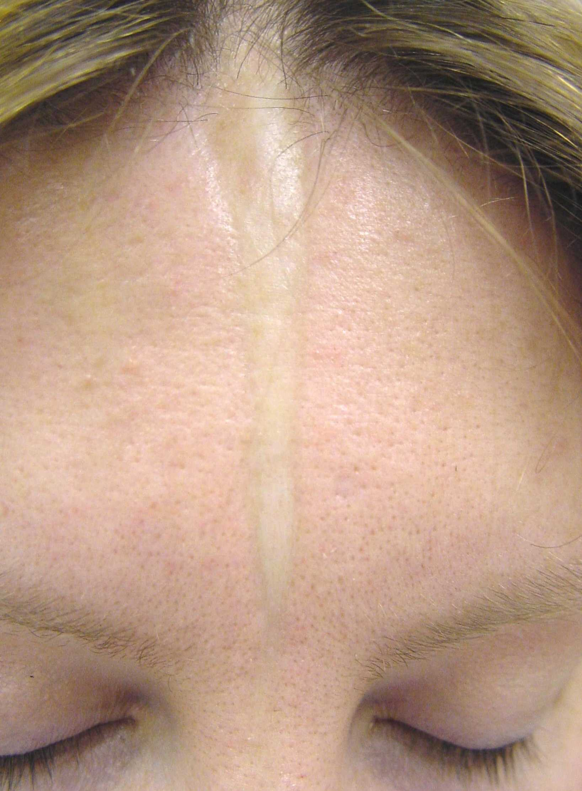
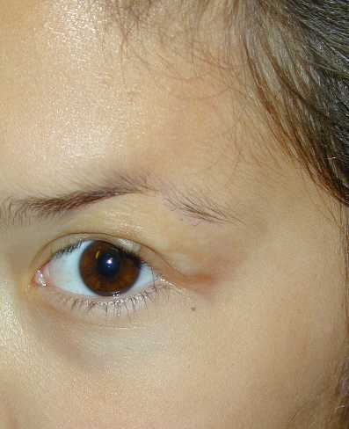

Slide 58
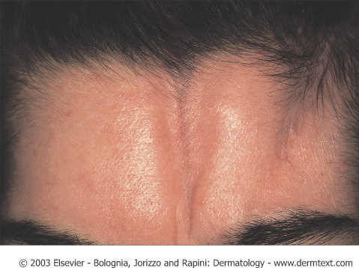
Notes:
Morphea en coup de sabre

Slide 59
CREST Syndrome
Is a limited form of systemic sclerosis in which there is Calcinosis, Raynaud's phenomenon, Esophageal involvement, Sclerodactyly and Telangiectases.
Anticentromere antibodies are characteristic for this syndrome.

Slide 60
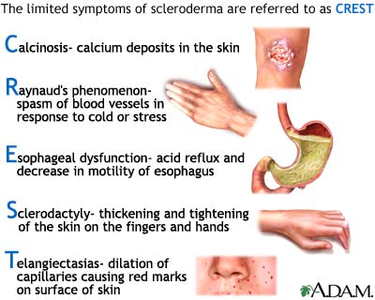

Slide 61
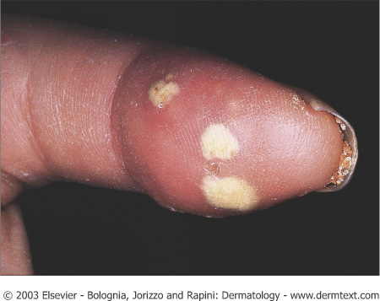
Notes:
Calcinosis cutis of the thumb in a patient with scleroderma

Slide 62
Systemic Sclerosis
An autoimmune multisystem disease that results in fibrosis and vascular abnormalities in association with autoimmune changes.
usually starts between 30-40 years in women who are more affected and later in men.
Pathophysiology :may involve some injury to the endothelial cells and this results in excessive activation of the dermal connective tissue cells, the fibroblasts.

Slide 63
Systemic Sclerosis
Usually presents with Raynaud's phenomena,
Thickening of the skin of the fingers, then atrophy and sclerosis.
The fingers become spindle-shaped (sclerodactyly) from resorption of the fingertips.
Fragile nails become smaller with ragged cuticles

Slide 64
Systemic Sclerosis
The tight shiny skin may affect most parts of the body, including the face, resulting in loss of expression and difficulty opening the mouth properly.

Slide 65
Systemic Sclerosis
telangiectasia appear on the fingers, palms, face, lips, and chest.
Ulcers may follow minor injuries over the joints, or on the tips of fingers and toes. Ulceration can lead to dry gangrene and eventual loss of the tips of the fingers
Joint contractures. Patients will be bed ridden with time.

Slide 66
Systemic Sclerosis
Esophageal reflux and dysphagia.
Lung and heart involvement may manifest as shortness of breath, high blood pressure, chest pain, pleurisy, pneumothorax, pericarditis arrhythmias, general heart enlargement and heart failure.
Progressive kidney disease resulting in proteinuria, high blood pressure and eventually renal failure.

Slide 67
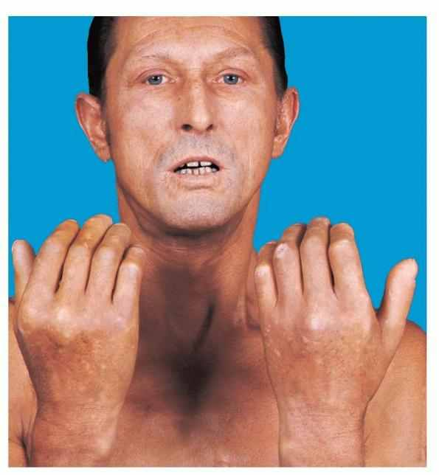
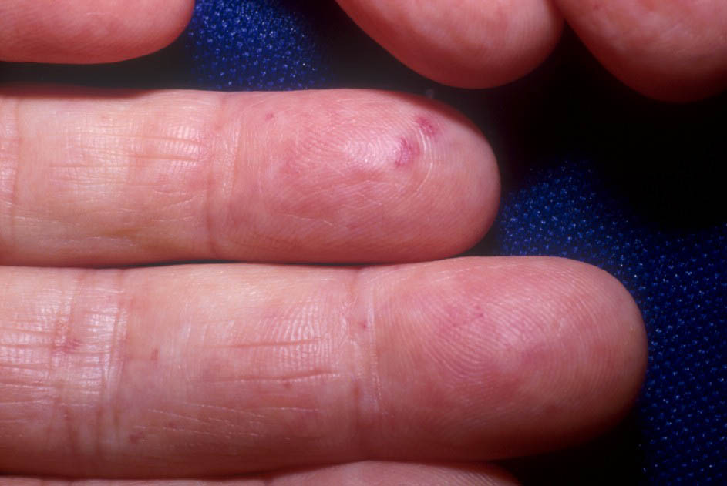
Systemic Sclerosis

Slide 69
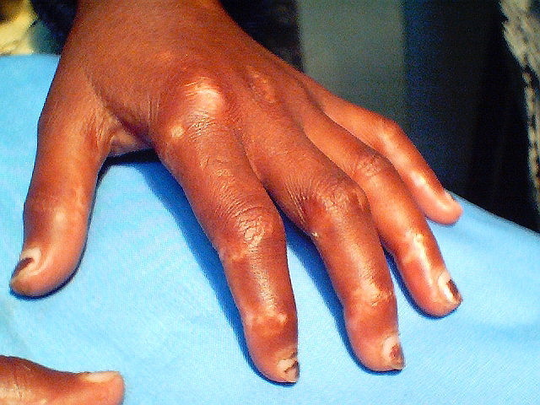
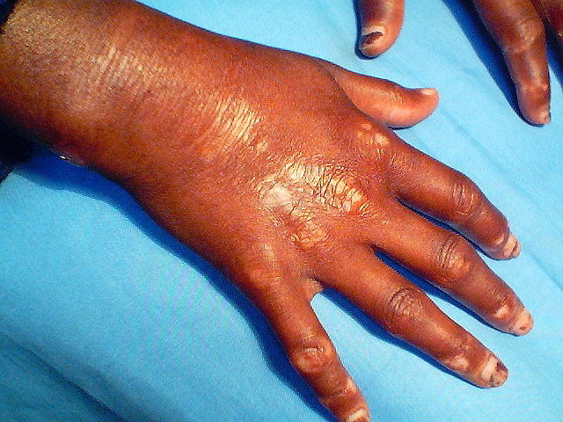
Systemic Sclerosis

Slide 70
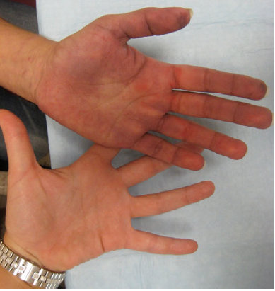

Slide 71
Systemic Sclerosis
Diagnosis is made based on clinical features and presentation.
Skin biopsy will show skin atrophy with preservation of skin appendages.
ANA is usually positive.
Anti topoisomerase I (Scl 70) is characteristic for it especially in severe cases.

Slide 72
Treatment
symptomatic.
Raynaud's phenomena:
Stop smoking, keep hands warm and decrease trauma. calcium channel blockers, aspirin and vasodilating drugs including nifedipine and iloprost infusions.
Calcinosis cutis: nifedipine, surgical or laser excision.

Slide 73
treatment
Skin sclerosis: physiotherapy, phototherapy.
GI: proton pump inhibitor, surgery for strictures.
Kidney: ACE inhibitors.
In severe cases: immunosuppressant , D-Penicillamine might be used.

Slide 74
Rheumatoid Nodules
20-30% of RA patients
Subcutaneous nodules
Found anywhere on the body
Histologically shows dense foci of fibrinoid necrosis surrounded by histiocytes in palisaded arrangement.

Slide 75
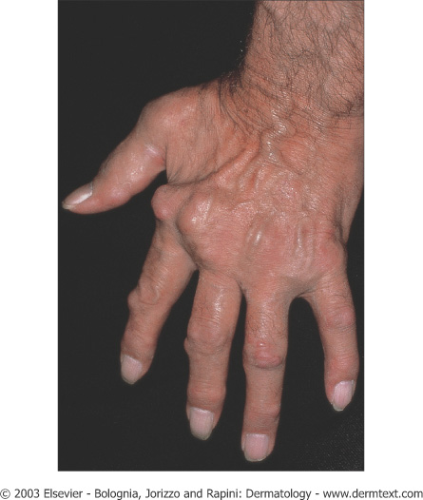

Slide 76
Mixed Connective Tissue Disease
Mixed features of scleroderma, SLE, and dermatomyositis
Raynaud phenomenon, sausage-shaped fingers, and swelling of the dorsa of the hands that never becomes sclerodactyly are the most typical features

Slide 77
MCTD
Alopecia, facial erythema, periungual telangiectasia, and pigmentary disturbances.
Painful dermal nodules may appear on the hands or elbows.
Cutaneous ulceration due to subcutaneous dystrophic calcification

Slide 78


Slide 79


