Slide 1
Blistering Diseases
Dr. Abdulmajeed Alajlan
Associate Professor
Hair Transplant & Laser
Department of Dermatology- KSU

Slide 2
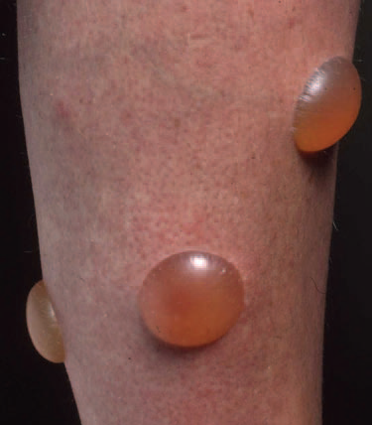
Blistering Diseases
Objectives
To know the definition
& classification of Blistering diseases
To recognize the primary presentation of different types of main blistering diseases
To understand the possible pathogenesis of the main types of blistering diseases
To have an overview about managements lines of these diseases

Slide 3
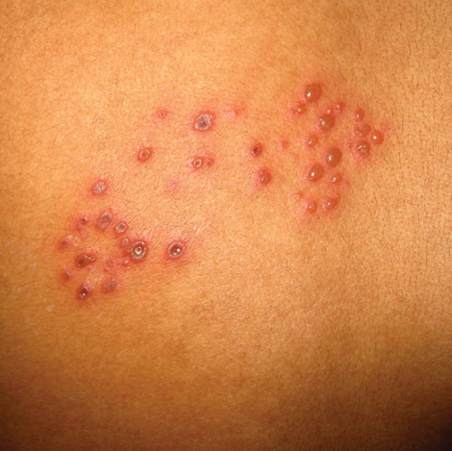
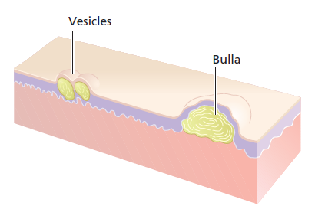

Slide 4
definition
Vesicles and bullae are raised lesions that contain fluid.
A vesicle is less than 0.5 cm in diameter.
A bulla is larger than 0.5 cm in diameter.

Slide 5
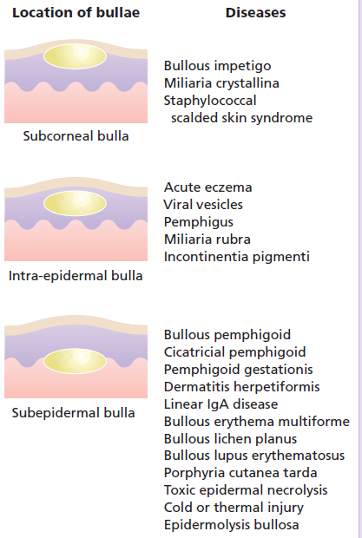
CLASSIFICATION OF VESICULOBULLOUS DISEASES
INTRA EPIDERMAL BLISTERS
The lesion is formed within the
epidermis
SUB EPIDERMAL BLISTERS :
Lesions formed between the
epidermis and the dermis

Slide 6
PEMPHIGUS VULGARIS
BULLOUS PEMPHIGOID
CHRONIC BULLOUS DISEASE OF CHILDHOOD
PARANEOPLASTIC PEMPHIGUS

Slide 7
Blistering Diseases
Objectives
To know the definition
& classification of Blistering diseases
To recognize the primary presentation of different types of main blistering diseases
To understand the possible pathogenesis of the main types of blistering diseases
To have an overview about managements lines of these diseases

Slide 8
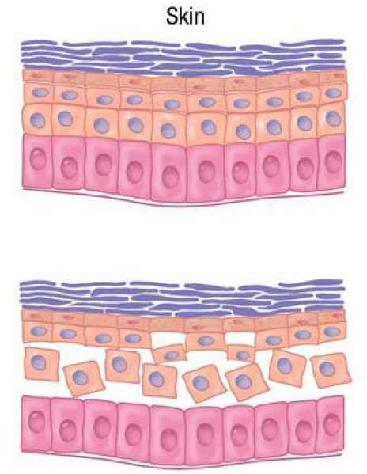

Slide 9
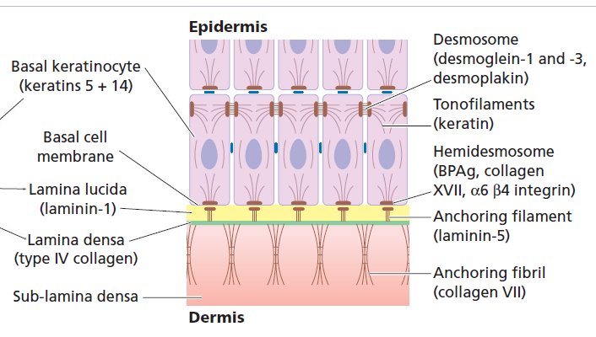
Dermo-edidermal junction

Slide 10
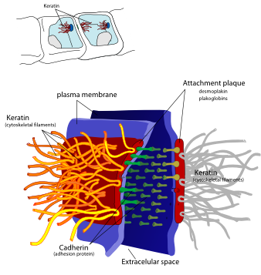

Slide 11
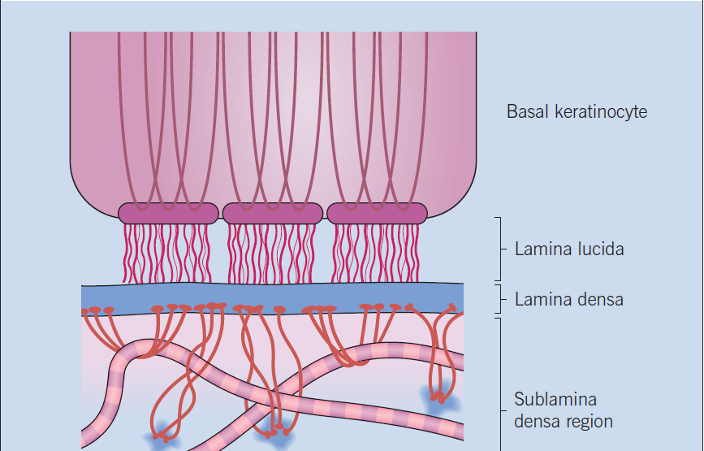
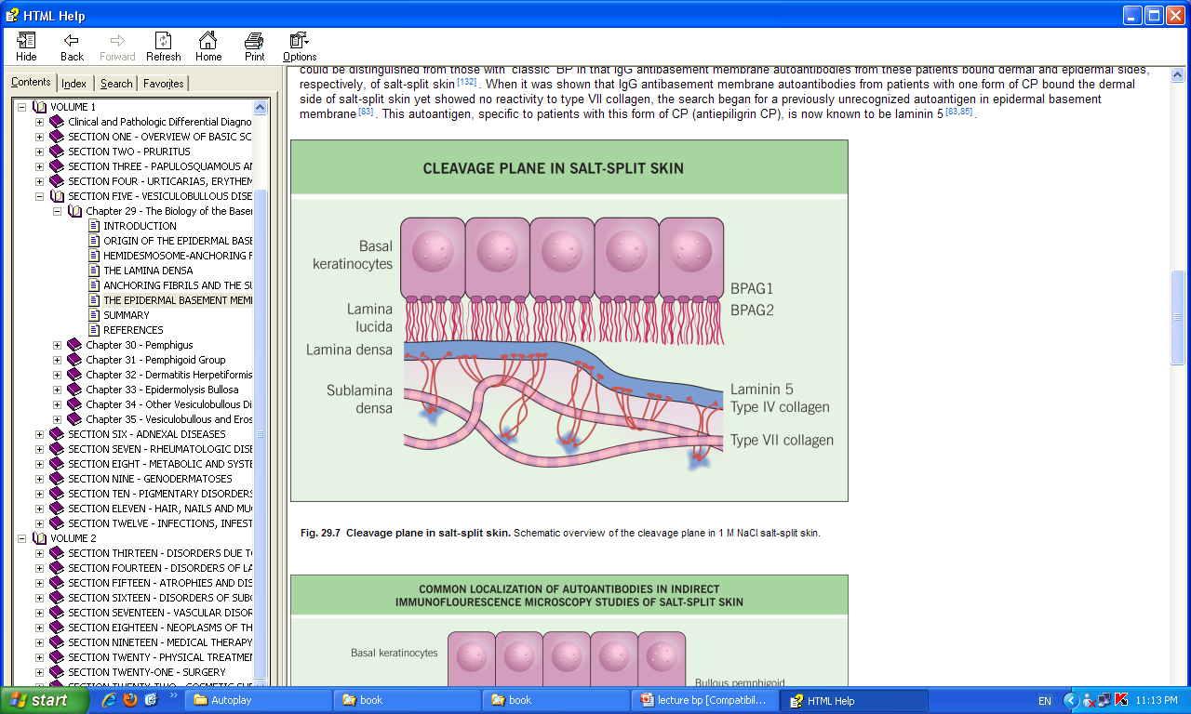

Slide 12
PEMPHIGUS VULGARIS
BULLOUS PEMPHIGOID
CHRONIC BULLOUS DISEASE OF CHILDHOOD
PARANEOPLASTIC PEMPHIGUS

Slide 13
Accurate pathological diagnosis requires a biopsy of a small newly formed lesion and of perilesional skin for immunopathological studies.

Slide 14
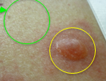
Diagnostic tests
Routine histology
  Lesional sample –small bulla or edge of large one.
Direct immunofluorescence
  Perilesional sample
Indirect immunofluorescence
  Patient’s serum is added to specific substrates that express antigen of interest.
Electron microscopy.

Slide 15
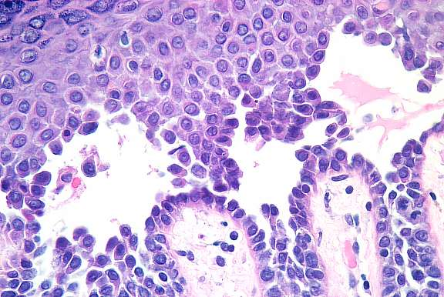
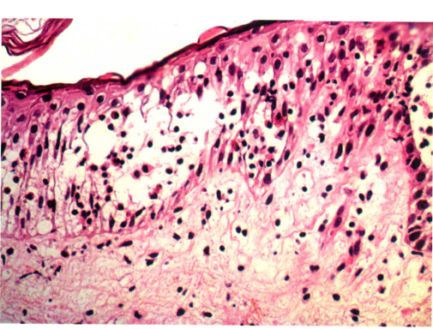
Routine histology

Slide 16
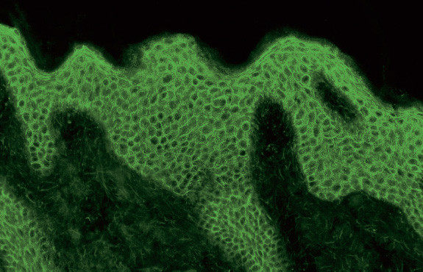
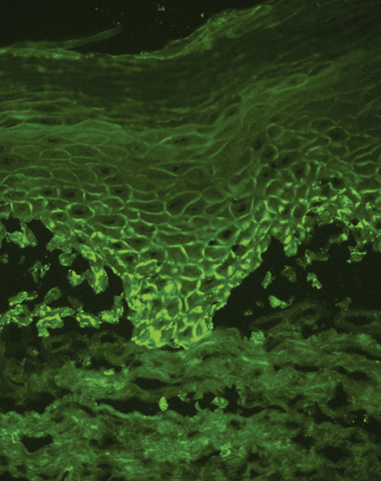
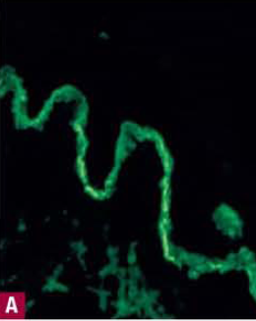
immunofluorescence
IgG
C3
IgA

Slide 17
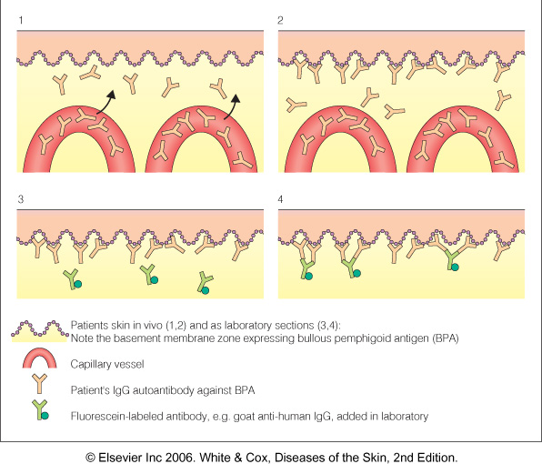

Slide 18
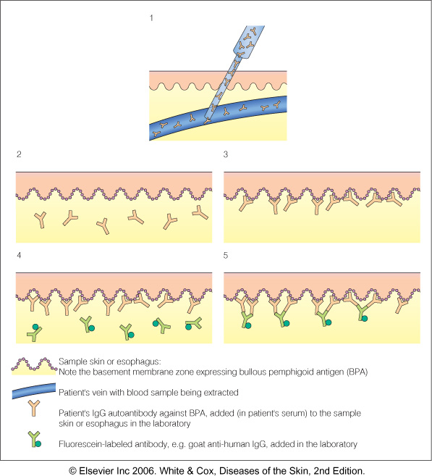

Slide 19
Dermo-edidermal junction

Slide 20
PEMPHIGUS VULGARIS
BULLOUS PEMPHIGOID
CHRONIC BULLOUS DISEASE OF CHILDHOOD
PARANEOPLASTIC PEMPHIGUS

Slide 21
Blistering Diseases
Pemphigus Vulgaris

Slide 22
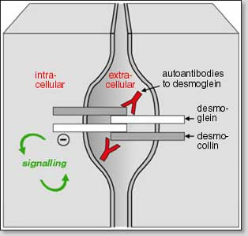
Pemphigus
Pemphigus is a group characterized by blistering of the skin and mucous membranes.
Auto-antibodies against
DESMOSOMES in epidermis and mucosal surface.

Slide 23
Intra epidermal blister

Slide 24
Four sub-clinical varients :
Pemphigus Vulgaris: is the most common Pemphigus variant, and the form usually responsible for oral lesions
Others are:
Folacious, vegetens, erythematosus

Slide 25
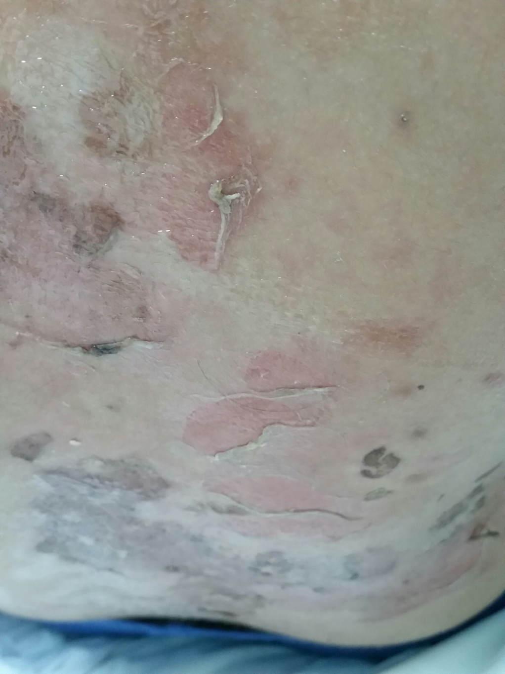
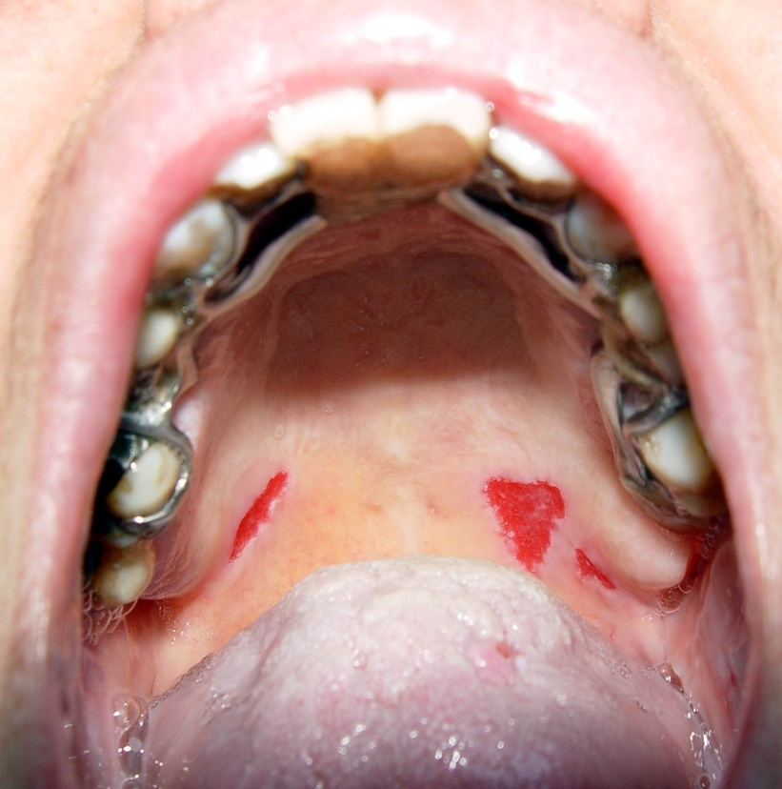
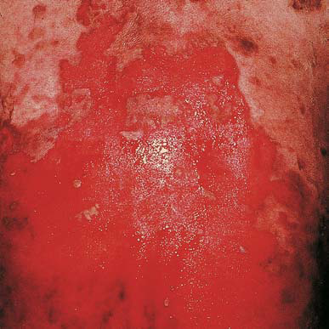

Slide 26
Pemphigus Vulgaris
Begins with erosions on mucous membrane then other skin areas.
Mostly erosions and few flaccid blisters
Very painful.
+ve Nikolsky’s sign

Slide 27
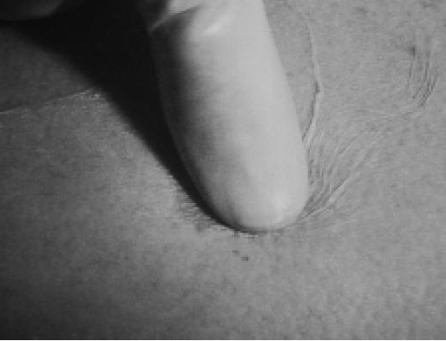
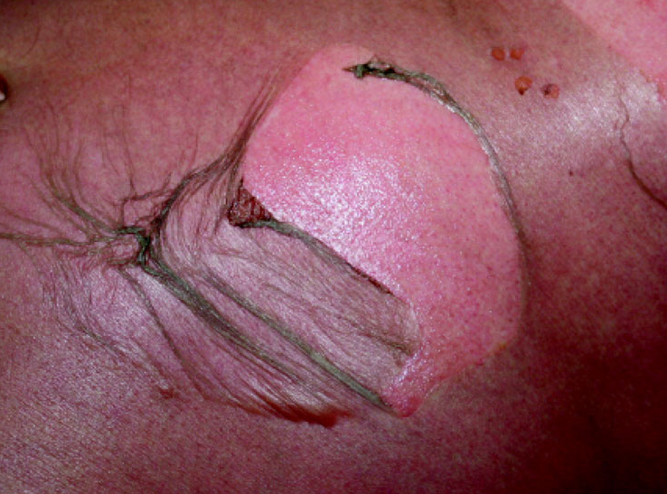
+ve Nicholsky sign
  Twisting pressure on normal skin shears skin.

Slide 28
Pemphigus Vulgaris
Begins with erosions on mucous membrane then other skin areas.
Very painful.
+ve Nikolsky’s sign.
Age: middle-age 40-60 years.
Secondary infection and disturbance of fluid and electrolyte balance are common complications .

Slide 29
Pathology and immunopathology

Slide 30
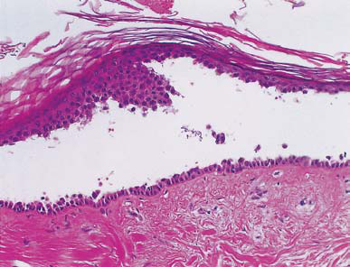
Acantholysis
Immunofluorescence
IgG and C3

Slide 31
Treatment
High dose systemic steroids 60-100 mg of prednisolone.
Immunosuppressive agent such as azathioprine cyclophosphamide , Methotrexate or mycophenolate
Topical therapy is mainly symptomatic.
Patient will probably have to remain on systemic steroids for long time.
Antibiotics

Slide 32
Biological Rx:
Rituximab
Biological Rx:
IVIG (intravenous Ig)

Slide 33
How do I treat pemphigus?
mild
  class III/IV corticosteroid creme / intralesional injection
severe
  prednisolon 80 mg, taper in 5 months
b. Other immunosuppressive: azathioprine,
  Mycophenolate, etc
  C. Biological Rx: Rituximab and IVIG (intravenous Immunoglobuling)

Slide 34
Paraneoplastic pemphigus
The least common and most severe type of pemphigus is paraneoplastic pemphigus (PNP). This disorder is a complication of cancer,
usually lymphoma and Castleman's disease. It may precede the diagnosis of the tumor. Painful sores appear on the mouth, lips, and the esophagus.
Complete removal and/or cure of the tumor may improve the skin disease,

Slide 35
Both Intra epidermal and sub epidermal blister

Slide 36
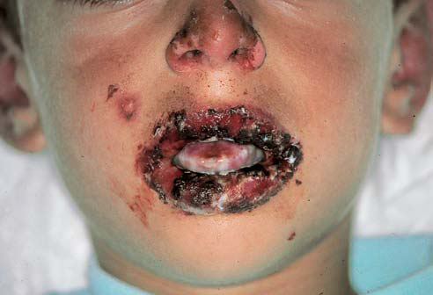

Slide 37
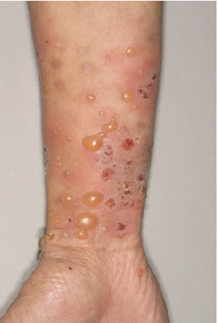
Bullous pemphigoid
Characterized by large intact blisters on an erythematous base. it can errupt
to form erosions
Mainly in older age group
more than 60 y.
The prognosis is usually good.

Slide 38
Clinical features
Elderly patents.
Large tense blisters on upper arms and thighs.
Eczematous base .
Itch rather than pain.
Oral lesions are less frequent than pemphigus.

Slide 40
Pathology
Sub epidermal between epidermis and dermis the epidermis forms the roof of the blister.
Antigens identified are in hemidesmosomes.
Immunoglobulin and complement are deposited in the lamina lucida of the basement membrane in a linear band.

Slide 41
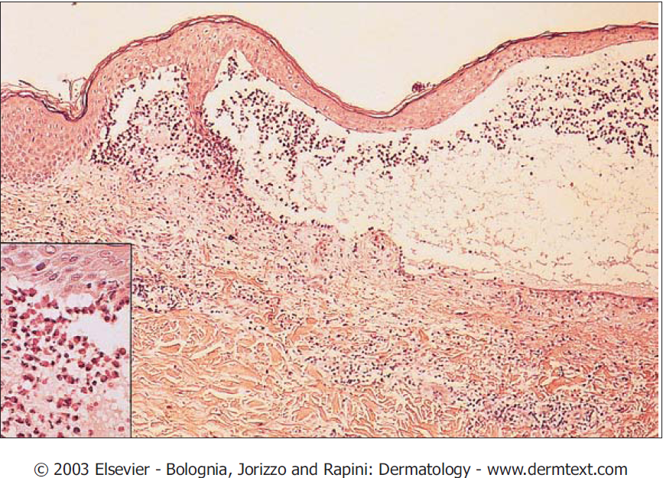
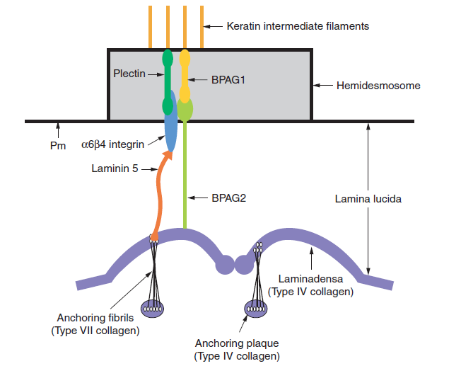

Slide 42
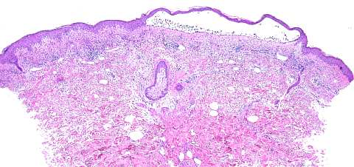
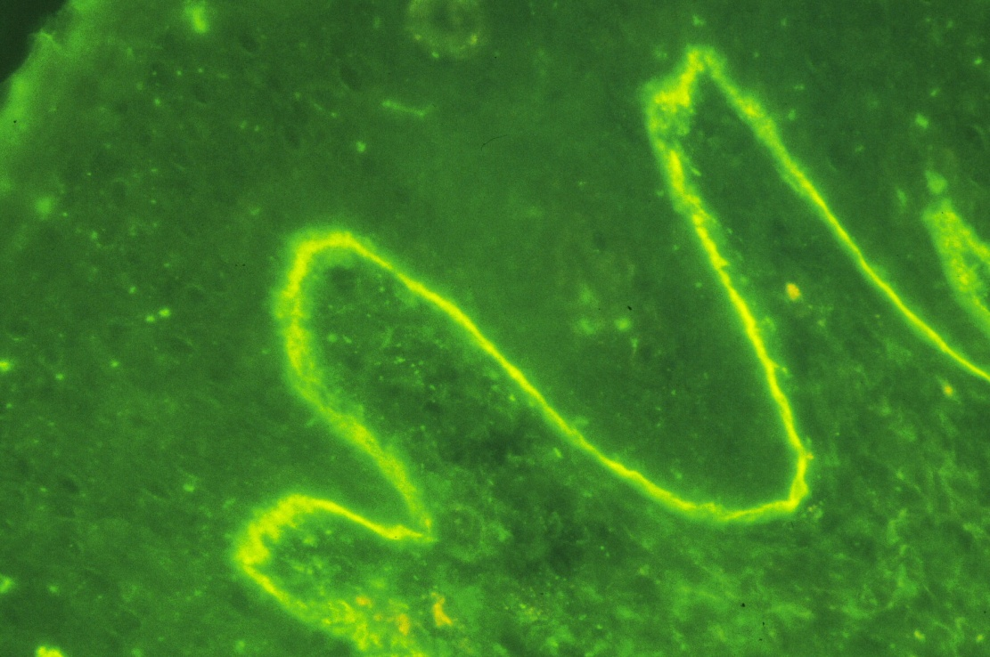

Slide 43
Treatment
Topical Steroids
Severe pemphigoid :Systemic steroids , but unlike pemphigus, usually possible to discontinue Rx.
The addition of either azathioprine enable the oral steroid dose to be reduced more rapidly.
Milder may also respond very well to potent or moderately potent topical steroids alone.

Slide 44
Other treatment:
Antibiotics like tetracyclines group

Slide 45
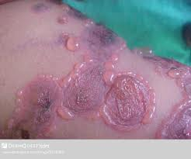
CHRONIC BULLOUS Disease OF CHILDHOOD
Chronic blistering dis. which occur in children, usually starts before the age of 5yrs
Small and large blisters appears predominantly on the lower trunk, genital area, and thighs
May also affects the scalp and around the mouth
New blisters form around healing old blisters forming a CLUSTER OF JEWELS

Slide 46
CHRONIC BULLOUS Disease OF CHILDHOOD
Course is chronic and spontaneous remission usually occurs after an average of 3-4 yrs
IgA autoantibodies binds to proteins at dermo epidermal junction as linear pattern like the pattern of bullous pemphigoid

Slide 47
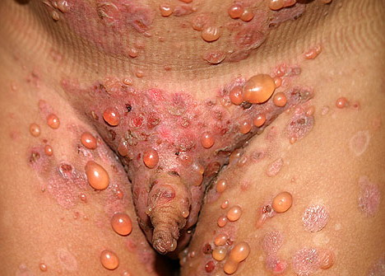
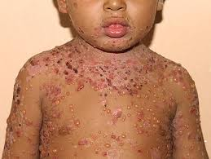
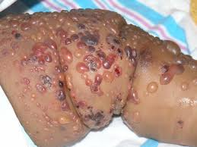

Slide 48
CLINICAL FEATURES
Circular clusters of large intact blisters and can erupt to form erosions
It involves the perioral area, lower trunk, inner thighs and genitalia
Blistering may spread all over the body

Slide 49
INVESTIGATION
Skin Biopsy will show subepidermal splits
Direct IF reveals IgA along the BM of the epidermis in a linear pattern

Slide 50
TREATMENTS
Oral dapsone (check G6PD)
What the side effect of dapsone?
Sulphonamides and immunosupressants
Erythromycine
Flucloxacillin

Slide 51
Drug-induced PV
Drugs can induce PV
Drugs reported most significantly in association with PV are;
Penicillamine
captopril

Slide 52
Blistering Diseases
Objectives
To know the definition
& classification of Blistering diseases
To recognize the primary presentation of different types of main blistering diseases
To understand the possible pathogenesis of the main types of blistering diseases
To have an overview about managements lines of these diseases

