Slide 1
Structure and Function of the Skin
Mohammed Al-Haddab,MD,FRCPC
Assistant Professor, Dept. of Dermatology
College of Medicine, King Saud University

Slide 2
Objectives
To be familiar with the different structures of the skin.
To have basic knowledge of anatomy and function of the skin.
To be familiar with different tools to investigate skin disorders.
The relation between anatomy and diseases.
To have a general idea about different therapeutic options used in dermatology practice.

Slide 3
The skin is the largest organ of the human body (1.75 m2).
It is divided into epidermis(ectoderm), dermis(mesoderm), subcutaneous fat and skin appendages(ectoderm and mesoderm).
Dermal- Epidermal junction is called basement membrane, the weakest part in the skin and the usual site of blisters.
Palms, soles, genitalia and scalp skin has slightly different structure.

Slide 4
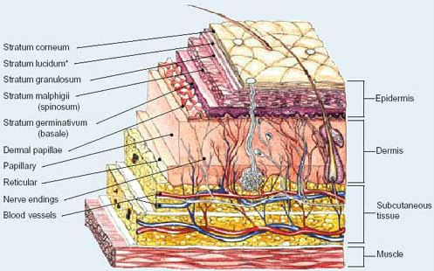

Slide 5
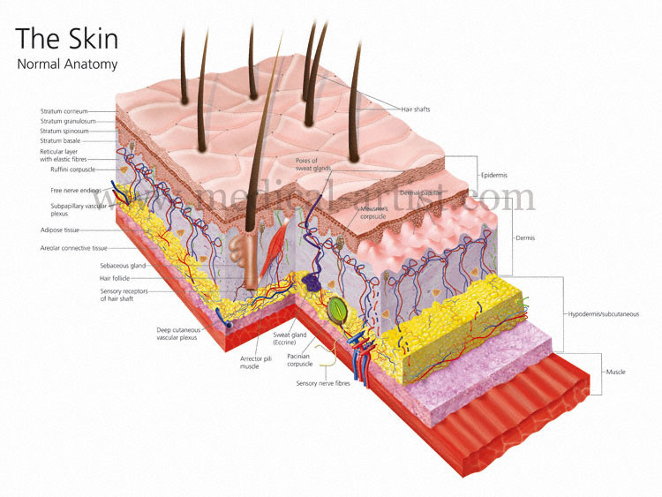

Slide 6
Epidermis
Subdivided into 4 layers:
Cornified or horny layer: the outer non-nucleated barrier layer.
Granular layer.
Spinous or prickle cell layer comprise the bulk of keratinocytes.
Basal layer with stem cell dividing keratinocytes and melanocytes.

Slide 7
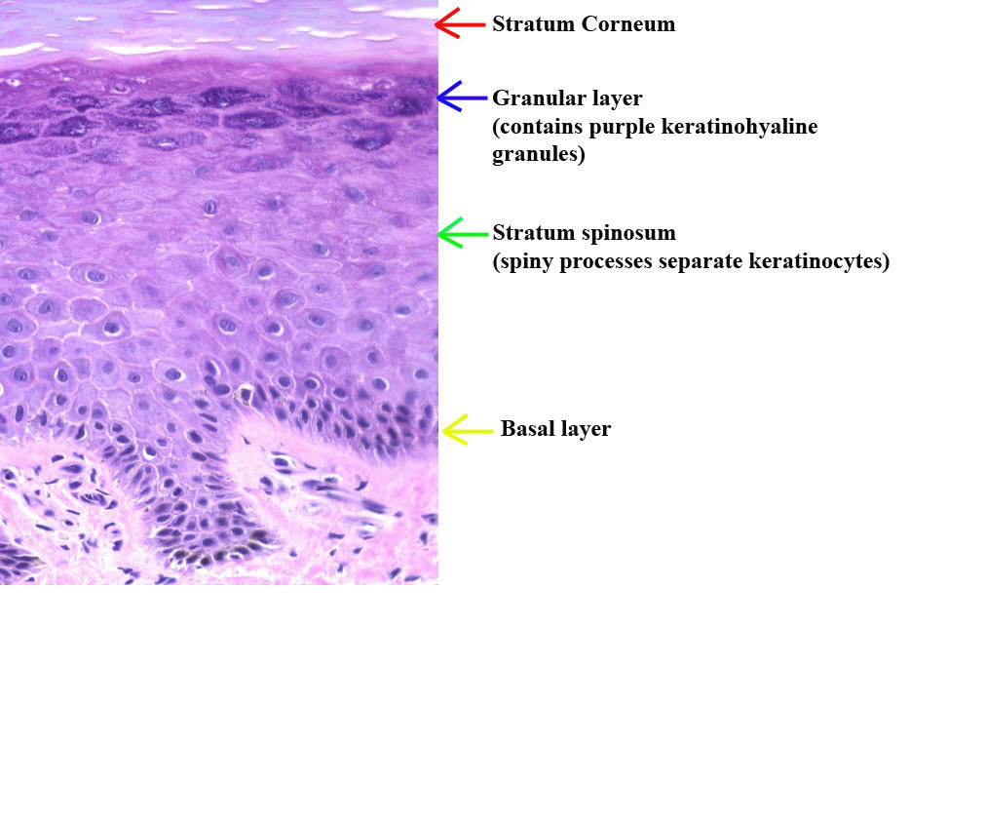

Slide 8
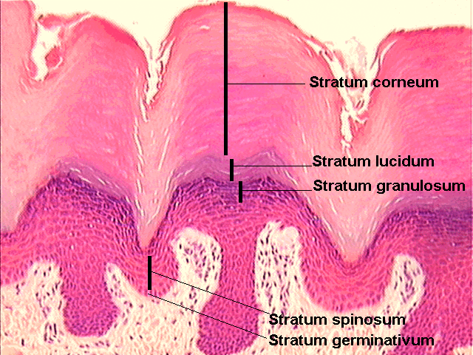

Slide 9
Cells of the Epidermis
Keratinocytes: 95% of the cells in epidermis. Division of these cells only occur in the basal layer where 10% of them are stem cells.
In the spinous layer they are connected to each other by desmosomes and gap junctions.
Keratinocytes in basal layer express keratin 5 and 14, other keratinocytes express keratin 1 and 10.
The normal transit time of a differentiating keratinocyte from basal layer to the outer surface of the stratum corneum is 28 days. ( in psoriasis it is much shorter).

Slide 10
Cells of the Epidermis
Melanocytes are responsible for producing skin pigment.
Mainly seen in the basal layer.
Numbers of the melanocytes are the same in equivalent body sites in white and black skin.
On the face the ratio of melanocytes to basal keratinocytes is around 1 to 5, while on the lower back it is around 1 to 20.
Melanocytes are found in the epidermis, the hair bulb, the eye, and the brain.
Melanin provide protection from ultraviolet light.

Slide 11
Cells of the Epidermis
Langerhans cells are derived from the bone marrow.
usually situated in the middle of the spinous layer.
Birbeck granules can be seen by electron microscope in the cytoplasm.
The only cell in the skin that express MHC class 2 antigens.
Act as antigen presenting cells.
Abnormal proliferation of these cells is seen in Langerhans cell histiocytosis.

Slide 12
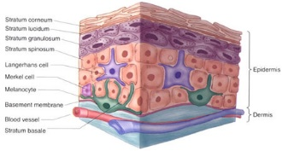

Slide 13
Cells of the Epidermis
Merkel cells are found in great numbers in touch sensitive sites like fingertips and lips.
Usually around basement membrane area and around nerve endings.
Cytoplasm has dense granules which contain large quantities of catecholamine.
Their function is not well understood.
Merkel cell carcinoma is aggressive malignant tumor.

Slide 14
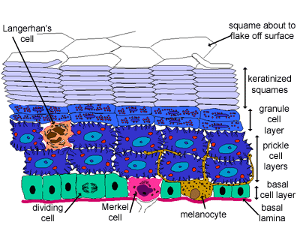

Slide 15
The Basement Membrane
It divides the epidermis from the dermis.
Complex multi layered structure.
Has 2 layers, lamina lucida and lamina densa.
Keratinocytes attach to basement membrane via hemidesmosomes.
Anchoring filaments connects lamina lucida to lamina densa.
Anchoring fibrils connects lamina densa to papillary dermis.
Many bullous disorders whether congenital or autoimmune have their pathology in this area.

Slide 16
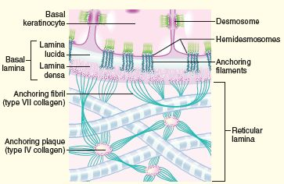

Slide 17
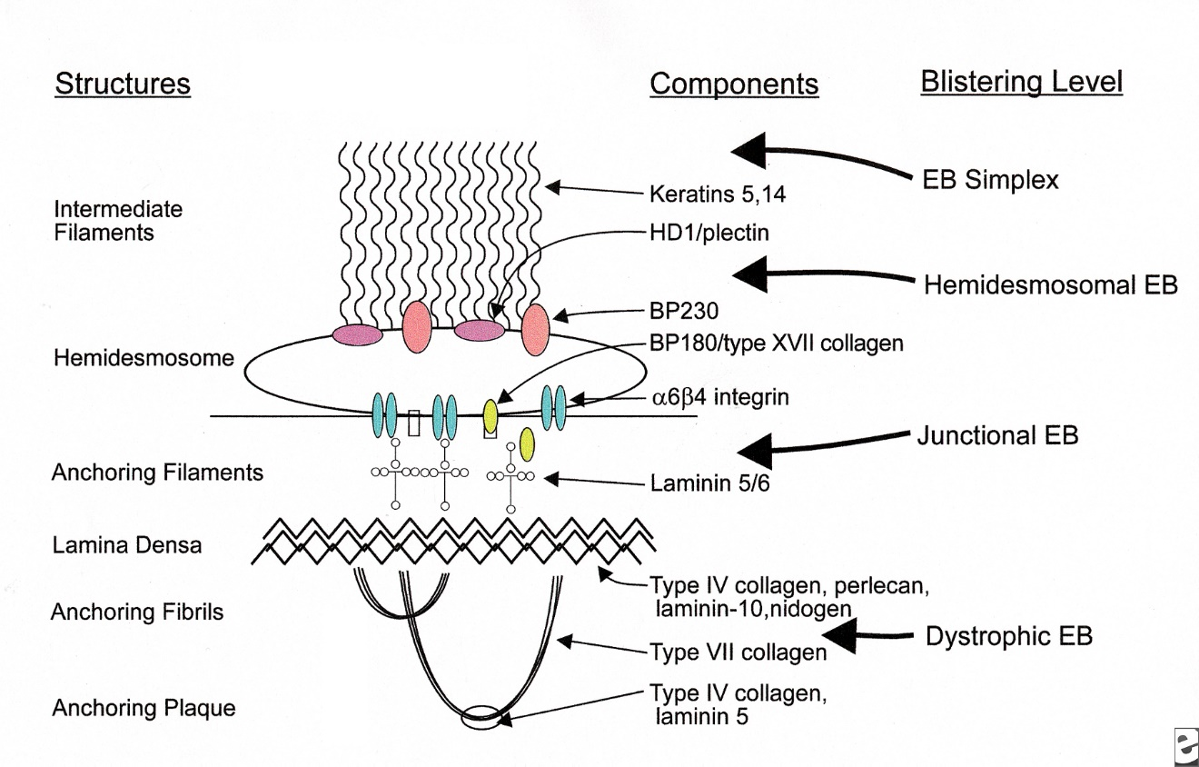

Slide 18
The Dermis
Upper layer is called papillary dermis, the lower part is called reticular dermis.
Mucopolysacchride gel held together by collagen and elastin fibrous matrix.
The cells in the dermis include: fibroblasts ( produce collagen), macrophages, dermal dendritic cells and mast cells (immune functions).
Also has blood vessels, nerves, lymphatics and muscles.

Slide 19
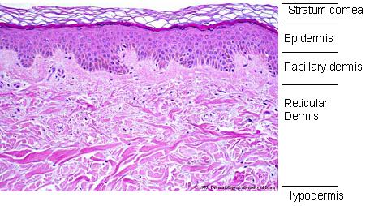

Slide 20
The Skin Appendages
Pilosebaceous unit, eccrine sweat glands, apocrine glands (axilla and groin) and the nails.
Pilosebaceous unit include: hair follicle+sebaceous gland+ arrector pili muscle.
Hair follicle has the hair shaft, hair bulb and the bulge.
3 types of hair: terminal coarse hair, vellus hair, and androgen dependent hair on beard, axilla and groin areas.
Hair follicle cycle in anagen or growth phase 80%, catagen or resting phase and telogen or shedding phase both 20%.

Slide 21
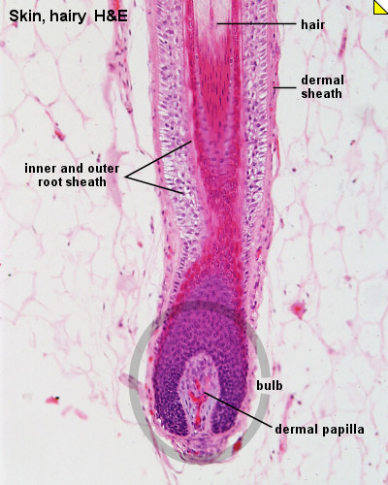
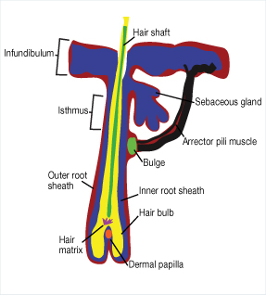

Slide 22
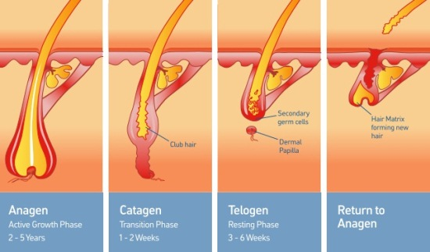

Slide 23
The Skin Appendages
Sebaceous glands are hormone responsive and become active at puberty. They secrete sebum (squalene, cholesterol esters, wax esters and triglycerides) to moisturize the skin through a process called holocrine secretion through hair follicle opening.
Apocrine sweat glands mostly found in axilla and groin. Their secretion through a process called decapitation secretion. They only become functional after puberty.
Eccrine sweat glands are seen on all body sites. Their ducts open directly onto skin surface. Most numerous on the sole of the foot and least abundant on the back.
Periglandular acetylcholine is the major stimulant of sweat secretion.

Slide 24
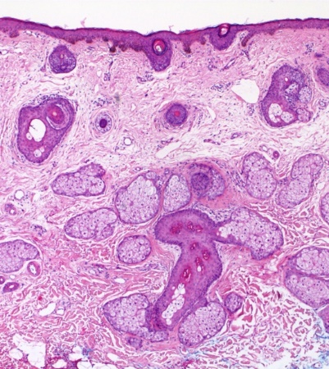

Slide 25
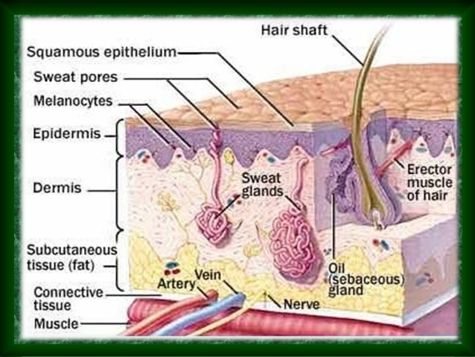

Slide 26
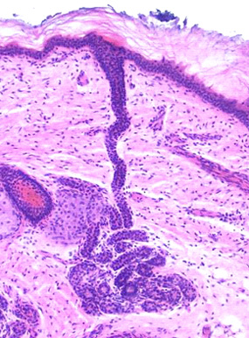

Slide 27
The Nails
Highly modified skin appendage.
Grows out of nail matrix.
Protected by the cuticle.
Consists of nail plate, proximal nail fold, nail matrix, nail bed, and hyponychium.
Fingernails grow at 3 mm per month and need 6 months to be replaced after avulsion.
Toenails grow at 1 mm per month and need 12-18 months to be replaced.

Slide 28
The Nails

Slide 29
Skin Types

Slide 30
Functions of The Skin
Prevent infections via innate and adaptive immunity ( infections, autoimmunity, cancers).
Maintain a barrier ( infections, dehydration, eczema).
Repair injury ( cancer, ulcers).
Provide circulation ( infarction, vasculitis).
Communicate ( sensory neuropathy, pruritus).
Provide nutrition ( vit D deficiency).
Regulate temperature ( hypo and hyperthermia).
Attract attention ( photo ageing, vitiligo, alopecia).

Slide 31
Classification of Dermatological Disorders
Inflammatory:
Infectious: viral, bacterial, fungal, protozoal, and infestation.
Non infectious: eczematous, papulosquamous, urticaria and erythema, bullous diseases, autoimmune diseases.
Neoplastic: benign, malignant.
Other: metabolic, toxic, genodermatosis.

Slide 32
Investigations
Wood’s lamp to examine the skin color and some florescent organisms.
Dermoscopy for benign and malignant lesions.
KOH for fungal infections.
Tzanck smear for herpes.
Direct Immunofluorescence for bullous diseases.
Patch testing for allergic contact dermatitis type 4 hypersensitivity.
Prick test for common allergens type 1 hypersensitivity.
Skin biopsy: shave, punch, incisional, excisional or curettage.

Slide 33
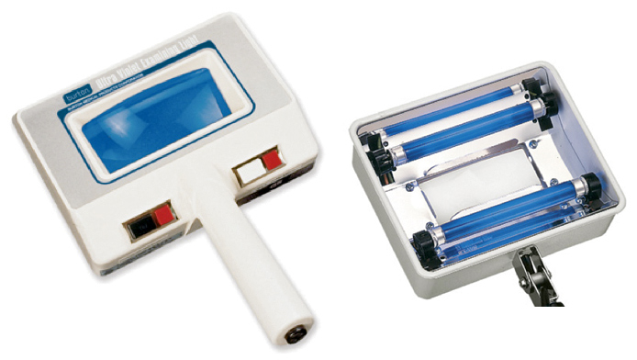

Slide 34
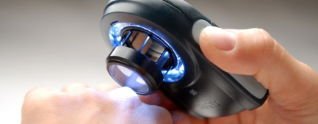
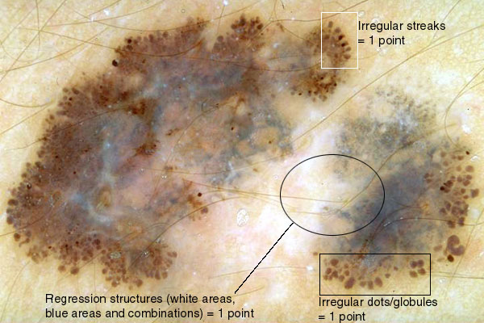

Slide 35
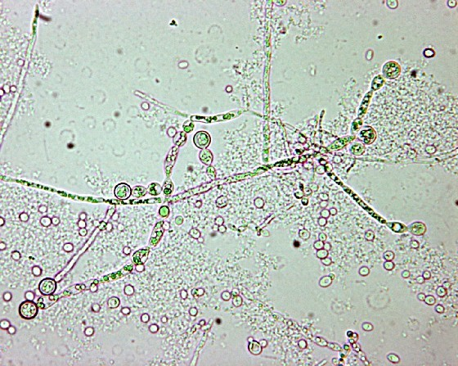

Slide 36
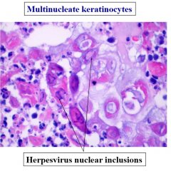

Slide 37
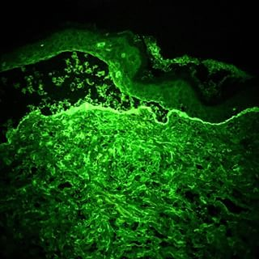

Slide 38
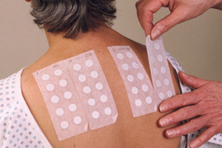
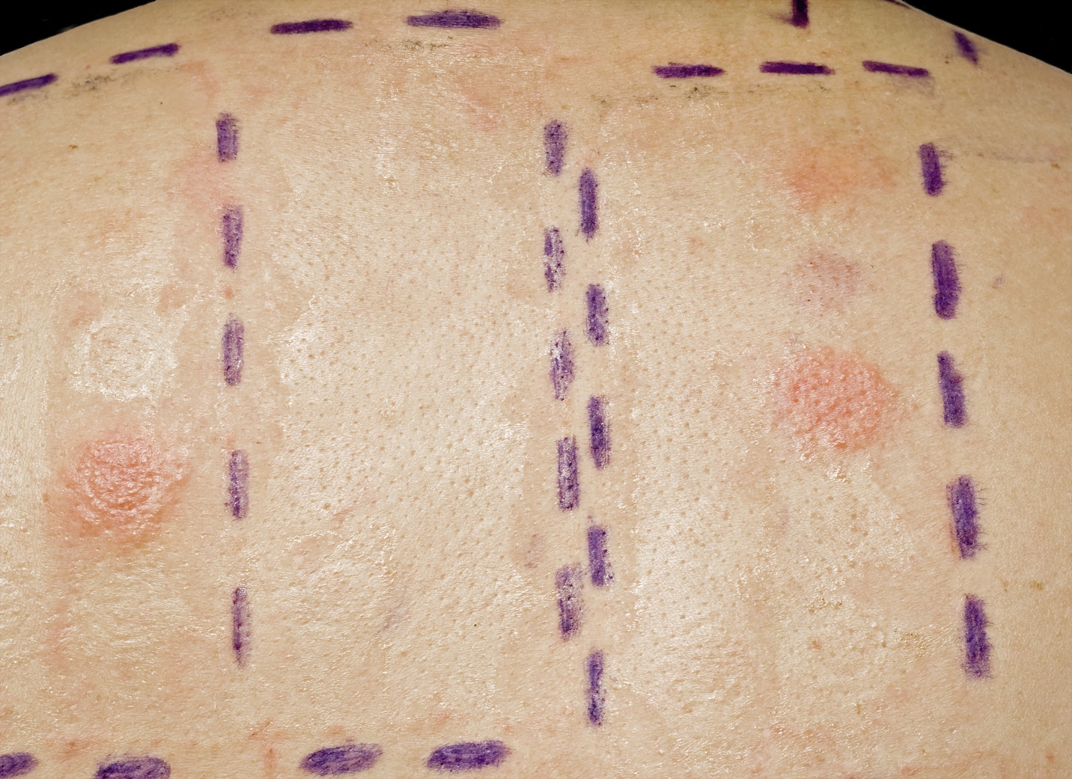

Slide 39
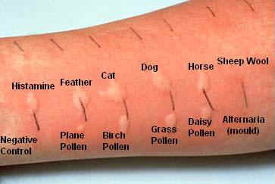

Slide 40
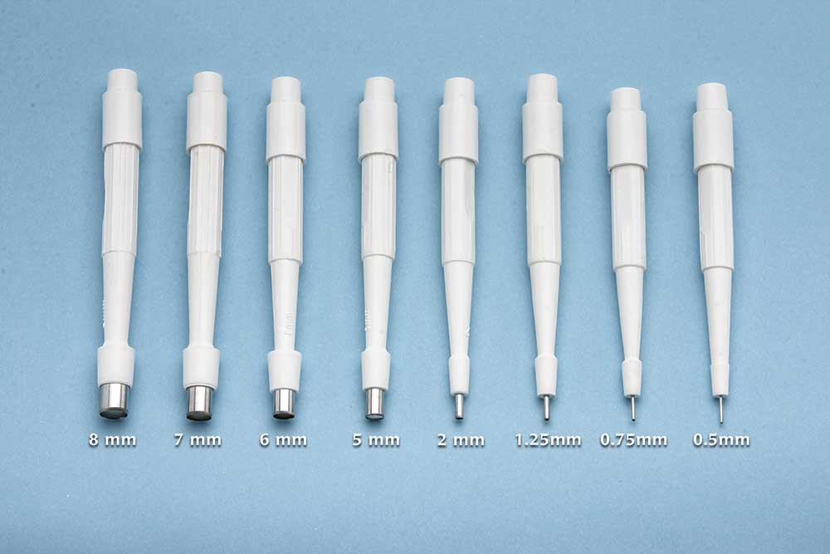

Slide 41
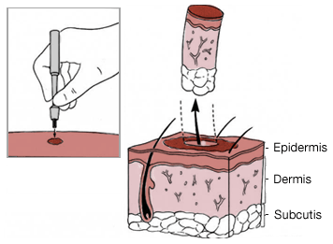
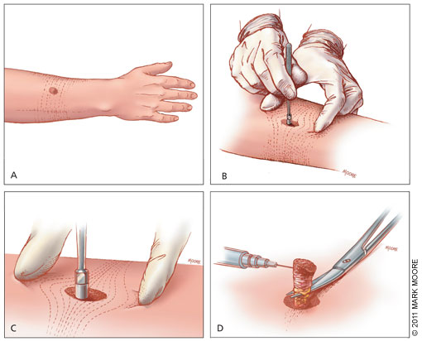

Slide 42
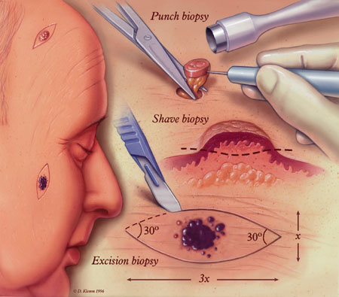

Slide 43
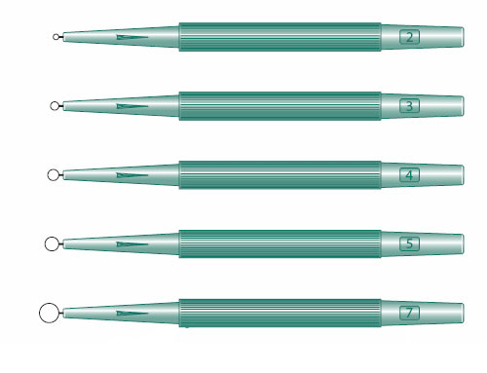
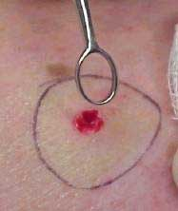

Slide 44
Treatment Modalities
Topical and systemic therapies.
Cryotherapy.
Electrocautery.
Laser surgery.
Cutaneous and nail surgery.
Phototherapy.
Immunomodulation for warts and alopecia areata.
Cosmetic surgery and hair transplant.

Slide 45
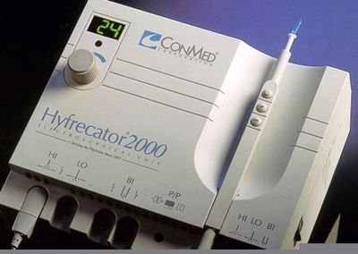

Slide 46
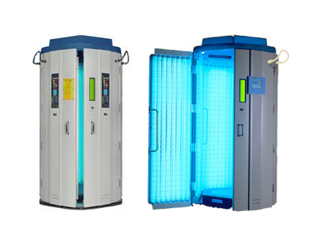
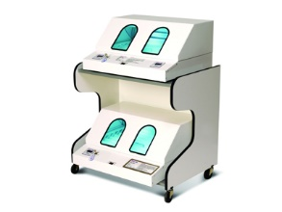

Slide 47
Questions?

