Slide 1
ATOPIC DERMATITIS AND ECZEMATOUS DISORDERS
Dr. Hend Alotaibi
Assistant professor & Consultant
College of Medicine, King Saud University
Dermatology Department /KKUH
Email: halotaibi1@ksu.edu.sa

Slide 2
Objectives
To know the definition & classification of Dermatitis/Eczema
To recognize the primary presentation of different types of eczema
To understand the possible pathogenesis of each type of eczema
To know the scheme of managements lines

Slide 3
Eczema - dermatitis
Definition: inflammation of the skin
What are the eczema phases?
Acute eczema: erosion, oozing and vesicles
Subacute eczema: Redness+ swelling, crust-+ scale +infection
Chronic eczema: lichenification, dark pigmentation and thick papules and plaques

Slide 4
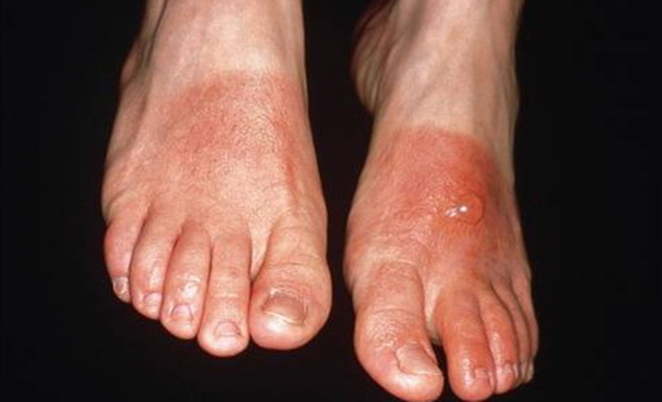
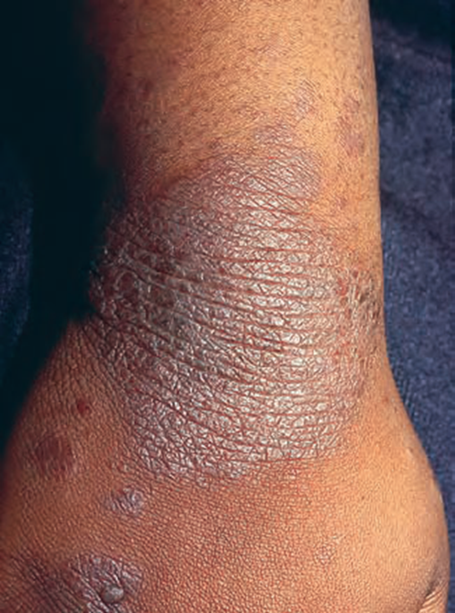
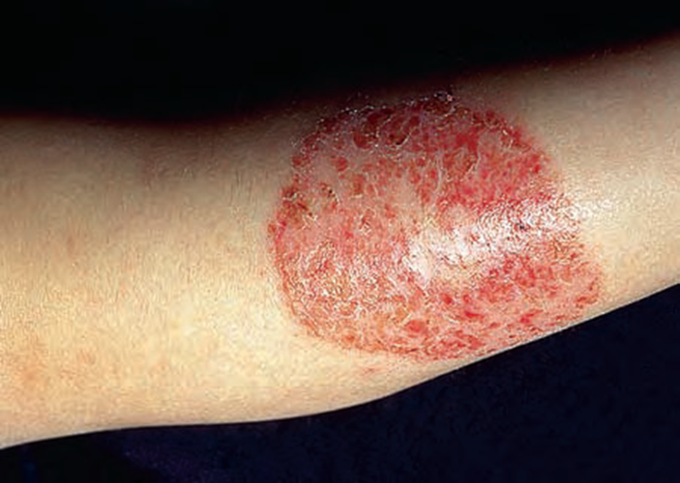

Slide 5
Atopic Dermatitis
Definition: chronic relapsing itchy skin disease in genetically predisposed patients.
Associated diseases: bronchial asthma, allergic rhinitis, allergic conjunctivitis( personal or family Hx)
Incidence: up to 15-20 % in early childhood
More in male
Age of onset:
60% ------ first 2 months of life
30 %------- by age of 5
10%-------- between age 6- 20 years
Improves in summer and flare in winter

Slide 6
Pathogenesis:
Atopy”: genetic predisposition
Dry skin (decrease production of moisturizing lipids; sebum)
Ig E ? (Epiphenomenon)
T-Cell activation
Allergy, increased tendency to certain allergens
Infection : skin of pts with AD is colonized by S aureus. infection with S aureus often causes a flare of AD
AD and Food! minor role

Slide 7
Clinical Variants:
Infantile AD
Childhood AD
Adult AD

Slide 8
Infantile AD
Distribution
Presentation
Red skin, tiny vesicles on
“puffy “ surface. Scaling, exudate
With wet crust and fissures.
Diaper area is usually spared

Slide 9
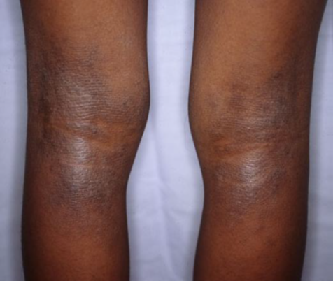
Childhood AD:
Distribution
Presentation
Antecubital, popliteal fossae, neck and face.
May be generalized
Papular, lichenified plaques, erosions, crusts.

Slide 10
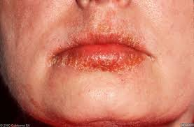
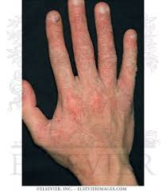
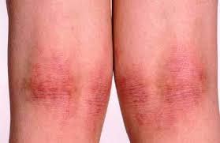
Adult AD:
Distribution
Presentation
Mostly flexural, face and neck.
May be generalized
Lichenification and excoriations

Slide 11
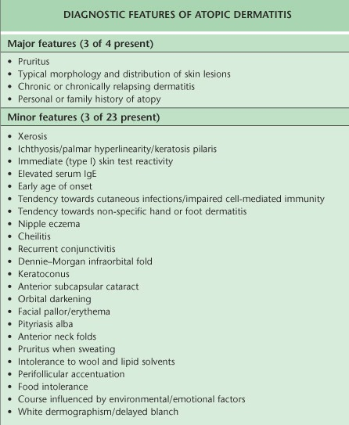

Slide 12
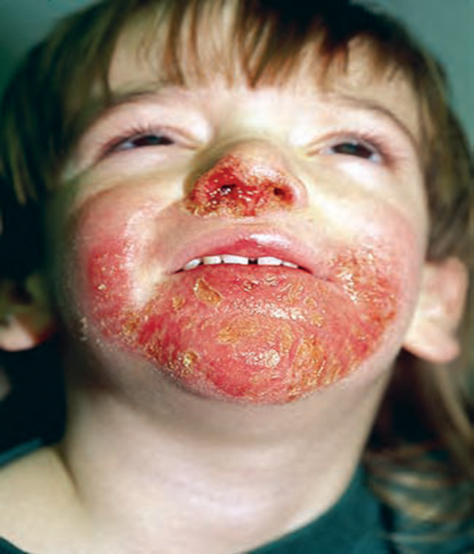
Complications:
Secondary infections
Eczema herpeticum
Growth retardation
psychological

Slide 13
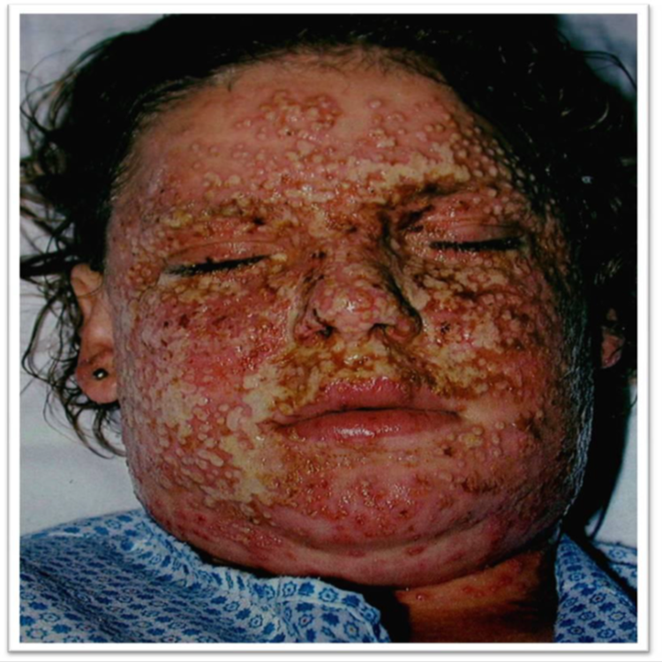
Eczema herpeticum

Slide 14
Prognosis
Half of the cases improve by 2 years of age
• Most improve by teenage years
• <10% of patients have lifelong problems
30-50% will develop BA or hay fever

Slide 15
Management:
Education! Education! Education!
Psychological support!
Skin care: moisturizing the skin
Avoid irritant like soaps
Topical therapy: (topical steroids, Tacrolimus, Pimecrolimus)
Antibiotics--- Antistaphylococcal drugs
Sedative antihistamine to control itching and help sleep
Phototherapy
Systemic therapy: steroids, Cyclosporin, Methotrexate, Azathioprine

Slide 16
Seborrhoeic Dermatits
Definition: redness and scaling in regions where the sebaceous glands are most active as the face, scalp, presternal area and body folds.
Very common chronic dermatosis.
Age: infancy, puberty , old age
More in male
Pathogenesis:
Increased Sebum!( seborrheic state)
Tendency
Pityrosporum ovale ( Maalassezia furfur )over growth
More in Parkinson, HIV/AIDS patients.

Slide 17
Clinical features
Presentation
Pruritus is variable
Gradual onset, worse in winter dry environment.
Orange- red greasy scaling macules, papules of varying size
Trunk: nummular, annular
Scalp: marked scaling, diffuse involvement

Slide 18
Distribution:
Hairy are of head, cradle cap
Face: forehead, nasolabial folds , glabella and eyebrows.
Trunk: DDx: PR vs pityriasis versicolor
Body folds: axillae, groins, anogenital area, submammary areas, umbilicus and diaper area (infants)--- sharply marginated erythematous eruption, erosions and fissures
Genitalia: with yellow crust and psoriasiform lesions.

Slide 19
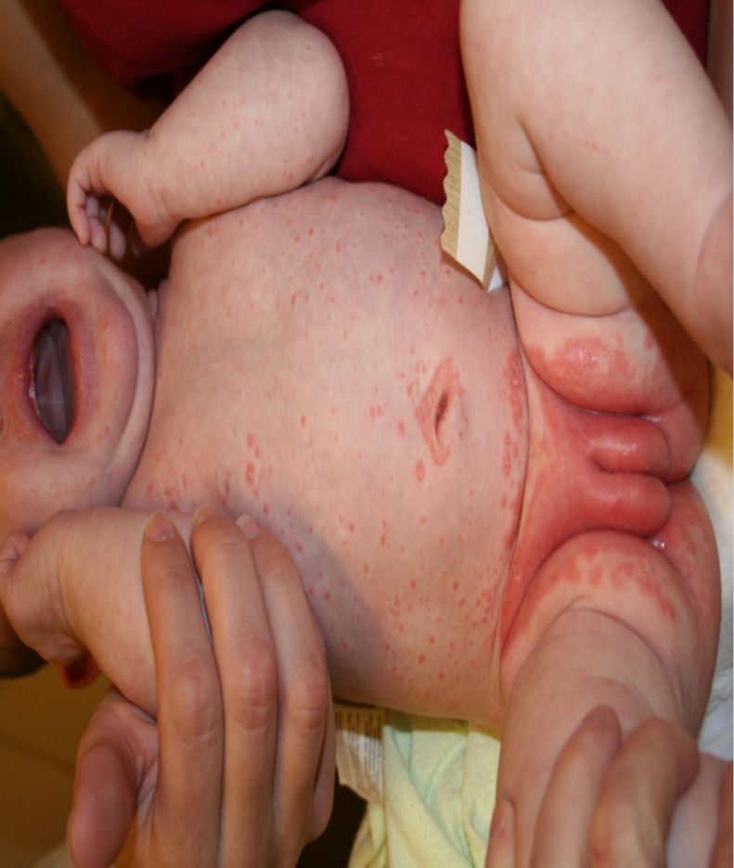

Slide 20
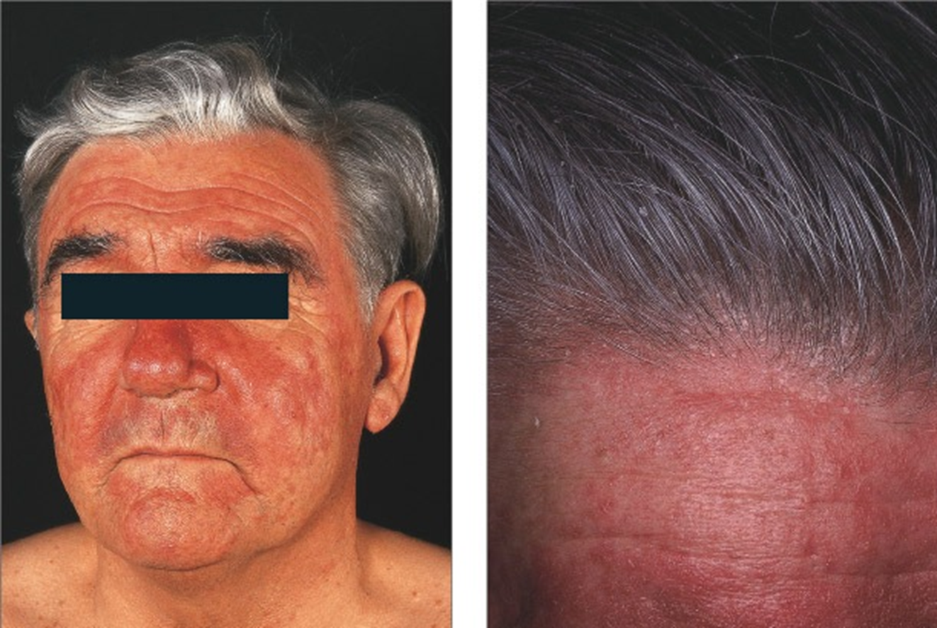

Slide 21
Management:
Scalp :
Zinc pyrithione Shampoo
Selenium sulfide 2.5% shampoo
2% ketoconazole shampoo
Low – potency glucocorticoid solution, lotion or gels.
Skin:
Topical: antifungals, glucocorticoid, pimecrolimus
Combined therapy
Maintenance & recurrence

Slide 22
Contact Dermatitis
Definition: dermatitis results from contact with external materials.
Pathogenesis:
Irritant vs. allergic : (cytotoxic vs type IV)
Common irritants: detergent, acids, dust, burning chemicals, etc
Common allergens: perfumes, hair dyes, nickels, leathers, metals, rubbers, latex, cosmetics, etc

Slide 23
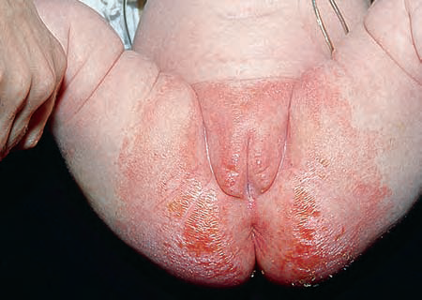
IRRITANT CONTACT DERMATITIS
All people will react to an irritant if applied in a high enough concentration
At 1st exposure
Common causes:
Hands repeatedly exposed to water, cleansers
Lip-licking habit – wetting and drying caused by saliva
Napkin dermatitis

Slide 24
ALLERGIC CONTACT DERMATITIS
Characteristics
First exposure does not cause a reaction
Begins 24 h after subsequent exposure if already allergic
Commonest: Nickel, chromates, rubber, preservatives, topical Abx, topical cs
Diagnosis: Skin patch tests( read at 48, 96 h)

Slide 25

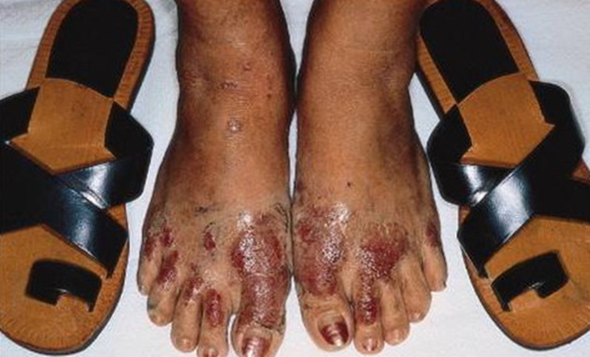
Shoe dermatitis
Causes:
a. Rubber (most common)
b. Chromates (in leather)
c. Glutaraldehyde (in leather)
d. Adhesives
e. Dyes

Slide 26
Clinical features
Predilection sites: site of contact
Distribution & configuration

Slide 29
Management:
Identification removal of causes.
Patch testing:
for allergic contact dermatitis not for irritant
Avoidance allergens
Topical corticosteroids

