Slide 1
Cutaneous Manifestation of Systemic disease
By:
Dr.Eman Almukhadeb
Consultant dermatologist , Assistant professor

Slide 2
Introduction
-CUTANEOUS MANIFESTATIONS OF :
-Endocrine disorders
-Metabolic disorders (Hyperlipoproteinemias )
-GIT disorders
-Liver cirrhosis
-Renal failure

Slide 3
CUTANEOUS MANIFESTATIONS OF ENDOCRINE DISORDERS

Slide 4
CUTANEOUS MANIFESTATIONS OF ENDOCRINE DISORDERS
Cutaneous Manifestation of :
Diabetes Mellitus
Hypothyroidism
Hyperthyroidism
Addison disease
Cushing syndrome

Slide 5
CUTANEOUS MANIFESTATIONS OF DIABETES MELLITUS
Diabetic dermopathy
Necrobiosis Lipoidica Diabeticorum (NLD)
Acanthosis nigricans
Bullous diabeticorum
Generalised granuloma annulare
Scleredema Diabeticorum
Bacterial and fungal infections.
OTHER: Perforating dermatosis , Skin tags , eruptive xanthomas , neuropathic ulcers

Slide 6
1-Diabetic Dermopathy or “Shin Spots”
• Most common cutaneous manifestation of diabetes; M > F, males over age 50 years with long standing diabetes
- Possibly related to diabetic neuropathy and vasculopathy
• There are bilateral asymptomatic red-brown atrophic macules on shins
• There is no effective treatment

Slide 7
2-Necrobiosis Lipoidica Diabeticorum (NLD)
• Patients classically present with single or multiple red-brown papules, which progress to sharply demarcated yellow-brown atrophic, telangiectatic plaques with a violaceous,irregular border.
-Common sites include shins followed by ankles, calves, thighs and feet.
-Ulceration occurs in about 35% of cases. Cutaneous anesthesia, hypohidrosis and partial alopecia can be found
• Pathology: Palisading granulomas containing degenerating collagen (necrobiosis).

Slide 8
NLD
• Approximately 60% of NLD patients have diabetes & 20% have glucose intolerance. Conversely , up to 3% of diabetics have NLD. Women are more affected than men.
-Pathogenesis is thought to involve the non-enzymatic glycosylation of dermal collagen and elastin
• Treatment: Ulcer prevention. No impact of tight glucose control on likelihood of developing NLD.
-Intralesional steroids
- Aspirin
-Antiplatelet
-Pentoxyfylline.
-Preilesional heparin injection

Slide 9
Acanthosis nigricans

Slide 10
3-Acanthosis Nigricans
-Causes:
-obesity & insulin resistance & endocrinopathy
(DM ,acromegaly ,cushing syndrome ,hypothyroidisim & hyperandrogenic state as HAIRAN syndrome (hyperandrogen, insulin resistance, acanthosis nigricans)
-Malignancy (esp. GIT, Lung & Breast CA)
-Medications (nicotinic acid ,niacinamide , testosterone, OCP & Glucocorticoid)

Slide 11
Acanthosis nigricans
• Clinical picture: Hyperpigmented velvety plaques of the flexures. The face, external genitalia, medial thighs, dorsal joints, lips and umbilicus can be involved in extensive cases

Slide 12
3-Acanthosis Nigricans
• Pathogenesis involves:
– Genetic sensitivity of the skin to hyperinsulinemia
– Aberrant keratinocyte and fibroblast proliferation stimulated by excess growth factor(e.g., Insulin like growth factor)
• Treatment:
Treat the underlying cause :
-Tight blood glucose control,
-treatment of underlying malignancy,
-weight control
-discontinuation of offending agent

Slide 13
Acanthosis nigricans of the palms (tripe palm)

Slide 14
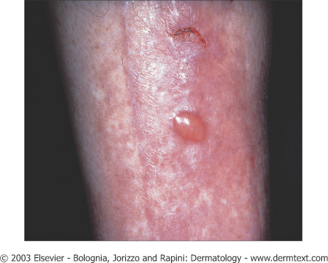
4-Diabetic Bullae or Bullae Diabeticorum
• Rarest cutaneous complications of diabetes; M > F, long standing diabetics.
-Trauma and microangiopathy may play a role
• Clinical: Rapid onset of painless tense blisters on the hands and feet
• Pathology: Intraepidermal and/or subepidermal split without acantholysis. DIF is negative
• Treatment: Spontaneous healing without scarring

Slide 15
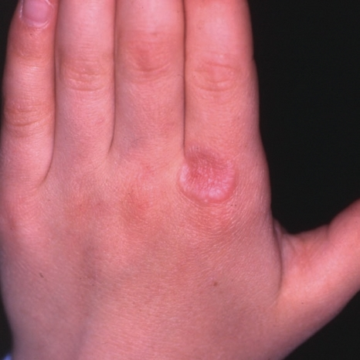
5-Granuloma Annulare
• Association between granuloma annulare and diabetes is controversial.
-Generalized form of GA is the most closely associated with DM.
-It has a chronic and relapsing course
• Treatment :
IL steroid
Systemic steroid
PUVA
• Asymptomatic red-purple dome shaped papules arranged in annular configuration

Slide 16
6-Scleredema Diabeticorum
• Occurs diabetics with poorly controlled , long-standing disease, and obese men
• Painless, symmetric woody “peaud’orange” induration of the upper back and neck.
-No specific treatment is available
-Control of hyperglycemia does not improve the scleredema

Slide 17
7-Cutaneous Infections
Diabetic patients are predisposed to develop cutaneous infections due to poor microcirculation
-Bacterial
-Fungal

Slide 18
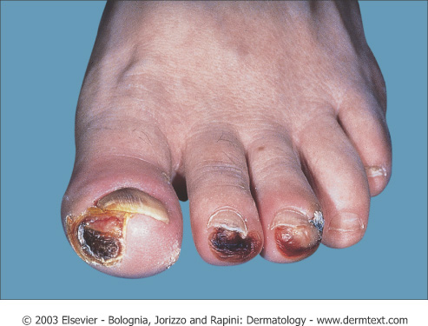
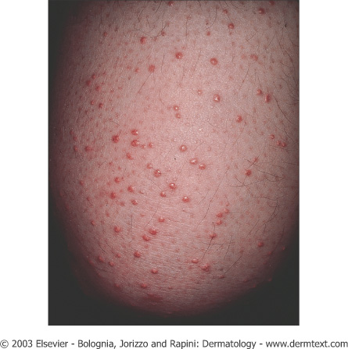
Other manifestation of DM:
-Diabetic neuropathy (peripheral) ,Neuropathic ulcers
Eruptive Xanthomas

Slide 19
Cutaneous Manifestation Of Thyroid disease

Slide 21
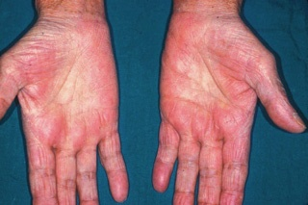
Non-specific Manifestations of Hyperthyroidism
Skin
• Warm, and moist
• Palmar erythema
• Flushing of head/neck, trunk
Hair
• Soft/fine/straight
• Diffuse reversible alopecia(Telogen effluvium)
Nails
• Faster rate of growth
• Onycholysis
• Plummer nails: concave deformity with distal onycholysis
Pigmentation
• Focal or generalized hyperpigmentation
• Vitiligo

Slide 22
Thyroid dermopathy (Pretibial Myxedema):
-Bilaterally symmetric, non-pitting yellowish-brown to red waxy papules, nodules and plaques on the shins
- Occur in Graves disease.
-The clinical findings are due to an increase in hyaluronic acid in dermis.
- Treatment regimens include high potency topical steroids & intralesional steroid.

Slide 24
Non-specific Manifestations of Hypothyroidism
Skin
• Cool, dry, pale
• Xerosis
• Hypohidrosis
• Yellowish hue secondary to carotenemia
• Generalized myxedema: swollen waxy appearance
• Swollen lips, broad nose, macroglossia
• Purpura secondary to impaired wound healing
Hair
• Dry, brittle, coarse hair
• Diffuse alopecia, Telogen effluvium
• Loss of lateral third of eyebrow (madarosis)

Slide 26
Hypocorticism (Addison disease):
-Generalized hyperpigmentation that is more prominent in light exposed areas, scars, genitalia, palmar and finger creases, and under the nails. The pigmentation characteristically affects the mucous membranes.
-Loss of pubic and axillary hair in females.
-Improvement of acne

Slide 28
Cushing syndrome:
- Endogenous or Exogenous
- Deposition of fat over the clavicles and back of the neck” Buffalo hump”
- Rounded erythematosus face with telangiectasia “Moon face”
- Truncal obesity with slender wasting limbs.
- Striae distensae .
- Hirsutism, acneform rash, androgenetic alopecia.
-Easy bruising of the skin on simple trauma.

Slide 29
Striae distensae

Slide 30
Buffalo hump

Slide 32
Hyperlipoproteinemia
Type I
• Familial lipoprotein lipase deficiency (AR) or apoprotein CII deficiency
• Increased chylomicrons
• Associated with hepatomegaly, pancreatitis
Type IIa
•Familial hypercholesterolemia, common hypercholesterolemia (AD)
• Increased LDL
Type IIb
• Familial hypercholesterolemia (AD)
• Increased LDL and VLDL
Type III
• Familial Dysbetalipoproteinemia (AR)
• Increased IDL
Type IV
• Familial hypertriglyceridemia (AD)
• Increased VLDL
Type V
• Familial type V hyperlipoproteinemia, familial lipoprotein lipase deficiency (AD)
• Increased chylomicrons and VLDL

Slide 33
Xanthomatosis
6 Clinical Types:
Tuberous Xanthoma
Tendinous Xanthoma
Eruptive Xanthoma
Planar Xanthoma
Palmar Xanthoma
Xanthelasma

Slide 34
1-Tuberous Xanthoma
• Flat or elevated, rounded, grouped, yellowish-orange nodules over joints (particularly elbows and knees)
• Types II, III, and IV
• Biliary cirrhosis
2-Tendinous Xanthoma
• Papules or nodules over tendons (extensor tendons on dorsum of hands, feet, and achilles tendon)
• Types II, III

Slide 35
3-Eruptive Xanthoma
• Small yellow/orange/red papules appearing in crops over entire body → buttocks, flexor surfaces, arms, thighs, knees, oral mucosa and may koebnerize
• Associated with markedly elevated or abrupt increase in triglycerides (elevated chylomicrons)
• Types l ,lll , lV , and V
• Diabetes, obesity, pancreatitis, chronic renal failure, hypothyroidism, estrogen therapy, corticosteroids, isotretinoin, acitretin

Slide 36
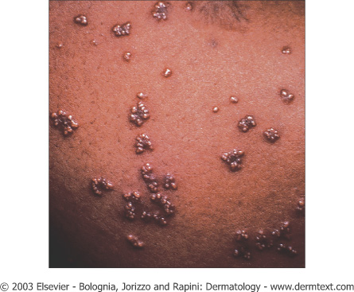
Eruptive xanthomas. Note the yellowish hue

Slide 37
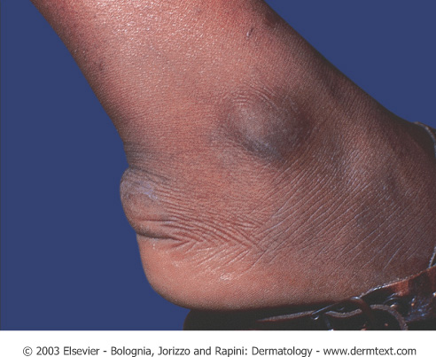
Tendinous xanthoma. Linear swelling of the Achilles area representing a tendinous xanthoma in a patient with dysbetalipoproteinemia.
Tendinous xanthomas of the fingers in a patient with homozygous familial hypercholesterolemia.

Slide 38
4-Planar Xanthoma
• Flat macules or slightly elevated plaques, yellow/tan color
• Associated with biliary cirrhosis, biliary atresia, myeloma, monoclonal gammopathy, lymphoma.
• Characteristically around eyelids, neck, trunk, shoulders, or axillae
• Types ll,lll
5-Palmar Xanthoma
• Nodules and irregular plaques on palms and flexural surfaces of fingers
• Type III
Plane xanthoma in a patient with a monoclonal IgG gammopathy

Slide 39
6-Xanthelasma
• Most common type of xanthoma
• Eyelids
• Usually present without any other disease, but can occur in types II and III
• Common among women with hepatic or biliary disorders, also seen in myxedema, diabetes
• Best treated with surgical excision

Slide 40
Plane xanthomas of the palmar creases in a patient with dysbetalipoprotenemia (arrows).

Slide 41
CUTANEOUS MANIFESTATIONS OF GASTROINTESTINAL DISORDERS

Slide 42
Manifestations of Inflammatory Bowel Disease (IBD)

Slide 43
Other less common manifestation: Epidermolysis bullosa acquisita, erythema multiforme, urticaria, clubbing, psoriasis, vitiligo. Note: CD = Crohn’s disease ,UC = Ulcerative Colitis
Cutaneous Findings | Association
Commonly involves perineum associated with edema and inflammation | CD > UC | Fissures and Fistulas
Edema, cobblestone, ulcerations, nodules | CD | Oral Crohn’s
Nodules, plaques, ulcerations; commonly on extremities or intertrigenous regions mimics Erythema Nodosum | CD | Metastatic Crohn’s
Tender red nodules on anterior lower legs; precedes or occurs simultaneous with IBD flare | UC>CD | Erythema nodosum
Papules, pustules, hemorrhagic blisters → enlarge, ulcerate with dusky undermined edges; exacerbated by trauma; frequently on legs | UC>CD | Pyoderma Gangrenosum (PG)
Vegetating plaques, vesiculopustules of intertrigenous areas; heal with hyperpigmentation; when process involves mucosa =Pyostomatits vegetans | UC | Pyoderma Vegetans
Identical to common aphthous ulcers; develop with IBD flares | UC>CD | Chronic Aphthous Ulcers

Slide 44
Metastatic crohns disease

Slide 45
Erythema Nodosum
• Erythematous, tender nodules on anterior shins; also seen on thighs, lateral aspects of lower legs, arms, and face , bilateral , symmetrical.
• Often accompanied by fever, chills, malaise, and leukocytosis
• 70% have associated arthropathy
• Occurs at any age, but most prevalent between 20 and 30 years of age

Slide 47
Erythema Nodosum
Causes :
MNEMONIC
SHOUT BCG
S=Sarcoid, Sulfa drugs, Strept.
H=Histoplasmosis
O=Oral contraceptives , pregnancy
U=Ulcerative colitis
T=TB
B=Bechet’s
C=Crohns
G=GI (Yersinia, salmonella )

Slide 48
Erythema Nodosum
Work up:
-Hx ( exclude drugs , hx of infection & GI symptoms)
-CBC ,diff.
-ESR
-Throat swab
-ASO titre
-CXR
-PPD
-Stool for occult blood
-Skin biopsy

Slide 49
Erythema Nodosum
Histology :
Septal panniculitis without vasculitis

Slide 50
Erythema Nodosum
Treatment
• Spontaneous resolution usually occurs within three to six weeks without scarring
• NSAIDs such as indomethacin or naproxen
• Systemic steroids effective in severe cases and can be dangerous if infection is etiology
• Potassium iodide

Slide 51
Pyoderma gangrenosum (PG)
-1.5-5% of patients with IBD develop PG
• Associated with leukemia, myeloma ,
monoclonal gammopathy (IgA),
polycythemia, chronic active hepatitis, HCV , HIV , SLE & pregnancy
• Associated with PAPA syndrome → pyogenic arthritis, pyoderma gangrenosum, severe cystic acne
• May be associated with arthritis

Slide 52
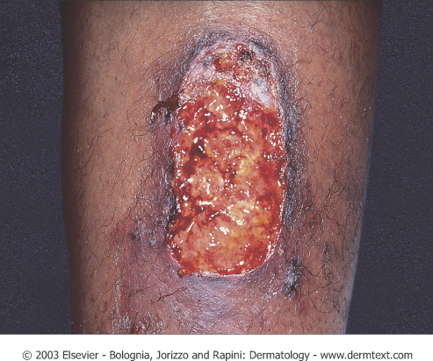
Pyoderma gangrenosum
Four Types:
Ulcerative
Pustular
Bullous
Vegetative
Distinct rolled edges and show satellite violaceous papules that break down and fuse with central ulcer

Slide 53
Peristomal Pyoderma Gangrenosum

Slide 54
Pyoderma gangrenosum
Histology
• Massive dermal edema with epidermal neutrophilic abscesses.

Slide 55
Pyoderma gangrenosum
Treatment :
-Treat underlying cause
• Potent topical steroids or IL steroids
• Topical tacrolimus
• Systemic steroids
•Cyclosporine,Sulfapyridine, sulfasalzine, and dapsone
• Infliximab
• Other agents: thalidomide, SSKI, azathioprine, cyclophosphamide

Slide 56
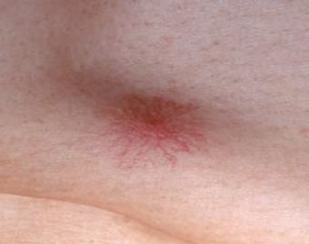
Cutaneous Manifestation of Liver diseases
-Pruritus: generalized itching especially in the presence of biliary obstruction or jaundice.
-Jaundice.
-Spider nevi: small telangeictatic blood vessels especially on the face and upper chest.
-Palmar erythema.
-Thinning of the hair and sometime loss of sexual hair in the axillae and pubic areas.
-Porphyria cutana tarda.
-Xanthoma

Slide 57
Cutaneous Manifestation of Liver diseases
Terry’s nail :

Slide 58
Porphyria Cutanea Tarda (PCT)
• The pathogenesis may be related to the suboptimal clearance of uroporhyrins (product of heme synthesis pathway) from the circulation which is a photosensitizer .
• Patients may present with photodistributed bullae, skin fragility, hyperpigmentation and hypertrichosis

Slide 59
PCT

Slide 60
CUTANEOUS MANIFESTATIONS OF RENAL DISEASE

Slide 61
End Stage Renal Disease (ESRD) and Dialysis
1- Pruritus: the most common cutaneous manifestation of ESRD
secondary to increased serum urea
2-Half and half (Lindsay’s) nails result from edema of the nail bed and capillary network and give the proximal half of the nail an opaque white appearance

Slide 62
End Stage Renal Disease (ESRD) and Dialysis
3-Metastatic Calcification
• Deposition of calcium within tissue secondary to abnormal calcium and or phosphate metabolism
• It can manifest in the skin as benign nodular calcifications (calcinosis cutis) or as a more serious condition (calciphylaxis) with an associated mortality rate between 60-80%
calcinosis cutis

Slide 63
calciphylaxis
• Calciphylaxis presents as painful purpuric plaques and retiform pupura with progression to ulceration and necrosis.
• Histological finding of medial calcification/intimal hyperplasia of small arteries and arterioles
• Management of these patients includes total or subtotal parathyroidectomy (if PTH levels are elevated), wound care, and avoidance or precipitating factors. Mortality is related to Staphylococcal superinfection of ulcers with resultant sepsis

Slide 64
End Stage Renal Disease (ESRD) and Dialysis
4-Pseudo-Porphyria Cutanea Tarda
•Similar clinical and histological findings of PCT, in setting of normal porphyrin profile
• Usually due to certain medications such as furosemide, naproxen, tetracycline, nalidixic acid, or amiodarone or in patient with renal failure on dialysis

Slide 65
Generalized Pruritus
-Generalised pruritus in the absence of a rash requires investigation and exclusion of an underlying systemic disorder
-it is important to distinguish these from an underlying primary skin disease such as scabies or eczema

Slide 66
Conditions that Cause Pruritus
1-Chronic Renal Disease
2-Cholestasis
3-Endocrine Disease
• Thyrotoxicosis – often due to increased skin blood flow which raises skin temperature
• Hypothyroidism – pruritus secondary to the dry skin
4-Malignancy
• Most common association: Hodgkin’s disease and polycythemia rubra vera
5-HIV Infection
6-Iron deficiency anemia
7-Parasetic infection

Slide 67
Workup of Generalized Pruritus
•History and Physical exam
• CBC, diff , Blood film
• Stool for O&P, occult blood
• CXR
• Thyroid, renal, and liver function tests

Slide 69
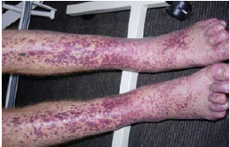
Purpura and vasculitis

Slide 70
Definitions
Visible hemorrhage into the skin or mucous membrane subdivided as a follow:
-Petechiae less than or equal 4 mm
-Purpura (>4mm - < 1cm)
which can be either Palpable or non-palpable(macular)
-Ecchymoses > or equal to 1 cm

Slide 71
Purpura
Causes
Platelet disease
Coagulation defect
Blood vessel wall pathology

Slide 72
Causes
1-Platelet Disorders
Thrombocytopenia
Platelet Dysfunction
2-Coagulation Factor Deficiency
Congenital
Factor VIII Deficiency
Factor IX Deficiency
Von Willebrands disease
Acquired
Disseminated Intravascular Coagulopathy
Liver disease
Uremia
Vitamin K deficincy
3-Vascular Factors
Congenital
Hereditary Hemorrhagic Telangectasia
Ehlers-Danlos Syndrome (Type IV)
Acquired:
Inflammation(Vasculitis)
Trauma
Vitamin c deficiency (scurvy)

Slide 73
vasculitis

Slide 74
Definition
A clinicopathologic process characterized by inflammatory destruction of blood vessels that results in occlusion or destruction of the vessel and ischemia of the tissues supplied by that vessel.

Slide 75
Classification

Slide 76
Classification
-Large-vessel vasculitis
Aorta and the great vessels (subclavian, carotid)
Claudication, blindness, stroke
-Medium-vessel vasculitis
Arteries with muscular wall
Mononeuritis multiplex (wrist/foot drop), mesenteric ischemia, cutaneous ulcers
-Small-vessel vasculitis
Capillaries, arterioles, venules
Palpable purpura, glomerulonephritis, pulmonary hemorrhage

Slide 77
Cutaneous small vessel vasculitis ( Leukocytoclastic vasculitis )
-Is the most common type of vasculitis and it primarily affect post-capillary venules

Slide 78
Pathogenesis:
-Many forms of small-vessel vasculitis are felt to be caused by circulating immune complexes
-These lodge in vessel walls and activate compliment

Slide 79
Cutaneous small vessel vasculitis ( Leukocytoclastic vasculitis )

Slide 80
Cutaneous small vessel vasculitis ( Leukocytoclastic vasculitis )
-Palpable purpura is the hallmark
-Pinpoint to several centimeters
-Early on lesion may not be palpable
- Papulonodular, vascular, bullous, pustular or ulcerated forms may develop
-Predominate on the ankles and lower legs i.e. dependent areas

Slide 81
Cutaneous small vessel vasculitis ( Leukocytoclastic vasculitis )
-Mild itching , fever, malaise, arthralgia and/or myalgia may occur
-Typically resolve in 3 to 4 weeks
-Residual postinflammatory hyperpigmentation may be seen
-Self-limiting
-May recur or become chronic
-Hemorrhagic vesicles or bullae may develop

Slide 82
Cutaneous small vessel vasculitis ( Leukocytoclastic vasculitis )
-may be localized to the skin or may manifest in other organs.
-The internal organs affected most commonly include the joints, GIT, and the kidneys.
-Renal involvement present as glomerulonephritis
- The prognosis is good in the absence of internal involvement

Slide 83
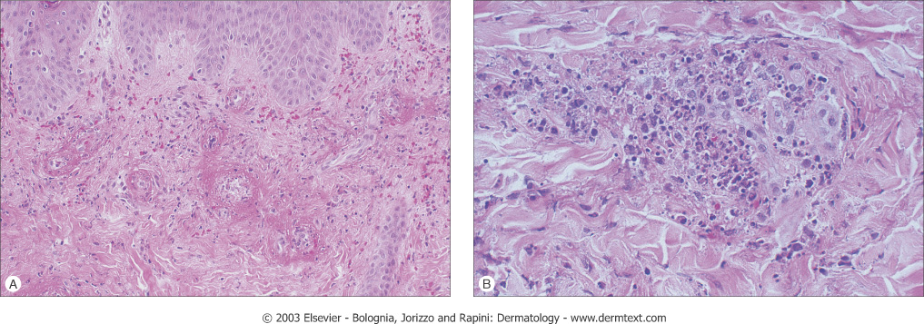
Histology
Agiocentric segmental inflammation, endothelial cell swelling, fibrinoid necrosis of blood vessel walls and a cellular infiltrate composed of neutrophil with RBC extravasation.

Slide 84
Work up
-Detailed history and physical examination
-History should focus on possible infectious disorders, prior associated diseases, drugs ingested, and a thorough review of systems
-CBC, strep throat culture or ASO titer, Hep B & C serologies and ANA are a reasonable initial screen, renal profile
-URINALYSIS FOR RBC , PROTIEN & CAST
-Skin Biopsy for histopathology and DIF

Slide 85
Treatment
-treatment of cause.
-Symptomatic treatment (if skin is only involved): rest , NSAIDS , Antihistamine
-severe visceral involvement may require high doses of corticosteroids with or without an immunosuppressive agent
-Immunosuppressive agents for rapidly progressive course and severe systemic involvement

Slide 86
Henoch-Schönlein purpura((HSP)
-Primarily occurs in male children
-peak age 4-8 years
-Adults may be affected
-A viral infection or streptococcal pharyngitis are the usual triggering event
-In about 40 % of the cases the cutaneous manifestations are preceded by mild fever, headache, joint symptoms, and abdominal pain for up to 2 weeks

Slide 87
Henoch-Schönlein purpura(HSP)
-Characterized by intermittent purpura, arthralgia, abdominal pain, and renal disease
-Typically purpura appears on the extensor surfaces of the extremities
-Become hemorrhagic within a day and fades in 5 days
-New crops appear over a few weeks

Slide 88
Henoch-Schönlein purpura
-May be associated with:
pulmonary hemorrhage
Abdominal pain and GI bleeding
-GI radiographs may show “cobblestone” appearance
-Renal manifestations may occur in 25% or more but only 5% end up with ESRD

Slide 89
Henoch-Schönlein purpura
-The long-term prognosis in children with gross hematuria is very good; however, progressive glomerular disease and renal failure may develop in a small percentage
-IgA, C3 and fibrin depositions have been demonstrated in biopsies of both involved and uninvolved skin by immunofluorescence techniques

Slide 90
Thank you

