Slide 1
PAPULOSQUAMOUS DISEASES
Dr. Saleh Al rasheed
Consultant in Dermatology &
Laser Surgery
Assistant Professor - Dermatology Department
College of Medicine
KSU , Riyadh.

Slide 2
Papulosquamous diseases
are those in which the primary lesions typically consist of papules with scale

Slide 3
The category of papulosquamous disease classically includes :
-Psoriasis
-Lichen planus
-Pityriasis rosea
-Seborrheic dermatitis
-Pityriasis rubra pilaris
-Secondary syphilis
-discoid lupus erythematosus,
-Ichthyosis-
-Miscellaneous (mycosis fungoides,) -

Slide 4
Psoriasis

Slide 5
Prevalence
Psoriasis occurs in 2%(1-3%) of the world’s population
Equal frequency in males and females
May occur at any age from infancy to the 10th decade of life
First signs of psoriasis
Females mean age of 27 years
Males mean age of 29 years

Slide 6
Prevalence
Two-thirds of patients have mild disease
One-third have moderate to severe disease
Early onset (prior to age 15)
Associated with more severe disease
More likely to have a positive family history
Life-long disease
Remitting and relapsing unpredictably
Spontaneous remissions of up to 5 years have been reported in approximately 5% of patients

Slide 8
Genetics and Pathogenesis
Psoriasis and the Immune System
The major histocompatibility complex (MHC)
Short arm of chromosome 6
Histocompatibility Antigens (HLA)
HLA-Cw6
HLA-B13, -B17, -B37, -Bw16
T-lymphocyte-mediated mechanism

Slide 9
Triggering factors>
• Infections- streptococcal pharyngitis/tonsillitis
• Drugs- NSAID, beta blockers, lithium,
antimalarials, corticosteroids
• Trauma- Koebner phenomenon
• Pregnancy
• Stress
• Alcohol
• Sunlight- worsening in ~10% of patients although majority
beneficial to sun exposure

Slide 10
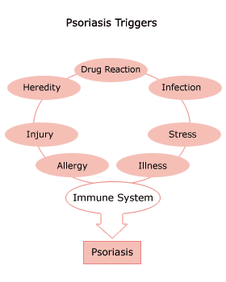

Slide 11
Psoriasis : clinical features
Well defined & circumscribed plaque
• Erythematous
• Silvery scaling
• Symmetrical
• Extensors of limbs, scalp, sacral area
Auspitz’s sign:
• light scraping of the scale with a
wooden spatula produces multiple
bleeding points
• extreme thinning of the epidermis over
the capillary laden dermal papillae

Slide 12
Psoriasis as a Systemic Disease
Koebner Phenomenon
Elevated ESR
Increased uric acid levels → gout
Mild anemia
Elevated α₂-macroglobulin
Elevated IgA levels
Increased quantities of Immune Complexes

Slide 13
Clinical Variants of Psoriasis

Slide 14
Clinical Types of Psoriasis
Non-pustular Psoriasis
B. Pustular Psoriasis
• Localized
• Generalized
C. Erythrodermic Psoriasis
D. Psoriatic arthritis

Slide 15
Non-pustular Psoriasis
• Chronic Plaque Psoriasis
• Regional Psoriasis
• Scalp Psoriasis
• Palmo-plantar Psoriasis
• Inverse Psoriasis (Flexural)
• Nail Psoriasis
• Guttate Psoriasis

Slide 16
Chronic Plaque Psoriasis
• ~80% of psoriasis
• Characteristic erythematous well defined
circumscribed silvery scaly patches/ plaques
• Koebner phenomenon
• Appearance of psoriasis in sites of skin
trauma or pressure e.g. scratch marks,
operation sites .
• Present in lichen planus, vitiligo, viral wart
• “Atypical” with no scaling in moist flexural
intertriginous area

Slide 17
Chronic Plaque Psoriasis
Most Common Variant
Plaques may be as large as 20 cm
Symmetrical disease
Sites of Predilection
Elbows
Knees
Presacrum
Scalp
Hands and Feet

Slide 18
Chronic Plaque Psoriasis
May be widespread – up to 80% BSA
Genitalia involved in up to 30% of patients
Most patients have nail changes
Nail pitting
“Oil Spots”
Involvement of the entire nail bed
Onychodystrophy
Loss of nail plate

Slide 19
Auspitz’s sign:
• light scraping of the scale with a
wooden spatula produces multiple
bleeding points
• extreme thinning of the epidermis over
the capillary laden dermal papillae

Slide 20
Koebner phenomenon
• Appearance of psoriasis in sites of skin
trauma or pressure e.g. scratch marks,
operation sites .
• Present in : lichen planus, vitiligo, viral wart

Slide 21
Scalp Psoriasis
• Common
• Well demarcated erythematous silvery scaly
plaque with normal skin intervening
• Post-auricular area commonly involved
• Non scarring alopecia when severe, regrow
when condition improve
• DDx with seborrhoeic dermatitis by presence of
typical plaque elsewhere +/- psoriatic nail
changes

Slide 22
Palmoplantar Psoriasis
• Common
• Indurated heavily scaled plaque +/-
fissuring
• Well-demarcated
DDx with foot/ hand eczema

Slide 23
Nail Psoriasis
• ~50% of psoriasis have nail changes
• Pitting
• Onycholysis (separation of nail plate
from nail bed)
• Oil drop sign (a yellow brown,
subungual spot surrounded by erythema)
• Subungual hyperkeratosis
• Secondary onychomycosis is common

Slide 24
Guttate Psoriasis
• Latin “gutta” means a drop
• Mainly affects children and young adults
• Characterized by numerous 0.5 to 1.5 cm papules /plaques
Very small plaques generalized with
centripetal distribution
• May coalescent into larger plaques
• Preceded by streptococcal tonsillitis or
pharyngitis 2 weeks before onset
Spontaneous remissions in children
Often chronic in adults

Slide 25
Flexural Psoriasis
• Psoriasis affecting axillae, perineum and
umbilicus
• Atypical psoriasis as friction & humidity removes
the scale (diagnostic confusion)
• Irritating when sweating

Slide 26
Life–Threatening Forms of Psoriasis
Generalized Pustular Psoriasis
Erythrodermic Psoriasis

Slide 27
Palmoplantar Pustular Psoriasis
• Relatively uncommon variant
• Painful, sterile pustules develop within plaque
at palms and soles
• Pustules resolve to leave post inflammatory
hyperpigmentation
• Female predominance
• 20% associated with psoriasis elsewhere
• Almost exclusively associated with smoking
• Resistant to topical treatment

Slide 28
Generalized Pustular Psoriasis
• Von Zumbusch’s disease
• Erythematous edematous plaques studded with
monomorphic sterile pustules. often after short episodes of fever of 39˚ to 40˚C
Weight loss , Muscle Weakness, Hypocalcemia Leukocytosis , Elevated ESR
• Precipitated by :
• withdrawal of oral steroid or widespread
use of ultra potent topical steroid
• pregnancy
• Can be life-threatening due to fluid loss, sepsis

Slide 30
Erythrodermic Psoriasis
• >90% of BSA affected
• Life threatening with transcutaneous
fluid loss, temperature dysregulation,
sepsis, high output, cardiac failure
• Other DDx of erythroderma-
atopic eczema, drug eruption
, cutaneous T cell lymphoma, pityriasis rubra pilaris

Slide 31
Erythrodermic Psoriasis
Triggering Factors
Systemic Infection
Withdrawal of high potency topical or oral steroids
Withdrawal of Methotrexate
Phototoxicity
Irritant contact dermatitis

Slide 32
Drug-provoked (Induced)psoriasis: Reported agent
MOST COMMONLY ASSOCIATED AGENTS
Beta blockers
Lithium
AntimalarialA nti-Inflammatory Drugs Nonsteroidal Anti-Inflammatory Drugs

Slide 33
Psoriatic Arthritis
• ~10% of chronic plaque psoriasis
• Only ~15% of cases with skin and joint disease begin simultaneously
• ~60% of skin disease precedes arthritis
• ~25% of arthritis precedes skin disease
• Probably a positive correlation between severity of skin disease and arthritis developing
• Association: HLA B27: sacro-ileitis;
• B38 and DR7: peripheral arthritis;
• B39: all types;
• DR4: symmetrical arthritis

Slide 34
5 Types of Psoriatic Arthropathy
• Classical distal arthropathy-distal IP joint
• Seronegative RA-like polyarthritis
• Oligoarticular asymmetrical arthritis
• Spondyloarthropathy- Ankylosing spondylitis-like
• Arthritis mutilans

Slide 35
Psoriatic Arthritis treatment
• NASIDs- may exacerbate psoriasis
• Methotrexate
• Sulphasalazine
• Cyclosporine
• Systemic steroid- may make the skin
lesions more difficult to control
• Biologics

Slide 36
Histopathological changes
• Inflammation
• Epidermal keratinocyte hyperproliferation
• ( parakeratosis) incomplete cornification of keratinocytes with retention of nuclei
• (acanthosis), irregular thickening of the epidermis over the rete ridges but thinning over dermal papillae
•(munro abscesses) epidermal polymorphonuclear leucocyte infiltrates
• Vascular proliferation :dilated capillary loops in the dermal papillae

Slide 37
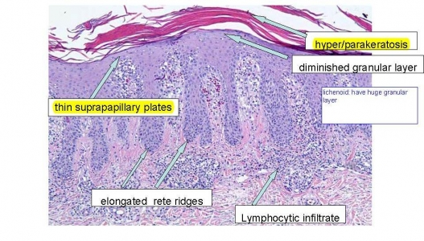

Slide 38
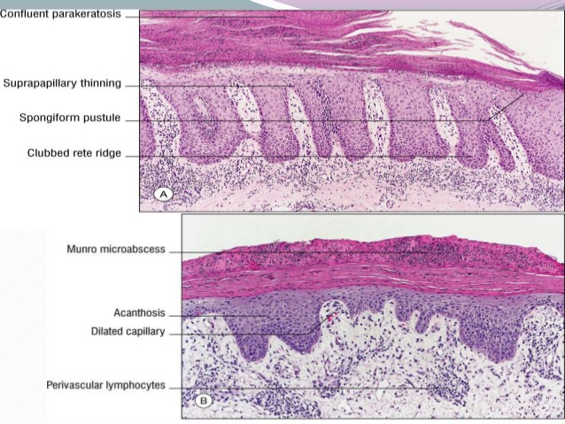

Slide 39
Laboratory findings
Elevated uric acid
Mild anemia
Negative nitrogen balance
Increase sedimentation rate
Increase alpha-2-microglobulin
Incresae IgA and IgA immune complex

Slide 40
Differential diagnosis
Erythroderma
Atopic dermatitis
Sezary syndrome
Drug eruption
Generalized contact dermatitis
Intertrigenous psoriasis
Candidiasis
Contact dermatitis
Darier’s disease

Slide 41
Differential diagnosis
Psoriasis vulgaris
Nummular eczema
Mycosis fungoides, plaque stage
Tinea corporis
Guttate psoriasis
Pityriasis rosea
Pityriasis lichenoides et varioliformis
Syphillis
Tinea corporis

Slide 42
Differential diagnosis
Nail psoriasis
Tinea ungium
Dyskeratosis : secondary to injury
Scalp and face
Seborrheic dermatitis
Genitalia
In situ squamous cell CA

Slide 43
Treatment Options
• Monotherapy
• Combination therapy
• Rotational therapy
• Sequential therapy

Slide 55
Systemic Treatment of Psoriasis
Currently licensed biologics for psoriasis
Type Drug Route Dosing Freq PlasmaHalf-life
Adalimumab
TNF-α inhibitor
Subcutaneous
80mg 1st week, then40mg 2nd wk ,ThenEvery 2 wk
2 weeks

Slide 56
Etanercept
Subcutaneous
50mg (0.8mg/kg, max 50mg)
First 12 week: twice a wk Then once aweek
70 hours

Slide 57
Infliximab
IL-12/23Antibody
Intravenous
5mg/kg
0,2,6 wk, then every 8 wk8-9.
5days

Slide 58
Ustekinumab
Subcutaneous
45mg for <100 kg90mg for >100kg0,4 wk, thenevery 12 wk
15-32days

Slide 59
Absolute Contraindications:
Pregnancy/breastfeeding
Active (chronic) infections (including tuberculosis and active chronic hepatitis B)
Congestive heart failure (NYHA grade III or IV)
Relative contraindications
History of recurrent infections
PUVA >200 treatments (especially if followed by cyclosporin use)
HIV or AIDS
Hepatitis C
Congestive heart failure (NYHA grade I or II)
SLE, Demyelinating disease
Malignancies or lymphoproliferative disorders
Live vaccines

Slide 60
Treatment Modalities:
• Combination therapy
• -contraindicated in additive increase risk/ S/E, e.g.
• Phototherapy +CsA increase risk of cutaneous cancer
• Acitretin +MTX increase risk of hepatotoxicity

Slide 61
Treatment Modalities:
• Rotational therapy
- use of therapies for a
specified period (e.g.1-2 year) then rotate to an
alternative therapy to minimize long-term toxicity
in any given therapy and decrease therapy
“resistance/ tachyphylaxis

Slide 62
Treatment Modalities:
• Sequential therapy-
• Induction phase: use stronger potentially more toxic
agents to clear psoriasis initially
• e.g. Ultrapotent topical steroid or CsA
• Transitional phase
• e.g. OM steroid+ Nocte calcipotriol or acitretin
• Maintenance phase: use of a “weaker”, less toxic agent
for maintenance
• e.g. weekday calcipotriol +weekend steroid or
acitretin +/-UVB/ PUVA

Slide 63
PITYRIASIS ROSEA

Slide 65
-Epidemiology:
In children and young adult
-Increased incidence in spring and autum
-PR has been estimated to account for 2% of dermatologic outpatient visits
-PR is more common in women than in men

Slide 66
Pathophysiology:
-PR considered to be a viral exanthem
-Immunologic data suggest a viral etiology
-Families and close contacts
-A single outbreak tends to elicit lifelong immunity
-Human herpesvirus (HHV)–7and HHV-6
-PR-like drug eruptions may be difficult to distinguish from non–drug-induced cases
-Captopril, metronidazole, isotretinoin, penicillamine, bismuth, gold, barbiturates, and omeprazole

Slide 67
- Begins with a solitary macule that heralds the eruption(herald spot/patch )
- Usually a salmon-colored macule
- 0ver a few days it become a patch with a collarette of fine scale just inside the well-demarcated border
- Within the next 1-2 weeks, a generalized exanthem usually appears
- Bilateral and symmetric macules with a collarette scale oriented with their long axes along cleavage lines
- Tends to resolve over the next 6 weeks
- Pruritus is common, usually of mild-to-moderate severity
- Over trunk and proximal limbs

Slide 68
oval
XXXX

Slide 69
Atypial form of PR :
Occurs in 20% of patients
Inverse PR
Unilateral variant
Papular PR
Erythema multiforme–like
Purpuric PR

Slide 70
Differential Diagnosis :
Viral exantheme
Drug Eruption
Lichen Planus
Psoriasis, Guttate
Syphilis
Tine Corporis Seborrheic Dermatitis
Nummular Dermatitis Pityriasis Lichenoides

Slide 72
Lichen planus (LP)

Slide 73
Background:
-Lichen planus (LP) is a pruritic, papular eruption characterized by its violaceous color; polygonal shape; and, sometimes, fine scale
-It is most commonly found on the flexor surfaces of the upper extremities, on the genitalia, and on the mucous membranes.

Slide 75
Epidemiology :
-Approximately 1% of all new patients seen at health care clinics
-Rare in children
-F=M
-No racial predispositions have been noted
-LP can occur at any age but two thirds of patients are aged 30-60 years

Slide 76
Pathophysiology :
The cause of LP is unknown
-LP may be a cell-mediated immune response of unknown origin
-LP may be found with other diseases of altered immunity like ulcerative colitis, alopecia areata, vitiligo, dermatomyositis
-An association is noted between LP and hepatitis C virus infection ,chronic active hepatitis, and primary biliary cirrhosis
-Familial cases
-Drug may induce lichenoid reaction like thiazide,antimalarials,propranolol

Slide 77
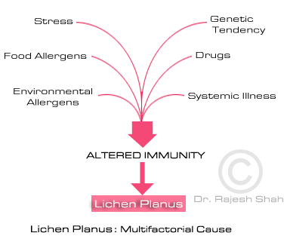

Slide 78
Clinical Features :
Most cases are insidious
-The initial lesion is usually located on the flexor surface of the limbs
-After a week or more, a generalized eruption develops with maximal spreading within 2-16 weeks-
-Pruritus is common but varies in severity
-Deep pigmentations may persist for long time.
-Oral lesions may be asymptomatic or have a burning sensation
-In more than 50% of patients with cutaneous disease, the lesions resolve within 6 months, and 85% of cases subside within 18 months

Slide 79
The papules are violaceous, shiny, and polygonal; varying in size from 1 mm to greater than 1 cm in diameter
They can be discrete or arranged in groups of lines or
Circles
Characteristic fine, white lines, called Wickham stria, are
often found on the papules
Oral lesions are classified as reticular, plaquelike, atrophic, papular, erosive, and bullous
Ulcerated oral lesions may have a higher incidence of malignant transformationO(the development of squamous cell carcinoma)k for
Genital involvement is common in men with cutaneous disease
Vulvar involvement can range from reticulate papules to severe erosions

Slide 81
Clinical types:
Hypertrophic LP
-These extremely pruritic lesions are most often found on the extensor surfaces of the lower extremities, especially around the ankles
Atrophic LP
-is characterized by a few lesions, which are often the resolution of annular or hypertrophic lesions
Erosive LP
Folliculalar LP
-keratotic papules that may coalesce into plaques
-A scarring alopecia may result

Slide 82
Annular LP
-Annular lesions with an atrophic center can be found on the buccal mucosa and the male genitalia
Vesicular and bullous LP
-develop on the lower limbs or in the mouth from preexisting LP lesions
Actinic LP
-Africa, the Middle East, and India
-mildly pruritic eruption
-characterized by nummular patches with a hypopigmented zone surrounding a hyperpigmented center
LP pigmentosus
-common in persons with darker-pigmented skin
-usually appears on face and neck

Slide 83
LP and Nails
IIn 10% of patients
nail plate thinning causes longitudinal grooving and ridging
subungual hyperkeratosis, onycholysis
Rarely, the matrix can be permanently destroyed with prominent pterygium formation
twenty-nail dystrophy

Slide 85
Management :
self-limited disease that usually resolves within 8-12 months
-Anti-histamine
-topical steroids, particularly class I or II ointments
-systemic steroids for symptom control and possibly more rapid resolution
-Oral acitretin
-Photo-therapy
-Others

