Slide 1
Cutaneous manifestation of SLE and other CTD Diseases
By:
Dr. Eman Almukhadeb
Consultant dermatologist, Assistant professor

Slide 2
Objectives
At the conclusion of this lectures the student should be able to:
Differentiate between the various types of Lupus
Recognize how Lupus affects the various systems of the body
Identify all of the current treatment options available for Lupus

Slide 3
Lupus Erythematosus (LE)
LE is an autoimmune diseases associated with antibodies directed against components of cell nuclei.
Is a multisystem disorder that may affect any tissue, kidneys, CNS, lungs and others. It might affects only skin without systemic involvement
It is an immune complex disease that target collagen or ground substance .

Slide 4
Lupus Erythematosus( LE)
Classification :
LE classified as
Cutaneous
Systemic

Slide 5
Classification of cutaneous lupus erythematous
Acute
Subacute
Chronic

Slide 6
Cutaneous classification
1- Acute LE :
Specific :
- Malar eruption or ‘butterfly rash’
- Erythematous papular rash on arms
- Photosensitivity
- Cheilitis and mouth ulcers
- Blisters (bullous LE)
Non-specific : as hair fall , raynaud’s phenomena, periungual telangiectasia , vasculitis

Slide 7
Cutaneous classification
2- Subacute cutaneous LE ( SCLE ):
Annular
Papulosquamous
Associated with syndromes :
- neonatal LE
- complement deficiency syndrome
- drug induced SCLE

Slide 8
Cutaneous classification
3- chronic :
Discoid LE
Verrucous ( hypertrophic ) LE
Lupus erythematous –Lichen planus overlap
Chilblain LE
Tumid LE
Lupus panniculitis

Slide 9
Chronic LE
1 – Discoid LE (DLE)
Commonest form of cutaneous LE
Common in young females
Started as red indurated plaques and evolve with atrophy , scarring and pigment changes ( mostly Hypopigmentation or depigmentation )
Hyperkeratosis characterized by follicular plugging (scarring alopecia).
Common above head and neck
on the sun exposed areas .
localized form associated with 5% with SLE.
Generalized form associated with 20% with SLE.

Slide 10
Discoid LE (DLE)
may involve M.M
Aggressive SCC may arise from long standing DLE .
Generalized form associated more with SLE , +ve ssDNA , +ve ANA , leukopenia, high ESR.
Treated by superpotent topical steriod , antimalarial , retinoid .

Slide 11
Discoid Lupus Erythematosus

Slide 12
Discoid Lupus Erythematosus

Slide 13
Other chronic cutaneous LE
2- Hypertrophic LE (Verrucous ): commonly seen on the extremities .
3- LE-LP : common on the extremities , palm and soles associated with oral ulcers and nail involvement .
4- Chilblain LE ( pernio): presents as tender red or purple skin lesion that involve fingertips , rim of the ears, calves and heals , exacerbated by cold exposure
5- Tumid LE : presented with edematous erythematous plaques on the trunk and respond to antimalarial .
6- LE panniculitis : presented as non-tender subcutaneous nodules on face or proximal extremities that heals with atrophy

Slide 14
Chilblain LE
Lupus Tumidus

Slide 15
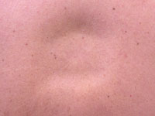
Lupus panniculitis

Slide 16
Subacute cutaneous lupus erythematosus
10 to 15% of LE .
Common on young females.
a non-itchy rash appears on the upper back and chest( on sun exposed regions )
Associated with photosensitivity and arthralgia .
Systemic involvement is not usually severe.
Can be annular or psoriasiform and heals without scarring.
Labs: 80% ANA and 70% anti-RO , anti-LA .
Treated by antimalarial and sun protection.

Slide 17
Neonatal lupus erythematosus
Newborn babies born to mothers with subacute LE may develop annular rash, known as neonatal LE that resolve spontaneously.
The neonates could be at risk of complete heart block, thrombocytopenia , increased liver enzymes

Slide 18
Neonatal lupus erythematosus

Slide 19
SLE
Only a few patients with cutaneous LE also have SLE. The most common presentation is with a malar eruption or butterfly. Other skin changes in SLE are photosensitivity, mouth ulcers, and diffuse hair loss.
SLE may also affect joints, kidneys, lungs, heart, liver, brain, blood vessels and blood cells

Slide 20
SLE
ACR criteria for the diagnosis :
4 out of 11 need for the diagnosis .
Malar rash .
DLE .
Photosensitivity .
Oral ulcers .
Arthritis
Serositis ( pleuritis , pericarditis )

Slide 21
SLE
7- renal : proteinuria more than 0.5 g/day
8- CNS : Seizure or psychosis
9- blood : hemolytic anemia, leukopenia, thrombocytopenia
10- +VE ANA
11 - +VE anti-ds DNA and anti-smith and anti-phospholipid antibodies .

Slide 22
Drug induced Lupus :
associated with ANA and anti-histone antibodies.
does not usually affect the skin.
hydralazine, procainamide, sulfonamide, anticonvulsants, Minocycline.

Slide 23
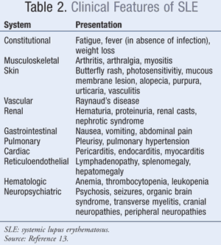

Slide 24
SLE
Specific :
- Malar eruption or ‘butterfly rash’
- Erythematous papular rash on arms
- Photosensitivity
- Cheilitis and mouth ulcers
- Blisters (bullous LE)
Non-specific : as hair fall , raynaud’s phenomena, periungual telangiectasia , vasculitis

Slide 25
Lab findings
CBC : anemia , Leucopenia , thrombocytopenia
High ESR
Coombs test : hemolytic anemia
Urinalysis and 24 hr urine collection : for proteinuria
U &E .
Serology : ANA (+ve in 95% of SLE patients, screening test ) , anti-ds DNA (specific ), anti-ss DNA , anti smith (specific ) , anti-RO , anti-LA , lupus anticoagulant and anti cardiolipin , anti-n RNP.
low C2 and C4.
Skin biopsy may be diagnostic especially in DLE. Direct IF may show positive antibody deposition along the basement membrane (lupus band test).

Slide 26
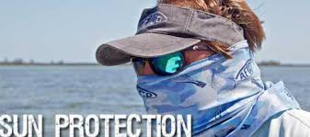
Treatment of cutaneous lupus
The aim of treatment for cutaneous LE is to alleviate symptoms and to prevent scarring.
Local therapy :
Sun protection.
Topical or intralesional steroid
Topical calcineurin inhibitor

Slide 27
Systemic antimalarial therapy :
hydroxychloroquine 200 mg OD or BD in adults up to 6.5mg/kg .
chloroquine ( 125-250 OD in adults up to 3.5-4 mg/kg.
quinacrine 100 mg OD .
Combination
Side effects of hydroxychloroquine :
eye toxicity .
skin eruption .
leukopenia and thrombocytopenia
Hemolytic anemia in G6PD def .

Slide 28
Other Systemic therapy
Retinoid.
Thalidomide.
Dapsone of bullous lupus
Systemic steroids
Azathioprine ,Methotrexate, Mycophenolate mofetil,cyclosporine, cyclophosphamide, IVIG, and Rituximab.

Slide 30
Objectives
To learn how to diagnose , investigate and manage dermatomyositis.
To learn the presentation of morphea and systemic sclerosis and ways to manage them.

Slide 31
Dermatomyositis
An uncommon inflammatory disease affects adults between 40-60 (females mainly) and children 5-15.
Skin changes.
Muscle weakness

Slide 32
Classification
Classic DM :
-Adult type
-Juvenile type
Amyopathic DM
Paraneoplastic DM
Overlap with CTD
Drug induced DM : D-penicillamine, hydroxyurea ,NSAID,STATIN and Phenytoin

Slide 33
CLINICAL FEATURES
Skin :
Heliotrope rash : scaly edematous pinkish plaques over both eyelids .
Gottron’s sign : scaly erythematous plaques over elbows and knees
Gottron’s papules : pink to purple flat topped papules over knuckles
Erythema of upper chest (V) pattern or over shoulders
( shawl sign )

Slide 34
CLINICAL FEATURES
Skin:
Periungual telangectasia
Mechanics Hand :hyperkeratosis , fissuring , scaling with hyperpigmentation over finger tips, sides of fingers and palms
holster sign : scaling and erythema over hips and thigh.
Poikiloderma : atrophy , Mottled hyper and hypopigmentaion , telangiectasia

Slide 35
CLINICAL FEATURES
Other cutaneous signs and symptoms include:
Ulceration
Photosensitivity
Raynaud's phenomenon
Calcinosis cutis especially in children

Slide 36
Heliotrope rash

Slide 37
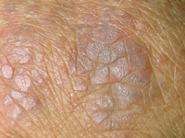
Gottron’s papules

Slide 38
Gottron’s papules

Slide 39
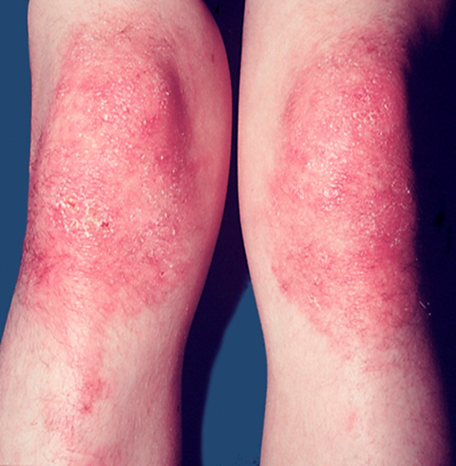
Gottron’s sign

Slide 40
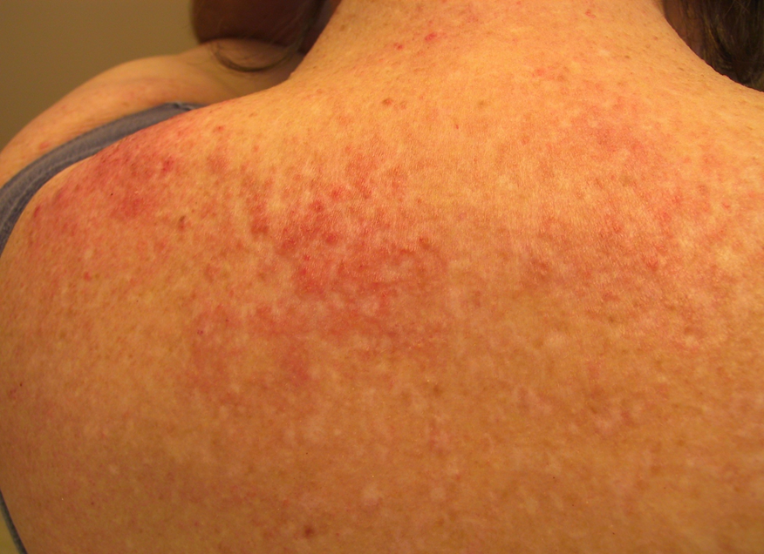
V-shape erythema of neck Shawl sign

Slide 41
Periungual telangiectasia and cuticle hypertrophy

Slide 42
Clinical features :
Muscle
Weakness, progressive proximal muscle weakness involves the hips, thighs, shoulders, upper arms and neck. The weakness is symmetrical and more in the extensor muscles.
Lungs :
interstitial lung disease

Slide 43
Associated disease
It can be associated with:
Other CTD:
Such as lupus, rheumatoid arthritis, scleroderma and Sjogren's syndrome.
Cancer:
Especially in older patients.
common : ovarian CA
Cancer of the cervix, lungs, pancreas, breasts, lymphoma and gastrointestinal tract.
Malignancy could precede, coincide or follow the diagnosis of DM.

Slide 44
Investigations and Diagnosis
CRITERIA :
1- Typical skin rash .
2- Muscle weakness ( proximal upper or lower extremity)
3- +ve ms enzymes ( CK and aldolase )
4- +ve EMG ( short duration , polyphasic)
5- +ve muscle biopsy
Definite : rash with 3 muscle findings.
OTHER LABS:
Serology:
Anti- Jo-1 ( histidyl- tRNA synthetase): lung disease & mechanical hands.
Mi-2 : specific for DM with skin findings
Skin Bx
Magnetic resonance imaging (MRI).

Slide 45
Treatment
SKIN :
Sunscreen
Topical steroid , Topical Tacrolimus
Hydoxychloroquine
Oral steroids are the mainstay treatment.
Systemic therapy:
Steroid sparing agents are:
Methotrexate, azathioprine, mycophenolate mofetil, cyclosporine, cyclophosphamide, IVIG, and Rituximab.
Physiotherapy to improve strength and flexibility of the muscles.
Surgical excision or Co2 laser could be utilized to remove tender calcium deposits .

Slide 46
Systemic sclerosis(Scleroderma)
A group of diseases that involve the hardening and tightening of the skin and connective tissues
affects women more often than men .
most commonly occurs between the ages of 30 and 50.

Slide 48
Classification of SS
Cutaneous Sclerosis : morphia and linear SS.
Limited SS : CREST syndrome
Diffuse SS : -progressive SS
- overlap with CTD.

Slide 49
MORPHIA
more common in Female
oval reddish or purplish patches and plaques on the skin that progress to smooth , hard , sclerotic , depressed plaque surrounded by violaceous zone
It subsides on its own over time leaving dyspigmentation and atrophy
Can be localized or generalized without visceral involvement

Slide 52
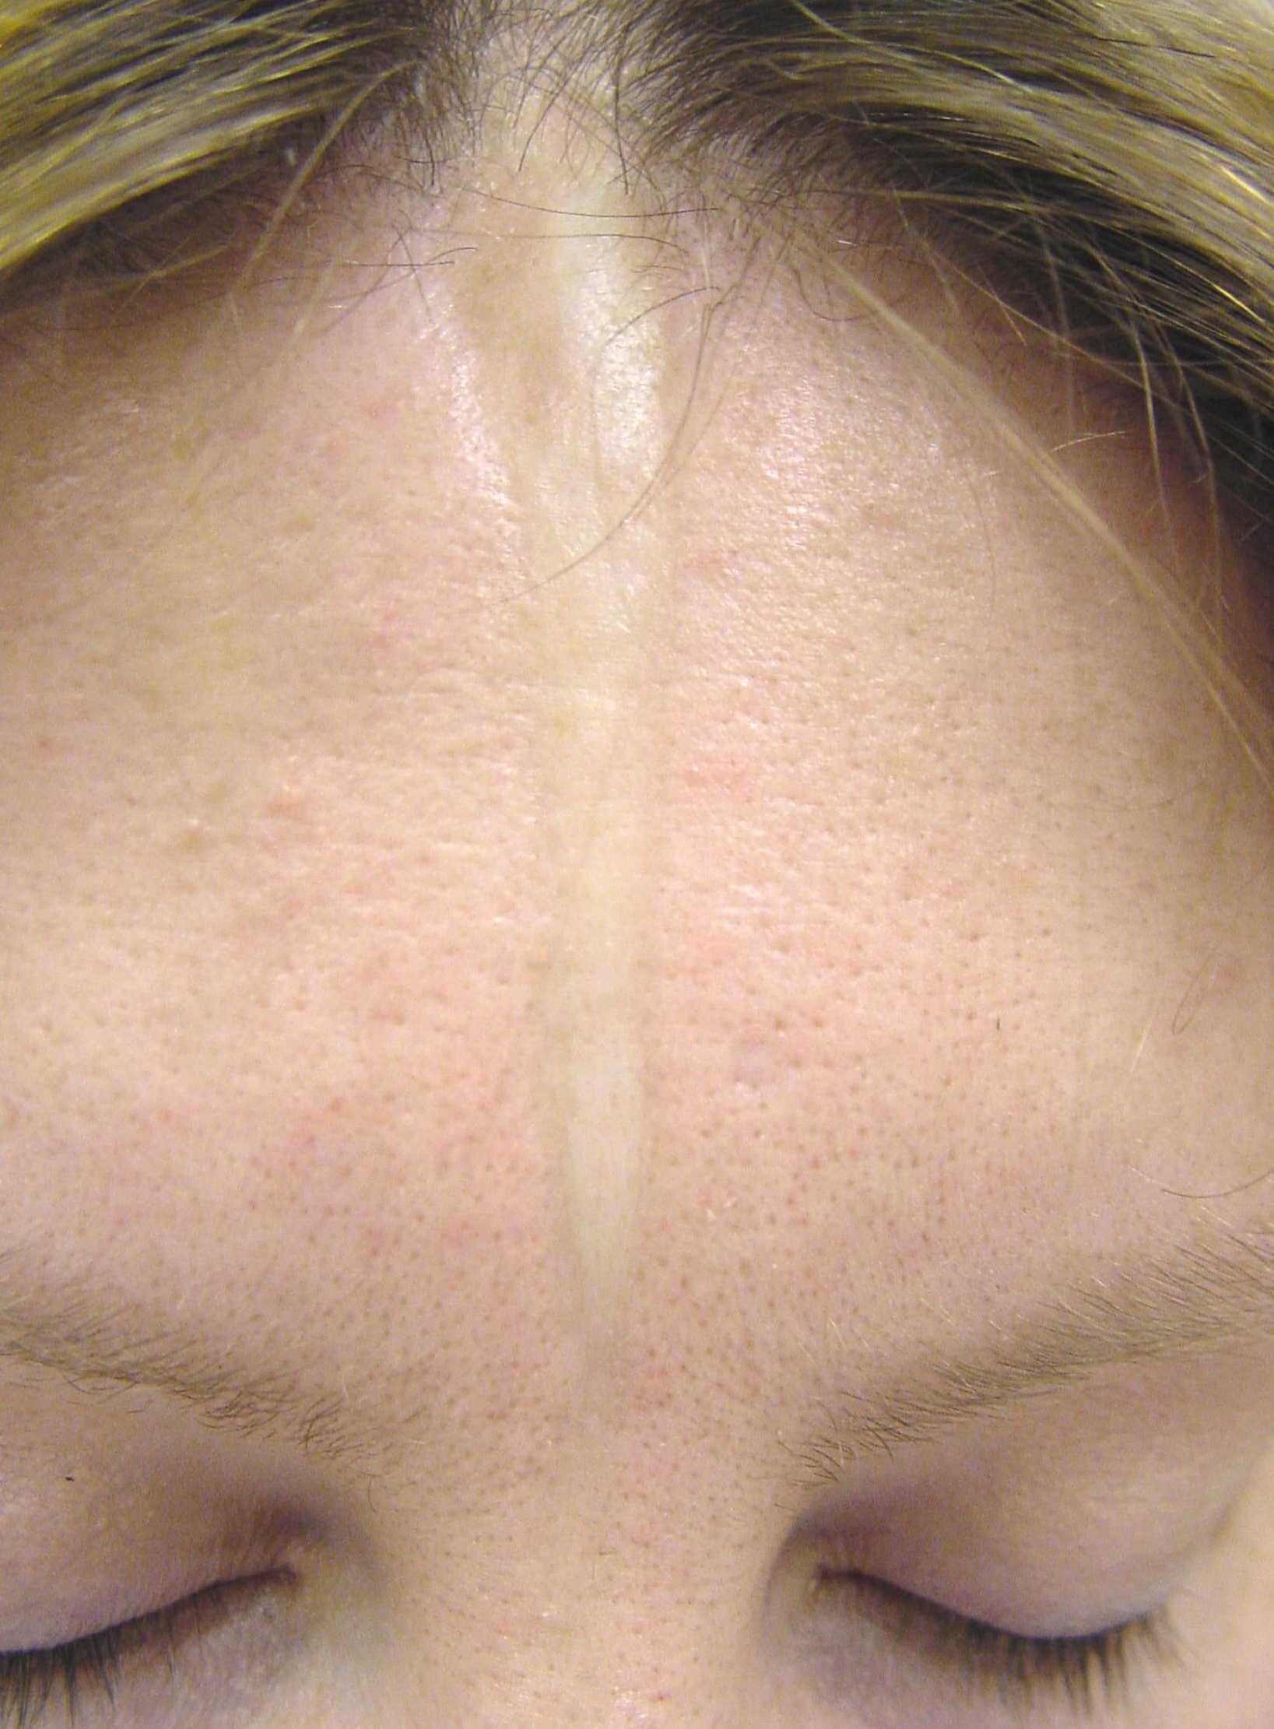
Linear scleroderma
parasagittally on the forehead ( encoup de sabre )
parry-Romberg syndrome manifested as progressive hemifacial atrophy, epilepsy , exopthalmos, and alopecia.
may extend on the extremities associated with muscle atrophy and flexion contracture.
.

Slide 53
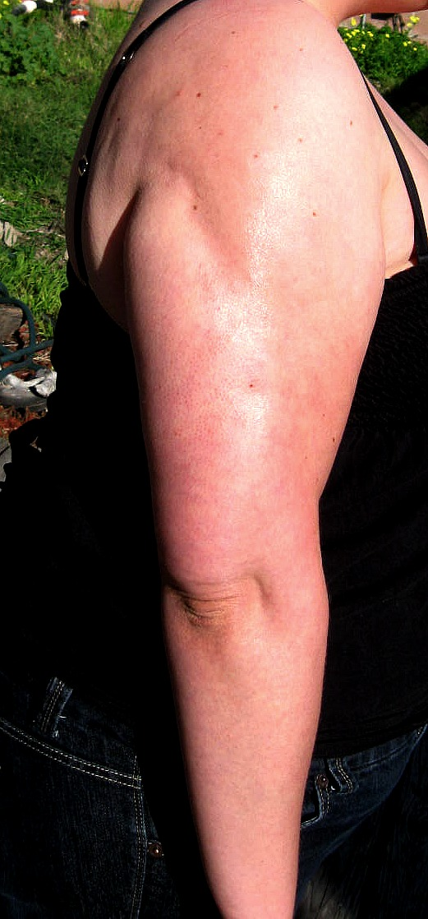

Slide 55
Limited Systemic Sclerosis
CREST syndrome :
C CALCINOSIS CUTIS
R RAYNAUDS PHENOMENA
E EOSOPHAGEAL DISMOTILITY
S SCLERODACTALY
T TELANGECTASIA
Good prognosis.
Anticentromere antibodies ( specific)

Slide 60
Systemic Sclerosis (Diffuse SS )
An autoimmune multisystem disease that results in fibrosis and vascular abnormalities in association with autoimmune changes.
Usually starts between 30-40 years. More in women
Pathophysiology may involve some injury to the endothelial cells and this results in excessive activation of the dermal connective tissue cells, the fibroblasts.
Usually presents with Raynaud's phenomena, Thickening of the skin of the fingers, then atrophy and sclerosis. The fingers become spindle-shaped (sclerodactyly) from resorption of the fingertips

Slide 61
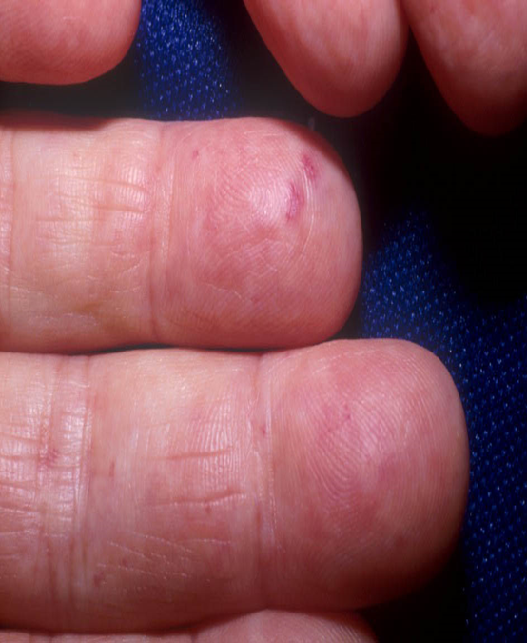
Skin findings
Raynaud phenomena.
Face : expressionless, constricted mouth, peaked nose. Thin lips with radially furrowed.
Claw like hands
Neck sign : rigdging and tightening of neck on extension.
Finger tip atrophy, ulceration and gangrene.
Nail fold capillary hemorrhage
Telangiectasia appear on the fingers, palms, face, lips, and chest
Hyper or depigmented spots (salt and pepper skin )

Slide 62
Internal involvement
Esophageal dysmotility( distal ) Esophageal reflux and dysphagia:
Pulmonary fibrosis
Pericarditis , HTN
Retinopathy
polyarthritis
Progressive kidney disease resulting in proteinuria, high blood pressure and eventually renal failure

Slide 63
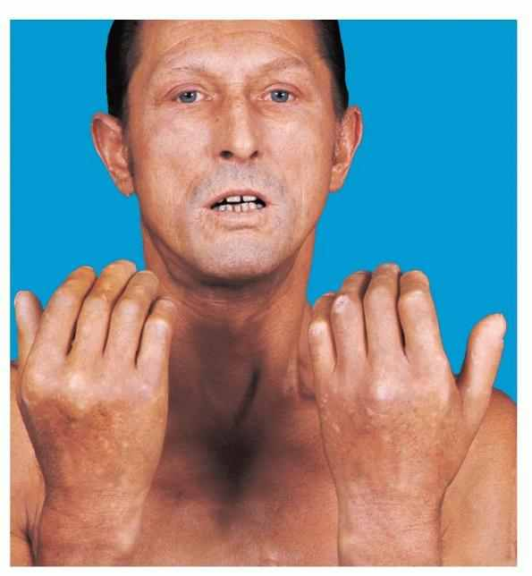
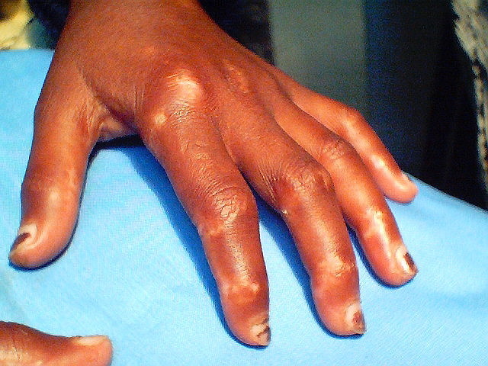

Slide 64
Investigations and Diagnosis
Diagnosis is made based on clinical features and presentation.
ANA is usually positive. Anti topoisomerase I (Scl 70) is characteristic for it especially in severe cases.
High ESR , thrombocytopenia, hemolytic anemia
High CK with muscle involvement
CXR : diffuse ground glass and honeycomb lung pattern
CT :lung fibrosis
ECG : arrythemia
Skin biopsy will show skin atrophy with thickened collagen bundles

Slide 65
Treatment of SS
Is symptomatic.
Raynaud's phenomena: Stop smoking, keep hands warm and decrease trauma. calcium channel blockers, aspirin and vasodilating drugs including nifedipine and iloprost infusions.
Calcinosis cutis: nifedipine, surgical or laser excision.
Skin sclerosis: physiotherapy, phototherapy.
GI: proton pump inhibitor, surgery for strictures.
Kidney: ACE inhibitors.
In severe cases: immunosuppressant , D-Penicillamine might be used

Slide 66
Thank you

