Slide 1
Today lecture Content
Acute & chronic sinusitis(causes,cliinical & management),
Fungal sinusitis (in brief)
Complication -sinusitis (classification, management & with special attention to orbital complications, investigation & general treatment)
Radiology illustration

Slide 2
Today lecture Content
Diseases-nasal septum (DNS etc.),
Epistaxis (causes, clinical & mngt),
turbinate hypertrophy,
Nasal operations( FESS, septoplasty, turbinate)

Slide 3
RHINOSINUSITIS
Prof. Surayie H Al Dousary MD
Rhinology research Chair Director
www.rhinologychair.org
www.profseraye.com

Slide 4
At glance
Basics (Anatomy, Pathophysiology)
Definitions (Acute, Chronic)
Clinical Manifestation (Symptoms, Examination, Investigations & Treatment)
Microbiology
Medical Treatment
Surgical Treatmrnt
Complications
Fungal sinusitis

Slide 5
The session was clearly constructed
It was easy to take notes during the session
The session was thought provoking
The main points given clear and understandable
The example given were relevant and interesting
The talk was clearly audible
The audiovisual aids were used appropriately
The session was well conducted
The tutor summarized the main points of the session
The overall impression is

Slide 6
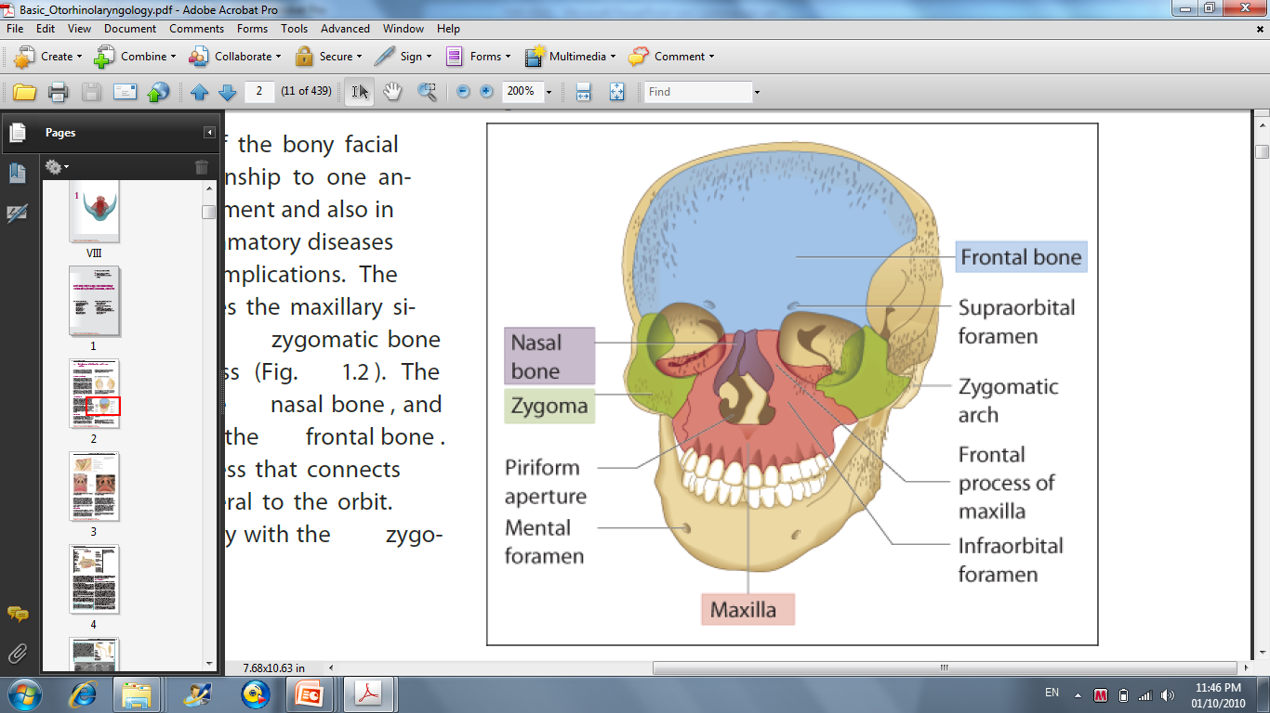
Skull

Slide 7
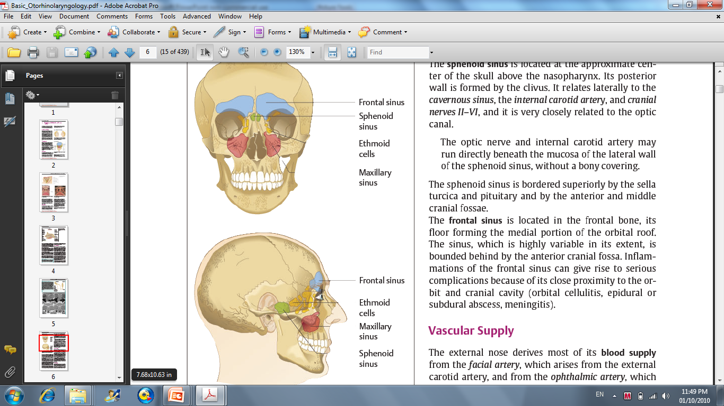
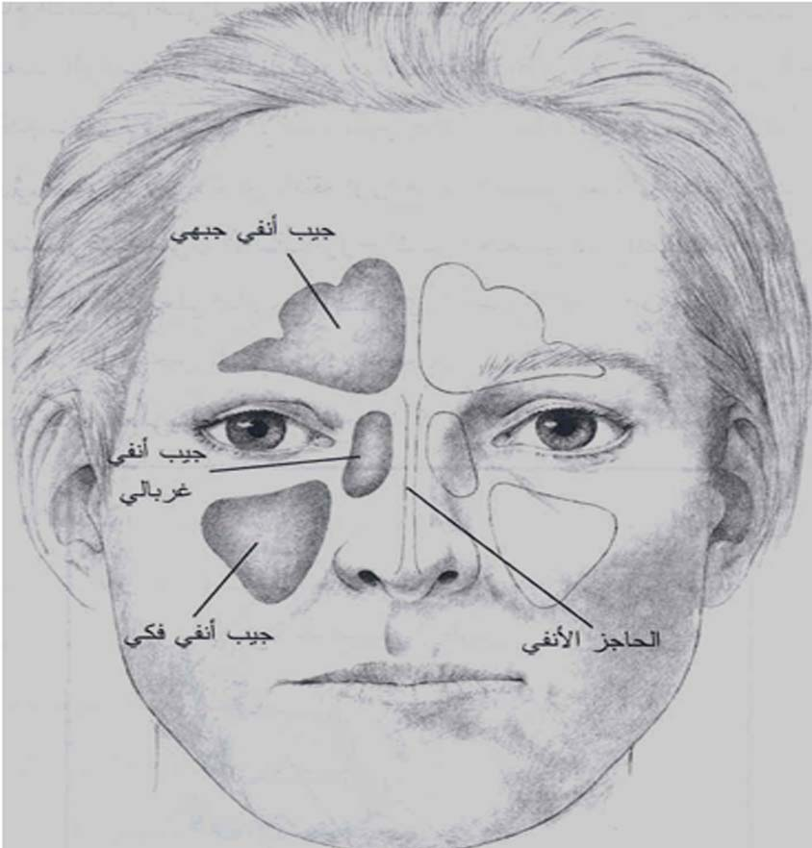
Four Pairs PNS

Slide 8
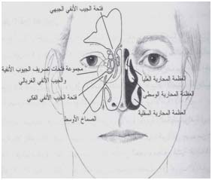
LATERAL NASAL WALL

Slide 9
OMC

Slide 10
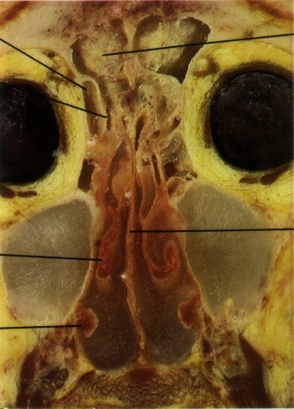
Cadaveric Coronal Section

Slide 11
Nasal mucosa Histology
Pseudostratified Columnar Epithelium
  Cilia specifically arranged Similar mucosa to remainder of tracheobronchial tree
Squamous Epithelium

Slide 12
Physiology
The muocsa secretes a mucous which traps bacteria
The mucous is naturally extruded through sinus ostia to be expectorated or swallowed
The drainage of the maxillary and frontal sinuses follows a circular pattern through the natural ostia
Smell Function

Slide 13
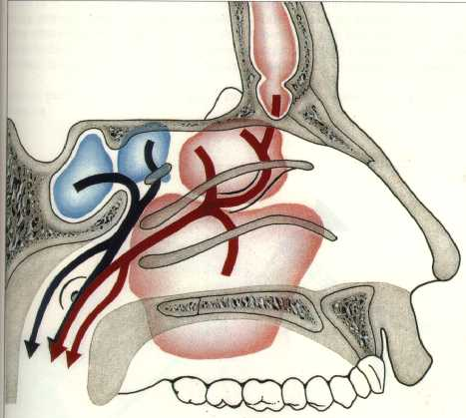
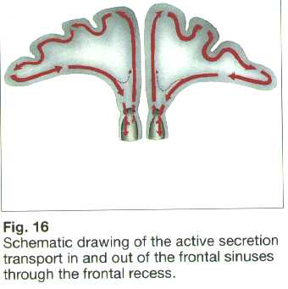
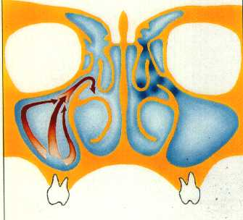
Nasal mucosa Histology
Ciliary Pattern in Sinuses Mucosa

Slide 14
The Ethmoid Sinus
Appear as evaginations of the lateral nasal wall around the third month of fetal gestation
Present at birth, reach adult size by age 12
Separated by the ground (basal) lamella into the anterior and posterior ethmoids
Drain into the middle and superior meatus

Slide 15
The Ethmoid Sinus, continued
Consist of vertical and horizontal plates
The vertical plate is divided into two portions, the perpendicular plate of the ethmoids and the crista galli
The horizontal plate is known laterally as the fovea ethmoidalis and medially as the cribriform plate
Medially is the lamina papyracea

Slide 16
The Ethmoid Sinus, continued
Blood supply is from both the external and internal branches of the carotid, through the sphenopalatine and the anterior and posterior ethmoidal arteries
Innervation is from V2 and V3

Slide 17
The Maxillary Sinuses
The largest sinus
Pyramidal shaped with apex near zygomatic arch
In child, inferior border near nasal floor.
In adult, 1 cm below nasal floor
Floor over maxillary dentition, which is often thin and dehiscent over tooth roots

Slide 18
Maxillary Sinuses, Continued
The infraorbital nerve runs along roof, and is often dehiscent. At risk during antral procedures
Sinus ostia loacated anteriorly in the middle meatus
Accessory ostia are usually more posterior and are a sign of chronic disease

Slide 19
Maxillary Sinus, continued
Blood supply is from divisions of the maxillary artery
Innervation is via V2
Postganglionic sympathetic fibers are from VII via the sphenopalatine ganglion and the greater superficial petrosal nerve

Slide 20
Frontal Sinus
Begins as evagination of the anterior nasal capsule around the fourth month of development
Rarely present at birth; usually not visible until age 2
Great variability in size; congenitally absent in 5%

Slide 21
Frontal Sinus, continued
Drains into the frontal recess in the middle meatus near the upper portion of the infundibulum
Like the maxillary sinuses, have circurlar mucociliary clearance
Blood supply from the supraorbital and supratrochlear arteries, innervation from nerves of the same name

Slide 22
Sphenoid Sinuses
Began as outpuchings of the superior nasal vault around the fourth month of gestation
Rarely present at birth, usually seen around age 4
Drain into the superior meatus in the sphenoethmoidal recess
Ostia of variable size

Slide 23
Sphenoid Sinuses, continued
The optic nerve lies superiorly
The pons lies posteriorly
The cavernous sinus is lateral, along with CNIII, IV and VI and the carotid artery
The carotid artery is dehiscent in 50% of specimens

Slide 24
Sphenoid Sinuses, continued
Blood supply from both the internal and external carotid arteries via the sphenopalatine (floor) and the posterior ethmoidal arteries (roof)
Innervation from V2 and V3

Slide 25
Pathophysiology of Rhinosinusitis
Lined by respiratory epithelium
Mucous blanket is in two layers:
  Superficial viscous layer
  Serous layer.
Cilia beat in the serous layer, moving the blanket towards the natural ostia

Slide 26
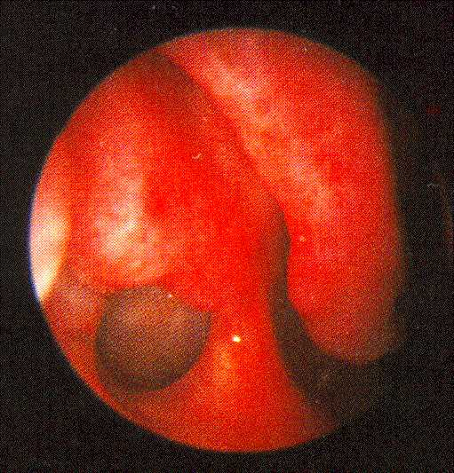

Slide 27
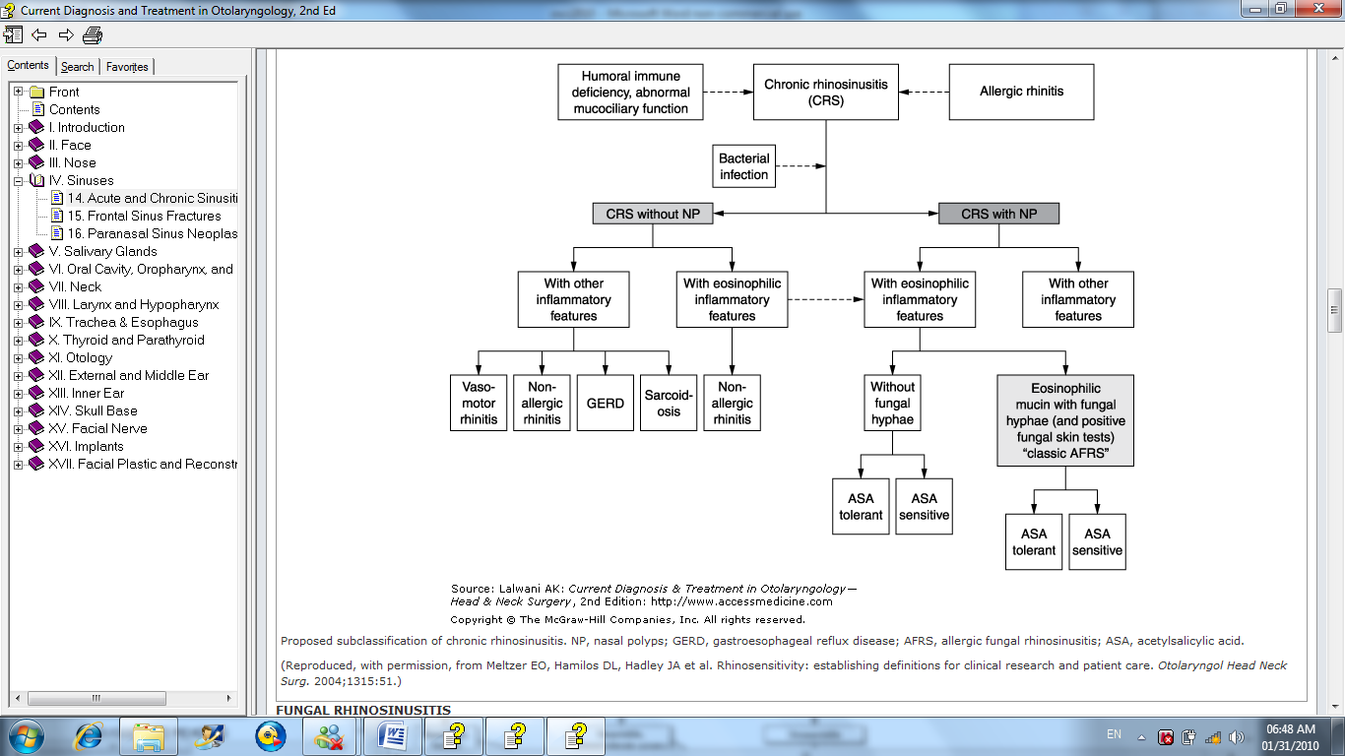

Slide 28
Pathophysiology of Rhinosinusitis,
Most important pathologic process in disease is obstruction of natural ostia
Obstruction leads to hypooxygenation
Hypooxygenation leads to ciliary dysfunction and poor mucous quality
Ciliary dysfunction leads to retention of % Bacterial

Slide 29
Normal Function of PNS
Patent Ostia
Normal Ciliary Function
Normal Quality of Mucous
Disturbance of these Function will lead to sinusitis

Slide 30
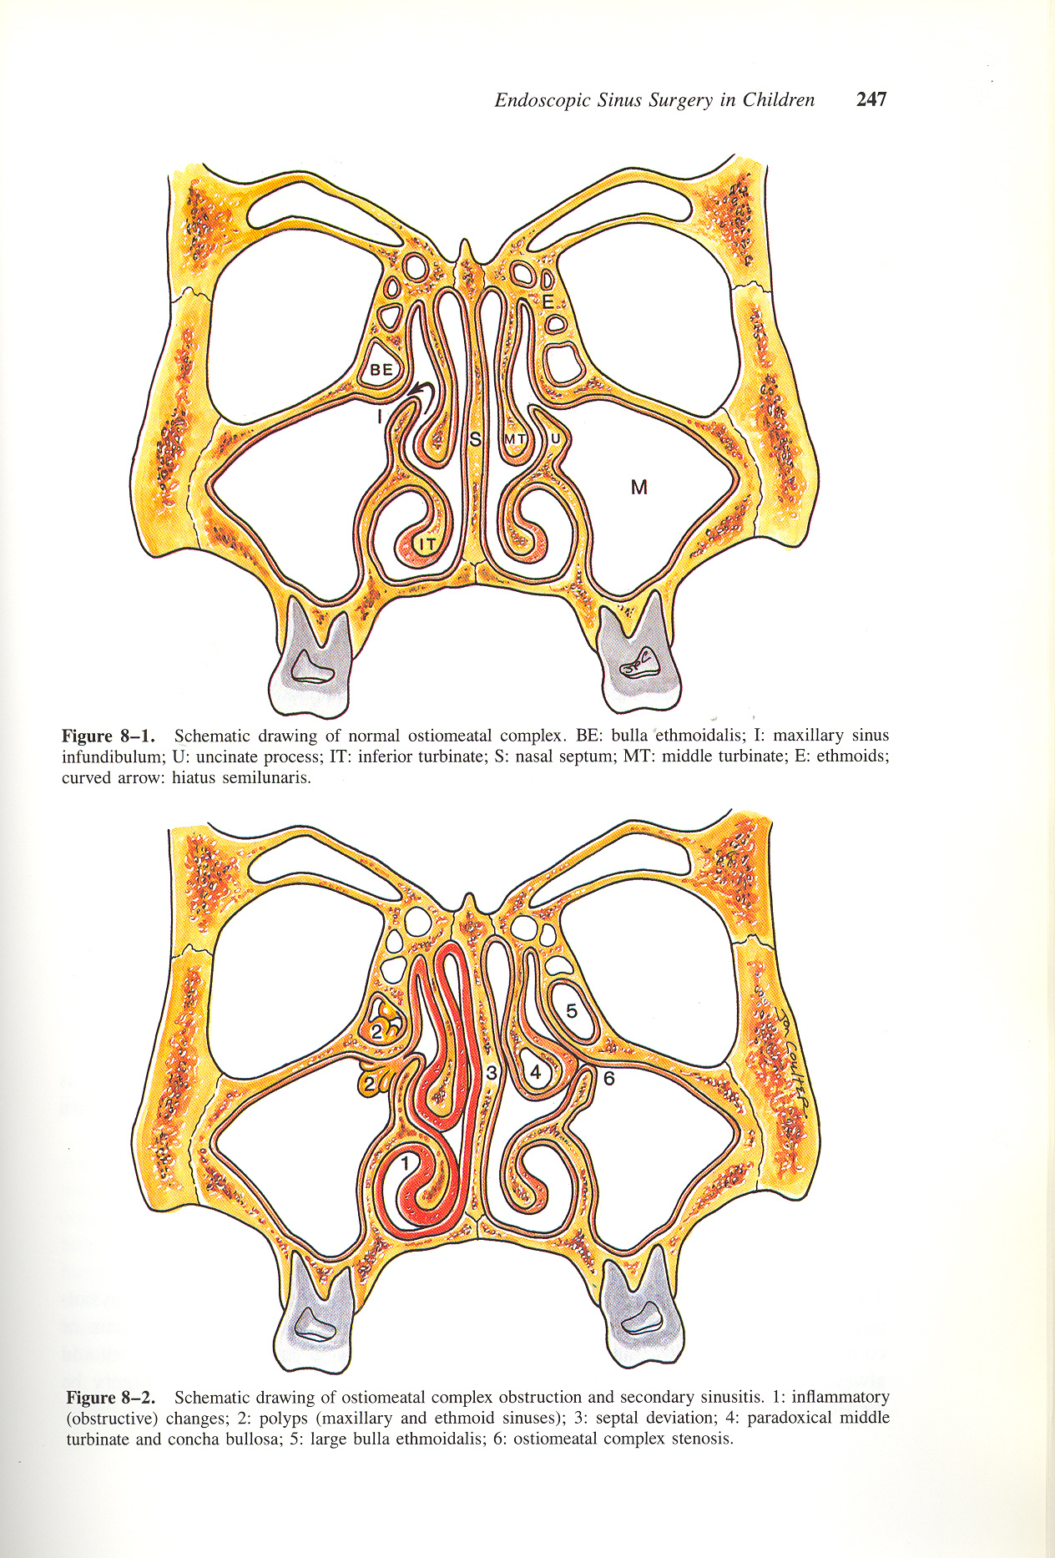
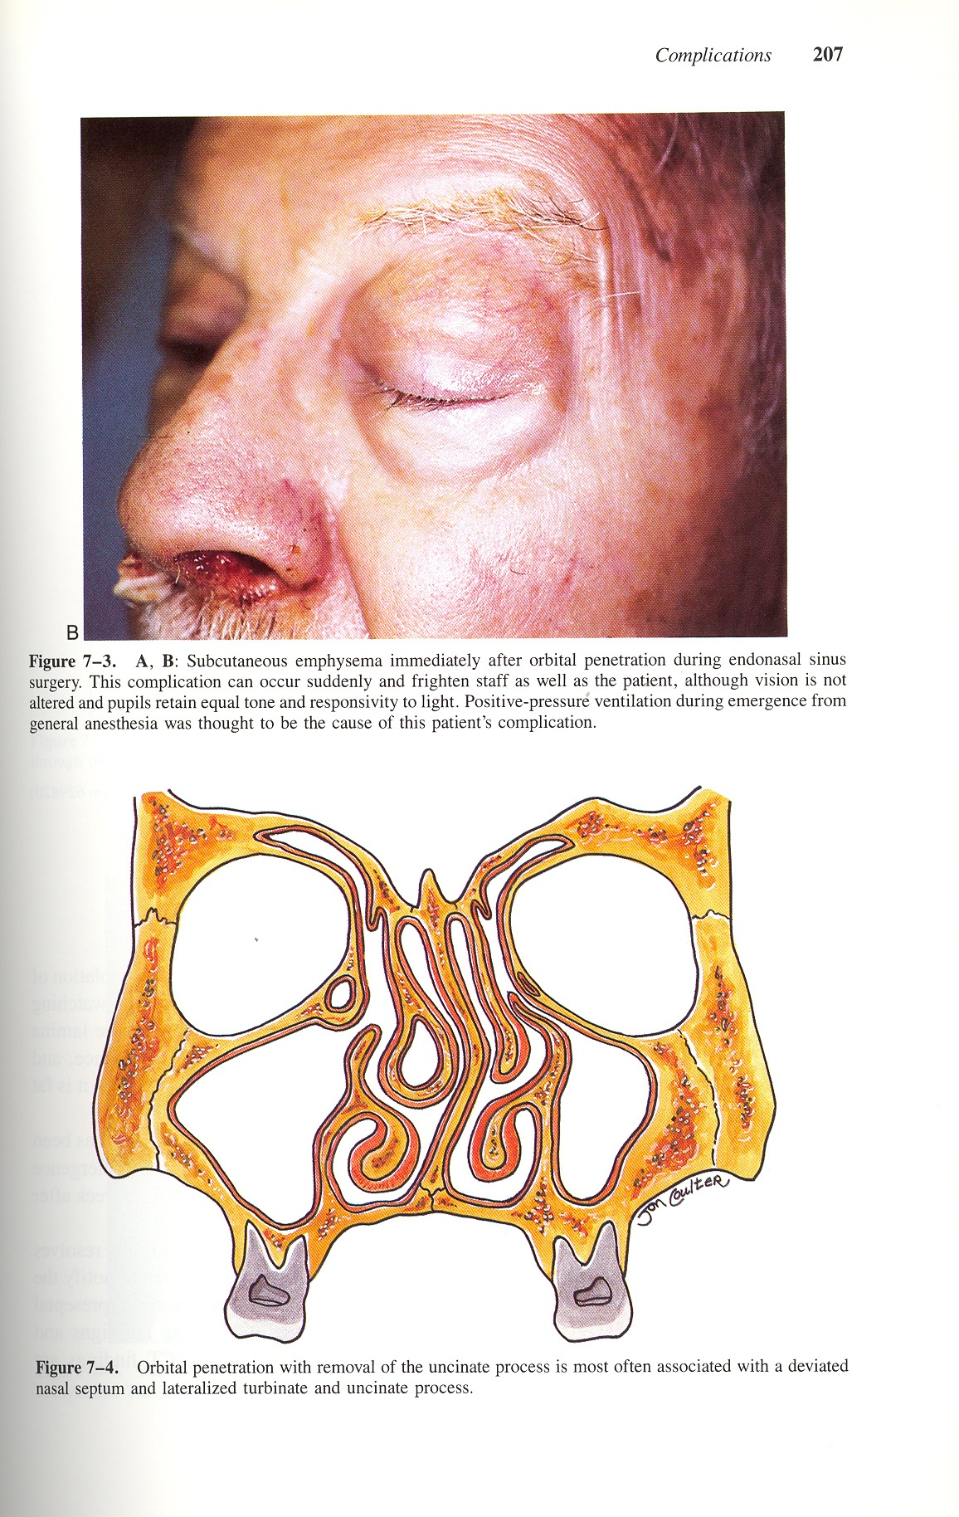

Slide 31
Acute and Chronic rhinosinusitis
Acute rhinosinusitis is defined as disease lasting less than three weeks
Subacute sinusitis is defined as disease lasting 1 to 3 months
Chronic rhinosinusitis is defined as disease lasting more than three months
  Chronic rhinosinusitis with nasal polyps
  Chronic rhinosinusitis without nasal polyps

Slide 32
Etiology
Inflamatory:
  URTI
  Allergy
Mechanical:
  Naso/Septal Deformity
  OMC Obstruction
  Turbinate Hypertorophy
  Polyps
  Tumours
  Large Adenoid
  Foreign Bodies
  Cleft Palate
  Choanal Atresia
Systemic Disease
  Cyctic Fibrosis
  Immotile cilia Syndrome
  Kartegener’s Syndrome
Miscellaneous:
  Swimming
  Flying
  Diving

Slide 33
Definitions
Recurrent Acute Rhinosinusitis
  Repeated acute episodes completely resolving within 12 week time frame
Chronic Rhinosinusitis
  Low grade symptoms and signs persistent for over 12 weeks
  Acute exacerbations can occur

Slide 34
Clinical Presentation
Viral URI
  Unable to differentiate within 10 days
  Serous rhinorrhea--may be mucopurulent
  Nasal congestion and cough prominent
  Low grade fevers, malaise, headaches
  Nighttime cough may linger

Slide 35
Acute Rhinosinusitis
  Usually after 10 days but may be sooner
  High fever, purulent and copious rhinorrhea, periorbital swelling, dental pain
  Nasal congestion
  Facial pain, headaches (periodicity)
  Anosmia
  Nasal & Postnasal Discharge

Slide 36
Acute Rhinosinusitis
  Persistent cold symptoms over 10 days
  Rhinorrhea (any type)
  Cough (dry or wet) worse at night
  Low grade fevers
  Fetid breath
  Painless Periorbital swelling in AM
  Facial pain \ Dental pain
  Headaches (Periodicity)
  Anosmia
  Nasal & Postnasal Discharge

Slide 37
Diagnosis of Chronic Rhinosinusitis
Major Factors | Minor Factors
Facial pain/pressure | Headache
Facial congestion/fullness | Fatigue
Nasal obstruction/blockage | Halitosis
Nasal discharge/purulence/discolored postnasal drainage | Dental pain
Hyposmia/anosmia | Cough
Purulence in nasal cavity on examination | Ear pain/pressure/fullness
Fever

Slide 38
Diagnosis
Symptoms present longer than 12 weeks.
Two or more symptoms one of which should be either nasal
blockage/obstruction/congestion or nasal discharge (anterior/posterior nasal drip):
± facial pain/pressure,
± reduction or loss of smell;

Slide 39
Signs
ENT examination, endoscopy;
Review primary care physician’s diagnosis and treatment;
Questionnaire for allergy and if positive, allergy testing if it has not already been done.

Slide 40
Strong History of Sinusitis
One of the following situations:
  Two major factors
  One major factor and two minor factors
  Pus in the nose on examination

Slide 41
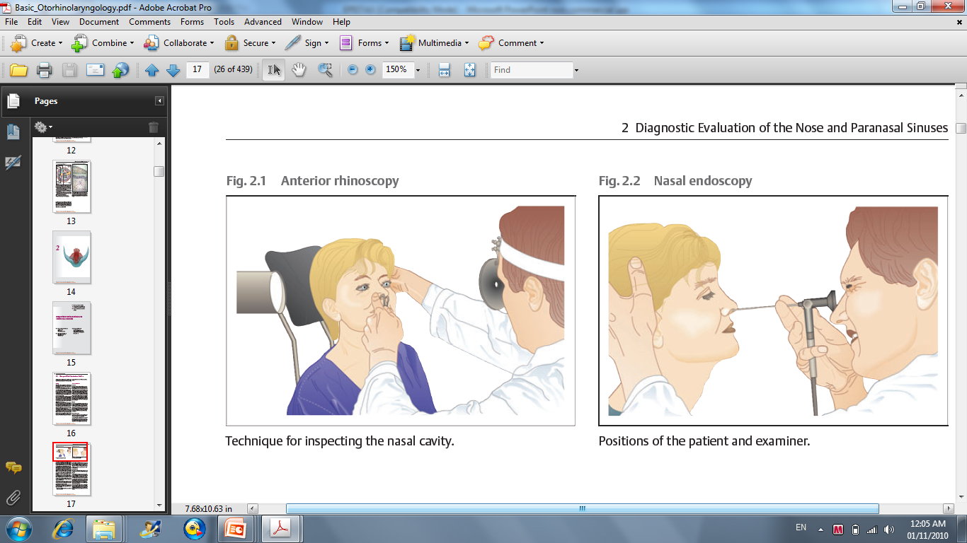
Nasal Exam

Slide 42
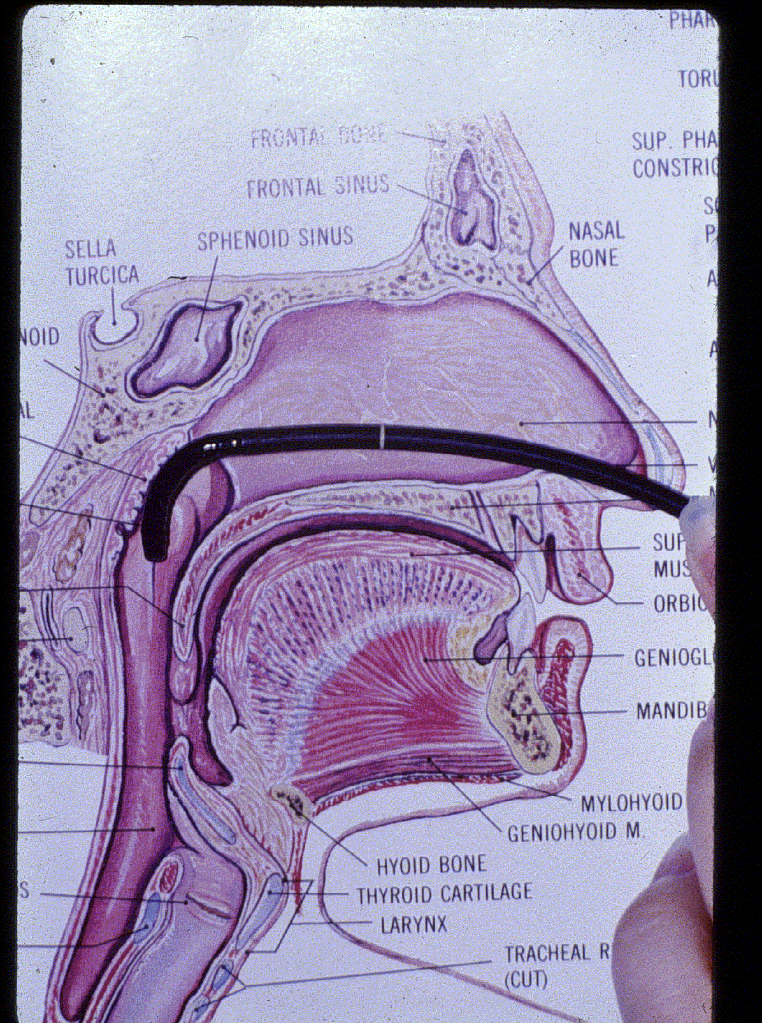
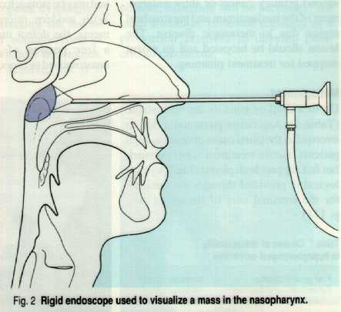
Nasal Endoscopy
Flexible
Rigide

Slide 43
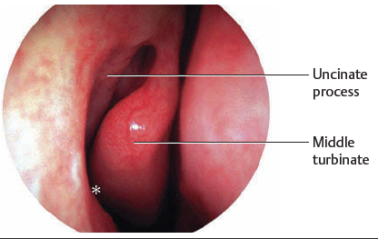
Endoscopy landmarks

Slide 44
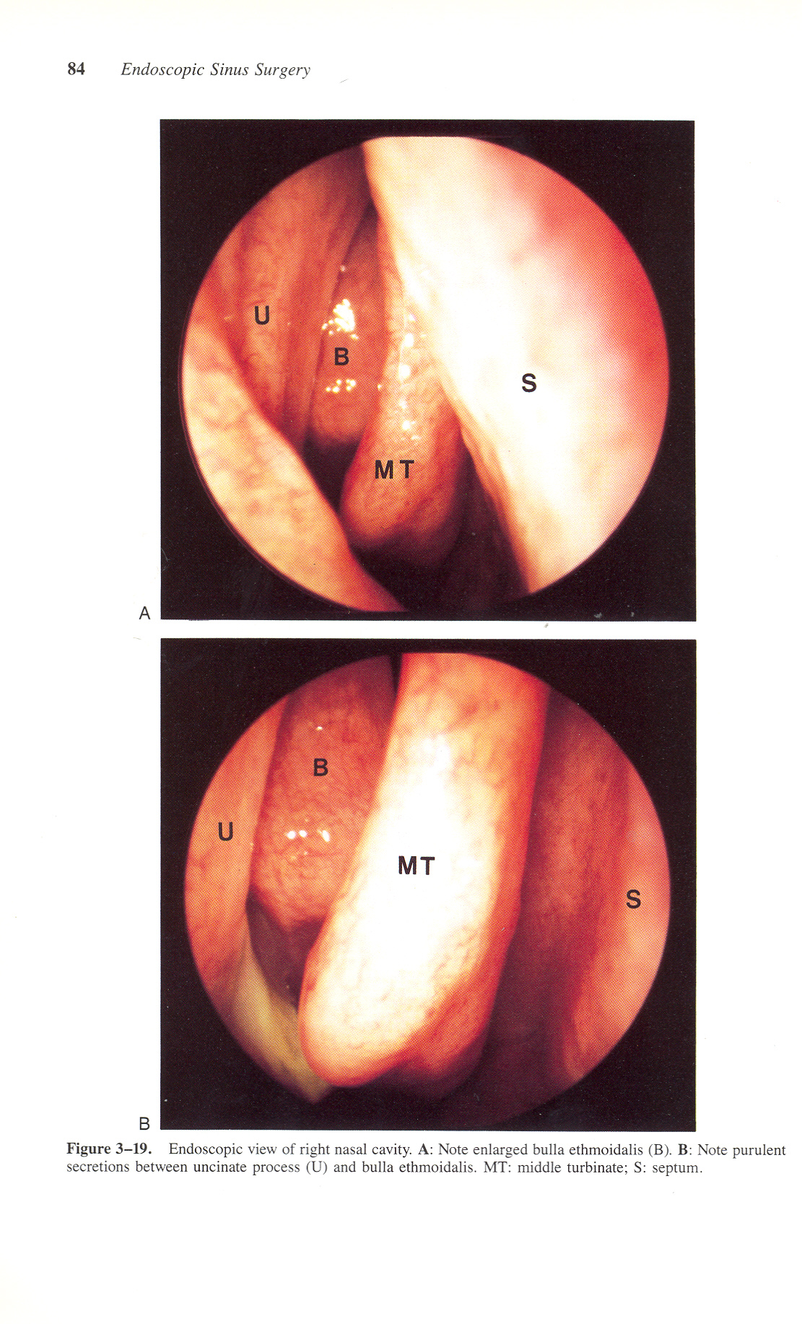
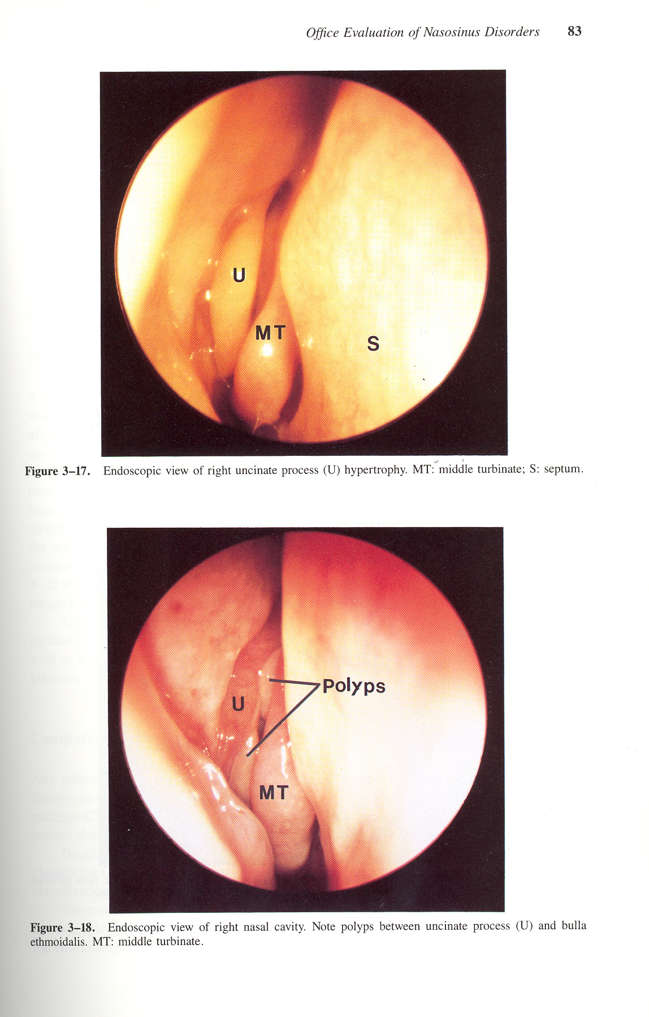
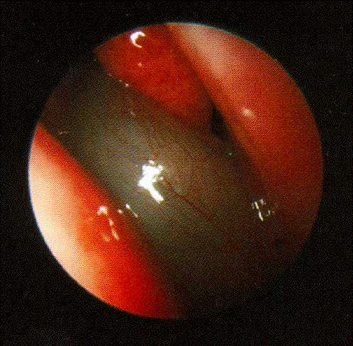
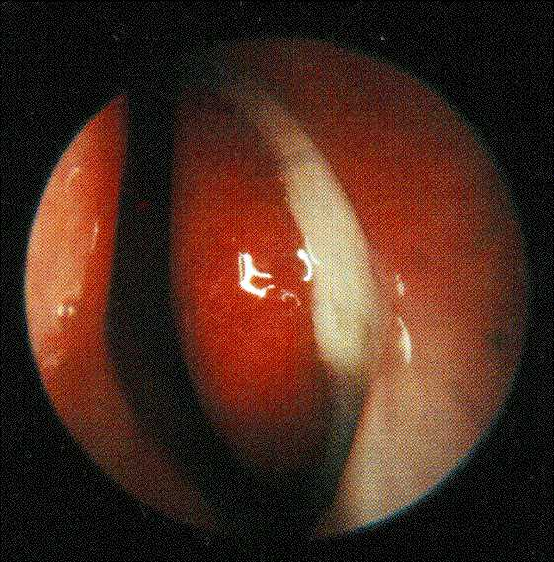
Endoscopy Finding

Slide 45
Examination Continue
Oropharynx
Tenderness over sinuses
Periorbital edema and discoloration
Most specific-- Mucopurulence, periorbital swelling, facial tenderness

Slide 46
Radiography
Plain X Rays
  Traditional views
    Water’s
    Caldwell
    Lateral
    Submentovertex
CT Scan
MRI

Slide 47
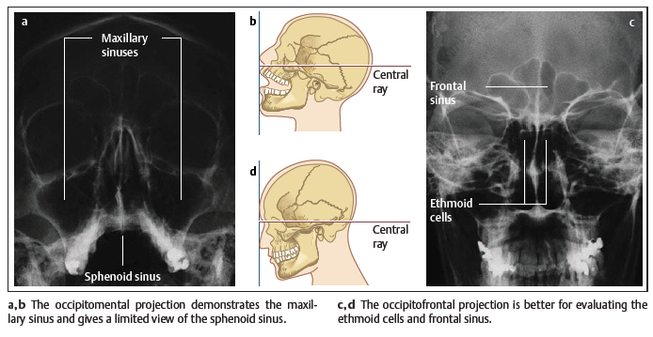
Plain Radiography

Slide 48
Plain Radiography
water’s
Caldwell

Slide 49
Plain Radiography
Lateral
Submentovertex

Slide 50
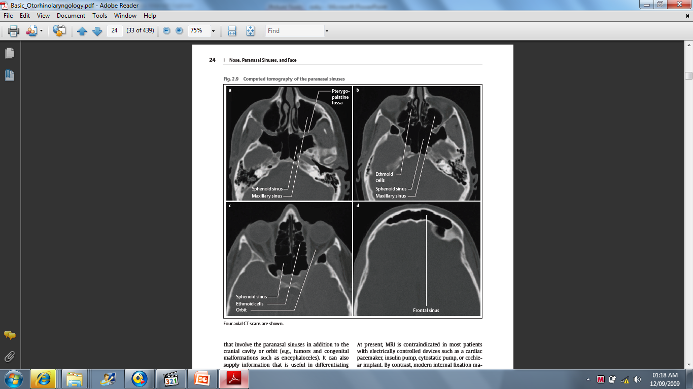
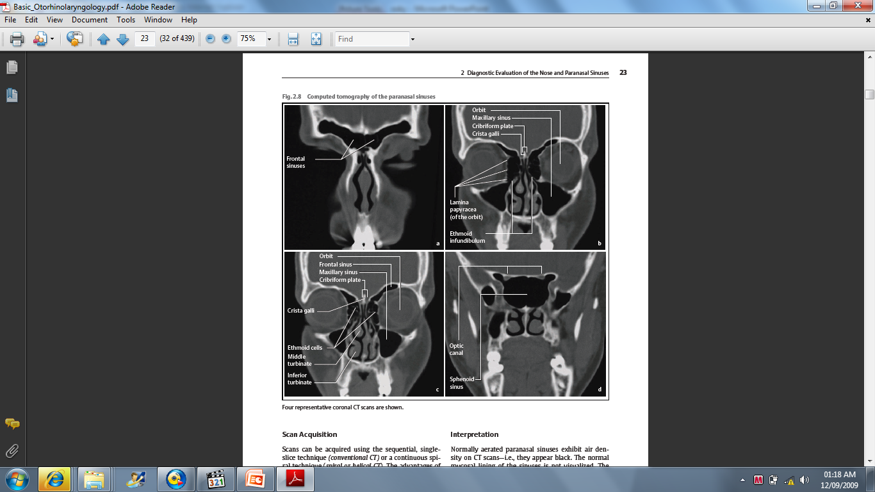
Computed Tomography
Study Type
  Coronal perpendicular 2 Hard Palate
  Axial Paralell 2 Hard Palate
    Reformatted Sagital
  Multiplannr CT Scan axail and reformatted other cuts

Slide 51
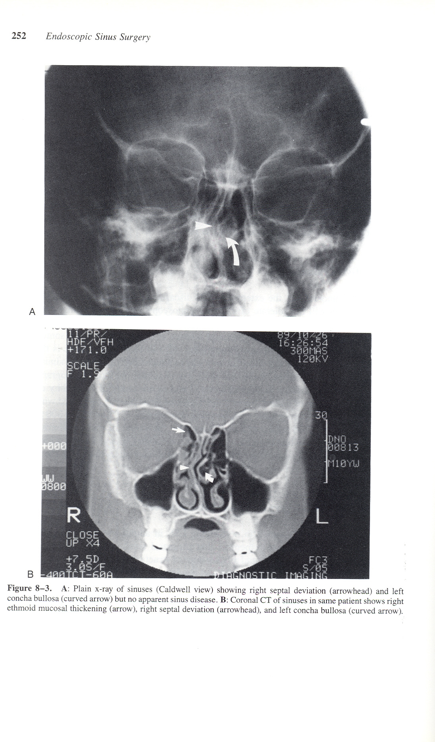
CT Scan and Plain X Ray

Slide 52
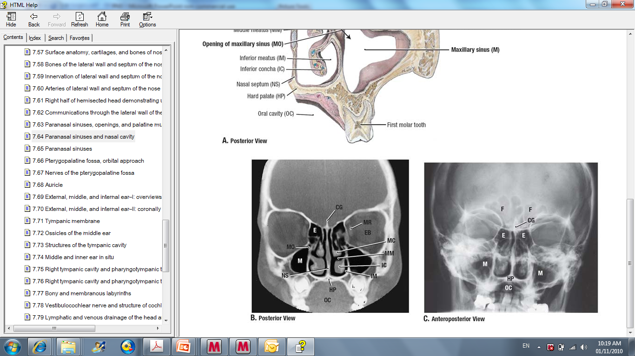

Slide 53
Coronal CT Scan

Slide 54
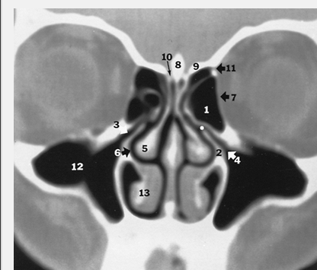
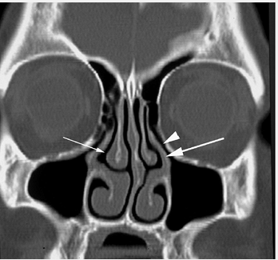
Coronal CT Scan

Slide 55
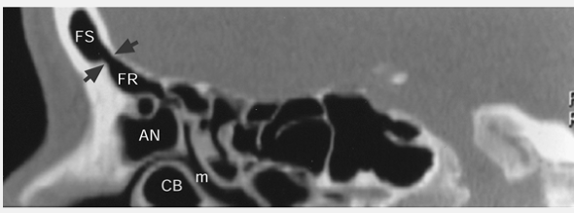
Sagital CT Scan

Slide 56
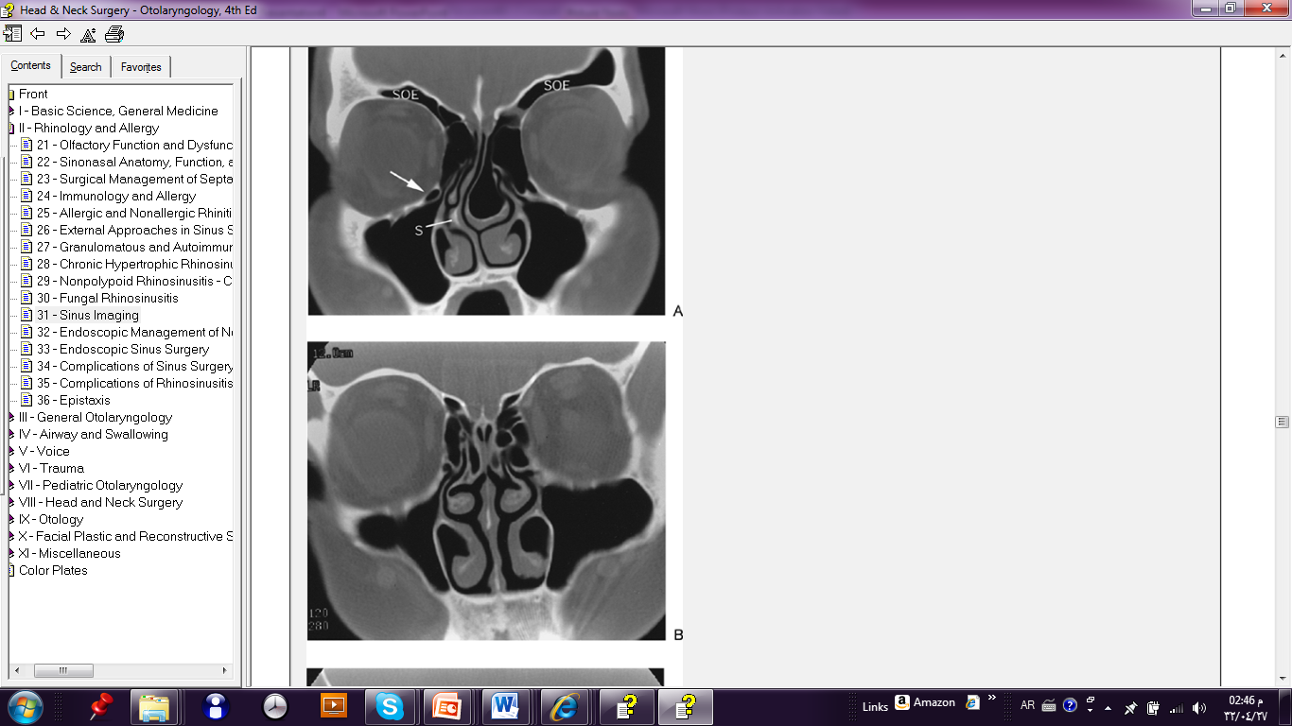
Anatomic Variation

Slide 57
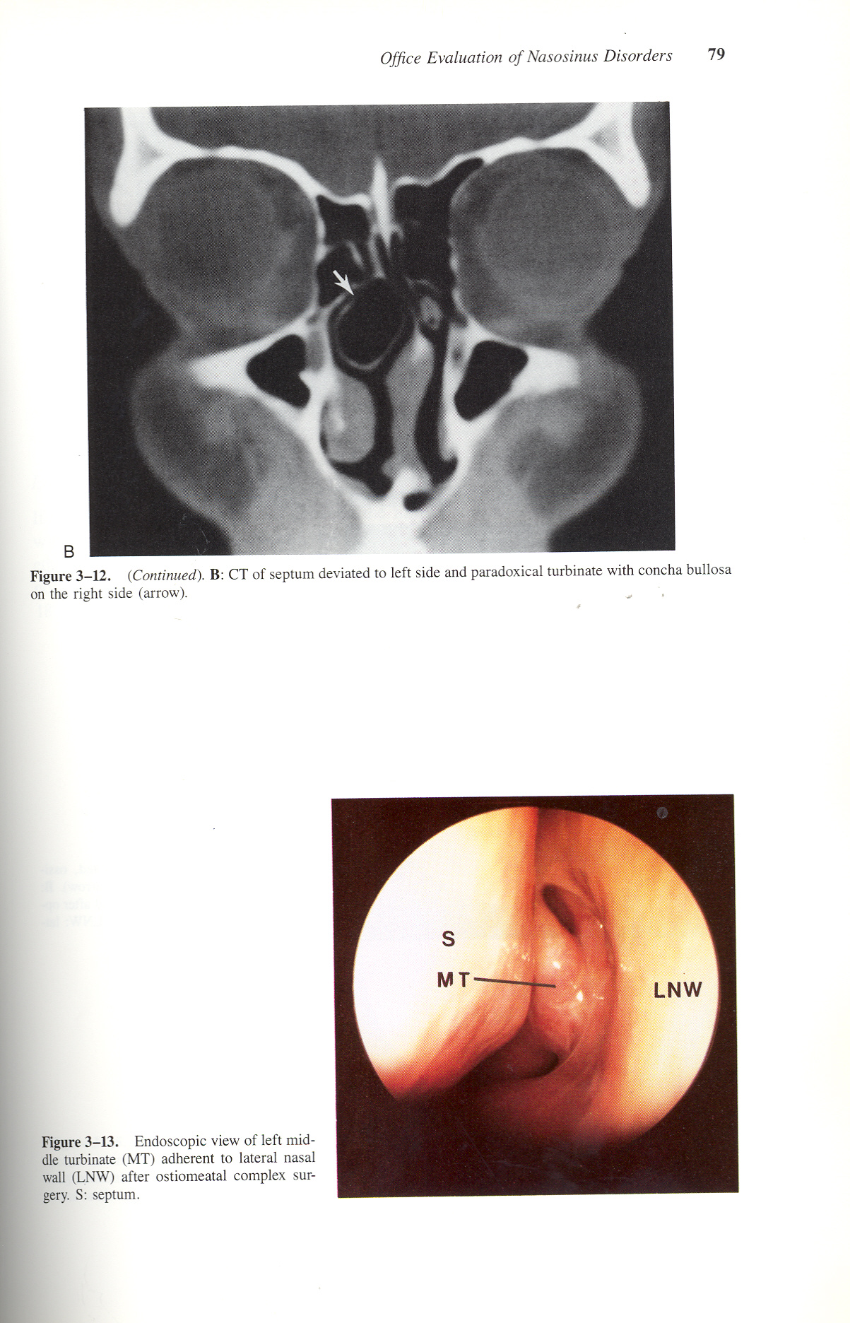
Concha Bullosa

Slide 58
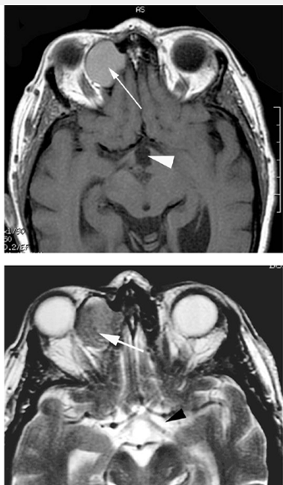
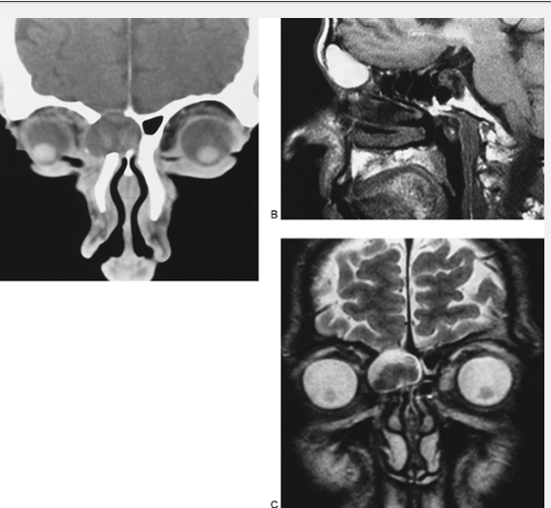
MRI

Slide 59
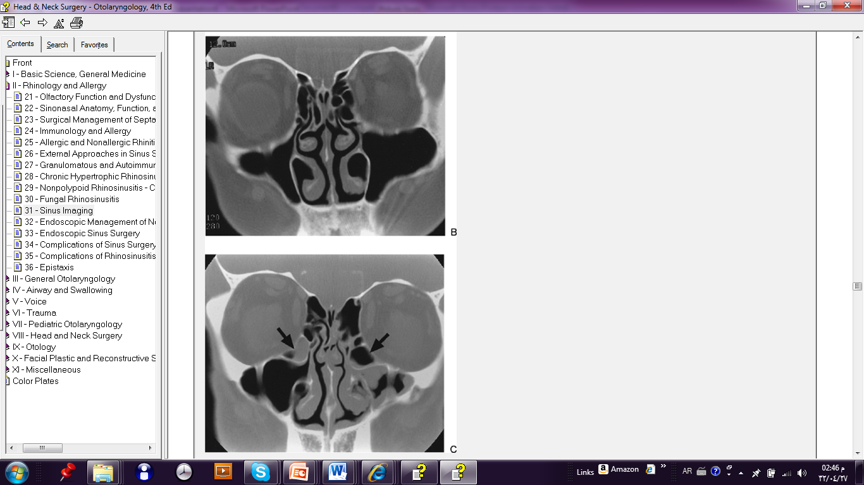
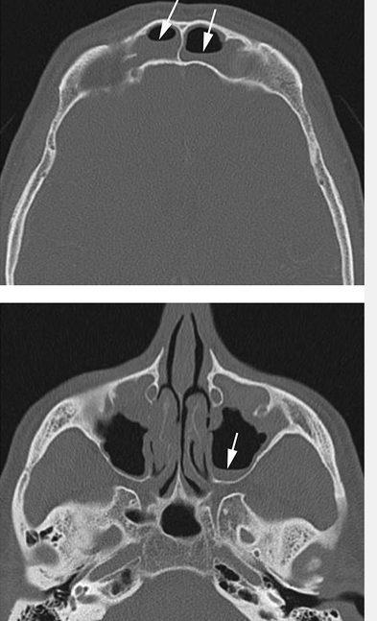
CRS

Slide 60
Axail CT Scan

Slide 61
Indications
Gold standard for CRS
Planning surgery or failed medical management
Indications
  Clinical unresponsiveness to medical therapy
  Immunosuppressed patient
  Severe symptoms or signs
  Life threatening complications

Slide 62
Axial and Coronal CT SCAN

Slide 63
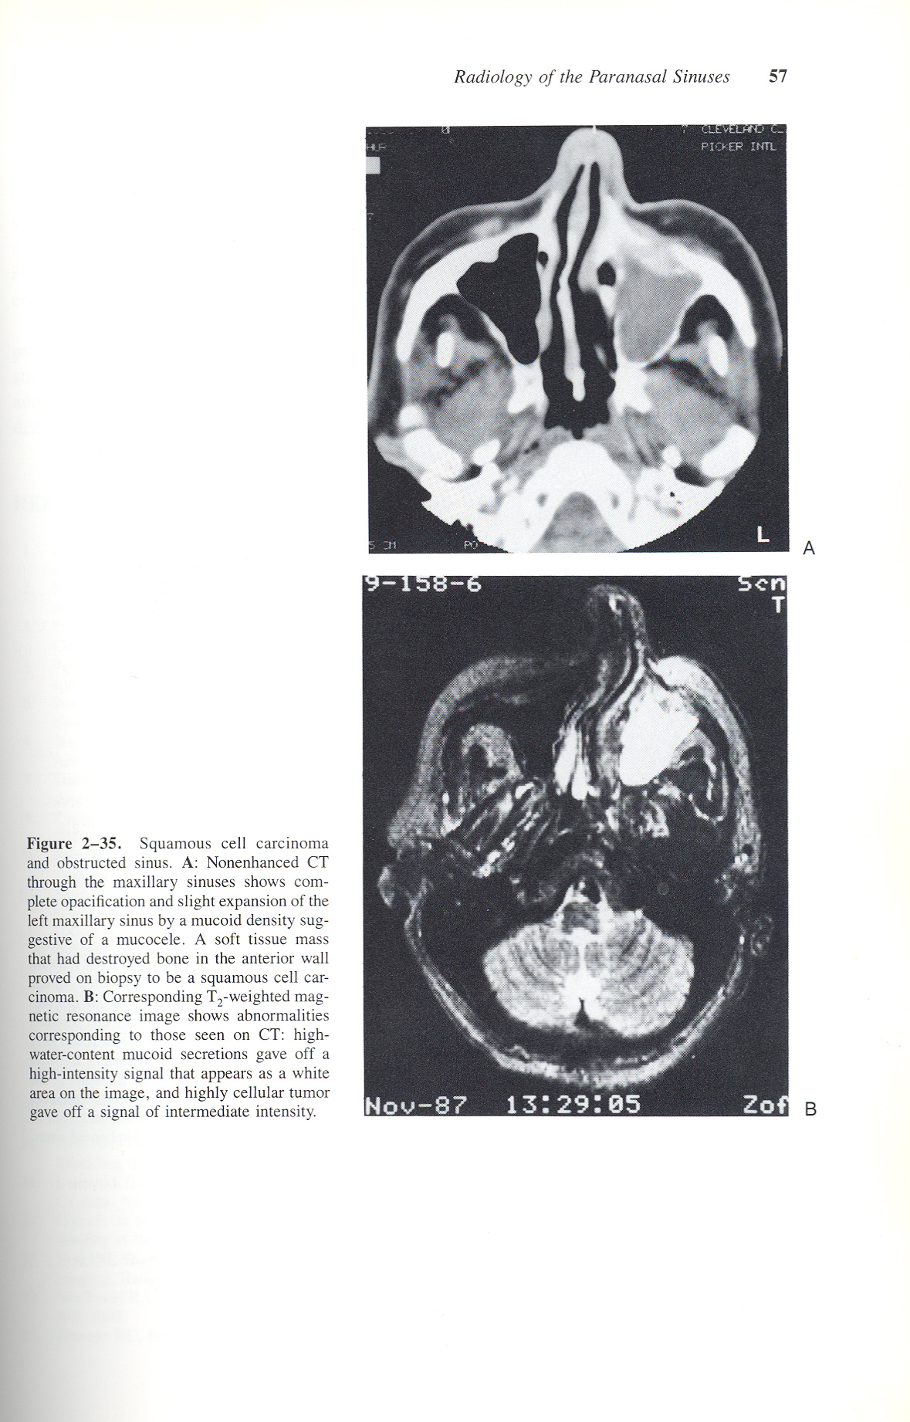

Slide 64
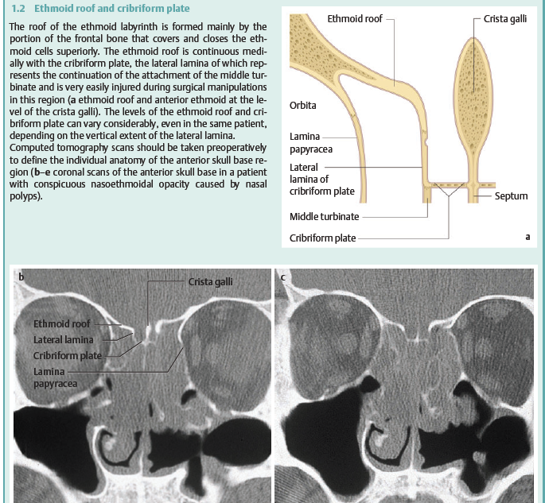
CRS Coronal CT Scan

Slide 65
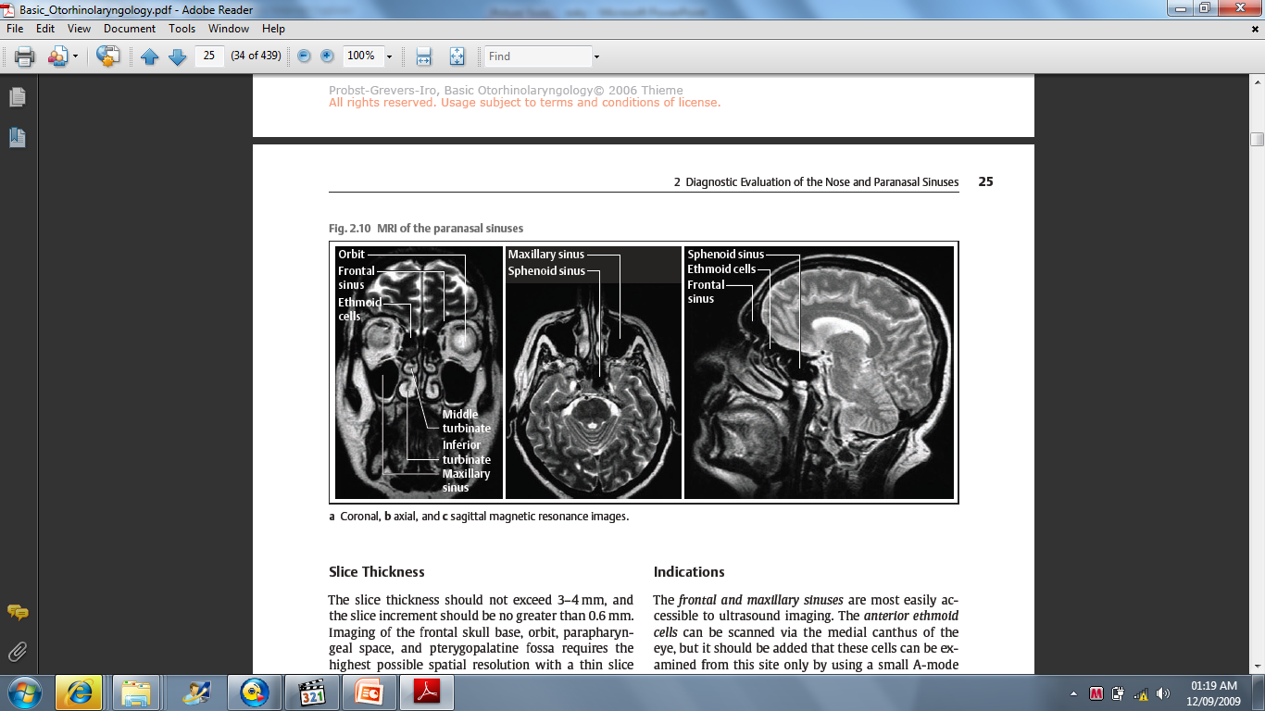
MRI PNS
Indicated for Disease Extension

Slide 66
MRI Indicated for Disease Extension

Slide 67
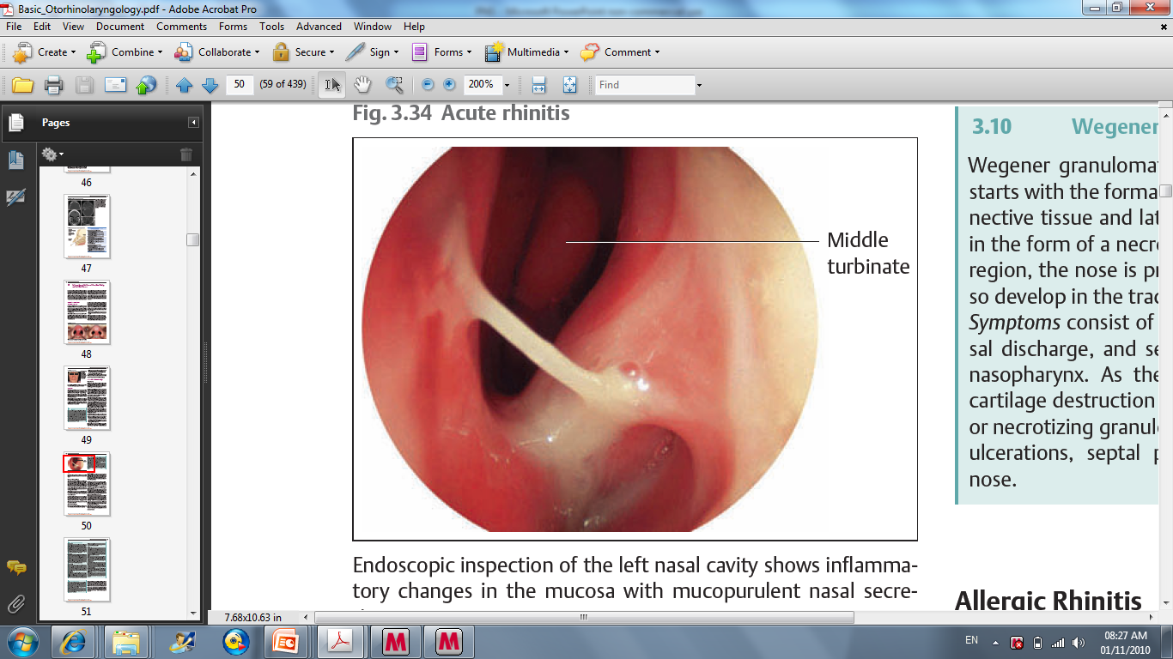
Sinus Swab & Aspirate
Nasal, oral, nasopharyngeal cultures poor result
Needs cooperative patient -- usually get a Middle meatal cultures?
Staining
Culture

Slide 68
Microbiology in Acute sinusitis
Sinus Swab & Aspirate
Streptococcus pneumoniae 20-30%
Moraxella catarralis 15-20 %
Hemophilus influenzae 16-20 %
Streptococcus Pyogens 2-5 %
Sterile 20-35%
Anearobs 2-5%
Rare viruses, anaerobes, Staphylococcus
Normal flora in the sinus-- controversy

Slide 69
Microbiology in Chronic Sinusitis
Gram Negative
  Bacteroid
  Klebcilla
Anearobs
Staph aureus
Usually Polymicrobial

Slide 70
Medical Management
Antibiotics -- viral URI common and increasing numbers of drug resistant bacteria
  40-60% sinusitis episodes resolve
  35% of S. pneumoniae penicillin-resistant
  16% of S. pneumoniae penicillin-intermediate
Rapid cure, prevent complications, prevent chronic sinusitis, sterilize sinus

Slide 71
Medical Management
Antibiotic for 10 – 14 days (Pen, Cephalo)
Decongestant
  Topical
  Systematic
Steroid Topical spray
Symptomatic treatment
Treat the underlying cause

Slide 72
Recalcitrant Rhinosinusitis
  Allergy
  Immunodeficiency
  Cystic fibrosis
  Ciliary dismotility disorders
  Gastroesophageal Reflux Disease
Rpeat treatment 2x or 3x over 2-3 Months
Obtain CT Scan

Slide 73
Antimicrobial

Slide 74
Medical Management
Acute Nonsevere Rhinosinusitis (no ABX)
  Amoxicillin (45-90 mg/kg/day), amoxicillin/clavulanate, cefpodoxime, or cefuroxime
  10 to 14 day course
  PCN-allergic may receive azithromycin, clarithromycin, erythromycin, or TMP/SMX but limited effectiveness (25% failure rate)

Slide 75
Medical Management
Acute nonsevere rhinosinusitis (with ABX) Acute severe rhinosinusitis (no ABX)
  Amoxicillin/clavulanate, high dose amoxicillin (80-90 mg/kg/day), cefpodoxime, or cefuroxime
Acute severe rhinosinusitis (with ABX)
  amoxicillin/clavulanate or combination therapy (amoxicillin or clindamycin plus cefpodoxime or cefixime)

Slide 76
Medical Management
Complications or severe illness
  IV cefotaxime or ceftriaxone plus clindamycin
Chronic Rhinosinusitis
  beta lactam stable agent (amoxicillin/clavulanate or combination therapy) for 3 weeks

Slide 77
Complications or severe illness
  IV Cefotaxime or Ceftriaxone
  Clindamycin

Slide 78
Medical Management

Slide 79
Medical Management
Antihistamines -- dry mucosal secretions
Isotonic saline nose drops, sprays, irrigations, and steam inhalations -- anecdotal
Topical decongestants --inhibits cilial motion
Nasal steroids
Mucolytics

Slide 80
Surgical Management
Adenoidectomy
  nasal obstruction and symptoms
  small size of trials
Septoplasty
  rare to have significant septal deviation
Antral aspiration and lavage
  indications same as sinus aspiration
  only treats maxillary sinus
  need GETA

Slide 81
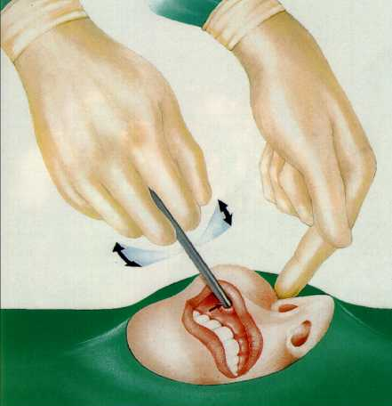
Surgical Management
Caldwell-Luc -- damages dentition
Inferior antrostomy
  goes against proven cilial outflow
  possible for cilial dismotility/CF
FESS
  controversial -- difficult, too radical (AOM), reversible changes on CT

Slide 82
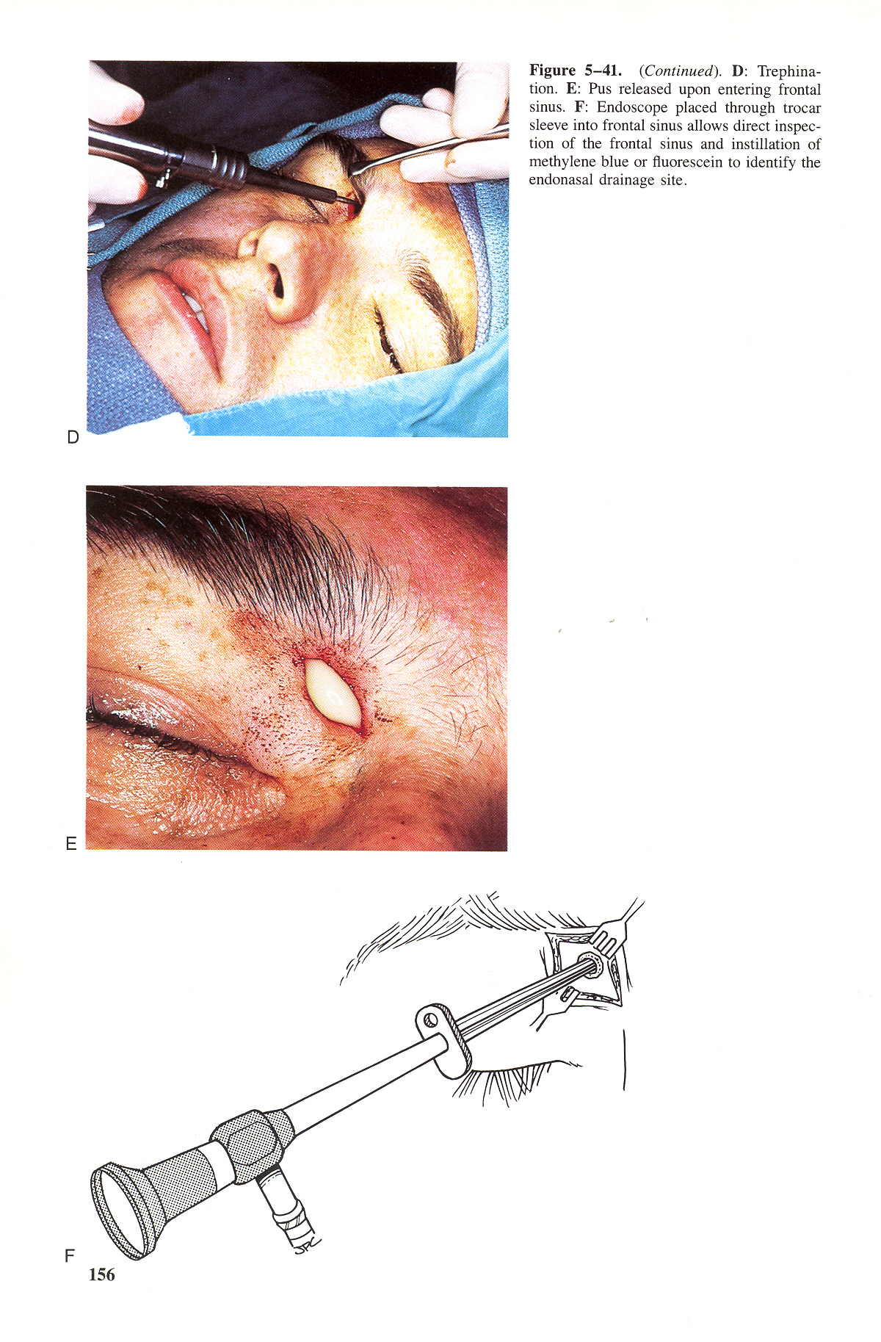
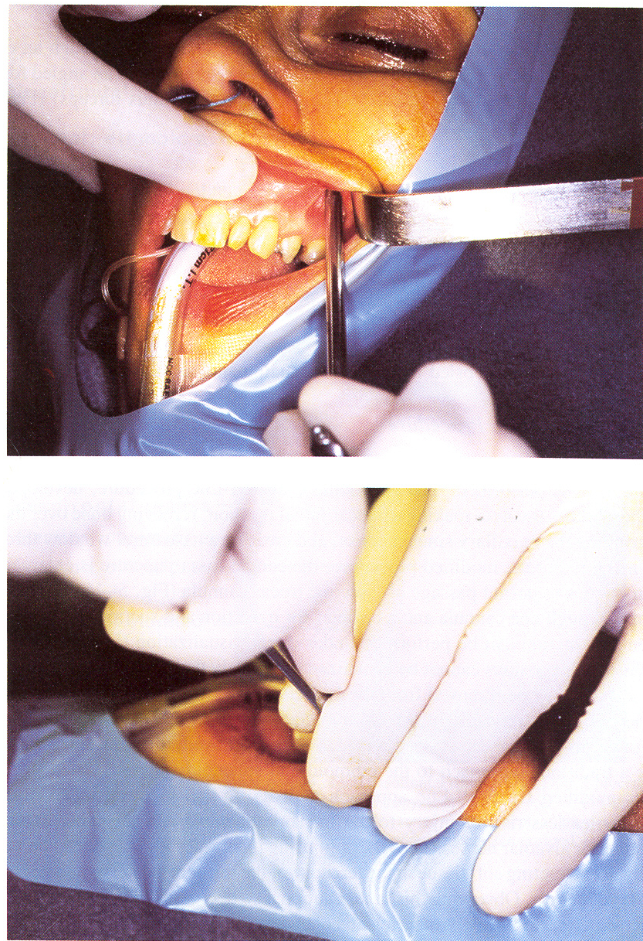
Surgical Approach old
Cal dual luc
Antrostomy
Frontal Sinus triphining

Slide 83
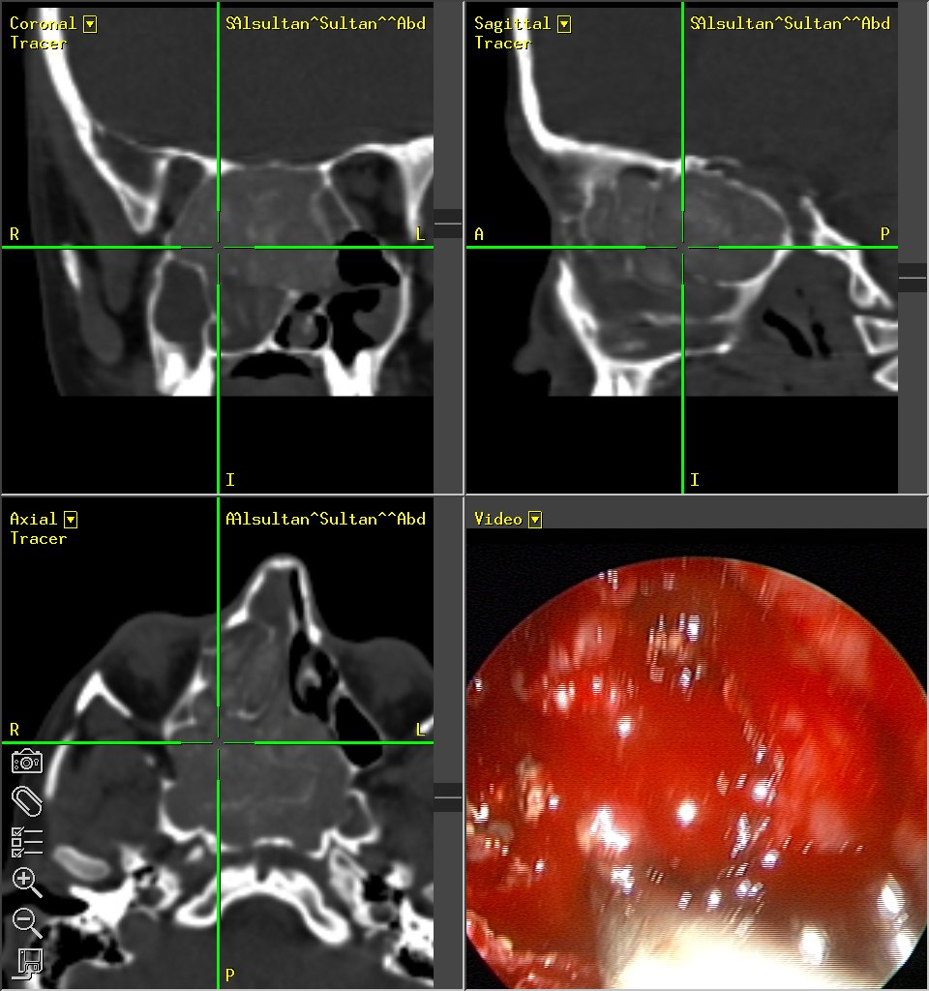
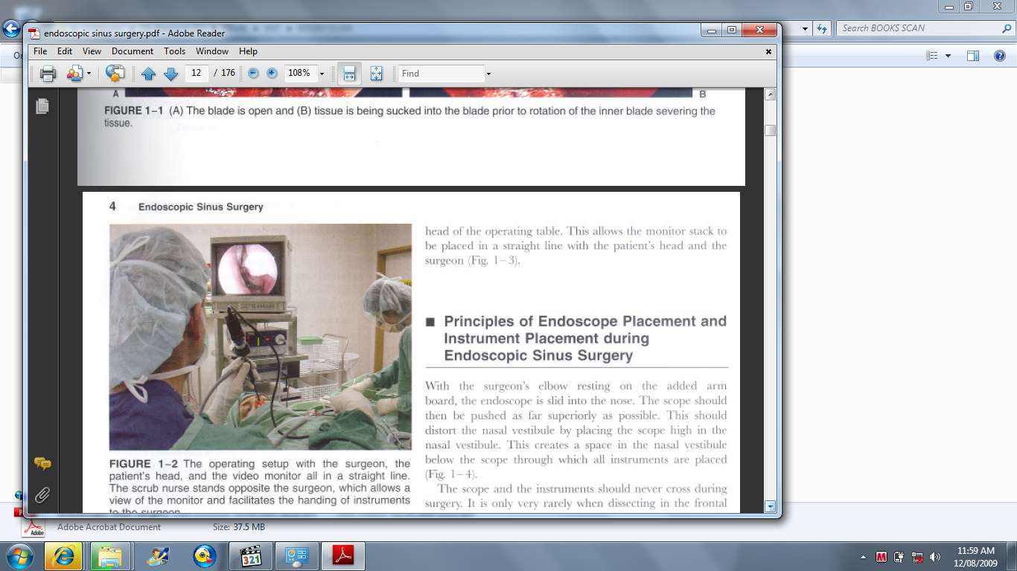
Functional Endoscopic Sinus Surgery (FESS)
Techniques
Indications

Slide 84
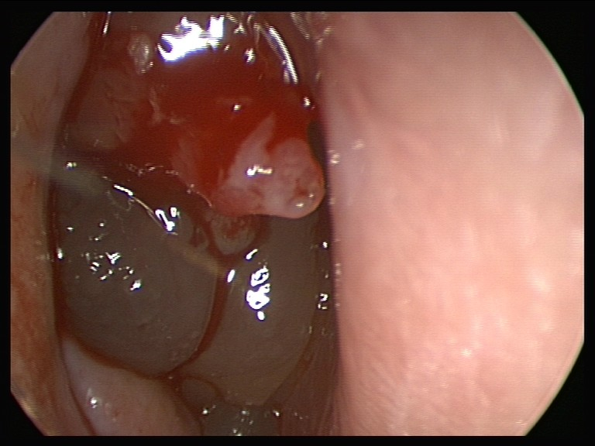
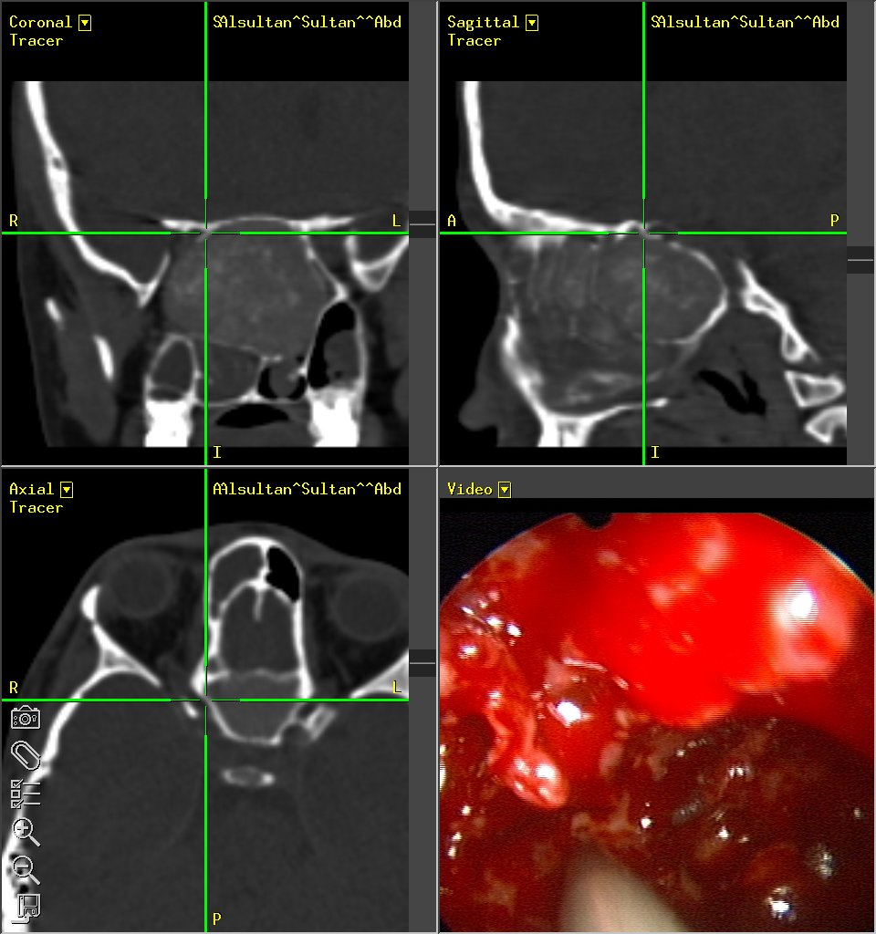
Computer Assisted Surgery
Power Instruments

Slide 85
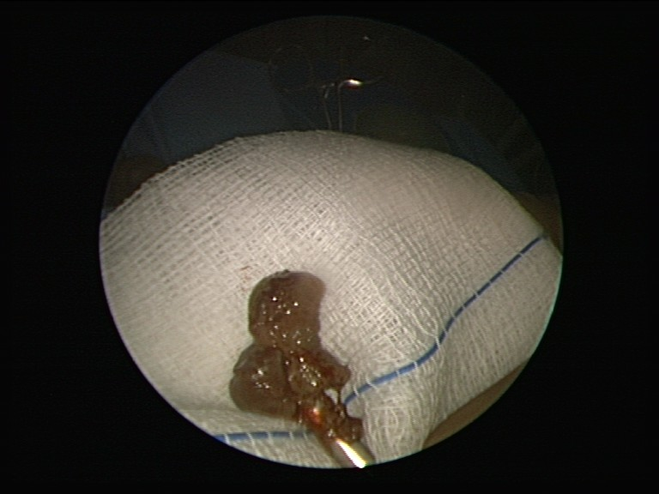
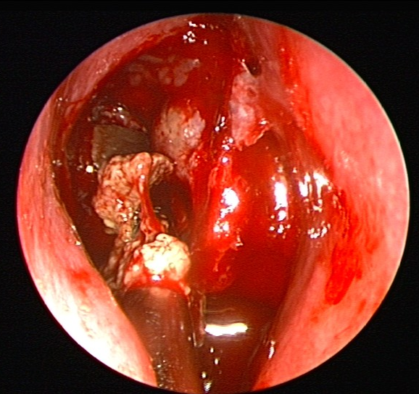
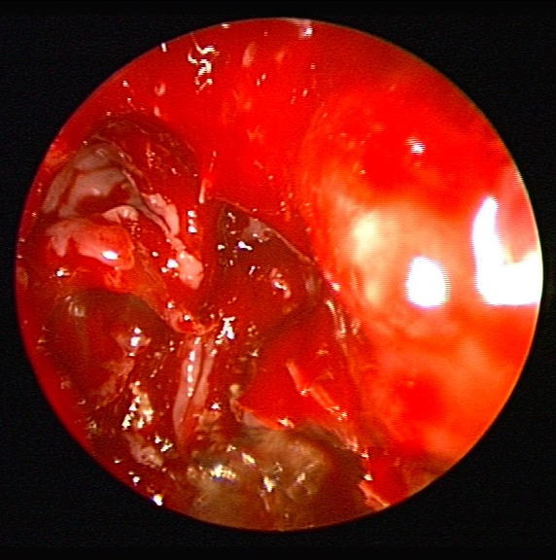

Slide 86
STEPS Of FESS
Medialize middle turbinate
Excise uncinate process
Anterior then posterior ethmoidectomies
Sphenoidotomy
Frontal recess sinusectomy
Create maxillary antrostomy

Slide 87
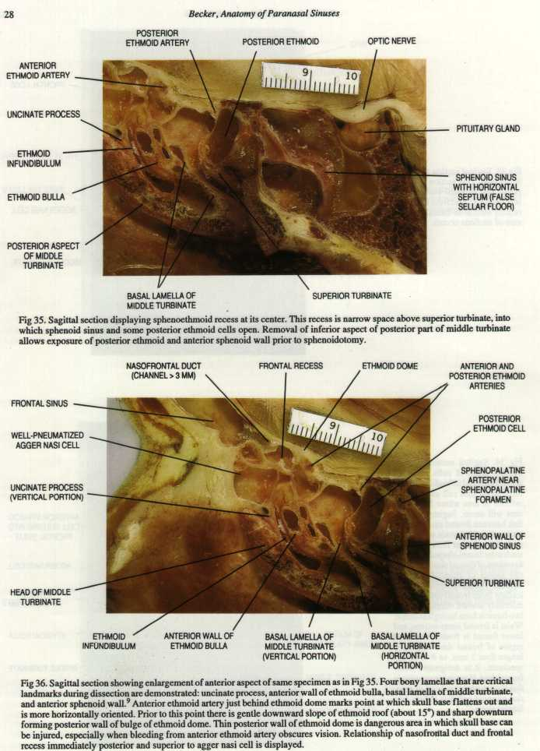
CADAVERIC HANDON

Slide 88
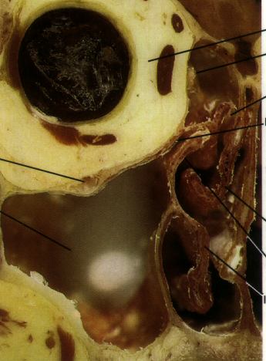

CADAVERIC HANDON

Slide 89


Slide 90


Slide 91
Indications for Endoscopic Sinus Surgery
• chronic sinusitis, complicated sinusitis, recurrent acute sinusitis,
failed medical management of acute sinusitis, fungal sinusitis
• obstructive nasal polyposis
• sinus mucoceles
• remove foreign bodies
• tumor excision, transsphenoidal hypophysectomy
• orbital decompression, dacryocystorhinotomy, orbital nerve
decompression, Grave’s ophthalmopathy
• choanal atresia repair
• CSF leak repair
• control epistaxis
• septoplasty, turbinectomy

Slide 92

Power Instrument

Slide 93


FESS

Slide 94
STEPS Of FESS
Medialize middle turbinate
Excise uncinate process
Anterior then posterior ethmoidectomies
Sphenoidotomy
Frontal recess sinusectomy
Create maxillary antrostomy

Slide 95
Extended FESS
CT Guided FESS
Power Instrument
Mini FESS

Slide 96
• Postoperative Care:
Sinus Packing
Oral Antibiotics for a minimum of 2 weeks
Aggressive nasal hygiene to prevent adhesions (saline irrigations)
Nasal steroids
Nasal debridement at 1, 3, and 6 weeks

Slide 97
Excellent results
71% normal at one year
Meta analysis 89% success
  with 0.6% complications

Slide 98
FESS Orbital Complications
• Blindness
Indirect injury (retrobulbar Hematoma)
Direct injury to the optic nerve
Orbital Fat Penetration:
increases risk of retrobulbar hematoma
Rx: recognize orbital fat (orbital fat floats);
avoid further trauma; may complete the FESS;
avoid tight nasal packing;
Observe for vision changes, proptosis, or restricted ocular gaze

Slide 99
• Diplopia: orbital muscle injury, most commonly from medial rectus
and superior oblique muscles
• Epiphora: injury to lacrimal duct system, avoid operating anterior to the attachment of the uncinate;
Rx: observation initially, if no resolution then dacryocystorhinostomy

Slide 100
Retrobulbar Hematoma
• Pathophysiology: most commonly from retraction injury of the anterior ethmoid artery which causes increased orbital pressure that compresses the vascular supply to the optic nerve, also may occur from venous injury near the lamina papyracea
• Avoidance: maintain orientation and operate under direct vision, examine CT for dehiscence, correct coagulopathies

Slide 101
• SSx: ecchymosis, proptosis, conjunctival changes (chemosis), pupillary changes (afferent pupillary defect)
•

Slide 102
Rx
1. if noticed intraoperatively terminate case
2. Ophthalmology consult
3. Mannitol (1–2 g/kg), consider high-dose steroids
4. orbital massage and place ice pack
5. lateral canthotomy, medial external (Lynch) procedure, or orbital decompression
6. control hemorrhage

Slide 103
FESS
Advantages:
superior visualization, better precision, preserves function and completene•
Disadvantages:
requires one-handed technique, monocular vision
Contraindications:
osteomyelitis, no evidence of paranasal disease on CT, inaccessible lateral frontal sinus disease
SS, no external scar

Slide 104
FESS Indications
(absolute)
  complete nasal obstruction in CF
  antrochoanal polyp
  intracranial or orbital complications
  mucocoeles or mucopyocoeles
  traumatic injury in optic canal
  resistant dacryocystorhinitis
  fungal sinusitis
  some meningoencephaloceles/neoplasms

Slide 105
FESS
(Possible)
  Persistent chronic rhinosinusitis that fails optimum medical treatment and after exclusion of systemic disease
  Asthmatic exacerbations associated with rhinosinusitis

Slide 106
CADAVERIC HANDON

Slide 107


Balloon Sinoplasty

Slide 108



Slide 109
Turbinate Hypertrophy
Causes
  Infection
  Compensation
  Dysfunctional
  Allergies
Manifestation
  Nasal obstrauction
  Mouth Breathing
  Cause manifestation

Slide 110
Turbinate traetment
Treat underlaying cause
Surgical treatment
  SMR
  Turbinoplasty
  SMD
  Somnoplasty RF
  Turbenectomy

Slide 111
Sinusitis Complications
Orbital
Cranial
Extracranial

Slide 112
Orbital Complications
Routes of spread
  arterial
  venous
  lymphatic
  direct

Slide 113
Complications: Orbital
Five classifications of orbital complications 1) Inflammatory edema: lid edema otherwise normal. 2) Orbital cellulitis: diffuse edema 3) Subperiosteal abscess: usually seen near lamina papyracea 4)Orbital abscess: collection within orbit 5) Cavernous sinus thrombosis: bilateral

Slide 115

Chandler’s classification ;Based on Eye Acute Infection and their anatomic location
CRS | AFS | ARS | Number | Presentation | Grade
5 | 10 | 0 | 15(36%) | Proptosis | I Anatomical Disturbance
3 | 8 | 0 | 11(26%) | Epiphoria Diplopia Ophthalmoplegia Ptosis | II Functional Involvement
5 | 3 | 3 | 11(26%) | Orbital cellulitis, Pre septal-cellulitis Orbital abscess Subpereostial abscess | III Orbital Infection
0 | 4 | 1 | 5(12%) | Visual Impairment, blindness | IV Visual Impairment
Clinical grading system that doesn’t require Imaging
Encompass Acute orbital infection and chronic Sinogenic pathology causing orbital manifestation.
Radiologic findings does not correlate well with clinical severity
Chronic Paranasal sinus disease in (74 %) of the cases.

Slide 116


Slide 117
Complications
Stage I
  periorbital inflammatory edema
  obstruction of venous channels
  no vision loss
  no EOM limitation

Slide 118


Slide 119
Complications
Stage II
  orbital cellulitis with edema, chemosis, proptosis, pain
  no abscess
  opthalmoplegia may occur due to edema or spasm
  no visual loss

Slide 120


Slide 121


Slide 122
Complications
Stage III
  subperiosteal abscess
  globe displaced laterally or downward
  orbital cellulitis present with decreased EOM
  vision decreased

Slide 124
Complications
Stage IV
  orbital abscess
  severe proptosis and chemosis
  usually no globe displacement
  opthalmoplegia present
  visual loss (13%) due to ischemia or neuritis

Slide 125
Complications
Stage V
  cavernous sinus thrombosis
  progressive symptoms
  proptosis and fixation
  CN II, IV, VI
  meningitis
  high mortality

Slide 126
Complications treatment
History an physical examination
Ophthalmology consultation
IV antibiotics (ceftriaxone plus metronidazole and oxacillin)
CT scan
Surgery -- abscess, worsening vision, progression, persistent after 24 hours
  external, FESS, frontal sinus trephine

Slide 127
Case Presentation

Slide 128
Complications: Orbital
Orbit separated from ethmoids by thin lamina papyracea
First indication of orbital involvemnt is infalmmatory edema of eyelids
Inflammatory edema of eyelids progresses to cellulitis, proptosis, chemosis and ophthalmoplegia

Slide 129
Complications: Orbital
Orbital complications sometimes seen in frontal sinusitis as the floor of the sinus is thin
Known as Pott’s puffy tumor
Treatment of orbital inflammation and cellulitis is with IV antibitoics with or without sinus drainage

Slide 130
Complications: Orbital
Abscesses are treated with surgical drainage and IV antibiotics
Indications for surgical drainage include progresive orbital cellulitis, symptoms which do not resolve, abscess, loss of visual acuity

Slide 131
Complications: Cavernous Sinus Thrombosis
High mortality rate
Usually results from retrograde transmission through valveless veins leading to the cavernous sinus
Heralded by bilateral orbital involvement, progessive chemosis, T 105F
Treat with drainage, IV antibiotics
Heparin is controversial

Slide 132
Intracranial Complications
Meningitis Common in Children
Subdural or Epidural Abscess
Cerebral Abscess
  neurosurgery, ophthalmology, ID

Slide 133
Subdural Abscesses
1/3 to 2/3 of all subdural abscesses believed due to sinusitis
Nuchal rigidity first symptom
Neurosurgery
  Manage ICP
  Surgical drainage

Slide 134
Mucoceles
Mucoceles are chronic, cystic lesions of the sinuses lined by pseudostratified epithelium
Expand slowly, often requiring many years
Etiology is debated. Either due to obstruction of ostia or to simple obstruction of minor salivary gland
30% are idiopathic

Slide 135
Complications: Mucoceles
Frequently noted on routine CT scan of maxillary sinuses. No treatment is required unless near natural ostia
Frontal sinus mucoceles are important to recognize as they cause proptosis and even blindness
Therapy involves obliteration of sinus

Slide 136
Complications: Mucoceles
Sphenoidal and ethmoidal mucoceles are less common
Seen with vertex headaches and deep nasal pain
Treatment is controversial; wide drainage into the nasal vault is common

Slide 137
Other Complications
• Osteitis: diagnose initially with technetium bone scan (osteoblastic
activity) and gallium bone scan (inflammation), follow with gallium
scans; Rx: parenteral antibiotics, surgical debridement, sinus surgery
• Pot’s Puffy Tumor: frontal bone osteomyelitis, soft doughy swelling
of forehead, high risk of intracranial extension; Rx: parenteral
antibiotics, trephination, may require surgical debridement
• Superior Orbital Fissure Syndrome: fixed globe, dilated pupil (CN
III, IV, VI), ptosis, hypesthesia of upper eyelid (CN V1); Rx: urgent
surgical decompression
• Orbital Apex Syndrome: similar to Superior Orbital Fissure
Syndrome with added involvement of optic nerve (papilledema,
vision changes)
• Sinocutaneous Fistula: usually begins as a frontal osteomyelitis

Slide 138
Fungal Sinusitis
400,000 known fungal species or which 400 are human pathogens and 50 of which cause Systemic or CNS infection
Clinical Presentation, Imaging features, and Treatment differ based on type of fungal sinusitis
Broadly Categorized into invasive and noninvasive

Slide 139
Fungal Sinusitis
Invasive
  Presence of fungal hyphae within the mucosa, submucosa, bone, or blood vessels of the paranasal sinuses
  Acute Invasive Fungal Sinusitis
  Chronic Invasive Fungal Sinusitis
  Chronic Granulomatous Invasive Fungal Sinusitis
Noninvasive
  Absence of fungal hyphae within the mucosa and other structures of the paranasal sinuses
  Allergic Fungal Sinusitis
  Fungus Ball (fungus Mycetoma)

Slide 140
Fungal Sinusitis - Classification
Invasive
  Acute Invasive Fungal Sinusitis
  Chronic Invasive Fungal Sinusitis
  Chronic Granulomatous Invasive Fungal Sinusitis
Noninvasive
  Allergic Fungal Sinusitis
  Fungus Ball (fungus Mycetoma)

Slide 141
History
Nasal obstruction
Allergic rhinitis, or chronic sinusitis
  Nasal congestion, Purulent rhinorrhea, Postnasal Drainage, or Headaches
Patients with AFS are atopic
  Unresponsive to antihistamines, Intranasal Corticosteroids, and prior immunotherapy
Patients with AFS always are immunocompetent
5-10% of chronic rhinosinusitis patients actually cases of AFS
Two thirds of patients report a history of allergic rhinitis
90% of patients demonstrate elevated specific IgE to one or more fungal antigens.
50% of patients in a series by Manning et al had asthma.
No linkage to aspirin sensitivity has been established.

Slide 142
Examination
Findings typically is broad
  Intranasal inflammation and polyposis
Facial dysmorphism:
  Proptosis
  Telecanthus
  Malar flattening
  More often was seen in children than in adults (42% vs 10%)
Orbital Features
  Proptosis usually occurs over long periods, no diplopia
  Visual loss from AFS caused by compression of the ophthalmic nerve or inflamatory process

Slide 143
Allergic fungal sinusitis
Inflammatory process with nasal polyposis (often unilateral) and eosinophilic mucin.
Histologic examination of the mucin is diagnostic if it shows hyphae present in the eosinophilic mucin.
The pathophysiologic basis for AFS is thought to be a hypersensitivity reaction to the fungi growing in the mucin.
Fungal cultures may not always be positive and generally show a dematiaceous fungus such as bipolaris or curvularia.

Slide 144
Allergic Fungal Sinusitis Criteria
History
Skin testing or serology
Nasal polyposis
Characteristic radiographic findings
Eosinophilic Mucin without fungal invasion into sinus tissue
Positive fungal stain of sinus contents

Slide 145


Bent and Kuhn Criteria (6)
Hypersensitivity
Atopic History
Skin Tests
Serological Testing
  Ig E
  RAST
  ELISA

Slide 146


Nasal Polyps

Slide 147



CT Scan Features

Slide 148
Allergic Fungal Sinusitis

Slide 149

Coronal CT Scan
Hetrogenocity

Slide 150



AFS & Skull Base Erosion

Slide 151


Unilateral Pathology

Slide 152


Pathology Extensions

Slide 153
Presentation
Similar to CRS
Some time Unilateral
Proptosis and Erosion of the sinus walls.
DDx Of Unilateral Nasal Mass

Slide 154

Mucin

Slide 155

Positive Fungal Stain or Culture
Calcofluor white stain demonstrating hyphal elements.
This immunofluorescent stain can be used for immediate identification of fungal elements.

Slide 156


Radiology of AFS (CT, MRI)

Slide 157
AFS Treatment
The treatment of choice
  Endoscopic debridement (FESS)
  a perioperative short course of steroids.
Postoperative mold containing immunotherapy is a promising therapeutic advance in limiting recurrence.
The role of systemic antifungal therapy is inadequately studied.
  Itraconazole orally is well tolerated and effective in vitro against common causes of AFS.

Slide 158

Recurrence

Slide 159
Unilateral Nasal Mass
Allergic Fungal Sinusitis
Antrochoanal Polyp
Inverted Papilloma
Carcinoma

Slide 160
FUNGAL BALL
Noninvasive Aspergillosis seen as fungal ball, usually in maxillary sinus
Therapy for noninvasive forms is surgical excision followed usually by PO Antifungals
No Mucosal immunological reaction

Slide 161
Acute Fungal Sinusitis
Uncommon
Seen usually in immunocompromised
Aspergillosis, mucormycosis, candidiasis, histoplasmosis and coccidiomycosis seen
Aspergillosis most common
Requires high index of suspscion
Diagnosed by biopsy and culture

Slide 162
Acute Fungal Sinusitis, continued
Aspergillosis a common pathogen of soil, fruits, vegetables, grains, birds and mammals
Suspect if dark, greasy material seen
Cultures of nose usually not diagnostic
Antrostomy with biopsy and fungal stain required

Slide 163
Acute Fungal Sinusitis, continued
Invasive aspergillosis can invade bone.
Fulminant aspergillosis occurs in immunocompromised and invades adjacent structures

Slide 164
Invasive fungal sinusitis
Mucormycosis is encountered in dust and soil and enters through the respiratory tract
Ketoacidosis predisposes to mucormycosis, as the fungus thrives in acidic environments
Initially seen as engorgement of turbinates, followed by ischemia and necrosis of the turbinates and adjacent nose
The fungus invades vascular channels and causes hemorrhagic ischemia and necrosis
Frequently fatal. 90% mortality in immunocompromised

Slide 165
Treatment
Treated with radical surgical debridement
Amphotericin B
Correction of underlying immunosuppression

Slide 166
At glance
Basics (Anatomy, Pathophysiology)
Definitions (Acute, Chronic)
Clinical Manifestation (Symptoms, Examination, Investigations & Treatment)
Microbiology
Medical Treatment
Surgical Treatment (Sinuses & Turbinate's)
Complications (Orbit, Brain & Cranium)
Fungal sinusitis

Slide 167
Allergy and Rhinosinusitis
Allergy estimated at 15-30% of population
Major contributing factor in rhinosinusitis
Similar pathogenesis as viral etiology with obstruction -- mucostasis --hypoxia -- colonization

Slide 168
Allergy Diagnosis
History is critical
  itching mucous membranes, clear rhinorrhea, eczema, food intolerance, nasal congestion, stuffiness, fluctuating rhinorrhea, sneezing, cough, behavioral changes, headaches, facial pressure
  prior history of infantile colic, formula changes, otitis media, ADHD

Slide 169
Allergy Diagnosis
Physical Examination
  allergic shiners and allergic salute
  nasal obstruction with cracked lips
  rash over cheeks or urticaria
  eczema
  posterior pharyngeal lymphoid tissue
  ETD

Slide 170
Allergy Diagnosis
Clinical diagnosis
Two to four week food diary
Open feeding challenge
RAST testing -- poor for food allergy
Nasal smear analysis
Skin testing

Slide 171
Allergy Treatment
Avoidance
  clean, allergy proof house, filter, no pets, air conditioning
Pharmacotherapy
  antihistamines, nasal steroids, mast cell stabilizers
Immunotherapy

Slide 172
Asthma and Rhinosinusitis
URI’s including rhinosinusitis may be trigger for asthmatic outbreaks
  cause-effect not proven
Rachelefsky found strong correlation with resolution of sinus disease on ability to stop bronchdilator therapy
Friedman showed improvements in PFT’s with resolution of rhinosinusitis in small group
Oliveria demonstrated bronchial hyperreactiveness was improved with treating rhinosinusitis

