Slide 1
بسم الله الرحمن الرحيم

Slide 2
Objectives
Gross applied anatomy of the ear
Nerve supply of the external and middle ears and the principles of referred earache
Central connection of the vestibulo- cochlear nerve
Physiology of the external, middle and inner ears

Slide 3
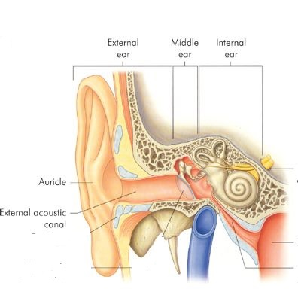
ANATOMY OF THE EAR

Slide 4
EXTERNAL EAR
Auricle
External Canal

Slide 5
The auricle
Site of Inesion

Slide 6
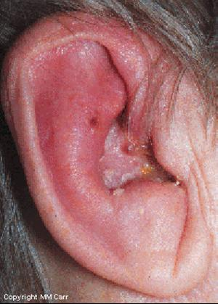
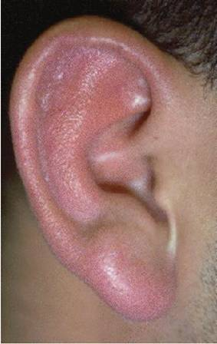
Perichondritis
Erysipelas

Slide 7
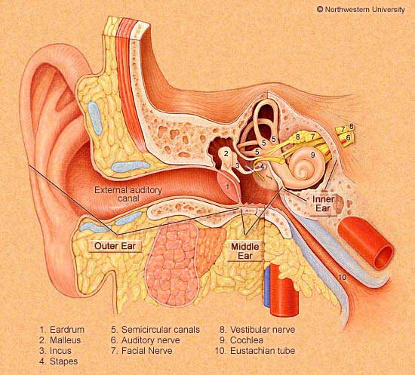
The External Auditory Canal

Slide 8
The External Auditory Canal
Lateral Third
Medial two thirds

Slide 9
The External Auditory Canal
Lateral Third
Medial two thirds
Cartilagenous Wall
Bony wall

Slide 10
The External Auditory Canal
Lateral Third
Medial two thirds
Cartilagenous Wall
Hair follicles
Ceruminous glands
Sebacous glands
Bony wall
No glands or hair follicles

Slide 11
The External Auditory Canal
Lateral Third
Medial two thirds
Cartilagenous Wall
Hair follicles
Ceruminous glands
Sebacous glands
Present at birth
Bony wall
No glands or hair follicles
Develops after Birth

Slide 12
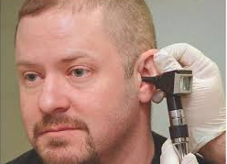

Slide 13
ANATOMY OF THE EAR
External Ear
Middle Ear Cleft
Inner Ear

Slide 14
MIDDLE EAR CLEFT
Eustachian tube (Pharyngo-tympanic)
Tympanum (Middle Ear Cavity)
Mastoid Antrum and Air Cells

Slide 15
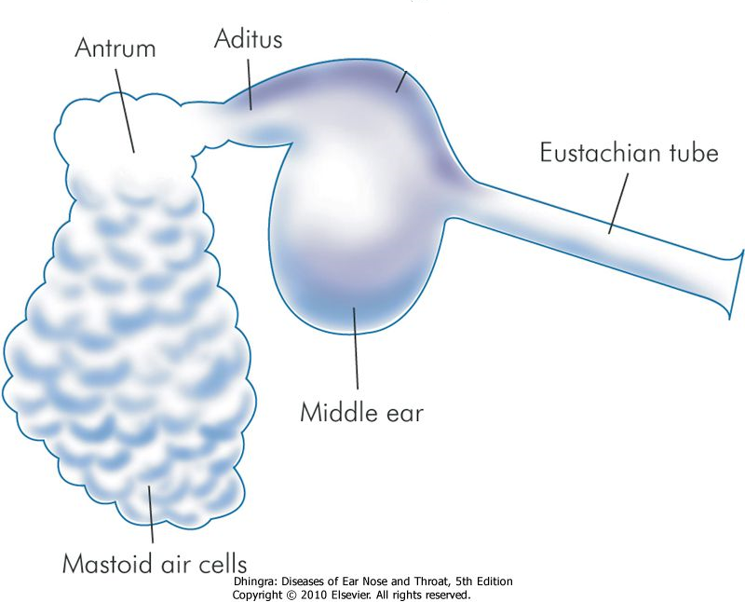

Slide 16
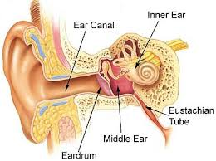
MIDDLE EAR CLEFT
Eustachian (Pharyngo-Tympanic) Tube

Slide 17
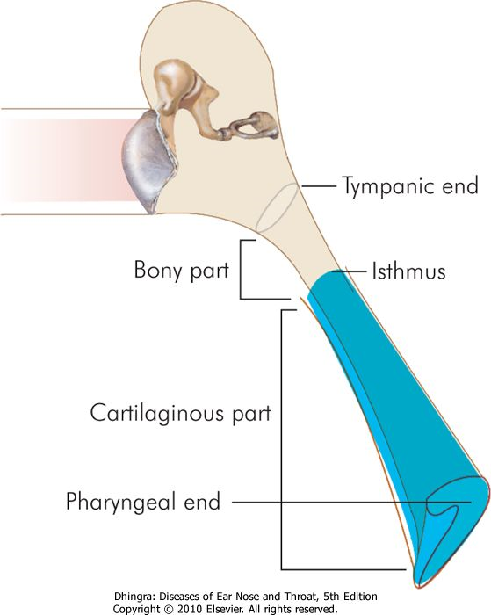
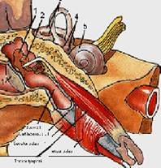
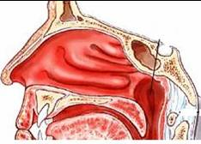
MIDDLE EAR CLEFT
Eustachian (Pharyngo-Tympanic) Tube

Slide 19
MIDDLE EAR CLEFT
Eustachian (Pharyngo-Tympanic) tube
Tympanic cavity (Middle ear cavity)

Slide 20
WALLS OF TYMPANIC CAVITY
Roof
Floor
Anterior wall
Posterior wall
Lateral wall
Medial wall

Slide 21
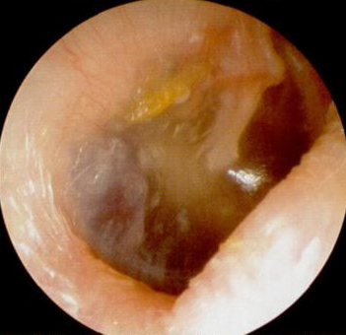
WALLS OF TYMPANIC CAVITY
Roof
Floor
Tegmen

Slide 22
WALLS OF TYMPANIC CAVITY
Roof
Floor
Anterior wall
Posterior wall

Slide 23
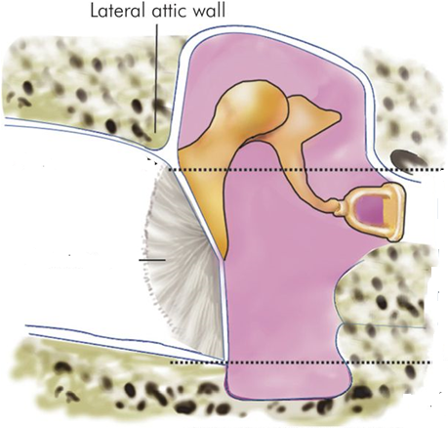
WALLS OF TYMPANIC CAVITY
Roof
Floor
Anterior wall
Posterior wall
Lateral wall

Slide 24
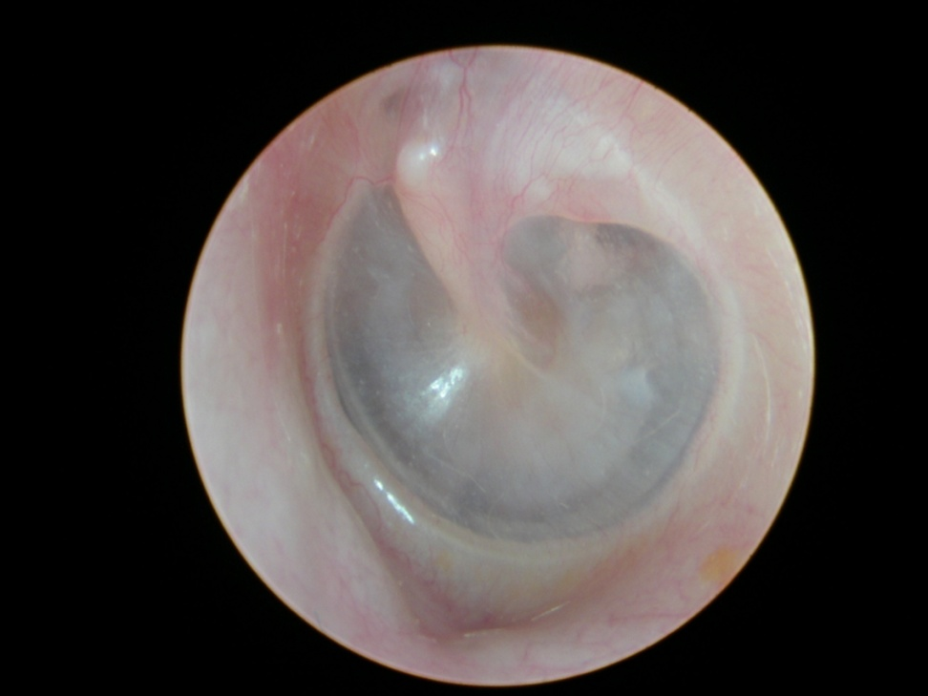
WALLS OF TYMPANIC CAVITY
Roof
Floor
Anterior wall
Posterior wall
Lateral wall
Membrana Flaccida
Membrana tensa

Slide 25
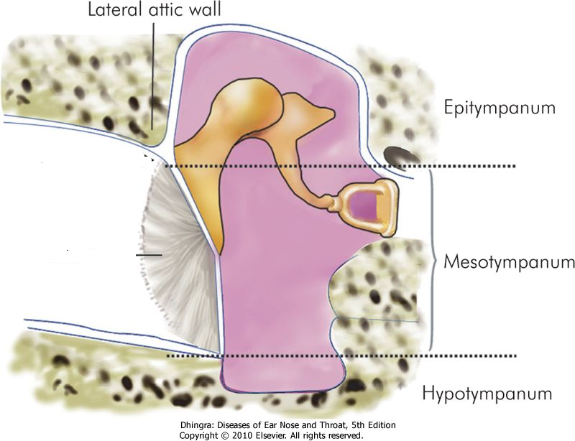

Slide 26
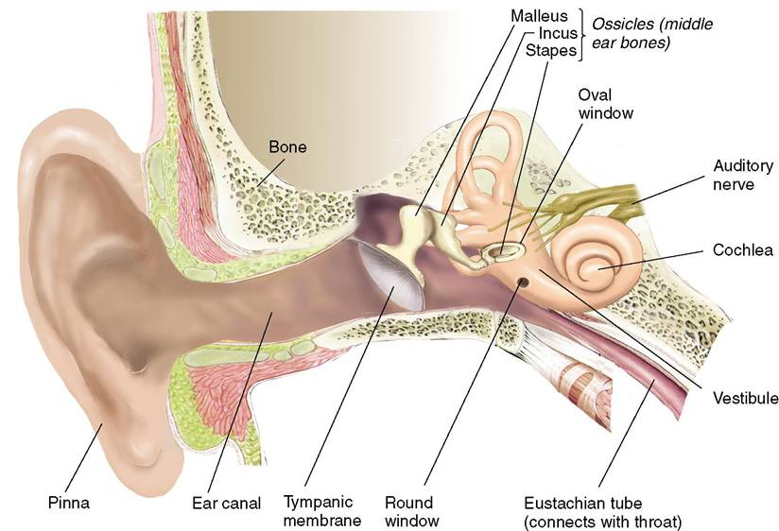
WALLS OF TYMPANIC CAVITY
Roof
Floor
Anterior wall
Posterior wall
Lateral wall
Medial wall

Slide 27
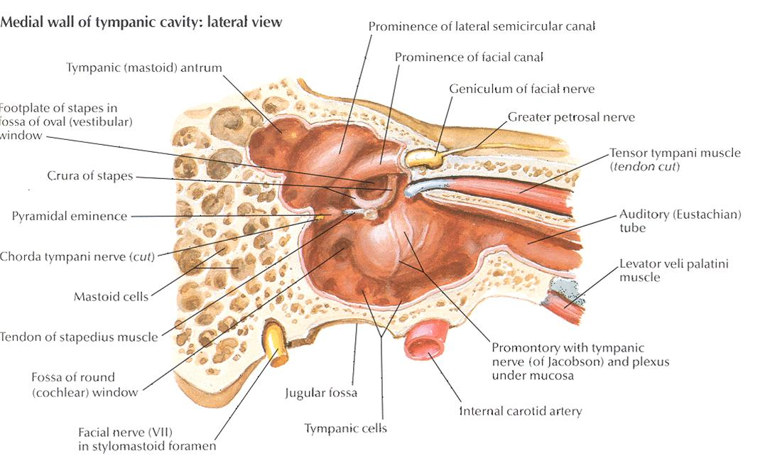

Slide 28
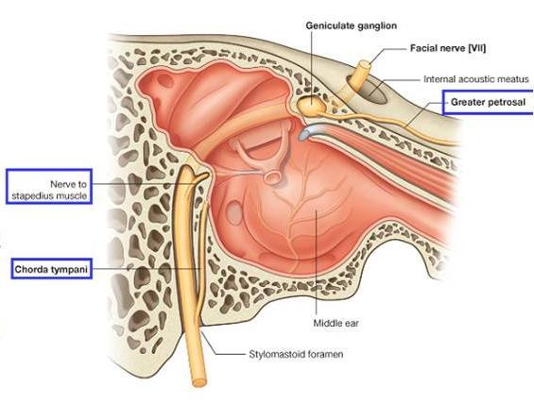

Slide 29
MIDDLE EAR CLEFT
Eustachian (Pharyngo-tympanic) Tube
Tympanic (Middle Ear) Cavity
Mastoid antrum and air cells

Slide 30
Mastoid Antrum & Air cells

Slide 31
Mastoid Antrum & Air cells

Slide 32
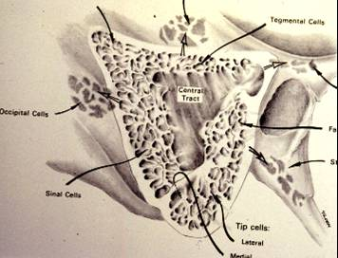
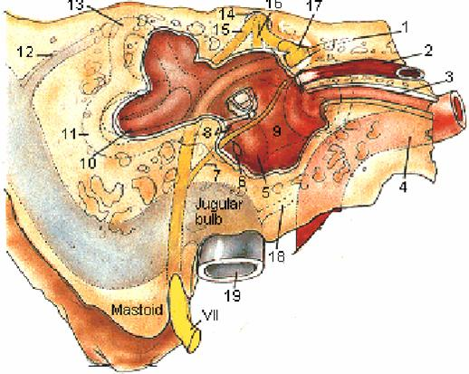
Mastoid Antrum & Air cells

Slide 33
CONTENTS OF MIDDLE EAR CAVITY
Air

Slide 34
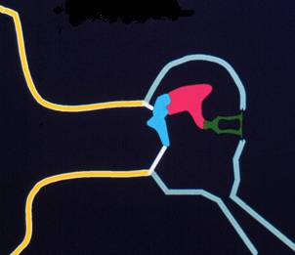
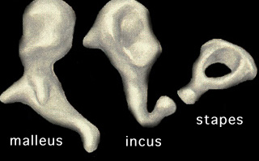
CONTENTS OF MIDDLE EAR CAVITY
Air
Ossicles
Malleus, Incus & Stapes

Slide 35
CONTENTS OF MIDDLE EAR CAVITY
Air
Ossicles
Muscles
Tensor tympani
Stapedius

Slide 36
CONTENTS OF MIDDLE EAR CAVITY
Air
Ossicles
Muscles
Nerves
Tympanic plexus
Chorda tympani

Slide 37
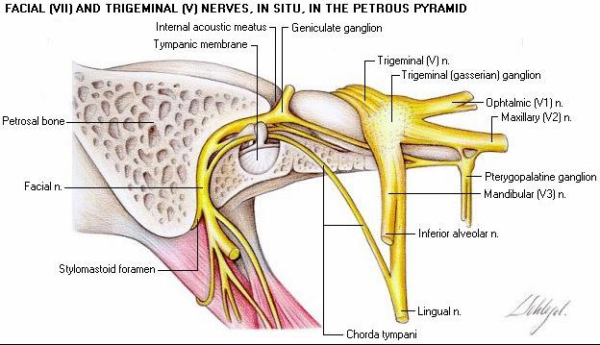

Slide 38
LINING OF MIDDLE EAR
Mucous membrane : ciliated columnar anteriorly and cuboidal or flat elsewhere

Slide 39
SENSARY SUPPLY OF MIDDLE AND EXTERNAL EAR
Cervical II & III ( great auricular and lessor occipital)
V cranial nerve ( auriculotemporal)
IX cranial nerve (tympanic or Jacobson’s)
X cranial nerve ( auricular or Arnold’s)
? VII cranial nerve

Slide 40
Referred Earache
Pain in the ear due to a disease in an area supplied by a nerve that also supply the ear.

Slide 41
Referred Earache
Cervical II & III
Cervical spondylosis, neck injury etc.
V cranial nerve
Dental infections, sinonasal diseases etc.
IX cranial nerve
Tonsillitis, post-tonsillectomy, carcinoma etc.
X cranial nerve
Tumors of hpopharynx, larynx & esophagus

Slide 42
ANATOMY OF INNER EAR

Slide 43
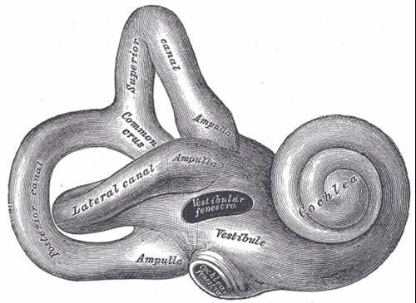
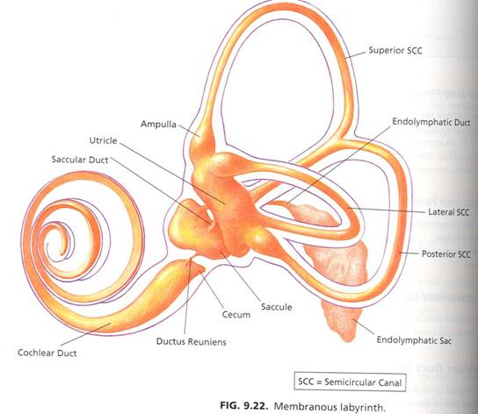
ANATOMY INNER EAR
Bony Labyrinth
Membranous Labyrinth

Slide 44
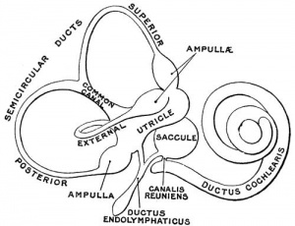

Slide 45
CONTENTS OF MEMBRANOUS LABYRINTH
Endolymph
Sensory epithelium
Cochlea: organ of Corti
Utricle & saccule: maculae
Semicircular canals: cristae

Slide 46
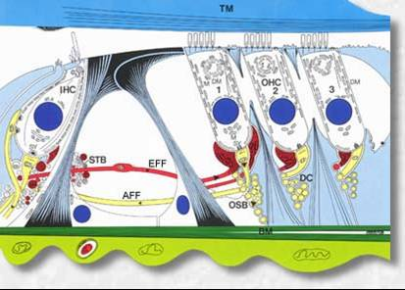
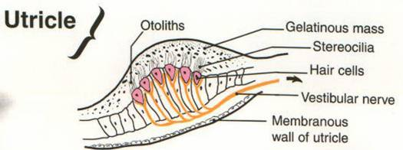
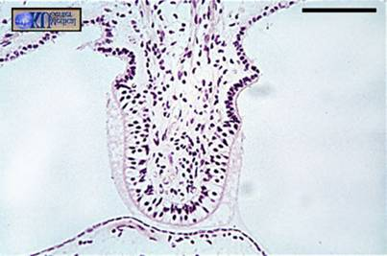
INNER EAR SENSORY EPITHELIUM
Cochlea: organ of Corti
Utricle & saccule: maculae
Semicircular canals: cristae

Slide 47
The vestibulo-cochlear nerve

Slide 48
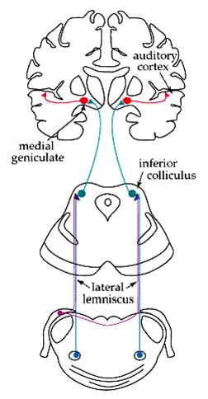
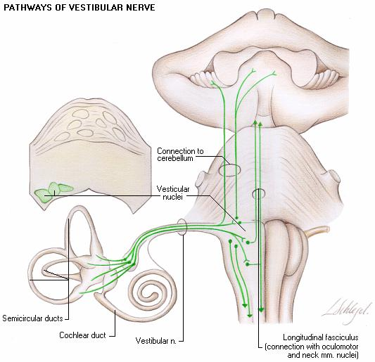
Central Connections

Slide 49
PHYSIOLOGY OF THE EAR

Slide 50
FUNCIONS OF THE EXTERNAL EAR
Protection of the middle ear
Curvature
Cerumen
Auditory functions:
Sound conduction
Increase sound pressure by the resonance function

Slide 51
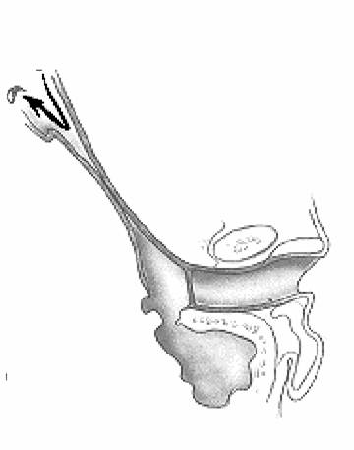
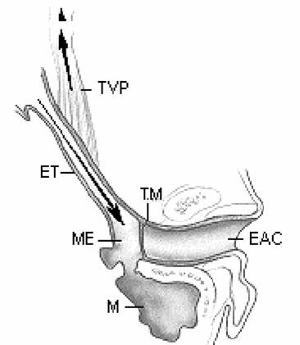
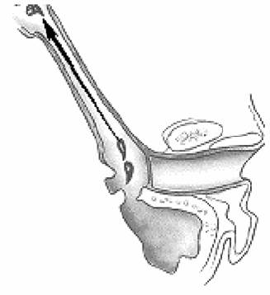
FUNCTIONS OF THE EUSTACHIAN TUBE
Protection
Ventilation
Drainage

Slide 52
FUNCIONS OF THE MIDDLE EAR
Conduction of sound
Transformer mechanism
Hydraulic action
Ossicular leverage

Slide 53
FUNCIONS OF THE MIDDLE EAR
Conduction of sound
Transformer mechanism
Hydraulic action
Ossicular leverage
Protection to the inner ear
stapedial reflex

Slide 54
FUNCIONS OF THE INNER EAR
Hearing Function:
Transduction of sound to action potentials

Slide 55
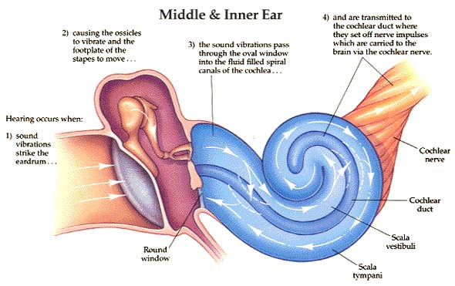

Slide 56
FUNCIONS OF THE INNER EAR
Hearing Function:
Transduction of sound to action potentials
Vestibular Function:
Participate in maintaining body balance

Slide 57
THE BALANCE SYSTEM
C. Cortex
Cerebellum
BRAIN-STEM

Slide 58
THE BALANCE SYSTEM
Vestibular
Proprioceptive
Visual
INPUT
C. Cortex
Cerebellum
BRAIN-STEM

Slide 59
THE BALANCE SYSTEM
Vestibular
Proprioceptive
Visual
INPUT
C. Cortex
Cerebellum
BRAIN-STEM
OUTPUT
Ocular muscles
Postural muscles

Slide 60
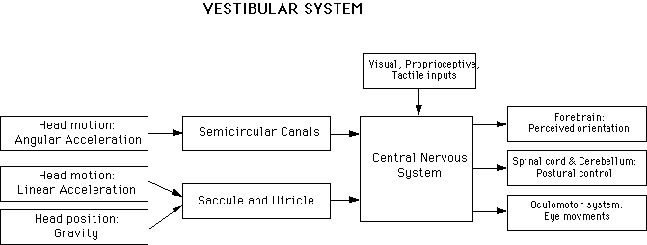

Slide 62
Diseases of External Ear & AOM

Slide 63
Objectives
Recognize the congenital anomalies of the external ear
Diagnose and treat wax accumulation
Diagnose and treat the common external ear inflammatory conditions
Discuss the pathology, clinical features and management of AOM

Slide 64
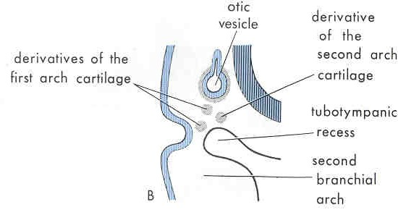
Development of the ear
External and Middle ears from the 1st and 2 ^{nd} pharyngeal arches.
Inner ear from the hind brain

Slide 65
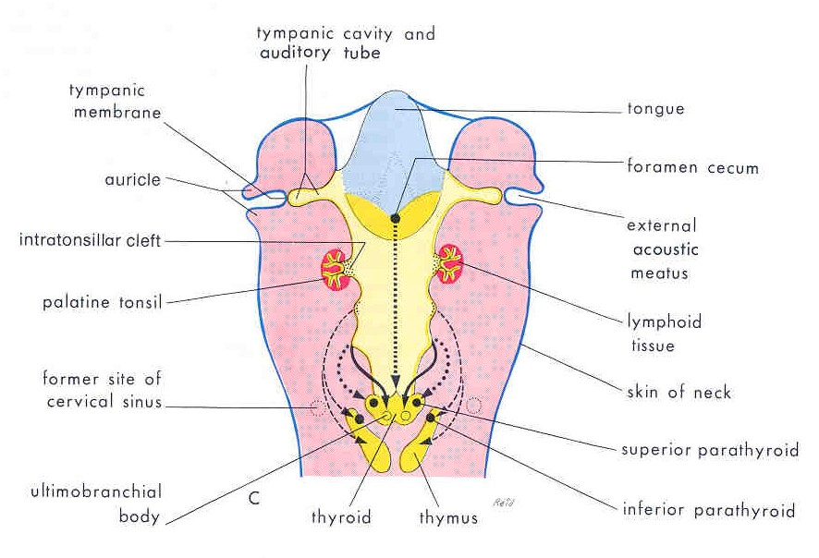

Slide 66
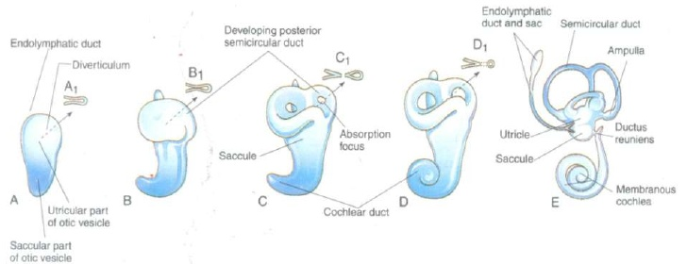

Slide 67
DISEASES OF THE EXTERNAL EAR

Slide 68
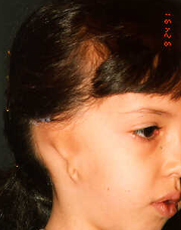
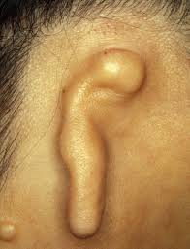
CONGENITAL MALFORMATIONS
Anotia & microtia

Slide 69
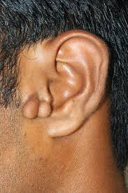
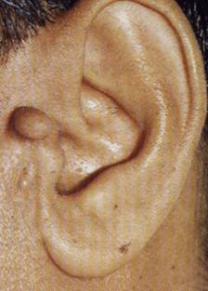
CONGENITAL MALFORMATIONS
Anotia & microtia
Accessory auricle

Slide 70
CONGENITAL MALFORMATIONS
Anotia & microtia
Accessory auricle

Slide 71
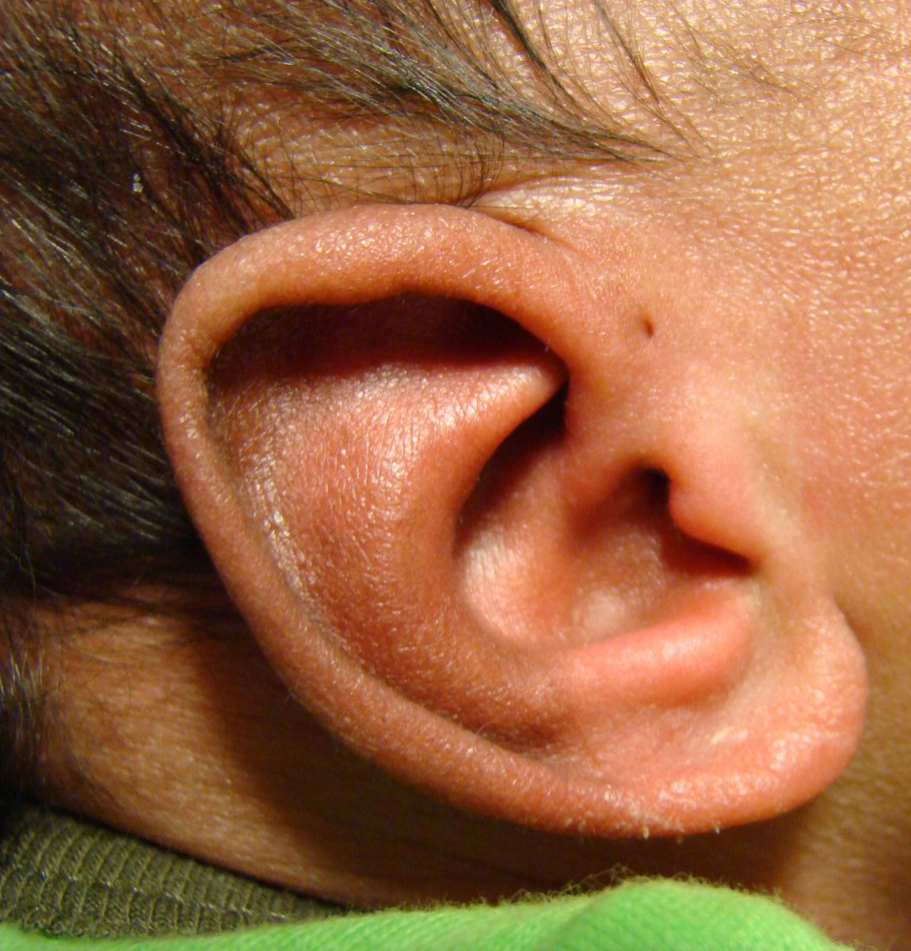
CONGENITAL MALFORMATIONS
Anotia & microtia
Accessory auricle
Pre auricular sinus

Slide 72
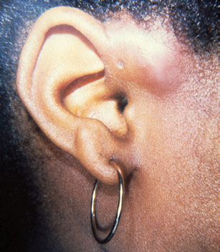
CONGENITAL MALFORMATIONS
Anotia & microtia
Accessory auricle
Pre auricular sinus

Slide 73
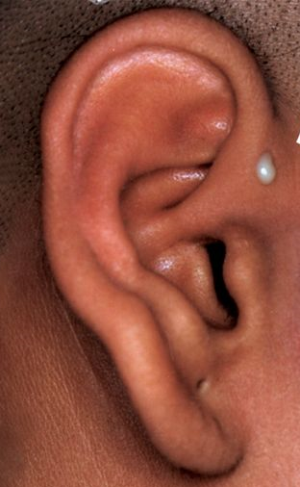
CONGENITAL MALFORMATIONS
Anotia & microtia
Accessory auricle
Pre auricular sinus

Slide 74
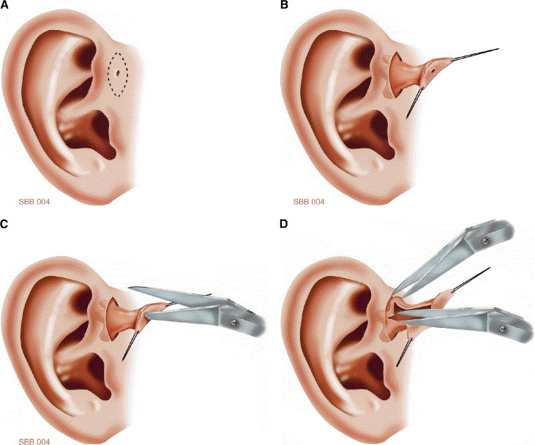

Slide 75
CONGENITAL MALFORMATIONS
Anotia & microtia
Accessory auricle
Pre auricular sinus

Slide 76
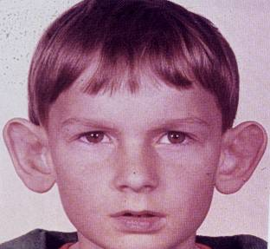
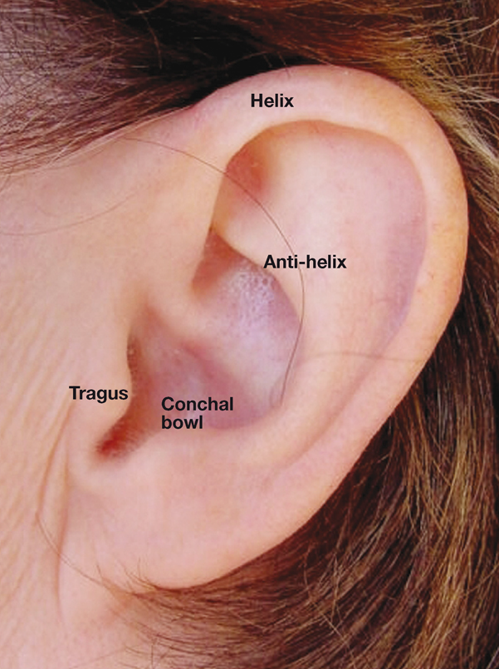
CONGENITAL MALFORMATIONS
Anotia & microtia
Accessory auricle
Pre auricular sinus
Protruding ear

Slide 77
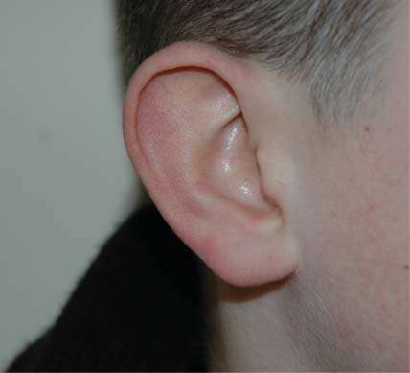
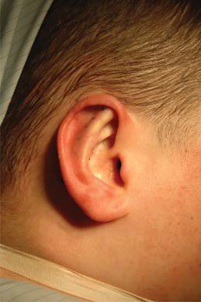

Slide 79
Trauma to the Auricle
Laceration

Slide 82
Trauma to the auricle
Hematoma auris

Slide 83
Complication
Cauliflower ear

Slide 84
Treatment

Slide 85
PERICHONDRITIS OF THE PINNA
Usually follow trauma (hematoma auris, surgical, frostbite, burn) or otitis externa
Commonly caused by Pseudomonas
Fever, pain, redness and swelling.

Slide 86
PERICHONDRITIS OF THE PINNA
Usually follow trauma (hematoma auris, surgical, frostbite, burn) or otitis externa
Commonly caused by Pseudomonas
Fever, pain, redness and swelling.

Slide 87
PERICHONDRITIS OF THE PINNA
Usually follow trauma (hematoma auris, surgical, frostbite, burn) or otitis externa
Commonly caused by Pseudomonas
Fever, pain, redness and swelling.

Slide 88
PERICHONDRITIS OF THE PINNA
Usually follow trauma (hematoma auris, surgical, frostbite, burn) or otitis externa
Commonly caused by Pseudomonas
Fever, pain, redness and swelling
.

Slide 89
PERICHONDRITIS OF THE PINNA
Usually follow trauma (hematoma auris, surgical, frostbite, burn) or otitis externa
Commonly caused by Pseudomonas
Fever, pain, redness and swelling
Treatment is by antibiotics
.

Slide 90
Complication
Cauliflower ear

Slide 92
OTITIS EXTERNA

Slide 93
DEFINITION
An acute or chronic infection of the whole or a part of the skin of the external ear canal

Slide 94
CAUSES OF OTITIS EXTERNA

Slide 95
CAUSES OF OTITIS EXTERNA
INFECTIVE
REACTIVE

Slide 96
CAUSES OF OTITIS EXTERNA
INFECTIVE
REACTIVE
Bacterial
Fungal
Viral

Slide 97
CAUSES OF OTITIS EXTERNA
INFECTIVE
REACTIVE
Bacterial
Fungal
Viral
Eczematous
Seborrheic

Slide 98
CAUSES OF OTITIS EXTERNA
INFECTIVE
REACTIVE
Bacterial
Fungal
Viral
Eczematous
Seborrheic
Staph. arues
Pseudomonos
Others

Slide 99
CAUSES OF OTITIS EXTERNA
INFECTIVE
REACTIVE
Bacterial
Fungal
Viral
Eczematous
Seborrheic
Staph. arues
Aspirigillus Niger
Pseudomonos
Candida Albicans
Others

Slide 100
CAUSES OF OTITIS EXTERNA
INFECTIVE
REACTIVE
Bacterial
Fungal
Viral
Eczematous
Seborrheic
Staph. arues
Aspirigillus Niger
Herpes zoster
Pseudomonos
Candida Albicans
Others
Others

Slide 101
Predisposing Factors
Local trauma from scratching the canal with a cotton swab, fingernail ….etc
Frequent swimming
Warm and humid climate
Use of hearing aids or earplugs
Diabetes or an immunocompromised state
Skin conditions: eczema,seborrhea, etc

Slide 102
Clinical features of otitis externa
Itching
Pain
Tenderness and swelling
Otorrhea
? Deafness (in case of 100% obstruction)
Changes in the lumen and skin of EAM

Slide 103
Clinical types of otitis externa
Localize O.E ( furuncle)

Slide 104
Clinical types of otitis externa
Localize O.E ( furuncle)

Slide 105
Clinical types of otitis externa
Localize O.E ( furuncle)
Diffuse infective O.E.

Slide 106
Clinical types of otitis externa
Localize O.E ( furuncle)
Diffuse infective O.E.

Slide 107
Clinical types of otitis externa
Localize O.E ( furuncle)
Diffuse infective O.E.
Otomycosis

Slide 108
Clinical types of otitis externa
Localize O.E ( furuncle)
Diffuse infective O.E.
Otomycosis

Slide 109
Clinical types of otitis externa
Localize O.E ( furuncle)
Diffuse infective O.E.
Otomycosis
Bullous myringitis

Slide 110
Clinical types of otitis externa
Localize O.E ( furuncle)
Diffuse infective O.E.
Otomycosis
Bullous myringitis

Slide 111
Clinical types of otitis externa
Localize O.E ( furuncle)
Diffuse infective O.E.
Otomycosis
Bullous myringitis
Herpetic O.E

Slide 112
Clinical types of otitis externa
Localize O.E ( furuncle)
Diffuse infective O.E.
Otomycosis
Bullous myringitis
Herpetic O.E

Slide 113
Clinical types of otitis externa
Localize O.E ( furuncle)
Diffuse infective O.E.
Otomycosis
Bullous myringitis
Herpetic O.E
Eczematous and seborrheic O.E.

Slide 114
Clinical types of otitis externa
Localize O.E ( furuncle)
Diffuse infective O.E.
Otomycosis
Bullous myringitis
Herpetic O.E
Eczematous and seborrheic O.E.

Slide 115
Management of otitis externa
Swab for culture and sensitivity

Slide 116
Management of otitis externa
Swab for culture and sensitivity
Ear toilet

Slide 117
Management of otitis externa
Swab for culture and sensitivity
Ear toilet

Slide 118
Management of otitis externa
Swab for culture and sensitivity
Ear toilet
Keep the ear dry
Local medications

Slide 119
Management of otitis externa
Swab for culture and sensitivity
Ear toilet
Keep the ear dry
Local medications

Slide 120
Management of otitis externa
Swab for culture and sensitivity
Ear toilet
Keep the ear dry
Local medications
Systemic medications
Surgery may be required in chronic cases

Slide 121
Acute necrotizing (malignant) otitis externa
An acute Pseudomonas infection of the skin of the external ear canal which has spread to the adjacent bone. It occurs mostly in elderly diabetic patients.

Slide 122
Complications

Slide 123
DIAGNOSIS
Diabetes
Advanced age
Severe otalgia
Granulation tissue & sequestra
Cranial nerve involvement
Radiology

Slide 125
TREATMENT
Control of diabetes
Anti Pseudomonas antibiotics
Local treatment and debridement
The role of surgery remains controversial

Slide 126
MISCELLANEOUS CONDITIONS OF THE EXTERNAL EAR

Slide 127
WAX
Mixture of ceruminous and sebaceous glands secretion
Normally is expelled from the canal aided by movements of the jaw
When accumulated it may cause deafness, earache or tinnitus

Slide 129
WAX
Treatment is by removal using syringing, suction or instrumentation

Slide 134
KERATOSIS OBTURANS
Accumulation of desquamated epithelium in the bony canal
It may be associated with sinusitis, bronchiectasis or primary ciliary dyskinesia
Usually cause deafness and pain
Treatment is periodic removal

Slide 135
ACUTE OTITIS MEDIA

Slide 136
DEFINITION
Acute infection of the mucous membrane lining of the middle ear cleft

Slide 137
PREDISPOSING FACTORS

Slide 138
PREDISPOSING FACTORS
Age

Slide 139
PREDISPOSING FACTORS
Age
Maleness

Slide 140
PREDISPOSING FACTORS
Age
Maleness
Bottle feeding

Slide 141
PREDISPOSING FACTORS
Age
Maleness
Bottle feeding
Climate

Slide 142
PREDISPOSING FACTORS
Age
Maleness
Bottle feeding
Climate
Crowded living conditions

Slide 143
PREDISPOSING FACTORS
Age
Maleness
Bottle feeding
Climate
Crowded living conditions
Heredity

Slide 144
PREDISPOSING FACTORS
Age
Maleness
Bottle feeding
Climate
Crowded living conditions
Heredity
Associated conditions: cleft palate, immunodeficiency, ciliary dyskinesia, Down syndrome, and cystic fibrosis

Slide 145
ROUTE OF INFECTION
Eustachian tube
External auditory canal
Blood borne

Slide 146
BACTERIOLOGY
Streptococcus pneumonia
Haemophilus influenzae
Branhamella catarrhalis
Streptococcus pyogens
Staphylococcus aureus

Slide 147
PATHOLOGY

Slide 148
CLINICAL PICTURE
Tubal occlusion
Suppurative inflammation
Tympanic membrane rupture
Resolution

Slide 149
CLINICAL PICTURE
Tubal occlusion
Discomfort, autophony, retracted drum
Suppurative inflammation
Tympanic membrane rupture
Resolution

Slide 150
CLINICAL PICTURE
Tubal occlusion
Discomfort, autophony, retracted drum
Suppurative inflammation
Fever, sever earache, deafness, bulging drum
Tympanic membrane rupture
Resolution

Slide 151
CLINICAL PICTURE
Tubal occlusion
Discomfort, autophony, retracted drum
Suppurative inflammation
Fever, sever earache, deafness, bulging drum
Tympanic membrane rupture
Otorrhea.
Temp & earache subside
Resolution

Slide 152
CLINICAL PICTURE
Tubal occlusion
Discomfort, autophony, retracted drum
Suppurative inflammation
Fever, sever earache, deafness, bulging drum
Tympanic membrane rupture
Otorrhea
Temp & earache subside
Resolution

Slide 154
TREATMENT
Symptomatic
Antimicrobials
Amoxycillin/clavulanic acid
Tri-methoprim-sulphamethoxazole
Cefaclor, cefixime
Erythromycin-sulfisoxazole
Decongestant
Myringotomy
Ear toilet and local antibiotics

Slide 155
RECURRENT ACUTE OTITIS MEDIA

Slide 156
DEFINITION
Three or more attacks over a 6-months period

Slide 157
TREATMENT
Long-term low dose antimicrobials
Ventilation tube insertion

Slide 159
OFFICE HOURS Prof. YOUSRY EL-SAYED
Flat 407 - Building 5 - King Abdel-Aziz University Hospital
Mondays from 11 am to 1 pm
Thursdays 11 am to 1 pm

Slide 160
THANK YOU

