Slide 1


ORL 432 Objectives
TEACHING
STUDENTS
THEORITICAL
SKILLS
CLINICAL
SKILLS
OPERATIVE
SKILLS

Slide 2
COURSE Objectives
Summary of the main learning outcomes for students enrolled in the course.
To know the basic ENT anatomy and physiology.
To recognize assessment and management of common ENT diseases, include ability to obtain patients’ history, perform comprehensive physical and mental status assessment, interprets findings
To know how to handle common ENT emergencies.
To handle simple ENT diagnostic instruments.
To be aware of common ENT operations.
To create an interest for further post-graduate study in ENT.
Enable to acquire and practice the code of medical ethics and demonstrates good and ideal attitude towards patients and their families, with the colleagues and other Staff and Sectors
To learn not only the theoretical and clinical aspects of the course but to mold as an ideal instruments in the line of medical profession includes communication and inter-relationship with colleagues and other Staff

Slide 3
Theoretical and Practical Activities in
ORL COURSE 432

Slide 4
Lectures content, new format

Slide 5
Lectures content, new format

Slide 6
COURSE STRUCTURE
1 st Cycle Male
  Division I 5 Weeks
  Division II 5 Weeks
2 nd Cycle Female
  Division I 5 Weeks
  Division II 5 Weeks
3 rd Cycle Male
  Division I 5 Weeks
  Division II 5 Weeks
  Note that at its 11th week of each Cycle will be the examination days –Written (MCQ, SAQ) and
  Oral (OSCE)
Summer Course 4 weeks

Slide 7
STUDENT’S GROUPING
GROUP 1 ENT – FIVE WEEKS 5 DAYS / WEEK | GROUP 2 OPHTHA - FIVE WEEKS 5 DAYS / WEEK
Subgroups 6: A, B, C, D, E, F. | Subgroups 6: A, B, C, D, E, F.

Slide 8
ACTIVITIES
ACADEMIC ACTIVITIES
  Lectures
  First TWO WEEKS
CLINICAL ACTIVITIES
  Clinics
  Rounds (Pre & Post Operation)
  Operative session
  Communication Disorders
  Audiology

Slide 9
ACTIVITIES
ACADAEMIC ACTIVITIES
Lectures:
Theoretical aspects
Building 4 For Male Students.
Main Building 1,4th Floor For Female Students.
First two weeks
From 8 AM – 4 PM
The WHOLE Group

Slide 10
CLINICAL ACTIVITIES
How to Examine ear, nose, throat, head & neck
Common ENT symptoms & signs

Slide 11
CLINICAL ACTIVITIES
I. CLINICS
II. ROUNDS (Pre and Post-Op)
III. OPERATIVE SESSION
IV. AUDIOLOGY
V. COMMUNICATION DISORDERS
(SPEECH)

Slide 12
CLINICAL ACTIVITIES
I. CLINICS
History taking
Examination
Building I – Clinic 1, 2 & 3 :Ground floor- Level 1, Clinic 4: Building 5 - primary care 3rd floor Male &Female sides.

Slide 13
CLINICAL ACTIVITIES
II. ROUNDS
Building I : 6th floor
6A (Male); 6B (Female)
Pre-operative rounds
Discussion of diseases, complications, outcome

Slide 14
CLINICAL ACTIVITIES
III. OPERATIVE SESSIONS
To see common surgical procedures and instruments
2nd floor- Building I.

Slide 15
CLINICAL ACTIVITIES
IV. AUDIOLOGY
Audiology & Vestibular tests
Audiometry reading
Building 5- Ground floor

Slide 16
CLINICAL ACTIVITIES
IV. COMMUNICATION DISORDERS (SPEECH DISORDERS)
Observe voice disorders
Building 5- second floor

Slide 17
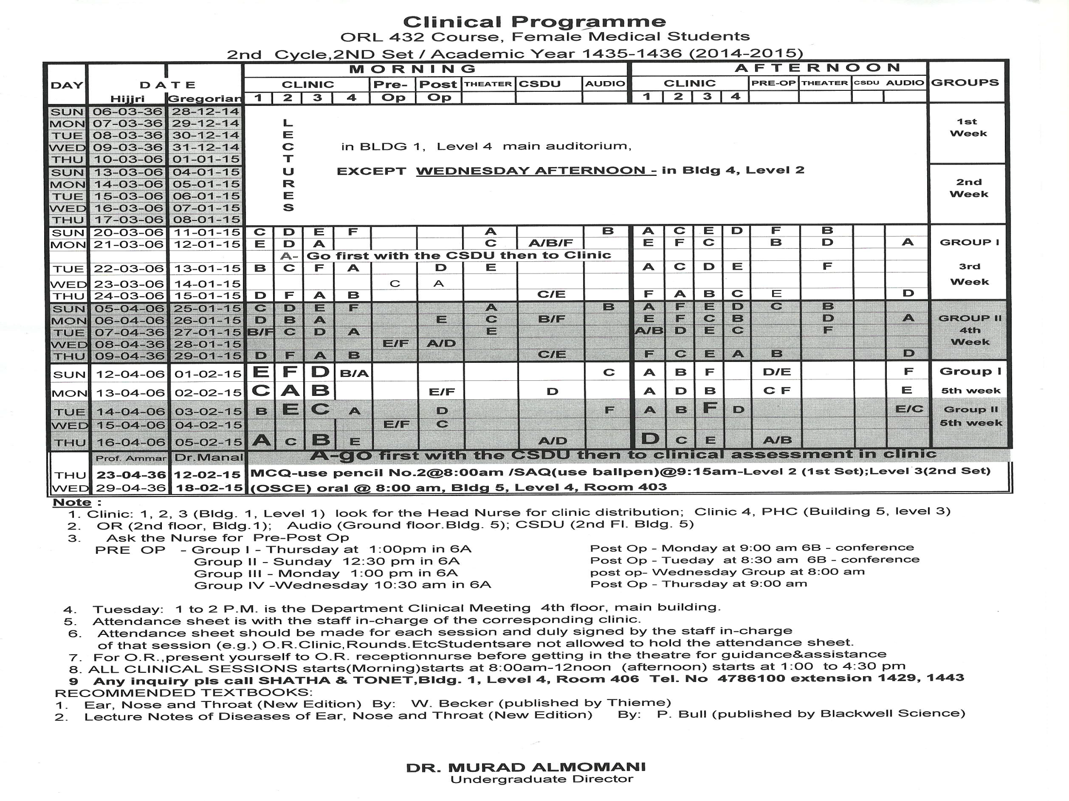

Slide 18
ATTENDANCE
Lectures (40%)
26 lectures
e.g. 1
26 X 40 = 1.54% per lecture
Clinical Session (60%)
14 sessions (7days : am & pm
e.g. 1
14 X 60 = 4.29% per session

Slide 19
ATTENDANCE
20 % WARNING
- 1 full day lecture (5 lectures)
- 1 & 1/2 days clinical activities
25 % - No EXAMINATION
-1 & 1/2 full day lecture; (8 lectures)
- 1 &1/2 days clinical activities

Slide 20
EXAMINATION
11th Week of each Cycle
10 Marks - Clinical assessment
(on the practical/clinical session/course)
30 Marks - MCQ (Scenario based) – Thursday
40 Marks - Short answer questions (SAQ)- Thursday
20 Marks - OSCE – Oral (Wednesday) [CELL PHONES ARE NOT ALLOWED]

Slide 21
Complaints From Students
Complaints concerning lectures, clinical activities, attendance & examination should be put in writing and forwarded to the Undergraduate Director.
Office hours: Audiology clinic, building 5, ground floor, appt # 10. Monday & Tuesday (10-12).
Coordinate also with Tonet and Shaza in building 1, 4th floor.

