Slide 1
??All about Cervix
Karima salama

Slide 2
contents
Anatomy, Etiology & Epidemiology
SCJ
HPV
Screening protocol
PAP
Management of abnormal PAP
Cervical intraepithelial lesion
Cancer related
Management
Invasive cervical cancer
Clinical picture
Work-up
Staging & Management

Slide 3
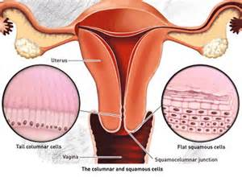
From Anatomy
The ectocervix ..surface of the cervix that is visualized on vaginal speculum examination is covered in squamous epithelium, and the endocervix, including the cervical canal, is covered with glandular epithelium.

Slide 4
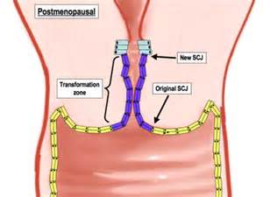
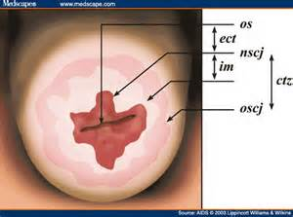
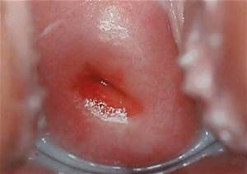
From anatomy

Slide 5
From anatomy
SCJ is a dynamic point that change in response to
Puberty
Pregnancy
Menopause
Hormonal stimulation
In neonate it located on the exocervix, at menarche, the production of estrogen causes the vaginal epithelium filled with glycogen.
Lactobacilli act on glycogen to lower the PH, stimulate the subcolumnar reserve cells to undergo metaplasia.

Slide 6
HPV
(HPV) is divided into two classes:
1) oncogenic
2) nononcogenic.
Infection with oncogenic (or high-risk) HPV usually is a necessary but not sufficient factor for the development of squamous cervical neoplasia. Therefore, only a small fraction of women infected with HPV will develop significant cervical abnormalities and cancer.

Slide 7
HPV
HPV 16 has the highest carcinogenic potential and accounts for approximately 55–60% of all cases of cervical cancer worldwide.
HPV 18 is the next most carcinogenic genotype and is responsible for 10–15% of cases of cervical cancer.
Approximately 10 other genotypes are associated with the remainder of cases of cervical cancer.

Slide 8
HPV
The current model of cervical carcinogenesis posits that HPV infection results in either transient or persistent infection.
Most HPV infection is transient and poses little risk of progression.
Only a small fraction of infections are persistent, but persistent infection at 1 year and 2 years strongly predicts subsequent risk of cervical intraepithelial neoplasia (CIN) 3 or cancer regardless of age.

Slide 9
Risk factors
Cofactors that increase the likelihood of persistence infection include
Cigarette smoking and HPV infection have synergistic effects on the development of CIN and cervical cancer.
compromised immune system.
human immunodeficiency virus (HIV) infection

Slide 10
Risk factors
Oral contraceptives — Long-term use of oral contraceptives has been implicated as a cofactor that increases the risk of cervical carcinoma in women who are.
The excess risk of cervical cancer declines after discontinuation of oral contraceptives, and by 10 years, returns to the baseline risk in nonusers

Slide 11
Risk factors
Herpes simplex virus and chlamydia
Infection with chlamydia, herpes simplex virus, or other sexually transmitted infections may be a surrogate marker of exposure to HPV rather than a causal factor itself .
Alternatively, these infections may modulate host immunity, thereby facilitating persistence of oncogenic HPV

Slide 12
Risk factors
The risk of transmission of HPV correlates with the lifetime number of sex partners, but the prevalence of HPV infection is substantial (4 to 20 percent) even in those with one partner.
In the United States (US), up to 50 percent of sexually active young women will have positive HPV tests within 36 months of first sexual activity, and up to 57 percent of sexually active female adolescents are infected with HPV at any one point in time

Slide 13
Human papillomavirus infection is most common in teenagers and women in their early 20s, with a decrease in prevalence as women age.
Most young women, especially those younger than 21 years, have an effective immune response that clears the infection in an average of 8 months or reduces the viral load in 85–90% of women to undetectable levels in an average of 8–24 months

Slide 14
screening,screening,screening
Most cervical cancer occurs in women who were either never screened or were inadequately screened.
Estimates suggest that 50% of the women in whom cervical cancer is diagnosed never had cervical cytology testing, and another 10% have not been screened within the 5 years before diagnosis.
Thus, approximately 60% of diagnoses of cervical cancer are a result of inadequate screening

Slide 15
When to screen
Cervical cancer screening should begin at age 21 years
21-29yrs…. PAP every 3years.
30-65yrs…. PAP +HPV every 5years
PAP every 3years.
Above 65… no screening
Vaccinated women should continue age specific screening protocol.

Slide 16
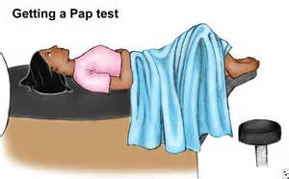
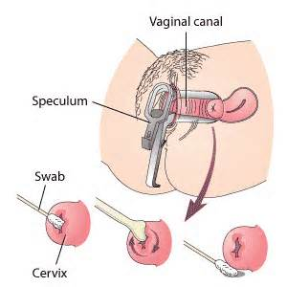
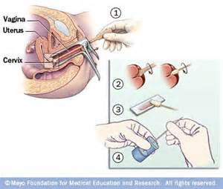
PAP… Cytology

Slide 17
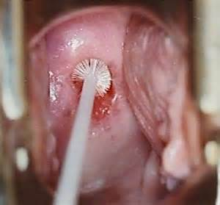
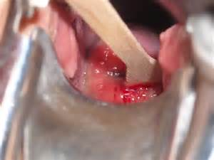
PAP… Cytology

Slide 18
PAP… interpretation
Bethesda system classification
Squamous cell abnormalities
ASC
ASC-US
ASC-H
LSIL… consistent with CIN 1
HSIL… consistent with CIN2, CIN3, CIS
SCC

Slide 19
Glandular cell abnormalities
Atypical glandular cell
Atypical endocervical cell
Atypical endometrial call
No otherwise specific
Atypical glandular cell favor neoplastic
Endocervical
No otherwise specific.
AIS
Adenocarcinoma

Slide 20
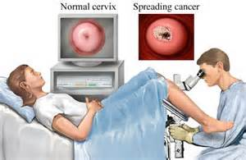
colposcopy

Slide 21
colposcopy
Steroscopic binocular microscope of low magnification.
3% ascetic acid to remove adherent mucus & cellular debris.
Green filter to accentuate the vascular changes.
Original squamous epithelium appears gray & homogenous.
The columnar epithelium appears red and grape like.
TZ glands opening that are not covered by the squamous metaplasia and by the paler color of the metaplastic epithelium.

Slide 22
Who need colposcopy
Persistent atypical cells of undetermined significance (ASC-US) or ASC-US with positive high-risk human papillomavirus (HPV) subtypes
ASC suggestive of high-grade lesion (ASC-H)
Atypical glandular cells (AGC)
Low-grade squamous intraepithelial lesions (LSIL)
High-grade squamous intraepithelial lesion (HSIL)
Suspicious for invasive cancer
Malignant cells present

Slide 23
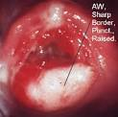
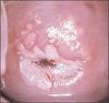
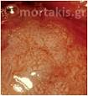
Abnormal finding on colposcopy
Leucoplakia
Aceto-white area
Mosaicism
Punctation

Slide 24
Biopsy and ECC
The most abnormally appearing areas are biopsied. Biopsies are relatively contraindicated in patients on anticoagulation medication, who have a known bleeding disorder, or who are pregnant.
Endocervical curettage or sampling is performed in patients with ASC-H, HSIL, AGC, adenocarcinoma in situ (AIS), LSIL but no visible lesion, if ablative treatment is contemplated, and those with an unsatisfactory colposcopic examination

Slide 25
Histological difinitions
CIN 1 is a low-grade lesion. It refers to mildly atypical cellular changes in the lower third of the epithelium. Human papillomavirus (HPV) cytopathic effect (koilocytotic atypia) is often present.
CIN 2 is considered a high-grade lesion. It refers to moderately atypical cellular changes confined to the basal two-thirds of the epithelium (formerly called moderate dysplasia) with preservation of epithelial maturation.
CIN 3 is a high-grade lesion. It refers to severely atypical cellular changes encompassing greater than two-thirds of the epithelial thickness and includes full-thickness lesions (previous terms were severe dysplasia or carcinoma in situ).

Slide 26
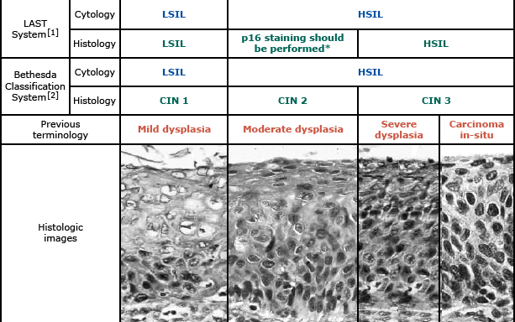
Biopsy… Histopathology

Slide 27
CIN to cancer
The outcome of CIN 1 lesion depends upon the preceding cytology:
CIN 1 preceded by ASC-US or LSIL cytology –will be diagnosed with CIN 2,3 within 6 to 24 months of follow-up . No studies have reported invasive cervical cancer in this patient population within this follow-up period.
CIN 1 preceded by ASC-H or HSIL cytology, five-year risk of CIN 3+ of 15 percent

Slide 28
CIN to cancer
For CIN 2 lesions, 40 to 58 percent of lesions will regress if left untreated, while 22 percent progress to CIN 3, and 5 percent progress to invasive cancer
For CIN 3, the estimated spontaneous regression rate is 32 to 47 percent, with 12 to 40 percent progressing to invasive cancer if untreated

Slide 29
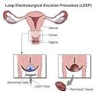
Management of CIN
LEEP cryosurgery

Slide 30
Management of CIN
Cone biopsy
Diagnostic and theraputic
Under GA
Complications
Bleeding
Infection
Cervical stenosis
Cervical incompetence

Slide 31
Cone for whom
Diagnostic cone
Colposcopy is unsatisfactory
ECC shows High grade lesion
Discrepancy between PAP and biopsy
CIS or AIS on PAP
Biopsy confirm invasion

Slide 32
Cone as therapeutic
CIN 3
Stage IAI

Slide 33
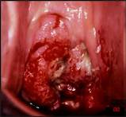
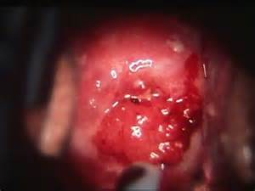
No PAP….NO colposcopy
Any patient with grossly abnormal cervix should have a punch biopsy regardless of any previous result.

Slide 34
Cervical cancer
2008
530,000 new cases …275,000 deathes worldwide..
8-6% in developing countries.
The tenth most common cause of death in developed countries 9 per 100,000 women
In the developing countries second most common type of cancer (17.8 per 100,000 women) and cause death 9.8 per 100,000 women.

Slide 35
In USA
Over 12,000 new cases anualy and 4000 cancer death
Third cause of death among gynecological cancer
With effective screening program and vaccination 75% decrease in incidence and mortality had noticed in the past 50years in the developed countries.

Slide 36
Cervical cancer
There are two main types of cervical cancer: squamous cell carcinoma and adenocarcinoma.
Squamous cell carcinoma of the cervix is more prevalent than adenocarcinoma.
Both types are found in sexually active women.
Infection with specific high-risk strains of human papillomavirus (HPV) is central to the pathogenesis of cervical cancer
Of the approximately 30 to 40 HPV genotypes that infect the mucosa of the genital tract, eight (types 16, 18, 45, 31, 33, 52, 58, and 35) are responsible for 95 percent of cervical cancers, and two (types 16 and 18) are responsible for about 70 percent of cervical cancer [5]. Two low-risk types (6 and 11) cause about 90 percent of benign anogenital warts.

Slide 37
How to evaluate
Symptoms
Abnormal vaginal bleeding
Poscoital
Intermenstrual
Postmenopausal.
Persistent vaginal discharge
Pelvic pain
Leg swealling
Urinary frequency
Constipation and PR bleeding.

Slide 38
Physical finding
Normal
Weight loss?
Enlarged inguinal or supraclavicular LN.
Lower limb edema.
Local exam….
Normal cervix
Lesion in endocervix
Ulcerative, exophytic, grannular or necrotic.
Friable cervix … bleeding to touch

Slide 39
Clinical exam
Rectovaginal exam is essential to determine the extent of the tissues invovlevement
Evaluate the vaginal fornices
Evaluate the pelvic side wall

Slide 40
Pattern of spread
Direct invasion of
Cervical stroma
Corpus
Vagina
Parametrium
Lymphatic spread
Pelvic
Paraaortic
Haematogenous
Lung
Liver
bone

Slide 41
Work up
History … Examination
Ask about last PAP
When
Result
Any specific management
Physical exam…
Biopsy for any gross lesion
PAP if no lesion seen
Sever bleeding… packing
LN asswsment

Slide 42
Work up
Blood work
CBC
Low HB in case of bleeding
KFT
High creatinin in case of ureteric obstruction
30% in stage III disease.
40% in stage IV disease.
Hypercalcemia indicate bone metastasis
LFT
Abnormal results indicate metastasis.

Slide 43
Work up
Images
CXR
IVP
Abdominal CT
MRI pelvis

Slide 44
Cervical cancer stages
Clinical exam…underanasthesia?
Evaluation of the cervix
Upper and lower vagina
Rectovaginal exam to evaluate the parametria and pelvic side wall
Cystoscopy
Bladder invasion
Proctoscopy
Rectal invasion

Slide 45
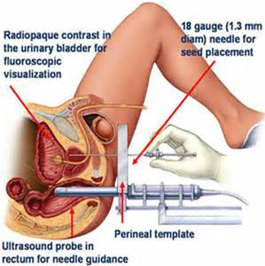

Slide 46
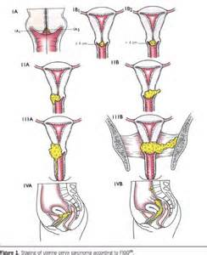
Figo staging

Slide 47
Figo staging
Stage I
The carcinoma strictly cofined to the cervix
IA microscopic disease… no gross lesion
IA1… invasion </=3mm extension </=7mm
IA2 …invasion >3mm but not more than 5mm, extension not more than 7mm.
IB microscopic disease more than stage IA or visible lesion
IB1 visible lesion </= 4cm in greatest dimension
IB2 visible lesion > 4cm in greatest dimension

Slide 48
Figo staging
Stage II
Extension beyond the cervix but not to the pelvic side wall or lower vagina
IIA…without parametrial invasion
IIA1 … clinically visible lesion </=4cm in greatest dimension.
IIA2… clinically visible lesion > 4cm in greatest dimension.
IIB… with parametrial invasion.

Slide 49
Figo staging
Stage III
Tumor invade pelvic side wall & or lower third of the vagina & or causing hydronephrosis or non – functioning kidney.
IIIA only lower third of the vagina
IIIB invading pelvic side wall & or causing hydronephrosis or
non – functioning kidney.

Slide 50
Figo staging
Stage IV
Tumor extended beyond the true pelvis or has invade the mucosa of the rectum or the bladder.
IVA.. Tumor invading adjacent organ
IV B.. Tumor invading distant organ.

Slide 51
Take home message

Slide 52
Thank you
Karima Salama

