Slide 1
Uterine fibroid
Karima salamah

Slide 2
leiomyomas
Definitions
Pathogenisis, Behavior & malignant potential.
Clinical presentations
Work – up
Managements.

Slide 3
What is it
Most common neoplasm of the uterus.
Benign monoclonal tumors.
Derived from the smooth muscle cell of the myometrium.

Slide 4
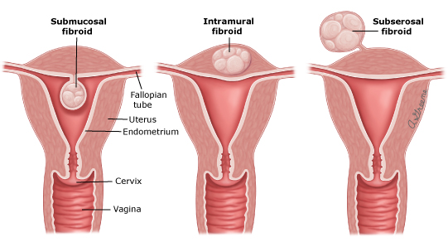
Terminology & Location

Slide 5
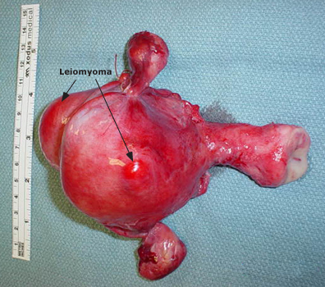

Slide 6
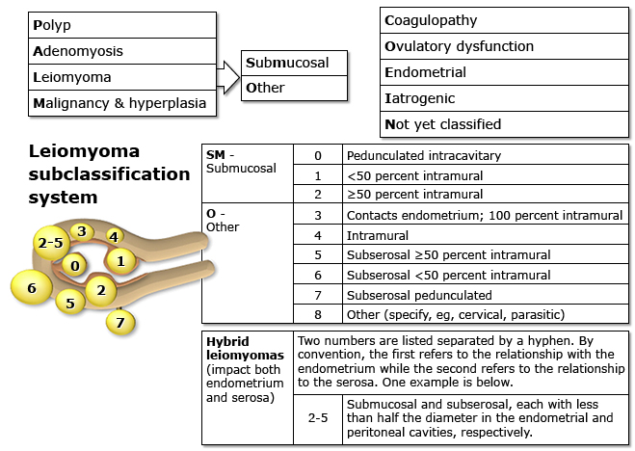
Figo staging

Slide 7
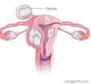
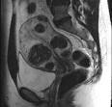
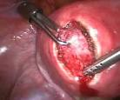
intramural
Intramural myomas (FIGO type 3,4,5) –
These leiomyomas develop from within the uterine wall.
They may enlarge sufficiently to distort the uterine cavity or serosal surface.
Some fibroids can be transmural and extend from the serosal to the mucosal surface.

Slide 8
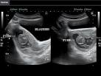
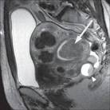
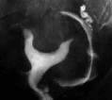
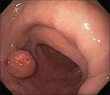
submucosal
Submucosal myomas (FIGO type 0,1,2)
These leiomyomas derive from myometrial cells just below the endometrium.
These neoplasms protrude into the uterine cavity.

Slide 9
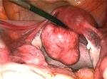
subserosal
Subserosal myomas (FIGO type 6,7)
These leiomyomas originate from the myometrium at the serosal surface of the uterus.
They can have a broad or pedunculated base and may be intraligamentary (ie, extending between the folds of the broad ligament).

Slide 10
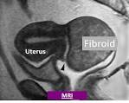
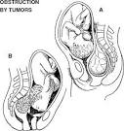
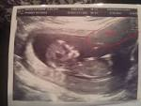
Cervical
Cervical myomas (FIGO type 8)
These leiomyomas are located in the cervix, rather than the uterine corpus

Slide 11
prevelance
A hysterectomy study found myomas in 77 percent of uterine specimens
The epidemiology of leiomyomas parallels the ontogeny and life cycle changes of the reproductive hormones estrogen and progesterone.
Myomas are clinically apparent in approximately 12 to 25 percent of reproductive age women and noted on pathological examination in approximately 80 percent of surgically excised uteri .
Most, but not all, women have shrinkage of leiomyomas at menopause.

Slide 12
Risk factors
Race.
Two- to three-fold greater in black women than in white women
The natural history of leiomyomas also differs by race. Most white women with symptomatic fibroids are in their 30s or 40s; however, black women develop symptoms on average four to six years younger and may even present with disease in their 20s
Fibroids grow at a slower rate after age 35 in white women, but not in black women
Compared with white women, black women experience more severe disease based on their symptoms and have more extensive disease at the time of hysterectomy

Slide 13
Risk factors
Menstrual history and parity
Early menarche (<10 years old) is associated with an increased risk of developing fibroids
Prenatal exposure to diethylstilbestrol is associated with an increased risk of fibroids
Parity decreases the chance of fibroid formation
Early age at first birth decreases risk and a longer interval since last birth increases risk

Slide 14
Hormonal contraception
Use of low dose oral contraceptives (OCs) does not cause fibroids to grow, therefore administration of these drugs is not contraindicated in women with fibroids
Long acting progestin-only contraceptives (eg, depot medroxyprogesterone) protect against development of leiomyomas
Heredity
Studies imply a familial predisposition to leiomyomas in some women. There is also increasing evidence of specific susceptibility genes for fibroids.

Slide 15
Ovulation induction agent
There are isolated reports of leiomyoma enlargement in women treated with clomiphene
Obesity
Most studies show a relationship between fibroids and increasing body mass index. The relationship is complex and is likely modified by other factors, such as parity, and may be more related to change in body habitus as an adult.

Slide 16
Diet, Caffeine, Alcohol & smoking
Beef and other reds meats (1.7-fold) is associated with an increased relative risk of fibroids and consumption of green vegetables (0.5-fold) and fruit (especially citrus fruit) with a decreased risk, There is increasing evidence that vitamin D deficiency or insufficiency is linked to fibroid risk
Consumption of alcohol, especially beer, appears to increase the risk of developing fibroids.
Caffeine consumption is not a risk factor.
Smoking decreases the risk of having fibroids

Slide 17
Clinical manifestations
Heavy or prolonged menstrual bleeding
Most common fibroid symptom
Degree of uterine bleeding are determined by the location of the fibroid, size is of secondary importance
Submucosal myomas that protrude into the uterine cavity (eg, types 0 and I)are most frequently related to significant menorrhagia

Slide 18
Clinical manifestations
Pelvic pressure and pain
Bulk-related symptoms
Urinary frequency, difficulty emptying the bladder, and, rarely, urinary obstruction can all occur with fibroids
Fibroids that place pressure on the rectum can result in constipation.
Back pain may, on occasion, be related to the presence of myomas
Very large uteri may compress the vena cava and lead to increase in thromboembolic risk
Dysmenorrhea
Dysmenorrhea is also reported by many women with fibroids. This pain in many women appears to be correlated with heavy menstrual flow and/or passage of clots.
Dyspareunia
It is controversial
anterior or fundal fibroids are the most likely to be associated with deep dyspareunia.

Slide 19
Clinical manifestations
Leiomyoma degeneration or torsion
Infrequently, fibroids cause acute pain from degeneration or torsion of a pedunculated tumor.
Pain may be associated with a low grade fever, uterine tenderness on palpation, elevated white blood cell count, or peritoneal signs.
The discomfort resulting from degenerating fibroids is self-limited, lasting from days to a few weeks, and usually responds to nonsteroidal antiinflammatory drugs.

Slide 20
Clinical manifestations
Reproductive dysfunction
Leiomyomas that distort the uterine cavity (submucosal or intramural with an intracavitary component) result in difficulty conceiving a pregnancy and an increased risk of miscarriage.
Adverse pregnancy outcomes (placental abruption, fetal growth restriction, malpresentation, and preterm labor and birth)

Slide 21
diagnosis
Pelvic exam
Bimanual pelvic examination, an enlarged, mobile uterus with an irregular contour
Infrequently, on speculum exam, a prolapsed submucosal fibroid may be visible at the external cervical os

Slide 22
diagnosis
Imaging
Ultrasound
Transvaginal ultrasound has high sensitivity (95 to 100 percent) for detecting myomas in uteri less than 10 weeks' size
Most widely used modality due to its availability and cost-effectiveness
Saline infusion sonography (sonohysterography) improves characterization of the extent of protrusion into the endometrial cavity by submucous myomas

Slide 23
diagnosis
Diagnostic hystroscopy
Office flexible hystroscope to diagnose submucos myoma and extend of protrusion to endometrial cavity
MRI
Best modality for visualizing the size and location of all uterine myomas. Due to the expense of this modality, its use is best reserved for surgical planning for complicated procedures
HSG
Good technique for defining the contour of the endometrial cavity

Slide 24
Difrential diagnosis
Leiomyoma
Uterine adenomyosis or adenomyoma
Leiomyoma variant
Adenomatoid tumors
Pregnancy
Hematometra
Uterine sarcoma
Uterine carcinosarcoma
Endometrial carcinoma
Metastatic disease (typically from another reproductive tract primary

Slide 25
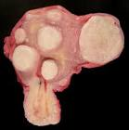
Pathology
Spherical, well circumscribed, white firm lesion with whorled appearance on cut section
Does not have true capsule… pseudocapsule.
Degenerative changes as the tumor enlarge
Hyaline degeneration ( Most common)
Cystic degeneration
Calcification ( After menopause)
Fatty degeneration ( Rare )
Red degeneration 5-10% during
pregnancy

Slide 26
Management
Relief of symptoms is the major goal in management
The type and timing of any intervention should be individualized, based upon the following factors:
Type and severity of symptoms
Size of the myoma(s)
Location of the myoma(s)
Patient age
Reproductive plans and obstetrical history

Slide 27
management
EXPECTANT
Can shrink substantially during the postpartum period,
Initial imaging study (usually an ultrasound) to confirm that a pelvic mass is a fibroid and not an ovarian mass.
Annual pelvic exams and, in patients with anemia or menorrhagia, check a complete blood count.
If symptoms or uterine size are increasing, we proceed with further evaluation and patient counseling regarding treatment options.
Rule out other causes of menorrhgea
Hypothyrodism.
Bleeding disorders.

Slide 28
management
Medical therapy
Gonadotropin-releasing hormone agonists
Most effective medical therapy for uterine myomas.
Work by initially increasing the release of gonadotropins, followed by desensitization and downregulation to a hypogonadotropic, hypogonadal state that clinically resembles menopause.
Most women will develop amenorrhea, improvement in anemia and a significant reduction (35 to 60 percent) in uterine size within three months of initiating this therapy.

Slide 29
management
GnRh agonist side effect
Rapid resumption of menses and pretreatment uterine volume after discontinuation of GnRH agonists.
Hot flashes, sleep disturbance, vaginal dryness, myalgias and arthralgias, and possible impairment of mood and cognition [15]. Bone loss leading to osteoporosis after long-term (12+ months) use is the most serious complication and most often limits therapy.

Slide 30
Used as preoperative therapy.
GnRH agonists are approved for administration for three to six months prior to leiomyoma-related surgery in conjunction with iron supplementation to facilitate the procedure and enable correction of anemia Reduction in uterine size can facilitate subsequent surgery by reducing intraoperative blood a transverse (rather than vertical) abdominal incision, or a minimally-invasive procedure

Slide 31
Gonadotropin-releasing hormone antagonists
Similar clinical results have been achieved with GnRH antagonists, which compete with endogenous GnRH for pituitary binding sites
The advantage of antagonists over agonists is the rapid onset of clinical effects without the characteristic initial flare-up observed with GnRH agonist treatment.

Slide 32
management
Interventional radiology
Uterine artery embolization
minimally invasive option for management of leiomyoma-related symptoms, excellent technical and clinical success has been reported.
It is an effective option for women who wish to preserve their uterus and are not interested in optimizing future fertility.
UFE results in shrinkage of myomas of approximately 30 to 46 percent

Slide 33
management
Magnetic resonance guided focused ultrasound
More recent option for the treatment of uterine leiomyomas in premenopausal women who have completed childbearing.
This noninvasive thermoablative technique converges multiple waves of ultrasound energy on a small volume of tissue, which leads to its thermal destruction

Slide 34
management
Surgical therapy
Myomectomy
Myomectomy is an option for women who have not completed childbearing or otherwise wish to retain their uterus.
Disadvantage of this procedure is the risk that more leiomyomas will develop from new clones of abnormal myocytes
Hysteroscopic myomectomy is the procedure of choice for removing intracavitary myomas

Slide 35
management
Surgical therapy
Hystrectomy
Women with acute hemorrhage who do not respond to other therapies
Women who have completed childbearing and have current or increased future risk of other diseases.
Women who have failed prior minimally invasive therapy for leiomyomas
Women who have completed childbearing and have significant symptoms, multiple leiomyomas, and a desire for a definitive end to symptomatology.

