Slide 1
Mechanism of labor abnormal presentation and breech
King Khalid University Hospital
Department of Obstetrics & Gynecology
Course 482

Slide 2
In women the pelvis has special form that adapts to childbearing .
It is composed of four bones .
The sacrum coccyx and two innominate bones ..
The innominate bone is is formed by the fusion of the ilium ,ischium, and pubis

Slide 3
The true pelvis is the portion importatnt in childbearing is bounded above by promontory and alae of the sacrum the linea terminalis and the upper margin of the pubic bone , and below by the pelvic outlet .
Ischial spines are of great obstetrical importance because it is the shortest pelvic diameter and has a valuable landmarks in assessing the level of the presenting part of the fetus

Slide 4
The sacrum form the posterior wall of the pelvis and it is curved to accommodate the rotating head .
The promontory may be felt on vaginal examination and provide a landmark for clinical pelvimetry

Slide 5
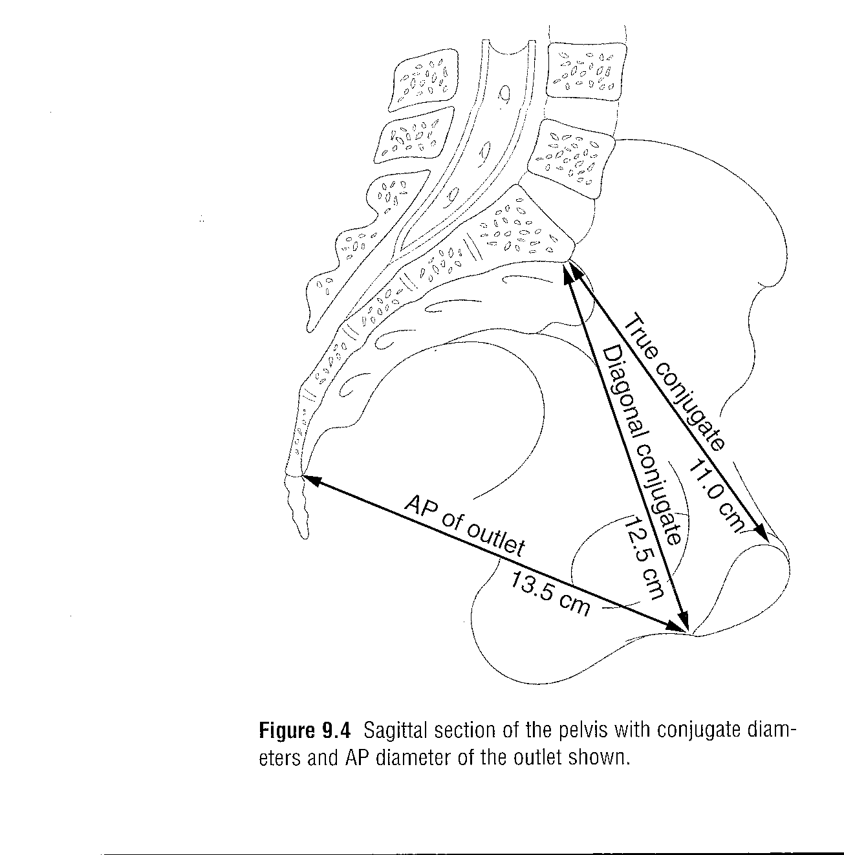

Slide 6
Pelvic inlet measurement
Diagonal conjugate it is the distant from the sacral poromontory to the lower margin of the symphysis pubis.
True conjugate from sacral promotory to upper border of symphysis pubis
Obstetric conjugate from sacral promontory to mid of posterior aspect of symphysis pubis subtract 1.5-2.0 cm from diagonal conjugate

Slide 7
The mid pelvis at the level of ischial spines the interspinous diameter is 10 cm .
Pelvic outlet clinically it is the distant between the ischial tuberosities it is around 8.0 cm

Slide 8
THE FETAL SKULL
BONES
Two frontal bones separated by frontal suture.
Two parietal bones separated by sagittal suture .
Two coronal sutures between frontal and parietal bones .
Two lambdoid sutures between parietal and and occipital bone .

Slide 9
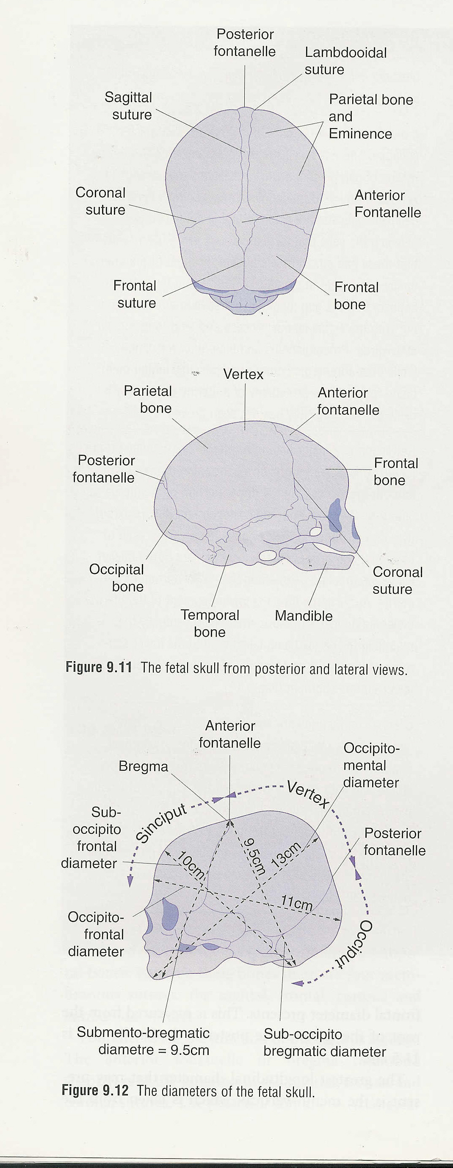

Slide 10
Sutures meet at an irregular space forms which is enclosed by a membrane called fontanel .
Anterior fontanel is a lozenge shape between the two frontal and two parietal bones usually it is opened .
Posterior fontanel at the junction of the two parietal bones and occipital bone .
It gives an important information concerning presentation and position of the fetus.

Slide 11
Fetal head diameters
Subocipotobregmatic 9.5 cm vertex presentation.
Submentobregmatic 9.5 cm face presentation.
Mentovertical 12.5 brow presentation .
Biparietal diameter 9.5cm .
Occiptofrontal 10.5 cm

Slide 12
Occipital bone is the landmark in vertex presentation.
Mentum is landmark for face presentation,
Frontal bone is land mark for brow presentation

Slide 13
Labour
Definition.
It is the onset of painful, regular,contractions,
more than one every ten minutes. With
progressive cervical effacement and dilatation
accompanied by descend of the fetal
presenting part.

Slide 15
Stages of labor
Labor is divided in to three stages.
1st stage from diagnosis of labor till full dilatation of the cervix.
2nd stage of labor from full dilatation of the cervix till delivery of the fetus.
3rd stage from delivery of the fetus until delivery of the placenta.

Slide 16
The duration of labor
Primigravida about 12 hours .
Multigravida 8.0 hours
The moral of most women deteriorate if labor is prolonged .
There is greater incidence of fetal hypoxia after long labor.
Greater incidence of operative vaginal delivery.

Slide 17
Mechanisim of labor
It is a series of changes in position and attitude that the fetus undergoes during its passage through the birth canal.
ENGAGEMENT.
It is when the widest diameter of the head has passed successfully through the inlet that is when the biparietal diameter passed to the level of the ischial spines

Slide 18
DESCENT.
It is secondary to uterine action in 1st and early phase of 2nd stage of labor .
FLEXION
When the head descent to the narrow mid cavity flexion should occur.

Slide 19
INTERNAL ROTATION .
The shape of the bony pelvis and direction of the pelvic floor muscles in addition to the well flexed head will help the head to rotate the head into the occipito anterior position .
In a well flexed head the occipit will meet the pelvic floor and will guide the direction of the rotation

Slide 20
EXTENSION.
The head is deliver by extension first the bregma ,face , and chin appear in succession over the posterior vaginal opening and perineal body.
RESTITUTION.
As soon as the head escape from the vulva the head aligns itself with the shoulder

Slide 21
EXTERNAL ROTATION.
In order to deliver the shoulders have to rotate into the direct anterior- posterior plane .
The doctor will rotate the head making the face of the fetus looking to medial aspect of the maternal thigh .

Slide 22
Delivery of the shoulders .
The anterior shoulder is under the
symphysis pubis and deliver first
,and the posterior shoulder deliver
subsequently

Slide 23
THIRD STAGE OF LABOR .
Separation of the placenta
occurs because of the
reduction of the volume of the
uterus due to the uterine
contraction and retraction

Slide 24
MALPRESENTATIONS
Fetal lie .
This is the relationship of the longitudinal axis of the fetus to longitudinal axis of the mother.
There are three lies longitudinal , oblique , and transverse lie .
Fetal attitude , this is the relationship of the different parts of the baby to each others , usually flexion attitude .

Slide 25
Presentation.
It is which part of the fetus occupies the pelvis eg ,cephalic , breech , shoulder presentation .
Position .
It is the relationship of the presenting part to the four pelvic quadarents .eg left occipito anterior , right mento posterior .

Slide 26
BREECH PRESENTATION
Baby is presenting with buttocks and legs and incidence is 3% at term .
Types .
Complete breech where the leg are flexed at hip joint and knee joint ,
Frank breech flexed hip but extended knee joint .
Footling breech with extended hip and knee joints and high buttocks .

Slide 27
Fetal causes .
Hydrocephalas , poly hydramnios oligohydramnios , placenta previa , short umbilical cord .
Maternal causes .
Uterine anomalies, fibroid uterus, small pelvis
The most important cause is preterm labor

Slide 28
MANAGEMENT
The patient can be offered the option of either vaginal breech delivery , caesarian section or external cephalic version .
External cephalic version ECV .
Done after 38 weeks.
Contra indications .
Contracted pelvis , scar uterus, placenta previa , hypertensive patient .
Complications.
Membrane rupture , uterine rupture, abruptio placenta , cord prolapse

Slide 29
Cont.
It should be done in the theater with every thing ready four c/s .
If blood group is rhesus negative should receive anti D immunoglobulin

Slide 30
Complications of vaginal breech delivery.
Cord prolaps , lower limb fracture , abdominal organs injuries , brachial plexus nerve injuries,
Difficulties in delivering the head and intracranial bleeding .

Slide 31
Management of breech delivery
Patient in lithotomy position ,
Cervix should be fully dilated .
When buttocks protrudes through the vulva an episiotomy should be performed .
Legs are delivered easily unless it is an extended that need to be flexed .
With delivery of the umbilicus small loop of cord is pulled down to feel the pulsations .
Then delivery of both arms first the anterior then the posterior .

Slide 32
Delivery of the head .
Keep the baby hanging to promote head flexion ( Burn Marshal) manoeuvre .
Jaw flexion shoulder traction .
Obstetrical forceps for the after coming head.

Slide 33
Face presentation
Incidence 1-500 .
Occurs as the result of complete extension of the head .
In majority of case the cause is unknown but is frequently attributed to excessive tone of the extensor muscles of the fetal neck.
Rare causes like tumor of the neck , thyroid , thymus gland and cord around the neck

Slide 34
The presenting diameter of the face is the submento –bregmatic , which measures 9.5 cm .
Diagnosed in labor by palpating the nose, mouth ,and the eyes on vaginal examination.
In case of mento-anterior vaginal delivery is possible and the head is delivered by flexion.
If the face is mento posterior the delivery is not possible and patient should be delivered by caesarian section.

Slide 35
Brow presentation
Incidence is 1-2000.
It occurs when there is less extension of the fetal head than that seen in face presentation, mid way between face and vertex presentation .
The presenting diameter is mento-vertical 13.5 cm.
Is diagnosed in labor by palpating the anterior fontanelle ,supra orbital ridges, and nose on vaginal examination .
Delivery is by caesarian section.

Slide 36
Shoulder presentation
It due to oblique or transverse lie in labor .
Common in women with high parity .
Also occurs in placenta previa , uterine anomalies , pelvic tumor.
If diagnosed in early labor with intact membrane and no other pathology external cephalic version can be tried .
In case of rupture of the membranes exclude cord prolaps .
Delivery of shoulder presentation in labor with rupture membrane is by caesarian section.

