Slide 1
PELVIC ORGAN PROLAPSE
Dr. Hazem Al-Mandeel
Associate Professor
College of Medicine, King Saud University

Slide 2
Objectives
To define pelvic organ prolapse
Recognize pelvic anatomy
Determine the Pathophysiology
Discuss the predisposing factors
Understand the grading systems
To learn about the treatment options

Slide 3
Pelvic Organ Prolapse
Is the descent of the pelvic organs as a result of the loss of muscular and fascial structural support .

Slide 4
Epidemiology
POP is seen in up to 50% (43-76%) of women presented for routine gynecological care [Samuelsson et al., 1999; Swift et al., 2005]
WHI study found that 41% of women (50-79yrs) showed some degree of prolapse [Hendrix et al., 2002]
POP is one of the most common indications for gynecological surgery

Slide 5
Anatomic Supports
Muscular : Pelvic Floor Muscles (Levator Ani muscles & Coccygeus muscle)
Ligaments : Uterosacral-Cardinal Complex
Fascial : Endopelvic Fascia (surrounding organs)

Slide 6
Levator Ani
Major structure of pelvic floor
Anterior to posterior orientation
Perforated by urogenital hiatus
Consists of : Puborectalis
Pubococcygeus
Iliococygeus
Coccygeus

Slide 7
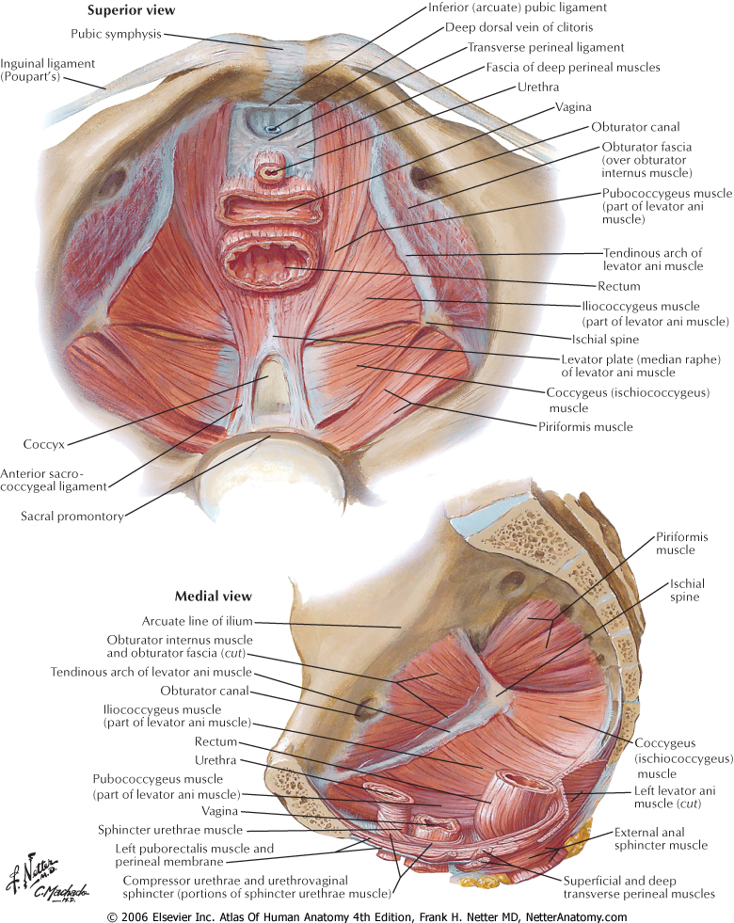

Slide 8
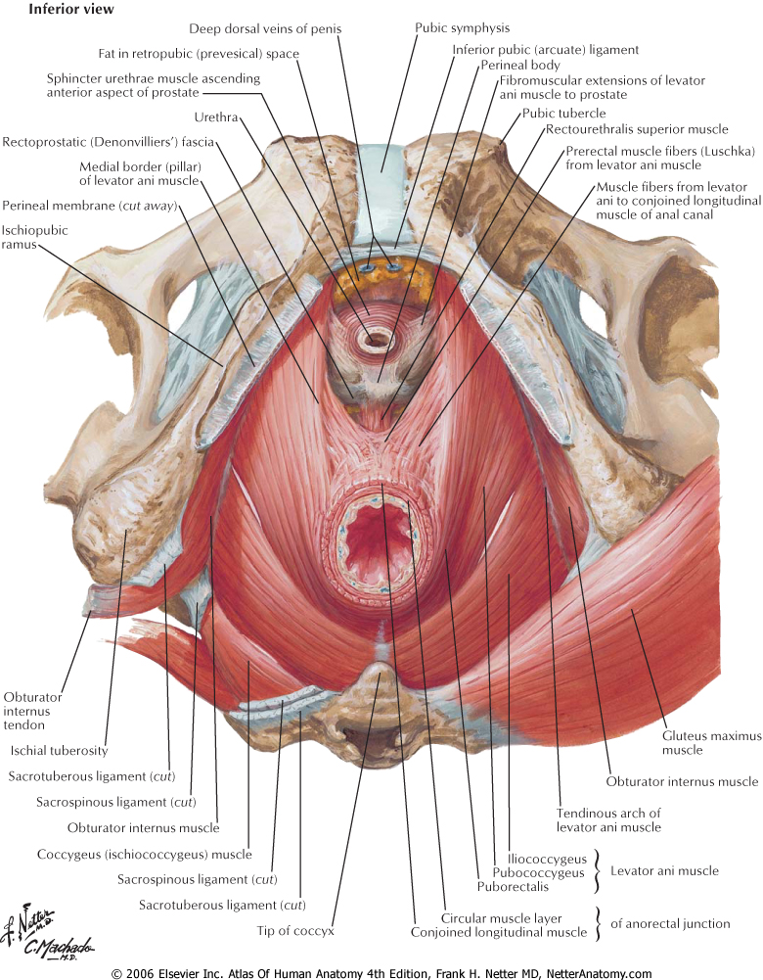

Slide 9
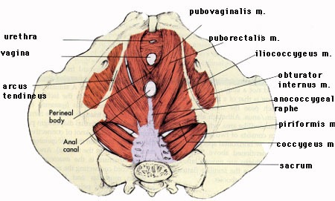

Slide 10
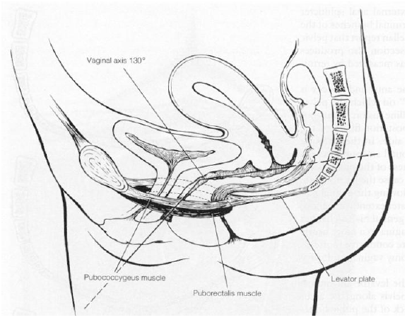
PFM: creates levator plate

Slide 11
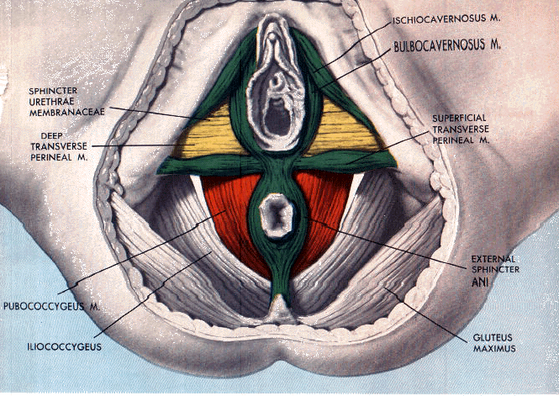

Slide 12
Endopelvic Fascia
Fibromuscular layer
Local condensations are ligaments
Principal ligaments are Uterosacral
Cardinal
Pubocervical and Rectovaginal Fascia important in specific surgical correction

Slide 13
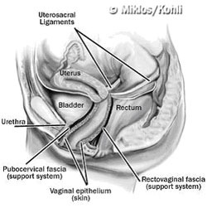

Slide 14
Pathophysiology
Direct Trauma to pelvic soft tissues
Neurological injury
Connective tissue disorders

Slide 15
Predisposing Factors
Hereditary (genetic) predisposition
Race: White > Black > Asian
Pregnancy and Vaginal Childbirth
Age and Menopause
Raised intra-abdominal pressure (e.g.: obesity, cough, constipation, lifting, etc)
Iatrogenic: surgical procedure

Slide 16
Symptoms of Prolapse
Pressure symptoms (heaviness, pressure, feeling a lump, visible bulge)
Urinary dysfunction
Bowel dysfunction
Pain / Discomfort symptoms
Sexual-related symptoms

Slide 17
Clinical presentation of POP
Bulge Symptoms
Sensation of vaginal bulging or protrusion
Seeing or feeling a vaginal or perineal bulge
Pelvic or vaginal pressure
Heaviness in pelvis or vagina
Sexual Symptoms
Dyspareunia
Decreased lubrication
Decreased sensation
Decreased arousal or orgasm
Pain
Pain in vagina, bladder, or rectum
Pelvic pain
Low back pain
Urinary Symptoms
Urinary incontinence
Urinary frequency
Urinary urgency
Weak or prolonged urinary stream
Hesitancy
Feeling of incomplete emptying
Manual reduction of prolapse for voiding
Position change to start or complete voiding
Bowel Symptoms
Incontinence to flatus or stool
Feeling of incomplete emptying
Hard straining to defecate
Urgency to defecate
Digital evacuation to complete defecation
Splinting vagina or perineum to start or complete defecation
Feeling of blockage/obstruction during defecation

Slide 18
Consequences of Prolapse
Vaginal spotting
Vaginal infection
Recurrent UTI’s
Urinary obstruction
Renal failure

Slide 19
Associated conditions
Urinary Incontinence :
Stress U.I
Urge U.I
Mixed U.I
Fecal Incontinence : sphincter injury

Slide 20
Pelvic Organs at Risk of Prolapse
1. Urethra
2. Bladder
3. Uterus
4.Vagina
5. Small Bowel
6. Rectum
7. Perineum

Slide 21
Compartments
Anterior :
Cystocele
Middle / Apical:
Uterine prolapse
Vaginal vault prolapse
Enterocele (can be even posterior)
Posterior :
Rectocele

Slide 22
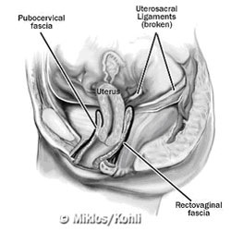

Slide 23
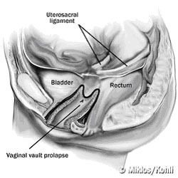

Slide 24
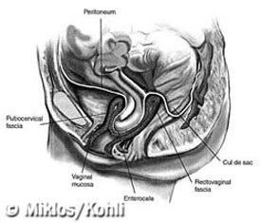

Slide 25
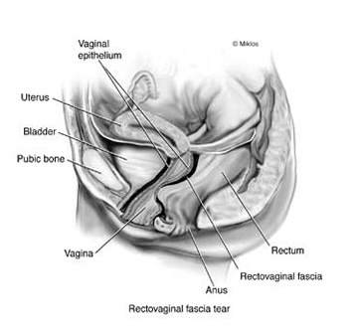

Slide 26
Assessment of POP
General, gynecologic, and lower neurologic exams should be done on every women with POP
Pelvic exam is essential (to assess the type and extent of POP, to rule out SUI & other pathology)
Pelvic exam best conducted in dorsal lithotomy position; Re-examine in standing if needed
Rectovaginal exam might be required to fully evaluate posterior vaginal prolapse

Slide 27
Assessment of POP
Types of POP:
Anterior vaginal prolapse: usually represent the bladder (cystocele: central &/or lateral paravaginal) ± urethral hypermobility
Apical/Middle vaginal prolapse: uterine or vaginal vault prolapse
Posterior vaginal prolapse: rectocele &/or enterocele. Perineal descent

Slide 30
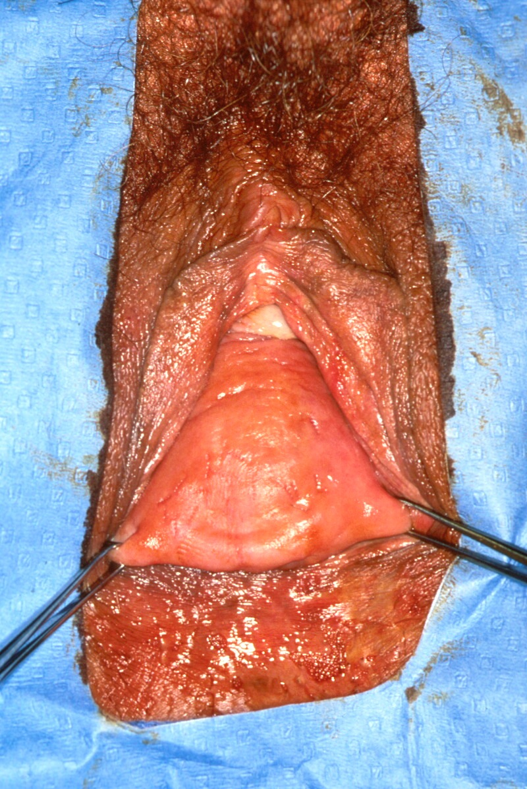

Slide 31
Classification of POP
Four different systems for classification of POP:
Porges severity system (1963)
Baden-walker grading system (1972)
Beecham grading system (1980)
Pelvic organ prolapse quantification system (POPQ by ICS-1996)

Slide 32
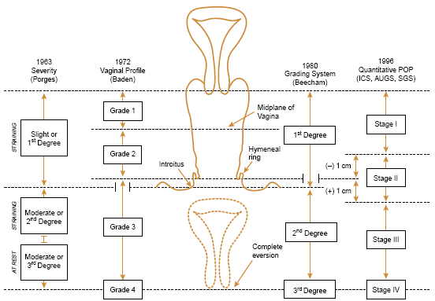
Comparison of POP Classification Systems

Slide 33
Options of Management
No Treatment ( pelvic floor exercise)
Conservative: such as
Physiotherapy or Pessary
Surgical Treatment

Slide 34
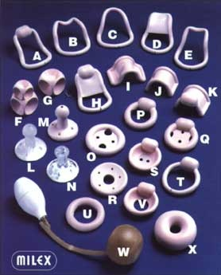

Slide 35
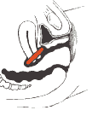

Slide 36
Aims of prolapse surgery
Alleviate symptoms
Restore normal anatomy
Restore normal visceral function
Avoid new bladder or bowel symptoms
Preserve sexual function
Avoid surgical complications

Slide 38
Conclusions
Pelvic organ prolapse is common
Results from injury to soft tissue and nerves
Childbirth most significant association
Treatment requires understanding of anatomic relationships
Treated with a combination of physio/pessary and often complex surgery

