Slide 1
Early pregnancy problems
Dr. Mohamed Khalil MD, MRCOG.
Diploma in Fetal Medicine RCOG/RCR
Consultant Obst & Gyn
Security Forces Hospital

Slide 2
Early pregnancy problems or bleeding
Miscarriage
Ectopic
Molar pregnancy
Local cause of bleeding
Corpus L. cyst problem

Slide 3
Miscarriage
Definition
Incideince
Causes
Clinical presentation
Type
Diagnosis
management

Slide 4
Spontaneous Miscarriage
INCIDENCE
is the most common complication of early pregnancy
The frequency decreases with increasing gestational age.
The incidence of spontaneous abortion (miscarriage) in clinically recognized pregnancies up to 20 gestational weeks is 8 to 20 percent.
However, the incidence among women who have previously had a child is much lower (5 percent)
The overall risk of spontaneous abortion after 15 weeks is low (about 0.6 percent) for chromosomally and structurally normal fetuses, but varies according to maternal age and ethnicity.

Slide 5
Causes of miscarriage
Maternal factors
Fetal factors
Chromosomal abnormalities
Congenital anomalies
Trauma
Unexplained
Uterine structural issues
Maternal infection disease
Unexplained

Slide 6
Type Miscarriage
Threatened
Complete
Incomplete
Pregnancy of uncertain viability
Missed CRL >7mm , no No fetal heart beat
Delayed= anembryonic sac
Silent= blighted ovum
Early fetal demise
Inevitable
Septic: Miscarriage with infection=sepsis

Slide 7
Miscarriage
Clinical presentation
Amenorrhea
Bleeding
Pain

Slide 8
Miscarriage
Diagnosis
Examination: cervix : open/close
Ultrasound: Gest. sac/yolk/amnion/CRL/ FH
B hCG
CBC
RH Typing

Slide 10
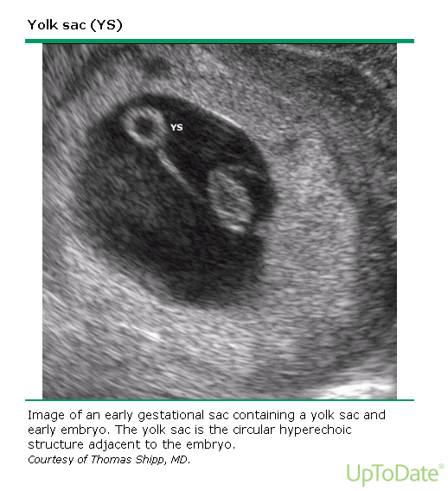

Slide 11
Yolk Sac :

Slide 12
Retained prod

Slide 13
Type Miscarriage
Threatened
Complete
Incomplete
Pregnancy of uncertain viability
Missed CRL >7mm , no No fetal heart beat
Delayed= anembryonic sac
Silent= blighted ovum
Early fetal demise
Inevitable
Septic: Miscarriage with infection=sepsis

Slide 14
Miscarriage
Management
Medical
Surgical
conservative

Slide 15
Recurrent pregnancy loss
Definitions have included:
Two or more failed clinical pregnancies as documented by ultrasonography or histopathologic examination.
Three consecutive pregnancy losses, which are not required to be intrauterine .
2 percent of pregnant women experience two consecutive pregnancy losses and only 0.4 to 1 percent have three consecutive pregnancy losses

Slide 16
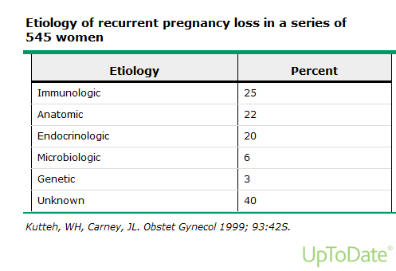

Slide 17
Anatomic Uterine factors
Mullerian anomalies
Leiomyoma
Endometrial polyps
Intrauterine adhesions
Cervical Insufficiency
Defective endometrial receptivity

Slide 18
Uterine factors
Anomalies
Congenital uterine anomalies are present in 10 to 15 percent of women with RPL versus 7 percent of all women.
Pregnancy loss may be related to impaired uterine distention or abnormal implantation due to decreased vascularity in a septum, increased inflammation, or reduction in sensitivity to steroid hormones.
The septate uterus is the uterine anomaly associated with the poorest reproductive outcome and the most common uterine abnormality associated with RPL
The fetal survival rate in women with untreated septate uterus is 6 to 28 percent and the miscarriage rate is greater than 60 percent
The longer the septum, the worse the prognosis.

Slide 19
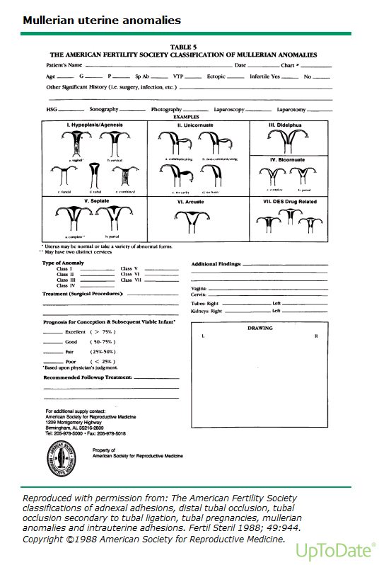

Slide 20
Uterine factors
Leiomyoma
Submucous leiomyomas that protrude into the endometrial cavity can impede normal implantation as a result of their position, poor endometrial receptivity of the decidua overlying the myoma, or degeneration with increasing cytokine production
An association between pregnancy loss and intramural or subserous myomas is less clear, having been demonstrated in some, but not all, studies.
Endometrial polyps — There have been no data showing a relationship between endometrial polyps and RPL
Intrauterine adhesions — Intrauterine adhesions or synechiae lead to pregnancy loss because there is insufficient endometrium to support fetoplacental growth.

Slide 21
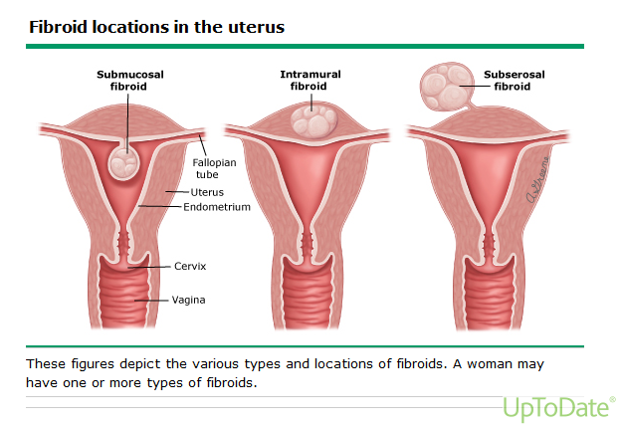

Slide 22
Uterine factors
Cervical Insufficiency — Cervical insufficiency is a cause of recurrent midtrimester, but not early, pregnancy loss.
Defective endometrial receptivity — Estrogen and progesterone prepare the endometrium for pregnancy. Normal endometrial receptivity allows embryo attachment, implantation, invasion, and development of the placenta.
These processes are likely to be disturbed when endometrial receptivity is defective, resulting in unexplained infertility and RPL.
Causes of defective endometrial receptivity and biomarkers for evaluation of endometrial receptivity are under investigation.
One example is a primary endometrial receptor defect

Slide 23
Immunologic factors
Each step in the establishment of normal pregnancy has been implicated as a possible site of immune-mediated reproductive failure.
Both autoimmune and alloimmune mechanisms have been proposed.
Since the mechanisms that allow a mother to tolerate her semi-allogeneic conceptus are not well defined, it is difficult to assess the role of aberrant immunologic factors in reproductive failure

Slide 24
Antiphospholipid syndrome
Several autoimmune diseases have been linked to poor obstetric outcome, but antiphospholipid syndrome (APS) is the only immune condition in which pregnancy loss is a diagnostic criteria for the disease.
5 to 15 percent of patients with RPL may have APS

Slide 25
Endocrine factors
Endocrine factors may account for 15 to 60 percent of RPL
Diabetes mellitus
Polycystic ovary syndrome
Thyroid antibodies and disease
Hyperprolactinemia
Luteal phase defect

Slide 26
Endocrine factors
Endocrine factors may account for 15 to 60 percent of RPL
Diabetes mellitus — Although rare, poorly controlled diabetes mellitus is associated with early (and late) pregnancy loss.
Several studies have linked high hemoglobin A1C values early in pregnancy (particularly values above 8 percent) to increased frequencies of miscarriage and congenital malformations
The increased risk in poorly controlled diabetic women is believed to be secondary to hyperglycemia, maternal vascular disease, and possibly immunologic factors.
There is no increased risk of miscarriage in women with well-controlled diabetes mellitus
Insulin resistance, as seen in women with polycystic ovaries, may also be a factor in pregnancy loss.

Slide 27
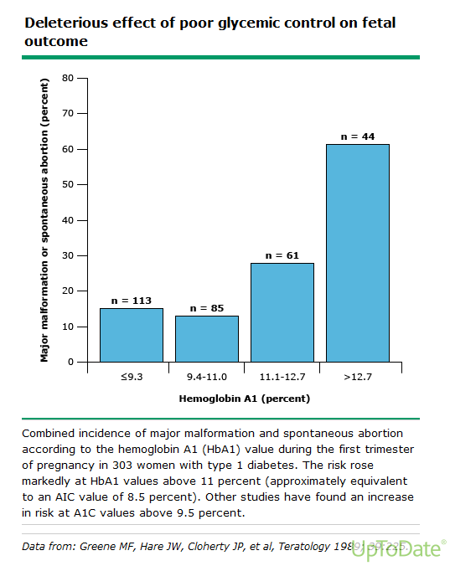

Slide 28
Endocrine factors
Polycystic ovary syndrome
The miscarriage rate in women with polycystic ovary syndrome (PCOS) may be as high as 20 to 40 percent, which is higher than the baseline rate in the general obstetric population (10 to 20 percent).
The mechanism for excess pregnancy loss in these patients is unknown, but may be related to elevated serum luteinizing hormone (LH) levels, high testosterone and androstenedione concentrations (which may adversely affect the endometrium), or insulin resistance.
The sex hormone abnormalities in women with PCOS may cause premature or delayed ovulation, poor endometrial receptivity, and disturbances insynthesis/secretion/action of prostaglandins and ovarian growth factors/cytokines.
In one study, a menstrual cycle longer than 34 days, which is common in women with PCOS, was the most important predictor for a RPL.
Women with RPL have a higher prevalence of insulin resistance than fertile controls, whether or not PCOS is present.
The role of insulin resistance was suggested in a study showing that treatment of insulin resistance with metformin in women with PCOS was associated with a reduction in pregnancy loss.
However, another well-designed trial showed no benefit of metformin compared to clomiphene in reducing the incidence of miscarriage, thereby casting doubt about the role of insulin resistance on pregnancy loss

Slide 29
Endocrine factors
Thyroid antibodies and disease
Some studies have reported an increased rate of fetal loss in women with high serum thyroid antibody concentrations (thyroid peroxidase or thyroglobulin), including those who are euthyroid
Thyroid autoimmunity has also been related to unexplained infertility and implantation failure
Direct evidence of causality, however, is still lacking and conflicting data have also been reported.
Poorly controlled thyroid disease (hypo- or hyper-thyroidism) is associated with infertility and pregnancy loss.
Excess thyroid hormone increases the risk of miscarriage independent of maternal metabolic dysfunction.

Slide 30
Endocrine factors
Hyperprolactinemia
Treatment to lower prolactin concentration was associated with a higher rate of successful pregnancy (86 versus 52 percent).
Prolactin levels during early pregnancy were significantly greater in women who miscarried.
Luteal phase defect
luteal phase defect) has been hypothesized to be a potential cause of impaired progesterone production and resultant infertility or pregnancy failure.
However, it is controversial as to whether such a defect really exists and is related to miscarriage, and there is no consensus on the best method of diagnosis or treatment

Slide 31
Genetic factors
Abnormalities of chromosome number or structure are the most common cause of sporadic early pregnancy loss,
accounting for at least 50 percent of such losses in multiple studies
A significant proportion of RPL may also be associated with structural or numerical chromosomal abnormalities (eg, aneuploidy, mosaicism, translocation, inversion, deletion, fragile sites)
Single-gene, X-linked, or polygenic/multifactorial disorders can also result in sporadic or recurrent miscarriage.
There appears to be an increased risk of RPL in first degree relatives of women with unexplained RPL
This may be related to shared HLA types, coagulation defects, immune dysfunction, or other undefined heritable factors

Slide 32
Others
Thrombophilia and fibrinolytic factors :acquired/congenital
Environmental chemicals and stress
Personal habits — The association between RPL and obesity, smoking, alcohol use, and caffeine consumption is unclear
Infection — Some infections, such as Listeria monocytogenes, Toxoplasma gondii, cytomegalovirus, and primary genital herpes, are known to cause sporadic pregnancy loss, but no infectious agent has been proven to cause RPL

Slide 33
Managements of RPL
Couples in whom chromosomal abnormalities are discovered in one or both partners or the abortus are generally referred for genetic counseling, which should include information about the probability of having a chromosomally normal or abnormal conception, and options for managing this risk.
Uterine abnormalities are managed surgically if the defect is a surgically correctable cause of pregnancy loss, such as a uterine septum, intrauterine adhesions, or submucosal myoma. These conditions can be treated hysteroscopically.
Thrombophilia : aspirin/heparin

Slide 34
Managements of RPL
For women with unexplained RPL, we recommend not using supplemental vaginal progesterone
Use of vaginal progesterone once a pregnancy has been established does not improve live birth rates. It is not known if intramuscular progesterone or other progestin therapies provide a benefit.
We recommend not using immunotherapy or glucocorticoids for treatment of RPL.
These drugs are not effective and may be harmful.
Treat hyperprolactinemia in RPL
Women with a history of RPL who become pregnant may be at higher risk for developing fetal growth restriction and premature delivery.
Detection of fetal cardiac activity in early pregnancy is reassuring of subsequent viable delivery, although the pregnancy loss rate remains above that of the general population

Slide 35
Ectopic pregnancy
Causes
Site
Clinical presentation
Diagnosis
Management
Hemorrhage from ectopic pregnancy is the leading cause of maternal mortality in the first trimester and accounts for 4 to 10 percent of all pregnancy-related deaths

Slide 36
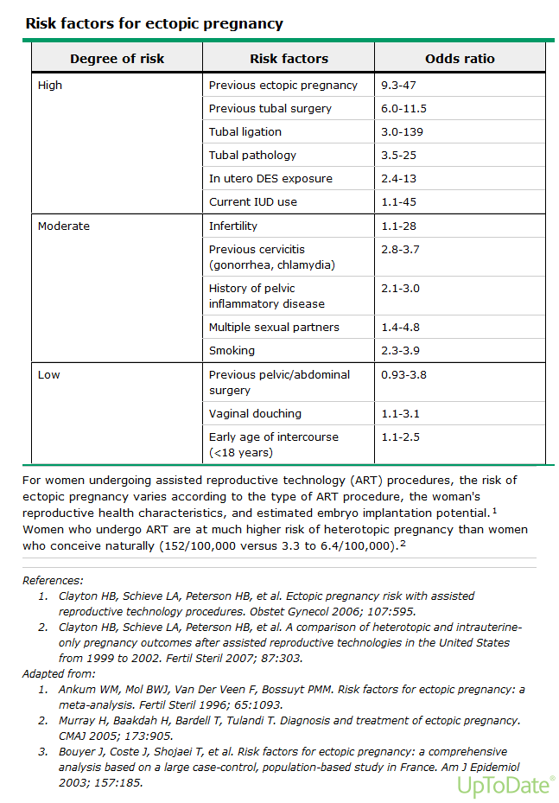

Slide 37
Ectopic pregnancy
RISK FACTORS

Slide 39
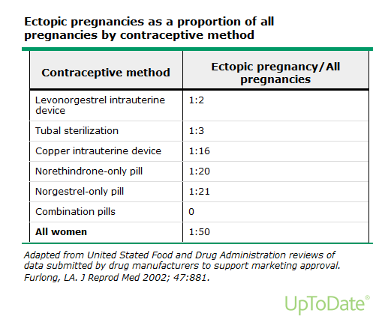

Slide 40
Ectopic pregnancy
Site
Tubes 95%
Ovarian
Cervical
Scare
Abdominal

Slide 41
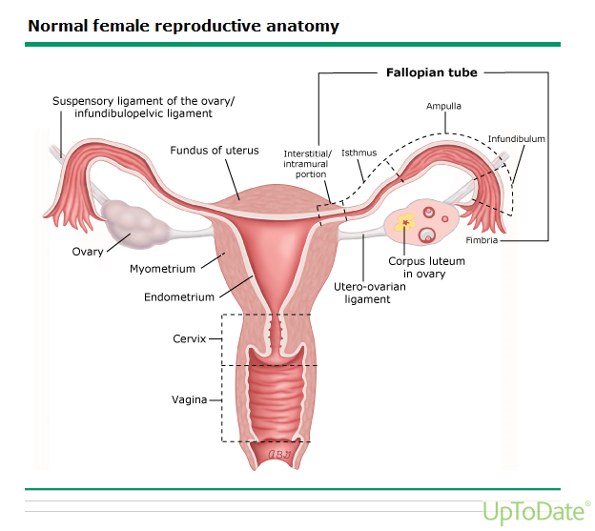
70%
12%
2%
3%
11%
1.3%
Almost all ectopic pregnancies occur in the fallopian tube (98 percent). In one series of 1800 surgically treated cases, the distribution of sites was ampullary (70 percent), isthmic (12 percent), fimbrial (11.1 percent), ovarian (3.2 percent), interstitial (2.4 percent), and abdominal (1.3 percent).

Slide 42
Ectopic pregnancy
Diagnosis
Symptomes
Sign
Ultrasound
B Hcg
Laparoscopy
CBC
RH Typing

Slide 43
Ectopic pregnancy
Clinical presentation
Pain
Bleeding
Shock

Slide 44
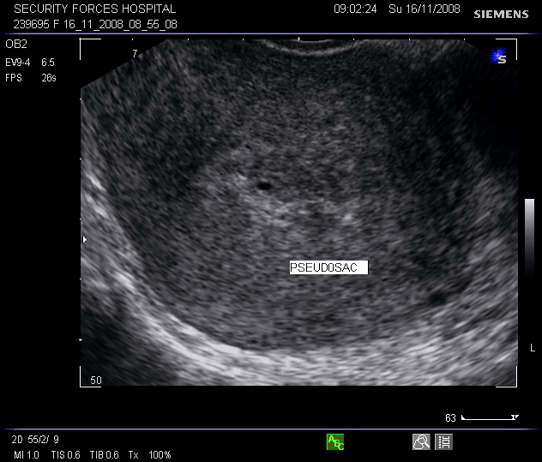

Slide 45
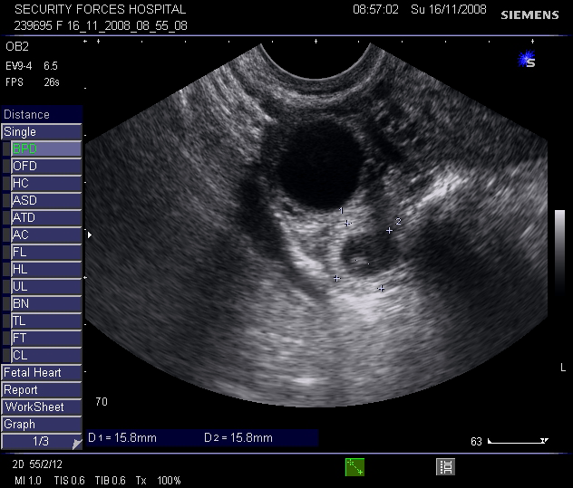

Slide 46
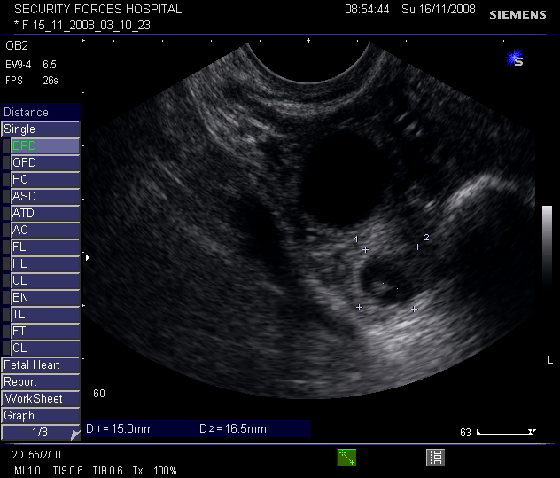

Slide 47
Ectopic pregnancy
Management
Medical-- methotrexate
Surgical Laparoscopy Laparotomy
Conservative

Slide 48
Methotrexate therapy
Hemodynamically stable
Willing and able to comply with post-treatment follow-up
hCG concentration ≤5000 mIU/mL,
No fetal cardiac activity.
Ectopic mass size less than 3 to 4 cm
Body surface area= square root ([cm X kg]/3600)

Slide 49
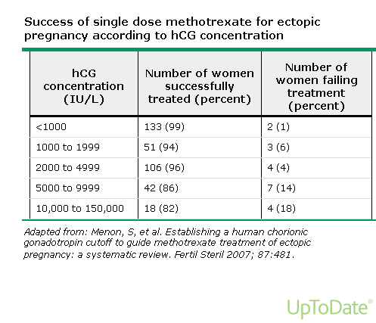

Slide 50
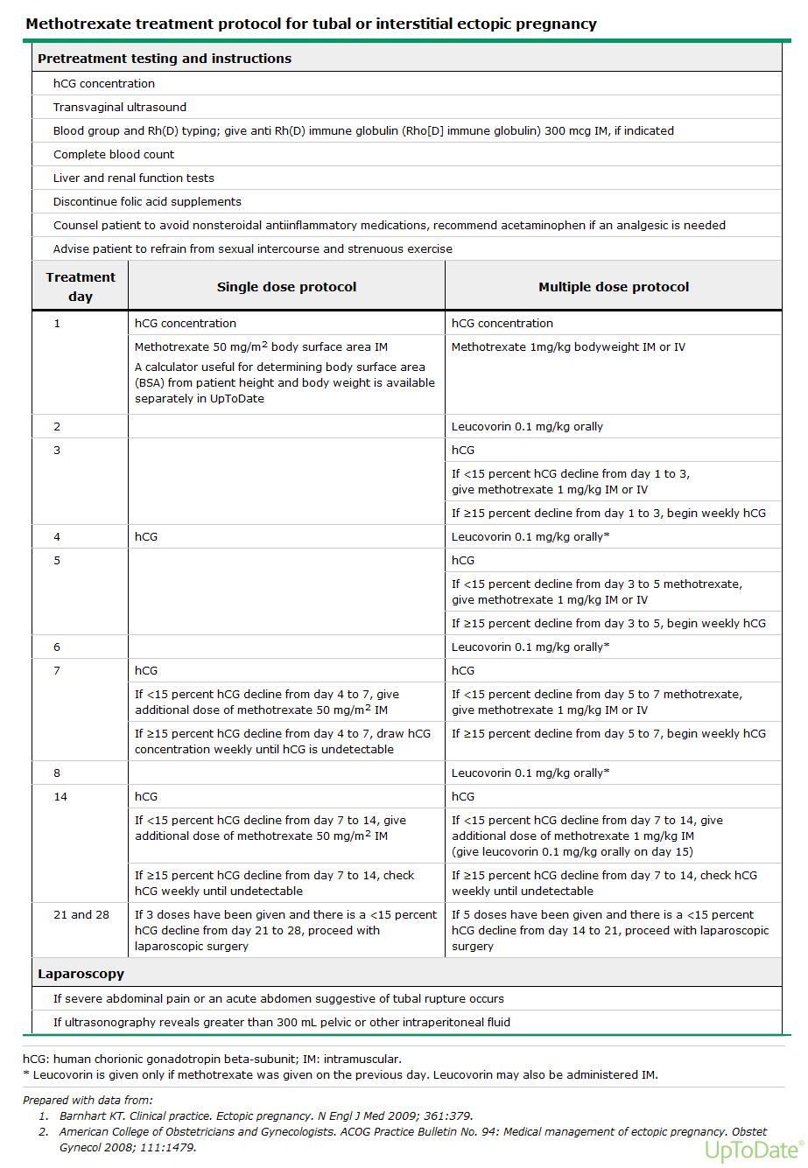

Slide 51
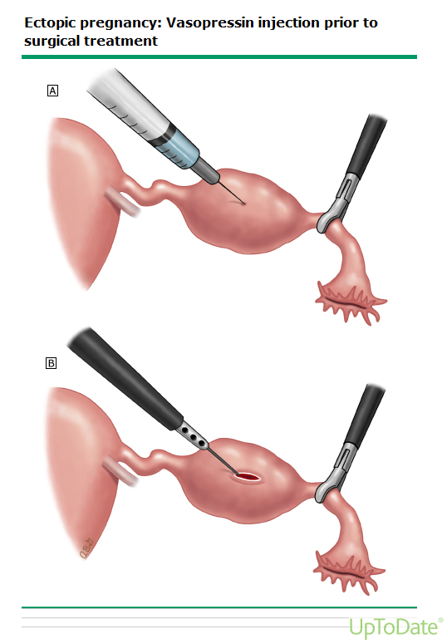

Slide 52
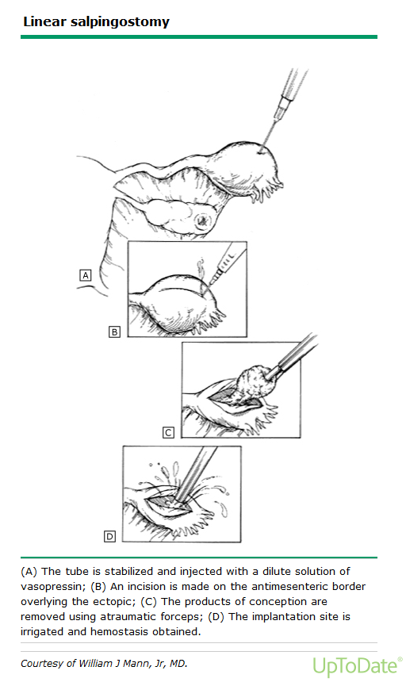

Slide 53
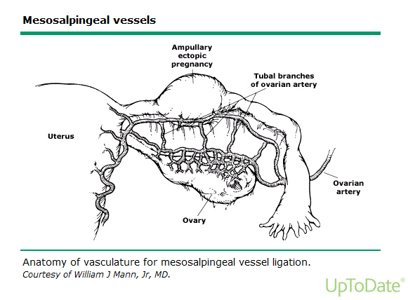

Slide 55
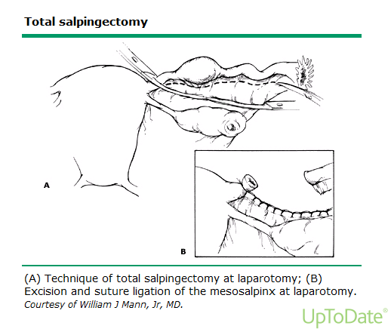

Slide 56
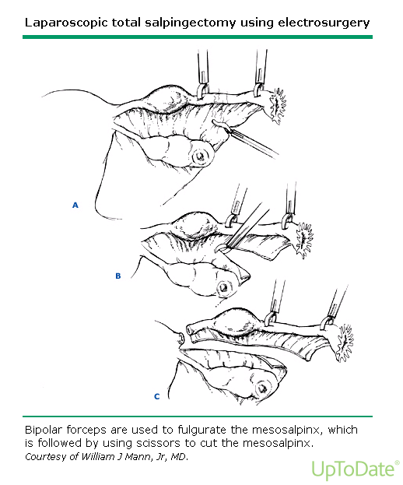

Slide 57
Molar pregnancy
Causes
Type complete-partial
Clinical presentation
Diagnosis
management

Slide 58
Molar pregnancy
Causes

Slide 59
Molar pregnancy
Type
Complete
Partial

Slide 60
Molar pregnancy
Clinical presentation

Slide 61
Molar pregnancy
Diagnosis
Symptomes
Sign
Scan
BhCG
CBC
RH Typing

Slide 63
Molar pregnancy
Management
CBC
RH Typing
Suction evacuation
Hysterectomy
Chemotherapy
Follow up

